Slide 1
ATLAS EF Farm management using Kubernetes in Phase-II
EP-ADT-DQ – Matteo Ferrari
On behalf of ATLAS TDAQ Collaboration
DAQ@LHC 2025 Workshop, FEBRUARY 2025

Slide 2
Outline
Introduction: ATLAS Event Filter Farm
  Enhancements for High Luminosity LHC (HL-LHC)
  HL-HLT Challenges
EF Farm Orchestrator
  Current Solution and Phase 2 enhancement
  What is Kubernetes? Why?
  Performance tests on P1 Cluster
  Current prototype implementation
  Benchmark and tests
Conclusions

Slide 3
HL-LHC: enhancements & challenges
 | Current | HL-LHC
L1 Output | 100 kHz (~300 GB/s) | 1 MHz (~5 TB/s)
Physics HLT Output | 3 kHz (~8 GB/s) | 10 kHz (~50 GB/s)
Output Event size | ~1.8 MB | ~5 MB
EF Size | ~2700 Servers | max ~5000 Servers (if no accelerators)

Slide 4
HL-HLT Challenges
HLT needs to scale compared to Run 3 and mitigate the rise in algorithm execution times (because of increased pile-up and luminosity)
This goal will be reached by scaling different aspects of HLT.
Horizontal scalability:
  Increase of hardware units (new servers)
  Increase hardware density
  Improve network topology
Vertical scalability:
  Better selection algorithms
  Evolution of the HLT Framework (multi-threading support)
  Support for external accelerators (co-processors or GPU)
  Better resource handling (orchestrator)

Slide 5
EF Orchestrator
Current solution is statically configured with no containerised application.
It's working fine, but we can do a lot better:
  Improving resource allocation
  Improve effortless scalability
  Improve monitoring
  Reliability and Flexibility
  Reproducibility (it's easier to debug containers in local if needed)
Kubernetes appears to be the perfect solution for this scenario

Slide 6
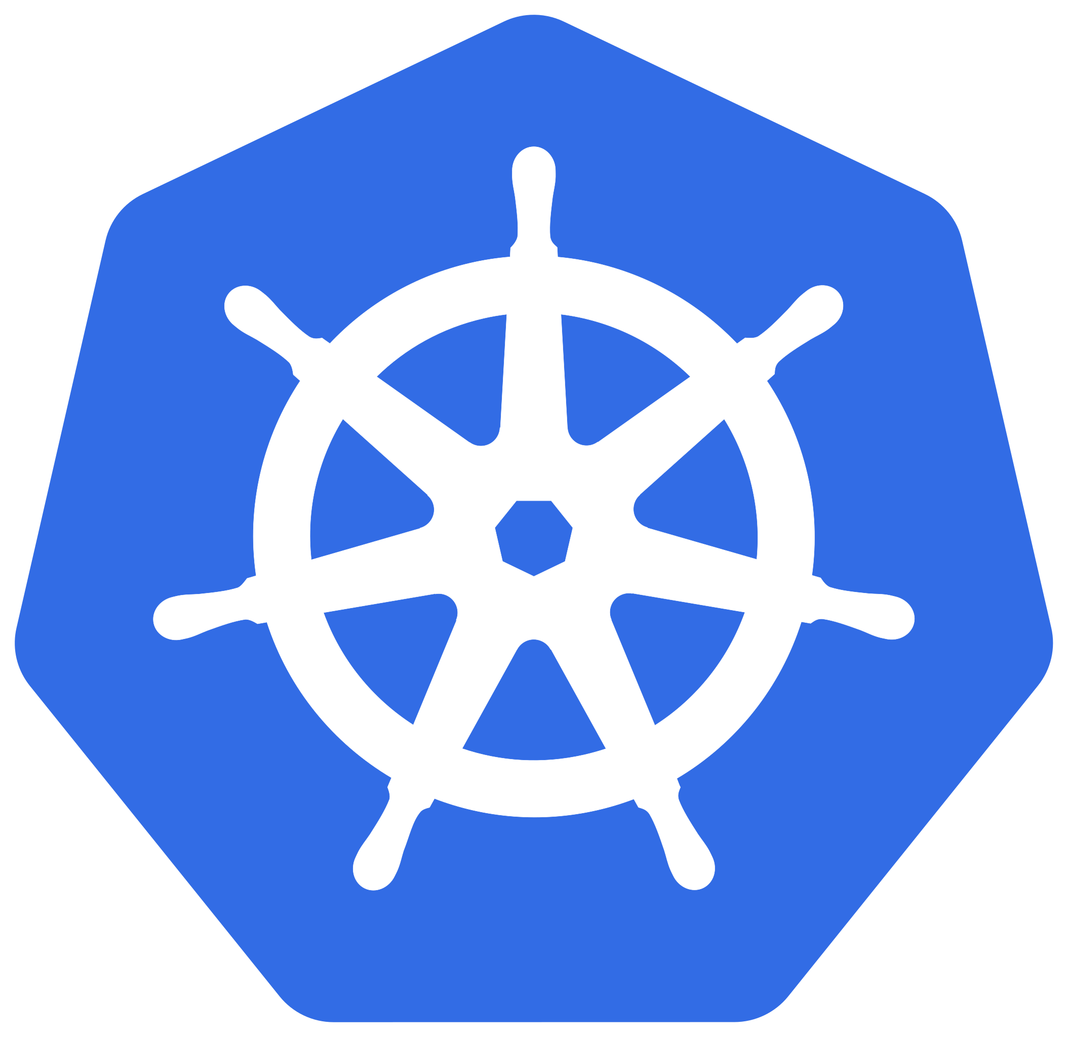
Kubernetes
Announced by Google in 2014, it can be described as "a system for automating deployment, scaling and management of containerised applications"
Just after 10 years is now one of the preferred deployment solution in the industry
Huge open-source community with big partners involved (RedHat, Intel, IBM... etc)
Some key features:
  Highly customizable at any level (scheduler, API, software)
  Scheduling based on required resources and other constraints
  Built-in support for service discovery and load-balancing
  Easy management of storage back-ends (transparent mounting of both local and network volumes)
  Built-in functionalities for manual or automatic scaling of applications

Slide 7
Testing Kubernetes in the EF Farm
We tested the cluster in P1 in Kubernetes mode during YETS.
  Close to production needs (4 control plane, 4 etcd nodes, 2600 workers)
  Tested different scheduling/deploying strategies
  Focusing on PODs start/stop times
Why start times? We need to be fast to set (or reset) the cluster when there is stable beams.

Slide 8
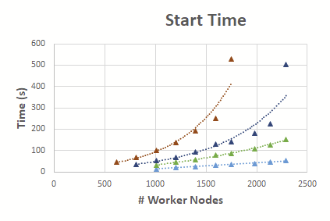
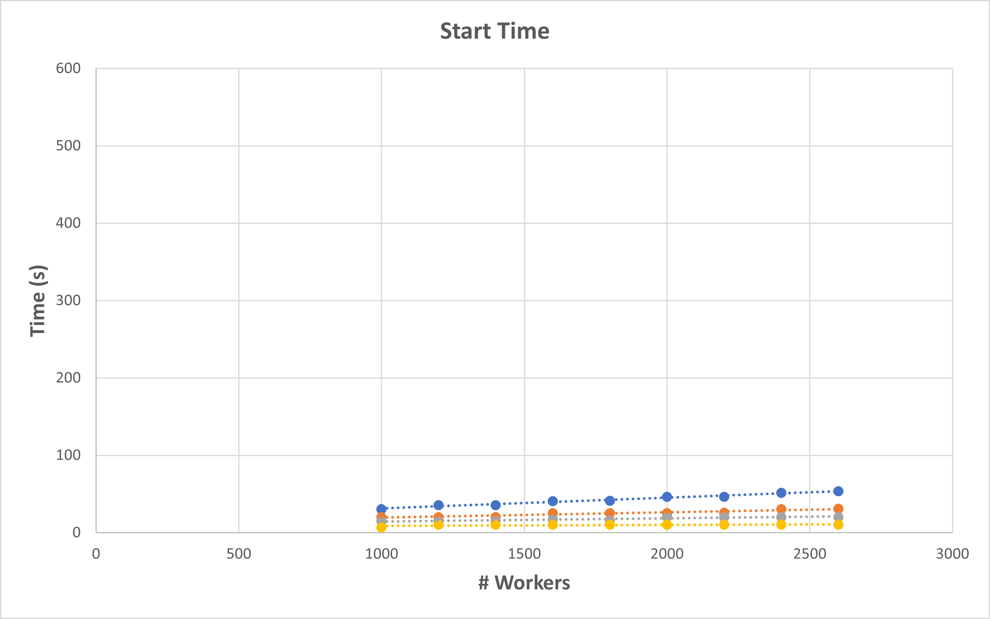
Testing Kubernetes in the EF Farm
Some Results:
  We are able to start 25k pods in ~65 seconds
  Calico is not linear.
  Cilium is a better CNI performance-wise
How:
  Scheduler configuration (QPS tuning)
  Controllers configuration (QPS tuning)
  Scheduler strategies (reduce scoring procedures)
  Testing different deployment strategies
  Improve ETCD cluster loads handling
Currently testing solution to start 75k pods
We had a talk at Kubecon North America 2024 about those results.
Talk has been published on YouTube if you are interested about performance.
With calico
With cilium

Slide 9
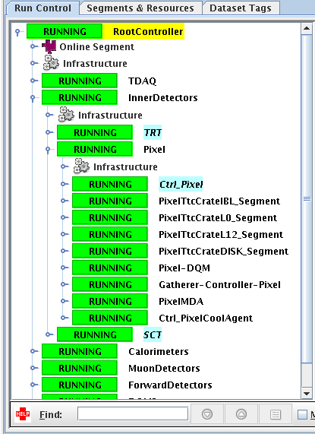
Kubernetes and DAQ sessions
How?
Tight synchronization between data acquisition components and computing infrastructure is crucial for the correct operation of the ATLAS detector
TDAQ Run Control leverages a Finite State Machine (FSM) model to manage the states of data acquisition components across thousands of servers, ensuring synchronized data processing and experiment control
We need a DAQ Bridge (KEFController) to the Kubernetes Cluster that respects the FSM and allow state management across TDAQ components and Kubernetes resources when a data taking sessions starts
Root Controller
Det.A Controller
Det.B Controller
KEFController
TDAQ Run Control Framework
Kubernetes environment
REST API
Custom CRD Objects
K8S Cluster
Session starts
K8S Deploy Even Filter Apps
Monitor the deployments
Session Ready
Data taking

Slide 10
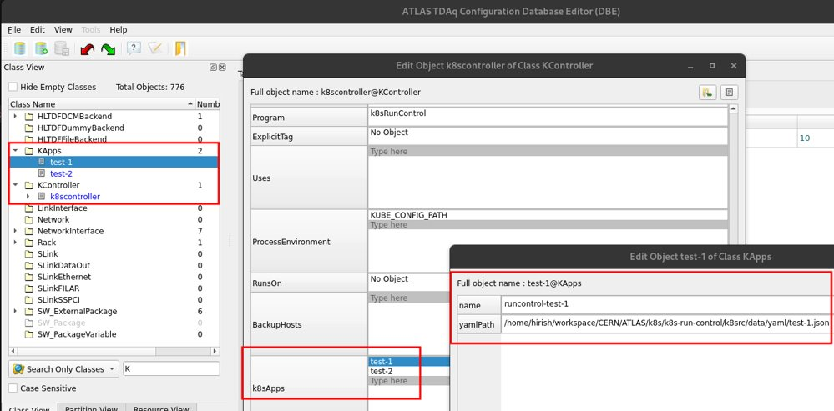
Configuration
The KEFController is fully configurable via the standard configuration tool used in ATLAS:
  Running parameters (timouts, delays, etc..)
  Definition of the applications that needs to be deployed

Slide 11

DAQ Bridge: Extending the Kubernetes API
Extending API is possible with CRD (Custom Resource Definition) that defines a new object type that can be handled
  Once you define a new CRD, you need to teach Kubernetes how to handle it via Operator Pattern
  Operators are software extensions to Kubernetes in order to manage CRD objects via the control loop (Kubernetes principles)
    Operators are clients of the Kubernetes API that act as controllers for a resource being deployed or configured.
Create / Update
Custom Resource Objects
Notify
K8S API
USER
(DAQ Application)
Watch
CRD
Controller
Reconcile Desired State

Slide 12
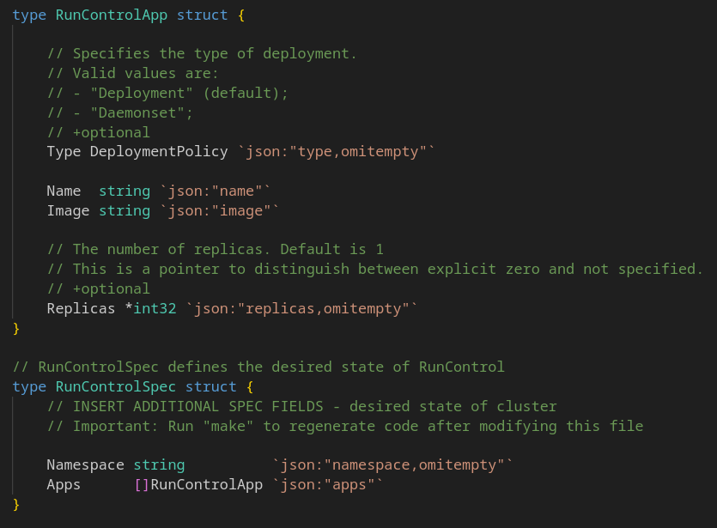
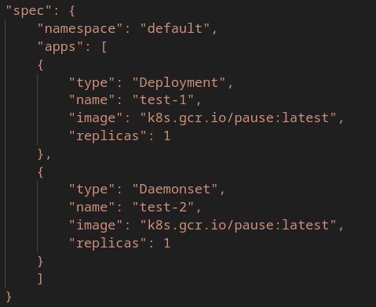
CRD Project with Kubebuilder
Kubebuilder
  It's an official tool/sdk (in GO) - Documentation
  It expands API in a declarative way with CRD (Custom Resource Definition) with strict grammar
  It helps to deploy easily this expansion on a k8s cluster

Slide 13
Kubernetes-c library
Official Kubernetes client library in order to interact with HTTP REST API
Kubernetes is based on OpenApi Specification
  C client generated with openapi-generator
  We found some critical bug on the C generator. It's going to be fixed
It's using libcurl for HTTP communications

Slide 14
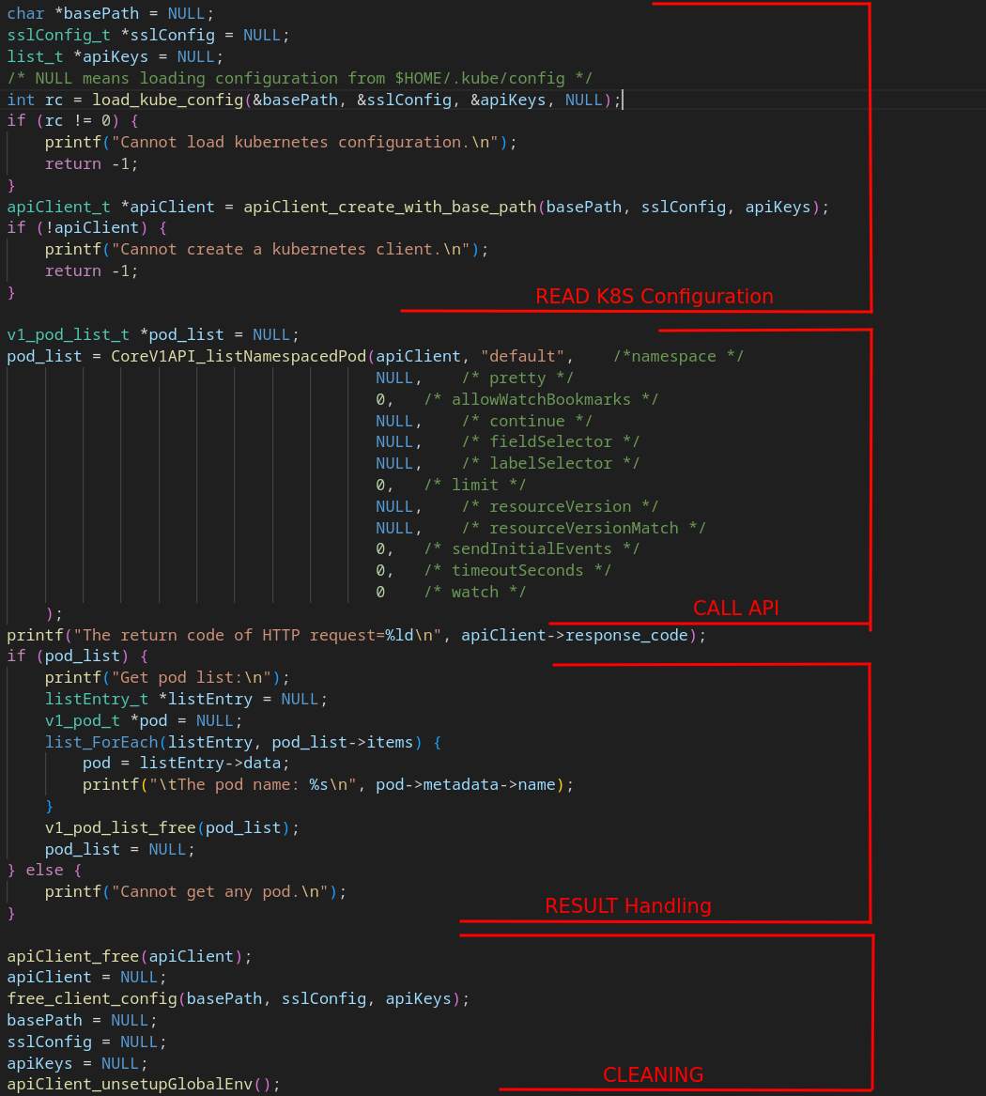
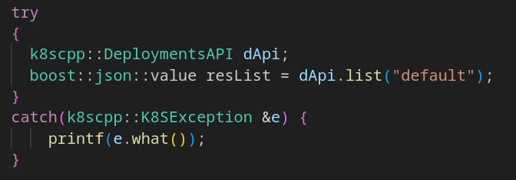
k8scpp
C++ Wrapper of the kubernetes-c library
  Make it easy to use
  In-house made
  RAII approach for resource handling
  Handle exceptions
  Convert results in (boost) JSON

Slide 15
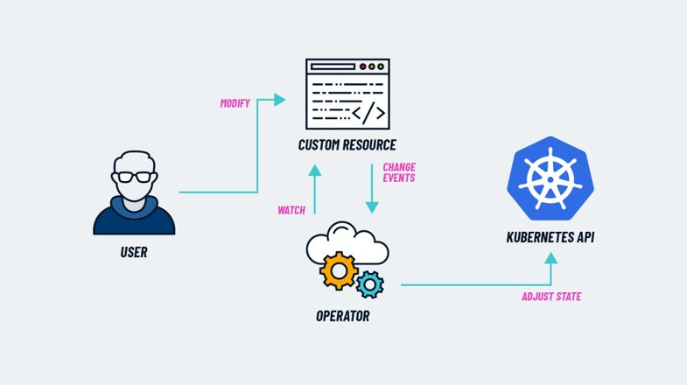
K8sop library
Implements Kubernetes operator pattern.
  In-house made SDK Operator
  Control Loop mechanism. It's a k8s principle for controlling resources over the cluster
  Take actions on CRDs
  Monitor CRDs Status (check that cluster reach the status specified by the CRD)
  It uses k8scpp to interact with k8s cluster

Slide 16
Software architecture recap
Kubernetes Cluster
ATLAS
CRD Project (kubebuilder)
Expands API
create
Run Control
(KEFController)
CRD Objects
RC FSM
REST API
Controller
(k8sop)
k8scpp (wrapper)
run
Kubernetes-c library (libcurl)
use
Monitoring
Red boxes -> In-house Software
Operator

Slide 17
Conclusions
The full current HLT farm could be orchestrated by Kubernetes
Start and Stop time benchmark are reasonable for the HLT use-case
A C++ approach is feasible with basic C++ SDK/Tools implemented.
Tip: You do not need C++ approach? Use the official SDK (go) with kubebuilder. Everything is ready and well supported and integrated!
What's next?
  Continue to improve the DAQ Bridge
    Adding monitoring solutions
    Error handling
  More stress and performance tests

Slide 18

Thanks for listening! Any Questions?

