Slide 1
Data Acquisition with SoC/SoM for the Phase-2 Upgrade of the LHC
Introduction
Operating system, network&booting
Host configuration (infrastructure)
User application software
Summary & outlook

Slide 2
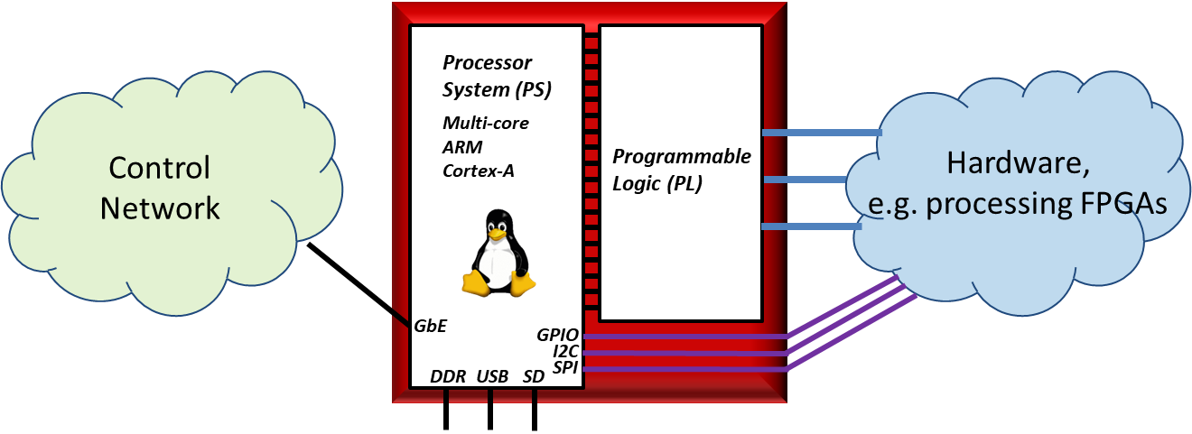
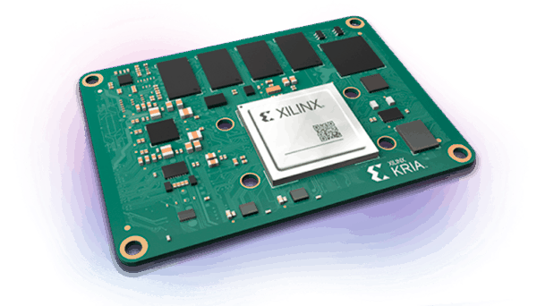
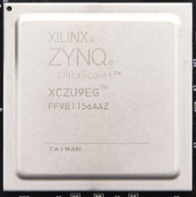
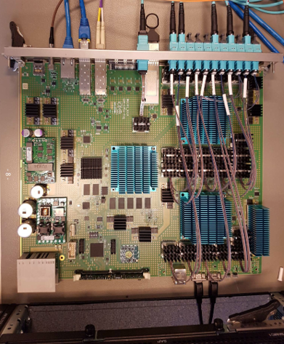
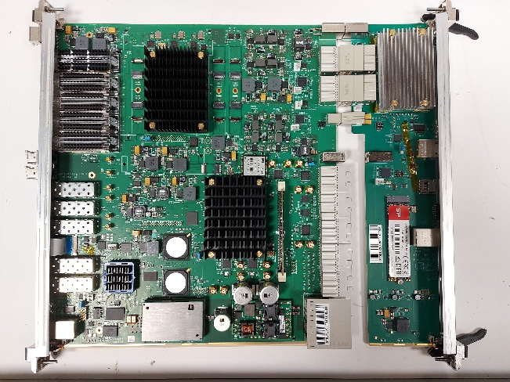
SoC/SoM – Introduction (1/2)
What is it?
  System-on-Chip (SoC) is an integrated circuit which combines hardware-programmable logic (FPGA) with a processor, e.g. AMD Xilinx Ultrascale+ MPSoC or Versal
    → Soldered on the module
  System-on-Module (SoM) is a SoC on a mezzanine: including some peripherals (like power converters and memory), e.g. AMD Xilinx Kria SoM
    → Uses connectors on the module: can be replaced if
    mezzanine pin compatible or rebuilt to fit
Why do we need it?
  Phase-2 developments move from VMEbus (limited in power and shared backplane) to ATCA (more power and multiple fast serial links)
  Move from Single-Board Computers (SBCs, ATLAS) or Control PCs (CMS) to “Computers on Board” which are SoCs or SoMs
System-on-Chip: Principle
AMD Xilinx Ultrascale+ MPSoC
AMD Xilinx Kria K26
ATLAS MUCTPI
CMS DTH

Slide 3
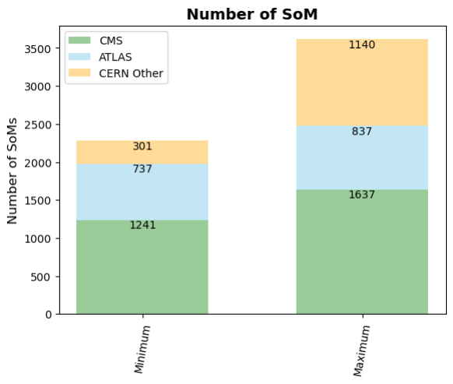
SoC/SoM – Introduction (2/2)
Why is it relevant?
  CMS and ATLAS are planning to deploy about 2000 SoMs during the Phase-2 Upgrade of the LHC
  Alice and LHCb do not plan to use SoC/SoM
  CERN ATS will use more than 1000 SoMs
  All projects plan to use SoMs (instead of SoCs)
Resources for this presentation:
  Survey on use of SoC/SoM: CERN-OPEN-2023-001
  SoC interest group: system-on-chip@cern.ch
  Indico category “System-on-Chip”: SoC workshops 2019, 2021, and 2023, and interest group meetings
  GitLab group “soc”: common software for SoC
  ATLAS Level-1 Central Trigger (L1CT) already using SoC since Run 3, e.g.
    “SoC Infrastructure for ATLAS Phase-II Level-0 Central Trigger”
    “ATLAS L1CT SoC Infrastructure: Automation and Monitoring System”
Survey of 2022 on SoC/SoM usage:
How many SoM are you using/will you use?
Note: numbers have gone down since the survey, e.g. discontinuation of ATLAS HTT

Slide 4
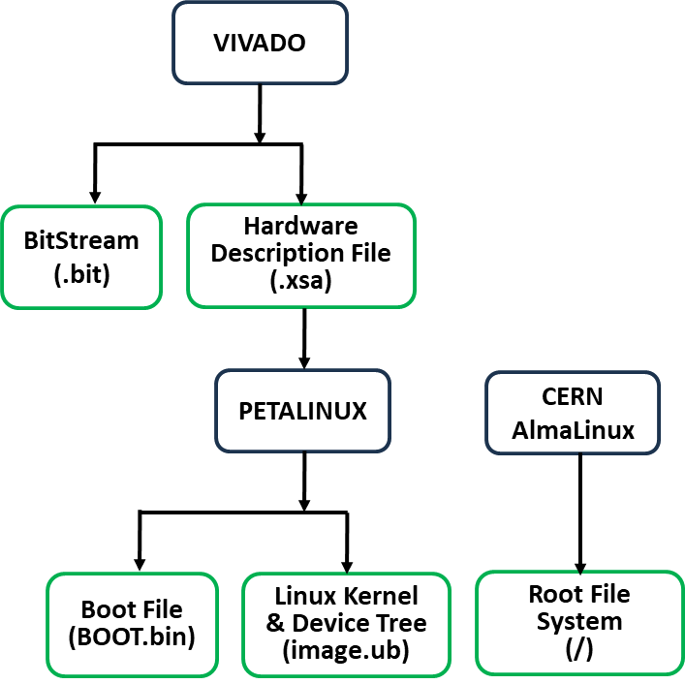
Operating System
SoC = FPGA + processor
SoC firmware:
  Use AMD Vivado tool to provide bit files for FPGA-part of SoC: proprietary and module specific
SoC software:
  General agreement to use common operating system: Linux
    → No DAQ project which wants to use real-time operating system
  Use AMD PetaLinux tool to provide boot files (see later), and the Linux kernel and module-specific device tree files
  Use common root file system: AlmaLinux (earlier CentOS):
    Well-known working basis
    Works already in current ATLAS TDAQ Run 3 system and is being used for CMS Phase-2 development/prototyping
    CERN-ATS are looking into using Debian as a long-term alternative
SoC boot files
[spiwoks@som-lti-01 ~]$ uname -srm
Linux 6.1.30-xilinx-v2023.2 aarch64
[spiwoks@som-lti-01 ~]$ cat /etc/os-release
NAME="AlmaLinux"
VERSION="9.4 (Shamrock Pampas Cat)"
SoC login

Slide 5
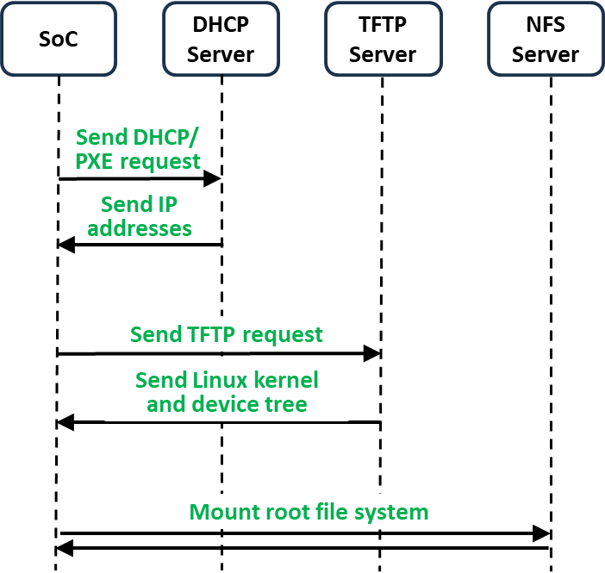
Network & Booting (1/2)
Boot sequence:
  First-stage boot loader (FSBL): module-specific initialisation
  U-Boot (Secondary Program Loader): load operating system
    → FSBL and U-Boot are provided by AMD PetaLinux tool
  Operating system: Linux kernel and device tree, and root file system
  Alternatively: U-Boot loads GRUB to use with UEFI (BIOS replacement), tested successfully by ATLAS TDAQ SysAdmins
Booting via the network (DHCP/PXE):
  Only store FSBL and U-Boot on module, e.g. QSPI flash memory
  Load operating system using DHCP/PXE from TFTP server:
    ⇒ Common image, updated regularly with security patches
    ⇒ Very much like the current system in ATLAS TDAQ
    ⇒ CMS DAQ foresees to use network boot, suggested for the rest of CMS
  Mount root file system using NFS:
    ⇒ Centrally provided image: updated regularly with security patches
    ⇒ Could use OverlayFS: common part read-only, module-specific part read-write
    ⇒ Provide common logging for a high number of nodes
SoC boot sequence

Slide 6
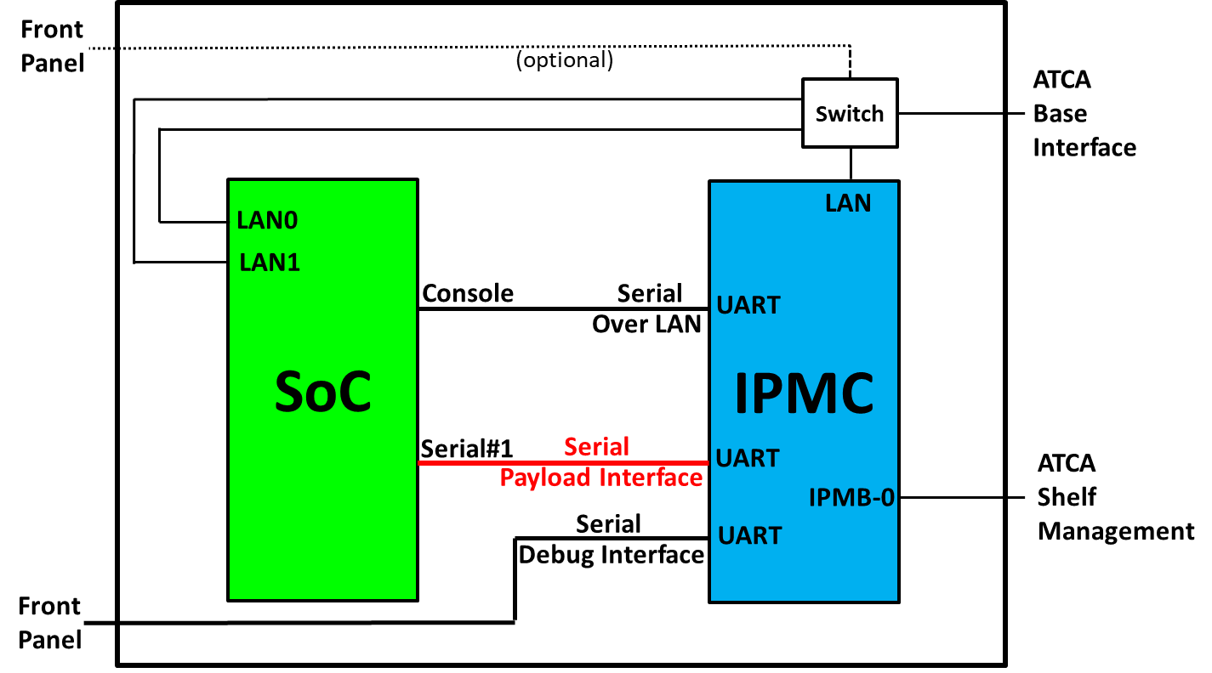
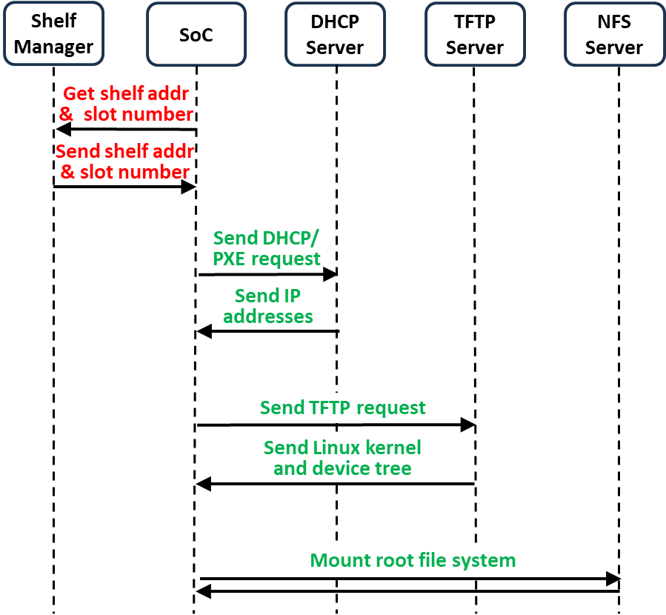
Network & Booting (2/2)
Identity of a module is key
Sources of identity:
  Module: required for any network point, e.g. MAC, read from EEPROM
  Location: geographical address for systems with multiple modules each of which handles a part of a detector (e.g. hemisphere or η,φ region)
  Could use a combination of both
How to obtain and use locational information?
  Read shelf address and slot number from ATCA Shelf Manager using the IPMC (required on each ATCA module)
  Use U-Boot to communicate between SoC and Serial Payload Interface of IPMC
  Make a Client ID from shelf address and slot number and use it for DHCP requests (in addition to MAC); ClientID will be the baseline for DHCP in CMS, see ”CMS Network and Booting”
  Software available in GitLab group “soc”
  Possibility to communicate with IPMC when running Linux
SoC – IPMC on a typical ATCA module
Extended SoC boot sequence

Slide 7
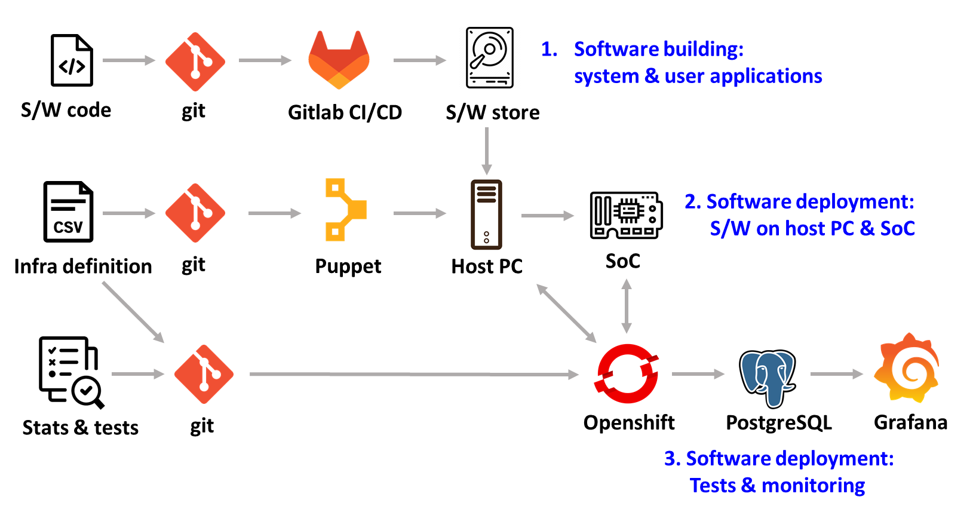
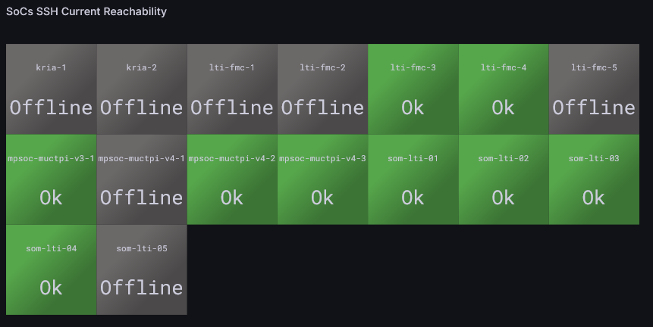
Host Configuration (Infrastructure)
Configure software and services on every module
Manage resources, e.g.:
  Access to hardware: udev rules for permissions and aliases
  Access to software: module or project-specific mount points
  Users: add/remove users
  Services: start/stop hardware monitoring, run control processes, etc.
Need infrastructure management:
  Many nodes, different types: SoCs and DHCP, TFTP, NFS servers, etc.
  Centralised management: e.g. CMS and ATLAS use Puppet
Example: ATLAS L1CT lab infrastructure
  Running Puppet on the SoC (and PCs), integrated with GitLab CI/CD pipelines, deploys software and configuration on SoCs
  ⇒ Works on the SoCs in the same way as it works on the SBCs or Control PCs
  Did some very first integration tests with ATLAS TDAQ TestBed, to be continued
  There are also first ideas how to monitor the infrastructure, to be continued
ATLAS L1CT lab infrastructure overview
ATLAS L1CT lab dashboard

Slide 8
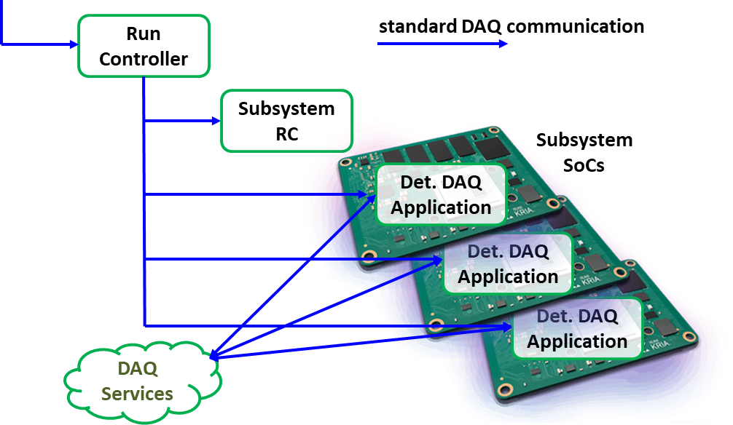
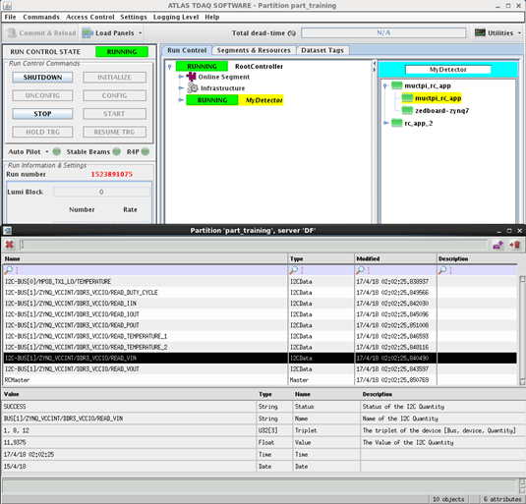
User Application Software (1/3)
Module-specific software which controls, configures, and monitors the hardware
One option: Run Control Applications on SoC
  SoC replaces the SBC or Control PC in the VMEbus-based system
  LCG and ATLAS TDAQ software can be run on SoC
    → ARM aarch64 architecture
  Subdetectors develop module-specific run control applications which are running on the SoC:
    → Reuse software and expertise gained over many years
  SoC run control application already successfully deployed by ATLAS L1CT in Run 3
  A TDAQ gateway process was required in Run 3 because of network isolation, but this can be removed because the network access will be controlled using managed network switches
ATLAS TDAQ overview and context
ATLAS TDAQ GUI:
run control application running on SoC

Slide 9
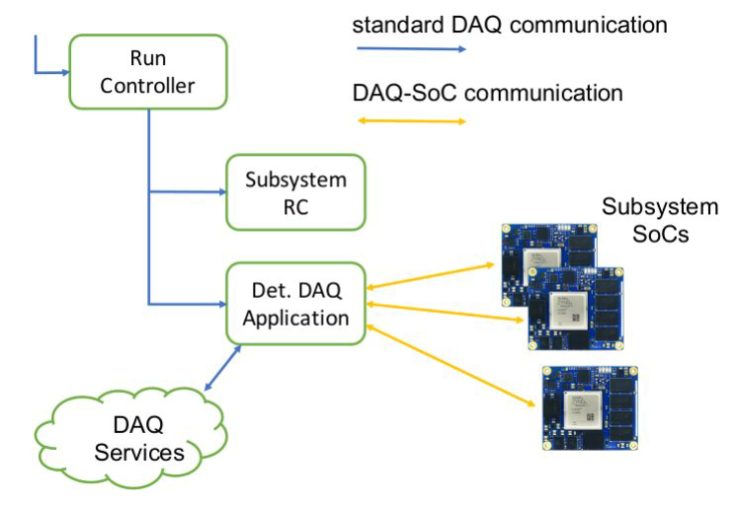
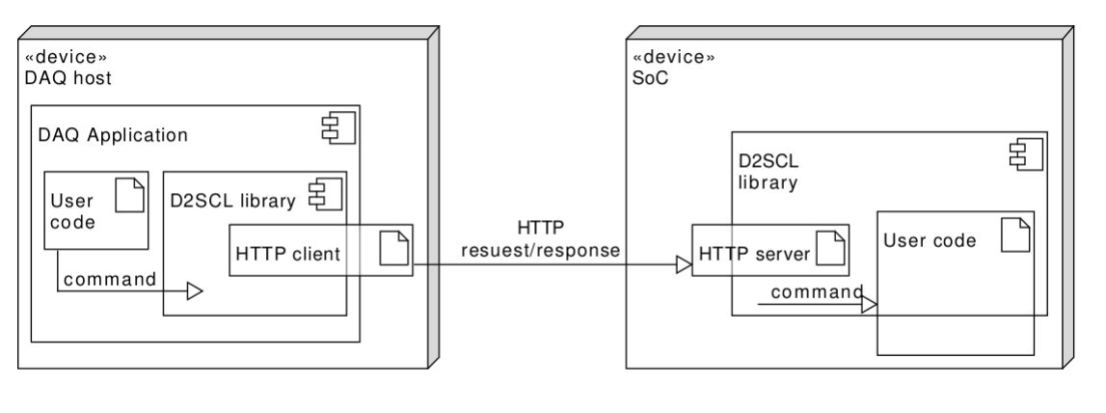
User Application Software (2/3)
Another option: Web-based Protocol -
ATLAS DAQ2SoC Library
  A communication layer allowing to pass commands and data between standard DAQ Run Control applications and SoCs
  Main objectives:
    No dependencies on TDAQ or external software on the SoC and
    minimize compile-time and run-time dependencies:
    ⇒ Improve maintainability and longevity of software
    Leverage on HTTP protocol, open to a variety of client and server implementations
  Features:
    Based on Boost HTTP implementation on both, client and server side
    Defines client and server-side C++ APIs
    Provides C++ to JSON serialisation for data
    See “Update on the ATLAS DAQ2SoC Library Status” and report of a user project in the last SoC interest group meeting
DAQ2SoC overview and context
DAQ2SoC components

Slide 10
User Application Software (3/3)
Further options include:
  Run bare metal (no project?)
  Real-time OS (no project for DAQ?)
  IPBus:
    Run IPBus server on SoC and communicate with hardware (e.g. ATLAS gFEX)
  Containers and Kubernetes:
    Could be used to set up services which are provided by specific hardware
    ATLAS Global Trigger haven been investigating the feasibility of Kubernetes for Versal firmware testing. Initial tests with Kria boards as GitLab CI/CD runners were encouraging. Work is ongoing to run directly on Versal boards, see “Automating SoC/FPGA Firmware Testing using Kubernetes/Container-based Infrastructure”
    CMS DAQ have been looking at running the DAQ applications on the SoMs for their hardware using Kubernetes. Initial tests including a Kria SoM with the full Kubernetes stack (K8s) were successful.

Slide 11
Summary & Outlook
SoMs will take over the role previously held by Single-Board Computers or Control PCs
System-level software:
  Common operating system: AlmaLinux works nicely, need to follow closely the future evolution …
  Tools are available on SoMs to provide system administration, including network booting, host configuration, etc.
  The exact implementation of the boundary between experiment-wide common software and subdetector specific software needs to be defined by the experiments
User application software:
  Several options exist for subdetectors to implement their user application software:
  run control on SoC, DAQ2SoC library, in a container or managed by Kubernetes, etc.

