Slide 1
ALICE, ATLAS, CMS & LHCb Third Joint Workshop on DAQ@LHC
Overview of DAQ @ (H)LHC
3-5 February 2025
Niko Neufeld
CERN EP/LBC

Slide 2
Acknowledgements
To my chers confreres: Vasco, Emilio, Wainer
To all the many colleagues I had the privilege to work with and learn from over the years: Beat Jost, Frans Meijers, Pierre Vande Vyvre, Clara Gaspar, David Francis,
-and for hiring me :-) Sergio Cittolin, Livio Mapelli

Slide 3
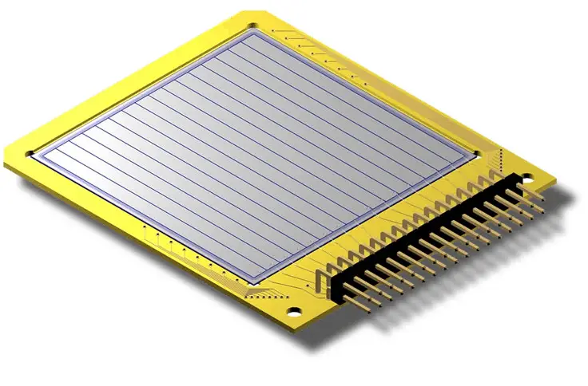
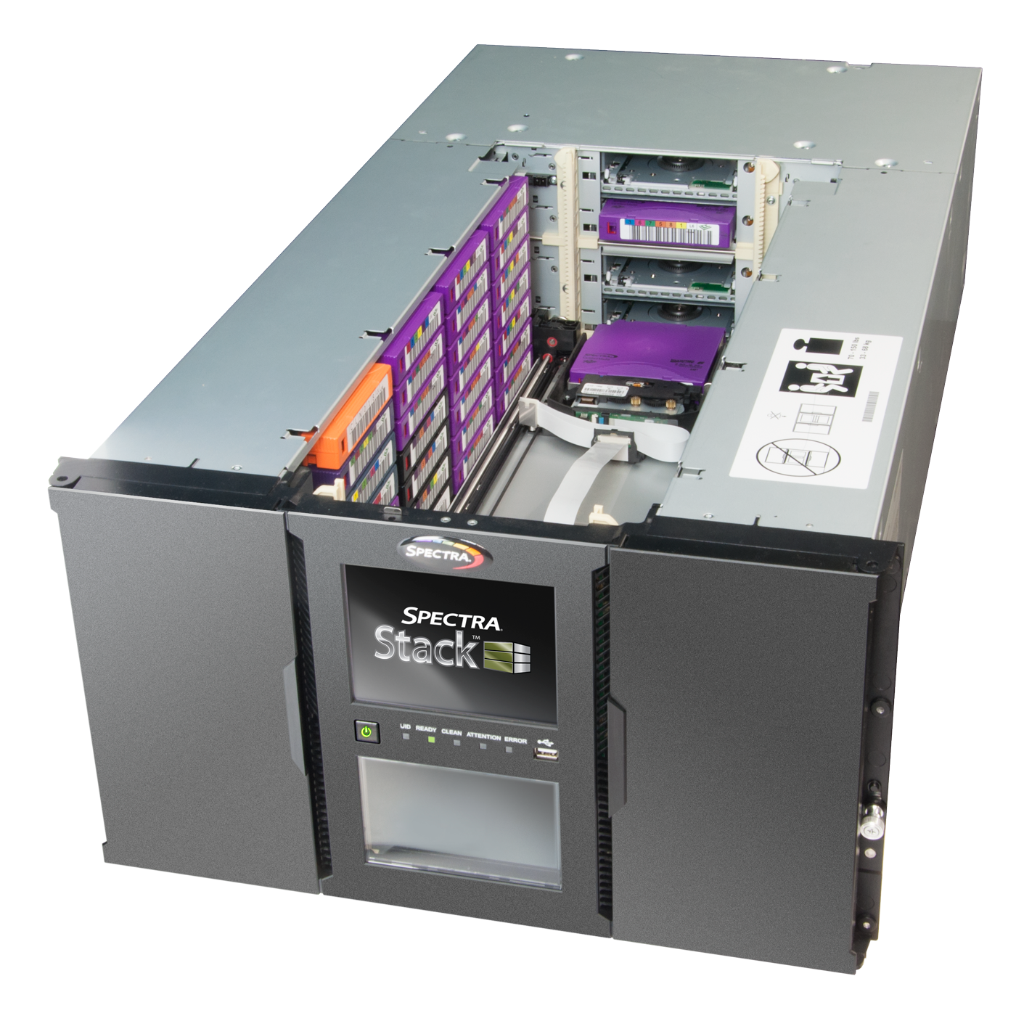
DAQ – getting data from the sensors to tape
DAQ is easy... Just get the data out
Don’t loose any on the way
Take into account that data (usually) get less in a controlled way during the transport
Distribute them to various processing elements
Send some of them to monitoring systems
All this 24/7, without error, no human intervention and for less money than budgeted :-)

Slide 4
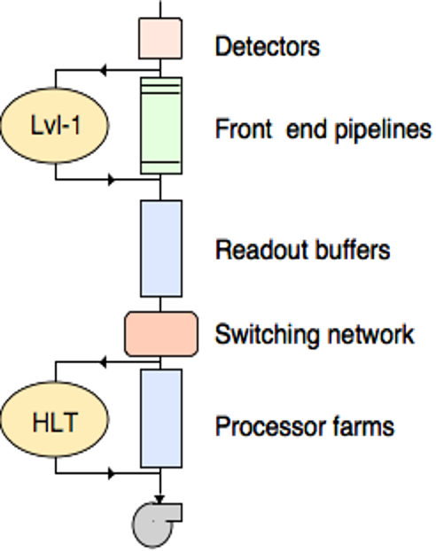
Some terminology
In DAQ we normally see and care about data after the action of the Level-1 trigger (if we have such a thing...)
Often anything before that is sloppily referred to as “front-end” or “detector”
Readout consist of readout-links and “back-end”
Everything between readout and processor farms is usually referred to as “event-building”
The processor farms run the “High Level Trigger” (HLT) which in essence is a software selection of events

Slide 5


DAQ at LHC
Make no mistake: size matters
The higher the rate, the bigger the events, the more challenging to build a DAQ ... At reasonable cost
That’s why DAQ is so much fun at (H)LHC. The only future DAQs, which will come close are DUNE, the FAIR experiments and SKA
The high rate (40 MHz bunch-crossing), the high luminosity (expect pile-up == number of proton-proton collisions go up to 200), and the huge number of sensors (millions) are only one challenge:
The radiation levels are another —> custom readout links from the detector needed

Slide 6
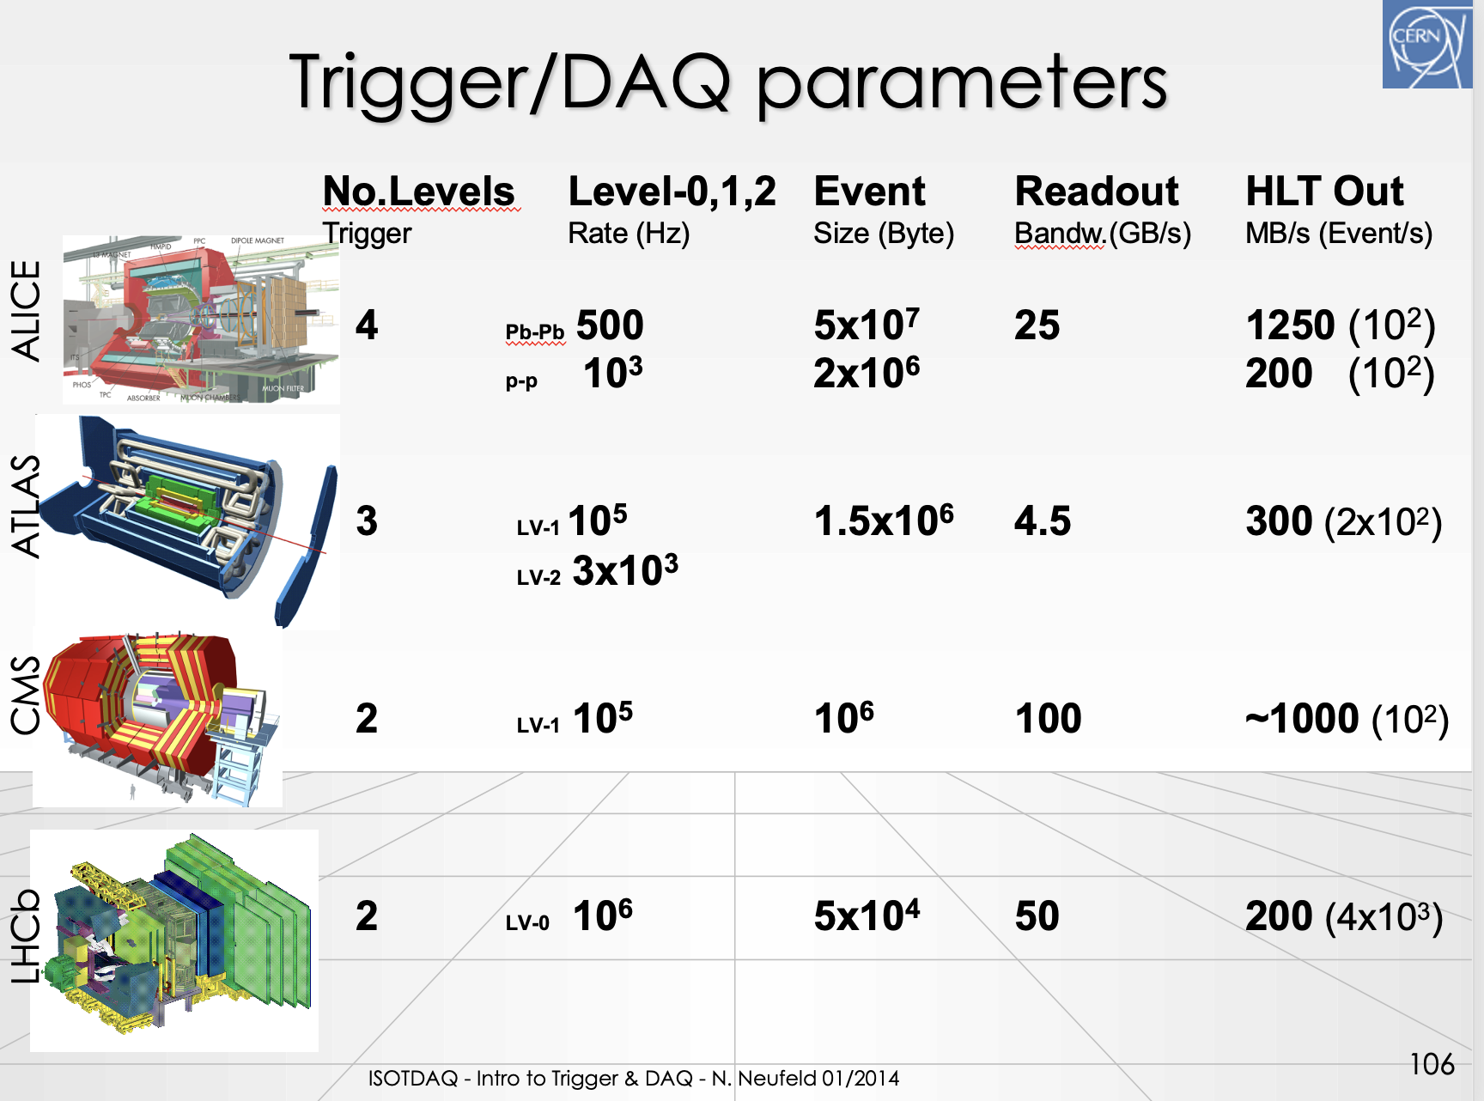
The glorious past of LHC DAQs
The Run1 and Run2 systems were land-mark DAQs, each with its own architectural riffs and different emphasis
Recommended exercise for the audience: read up on the! but we won’t cover them here

Slide 7
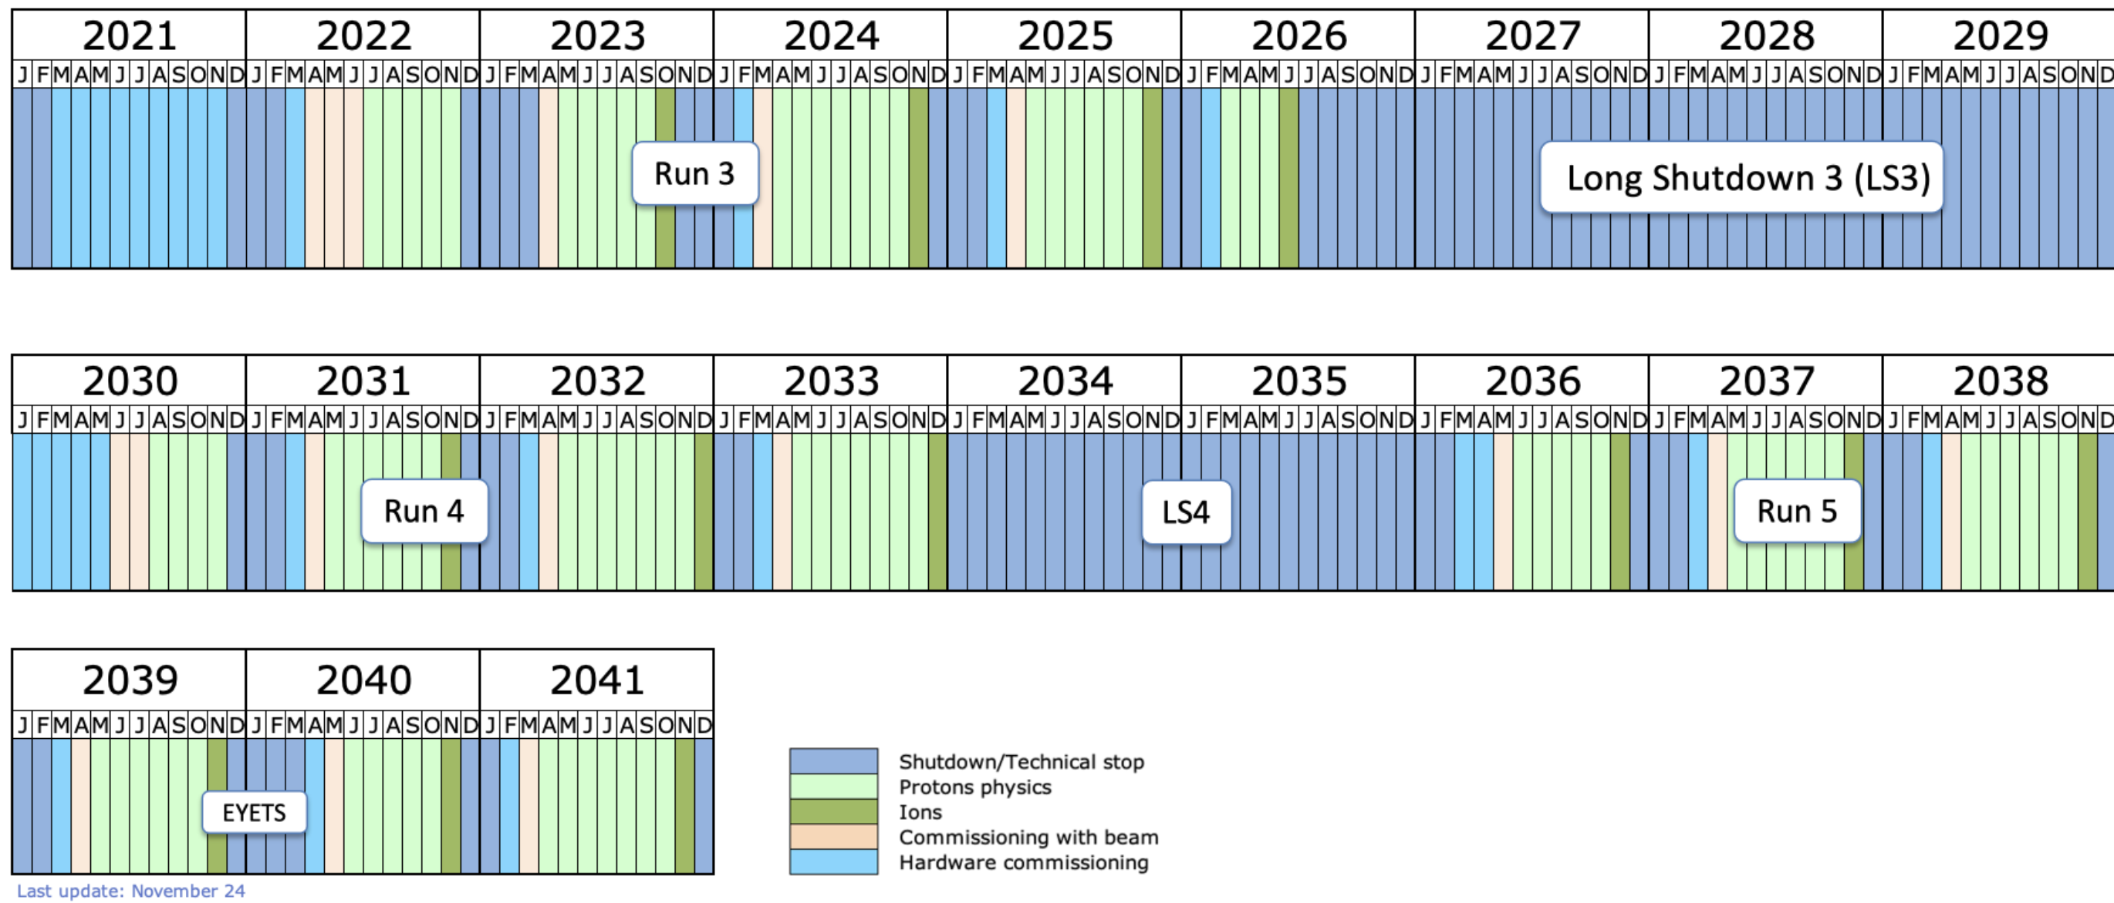
(At least) 16 more years of LHC DAQ
Enormous of possible luminosity in 2030: (ATLAS, CMS, Phase 2)
Enormous increase of accepted luminosity in 2036 (ALICE, LHCb Phase 2)

Slide 8
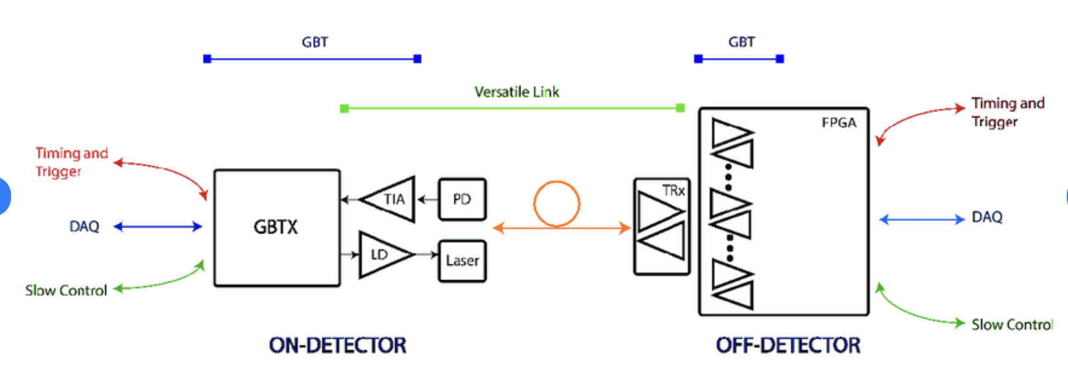
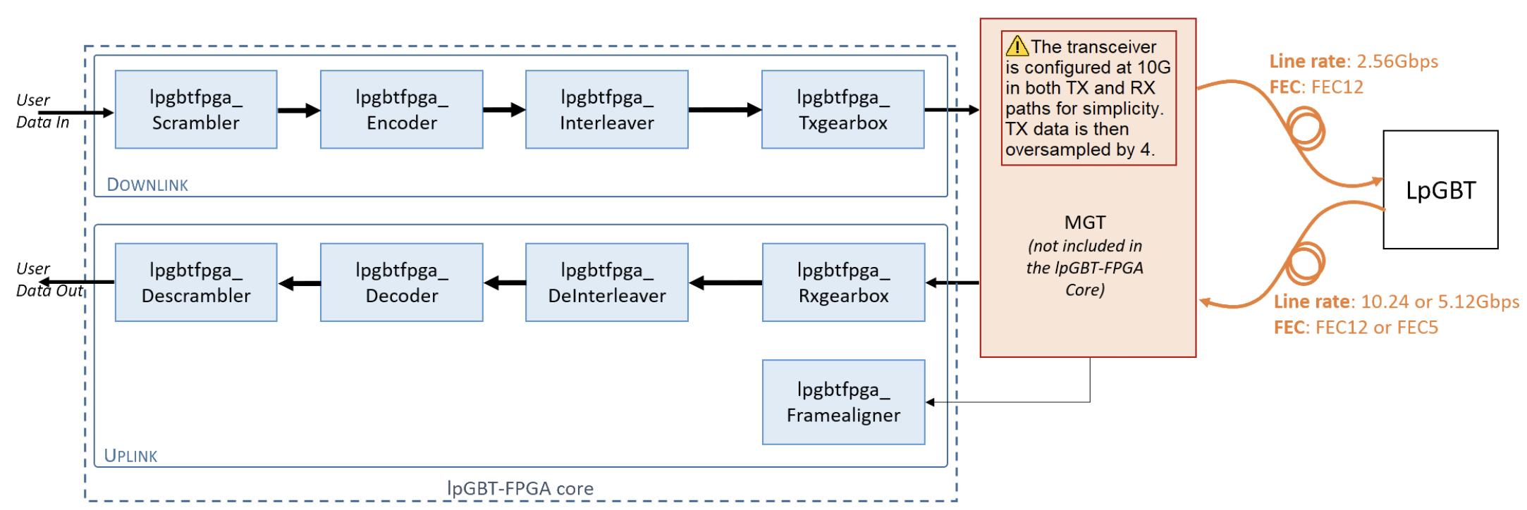
The front-end links today and tomorrow

Slide 9
The front-end links
Disclaimer: For Run3 ATLAS and CMS still have what are now “legacy” links in addition to these new standard links
If you want to appear as educated when chatting with our electronics colleagues: the link is called versatile link (+), the protocol is called (lp)GBTx
What’s special about this link and protocols (compared to LAN links like Ethernet or InfiniBand):
  they “swing” with the LHC 40 MHz
  They have optional very strong error correction (FEC)
  they can transport fast synchronous timing, slow control and data
  they operate efficiently with a very small frame size of 128 bits (no inter-frame gap)
  they have no addresses, —> no switching or aggregation
  they can be operated in simplex mode
  Vl+, lpGBT is asymmetric (4x10 Gbit/s down, 1x2.5 Gbit/s up)
  they are slow: 4.8 Gbit/s, 9.6 Gbit/s max for VL, VL+
—> incompatible with industry standard protocols (Ethernet, PCIe), need custom electronics to send (FrontEnd) and receive (BackEnd)

Slide 10
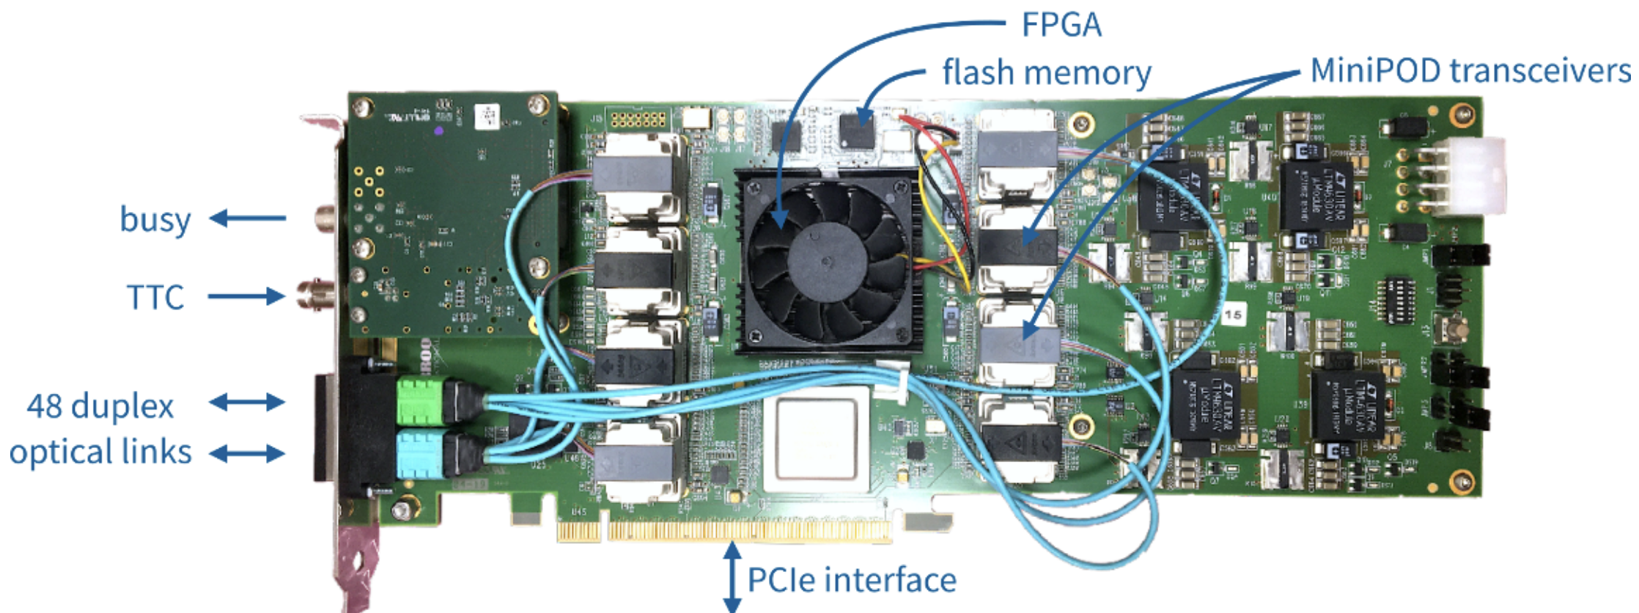
Collecting the front-end links
Many slow custom links – here up to 48
Received and merged into a industry-standard protocol – here PCIe
ATLAS Felix 712
Core-building block of a Readout Unit (RU)
(can also be crate-based unit as in CMS)

Slide 11
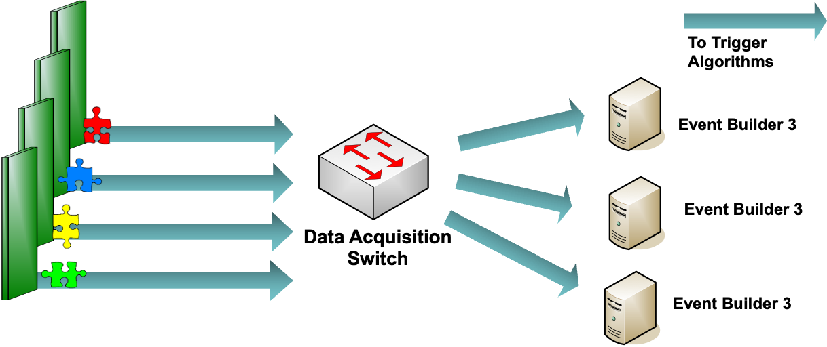
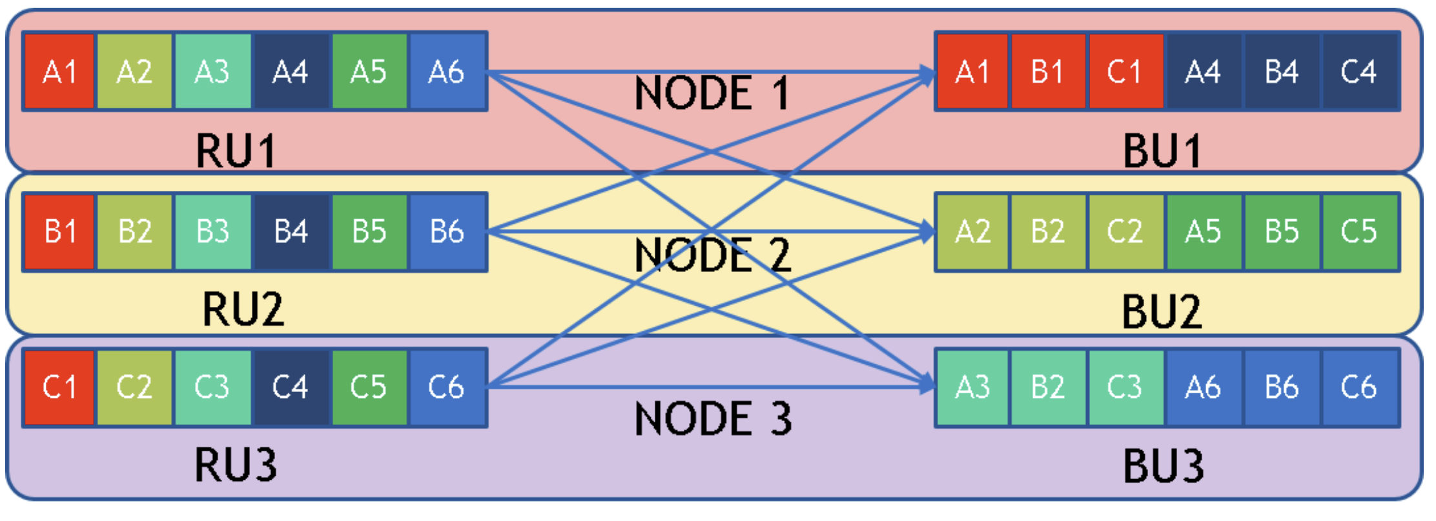
Event-building / matrix-transpose with networks
RU1
RU2
RU and BU on same node == folded event-builder (use network in both directions, half the ports)
BU1
RU3
BU2
RUn
BU3

Slide 12
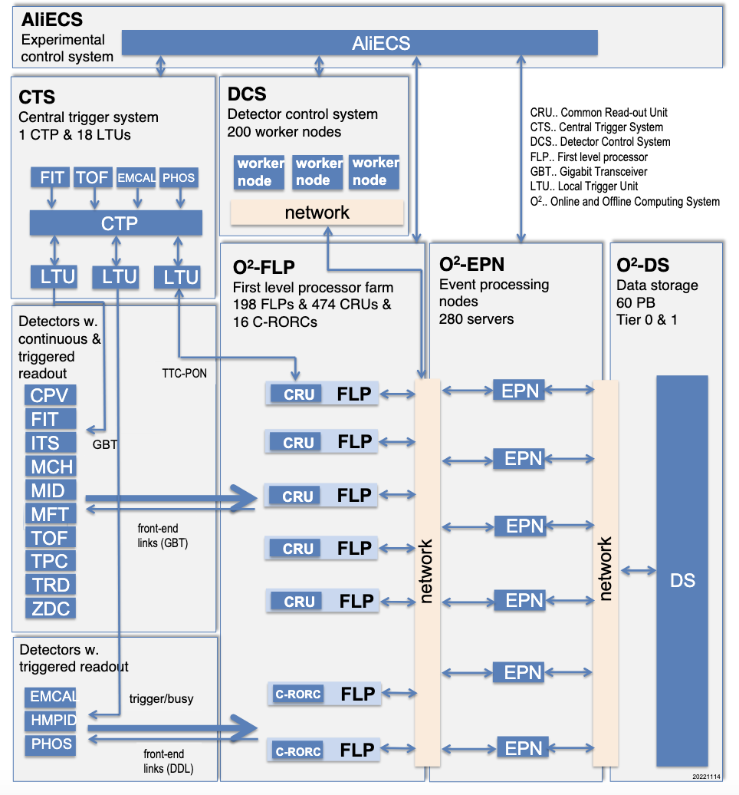
ALICE

Slide 13
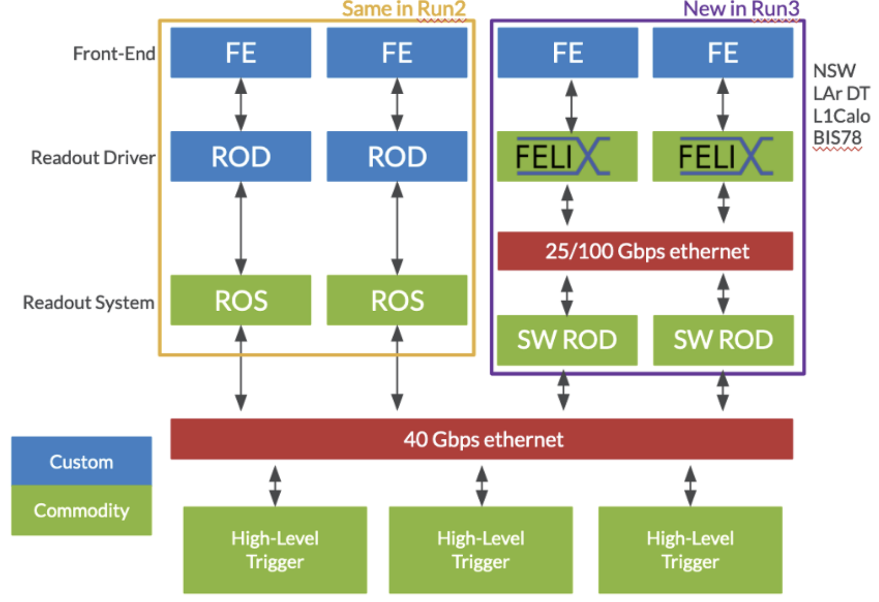
ATLAS Run3
Custom Link
Another Custom Link
GBT/VL
Nice example of a hybrid system, combining legacy and new technology
Using Ethernet and PCIe
Using a two stage HLT with Region of Interest to reduce network bandwidth
Custom Link GBT/VL

Slide 14
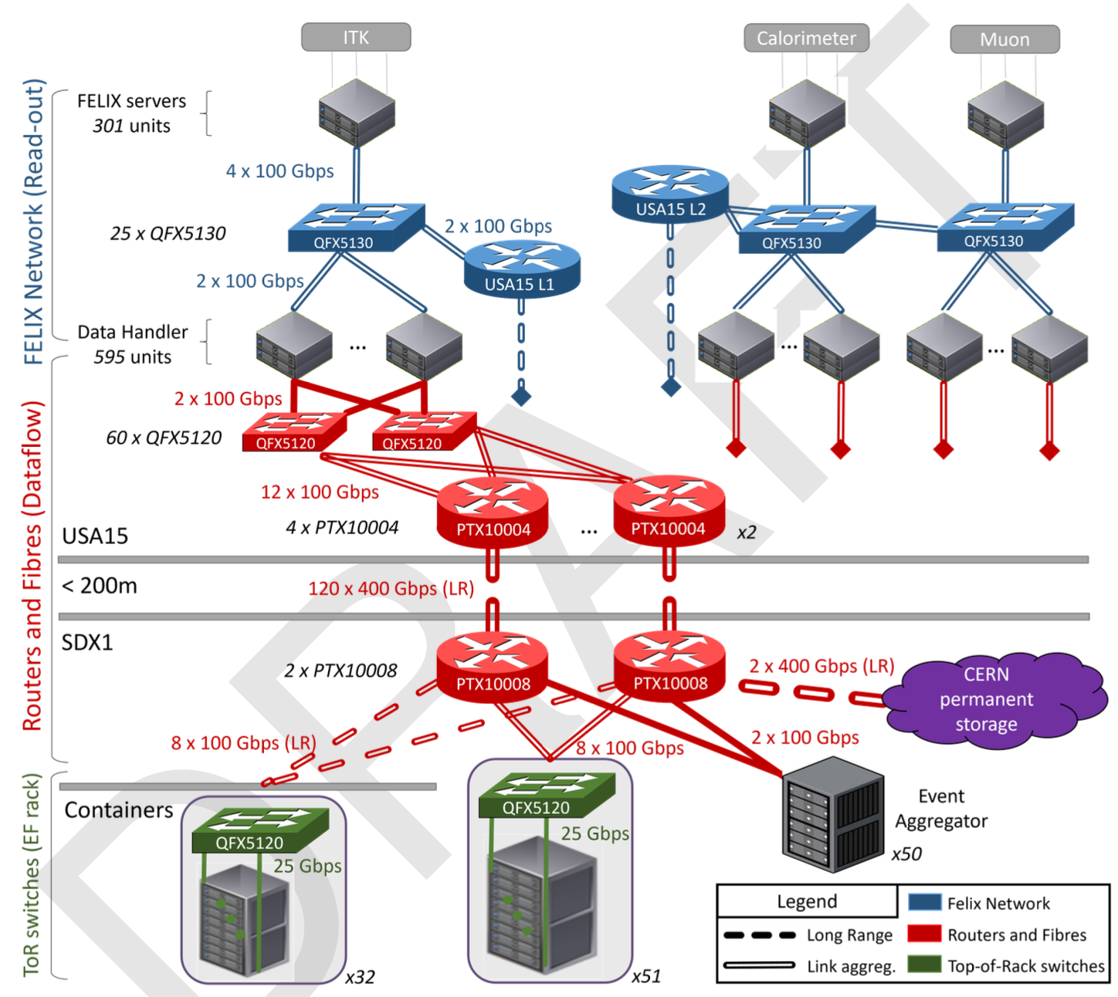
ATLAS Run4
Using Ethernet and PCIe
Single stage full event-building @ 1 MHz
No dedicated builder-nodes —> highly scalable system
In current form relies on availability of deep-buffer switches

Slide 15
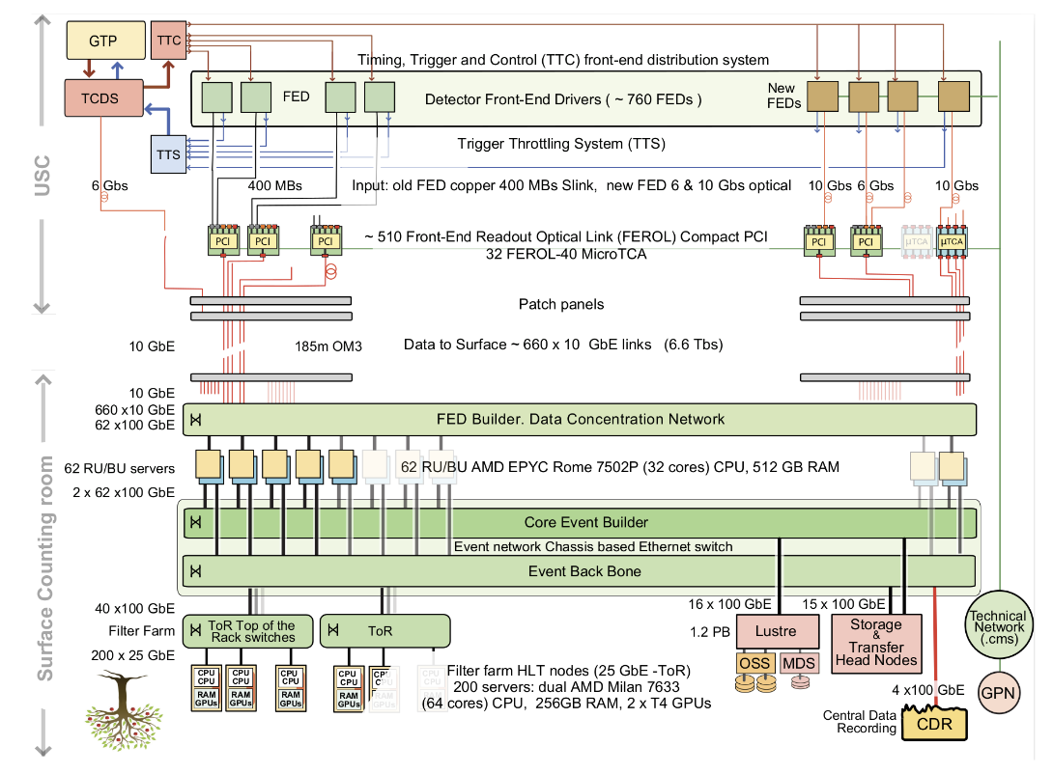
CMS Run3
Single stage event-building, folded (RU==BU)
Uses RoCE (which is basically InfiniBand over Ethernet)
Also combines legacy with new front-ends

Slide 16
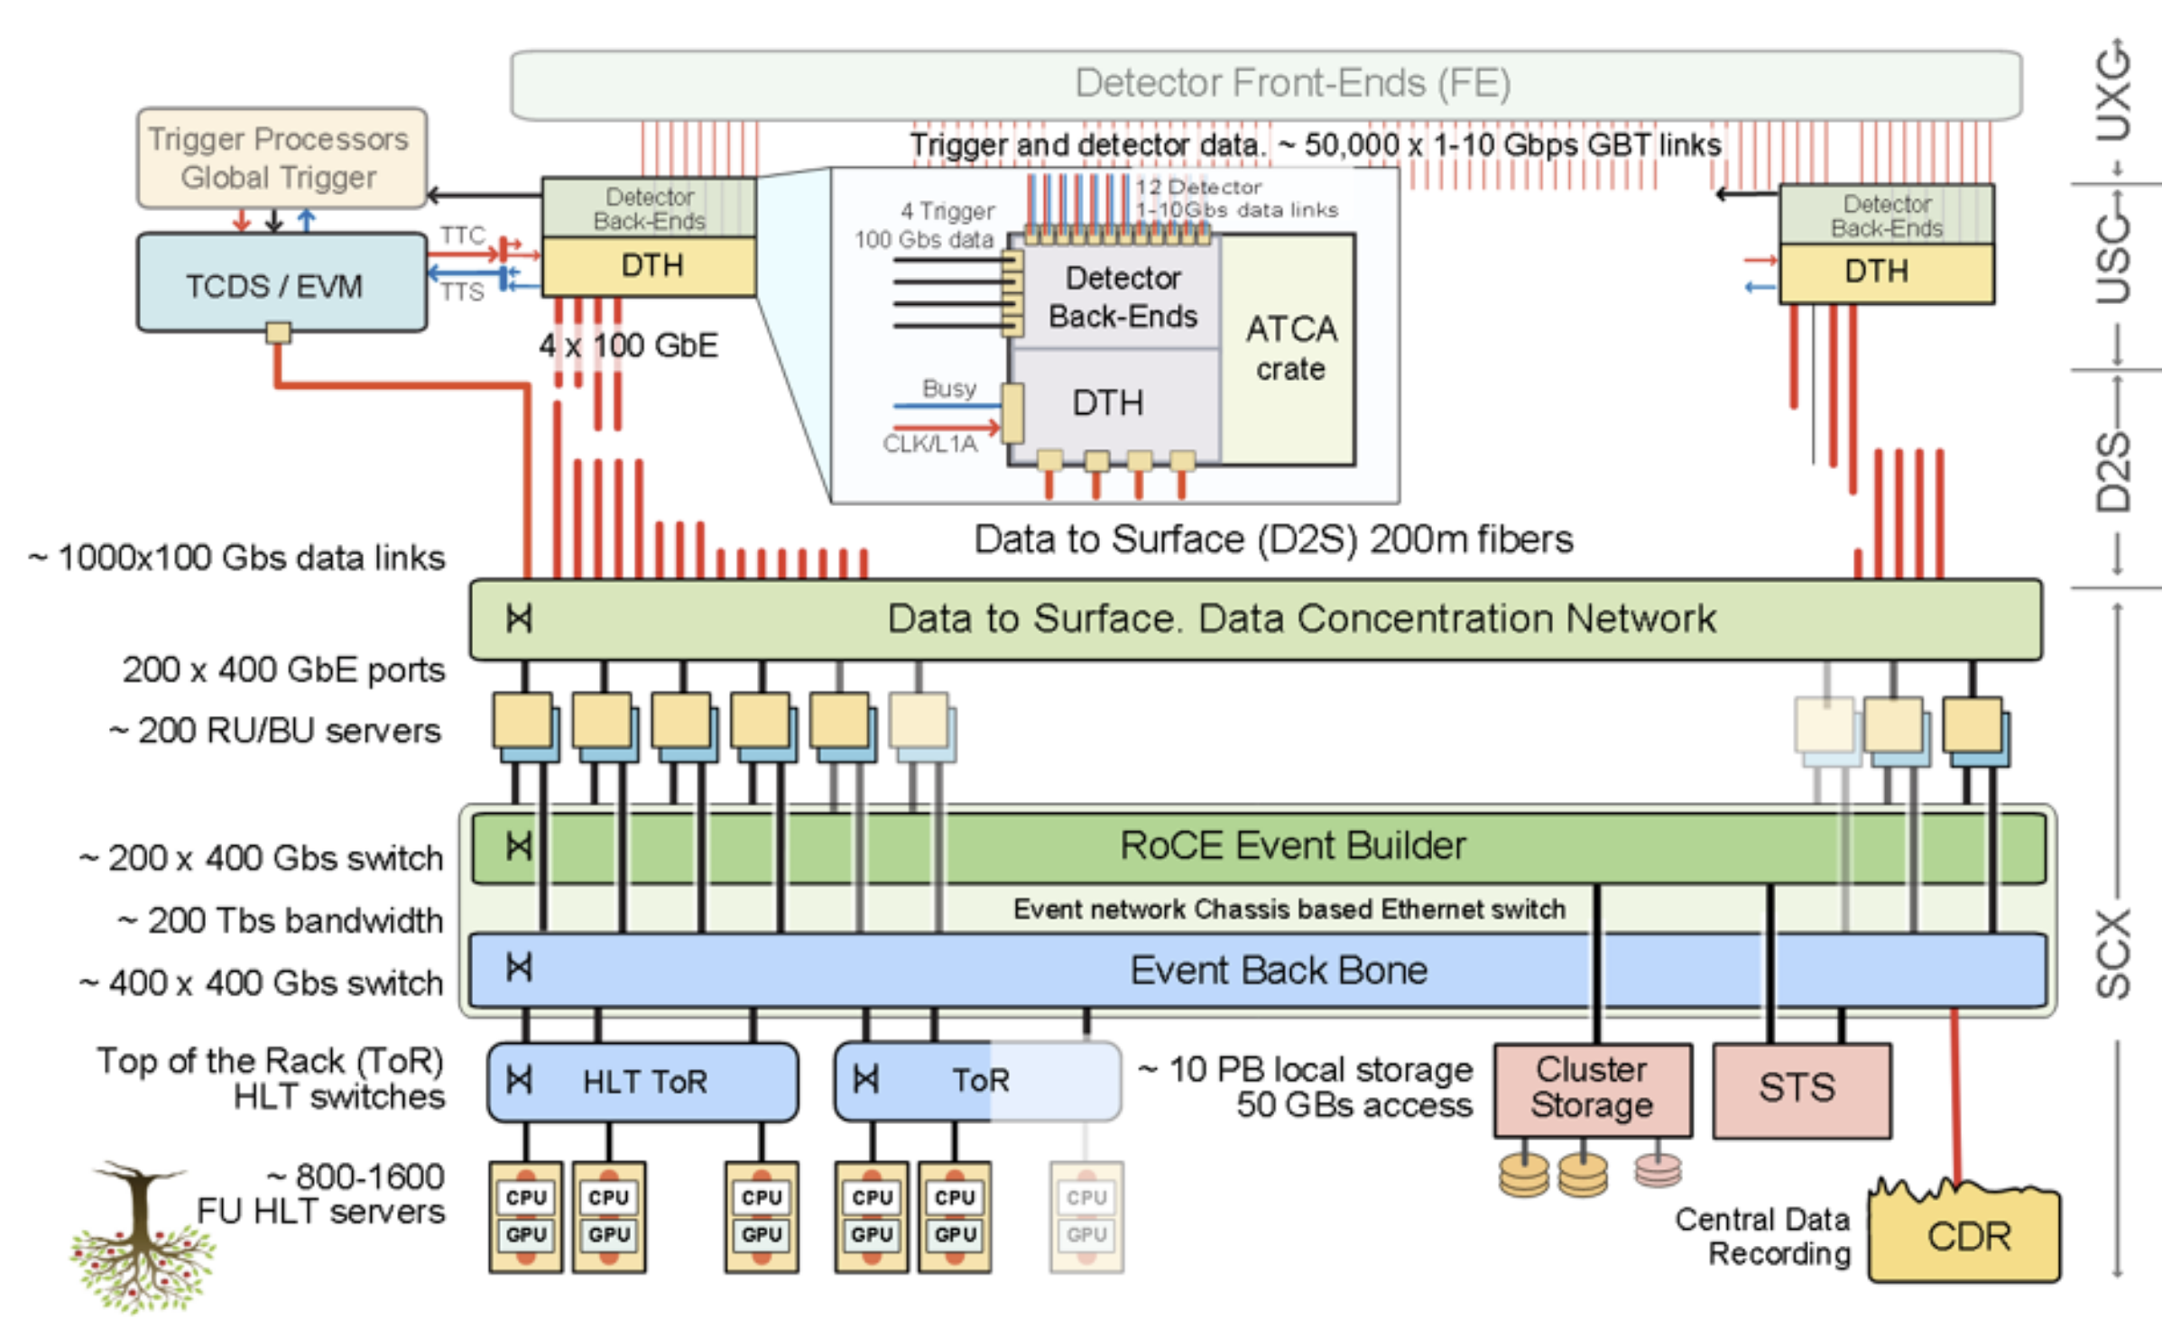
CMS Run4
Essentially Run3 architecture with modernized technologies

Slide 17
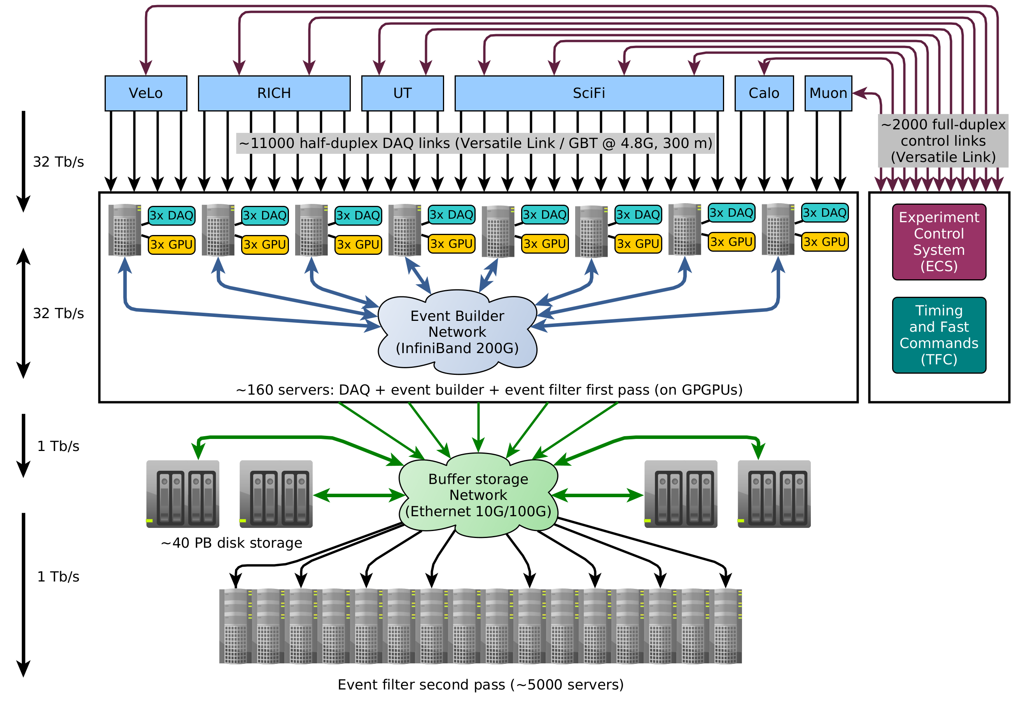
LHCb
Single stage event-building, folded (RU==BU)
Two stage software trigger with intermediate buffer

Slide 18
Run3&4 DAQs
Trend to more uniformity
  E.g.: The different drawing styles hide the fact that the CMS and the LHCb architecture are actually very similar
No more hardware trigger to define upstream DAQ: LHCb and ALICE
Emphasis more on software, to put off-the-shelf hardware to use
 | DAQ rate | Event size | EB B/W | LAN technology
ALICE | 50 kHz | 12 MB | 0.7 TB/s | InfiniBand HDR
ATLAS Run3 | 90 kHz |  | 55 GB/s | Ethernet / TCP/IP (100G)
ATLAS Run4 | 1 MHz | 5 MB | 5 TB/s | Ethernet / TCP/IP (400G)
CMS Run3 | 100 kHz | 2 MB | 0.2 TB/s | Ethernet / RoCE (100G)
CMS Run4 | 750 kHz | 8.4 M | 6.3 TB/s | Ethernet / RoCE (400G)
LHCb | 40 MHz | 60 kB | 2.4 TB/s | InfiniBand HDR
Numbers are approximate, actual installed network bandwidth is higher in all cases

Slide 19
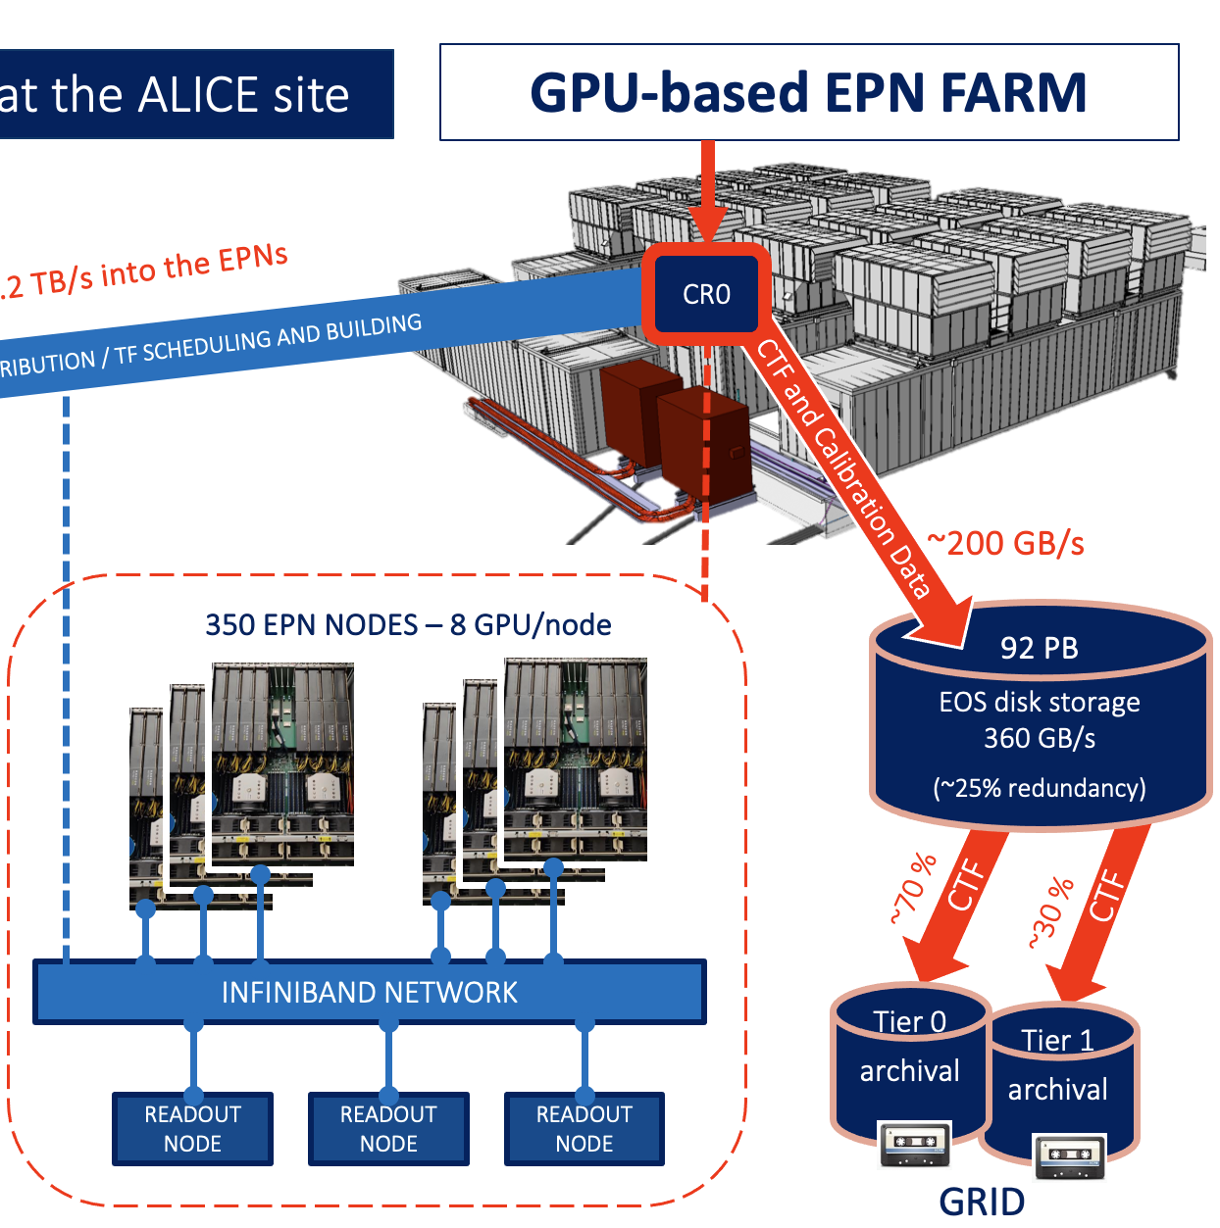
Storage
High bandwidth, high capacity storage systems are characteristic of the LHC DAQs
  Was less prominent in previous times (LEP,...)
The need is either intrinsic like in ALICE (large events) or to facilitate asynchronous event filtering (LHCb)
92 PB in ALICE based on CERN EOS (360 GB/s)
36 PB in LHCb using custom protocol (300 GB/s) + 9 PB CEPH (RAID6)
Mostly spinning drives / SSD only for meta-data

Slide 20

And I am neglecting a lot of interesting detail
There is a lot of clever zero-copy, remote DMA,
traffic shaping to cope with shallow-buffer switches
Even some reasonably fancy mathematics, for instance to work out new static routing tables in LHCb’s network to cope with network failures
While the bulk of the code is written in C++ (+ some glue-code in python) there are some beginnings of Go and Rust
While the data transport software tends to be based on “well-established” standards (Ethernet, TCP/IP, InfiniBand Verbs, RDMA, ZeroMQ, ...) there is much more variety and use of modern protocols / technologies in monitoring and controls (c.f. the talks in this workshop) —> probably because most of us still feel that we can’t give up control or performance easily

Slide 21

Trends in DAQ
(Drastic) reduction of the number of custom-made components
The rise of Ethernet
The physical infrastructure of a modern DAQ is a data-centre
  Can we run (some of) it in the cloud?
  Or in Prevessin?
  By building and operating data-centres we inherit a lot of the challenges of modern data-centres: increasing power-densities driven by the desire to lower interconnection costs, cooling challenges, environmental foot-print
The increasing use of GPUs
  Not only for machine-learning / neural network type applications (“AI”)
  But also using clever bespoke highly parallel algorithms (ALICE, LHCb, CMS)
  What does this mean for DAQ: it could be profitable / interesting to interface more directly with GPUs, maybe even dispose of the host CPU when using self-hosted GPUs or GPU/CPU hybrids like NVIDIAs GraceHopper
Over all there is a lot of convergence, from a technological point of view we could do much more in common than we do..., but of course the DAQ teams are always a crucial component of the Operation of the experiment – and operations people are usually not successfully “delegated” to an external group

Slide 22
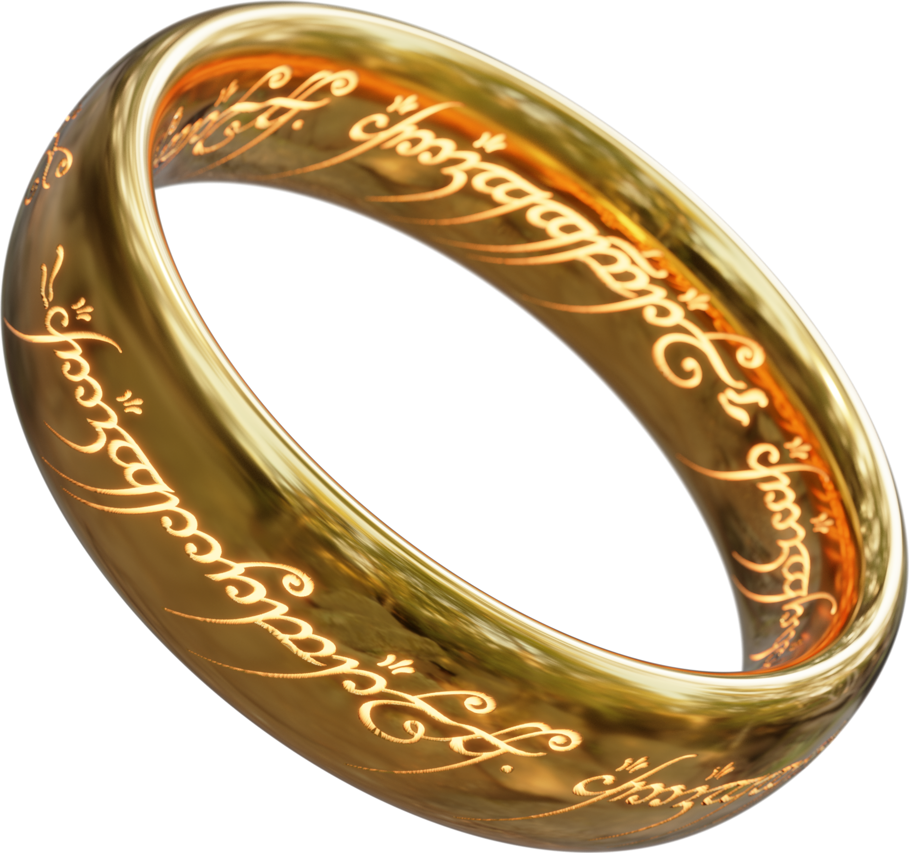
Ethernet all the way...
No protocol still in use is older (excepting perhaps RS232 :-))
Moore’s law is maybe dead for CPUs/GPUs/FPGAs but not for networks
800G is there today, 1600G will be there for the start of Run4, 3200G seems impossible today...
Everything “speaks” Ethernet from Arduinos to SuperComputers, why not the detector front-ends?
In the most extreme scenario we could do away with the back-end altogether!
For more food for thought in this direction listen to the talks by S. Baron and A. Perro
One Protocol to rule them all,
One Protocol to connect them,
One Protocol to transport it all
and ever more quickly and cheaply

Slide 23

The future
We live in great times!
We operate the biggest, meanest, coolest DAQ systems ever built
With some luck ALICE and LHCb will get a shot at another factor 5 or so, and who knows what ATLAS and CMS can add in LS4
After that you have to go to SKA
FCCee DAQ risks to be somewhat boring (sorry guys...) as DAQ systems go..., in particular with the technology of 2045, so let’s enjoy what we have now!

Slide 24

In case you wondered – DAQ (in the narrower sense) is ...
But I am sure it will find its use, in particular in run-control

