Slide 2
HFM Scientific and Societal Impact
-
Preliminary findings and discussion about priorities
HFM Forum
Thomas Rimbot - WP6.1 Leader
Enrico Chesta - RD6 Coordinator
CERN Knowledge Transfer Group
12.19.2024

Slide 3
Table of contents
Recall: Scope of the RD Line / Work Package
Patent Landscape Analysis Results
HFM Developments with Impact Potential
Identified Promising Application Areas
Next Steps

Slide 4
Recall: Scope of the RD Line / Work Package

Slide 5





Goal
Maximize the impact of HFM programme on society and science and facilitate collaboration among stakeholders and dissemination of the results.
NUCLEAR PHYSICS
ASTROPHYSICS
ENERGY
INDUSTRIAL PROCESS
BIOLOGY
MATERIAL SCIENCE
MEDICAL
TRANSPORTATION

Slide 6
General Approach
Collect/analyse perspectives
Integrate requirements
Define value proposition
Facilitate exchanges
Establish partnerships
HFM experts
RD1-5
CERN & national labs
Industrial
partners Technology
end-users & suppliers
HFM
Impact Forum
IP and KT
professionals
RD 6
CERN & national labs
Scientific community
HEP & beyond
Generate impact together.
Notes:
Enable exchange

Slide 7
Implementation
Triangulation of knowledge sources enables a holistic overview.
Scientific Perspective
Input HFM & RIs
Publication Analysis
Community building
HFM Impact Forum
Data Screening
Selection
Patent Analysis
Industry Products
Trend mapping
Workshops
IP Perspective
Industry Perspective

Slide 8
Patent Landscape – Results Analysis
Results from Linn Kretzschmar (former WP6.1 Leader)

Slide 9
General Approach
Screen patents from WIPO’s PatentScope using experts-selected keywords:
    Niobium Tin (HFM), Nb3Sn (HFM), Quench Detection (HFM), HTS (REBCO), Nb3Sn Cable, Nb3Sn Wire Production, High Field Magnets, Cryogenics (HFM).
Use text-analysis to understand industry trends.
    254 patents from 156 unique applicants across 16 countries spread over several decades with a peak in the last 10 years.
Dataset available at: https://cernbox.cern.ch/s/TVTcVKUy3RzOj4f

Slide 10
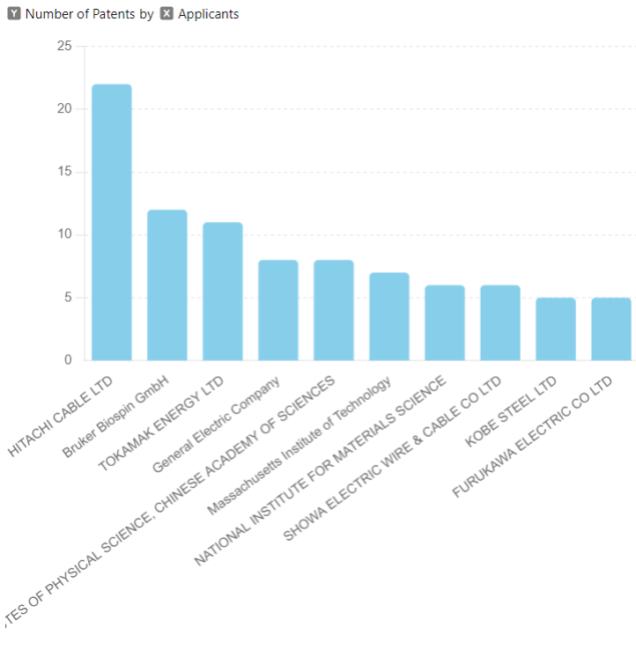
Results – Patents Analysis
254 patents, 70% from industry => High business interest in HFM from the industry.
Major applicants: Hitachi Cable, Bruker, Tokamak Energy, GE, Chinese Academy of Science, MIT => potential partners/competitors.

Slide 11
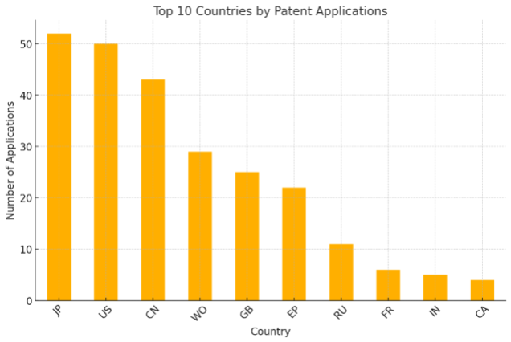
Results – Patents Analysis
Patents applied mostly in Japan, US and China, not so much in CERN Member States (about 25% in Europe) => strategic importance of HFM programme for European competitiveness.
WO refers to patents filed internationally, and EP refers to patents filed across multiple European countries through a single application

Slide 12
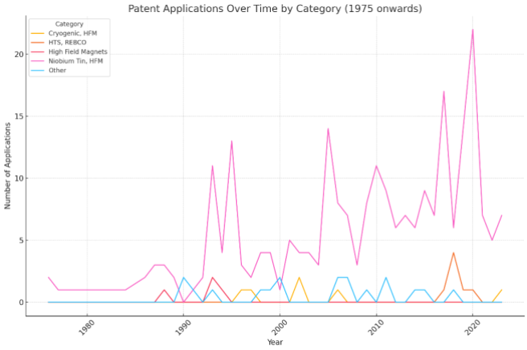
Results – Patents Analysis
Growth of patent numbers in specific categories => promising trends.

Slide 13
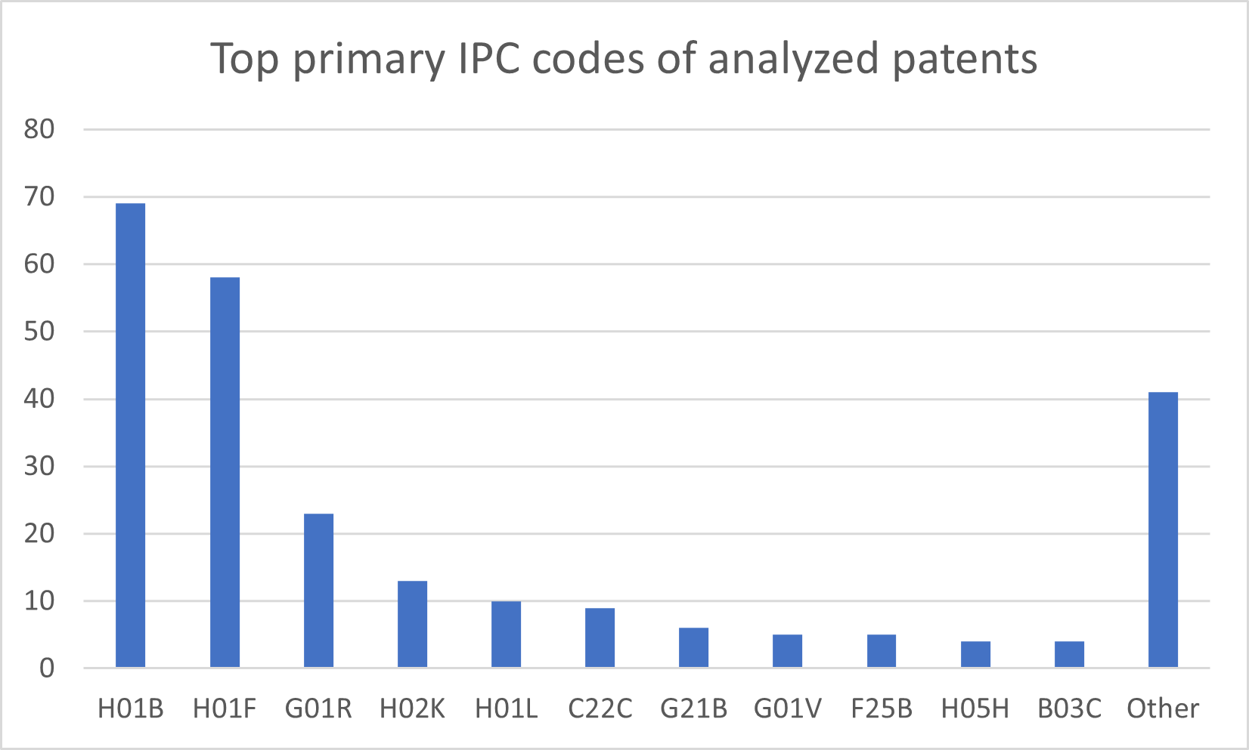
Results – Patent Family Analysis
International Patent Classification (IPC): worldwide system to classify and categorize patents based on different technology sectors.
IPC codes come with different amounts of occurrences:
  Many patents => more interest, higher TRL.
  Few patents => more opportunities for new research.
H01B (69 patents): cables; conductors; insulators; selection of materials for their conductive, insulating or dielectric properties.
H01F (58 patents): magnets; inductances; transformers; selection of materials for their magnetic properties.
G01R (23 patents): measuring electric variables; measuring magnetic variables.
H02K (13 patents): dynamo-electric machines.
H01L (10 patents): semiconductor devices .
C22C (9 patents): alloys.
G21B (6 patents): nuclear reactor design.
G01V (5 patents): geophysics; gravitational measurements; detecting masses or objects.
F25B (5 patents): refrigeration machines, plants or systems; combined heating and refrigeration systems; heat pump systems.
H05H (4 patents): plasma technique, production of accelerated electrically- charged particles or of neutrons, production or acceleration of neutral molecular or atomic beams.
B03C (4 patents): magnetic or electrostatic separation of solid materials from solid materials or fluids; separation by high-voltage electric fields.

Slide 14
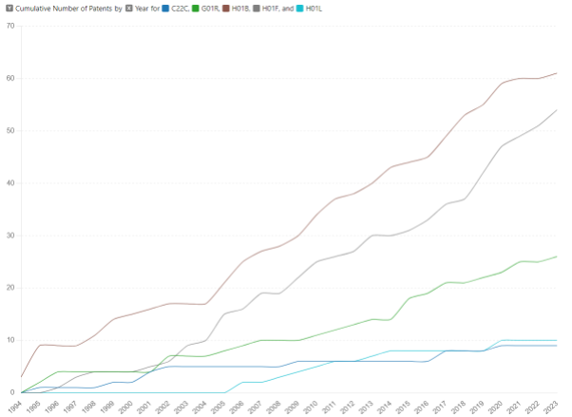
Results – Patent Family Analysis
Different growth rates for each IPC family but comparable between components and systems => integrating working components in a new system seems to be the priority.
H01B (Cables, Conductors, Insulators, Materials for Electric Properties)
H01F (Magnets, Inductances, Transformers, Materials for Magnetic Properties)
G01R (Measuring Electric & Magnetic Variables)
H01L (Semiconductor Devices)
C22C (Alloys)

Slide 15
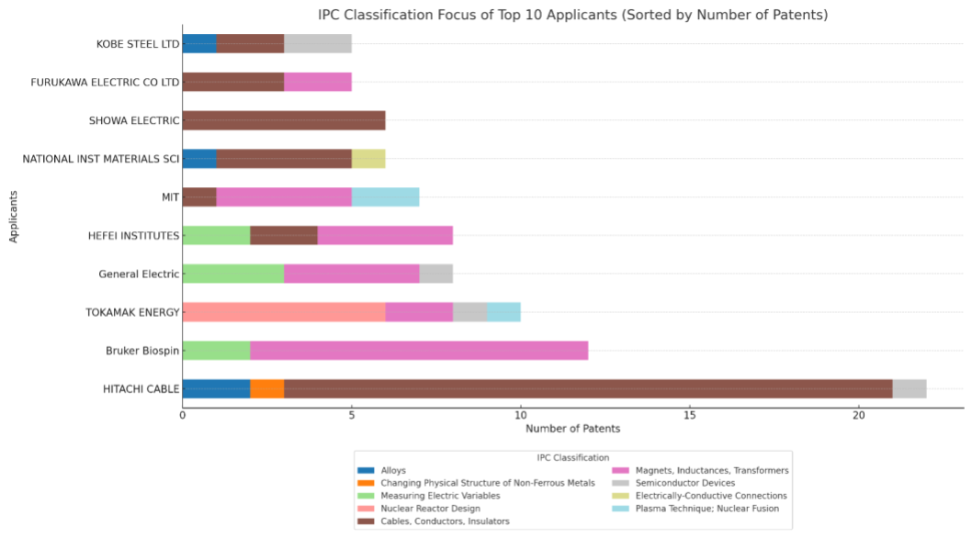
Results – Patent Family Analysis
IPC gives information on dominant focus areas for key applicants => major actors identified for specific technologies.

Slide 16
Results – Keywords Analysis
Idea: Analysing occurrences of recurring groups of words informs on key focus areas and evolution trends.
Top Trigrams 2000-2007 | Top Trigrams 2008-2015 | Top Trigram 2016-2023
sn based alloy (9) nb3sn wire rod (9) nb3sn based wire (7) hts band conductor (7) inner coil section (6) ag sn alloy (6) outer coil section (5) niobium nb niobium (4) nb niobium alloy (4) radially inner coil (4) | main coil section (17) diffusion barrier layer (10) single core wires (10) nb3sn wire rod (8) cu sn alloy (7) hts layer 11 (6) cu cu based (6) cu based alloy (6) nb nb based (6) nb based alloy (6) | hts current leads (18) sn based wire (8) based wire rod (8) metal interface layer (8) nb3sn stranded wire (8) Nb3sn wire (8) layer bonded metal (7) cu base material (7) nb3sn wire cable (7) hts protection switch (6)
Transition from material discovery and coil design to focused HTS applications and material improvements => field maturation.

Slide 17
Highlighted Industry Developments
Idea: Understand industry priorities related to the HFM Work Packages.
Procedure: Extract keywords from RD Lines description and match them to patent data to assess the major technological developments done in industry.
RD Line | Extracted keywords from RD Line description | Highlighted developments in the patents
RD1 (64 patents) | Nb3Sn conductors, high-field magnets, CERN Procurement, industrialization, specification, acceptance testing Critical current, magnetothermal stability, heat treatment, characterization Modeling, diffusion, phase tranformations, experimental techniques Mechanical and thermomechanical behaviour, cabling degradation, strain testing | Nb3Sn wires composite materials Alloy optimization and stranded wire technologies for high-performance cabling Coil construction Precursor tubes and layered structures for superconductors
RD2 (59 patents) | Procurement, testing, qualification, long-length REBCO tapes and cables REBCO racetrack coils, pancake coils, mechanical properties, performance in high-field HTS-CC architecture, stability, performance, long-length fabrication | Multi-layered REBCO tape structures Mechanical bonding techniques to improve stability under thermal cycling Soldering methods for tape-stack racetrack coils Mechanical properties of HTS materials for high-current applications
RD5 (17 patents) | Magnetic field measurement, field mapping, flux measurement, Data acquisition, DAQ, measurement software, sensor interface Croygenic measurement system, superconducting instrumentation, current measurement Test bench, magnet testing, cryostat, measurement infrastructure Calibration tools, validation techniques, sensor calibration | Cryostats Magnet systems Measurement apparatus Mass spectrometers
Notes:
Precursor tube: Intermediate products used in advanced manufacturing process to create high-performance structures

Slide 18
Conclusion – HFM Patent Landscape
254 patents from 156 unique applicants selected on the basis of HFM keywords across 16 countries were analyzed. The main results are:
  Identification of a few major actors in specific technologies and high interest from the industry (70% presence in the patents against academia’s 30%).
  Comparatively low presence in Europe with respect to other geographical zones (only 25% fraction), showing strategic importance of the HFM programme.
  Identification of different trends with the patent families:
    Fields with lots of developments and interest, hence high TRL and possibly less opportunities for breakthroughs (e.g cables, conductors, magnets).
    Fields with less developments, hence low TRL and more opportunities for breakthroughs, but possibly lower interest (dynamo-electric machines, plasma confinement).
  Field maturation with parallel development on both components and systems levels.

Slide 19
HFM Developments with Impact Potential

Slide 20
HFM Developments Applicability (TBD)
Components:
Conductors
Wires
Cables
Systems:
LTS Magnets
Infrastructures:
Power supply
Test benches
Software:
Physics models
Design software
DAQ
Processing
Subsystems:
HTS Magnets
Coils
Measurement and protection systems
Cryostats
Technology adaptation complexity for use in different applications, and expected impact level

Slide 21
HFM Developments Examples (TBD)
Level | Technology / Expertise | Possible Collaboration Form
1 - Software | Software tools for magnet design and optimization | Licensing
 | Software tools for Electromagnetic field and quench behavior simulation
2 - Components | Manufacturing and reinforcement techniques for high-field conductors | R&D collaboration
 | HTS REBCO tapes and cables
 | Superconducting wires based on innovative materials
3 - Subsystems | Quench detection and protection systems | R&D collaboration
 | Measurement equipment, instrumentation
4 - Infrastructures | Cryogenic testing facilities | Service
 | Magnetic measurement test benches
5 - Systems | HTS magnet for a specific application | R&D collaboration

Slide 22
Identified Promising Application Areas

Slide 23
Definition of Impact
Applied superconductivity experts in the world are working on very complex problems in specific fields, outside HFM’s scope of activities.
Nevertheless, they sometimes face technological challenges which are difficult to overcome and do have a link to HFM developments.
This can lead to small and incremental, but valuable and critical, improvement through industry partnership, leading to significant scientific, societal, and economical impact.

Slide 24
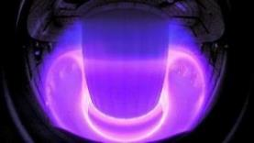

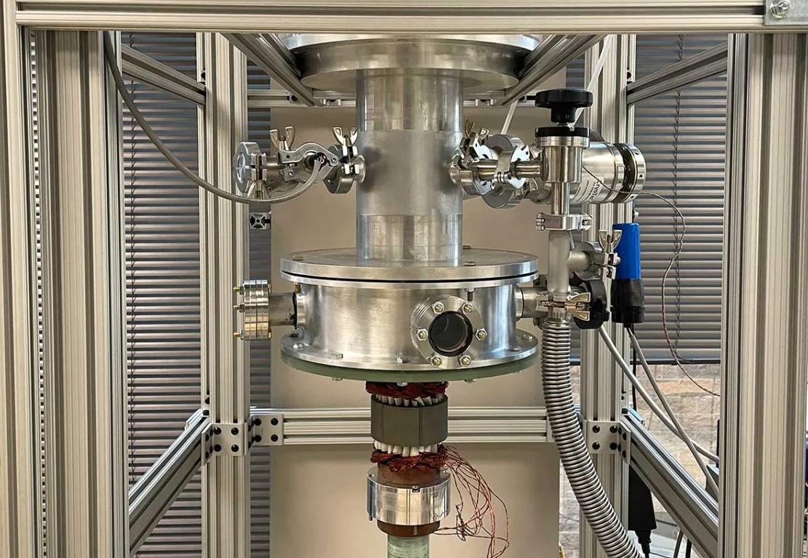
Energy
Level | Technology / Expertise | Application area
1 - Software | Advanced magnet design and simulation software | Optimized design of specialized magnets in fusion
2 - Components | Advanced superconductor materials | Increased energy storage and reduced cooling requirements in Superconducting flywheels
3 - Subsystems | Solenoid coils | Advanced generation and containment capabilities in fusion
 | Monitoring fault-detection systems | Safety in energy generation
4 - Infrastructures | Radiation tests facilities | Superconducting materials for fusion
Notes:
Fusion: 10-20 T for plasma confinement
SC Flywheel:
Energy stored is pptal to moment of intertia and square of angular velocity => need to increase velocity to increase energy density.
Main concerns now: viscous air drag (solved by putting inside vacuum chamber), mechanical strength (carbon fiber composite => 1 km/s) and increasing bearing loss.
energy also stored in the magnetic field itself. Advanced superconducting materials => higher critical current density => more energy stored. Also enable to enhance the energy efficiency of the system => reducing waste heat => essentially more energy stored. Also HTS => less cooling requirements => less energy wasted. Use YBCO
Grid: superconducting lines = reduced losses, smaller footprint (smaller cables) and thus environmental impact. Main limitation: use of cryogenic system. Studies on Magnesium Diborite MgB2

Slide 25
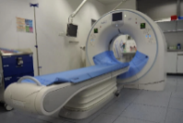
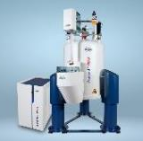
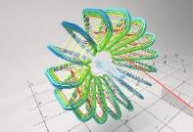
Medicine
Level | Technology / Expertise | Application area
1 - Software | Advanced magnet design and simulation software | Precise gantry magnet geometry for accurate targeting
3 - Subsystems | HTS coils | Lower cryogenics requirements in medical environments
4 - Infrastructures | Test benches | Characterization of MRI magnets
5 - Systems | High field magnets | Increased SNR and precision in NMR spectroscopy
Notes:
NMR and MRI are exactly the same principle (analysing the signal coming from excited particles in a magnetic field to investigate the structure and composition of the sample, tissue etc.). MRI is the application of NMR to medical imaging, with the addition of gradients which are used for spatial resolution. High magnetic fields are necessary to increase the sensitivity of this phenomenon.
But NMR can be used for a wider range of phenomena in research requiring structural and composition analysis, in particular in material science.
MRI magnetic field: typically 0.5 – 1.5 Tesla but also studies at ultra high fields (> 10T). 7T starting to arrive in some hospitals. Working on > 11.7T. Issues with Specific Absorption Rate of energy by the patient, more T >= higher SAR + more sensitivity to ferrous metal objects.
NMR and MRI: higher field => clearer image, higher SNR
NMR spectroscopy: 1-24 T

Slide 26
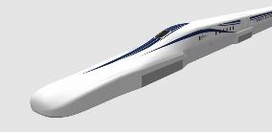
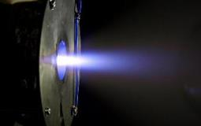
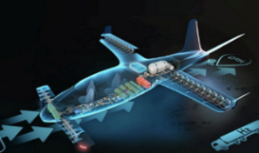
Transport
Level | Technology / Expertise | Application area
2 - Components | Advanced superconductor materials | Racetrack for Magnetic Levitation trains
3 - Subsystems | HTS coils | High specific impulse propulsion system in aerospace
 | Compact efficient cooling system | HTS propulsion motors for maritime ships and airplanes
4 - Infrastructures | Cable testing facilities | Onboard superconducting systems
Notes:
Maglev for train:
6 operational trains (3 China, 2 South Korea, 1 Japan). Currently only operational track is 30km between Shanghai and its airport (which is not worth at all because of the time it takes to accelerate)
Picture = LO. Plan to join Tokyo to Nagoya (285 km) in 2027, then to Osaka (438km), 10cm levitation, 500 km/h. Using passively controlled magnetic levitation, which operate when the train goes fast enough (100 km/h). SC-Maglev, using NbTi coils cooled with liquid He in a thermoacoustic cooler. Powerful magnetic field diverted from the passengers by using electric steel shielding + alternated coils so that there is a safe «bubble» around the passengers => reduced to 0.5 mT. Tracks made from low magnetic material
Train accelerated/decelarated using linear alternating electric coils, airbrake
Power generated by induction coil which generates electricity from changing magnetic field. This generates magnetic drag, but still efficient
Any weather condition, low maintenance costs
Challenges: need entire new tracks, special materials, more energy required for more speed

Slide 27
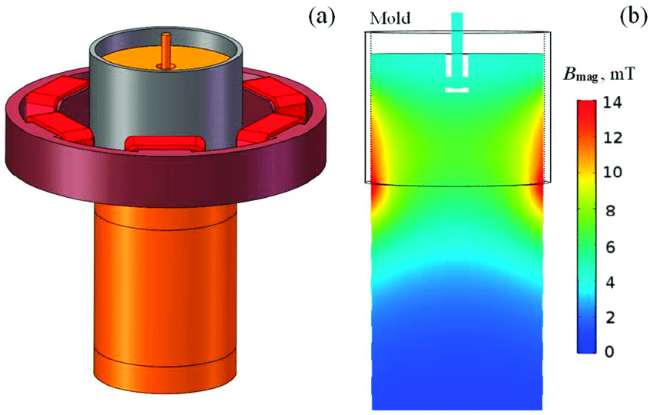
Industrial processes
Level | Technology / Expertise | Application area
1 - Software | Advanced magnet design and simulation software | Optimization of HTS separators design
3 - Subsystems | HTS coils | HTS-based high-gradient magnetic separation systems
 | Monitoring fault-detection systems | Safety in metallurgy
4 - Infrastructures | Magnetic measurement test benches | Characterization of magnets for Electromagnetic stirring
Notes:
Magnetic separation:
Used to separate magnetic metals from rest, also useful for stream purification, food processing, textiles, microbiology…
High fields used for separating weakly magnetic materials.
High Gradient Magnetic Separation using superconductors, going up to 7 T. => higher separation efficiency,
Main limitations: particle size, powering systems for SC magnets
EM stirring:
Used in continuous casting processes to avoid dendritic solidifaction at the edges and increase heat exchange
Higher yields, cleaner steel product, no moving parts
Superconductors not really used now, fields are pretty low (1-2T) but challenges in field uniformity, cooling mechanisms

Slide 28
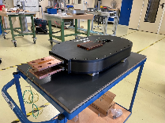
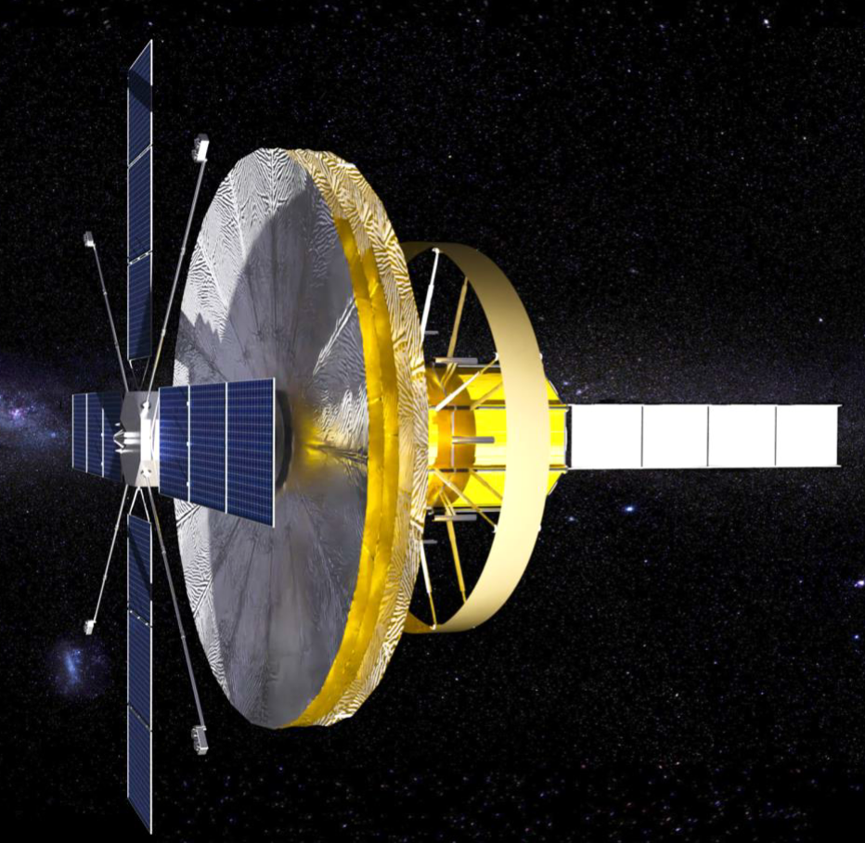
Astrophysics
Level | Technology / Expertise | Application area
1 – Software | Advanced simulation software | Predicting the instrument’s magnet operational and quench behaviour
2 – Components | Advanced materials and assembly procedures | Space-grade mechanical structure for launch constraints
3 - Subsystems | HTS coils | Improved performances with respect to NC magnets
5 – Systems | High field magnets | Increased sensitivity of cosmic rays detectors
Notes:
HTS Demonstrator Magnet for Space (HDMS)
Developed with the Italian Space Agency (ASI), the University of Trento, TIFPA and INFN Milano.
11.9T
AMS-100
1000 times larger acceptance area than AMS-02
Main solenoid and compensation coils: 0.5T magnetic field, HTS operating at 55K
105km of superconducting tape in total
Challenges:
Balancing ultra-thin magnet design with mechanical resilience.
Space-specific constraints, such as limited cooling, high-energy storage, and vibration during launch.
HTS coils performances:
No resistance => less energy dissipation
High magnetic field strength with small coils
Lightweight => crucial for space mass budget
Reduced heat load

Slide 29
KT’s Support
As responsible for the scientific and societal impact of the HFM Programme, the Knowledge Transfer group is committed to support the HFM members, including external partners, in the transfer of technologies and know-how to society, on the basis of the IP clauses set out in the HFM collaboration agreements.

Slide 30
Next Steps

Slide 31

Some Questions
Patent Landscape Analysis:
  How do the highlighted technological developments from industry compare to your RD lines ?
  Do you have particular feedback on the results?
  Is there any other specific analysis that could be interesting to perform on the patents?
HFM Developments Impact Potential:
  Do you have any recommendation on the HFM developments activity we should focus on?
  In your Work Packages, do you already see particularly interesting development with promising impact potential ?

Slide 32

Some Questions
Identified promising application areas:
  Do you agree with the proposed fields? Do you have additional ideas?
  Do you have recommendations on which application fields should be given priority?
  Are there technological developments in your Work Packages which particularly fit some of these fields ?

Slide 33

Next Steps
  Define HFM Value Proposition:
    Identify highest potential technologies & expertise developed within HFM.
    Industry-specific needs identification.
  Define dissemination strategy:
    Identify synergies with current CERN knowledge transfer projects.
    Develop new applied collaborations in partnerships with selected entities.
  Stakeholders relations:
    Organize thematic industrial workshops (TBD).
    Coordinate HFM Impact Forum.

Slide 34
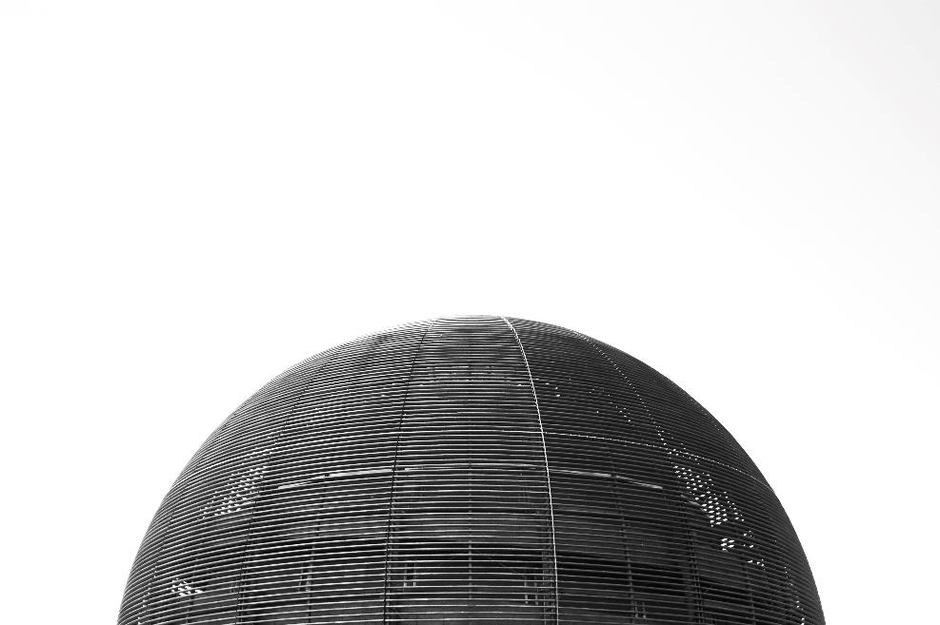
Thank you!
Contact
Thomas Rimbot
Thomas.Rimbot@cern.ch
Enrico Chesta
Enrico.Chesta@cern.ch

