Slide 1


AIPF Working Group: Risk Management
PROMOTE MECHANISM TO SHARE THE RISK BETWEEN RESEARCH INFRASTRUCTURES AND INDUSTRY
Members of the Working Group:
Laura Zanovello (Research Institution)
Isabel Bejar Alonso (Research Institution)
Mauro Morandin (Research Institution, ILO)
Jan Visser (ILO)
Raffaella Geometrante (Industry)
Michael Gehring (Industry)
Josef Troxler (Industry)

Slide 2
Board Meeting at CERN on 17.06.2025
AGENDA
EU Survey about innovative solutions to the public sector in Europe
Website of the Working Group
Actions for the Working Group
ERMINE network

Slide 3
EU Survey about innovative solutions to the public sector in Europe:
  At present no information about the workshop planned by EU and about new financial instruments
  Important for AIPF is that we were recognized at the EU!
  (at leased by Minerva Cano (IDOM) and Marieke von Putten (Consultant) responsible for the study)
  It seems that EU is quite slow with the survey.

Slide 4
2. Website of the Working Group:
  The website for the working group Risk Shearing is online!
  PROMOTE MECHANISM TO SHARE THE RISK BETWEEN RESEARCH INFRASTRUCTURES AND INDUSTRY – aipf.web.cern.ch

Slide 5
3. Actions for the Working Group:
√ Online meetings with working group: Every 8 weeks, last one on 21st April 2025
√ Website Working Group: Working Groups – aipf.web.cern.ch
√ Isabel established working groups with the Ermine network: see separete slides
√ Francis Pérez (Accelerators Division Head) willing to support AIPF
√ Raffaella contacted Marco Peloi (ILO Elettra) is willing to support us.
√ IPP-CZ (COMPASS-U Tokamak) contacted and information about AIPF sent. No reply yet.
Discussion and Decision in AIPF meeting in Geneva on 17th June 2025 how to proceed with Light Sources
Further contacts Light Sources planned (SOLARIS, DIAMOND, ESRF, EUXFEL- Bonucci)
Overview of Stakeholders (who can make decisions), Input from Risk Committee
AIPF workshop with stake holders
EU Survey: Follow and participate in EU workshop (Michael, Isabel)
EU event in spring 2026: (Jan works on it end feeds in information's)
√ Repository with documents (Laura): Problems with access to the documents seem to be solved!

Slide 6
4. ERMINE Network:
√ Isabel contacted Elisabetta Nori (President of the Ermine network)
√ She provided summary about AIPF and the WG to Ermine network for further distribution
√ ERMINe has agreed to have joint sessions about the subject risk innovation and asked for subjects
√ ERMINe distributed proposal for a joint session of ERMINe.
√ First meeting round finished on 14th and 16th May 2025.
At present dates for next discussion round to be fixed. Laura sent a doodle’s
Feedback from the participants, first impressions, ideas what to implement?
Link to ERMINe portal: AIPF - ERMINe Collaboration Notebook

Slide 7
Thank you!
Questions, Suggestions, Improvements ?

Slide 8
Backup Slides: Meetings 6th June 2025

Slide 9
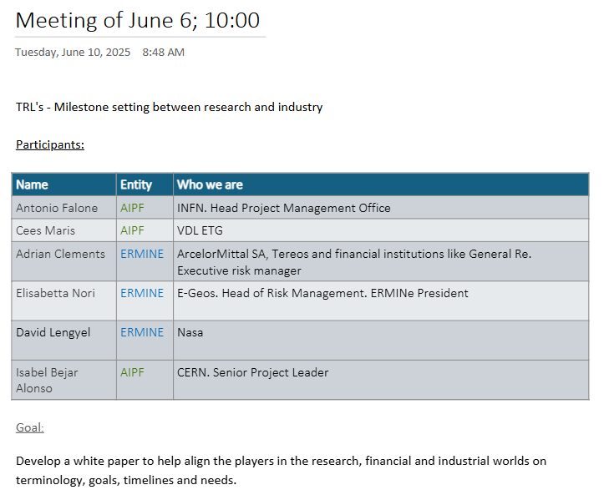
Topic TRL Levels TEAM 2

Slide 10
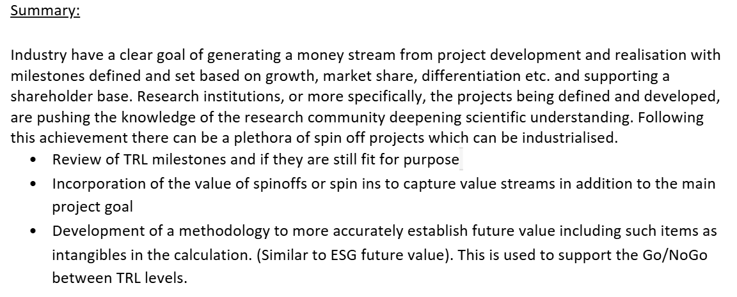
Topic TRL Levels TEAM 2

Slide 11
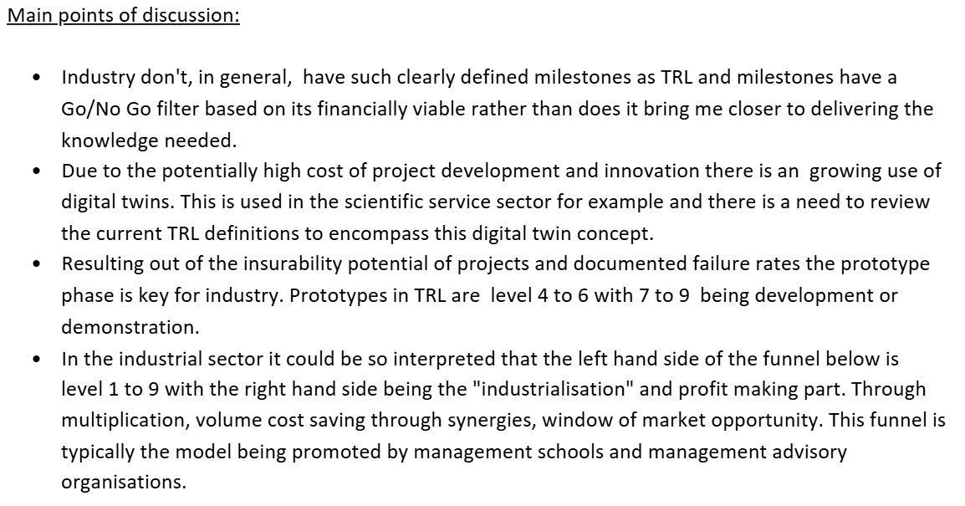
Topic TRL Levels TEAM 2

Slide 12
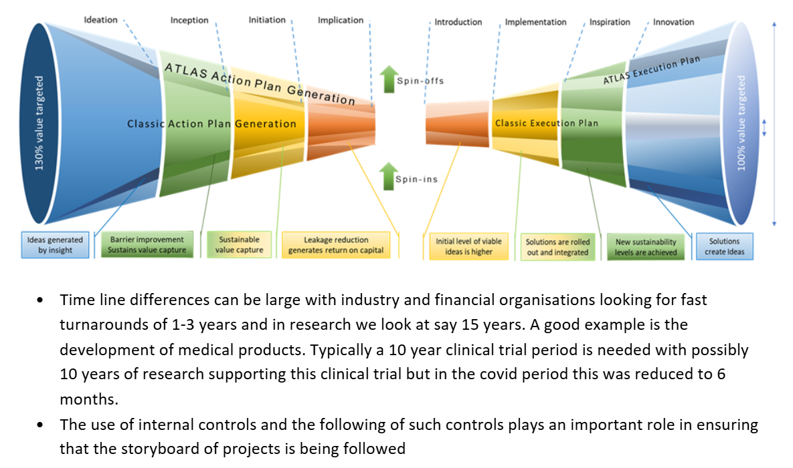
Topic TRL Levels TEAM 2

Slide 13
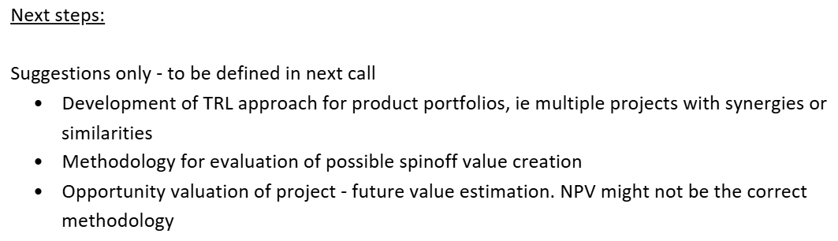
Topic TRL Levels TEAM 2

Slide 14
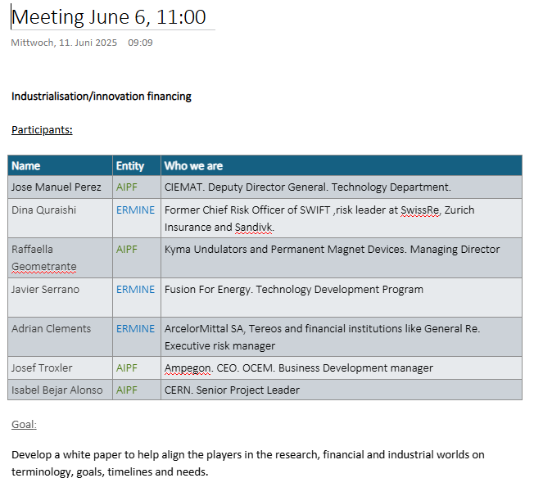
Financing, Industrialization

Slide 15
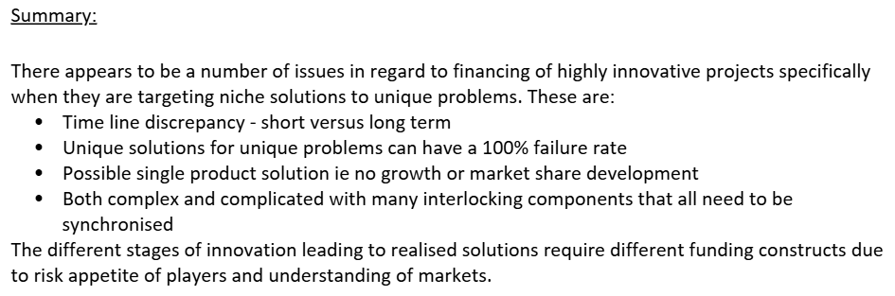
Financing, Industrialization

Slide 16
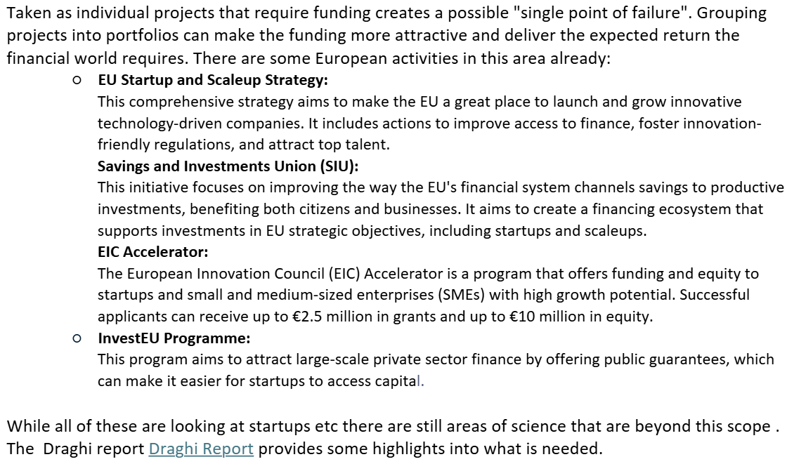
Financing, Industrialization

Slide 17
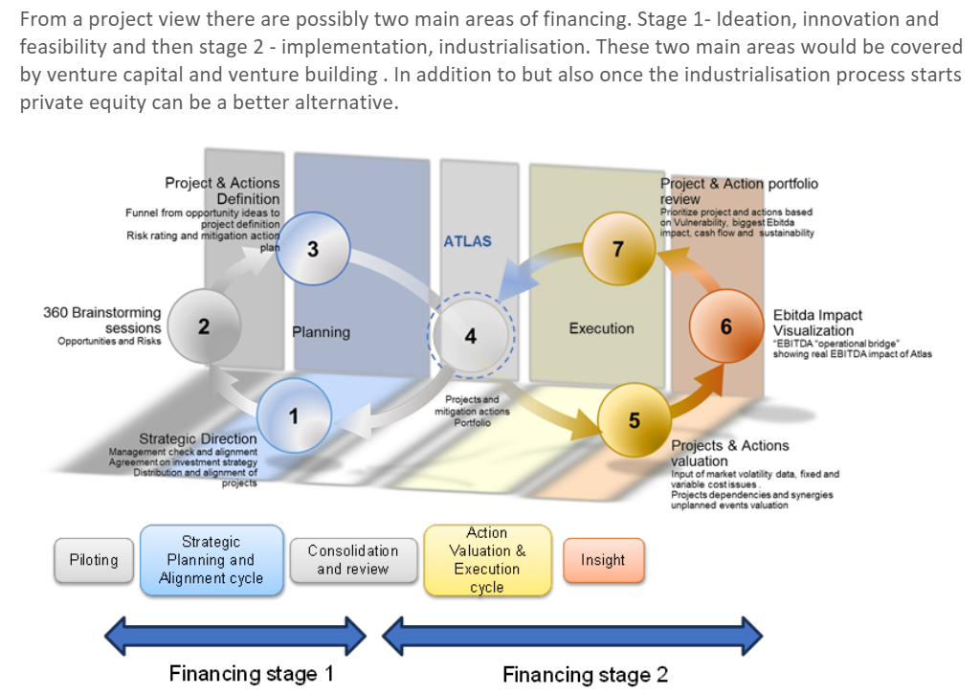
Financing, Industrialization

Slide 18
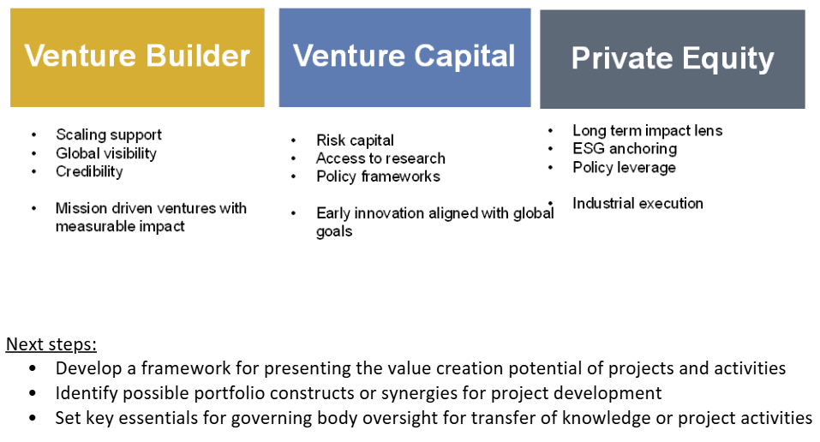
Financing, Industrialization

Slide 19
Backup Slides: Meetings 16th May 2025

Slide 20
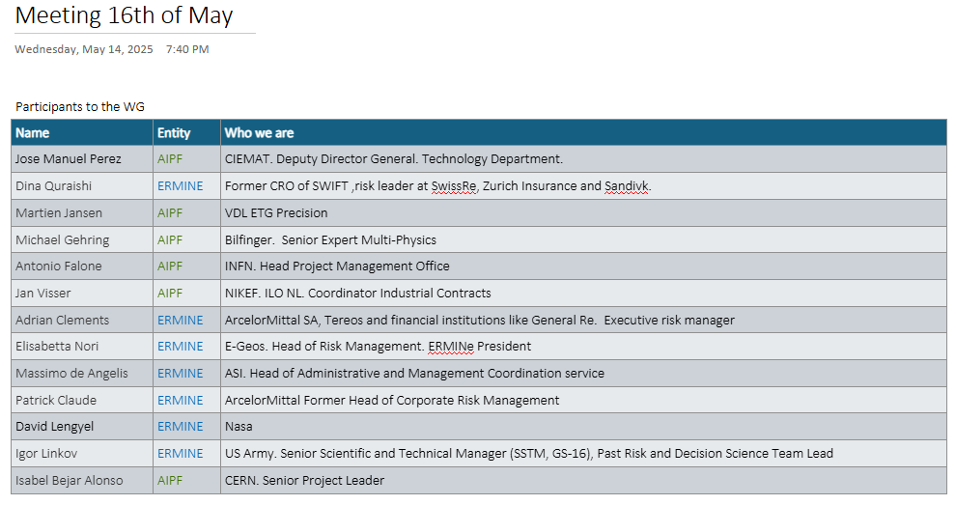
Topic TRL Levels

Slide 21
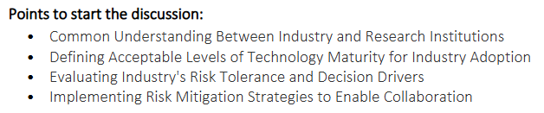
Topic TRL Levels

Slide 22
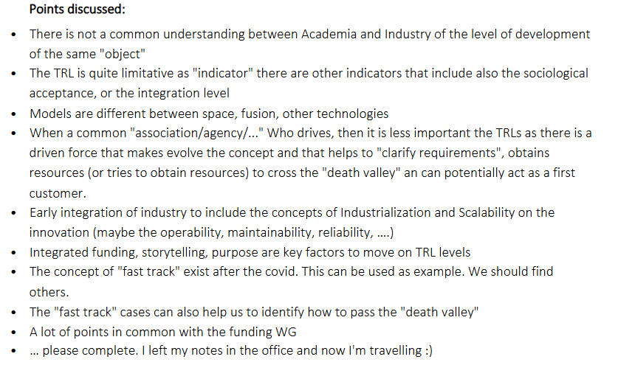
Topic TRL Levels

Slide 23
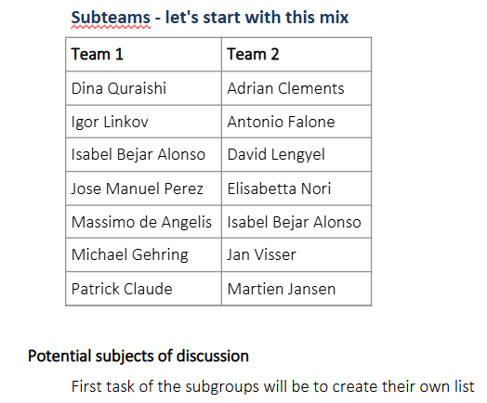
Topic TRL Levels

Slide 24
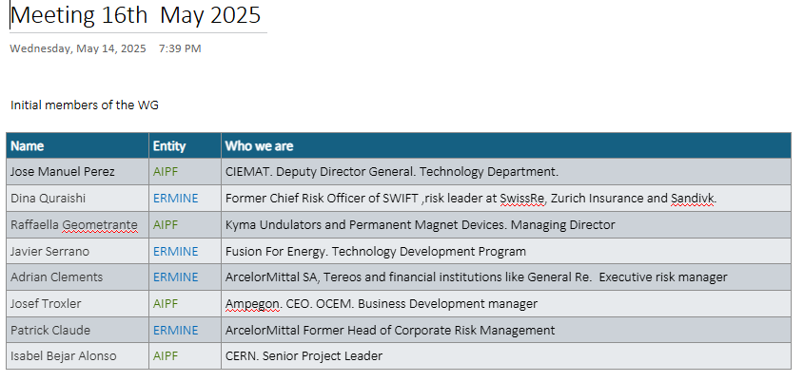
Financing, Industrialization

Slide 25
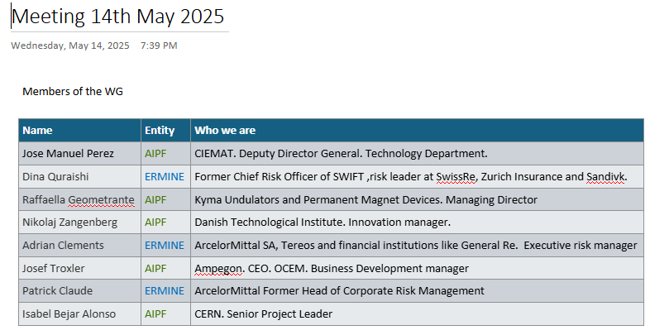
Financing, Innovation

