Slide 1


AD-ELENA
ADUC 11th February 2025
AD facility
Maintenance - Consolidation Developments
François BUTIN – BE-EA

Slide 2
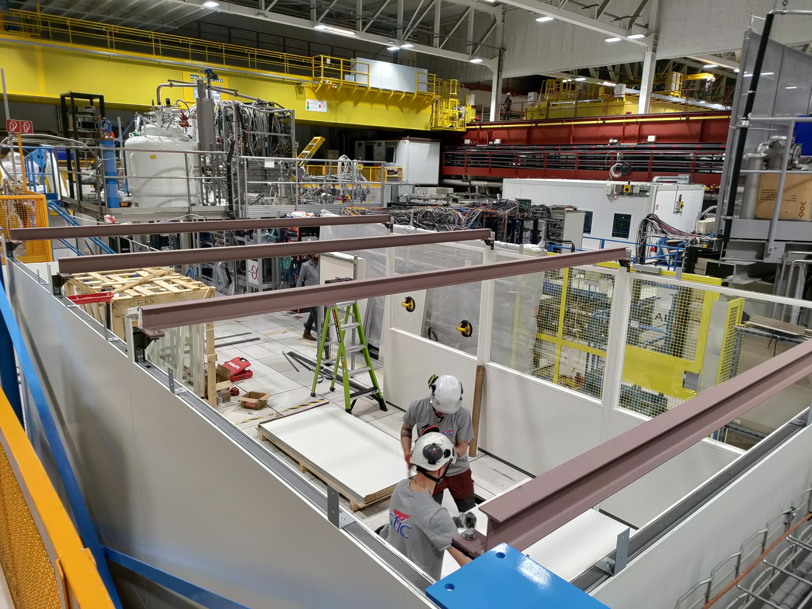
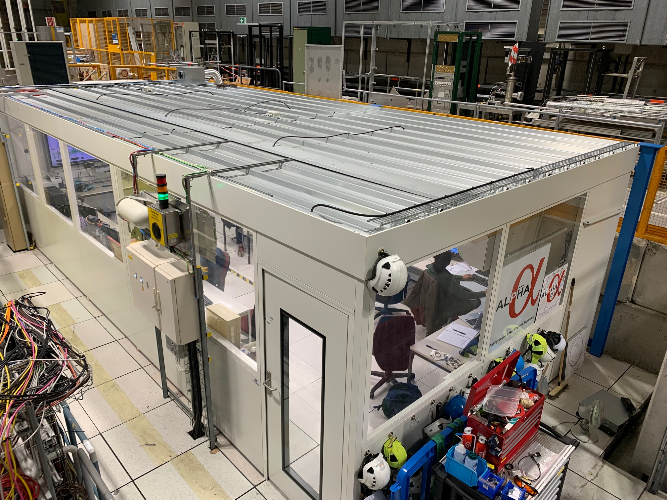
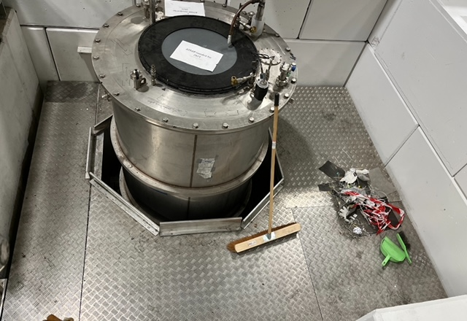
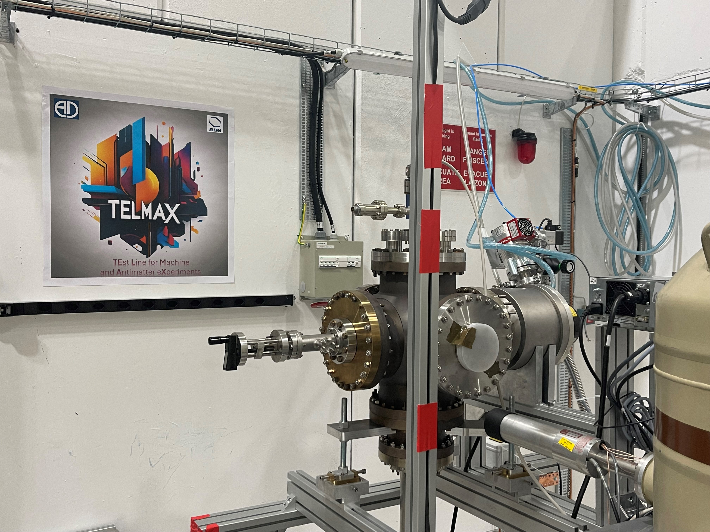
AD infrastructure 2024 Highlights
NewALPHA CR
New TELMAX
Exp Area
+ PAX test beam

Slide 3
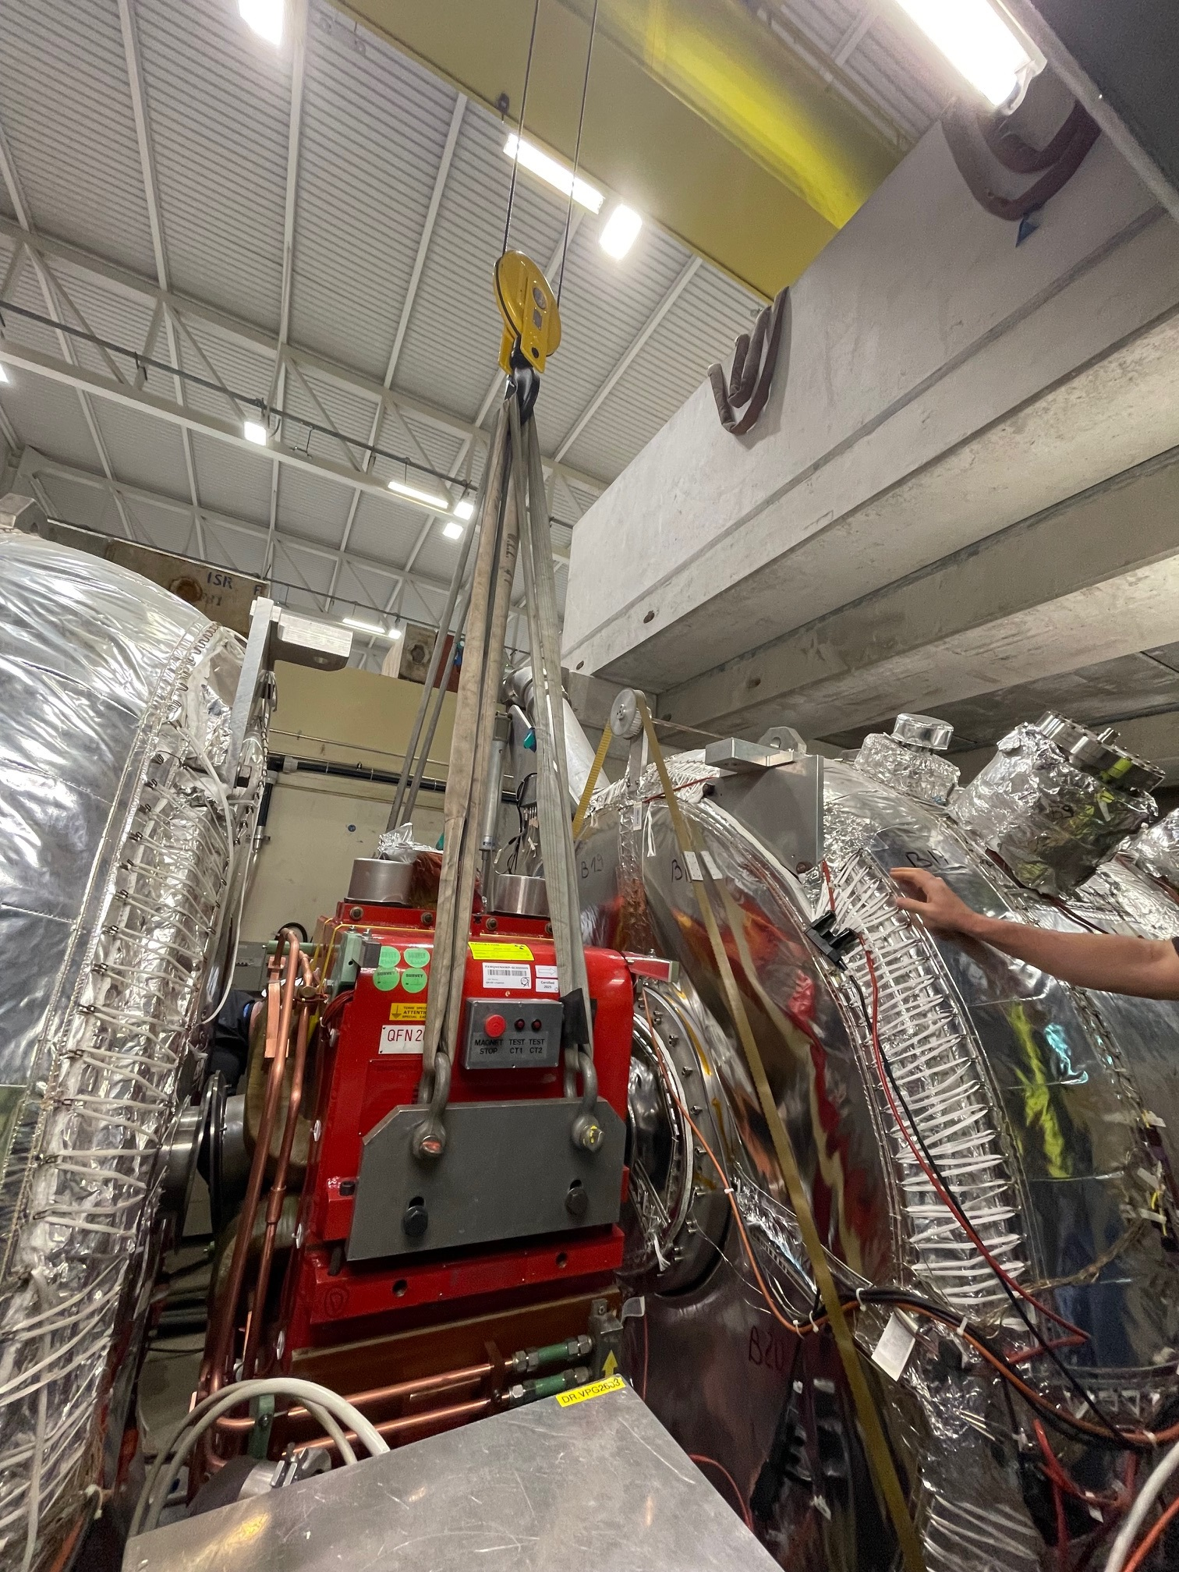
2024-2025 YETS activities
AD machine :
- 2 magnets extracted for refurbishment (QFN26 and BHN17): re-installed W6 and 8
-Routine maintenance for:
e-cooler + BCCCA + C10 + C02 RF cavities + injection/ejection kickers, septa magnets
-BIPM gas injection valve repair
-New power converters for injection line magnets

Slide 4
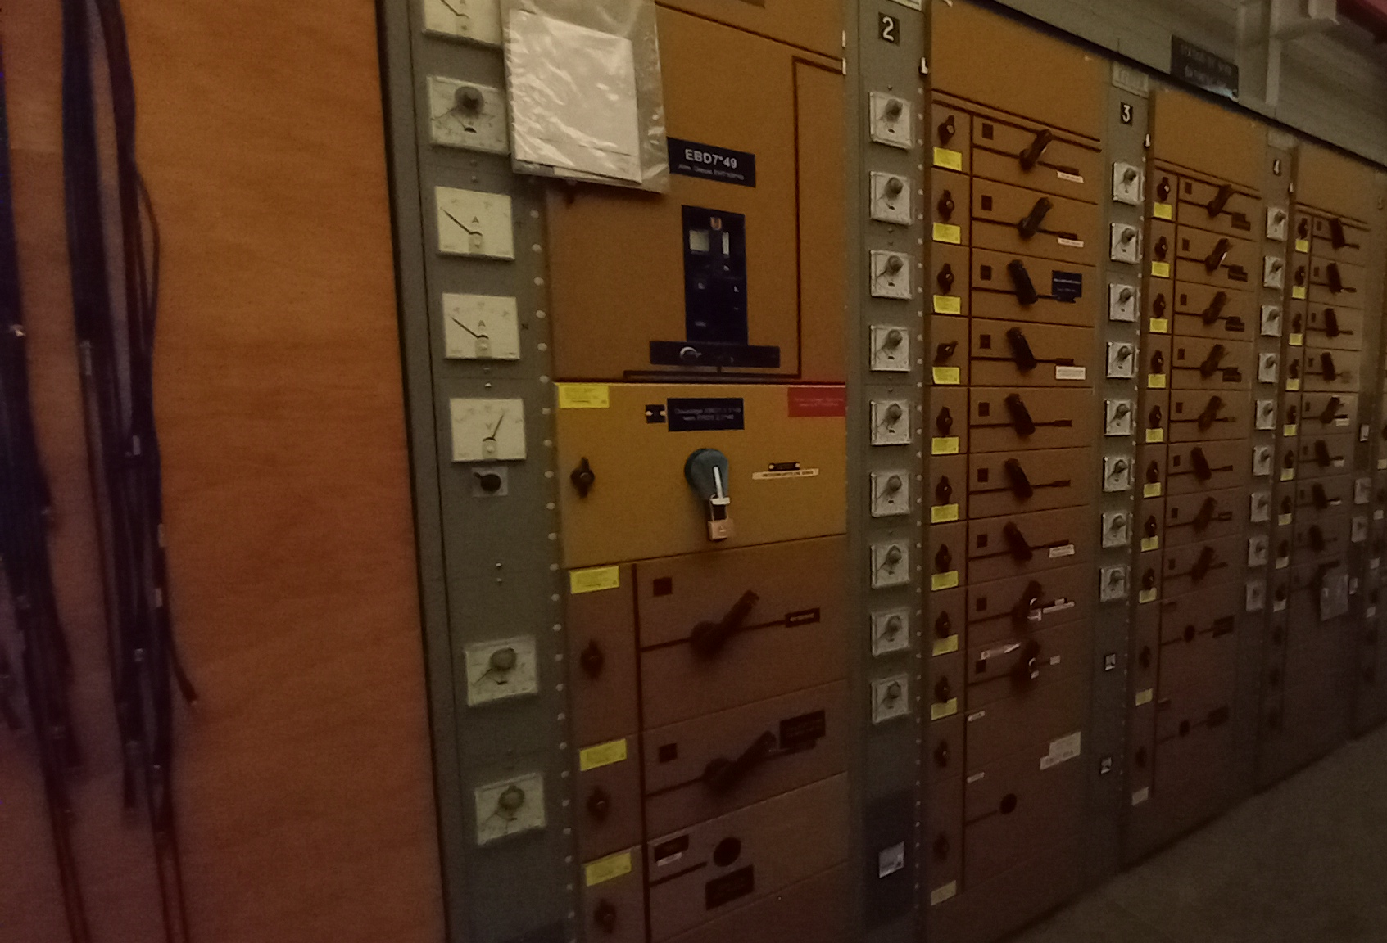
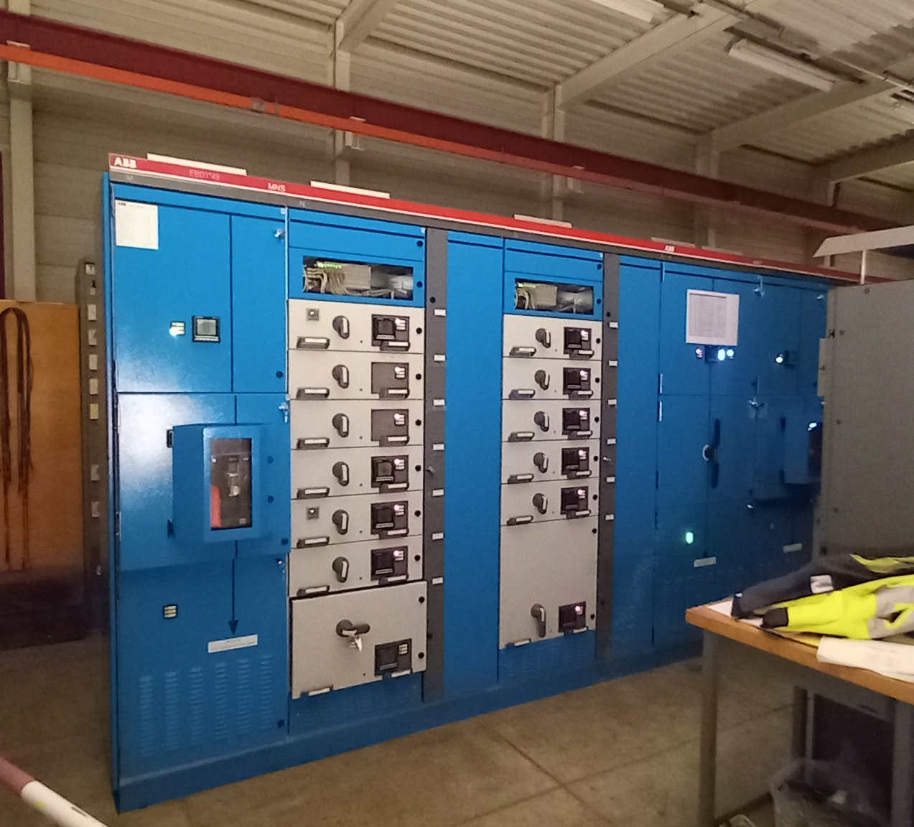
2024-2025 YETS activities
-ELENA / ion source:
-Ion source large maintenance performed + power supply conformity improvement + HV transformer oil exchange
-Routine maintenance of main systems
-Infrastructure
-Major works on BT switchboards replacement – causes disruptions
-Cabling for access safety system and for TELMAX

Slide 5
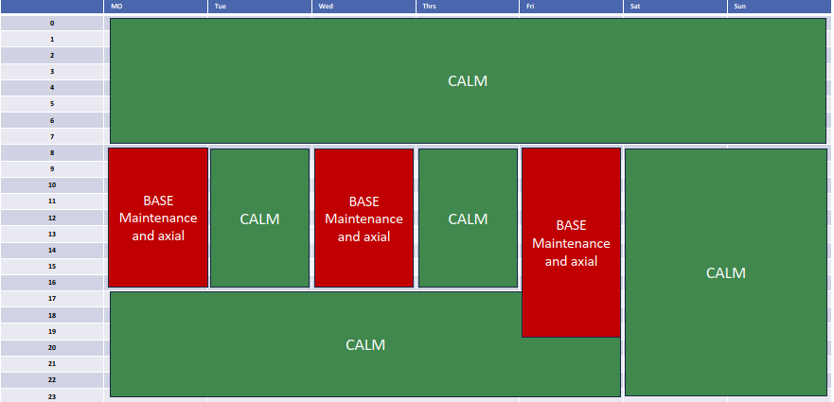
YETS services disruptions
Disruptions expected
-Cooling water ~1 week: 24th-28th Feb
-Cryogen fluids distribution stopped ~2 weeks: 24th Feb -7th March Arrangements agreed for BASE anticipated lHe delivery.
-Access to AD shielding areas limited during magnets extarction / re-installation: 14th – 21st Feb: opening for BHN17, no access to ALPHA cryo platform
-Timing for crane usage,
to limit perturbation to
BASE measurements:

Slide 6
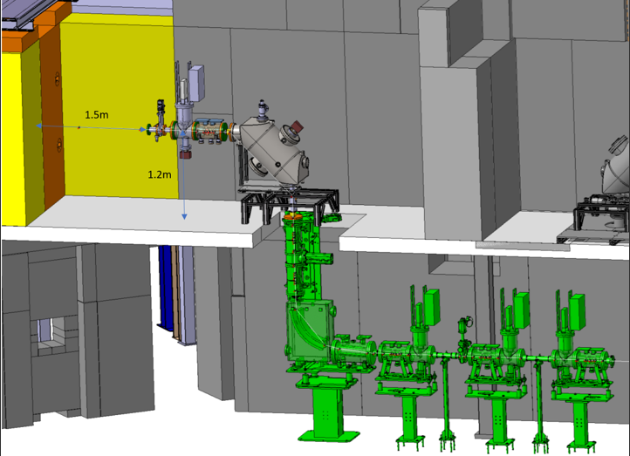
Next YETS planning
Next YETS will be short: 14.5 weeks (+Xmas break)
“All groups are requested not to make substantial changes in order to be able to shorten the hardware and beam commissioning time, gaining more time for physics”
-End of AD beam: 8th December 2025
-Restart of physics: 2nd April 2026
-Possible in principle to refurbish 1 quadrupole (11 weeks needed) – TBD !
-Routine maintenance
-Installation of TELMAX horizontal beam line section (ECR in approval loop), or delayed if no immediate need

Slide 7
AD-CONS project status
-Magnets refurbishment:
-Status: Will continue till LS3 included
-Planning: 12 (13) main magnets + 6 steerers/solenoids during LS3
-Financing: secured
-AD e-cooler:
-Status: project on track for swap with new cooler during LS3
-Financing is secured
-Stochastic cooling:
-Status: New kickers have to be engineered and produced – no design available yet. Future of amplifiers needs to be secured (regular failures)
-Financing: not secured yet
-Cooling and ventilation:
-Status: Planned for LS3
-Next: Studies in progress, and works to take place during LS3
-Financing: HVAC + hydraulics secured

Slide 8
AD-CONS WP’s (Continued)
-Power convertors:
-Status: ongoing. Injection line optimization in progress (magnets + converters)
-Next: bulk of spending/installation work after LS3 (mains)
-Financing: secured
-Cryo fixed distribution system:
-Status: stalled
-Next: Need to study the complete system with local liquefactor
-Financing: cost estimated to 8.3 MCHF, potential savings 0.6 MCHF/year. Will depend on AD long term future
-Magnetic horn (after production target):
-Consolidation approved

Slide 9

Miscelaneous
-Priorities should be established in the light of the anticipated physics program of AD experiments beyond LS3-LS4, and the corresponding anticipated needs of AD/ELENA machines operation.
-New physics experiments proposals proposed at SPSC to be analyzed
-Official call for TELMAX test beam time sent by physics coordinator. 2 “customers” already in the waiting line !
-Operating slots of ELENA during YETS and during LS3 with Hminus ion source to be discussed/agreed among experiments

