Slide 1
CTA status at IHEP
QiuLing Yao
On behalf of Storage group
Computing Center, IHEP
2025-03

Slide 2
Outline
Current Status
Progress
Problems
Summary

Slide 3
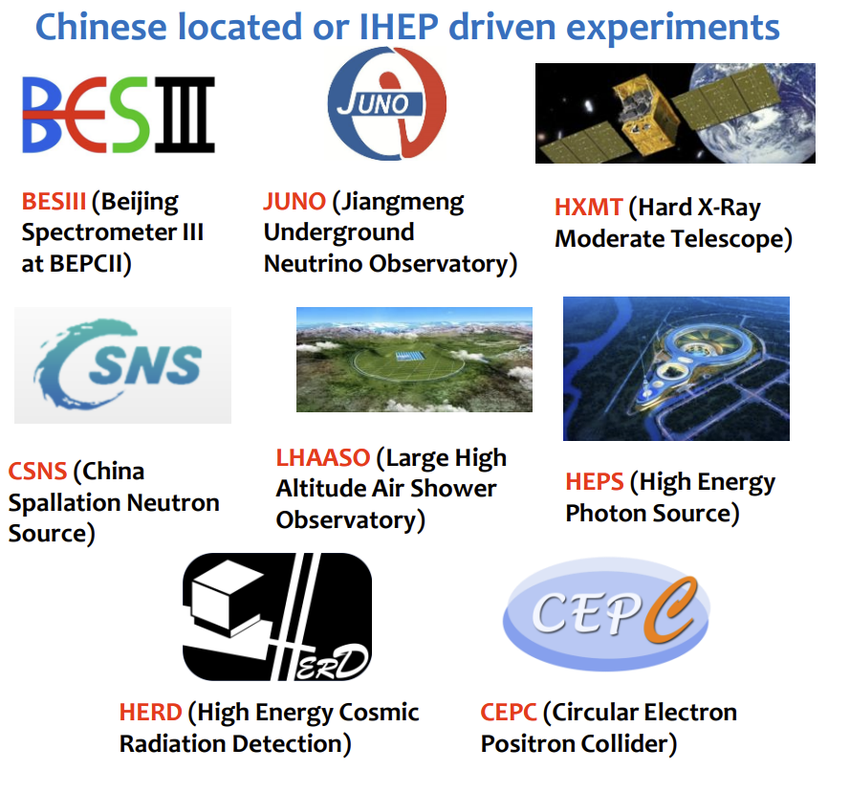

Overview
Long-term storage and Backup
BESIII: 1 PB/y LHAASO: 10 PB/y
JUNO: 3 PB/y HEPS: 300 PB/y
HXMT: 10 PB/y CSNS: 1 PB/y
CTA: tapes
  Version: 5.11
  88.27 PB LTO7 & LTO9
EOS: disk buffer
  Version:5.2.27
  2.77 PB HDD-based
  For more details: EOS Status at IHEP

Slide 4
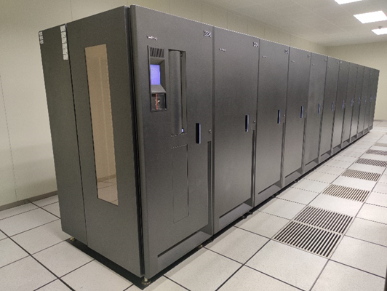
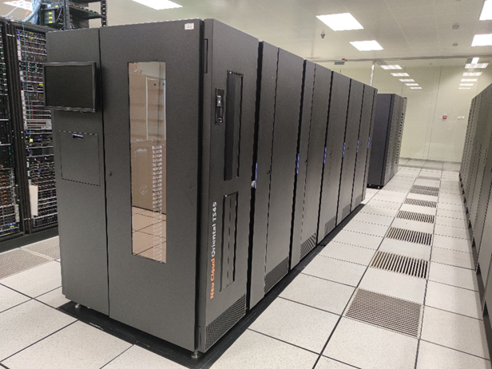
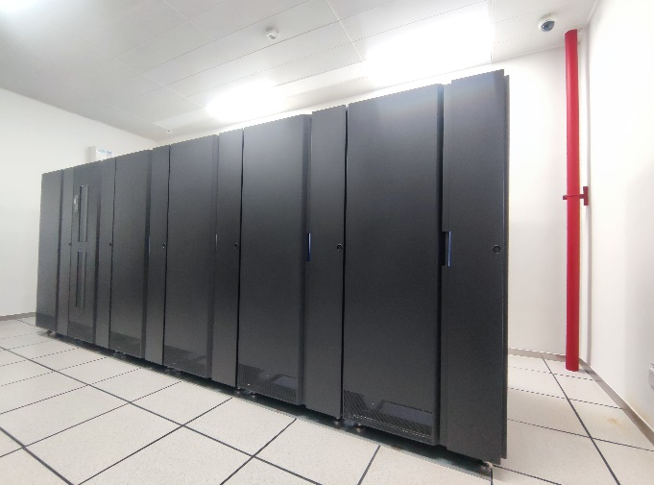
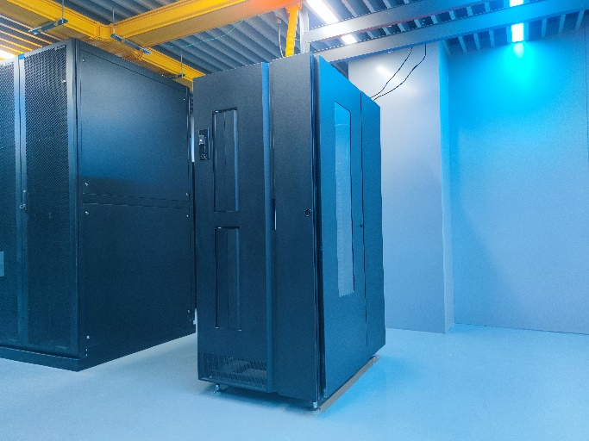
Tape Infrastructure
  IBM TS3500
  Frames: 12
  Drives: 15 LTO7
  Tapes: 5k+ LTO7(+500)
  (- LTO4)
  IBM TS4500
  Frames: 8
  Drives: 20 LTO9
  Tapes: 10k+LTO9(+1k)
BES lib
LHAASO lib
  IBM TS4500
  Frames: 6
  Drives: 9 LTO9
  Tapes: 840 LTO9(+520)
  IBM TS4500
  Frames: 1
  Drives: 2 LTO9
  Tapes: 120 LTO9
JUNO lib
HEPS lib

Slide 5
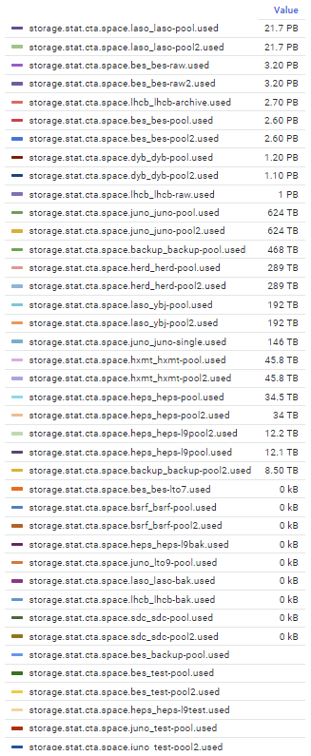
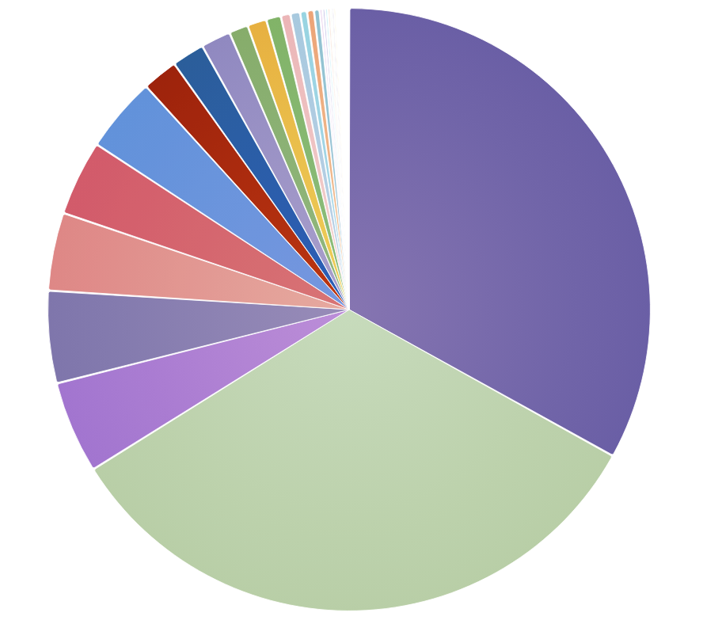
Stats
Total 88.27 PB/ Used 64.22 PB, 91.49 M Data
+ 2 Experiments (LHCb & HERD)

Slide 6
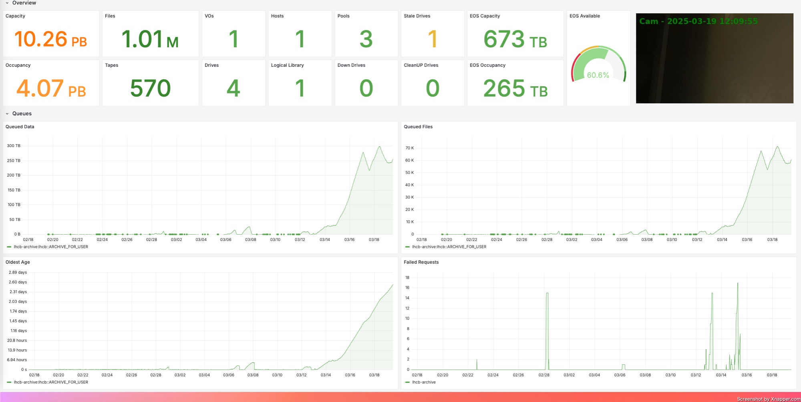
LHCb
Capacity increased from 3PB to 10PB, and 4 PB used
4 drives working hard to archive 1PB this month
Additional 2 drives under purchase

Slide 7
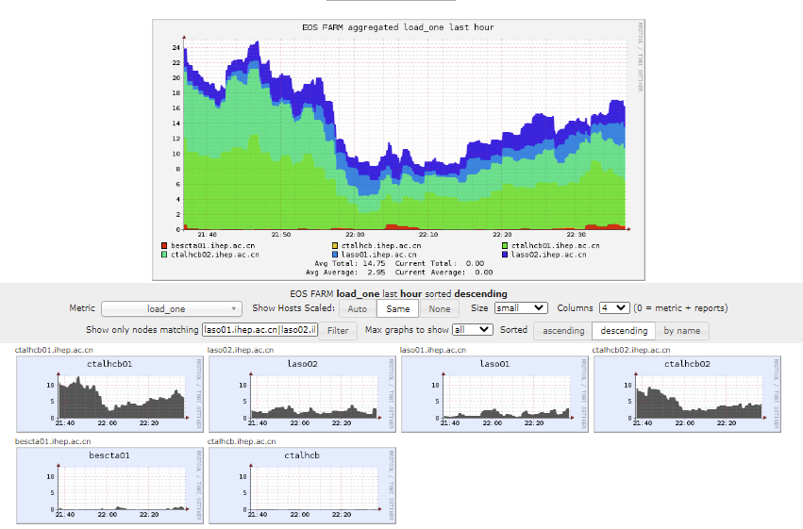
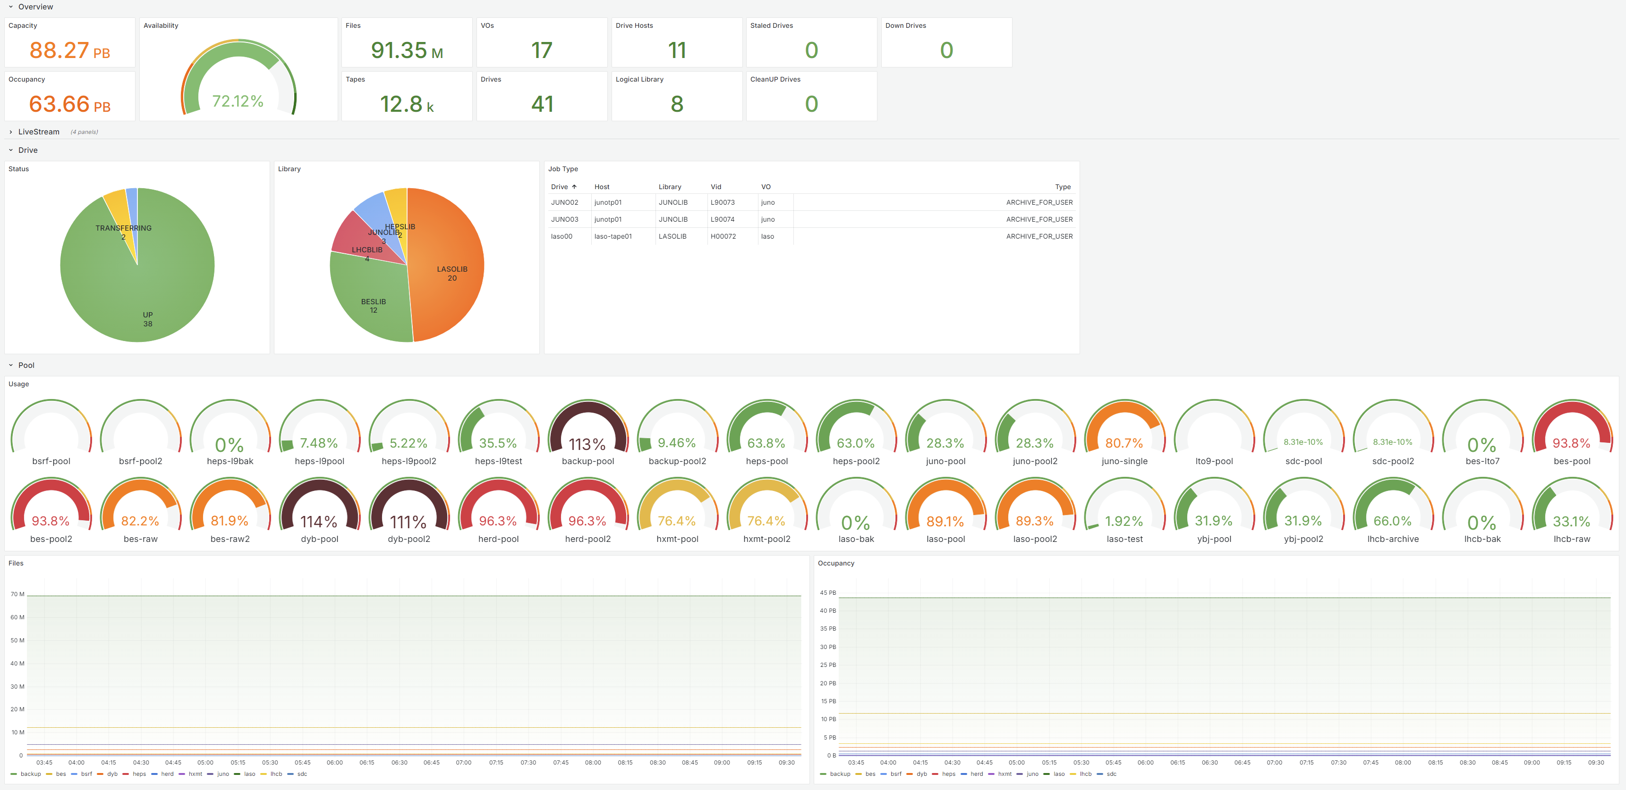
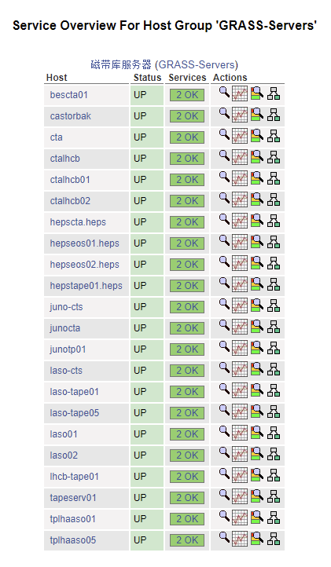
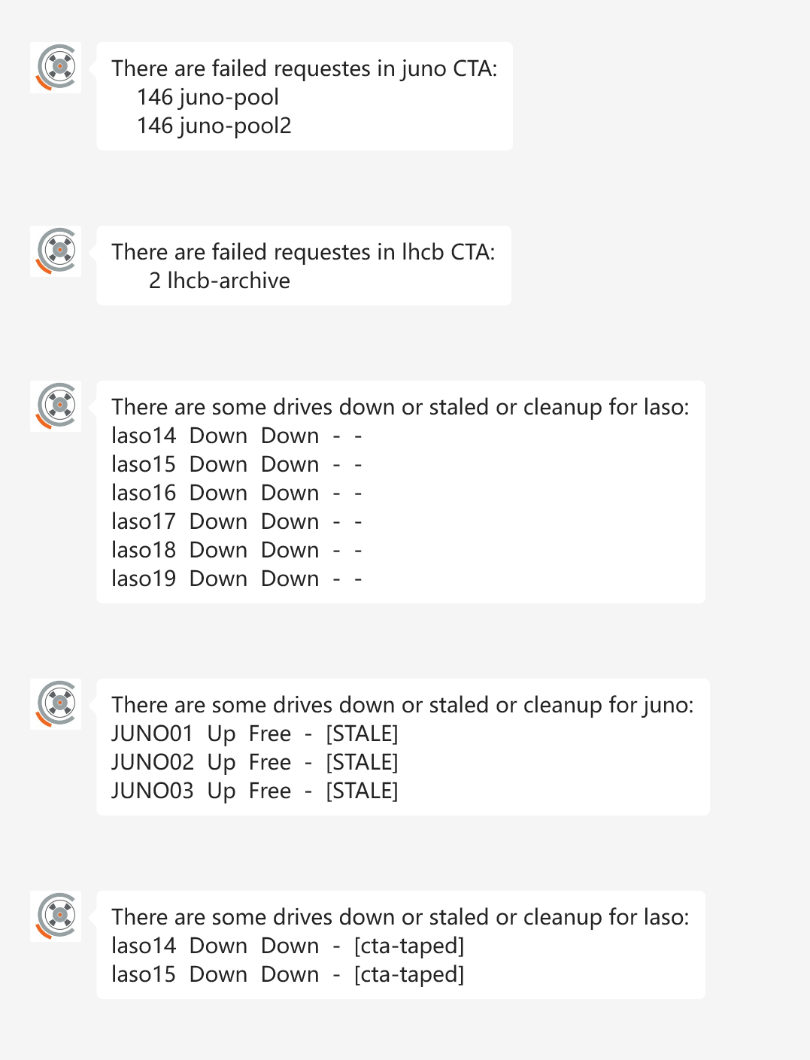
Monitoring
Ganglia
Prometheus + exporter + Grafana: Dashboard for CTA
Ganglia & Nagios & Wechat
GrafanaG
WechatG
Nagios

Slide 8
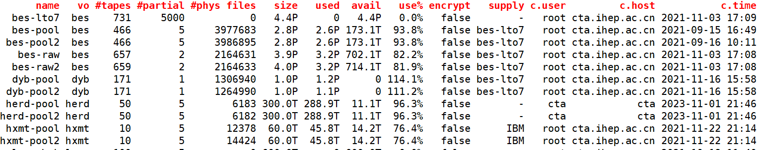
Progress
Cta-frontend Deployment
    Multiple cta-frontend instances deployed in VMs
      VMs with 1 core and 2G ram managed by PVE
    HA Setup for cta-frontend
      3 instances for lhaaso&bes3: cta ctalaso ctabes
      2 instances for juno: junocta ctajuno
      2 instances for HEPS： hepscta.heps ctaheps
      cta{laso,bes,juno,heps} are supposed to be read-only and for ops
    More instances in plan for LHCb
Modify the config “Supply”
Updated all nodes to
Alma Linux 9

Slide 9
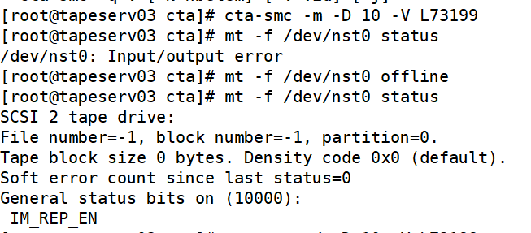
Problems
Drive startup error
  Similar to: https://cta-community.web.cern.ch/t/input-output-error-from-tape-drive-device-dev-nst0/302
  Temporary solution: Load a tape in the drive and unload
  Normal on Alma 9.3, Error on Alma 9.5

Slide 10
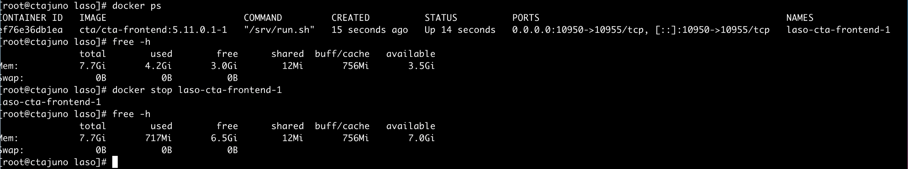
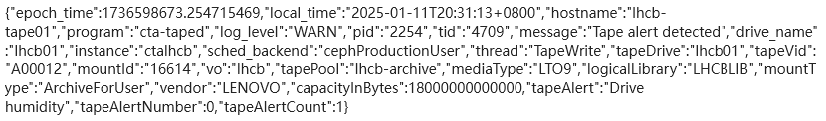
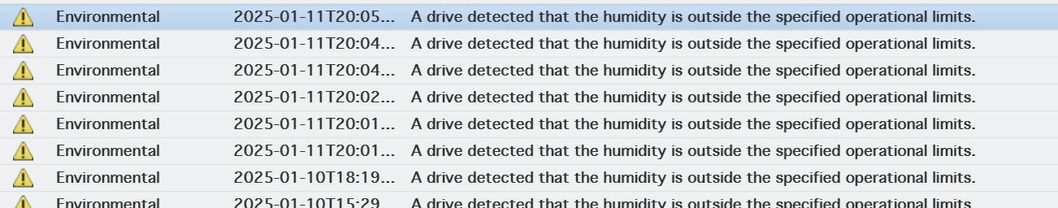
Problems
Cta-frontend in container cost more mem than in host
  4 GB in docker
  100 MB in host
Low humidity causes malfunctions in tape libraries
  17% (Humidity Range: 20% to 50% RH)
  Turn on the precision air conditioner and adjust

Slide 11
Next steps
PostgresSchedDB in production?
  To remove Ceph clusters
Ceph S3 pool backup to CTA?
  Gitlab, docs, mattermost …
  Massive small and mutable files
Optimization for monitor and alerting system
  Prometheus, AlertManager, Grafana

Slide 12
Summary
CTA ran well and supported additional experiments
Optimize CTA monitoring , frontend and configuration
Upgrade the operating system on all nodes to Alma Linux 9
Some problems were encountered and further work is necessary

Slide 13
Thank you

