Slide 1
Offsite
Tape Backup
Collaboration
Vladimír Bahyl March 2025

Slide 2
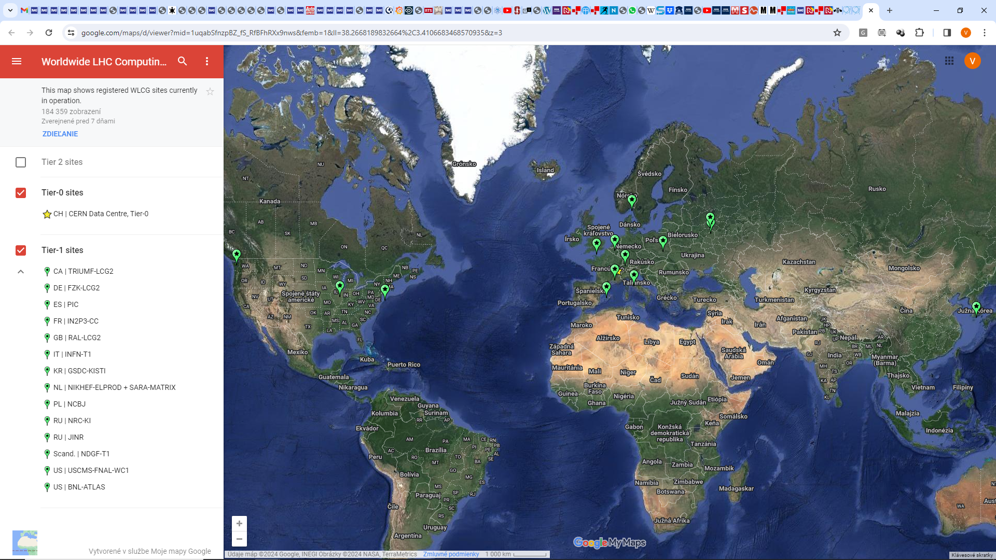

Slide 3
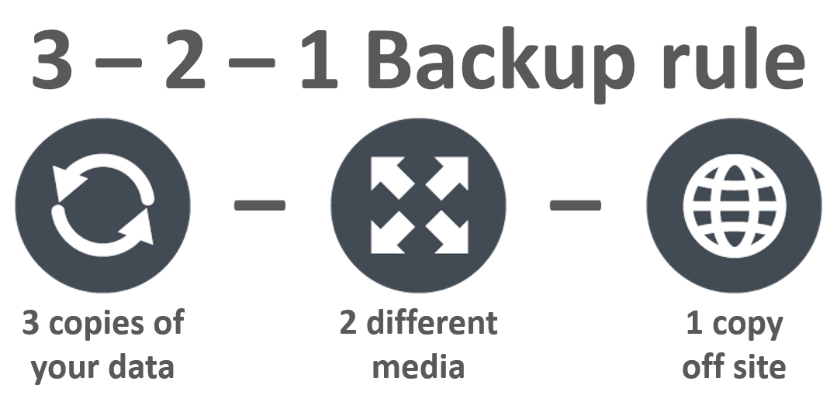
Source: https://cactus-it.co.uk/the-3-2-1-backup-rule/

Slide 4

Backup of critical organisation data
Most have onsite backup solution (CERN uses IBM Storage Protect)
  Protection against most use cases, but not in case of a major disaster
Some sites might have Offsite-Offline backup solution?
  Protection against ransomware and major disaster but requires manual workflow
Some sites might have Offsite-Online (cloud) backup solution?
  Protection against ransomware and major disaster but has extra cost

Slide 5

Collaboration proposal
A site will keep its onsite solution
Offsite-Online (LCG) backup solution
  Protection against ransomware and major disaster
  Cost negligible as reusing existing infrastructure
Most critical data can be sent offsite to collaborating institution(s)
Reciprocal approach – ideally:
  Site A backups to B and C
  Site B backups to A and C
  Site C backups to A and B

Slide 6

Expectations
Select 1 collaborating site
  Preferably from a CERN member state
Agree on technological choices
Demonstrate feasibility / usefulness
Start a pilot with 100 TB (~5 LTO-9 tape cartridges)
Offer such offsite backup solution to others

Slide 7

Questions about technological choices
Security model
Data transfer technology
Data storage technology
File catalogue

Slide 8

Security model
Protection against ransomware and major disaster
Encryption
  The source site is responsible for encrypting the data
Separation of administrative domains
  Users will be allowed to copy data, but must not be allowed to overwrite / modify / delete
Data immutability
  Data expiry automatically by the system after 1 year (?)
Notes:
Lifecycle

Slide 9
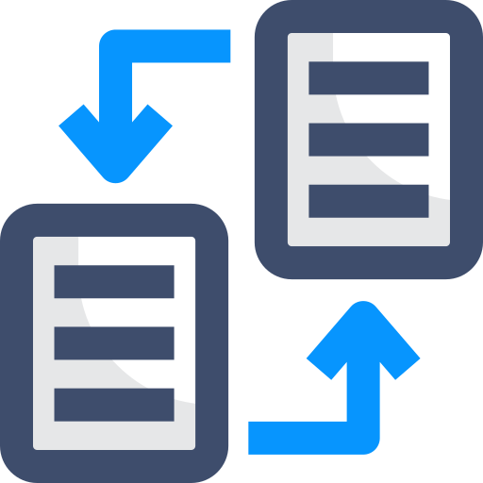
Data transfer technology
Many building blocks exist (in HEP community)
Simple Storage Service = (Amazon) S3
  Industry de-facto standard
Glacier storage class

Slide 10

Data storage technology
This service is to be used only in exceptional circumstances
Most cost effective storage technology should be used
  Tape storage
  Retrieve delay >12 hours acceptable
At CERN – S3 endpoint with tape backend expected in Q4/2025

Slide 11
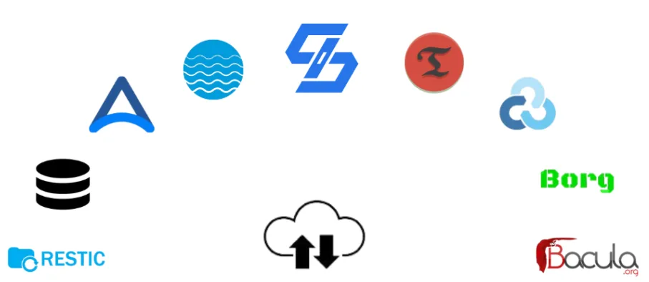
File catalogue
Each site is responsible for keeping track about which files were copied where.
Use open source application

Slide 12

Discussion

