Slide 1
Evolution of Continuous Integration for CTA
Niels Bugel
On behalf of the CTA Team

Slide 2

CI is about saving time
and increasing confidence
Faster and simpler development process
More flexible and robust testing setup
Smoother integration with new technologies
Notes:
Mention high turnover, fast feedback

Slide 3


What encompasses CTA CI?
GitLab Pipeline
Where?
.gitlab-ci.yaml
.gitlab/
continuousintegration/
Local Development Pipeline
Notes:
Move to beginning
Separate local/online
No surprises

Slide 4
The CI Pipeline
Build Binaries
Build Docker Image
Deploy Test Instance
Run System Tests
Notes:
Do before after for each
Split into local/online pipeline
Mention high turnover, fast feedback, no surprises when running local vs online

Slide 5

Building the CTA Binaries
Building older versions
OS migrations
Dev machine pollution
Inconsistent between GitLab CI and local workflow
!
Challenges
Consolidation of the
local & GitLab pipelines

Slide 6

Building a CTA Docker Image
Other files
ctageneric
ctageneric
Configuration Files
Startup scripts
eos.repo
versionlock.list
versionlock.list
Utility packages
Points either to local RPMs
or online RPMs
Utility packages
cta-artifacts.repo
cta-artifacts.repo

Slide 7

Deploying a Test Instance (before)
create_instance.sh
Other files
tests
ctageneric
Configuration Files
spawn pods with more magic
Startup scripts
eos.repo
versionlock.list
search-replace magic
Utility packages
Grab pre-existing config files
cta-artifacts.repo
Decide image to run

Slide 8


Deploying a Test Instance (after)
Disk buffer and CTA are decoupled
Components can be configured
and upgraded individually
Notes:
Provide short story about testing EOS feature

Slide 9

Running System Tests
=========================== short test summary info ============================
PASSED system_tests/test_setup.py::test_kinit_clients
PASSED system_tests/test_setup.py::test_check_catalogue
PASSED system_tests/test_setup.py::test_add_admins
PASSED system_tests/test_setup.py::test_version_info
PASSED system_tests/test_setup.py::test_populate_catalogue
PASSED system_tests/test_setup.py::test_populate_catalogue_tapes
...
PASSED system_tests/test_client_gfal2.py::test_setup_client_gfal_xrootd
PASSED system_tests/test_client_gfal2.py::test_archive_gfal_xrootd
PASSED system_tests/test_client_gfal2.py::test_retrieve_gfal_xrootd
PASSED system_tests/test_client_gfal2.py::test_evict_gfal_xrootd
PASSED system_tests/test_client_gfal2.py::test_delete_gfal_xrootd
PASSED system_tests/test_client_gfal2.py::test_setup_client_gfal_https
PASSED system_tests/test_client_gfal2.py::test_archive_gfal_https
PASSED system_tests/test_client_gfal2.py::test_retrieve_gfal_https
PASSED system_tests/test_client_gfal2.py::test_evict_gfal_https
PASSED system_tests/test_client_gfal2.py::test_delete_gfal_https
PASSED system_tests/test_client_gfal2.py::test_gfal_activity
PASSED system_tests/test_client_gfal2.py::test_xrootd_activity
PASSED system_tests/test_client_gfal2.py::test_eosreport_activity
PASSED system_tests/test_postrun.py::test_no_coredumps
PASSED system_tests/test_postrun.py::test_no_uncaught_exceptions
======================== 29 passed in 346.45s (0:05:46) ========================
Tied into EOS workflow
Bash difficult to maintain
Where does it fail?
!
Challenges

Slide 10



The goal is a maintainable
and decoupled test system
Workflow
Tests
System Tests
Generic
Tests
?

Slide 11
The developer workflow got faster and easier
Pipelines are
~40% faster
Build Binaries
Build Docker Image
Deploy Test Instance
Run System Tests
build_deploy.sh
Notes:
Don’t like this slide

Slide 12
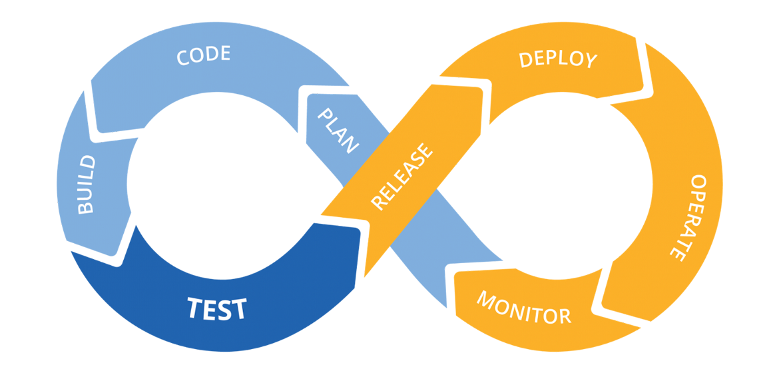
Where is the Continuous Deployment?
Now that we have
improved this
We can focus on this..
CI
CD
Notes:
Separate slide for the release pipeline

Slide 13
The future release pipeline
Update changelog with entries relevant for users/operators
Build RPMS
Test RPMs are ready for release
Tag commit
Publish RPMs
System Tests
Stress Test
unstable
testing
stable

Slide 14
The future..
Improved release pipeline -> Easier and more frequent releases
Python system tests -> Faster, more robust and more flexible tests
Telemetry -> Better stress tests
Let’s collaborate to make dCache part of our CI

