Slide 1
Deploying a CTA Test Instance using Helm
Niels Bugel
On behalf of the CTA Team

Slide 2

Why Helm?
my-chart:
|- templates/
|- krb5-configmap.yaml
|- statefulset.yaml
|- service.yaml
|- Chart.yaml
|- values.yaml
Simplifies deployments
Flexibility due to templating
Reusable & shareable charts
Industry Standard
Notes:
Quick note about our motiviation here, what are we trying to solve with Helm

Slide 3
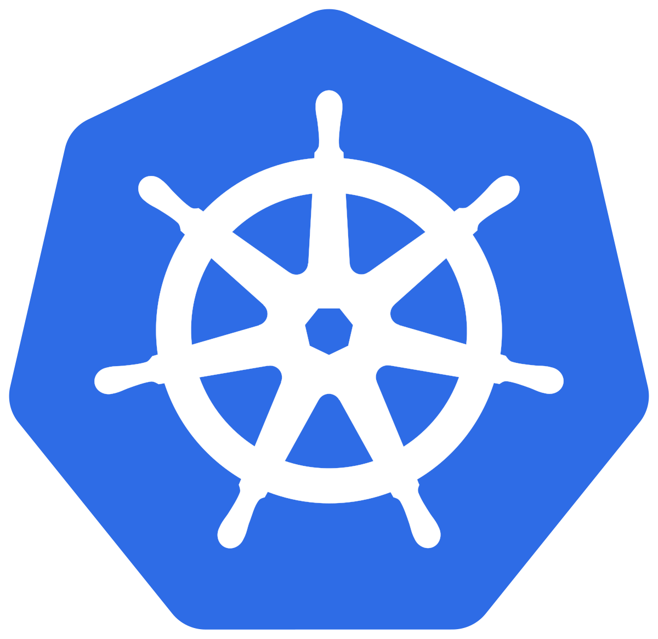

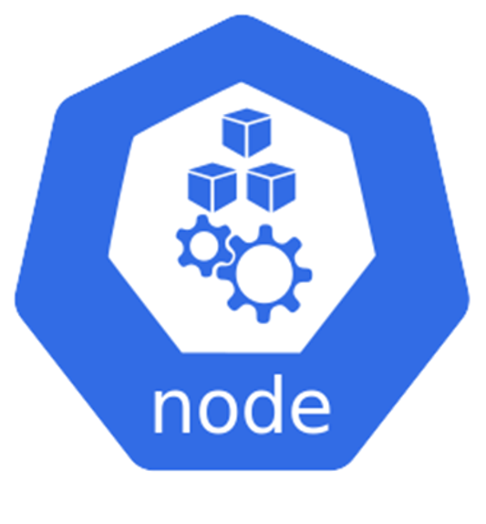



Brief Kubernetes Recap
Node
Pod
Pod
script.sh: <contents>
container 1
container 1
/etc/krb5.conf
container 2
/root/scripts/
krb5.conf: <contents>
/etc/krb5.conf
Notes:
Introduce Icons?
Better coloring
Add introduction on the CTA architecture

Slide 4


The CTA Docker Image
CTA RPMs are available
but not pre-installed
ctageneric
container
Install packages
cta-artifacts.repo
Run main process

Slide 5




CTA Architecture
Client
MGM
CTA Frontend
Catalogue
Scheduler
FST
Tape Server
FST
Tape Servers

Slide 6
A CTA Deployment
CTA
Catalogue
CTA Frontend
Scheduler
Authentication
Tape Server
Tape Server
Kerberos
Simple Shared Secrets (SSS)
Disk Buffer
Notes:
Explain SSS
Rename to just “Frontend” “Tape Servers”
Get rid of cta-cli

Slide 7

A CTA Deployment using Helm
CTA
catalogue
cta
scheduler
Authentication
auth
Disk Buffer
eos
Notes:
Explain SSS
Rename to just “Frontend” “Tape Servers”
Get rid of cta-cli

Slide 8
Helm Charts: auth
Pods:
Configmaps/Secrets:
kdc
krb5.conf
SSS keytabs

Slide 9

Helm Charts: catalogue
Pods (optional):
#oracle or postgres
backend: ""
oracleConfig:
username: ""
database: ""
password: ""
postgresConfig:
remote: ""
username: ""
password: ""
server: ""
database: ""
catalogue-postgres-db
Jobs (optional):
catalogue-reset-job
Configmaps:
cta-catalogue.conf

Slide 10
Helm Charts: scheduler
Pods (optional):
# VFS, ceph, postgres
backend: ""
vfsConfig:
path: ""
cephConfig:
mon: ""
monport: ""
pool: ""
namespace: ""
id: ""
key: ""
postgresConfig:
remote: ""
username: ""
password: ""
database: ""
server: ""
scheduler-postgres-db
Jobs (optional):
scheduler-reset-job
Configmaps:
cta-scheduler.conf
cta-objectstore-tools.conf
ceph.conf
Notes:
Don’t spend too much time, just mention it works the same as the scheduler

Slide 11

Helm Charts: eos
Pods:
eos-mgm
https://gitlab.cern.ch/eos/eos-charts/
eos-fst
eos-qdb

Slide 12
Helm Charts: cta
Spawned based on:
tapeservers-values.yaml
Pods:
Tape Server Pod 01
cta-frontend
cta-rmcd
cta-tpsrvxx
cta-taped-0
cta-cli
...
cta-taped-x
cta-client
For cta-admin commands
For eos and xrootd commands
Notes:
Make sure to explain the jargon. Make the difference between pod and container clear
Move tpsrv up
And explain cta-cli and cta-client
Make clear that we can have multiple tape servers

Slide 13
A fully containerized deployment
Instance dev successfully created:
NAME READY STATUS RESTARTS AGE
auth-kdc 1/1 Running 0 72s
cta-catalogue-postgres-db 1/1 Running 0 72s
cta-catalogue-reset-job-6xdjh 0/1 Completed 0 64s
cta-cli-0 1/1 Running 0 41s
cta-client-0 1/1 Running 0 41s
cta-frontend-0 1/1 Running 0 41s
cta-scheduler-reset-job-99qth 0/1 Completed 0 72s
cta-tpsrv01-0 2/2 Running 0 41s
cta-tpsrv02-0 2/2 Running 0 41s
eos-fst-0 1/1 Running 0 65s
eos-mgm-0 2/2 Running 0 65s
eos-qdb-0 1/1 Running 0 65s
Notes:
Color these values

Slide 14
create_instance.sh
cta
1 | Parse Arguments
client
2 | Generate tpsrv config
catalogue
cta-cli
3 | Create namespace
cta-frontend
scheduler
4 | helm install
cta-tpsrv
5 | Run setup scripts
auth
eos

Slide 15
create_instance.sh
--namespace <namespace>
--cta-image-tag <tag>
--catalogue-config <values.yaml>
--scheduler-config <values.yaml>
--reset-catalogue
--reset-scheduler
continuousintegration/orchestration/create_instance.sh

Slide 16
Try it yourself in the hands-on!

