Slide 1

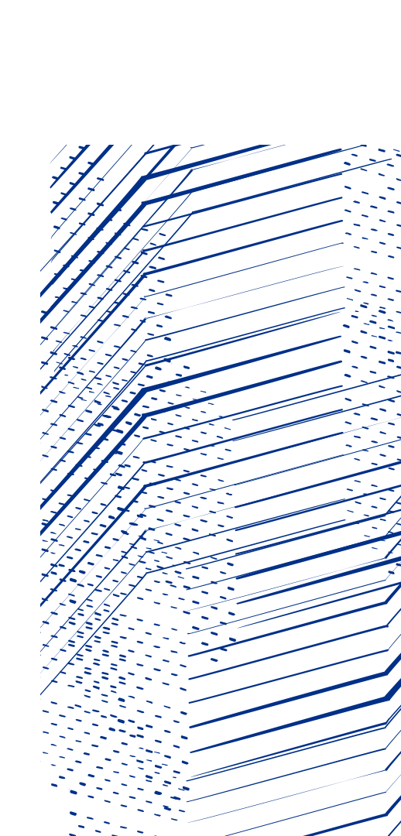

Developments in the Antares service at RAL
George Patargias on behalf of the Antares team
CTA 2025 Workshop

Slide 2

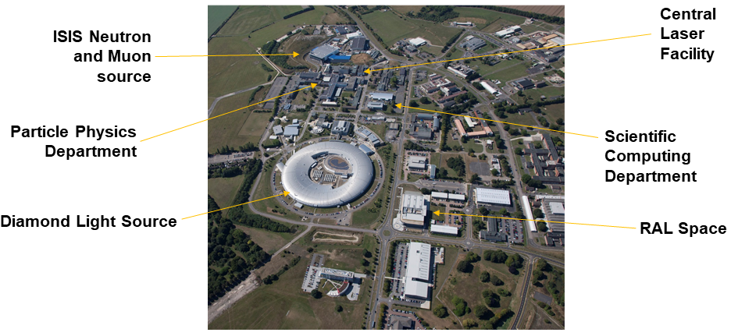
Introduction
Antares: Tape Archive service at RAL Tier-1 managing LHC and local Facilities data
2 EOS clusters
Single CTA instance
2 Tape libraries
Antares team: George Patargias, Tom Byrne, Atefeh Sharif, Maha Agilandamurthy, Alison Packer, Tim Folkes

Slide 3
Service updates
June 2024: Upgrade to EOS 5.2.23 and CTA 5.10.10.1 (SL7)
June – July 2024 Migration to EL9
October 2024: Install 12 x TS1170 drives for Facilities (DLS)
January 2025: CTA Frontend separation
February 2025: Install 6 x TS1170 drives for Facilities (CEDA)
March 2025: Begin migration to ADI in the Facilities tape library

Slide 4
Migration to EL9
Rocky was adopted by SCD as the target distribution following the SL7 EOL. For Antares, Rocky 9
Kernel 6.1.91-1.el9.elrepo.x86_64 was selected as this provided the right kernel module for the QLogic fibre channel card installed on Antares tape servers*
The Ceph nodes upgraded to Rocky 8
A total of 85 hosts (prod/preprod/dev) were migrated from SL7 with a single service downtime for the EOS MGM nodes and the CTA Frontend
*(https://cta-community.web.cern.ch/t/input-output-error-from-tape-drive-device-dev-nst0/302/10)

Slide 5
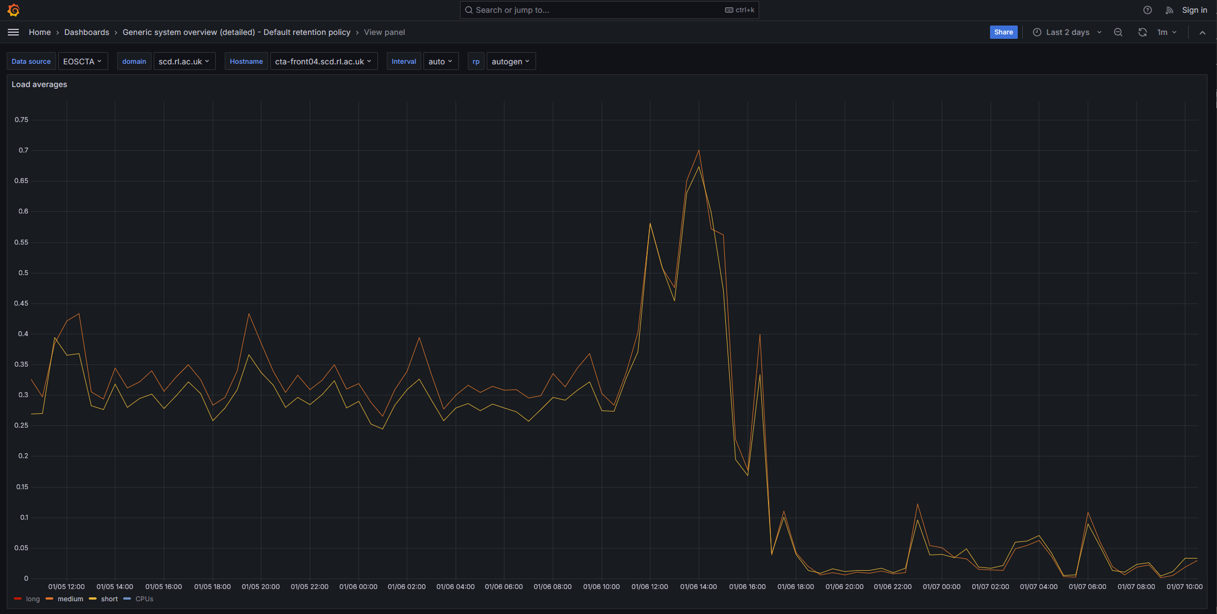
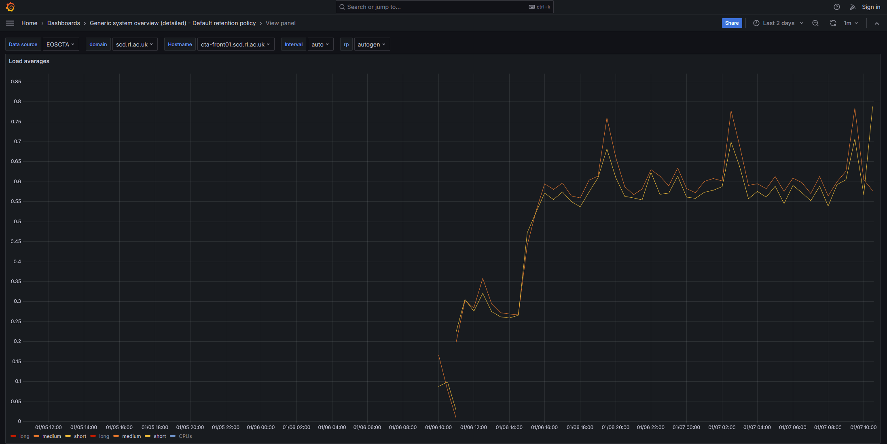
CTA Frontend separation
Occasionally, the cta-frontend service crashes and restarts (especially when submitting/deleting a large repack job)
Following CERNS’s example, a CTA Frontend was set up that handles only traffic related to cta-admin commands
Load on cta-front04
(user requests)
Load on cta-front01
(admin requests)

Slide 6
TS1170 installation (Facilities/DLS)
A set of 12 TS1170 drives were added to the TS partition of the Facilities library
After being tested on preprod, drives deployed in production
The supply of all DLS pools was replaced by the pool containing only TS1170 media
Repack of files from the old default diamond pool to the beamline-specific pools in progress

Slide 7
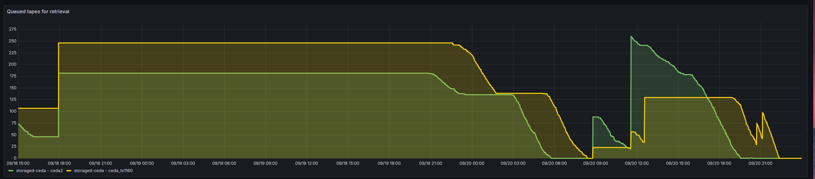
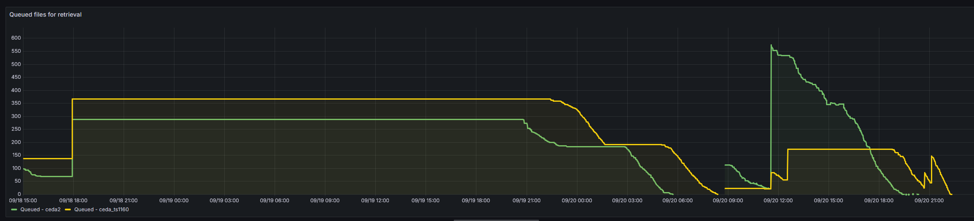
CEDA recall pattern
>99% of CEDA files are in two large multi-PB pools (ceda2 and ceda_ts1160)
Sparse recalls: many files from many tapes
May contribute to the issues seen in our Facilities tape library

Slide 8
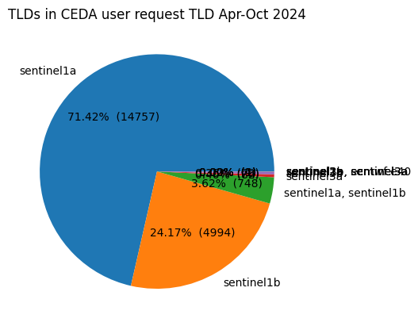
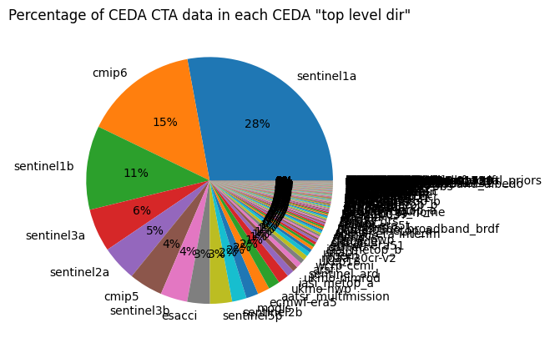
CEDA recall pattern
Related CEDA files are contained in separate EOS sub-directories
called “spots” (storage pots)
There are ~28,000 “spots” in the Facilities EOS namespace that map to various CEDA specific data collections (sentinel1a, cmip5 etc)
Analysis of CEDA recalls during April-October 2024 showed that sentinel1a and sentinel1b files amounted to more than 95% of the total of the recalls even though they represent <40%of the CEDA data in Antares

Slide 9
CEDA data reorganization
sentinel1a and sentinel1b files are almost in every one of the 1,376 tapes of ceda2 and ceda_ts1160 pools
Repack the sentinel1a and sentinel1b data into two new pools, ceda_sentinel1a and ceda_sentinel1b (supplied by TS1170 media)
Developed the procedure/tooling to do this
Identify spot directories mapping to sentinel1a and sentinel1b data
Identify files with mismatched storage class compared to their parent directory
Change these files storage classes in EOS and in CTA
Repack all the affected VIDs
Completed a successful end-to-end testing for a single sentinel1a spot

Slide 10
Facilities tape library issues
Our Spectra TFinity libraries are using the Robotic Interface Module (RIM) to mediate control requests between the drives and the Robotic Control Module (RCM)
Multiple mount/unmount requests often cause the RCM to reset which, in turn, results in the RIM units to become unstable
RIM controllers appear and disappear again causing drives to become unavailable to the mounted tapes to be stuck in them
Significant disruption in the Facilities tape service

Slide 11
Facilities library migration to ADI
Alternatively, the tape drives can be configured to use the Automation/Drive Interface (ADI) transport protocol to communicate directly with the library’s RCM
Aborted initial migration plan to move some LTO and TS drives to ADI due to the restriction that the control path in a given library partition can be only one or the other
In the first instance, only the (less busy) LTO partition was configured to use ADI with no issues so far
The configuration of the TS partition was cancelled because: 1) Could not configure ALL drives as exporters (limit of 48 ADI exporters in the whole library 2) Could not see the not exporting drives on the LCM front panel

Slide 12
Service changes in progress (EOS)
Decouple QuarkDB secret from eos.keytab to allow for keytab changes without full service restarts
Transition of backing up QuarkDB checkpoint from the old tape system to S3 buckets in our Tier-1 Ceph cluster (Echo)
Work in progress to establish a procedure to restore the EOS namespace from the backed up checkpoints
Phasing out of the EOS TPC proxy nodes: from originally 8 down to 2

Slide 13
Future plans
Complete the migration to ADI in the Facilities tape library
LumOS upgrade and TS1170 drive installation in the Tier-1 tape library
Upgrade to EOS 5.2.27 and CTA 5.11.2
Deployment of the new Tier-1 EOS instance
Repack CEDA sentinel data to the new pools
EOS/XRootD token support

Slide 14
Thank you!

