Slide 1


Scaleway S3: Beekeeper
Florian – Saalik - Jules
Mars 28th 2025

Slide 2
Table of content
01
Introduction
02
S3 a layered architecture
03
Glacier in the hot
04
Back to Tape
05
Conclusion

Slide 3

Introduction
Part 01
Scaleway Object Storage: Beekeeper
CTA Workshop 2025

Slide 4
Scaleway
European cloud provider

Slide 5
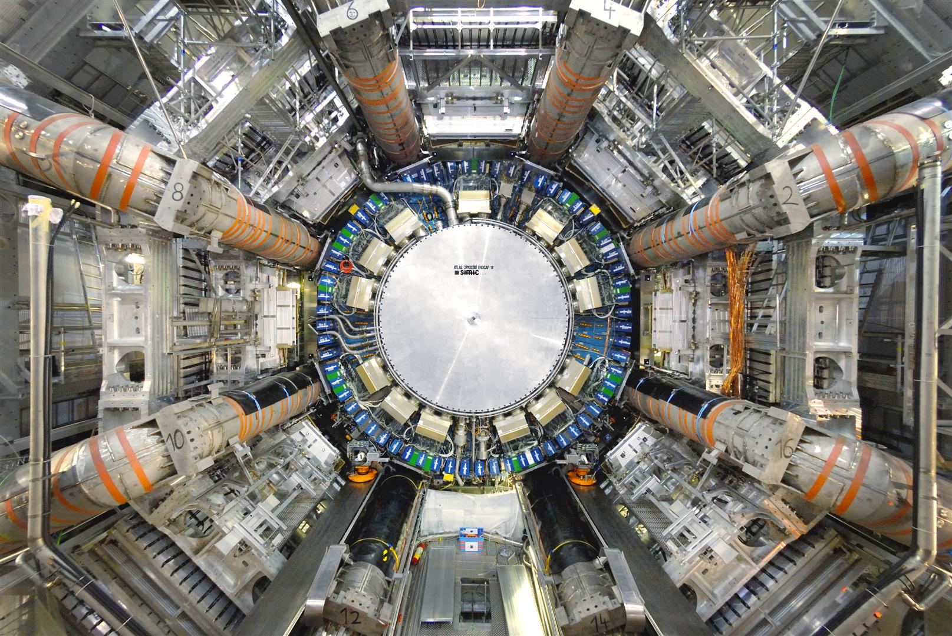

Slide 6


Slide 7
“What are the numbers”
Scaleway Object Storage: Beekeeper
CTA Workshop 2025

Slide 8

Them numbers
Object Storage at Scaleway
Bigger number better Object Storage
Number of servers
Client requests
~1 000
~45 000 req/s
Size of metadata
Internal calls
~1.3 PB
~2 000 000 req/s
Data stored
Metadata operations
~100 PB
~140 000 write/s
~1 200 000 read/s
Number of objects
Bandwidth per day
~29 500 000 000
350TB out / 300TB in
Scaleway Object Storage: Beekeeper
CTA Workshop 2025

Slide 9
Running an Object Storage service is a challenge
SLA, Durability
Maintaining an Object Storage Service implies having strict standards
High availability (99.99% SLO)
High durability (the infamous 11 9s)
SLAs
Amazon S3™ compatibility always up to date
Run and maintain our own infrastructure to handle our service
Hardware maintenance
Updates requires a lot of testing
Rolling release take time
SRE challenges
Scaleway Object Storage: Beekeeper
CTA Workshop 2025

Slide 10
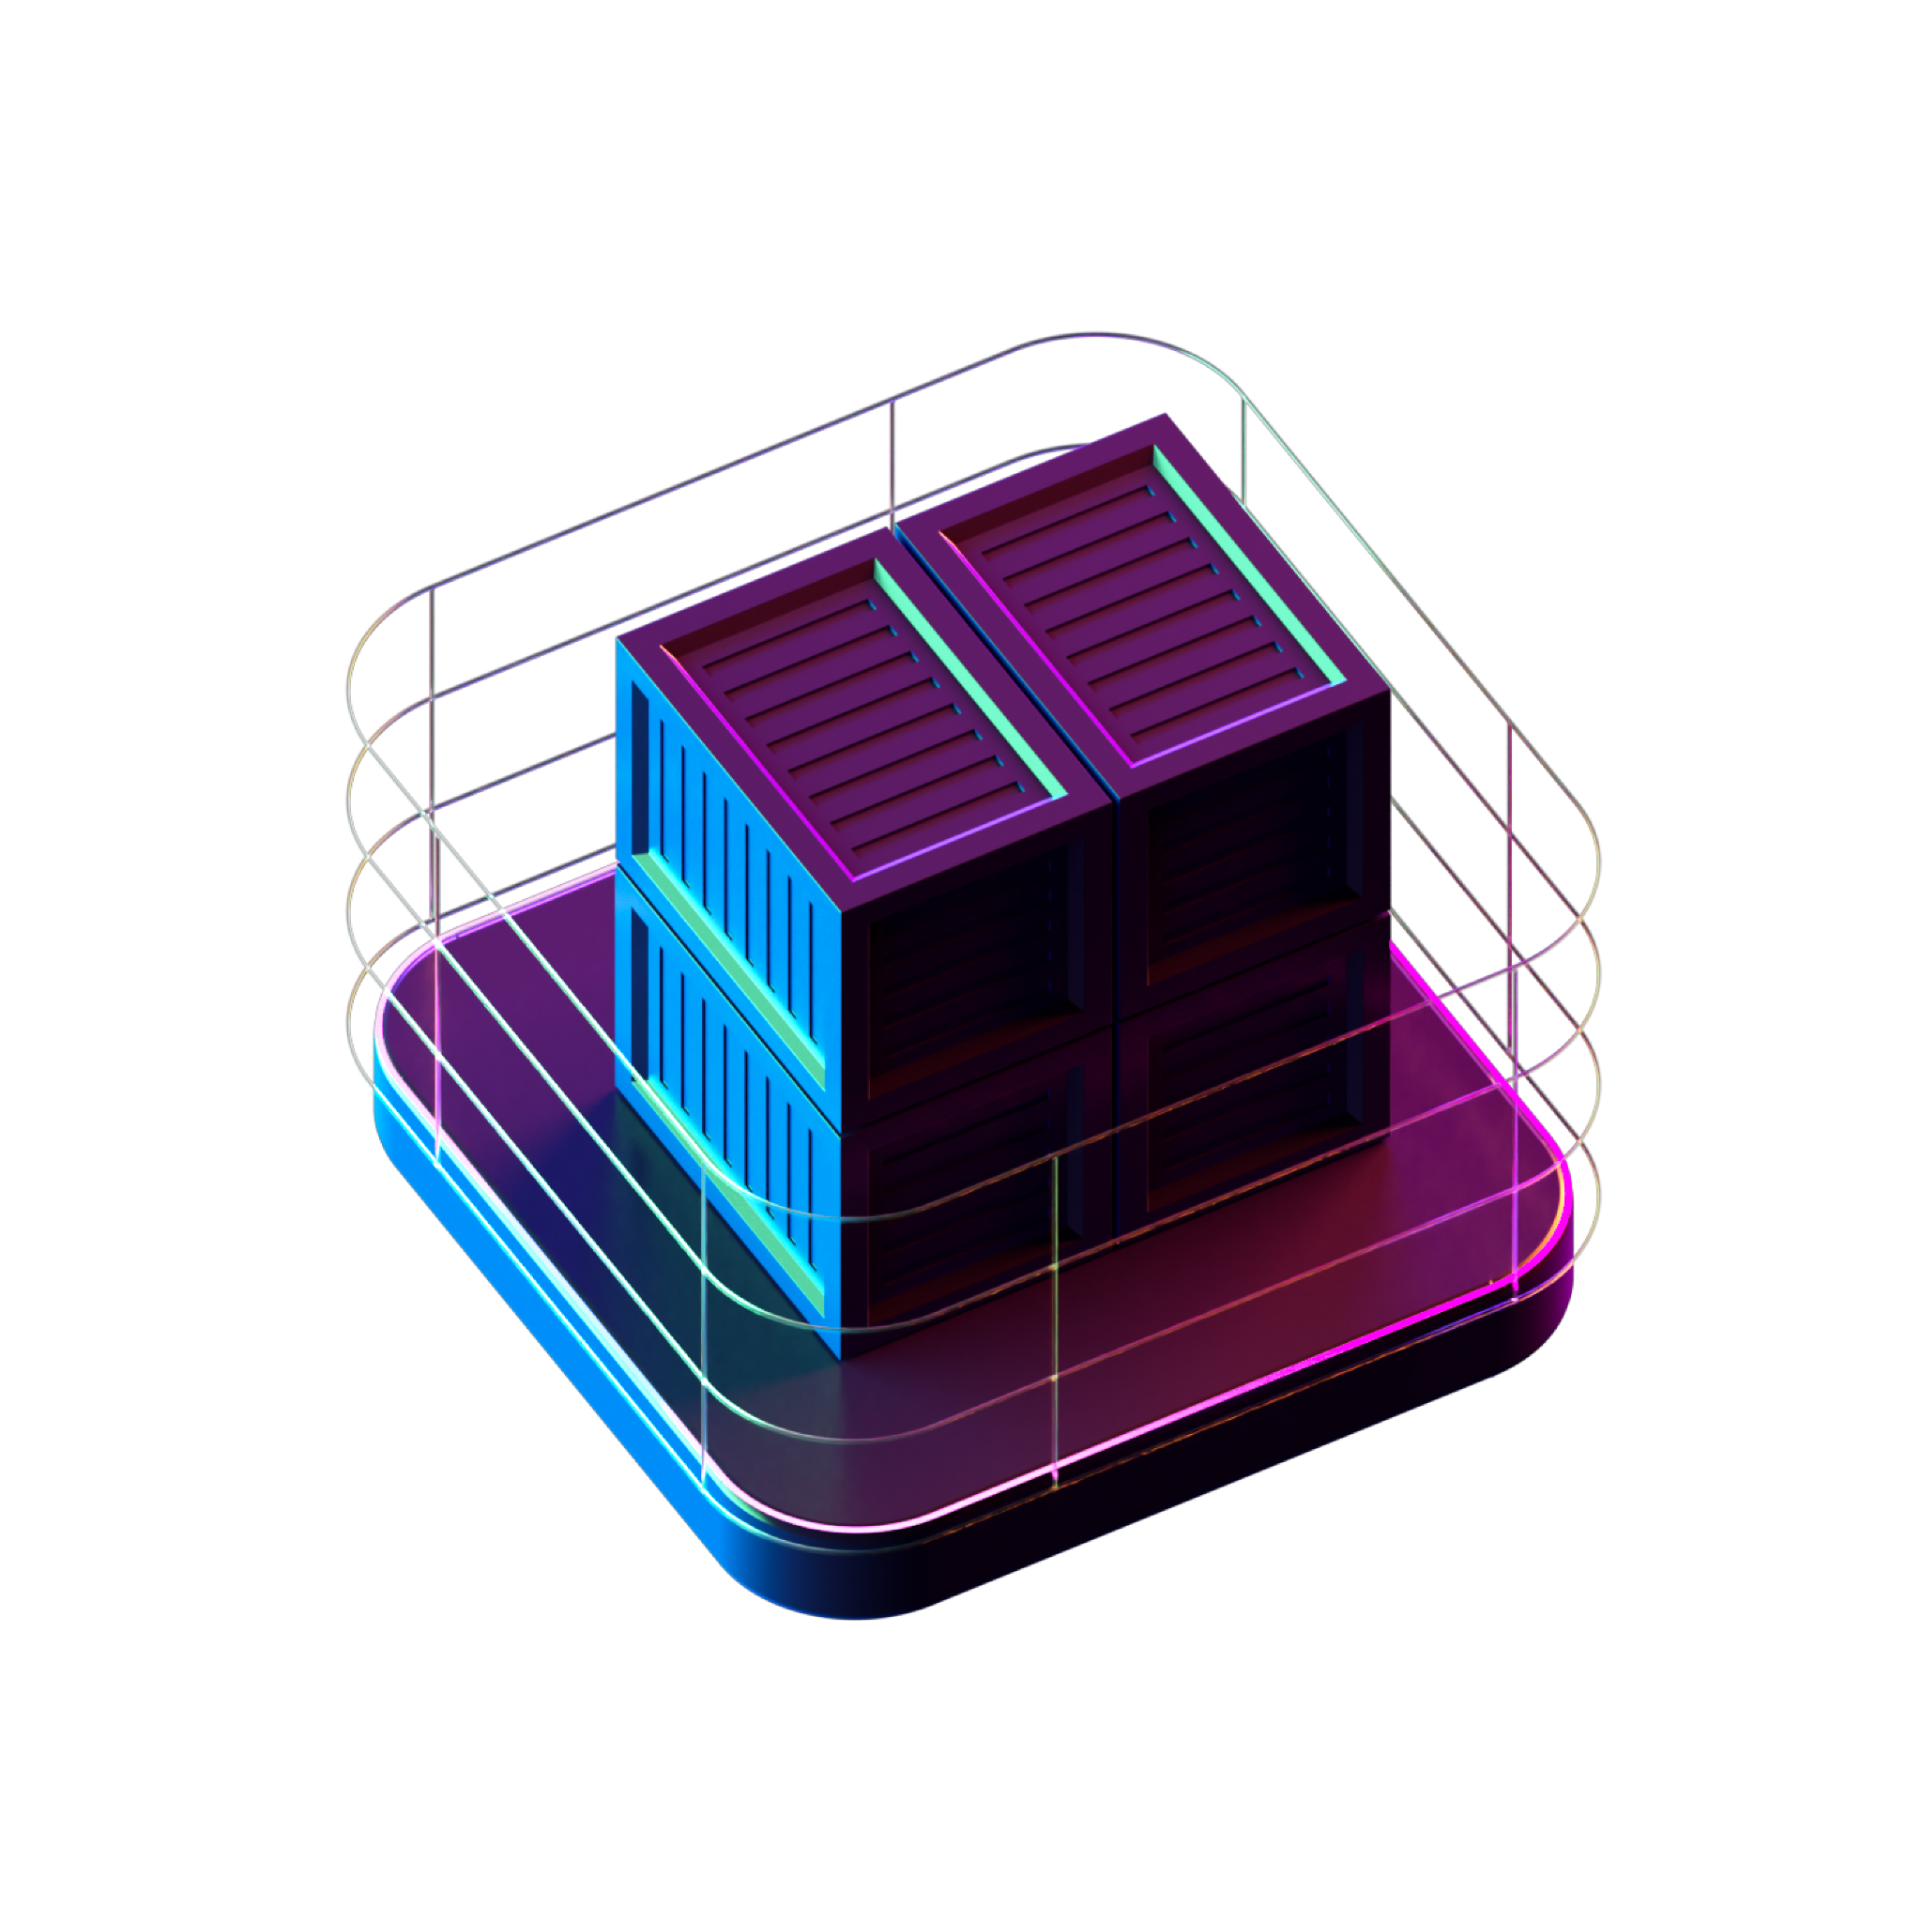
Beekeeper a layered architecture
Part 02
Scaleway Object Storage: Beekeeper
CTA Workshop 2025

Slide 11
Objects availability and durability
Cloud environment is harsh
Objects cannot be simply stored as they are sent.
We must plan against all kinds of failures :
disk wear-down
data corruption
hardware failures
network partitioning
fires, electricity outage, tsunamis, nukes, end of the world
And still, we must avoid hotspots and congestions
Scaleway Object Storage: Beekeeper
CTA Workshop 2025

Slide 12
Erasure Coding: Memento
Consistency Availability Partionning
Data safety
Object
Scaleway Object Storage: Beekeeper
CTA Workshop 2025

Slide 13
Erasure Coding: Memento
Consistency Availability Partionning
Data safety
Object
Metachunk
Metachunk
Metachunk
Metachunk
We split every object into same size metachunks
Scaleway Object Storage: Beekeeper
CTA Workshop 2025

Slide 14
Erasure Coding: Memento
Consistency Availability Partionning
Data safety
data
chunk
data
chunk
data
chunk
data
chunk
data
chunk
data
chunk
Object
Metachunk
Metachunk
data
chunk
data
chunk
data
chunk
data
chunk
data
chunk
data
chunk
parity
chunk
parity
chunk
parity
chunk
parity
chunk
parity
chunk
parity
chunk
Metachunk
Metachunk
data
chunk
data
chunk
data
chunk
data
chunk
data
chunk
data
chunk
data
chunk
data
chunk
data
chunk
data
chunk
data
chunk
data
chunk
parity
chunk
parity
chunk
parity
chunk
parity
chunk
parity
chunk
parity
chunk
Metachunks are erasure coded into data and parity chunks
Scaleway Object Storage: Beekeeper
CTA Workshop 2025

Slide 15
Buzzstore: Endgame
Consistency Availability Partionning
Data distribution
Region
AZ
Each rack contains multiple Storage Pods (SP) with N disks.
Every disk is handled by a Buzzstore agent.
We want to distribute our chunks among them.
Availability zone
Buzzstore
Scaleway Object Storage: Beekeeper
CTA Workshop 2025

Slide 16
Nectar: Good disk hunting
Navigating the sea of disks
One nectar per AZ
Give me
x disks
Buzzstore
[…]
Stateless AZ election
One logic nectar instance per AZ. This instance only handles the AZ where it is deployed. Nectar itself does the polling of disks local to the AZ, no agents.
Scores are computed by nectar, mainly based on I/O disk load.
For an election, the caller needs to make N requests to N nectars instances (N = len(AZs))
Nectar
Buzzstore
Buzzstore
Buzzstore
Buzzstore
AZ 3
Scaleway Object Storage: Beekeeper
CTA Workshop 2025

Slide 17
Storage layer
Beekeeper
Buzzstore
1 disk 1 thread
Nectar
Stateless elections
Availability and durability with EC
Chunks distributions
based on policies
Nectar
Nectar
Nectar
Buzzstore
Buzzstore
Buzzstore
Buzzstore
Buzzstore
Buzzstore
Fleet of
storage pods
Buzzstore
Buzzstore
Buzzstore
Buzzstore
Buzzstore
Buzzstore
AZ 1
AZ 2
AZ 3
Scaleway Object Storage: Beekeeper
CTA Workshop 2025

Slide 18
“How to find data ?”

Slide 19
Hive: Where is data ?
This is not Apache Hive
Root Cluster
DNS for S3 objects
1..*
Account Cluster
With objects being distributed everywhere we need a reliable and fast way of storing all the metadatas and locations of objects.
Hive is a distributed key-value store designed to store account, bucket and object metadata.
Each information is handled by a level and contains reference to next
Caching: we cache the path and the nodes of the requests in order not to have to resolve it again
1..*
Bucket Cluster
1..*
Shard Cluster
Scaleway Object Storage: Beekeeper
CTA Workshop 2025

Slide 20
Hive: Where is data ?
This is not Apache Hive
Root Cluster
Resilience, Availability, and Cluster Types
1..*
Account Cluster
Cluster Types: The type of a cluster dictates the type of data it stores
Root Cluster: Cluster allocator and references to account clusters.
Account Cluster: Account metadata and references to its buckets.
Bucket Cluster: Bucket metadata and references to its shards.
Shard Cluster: Object metadata (tags, creation date, physical location, etc.).
This is determined by the cluster's database-backends, defining the type of data stored.
1..*
Bucket Cluster
1..*
Shard Cluster
Scaleway Object Storage: Beekeeper
CTA Workshop 2025

Slide 21
Hive: Life of Raft
Nodes strong together
Writes
In every follower there is a leader
Leader
AZ1
Raft: consensus algorithm that works by electing a leader who become responsible for replication of log entries.
Leader Election: if a leader fails, the cluster stops accepting writes and automatically elects a new leader. We need at least k/2+1 nodes to have an election.
Cluster Distribution: typically, 5 nodes distributed across 3 Availability Zones (e.g., 2-2-1)
Follower
Follower
AZ2
Follower
Follower
AZ3
Reads
Scaleway Object Storage: Beekeeper
CTA Workshop 2025

Slide 22
Hive: Life of Raft
Nodes strong together
Writes
In every follower there is a leader
Leader
AZ1
Raft: consensus algorithm that works by electing a leader who become responsible for replication of log entries.
Leader Election: if a leader fails, the cluster stops accepting writes and automatically elects a new leader. We need at least k/2+1 nodes to have an election.
Cluster Distribution: typically, 5 nodes distributed across 3 Availability Zones (e.g., 2-2-1)
Follower
Follower
AZ2
Follower
Follower
AZ3
Reads
Scaleway Object Storage: Beekeeper
CTA Workshop 2025

Slide 23
Hive: scale with data
Still not Apache Hive
DNS for you S3 objects
To spread the load as much as possible to avoid congestion, we shard the key space into multiple Shards.
When a shard reaches a certain threshold, the key space is then split in three different shards.
Bucket Lewis
Shard 1 [a – j]
Shard 2 [k - z]
We have two shards each responsible for half the key space
Scaleway Object Storage: Beekeeper
CTA Workshop 2025

Slide 24
Hive: scale with data
Still not Apache Hive
Bucket Lewis
DNS for you S3 objects
To spread the load as much as possible to avoid congestion, we shard the key space into multiple Shards.
When a shard reaches a certain threshold, the key space is then split in three different shards.
Shard 1 [a – j]
sharding
Shard 2 [k - z]
Shard 3 [a – c]
sharding
Shard 4 [d - f]
sharding
Cluster 1 reached the threshold so allocate three clusters each responsible for ⅓ of its key space
Shard 4 [h – j]
sharding
Scaleway Object Storage: Beekeeper
CTA Workshop 2025

Slide 25
Hive: scale with data
Still not Apache Hive
Bucket Lewis
DNS for you S3 objects
To spread the load as much as possible to avoid congestion, we shard the key space into multiple Shards.
When a shard reaches a certain threshold, the key space is then split in three different shards.
Shard 3 [a – c]
Shard 2 [k - z]
Shard 4 [h – j]
Shard 4 [d - f]
Once the sharding is done we no longer need Shard 1, and we have 4 shards under the threshold
Scaleway Object Storage: Beekeeper
CTA Workshop 2025

Slide 26
Metadata layer
Beekeeper
Raft based
clusters
DNS style resolution
On-the-fly sharding
Fast resolution through caching
Fleet of
hive pods
Hive
Hive
Hive
Hive
Hive
Hive
Hive
Hive
Hive
Hive
Hive
Hive
Scaleway Object Storage: Beekeeper
CTA Workshop 2025
Nectar
Nectar
Nectar
Buzzstore
Buzzstore
Buzzstore
Buzzstore
Buzzstore
Buzzstore
Fleet of
storage pods
Buzzstore
Buzzstore
Buzzstore
Buzzstore
Buzzstore
Buzzstore
AZ1
AZ 2
AZ 3

Slide 27
Goteway: Scaleway’s S3™ compatible API
Gateway written in Golang original right?
Separating API business logic, storage, and ecosystem specificities
Implement an S3™ compatible api (so long Swift)
Scaleway Object Storage: Beekeeper
CTA Workshop 2025

Slide 28
Goteway: Scaleway’s S3™ compatible API
Gateway written in Golang original right?
Separating API business logic, storage, and ecosystem specificities
Implement an S3™ compatible api (so long Swift)
Convert S3™ authentication to Scaleway’s one
Scaleway Object Storage: Beekeeper
CTA Workshop 2025

Slide 29
Goteway: Scaleway’s S3™ compatible API
Gateway written in Golang original right?
Separating API business logic, storage, and ecosystem specificities
Implement an S3™ compatible api (so long Swift)
Convert S3™ authentication to Scaleway’s one
Written from scratch to fit our needs
Scaleway Object Storage: Beekeeper
CTA Workshop 2025

Slide 30
Goteway: Scaleway’s S3™ compatible API
Gateway written in Golang original right?
Separating API business logic, storage, and ecosystem specificities
Implement an S3™ compatible api (so long Swift)
Convert S3™ authentication to Scaleway’s one
Written from scratch to fit our needs
  Modular architecture that allows us to easily implement new features
  Single static binary to facilitate deployments
  Runnable locally with as few dependencies as possible to ease dev’s life
Scaleway Object Storage: Beekeeper
CTA Workshop 2025

Slide 31
Goteway: Scaleway’s S3™ compatible API
Gateway written in Golang original right?
Separating API business logic, storage, and ecosystem specificities
Implement an S3™ compatible api (so long Swift)
Convert S3™ authentication to Scaleway’s one
Written from scratch to fit our needs
  Modular architecture that allows us to easily implement new features
  Single static binary to facilitate deployments
  Runnable locally with as few dependencies as possible to ease dev’s life
Built upon abstraction layer :
Scaleway Object Storage: Beekeeper
CTA Workshop 2025

Slide 32
Goteway: Scaleway’s S3™ compatible API
Gateway written in Golang original right?
Separating API business logic, storage, and ecosystem specificities
Implement an S3™ compatible api (so long Swift)
Convert S3™ authentication to Scaleway’s one
Written from scratch to fit our needs
  Modular architecture that allows us to easily implement new features
  Single static binary to facilitate deployments
  Runnable locally with as few dependencies as possible to ease dev’s life
Built upon abstraction layer :
  Fetch metadata from Hive
  Stream data to and from the disks
  Seamlessly handles encryption and erasure-coding
Scaleway Object Storage: Beekeeper
CTA Workshop 2025

Slide 33
Workerbee: Saving private data
Housekeeping please
Separating S3 Logic and storage
We have billions of objects, and we cannot afford to linearly scale the times it takes to scrub or apply client’s lifecycle rules on them.
Scaleway Object Storage: Beekeeper
CTA Workshop 2025

Slide 34
Workerbee: Saving private data
Housekeeping please
ListAccounts
Separating S3 Logic and storage
We have billions of objects, and we cannot afford to linearly scale the times it takes to scrub or apply client’s lifecycle rules on them.
Parallelize jobs at the shard level whenever possible
ListBuckets
ListBuckets
ListShards
ListShards
ListShards
ListShards
CheckShard
CheckShard
CheckShard
CheckShard
CheckShard
Scaleway Object Storage: Beekeeper
CTA Workshop 2025

Slide 35
Workerbee: Saving private data
Housekeeping please
ListAccounts
Separating S3 Logic and storage
We have billions of objects, and we cannot afford to linearly scale the times it takes to scrub or apply client’s lifecycle rules on them.
Parallelize jobs at the shard level whenever possible
Scale the number of workers with the amount of data stored
ListBuckets
ListBuckets
ListShards
ListShards
ListShards
ListShards
CheckShard
CheckShard
CheckShard
CheckShard
CheckShard
Scaleway Object Storage: Beekeeper
CTA Workshop 2025

Slide 36
Workerbee: Saving private data
Housekeeping please
ListAccounts
Separating S3 Logic and storage
We have billions of objects, and we cannot afford to linearly scale the times it takes to scrub or apply client’s lifecycle rules on them.
Parallelize jobs at the shard level whenever possible
Scale the number of workers with the amount of data stored
ListBuckets
ListBuckets
ListShards
ListShards
ListShards
ListShards
CheckShard
CheckShard
CheckShard
CheckShard
CheckShard
=> Every storage server hosts one or more workers
Scaleway Object Storage: Beekeeper
CTA Workshop 2025

Slide 37
API layer
Beekeeper
From scratch
built in go
Amazon S3™
Compatible
Stateless
Load balancing through BGP+DNS
Fleet of
API pods
Goteway
Goteway
Goteway
Goteway
Goteway
Goteway
Goteway
Goteway
Goteway
Goteway
Goteway
Goteway
Scaleway Object Storage: Beekeeper
CTA Workshop 2025
Fleet of
hive pods
Hive
Hive
Hive
Hive
Hive
Hive
Hive
Hive
Hive
Hive
Hive
Hive
Nectar
Nectar
Nectar
Buzzstore
Buzzstore
Buzzstore
Buzzstore
Buzzstore
Buzzstore
Fleet of
storage pods
Buzzstore
Buzzstore
Buzzstore
Buzzstore
Buzzstore
Buzzstore
AZ1
AZ 2
AZ 3

Slide 38
CS3 glacier on disks
Part 03
Scaleway Object Storage: Beekeeper
CTA Workshop 2025

Slide 39
CS3: Fast and not so furious
Disk we know them
S3 Glacier solution based on disk
CS3: disk-based "Glacier"
Reduced Cost: Leveraging commodity hardware for reduced initial investment.
Improved Restore Times: Aiming for much faster data retrieval compared to typical deep archive solutions.
Quick development: leverages our current S3 solution. Less development time and less complexity.
Custom motherboard
"Mr. Freeze": specialized motherboard to manage a high density of disks.
High density: Supports 54 disk drives.
Feature / Limitation: disks are split across two buses, allowing only two disk to be actively mounted at any given time. Extending shelf life of disks.
Scaleway Object Storage: Beekeeper
CTA Workshop 2025

Slide 40
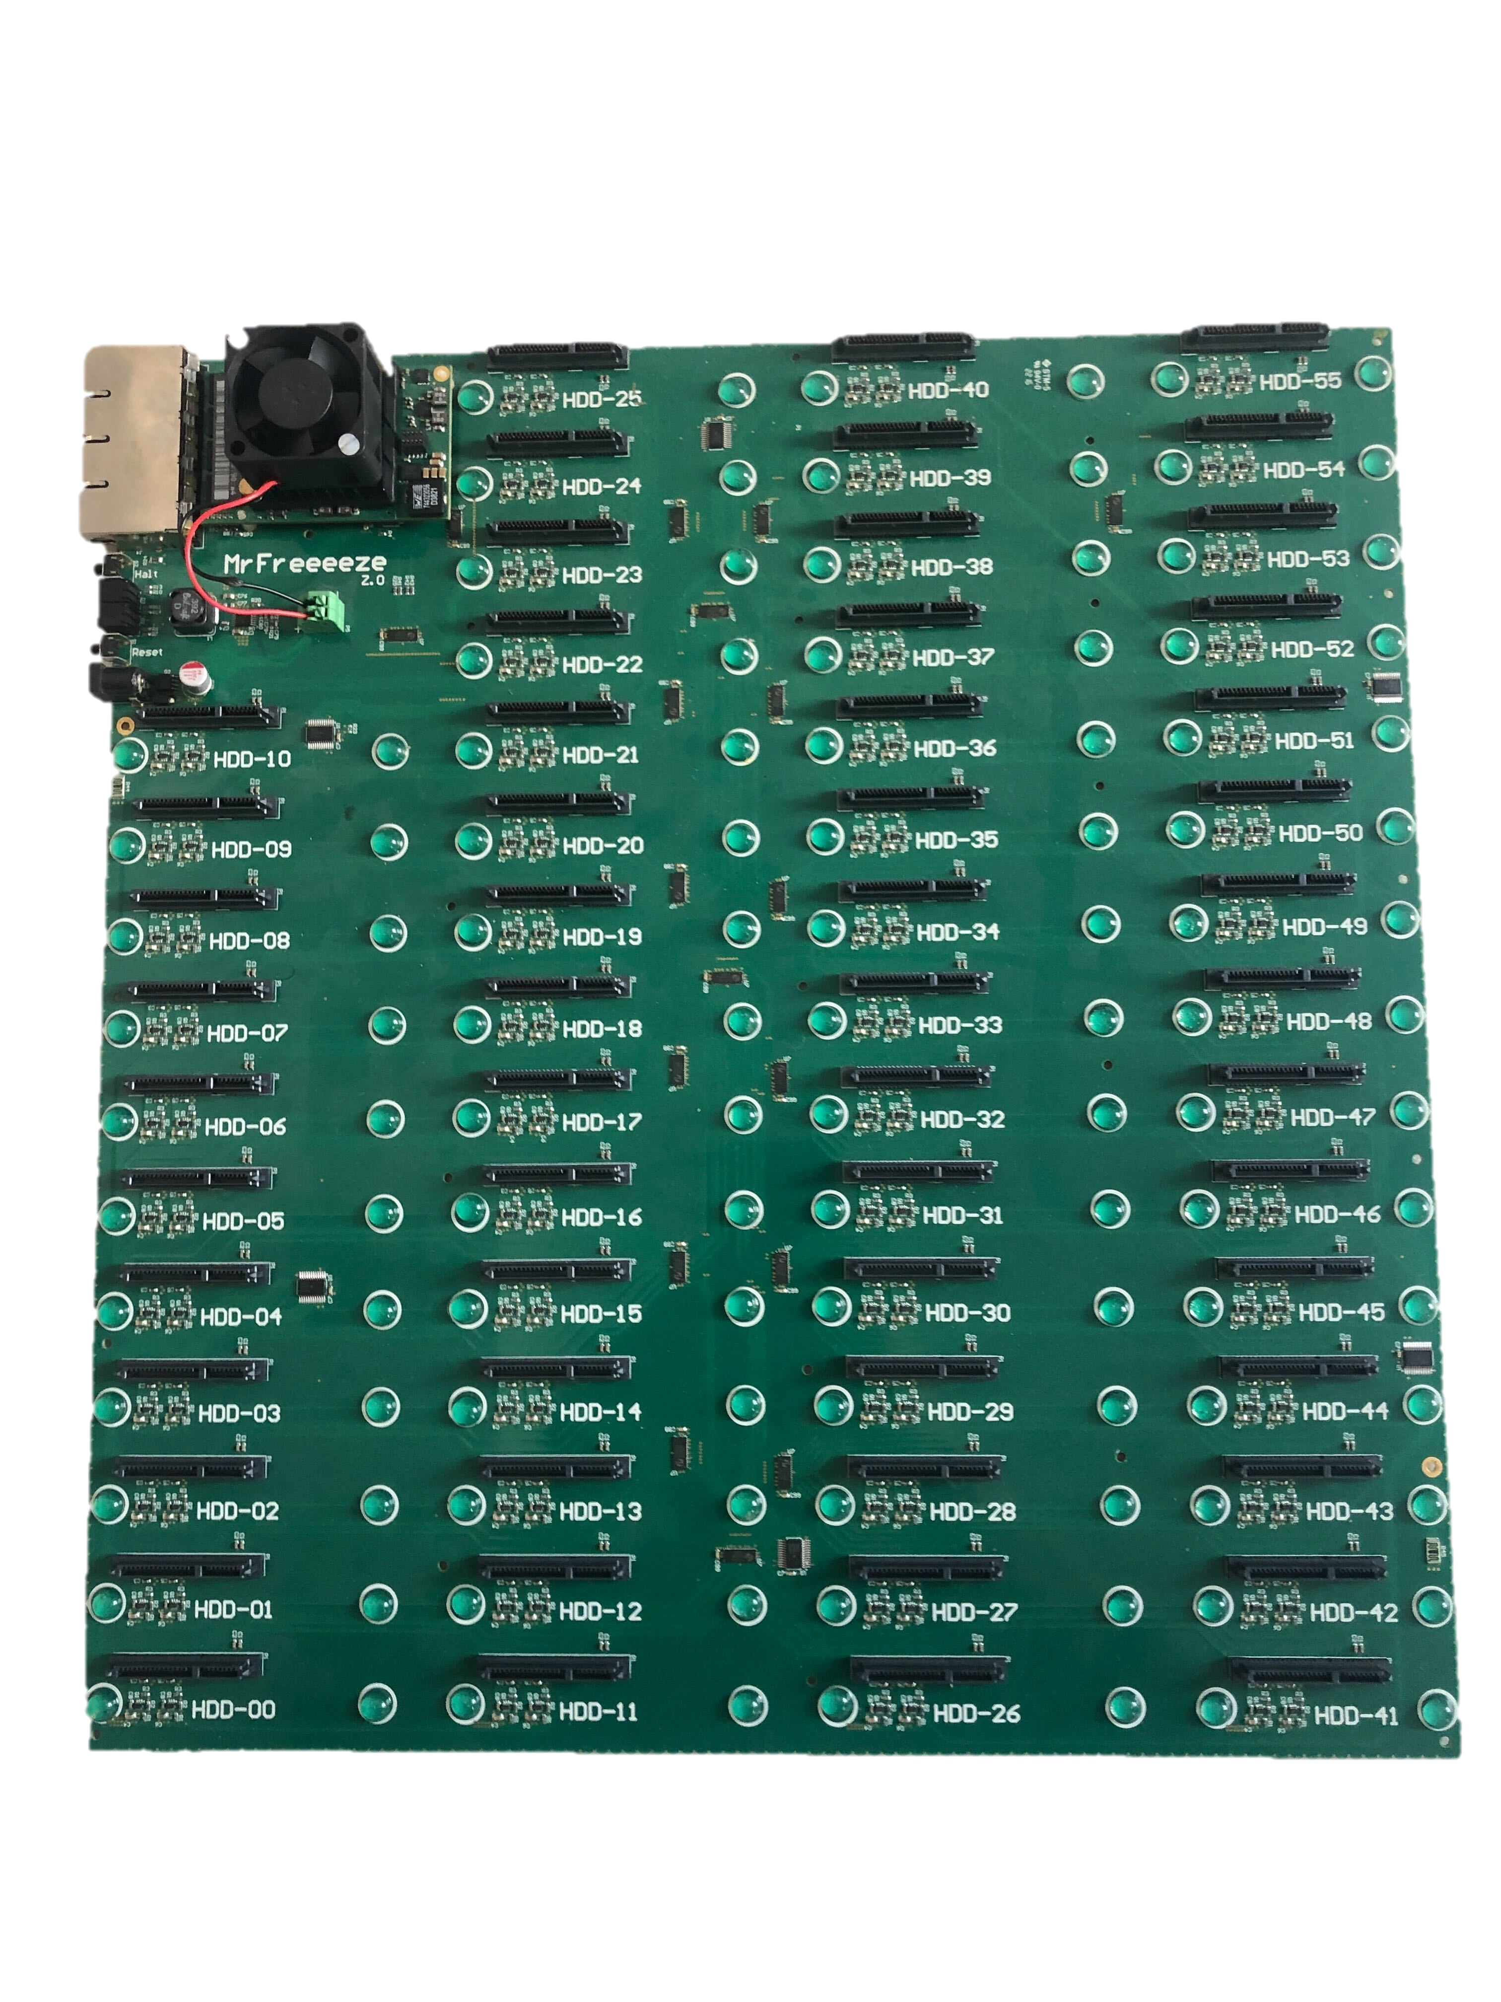
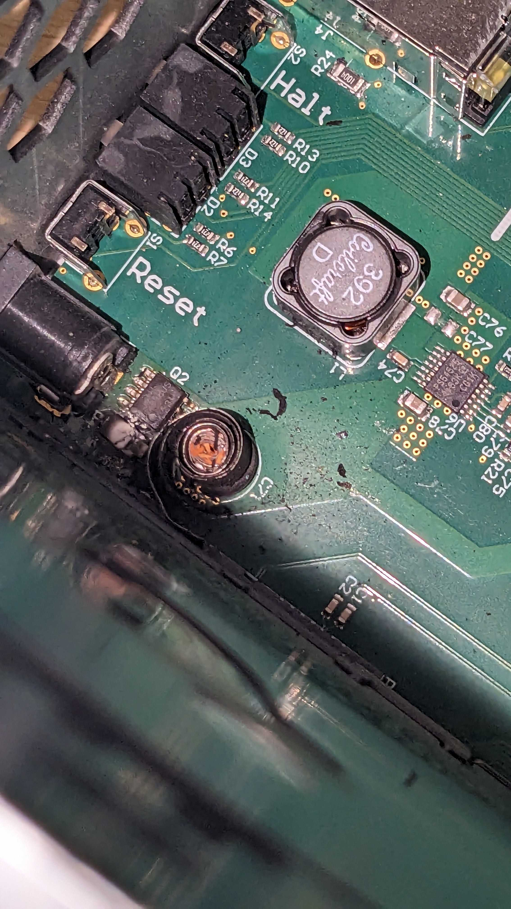
CTA Workshop 2025

Slide 41
CTA Workshop 2025

Slide 42
CS3: Too hot to handle
Climate change affects all
Why we are moving away
What went wrong
Restore concurrency: The two-mounted disk limitation means restore times does not scale over time.
Repairing data: disk break and rebuilding data is complex.
Disk are expensive: costs of disk overtime offsets initial investment savings.
Lessons learned
Durability: we need a storage medium that last a long time.
Storage cost: Cost per TB is what matters.
Electricity: when restores are active, disk consumption adds up.
Concurrency: Having only a few concurrent operations at the same time is not an option if we want to scale.
Scaleway Object Storage: Beekeeper
CTA Workshop 2025

Slide 43
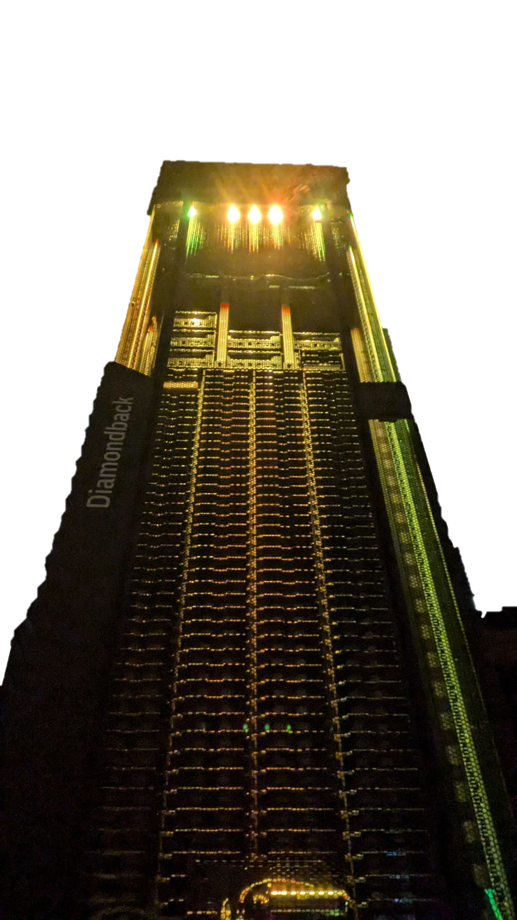
Glacier V2: glacier on tape
Part 04
Scaleway Object Storage: Beekeeper
CTA Workshop 2025

Slide 44
Staging
Production
1 Diamondback
3 Diamondback
6 Drives
42 Drives
180 TB
83.5 PB
4 Datamovers
12 Datamovers
Scaleway Object Storage: Beekeeper
CTA Workshop 2025

Slide 45
Glacier V2: Planet of the tapes
Baby it's cold outside
We our tape storage need is different
No economies of scale: we’re big but not GCP, AWS and Azure big.
Not our data: we don’t control the size of data that is going onto tapes.
Frequency: CRUD actions are done at random frequency that we cannot control. Therefore, we need to plan for sudden spikes in activity.
Minimum size: we pack per client data into archives before archiving them. We have a threshold before moving data to tape.
Indexing data: we maintain an index of ObjectID to ArchiveID in a bucket.
Erasure coding: We erasure code every archive. And we split every chunk across 3 libraries and separate tape cassettes. Bringing our failure domain to a full library + 1 tape cassette.
Soft deletion: when objects are deleted the index is deleted and we only delete the archive on tape when an archive has enough deleted object.
Scaleway Object Storage: Beekeeper
CTA Workshop 2025

Slide 46
(Un)Archiving: Workerbee Assemble
Yup beeswax
Workerbee scans production
Storage Class: All glacier objects are tagged Glacier in Hive
Object status:
In Hot: Currently in the hot storage.
Archived: Data has been packaged for long-term storage.
Glacier: Data resides on tape storage.
Restored: Data has been temporarily retrieved for access.
Bucket-Level Threshold: Data remains in the hot buffer until a size threshold is reached
Workerbee: performs a daily check on each bucket. If the threshold is met for a bucket:
Workerbee assigns a unique Archive ID to all eligible objects and stores it in their metadata.
Workerbee creates a task to archive for these objects.
Archive is placed in a specific bucket.
Workerbee forward all restore and deletion request to Wax.
Scaleway Object Storage: Beekeeper
CTA Workshop 2025

Slide 47
Wax: Payneless tape backend
Yup beeswax
An API for tape storage
Atempo Miria: software solution that handles writes and read from tapes. It operates all our library and offers a REST API.
Wax: archiving daemon that is a bridge between S3 and Miria. It has been designed to allow the rest of the stack to be backend agnostic, and it can be adapted to talk to any other tape solution.
Asynchronous Archiving: Wax periodically scans the designated bucket, if it finds an archive it will send an archiving request to Miria. Once finished the archive is deleted from the hot buffer.
Scaleway Object Storage: Beekeeper
CTA Workshop 2025

Slide 48
Wax to the future
We need you
Future work and aspiration
Support multiple tape storage backend
High performance Object Storage
Allow partially degraded writes (with at least one parity)
Open Source the project
Scaleway Object Storage: Beekeeper
CTA Workshop 2025

