Slide 1
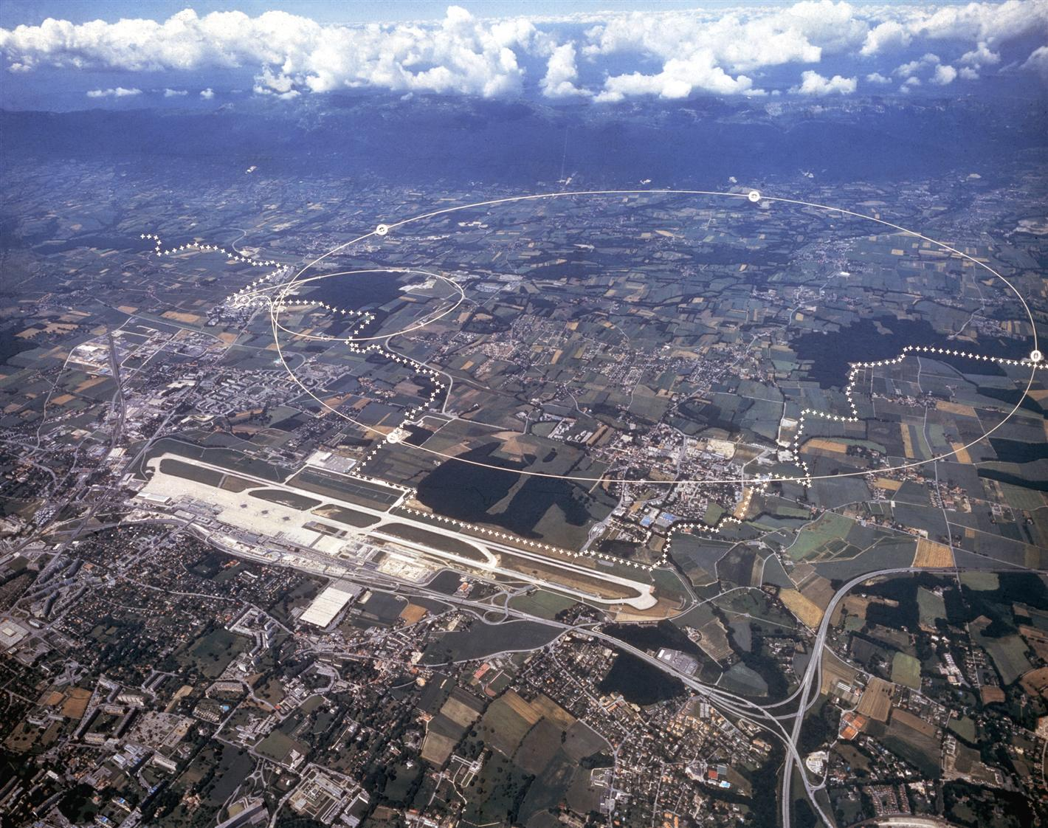
Prospects for ions at HL-LHC and outlook for FCC-hh
R. Bruce, R. Alemany, H. Bartosik, J.M. Jowett, M. Schaumann, E. Waagaard

Slide 2
Outline
Introduction: LHC ion programme
Ion operation in Run 3 and Run 4
Ion operation beyond Run 4
FCC-hh ion operation
Summary

Slide 3
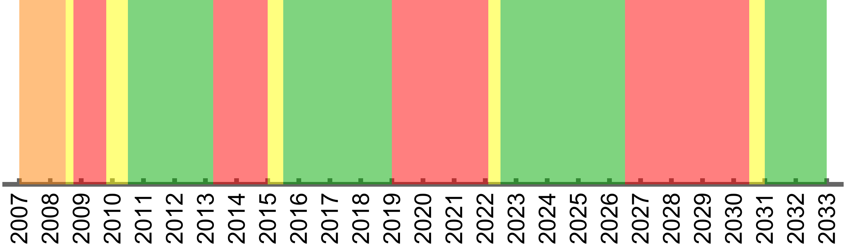
Past LHC ion runs and main achievements
16h p-Pb
p-Pb @ 4 Z TeV
P-Pb @ 6.5 Z TeV
1-week O-O and p-O
LHC typically runs 1 month per year with heavy ions
  So far Pb-Pb (6 runs),
  p-Pb (2 runs)
  Short pilot runs in other configurations
LHC Run 3
  First Pb-Pb runs with all HL-LHC ion upgrades implemented
    Shorter 50 ns bunch spacing from SPS, alleviation of collisional losses, …
    ALICE 2 upgrade allowed higher luminosity
16h Xe-Xe pilot run
p-Pb?
p-Pb run @ 4 Z TeV
12h partially stripped Pb⁸¹⁺
Run 1
Run 2
Run 3
Long Shutdown 1
Implementation of ion upgrades – LHC and injectors
Long Shutdown 2
Long Shutdown 3
Pb-Pb @ 3.5 Z TeV
Pb-Pb @ 6.37 Z TeV
Pb-Pb @ 6.8 Z TeV?
Pb-Pb @ 6.8 Z TeV

Slide 4
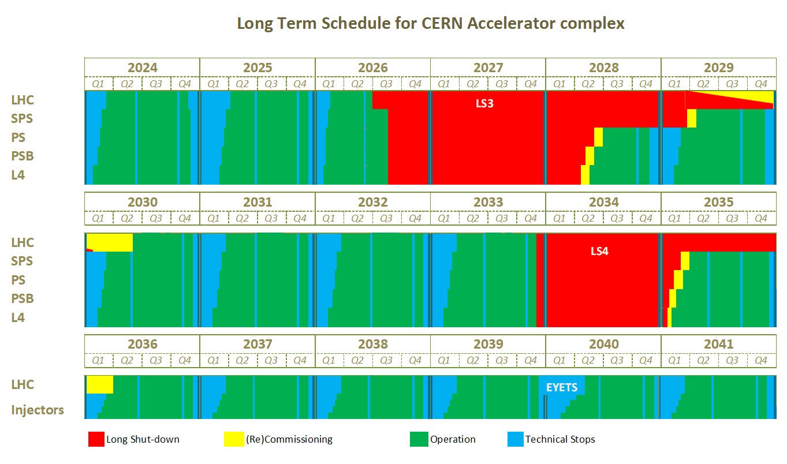
Future of LHC heavy-ion programme
Run 4: HL-LHC
  Yearly Pb-Pb and/or p-Pb operation except 2030
  Sharing between Pb-Pb and p-Pb not yet decided
  Shorter pilot runs with other ions?
Beyond Run 4
  ALICE3: new detector for significantly higher nucleon-nucleon luminosity
    Under study, not yet approved
  LHC ion runs formally approved if ALICE3 goes ahead
Run 3
Run 4
Run 5
EDMS 2311633 V 4.2

Slide 5
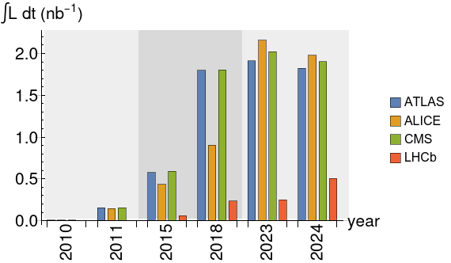
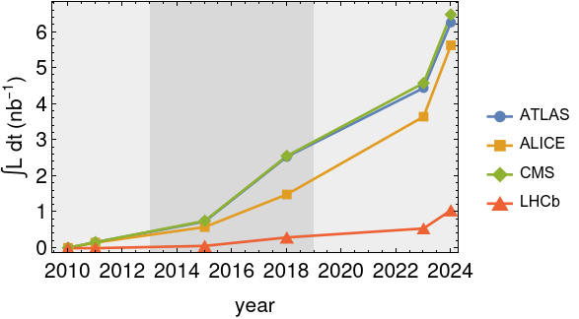
Integrated luminosity so far
Integrated luminosity per year
Total integrated luminosity
ALICE2 and HL-LHC upgrades in LS2 allowed higher luminosity from 2023
2024 was the by far best run so far
  Half of the time allocated compared to 2023
Total integrated Pb-Pb luminosity
  ATLAS: 6.3 nb⁻¹
  ALICE: 5.6 nb⁻¹
  CMS: 6.5 nb⁻¹
  LHCb: 1.05 nb⁻¹

Slide 6
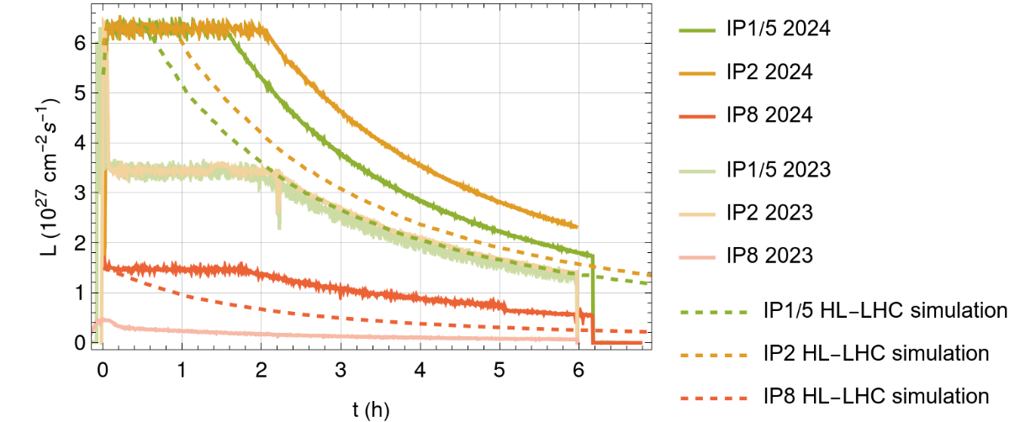

2024: surpassing nominal HL-LHC performance
2024: fill 10400; 2023: fill 9285 (among the best fills each year)
Achieved levelling time up to about 2h in ALICE
2024 luminosity production in single fills surpasses by far 2023, and even HL-LHC projections
  After 6h, ALICE has about 80% more data than in 2023 and 30% more than HL-LHC prediction
  After 6h, LHCb has 80% more data than in HL-LHC prediction
  Reason: significantly higher bunch intensity from injectors; mitigation of LHC limitations
Plan for rest of Run 3 and Run 4: continue production as in 2024
  incremental improvements may be within reach, but probably not big factors
Notes:
Summary of integrated luminosity after 6h at ALICE:
2024: 99/ub
2023: 55/ub
HL-LHC: 77/ub

Slide 7
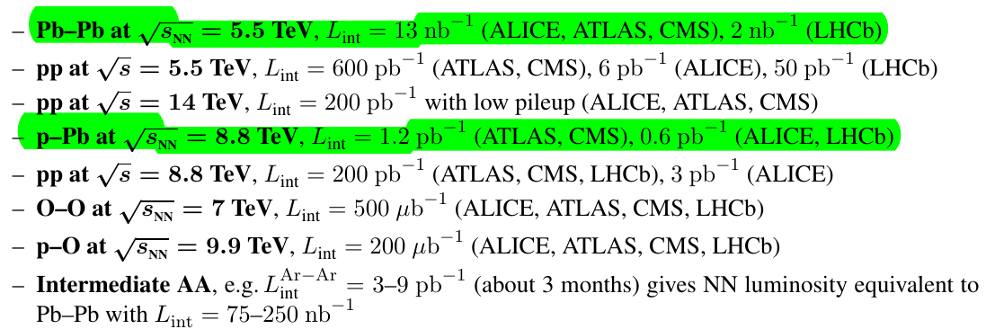
Physics goals from yellow report
WG5 in the 2018 HL-LHC / HE-LHC physics workshop dealt with heavy-ion physics
Yellow report details requests for Run 3 and Run 4, as well as proposal for extended heavy-ion running: CERN-LPCC-2018-07
In Run 3 + Run 4

Slide 8
Outline
Introduction: LHC ion programme
Ion operation in Run 3 and Run 4
Ion operation beyond Run 4
FCC-hh ion operation
Summary

Slide 9
LHC ion operation beyond Run 4
Aim at significantly higher nucleon-nucleon luminosity than HL-LHC Pb-Pb
  New ALICE3 detector under study, letter of intent prepared - to be installed in LS4 if approved
Many optimizations and upgrades in the injectors already gave factor >3 higher bunch intensities and factor >2 more bunches in 2024 than in LHC design report (2004)
  Not straight-forward to gain additional significant factors in Pb-Pb luminosity
Different ways to further increase luminosity under study
  Further optimizations and upgrades to the Pb beam production scheme in the injectors
  Use another ion species than Pb
    Potential to achieve higher bunch intensities from the injectors, and higher NN luminosity
    Electromagnetic cross sections in the LHC collisions scale with powers of the charge – will be less limiting
  Could combine both ways…

Slide 10
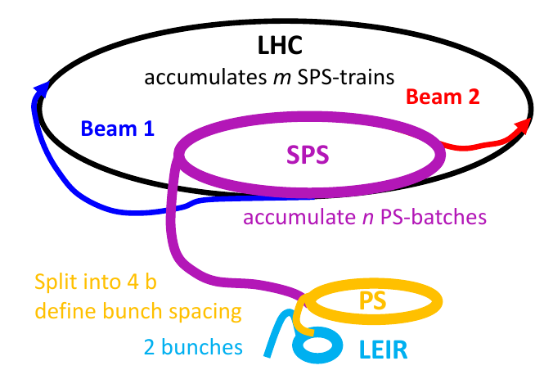
Injector model
Need to estimate potential luminosity with other beams and ion species than Pb →
  Need to estimate beam properties given by the injectors
  First rough estimate in WG5 yellow report based on fitted power law scaling
  Detailed limitations in injectors not accounted for
“Injector model” developed over the last years
  For any ion, propagate beam through the injector chain, accounting for realistic limitations depending on ion charge, mass and energy
    Space charge, electron cooling, …
  Still under development - hope to add further features in the future
Notes:
LINAC current and number of injections, space charge, electron cooling, splitting, stripping, (beam-gas interactions), (intrabeam scattering)
Uses scaling of space-charge tune shift – future development of full tracking would improve results, in particular emittance; could study combined effect of space-charge and intrabeam scattering

Slide 11
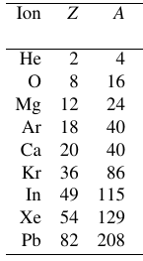
Studied ions and scenarios
Range of ion species studied
  based on previous experience and ion source constraints
Range of beam production scenarios in injectors
  50 ns baseline
    Same as presently used for Pb in LHC
  50 ns, no splitting in the PS
    Higher bunch intensity but fewer bunches and longer injection time
  Any of the above scenarios with optimized charge state or isotope
  Any of the above scenarios with additional electron stripping between LEIR and PS
  25 ns spacing
    Requires upgrade of RF system in PS
    40% more bunches in LHC but longer injection time
    Consider also scheme with 6 bunches from PS instead of 4 → more bunches in LHC and faster injection time, but lower bunch intensity
Used operationally for Pb
Potential improvements
but not demonstrated,
need developments

Slide 12
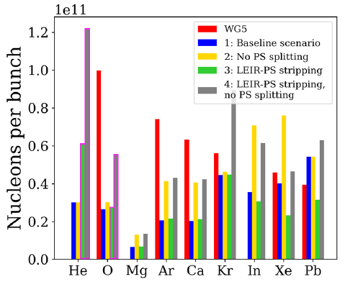
Projected intensities at LHC injection
Estimated intensity at LHC injection
Several iterations
  Latest version: scaling from demonstrated performance with 2024 Pb beams
Baseline scenario gives significantly lower bunch intensity than WG5
  Difference is larger for lighter ions
  Much lower LHC luminosity to be expected than WG5
E. Waagaard
Not feasible due to required
magnetic field in PS
Inject O8+?

Slide 13
3 scenarios for LHC studies
Baseline
  Using the well-proven scheme for Pb, extrapolate to other ions using our best knowledge and conservative assumptions
  Assume proven LHC performance (β*, energy, transmission, operational efficiency)
Optimistic
  Assume scenario with no splitting in PS and best charge state; reduced β*,crossing in LHC
  Account for fewer bunches, longer injection in LHC, giving also additional emittance blowup and lower transmission, extra LEIR injection from improved electron cooling
  Has some optimism, clearly relies on assumptions that have not been proven yet
25 ns
  Assume bunch parameters and LHC configuration as in baseline scenario, but with small additional emittance blowup and intensity loss due to longer injection time
  Not given that the experiments can handle 25 ns
  Relies on assumptions that have not been proven yet and also additional hardware upgrades of the PS RF system
In all scenarios, assume that luminosity levelling is no longer needed. Assume also that collimation and collisional losses are not limiting →
to be studied

Slide 14
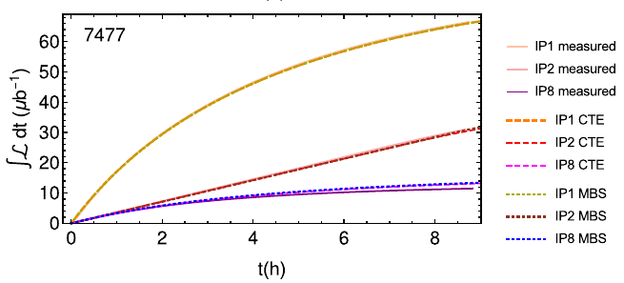
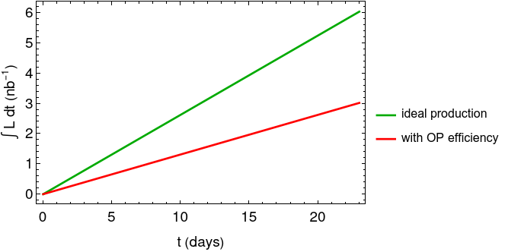
LHC simulation setup
Integrated luminosity in single fill
from EPJ Plus paper
LHC luminosity in single fills simulated with Collider Time Evolution programme (CTE)
  Benchmarked with LHC Pb data – gives excellent agreement for known starting conditions
Single fill luminosity extrapolated to total data in typical 1-month run (23 days for physics)
  Calculate optimal fill time, calculate total production in ideal conditions, reduce results by assumed operational efficiency factor

Slide 15
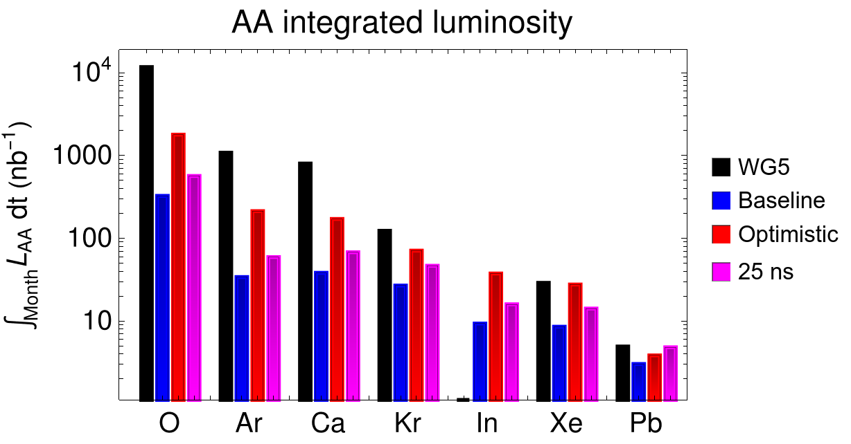
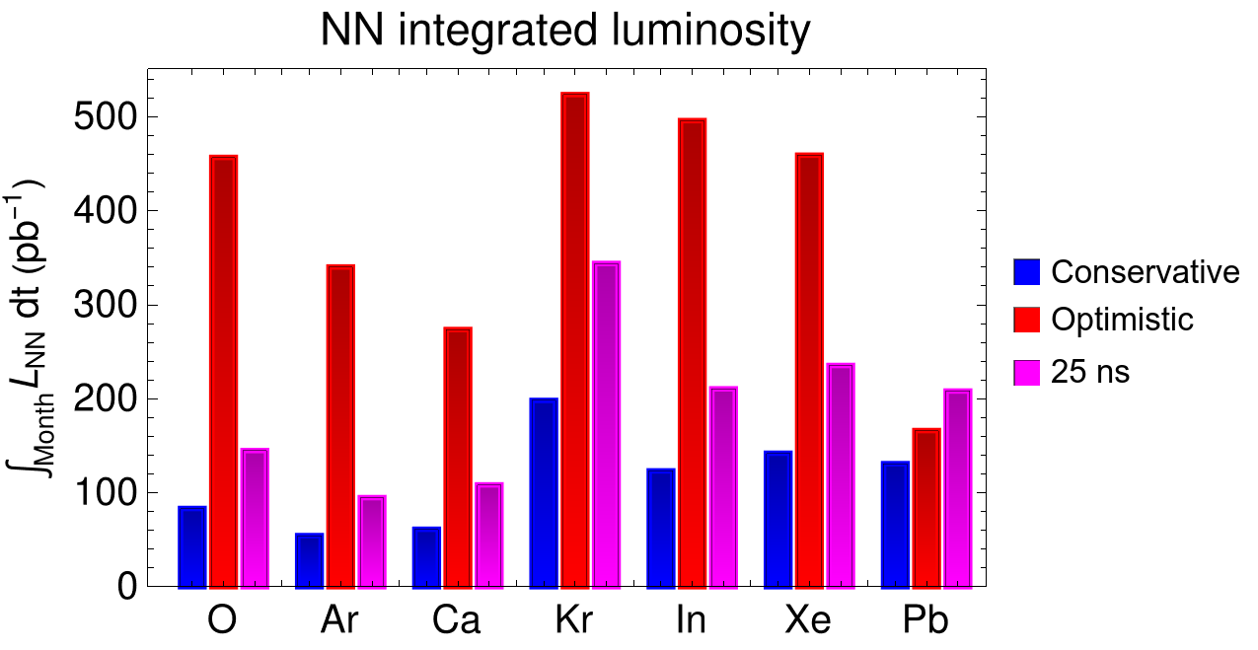
Projected one-month luminosity
Baseline
Even in optimistic scenario, we get significantly lower luminosity than in WG5 for most considered ions
For optimistic scenario, we get up to a factor 4 gain in NN-luminosity compared to Pb-Pb
  About 500 pb⁻¹ for Kr in optimistic scenario; 131 pb⁻¹ for Pb in baseline
  WG5 had gain ratio of 25 compared to Pb-Pb (for O)
In baseline scenario, up to 50% gain by using Kr instead of Pb
25 ns: with present assumptions pays off the best for the heavier ions
  About 60% gain over Pb in baseline scenario
Both optimistic and 25 ns scenarios rely on assumptions that have not been proven yet

Slide 16
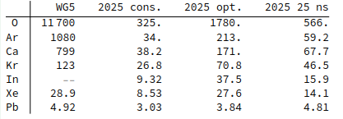
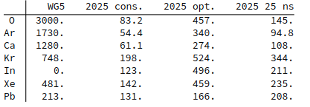
Projected one-month luminosity
Projected integrated AA luminosity over 23 days (nb⁻¹)
Projected integrated NN luminosity over 23 days (pb⁻¹)

Slide 17
Evolution of predictions
Over the years, the predicted luminosity has evolved, following improvements of the modelling and accounting for the progress in operation
Work is ongoing - results likely to evolve further in the future
  Expect further updates based on achieved performance in 2025 oxygen run
  Several parts of modelling still missing: interplay between intrabeam scattering and space-charge, space-charge tune shift dependent transmissions instead of hard cut-off

Slide 18
Outline
Introduction: LHC ion programme
Ion operation in Run 3 and Run 4
Ion operation beyond Run 4
FCC-hh ion operation
Summary

Slide 19
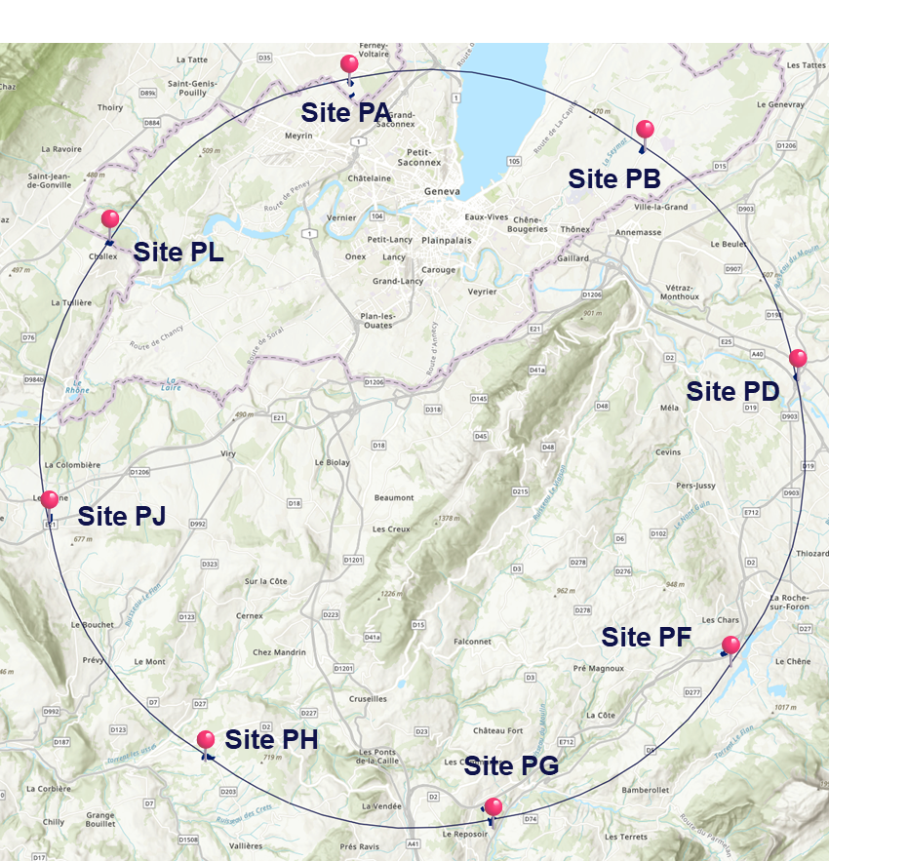
FCC-hh
FCC: design study of future ~91 km ring
  Would operate after HL-LHC
  FCC-ee: First stage with e+e- collisions
  FCC-hh: Second stage with p-p and A-A collisions
    Present assumption: 14 T magnets, 85 TeV c.m. energy
    CDR (2018): 16 T magnets, 100 TeV c.m. energy
Nuclear collisions part of
FCC-hh programme
  In 2019 CDR, assumed Pb-Pb and p-Pb collisions

Slide 20
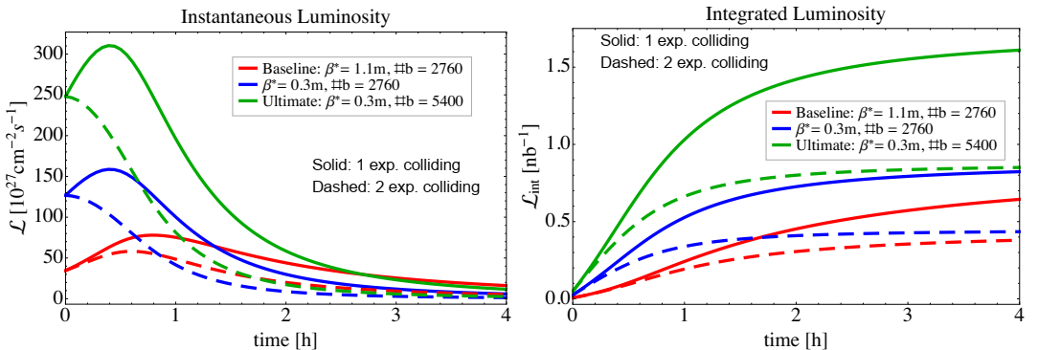
Heavy-ion studies for FCC-hh (CDR)
M. Schaumann
Assumptions:
  up to 5400 bunches per ring with 2×10⁸ Pb/bunch, 50 ns spacing
  LHC as injector – rather slow filling
  100 Z TeV c.m. energy
  1 or 2 experiments taking ion collisions
FCC-hh has potential to give very high ion luminosity
  With 2 experiments, estimated 30-day integrated Pb-Pb luminosity of 23-62 nb⁻¹
All studies need to be updated for the latest baseline
  Pb bunch intensity, fewer bunches, lower energy
  IP optics remained the same
Challenges to be studied and solved
  collisional losses, collimation, long injection cycle, maintaining ion injector capabilities
  Potentially consider other ions than Pb – relaxes limits from collisional losses

Slide 21
Outline
Introduction: LHC ion programme
Ion operation in Run 3 and Run 4
Ion operation beyond Run 4
FCC-hh ion operation
Summary

Slide 22
Summary
In Run 3 and Run 4
  LHC will continue operation with Pb-Pb and/or p-Pb for about 1 month per year
  HL-LHC performance established and significantly surpassed in 2024
  Envisage shorter “pilot runs” with other ions as for Xe in 2017 and oxygen in 2025?
Beyond Run 4
  LHC ion runs approved
  Aiming at significantly higher NN luminosity
  Investigating alternative ion species and beam production schemes
Performance studies for beyond Run 4
  Injector model developed to estimate achievable intensity for a range of ions
  LHC simulations to study luminosity
  Potential to reach up to factor ~4 higher NN luminosity with alternative ions and production schemes
    Relies on optimistic assumptions, still to be proven
Studies will continue
  Important to gather further information and improve the models – simulations and experimentally
  Expect valuable information from 2025 oxygen run and updated results
FCC-hh
  Potential for large leap in ion luminosity
  Scenarios to be updated and several challenges to be studied

Slide 23
Thanks for the attention!

Slide 24
Backup

Slide 25
Past LHC ion runs and main achievements
New collision mode: 16h p-Pb pilot run
p-Pb @ 4 Z TeV
P-Pb @ 6.5 Z TeV
Planned: 1-week O-O and p-O pilot run
1st high-luminosity
p-Pb run @ 4 Z TeV
New species: 16h Xe-Xe pilot run
p-Pb?
New mode: 12h operation with partially stripped Pb⁸¹⁺
Run 1
Run 2
Run 3
Long Shutdown 1
Implementation of ion upgrades – LHC and injectors
Long Shutdown 2
Long Shutdown 3
Pb-Pb @ 3.5 Z TeV –
0.5x design lumi
Pb-Pb @ 6.37 Z TeV –
6.1x design lumi
Pb-Pb @ 6.8 Z TeV - 6.4x design lumi, HL-LHC upgrades
Pb-Pb @ 6.8 Z TeV?
1st Pb-Pb collisions @ 3.5 Z TeV
Pb-Pb @ 6.37 Z TeV – 3.6x design lumi
Pb-Pb @ 6.8 Z TeV

