Slide 1


Turbulence in financial markets
Chapter 11 of Mantegna and Stanley’s book
T. Csörgő^{1,2}
¹ Wigner RCP, Budapest, Hungary
² MATE KRC, Gyöngyös, Hungary
R. N. Mantegna and H. E. Stanley:
An introduction to econophysics
Correlations and complexity in finance
Chapter 11:
Intro: physics w/o Hamiltonian
11.1 Turbulence
11.2 Parallels: fluids and markets
11.3 Scalings in fluids and markets
11.4 Discussion: similarities and differences

Slide 2
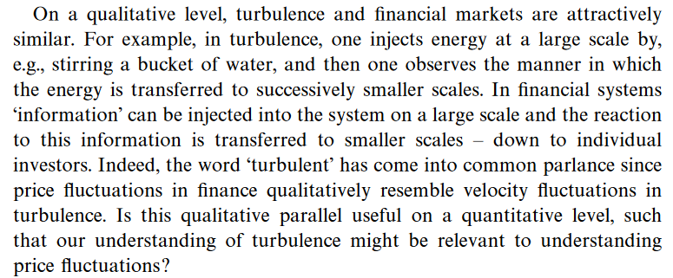
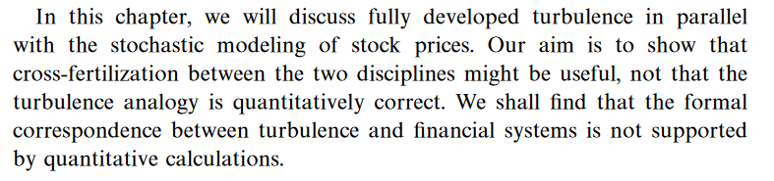
Introduction to Chapter 11
Basic problem: can physics discuss systems w/o a Hamiltonian?
w/o a known dynamical equation?
Examples: granular material
modelling friction
Viscous fluid dynamics – not yet mathematically solvable
(One of the unsolved Millennium Problems)
Opportunity: cross-fertilization
2

Slide 3
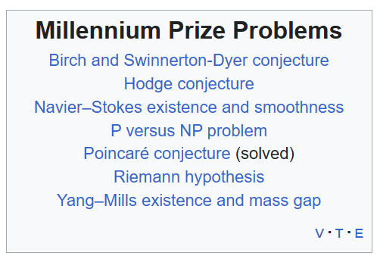
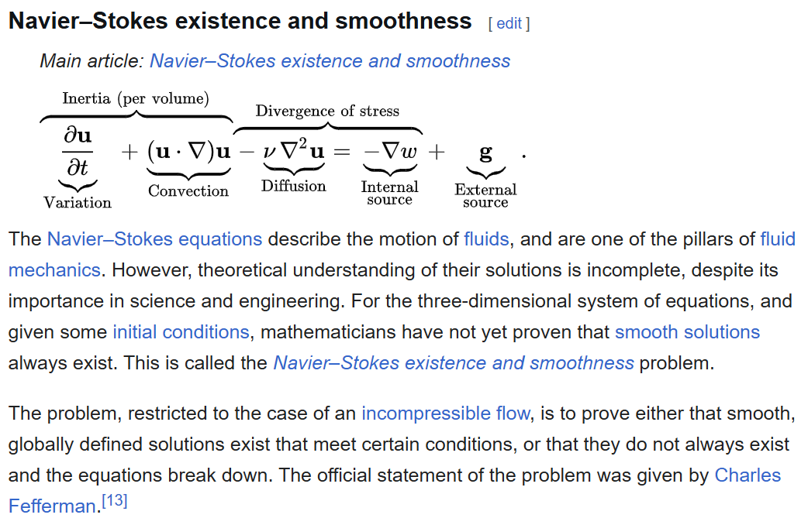
11.1 Turbulencia
Navier-Stokes egyenletek
3

Slide 4
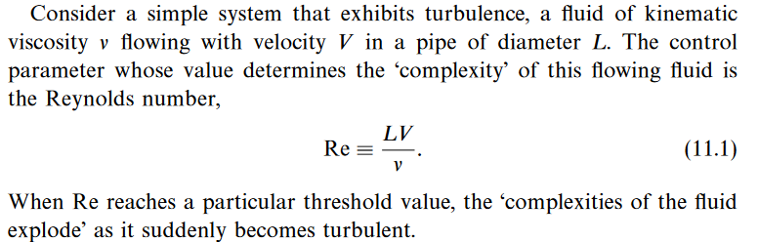
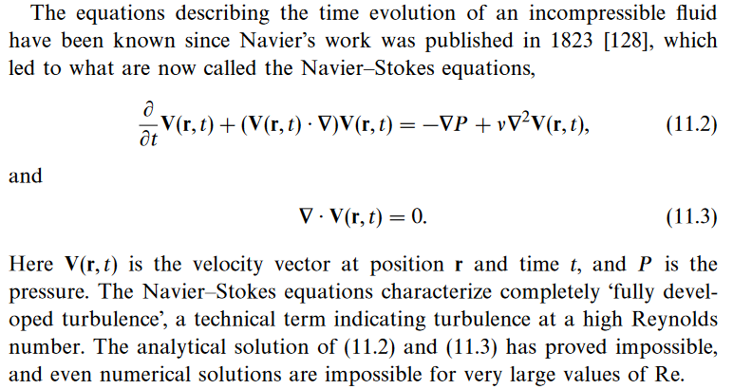
11.1 Turbulencia
Navier-Stokes egyenletek 2.
4

Slide 5
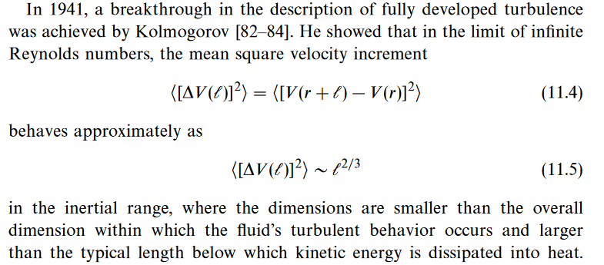
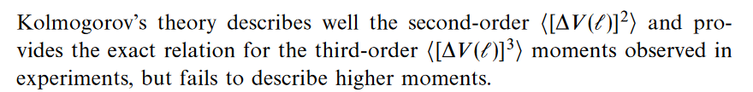
11.1 Turbulencia
Navier-Stokes 3: Kolmogorov’s scaling
5

Slide 6
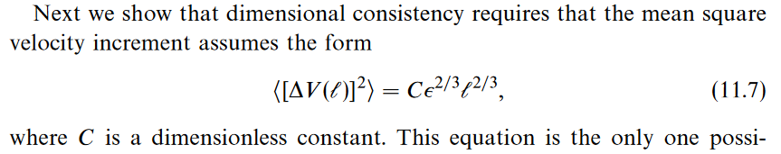
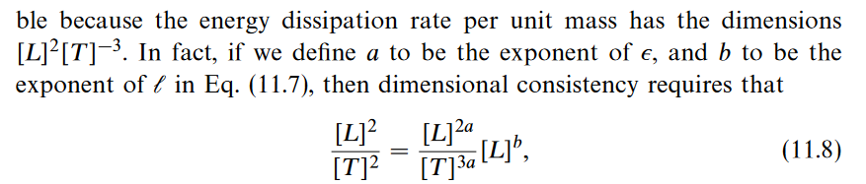
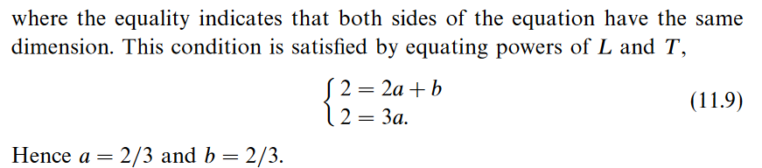
11.1 Turbulencia
Navier-Stokes 4: Kolmogorov’s scaling and dimensional analysis
Navier-Stokes 5:
dimensional
analysis from 11.3
6

Slide 7
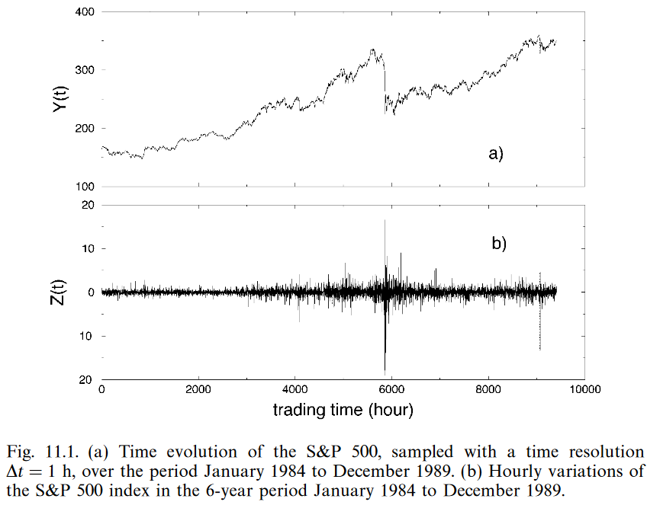
11.2 Parallels between prizes and flows
7

Slide 8
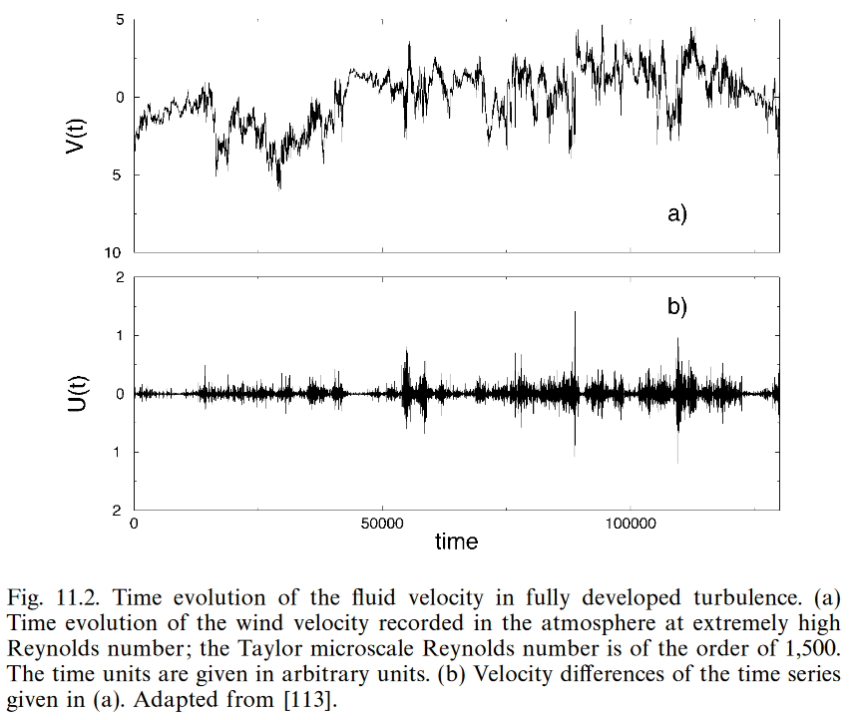
11.2 Parallels between prizes and flows
8

Slide 9
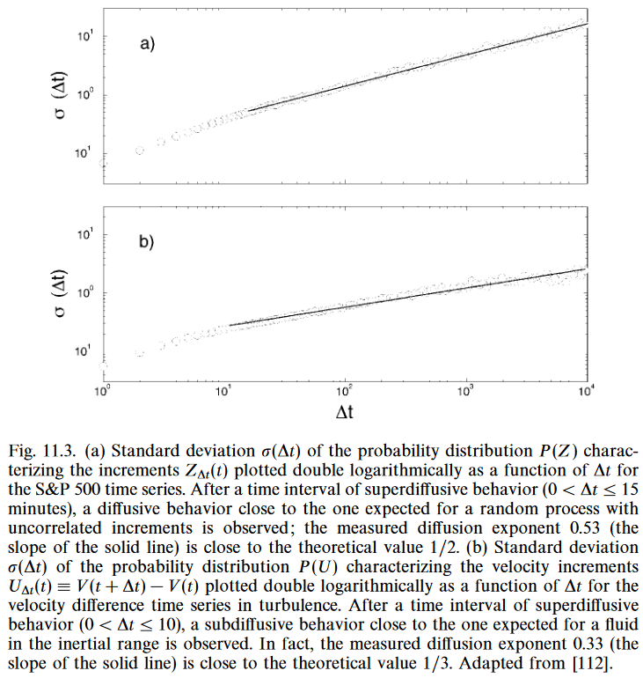
11.2 Parallels between prizes and flows
Similar scaling laws, different exponents!
9

Slide 10
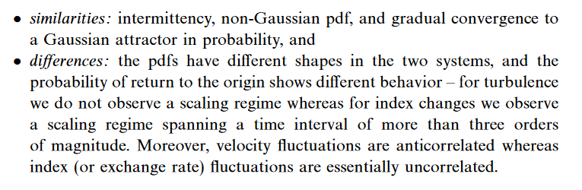
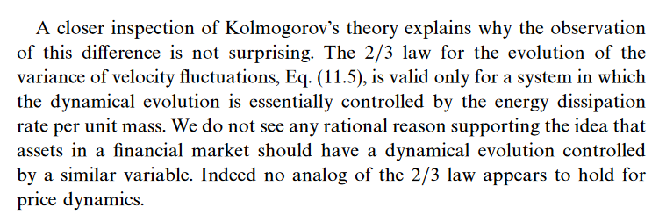
11.4. Discussion
10

