Slide 1
1
General Information
& Study News
Frank Zimmermann
FCC-ee Accelerator & Optics Design Meeting #199 & 70th FCCIS WP2.2 meeting, 12 December 2024

Slide 2
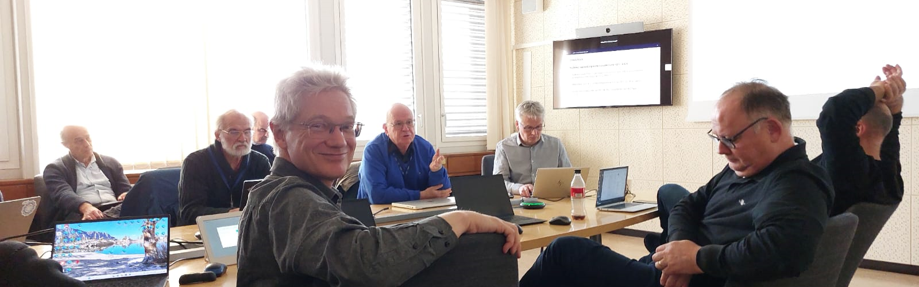
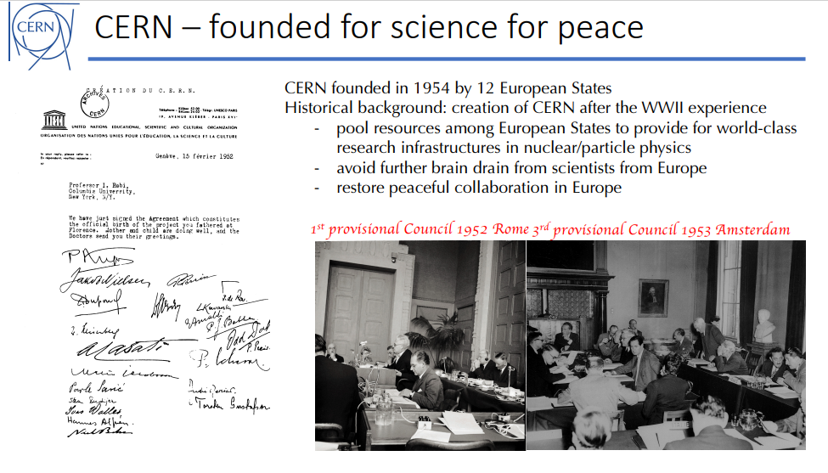
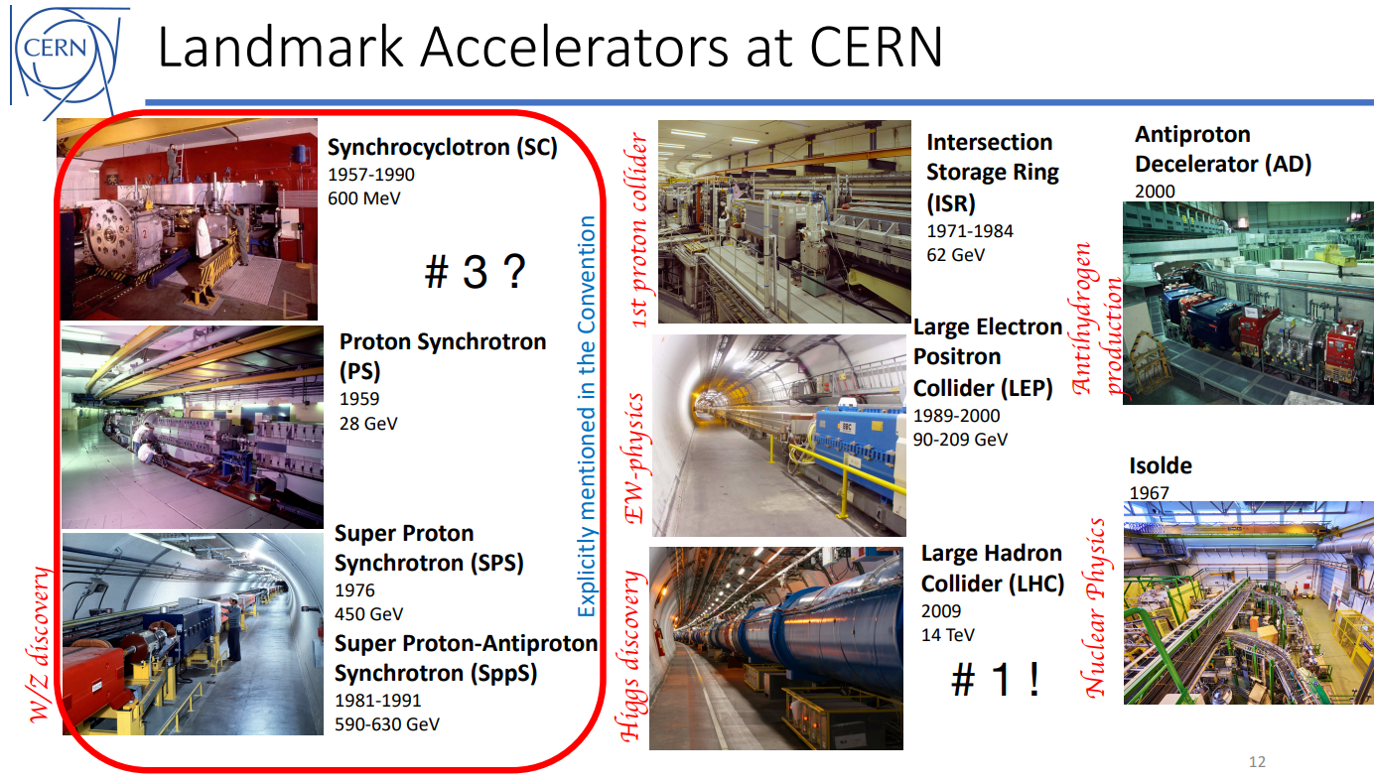
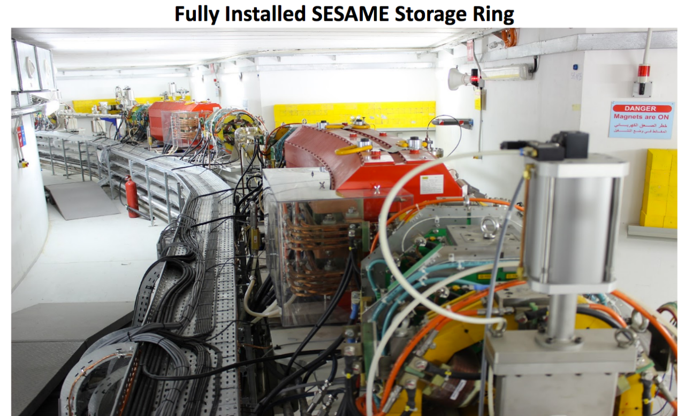
CGM last week – visit of honor by Council president
E. Rabinovici

Slide 3
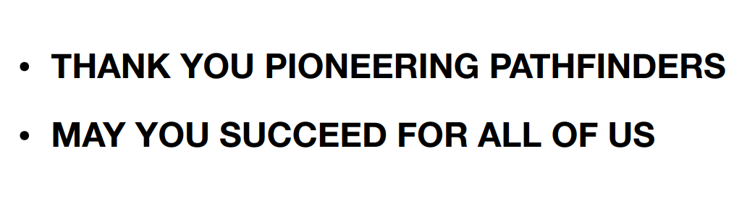
CGM last week – wishes from the Council president
E. Rabinovici

Slide 4
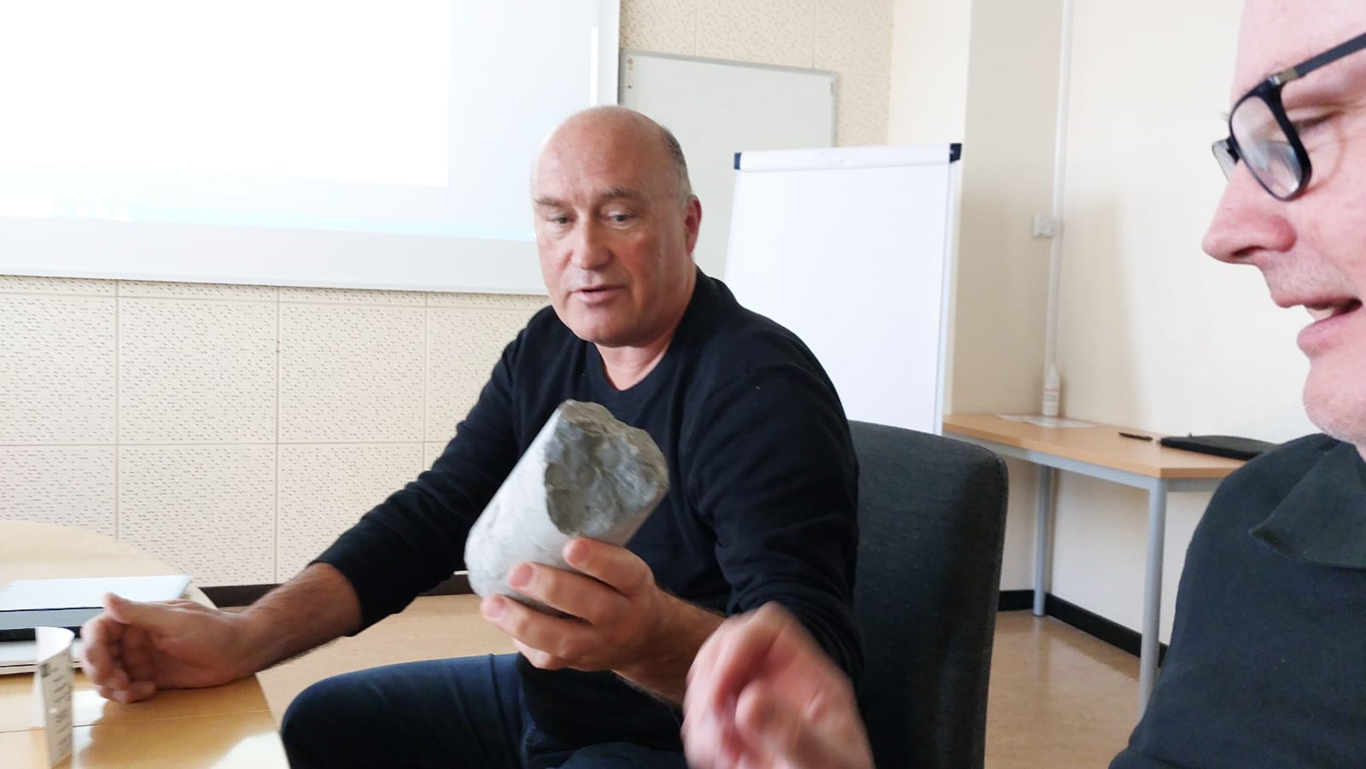
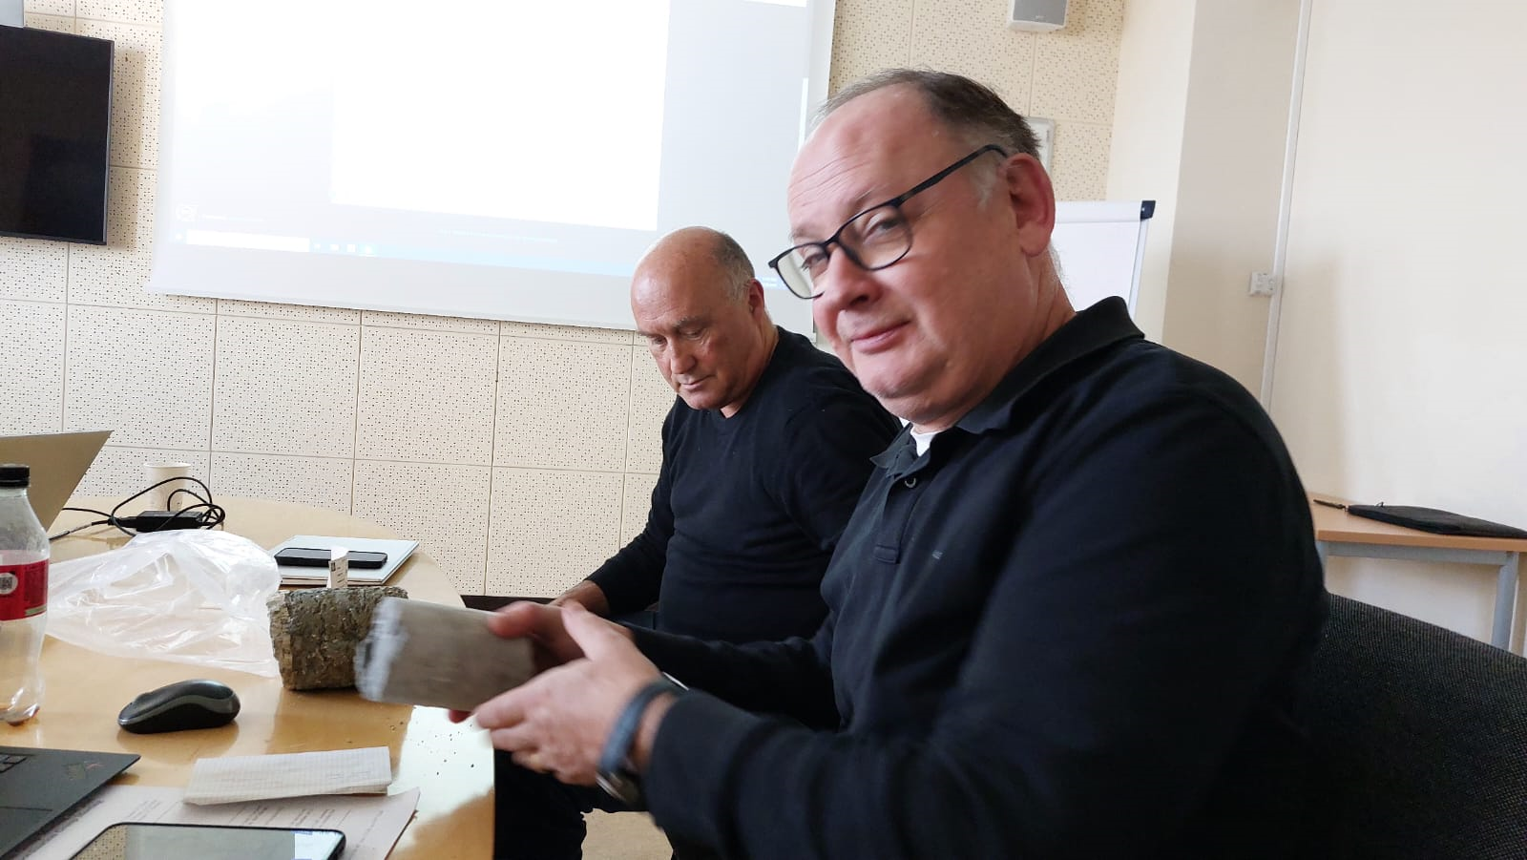
CGM last week – first drill cores presented
limestone
molasse
T. Watson

Slide 5
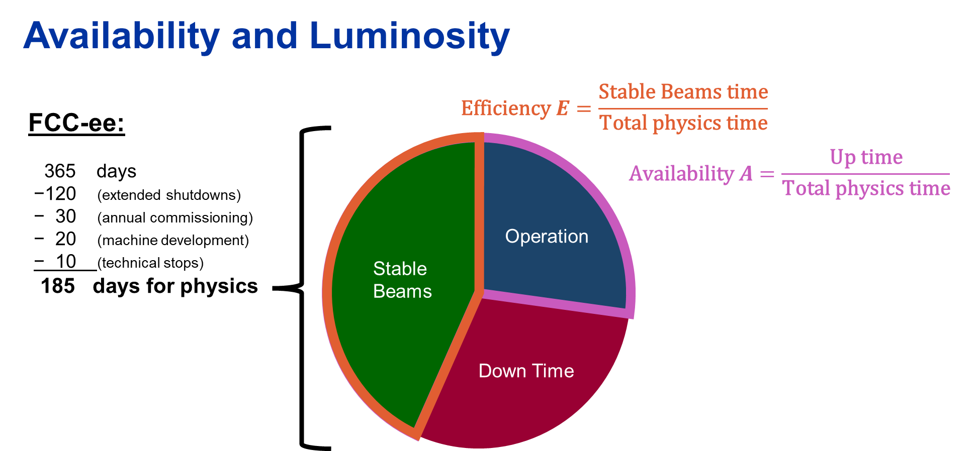
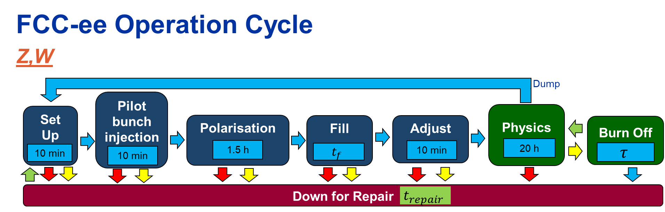
FCC-ee availability study (1)
H. Dostmann,
J. Heron

Slide 6
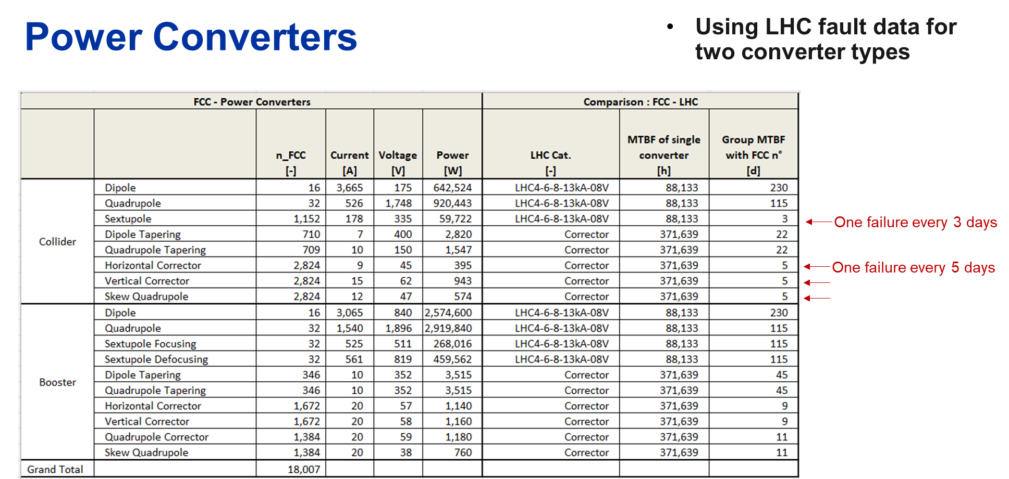
FCC-ee availability study (2)
Do we (need to) abort the beam when we lose a corrector circuit or a sextupole circuit ?
H. Dostmann,
J. Heron

Slide 7
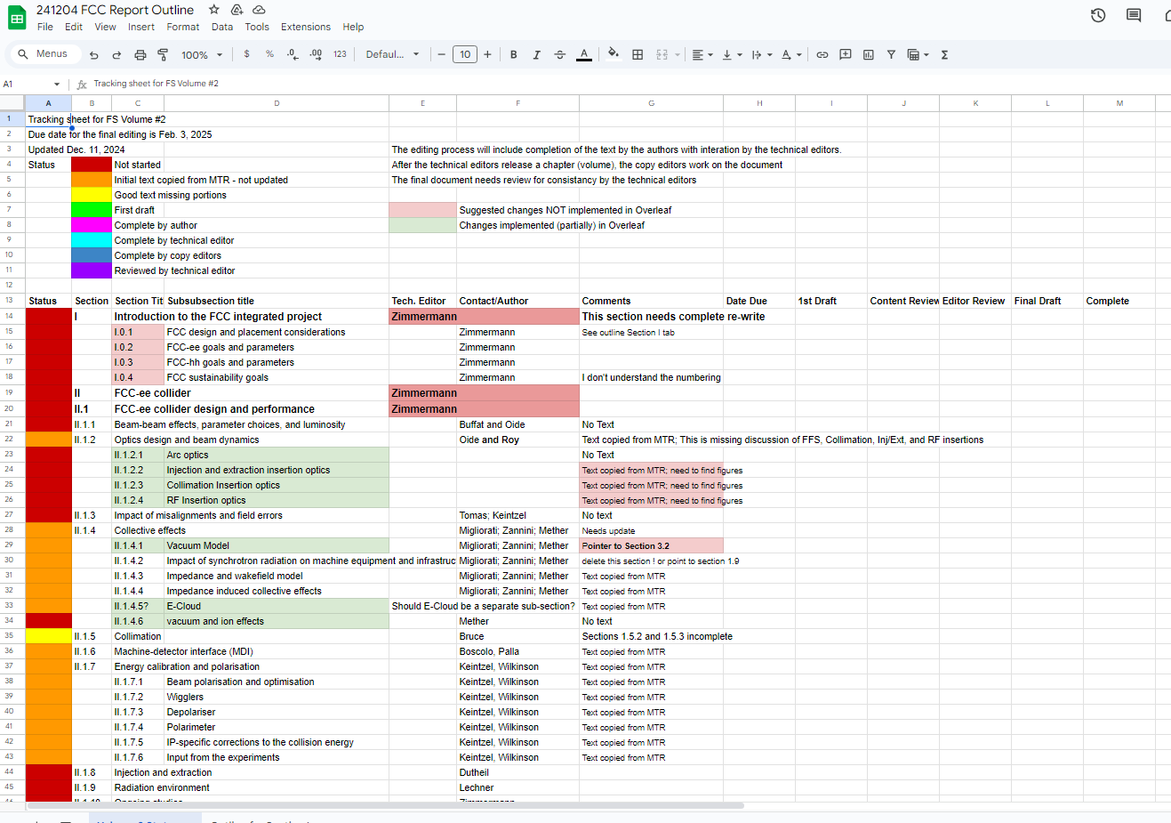
Tor’s spread
sheet
https://docs.google.com/spreadsheets/d/1AgeenFi7ckTphNdCv-gfKKTHD5UaK3fOOuf8IVtMN5s/edit?gid=0#gid=0

Slide 8
Tor’s proposed process
A) The editing process will include completion of the text by the authors with interaction by the technical editors;
B) After the technical editors release a chapter (volume), the copy editors work on the document;
C) The final document needs review for consistency by the technical editors.

Slide 9
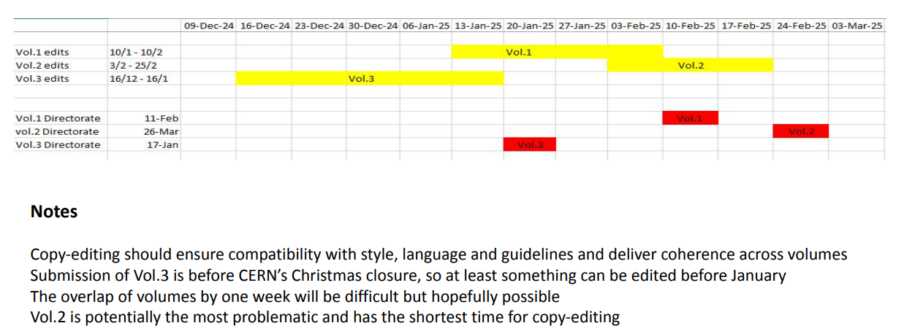
Master timeline – not negotiable

