Slide 1
(Another) Update on Transient Beam Loading from Reverse Phase Operation
Ivan Karpov and Franck Peauger for FCC SRF WP1 with input from:
Hannes Bartosik, Xavier Buffat, Yann Dutheil, Giorgia Favia, Jiquan Guo (JLAB),
Mauro Migliorati (INFN), Katsunobu Oide, Jorg Wenninger, Frank Zimmermann, Mikhail Zobov (INFN)
199th Accelerator Design Meeting & 70th FCCIS WP2.2 Meeting, 12.12.2024

Slide 2
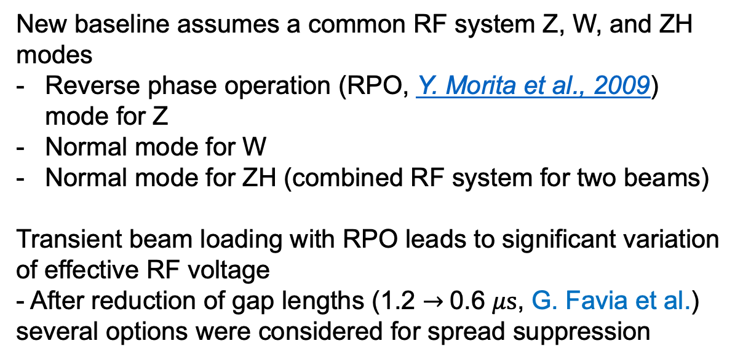
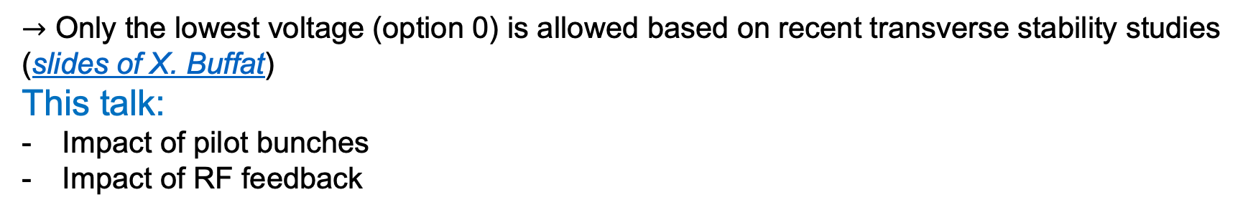
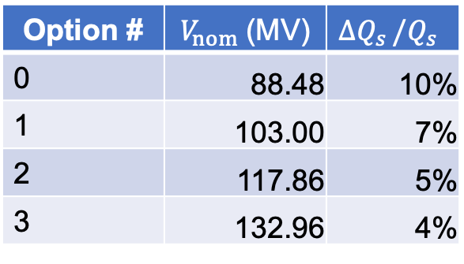
Quick recap
New baseline assumes a common RF system Z, W, and ZH modes
Reverse phase operation (RPO, Y. Morita et al., 2009) mode for Z
Normal mode for W
Normal mode for ZH (combined RF system for two beams)
Transient beam loading with RPO leads to significant variation of effective RF voltage
- After reduction of gap lengths (1.2 $→$0.6 $μs$, G. Favia et al.) several options were considered for spread suppression
Option # | $V_{nom}$(MV) | $${ΔQ}_{s }/Q_{s}$$
0 | 88.48 | 10%
1 | 103.00 | 7%
2 | 117.86 | 5%
3 | 132.96 | 4%
$→$ Only the lowest voltage (option 0) is allowed based on recent transverse stability studies (slides of X. Buffat)
This talk:
Impact of pilot bunches
Impact of RF feedback

Slide 3
Content
Impact on transient beam loading due to:
Pilot bunches
RF feedback

Slide 4
Content
Impact on transient beam loading due to:
Pilot bunches
RF feedback

Slide 5

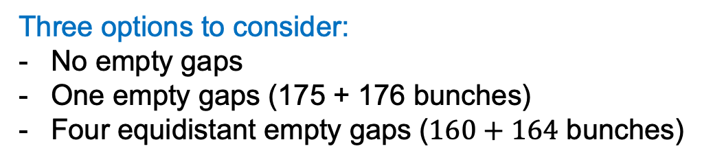
Filling scheme with pilot bunches
Low-intensity non-colliding bunches are need for energy calibration (100-160 bunches per beam)
New alternating filling scheme allows for $20∙5+20∙4=180$ bunches of either type
Three options to consider:
No empty gaps
One empty gaps (175 + 176 bunches)
Four equidistant empty gaps ($160+164$ bunches)
H. Bartosik, C. Carli et al., 8th FCC SAC, 2024

Slide 6
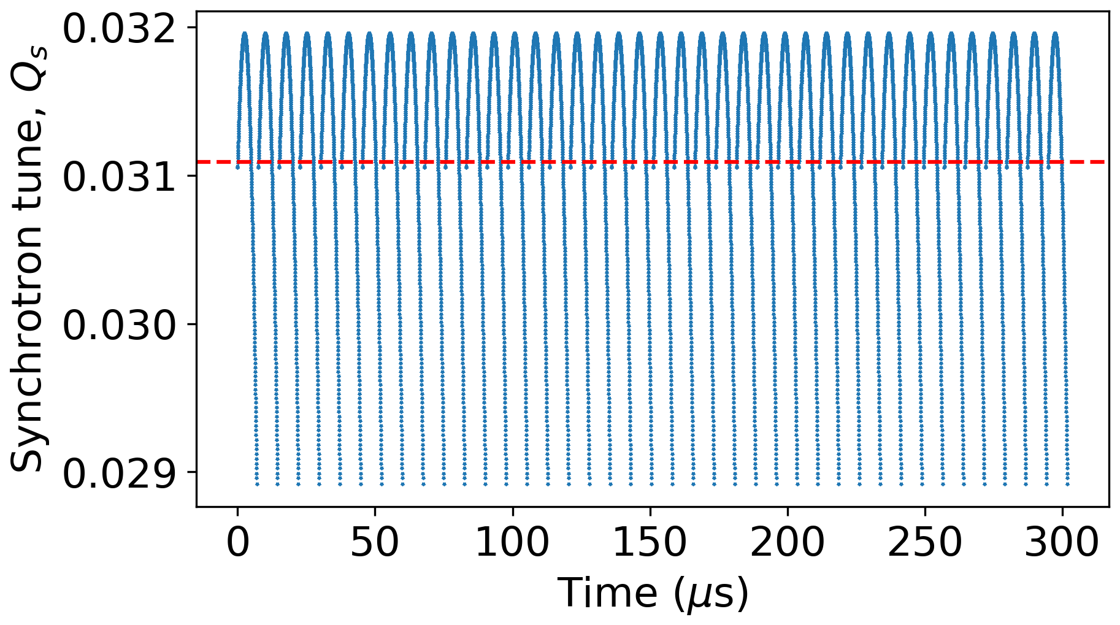
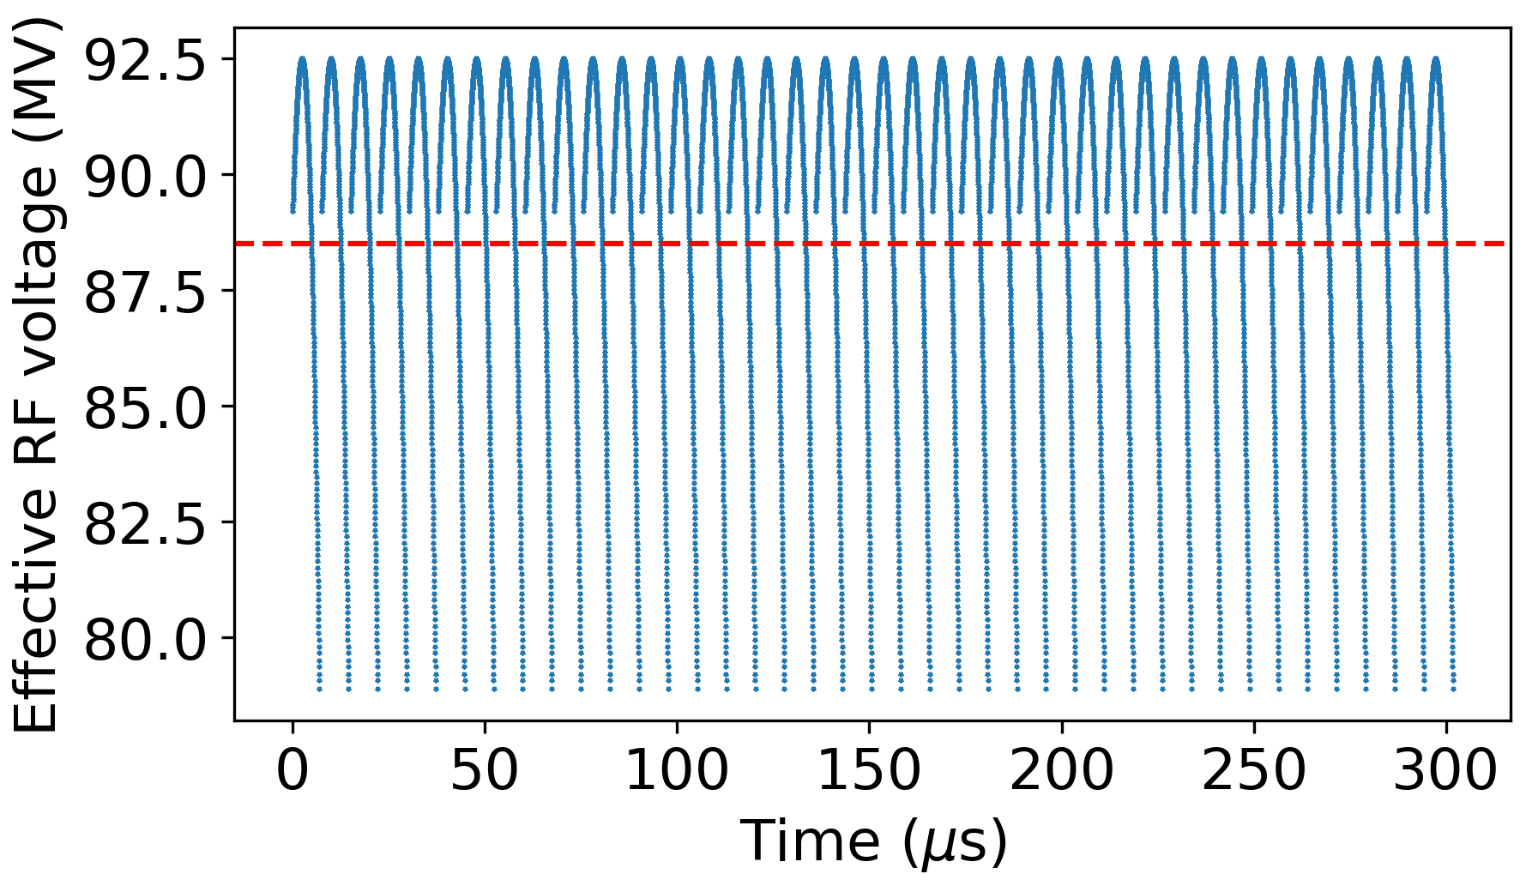
No pilots vs pilots in all gaps

Slide 7
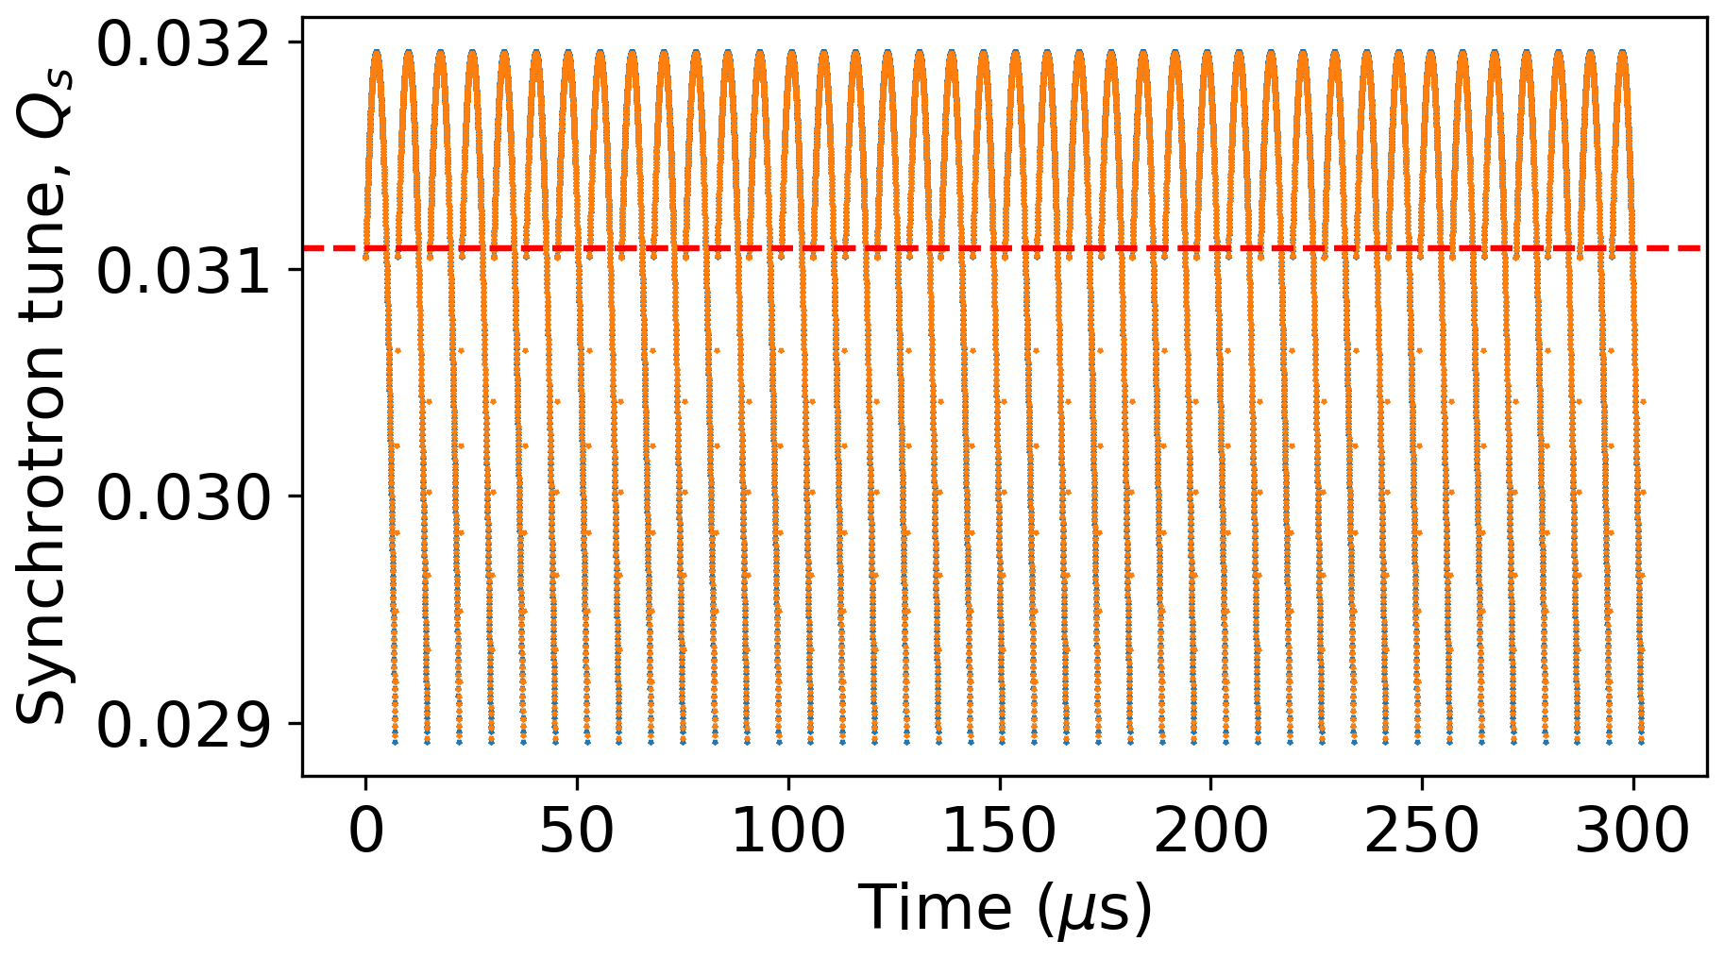
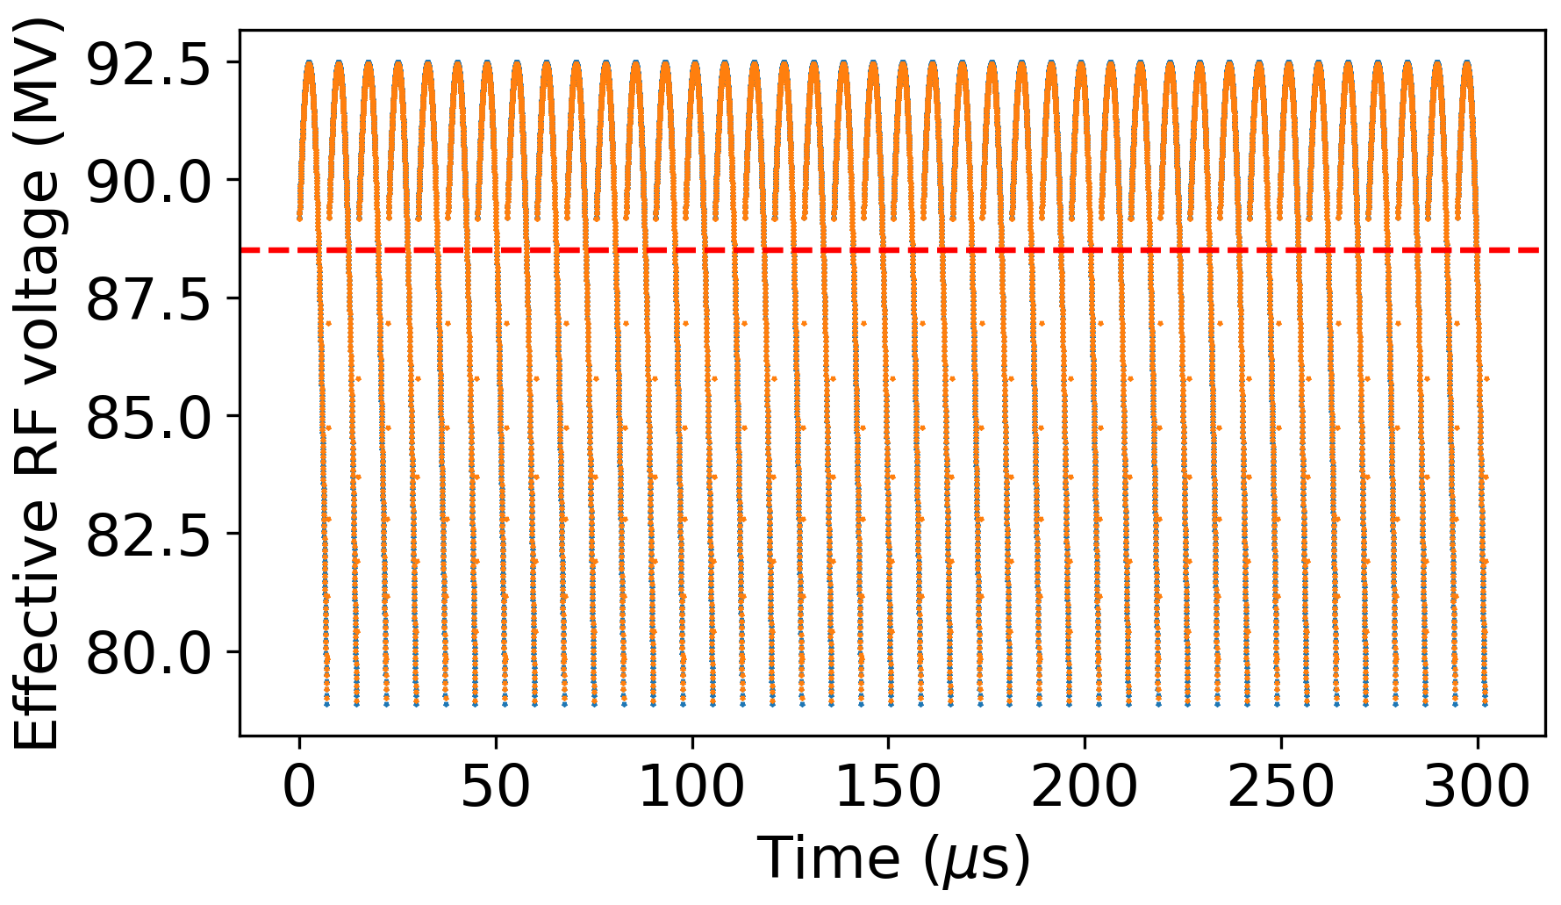
No pilots vs pilots in all gaps

Slide 8
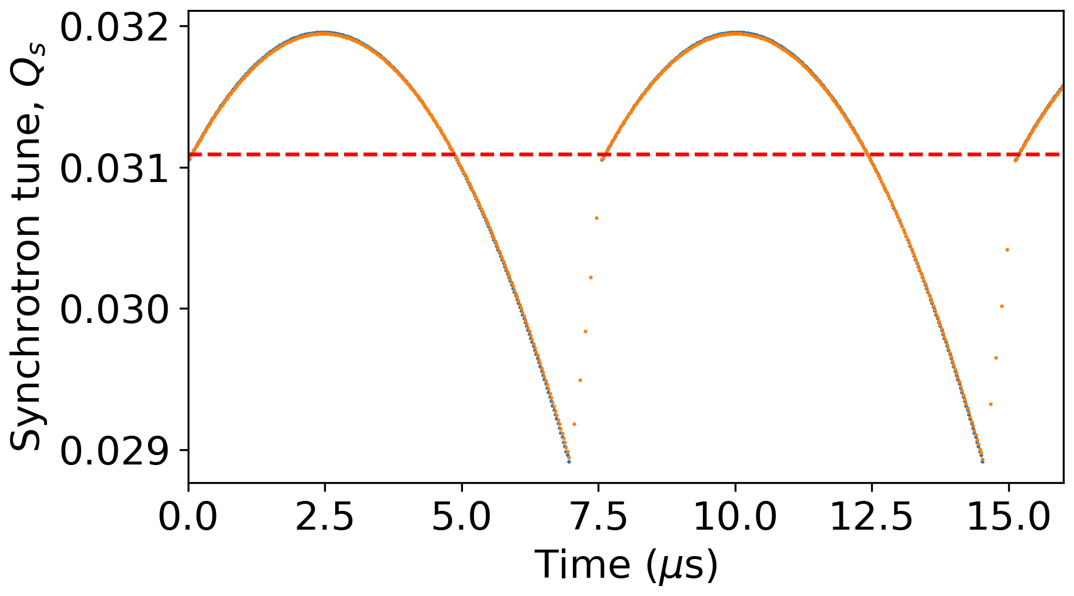
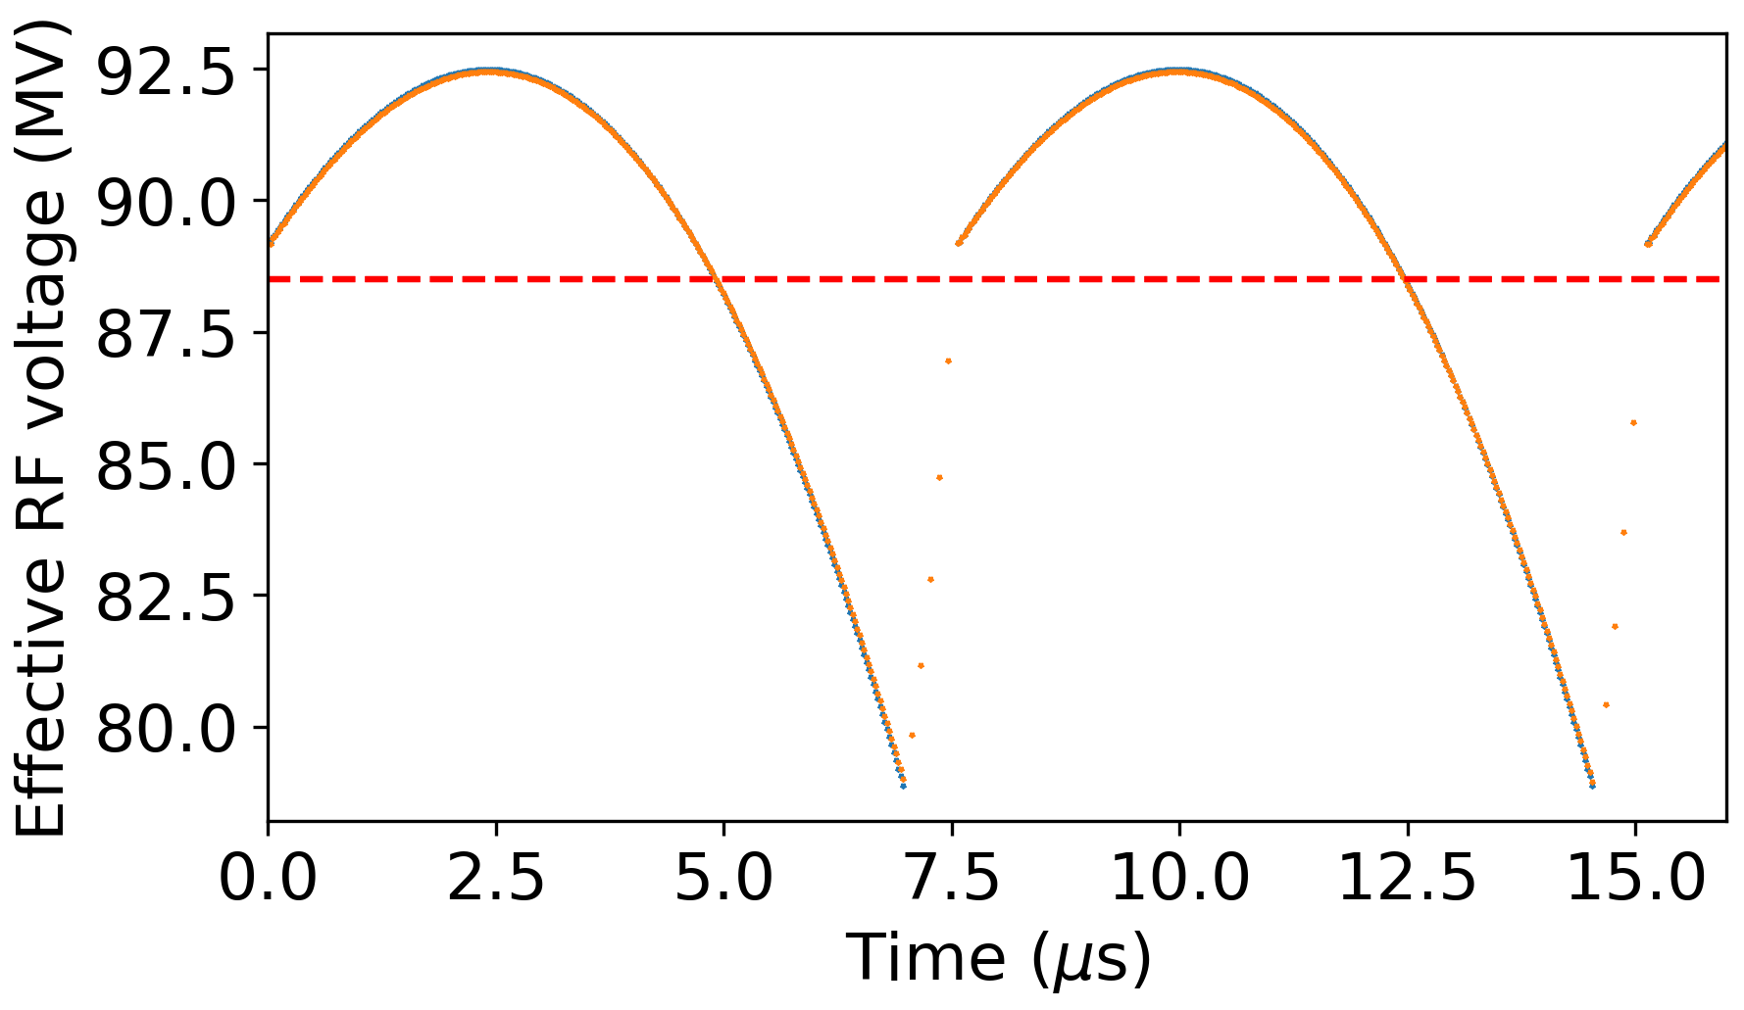
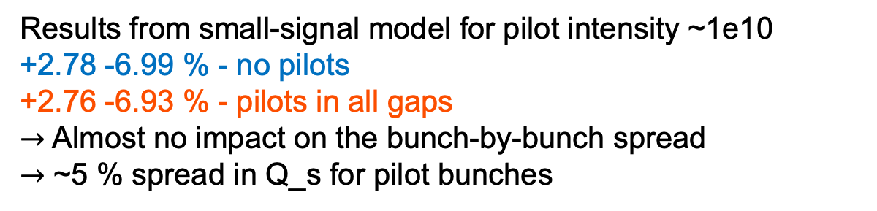
No pilots vs pilots in all gaps
Results from small-signal model for pilot intensity ~1e10
+2.78 -6.99 % - no pilots
+2.76 -6.93 % - pilots in all gaps
$→$ Almost no impact on the bunch-by-bunch spread
$→$ ~5 % spread in Q_s for pilot bunches

Slide 9
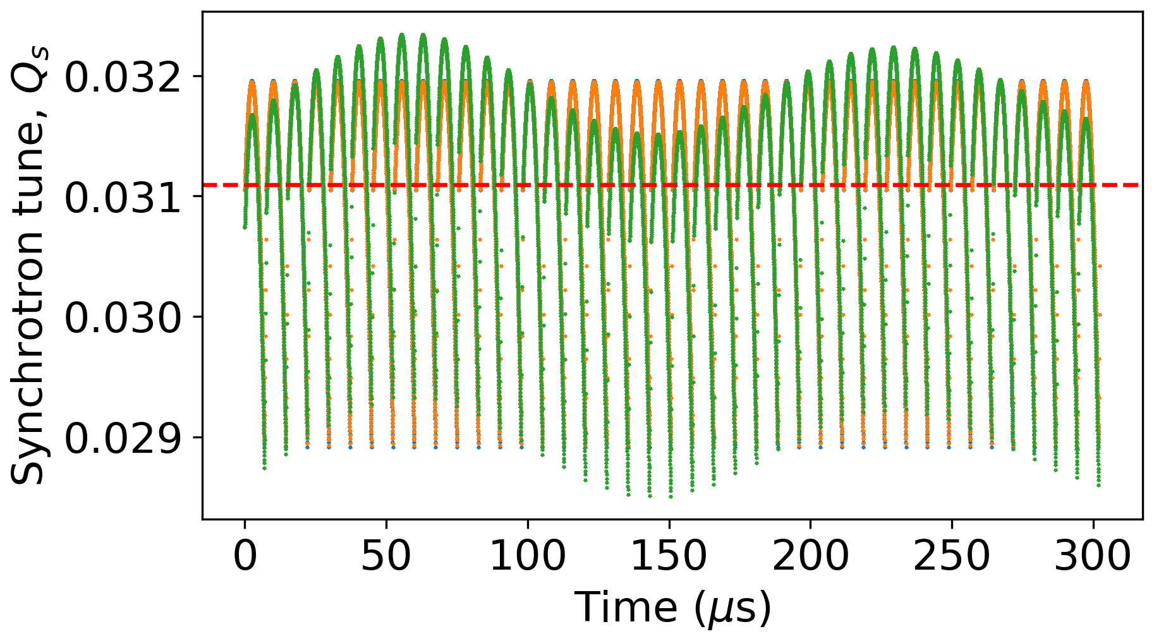
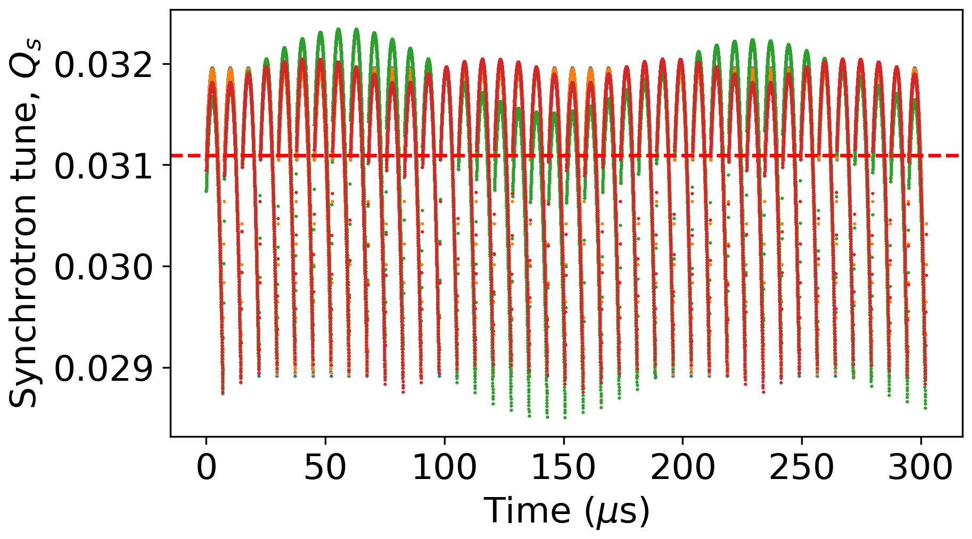
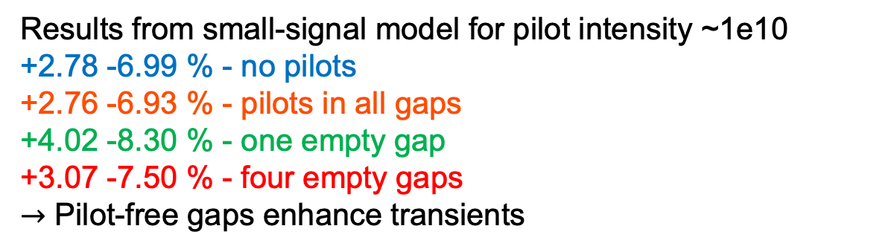
Gaps with missing pilots
Results from small-signal model for pilot intensity ~1e10
+2.78 -6.99 % - no pilots
+2.76 -6.93 % - pilots in all gaps
+4.02 -8.30 % - one empty gap
+3.07 -7.50 % - four empty gaps
$→$ Pilot-free gaps enhance transients

Slide 10
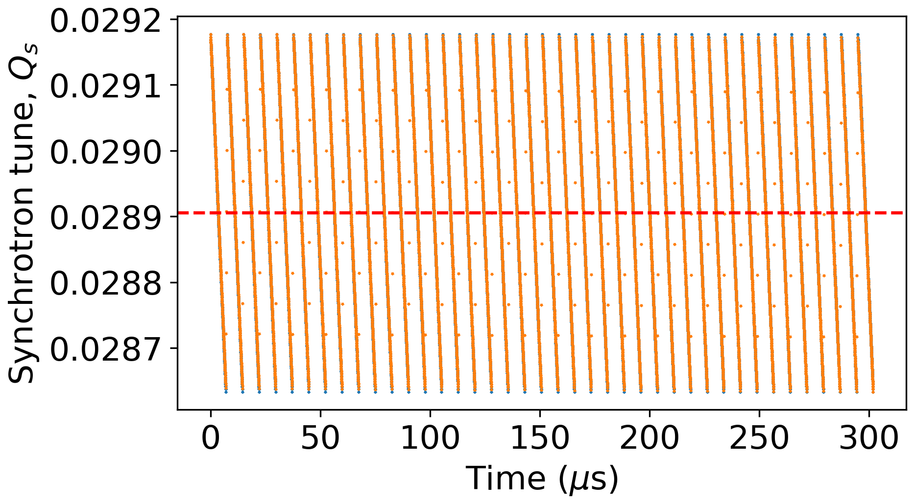
Case of single-cell cavities and one empty gap

Slide 11
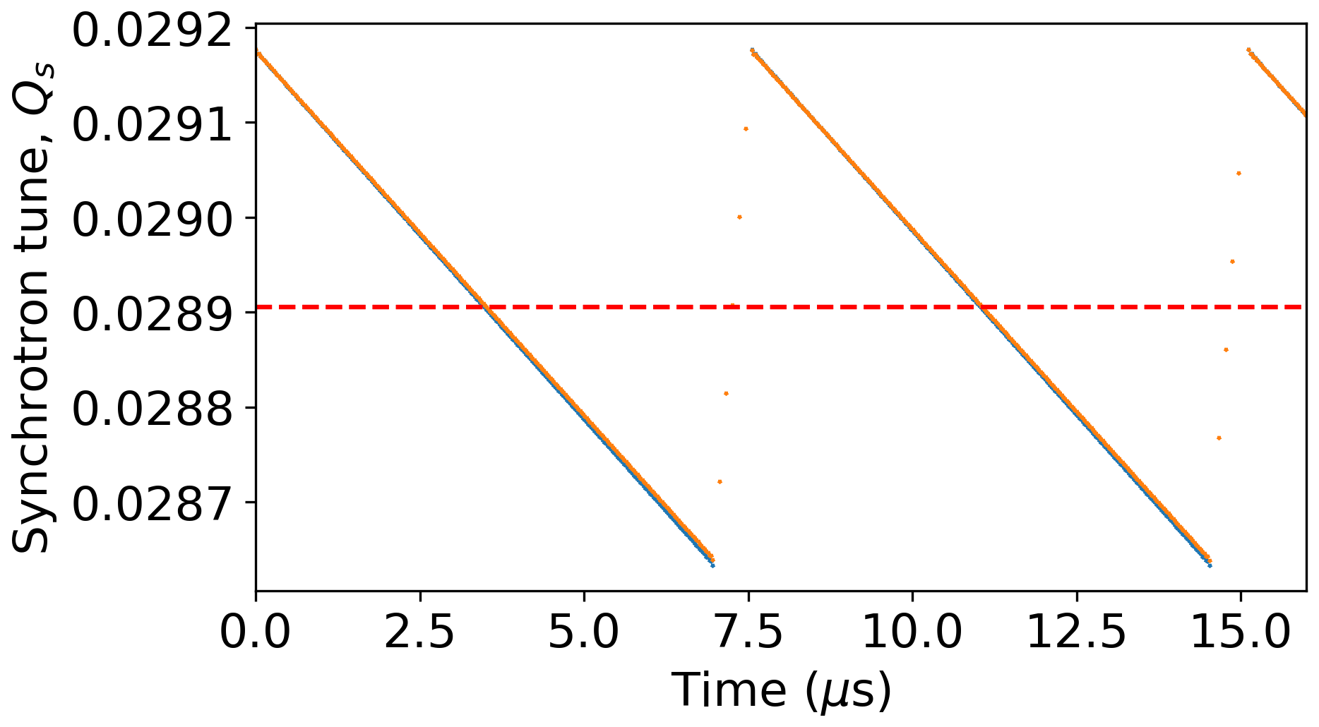
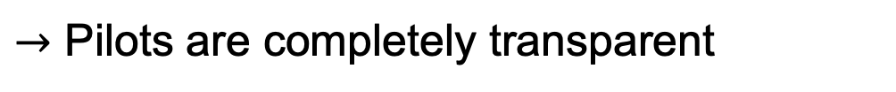
Case of single-cell cavities and one empty gap
$→$ Pilots are completely transparent

Slide 12
Content
Impact on transient beam loading due to:
Pilot bunches
RF feedback

Slide 13








RF system block diagram
FCC feedback system assumed to be similar to one in the LHC (P. Baudrenghien et al, 2006)
$I_{b,rf}$, rf component of the beam current
Circulator
$I_{g}$, generator current
BW of 2 MHz
Generator
rf cavity
$I_{r}$, Reflected current
delay
Load
$V$, cavity voltage
+
–
Low-pass direct rf feedback
$V_{ref}$, reference voltage
$$Σ$$
$$Σ$$
+
+
$ε=V_{ref}−V$, error signal
High-pass direct rf feedback

Slide 14
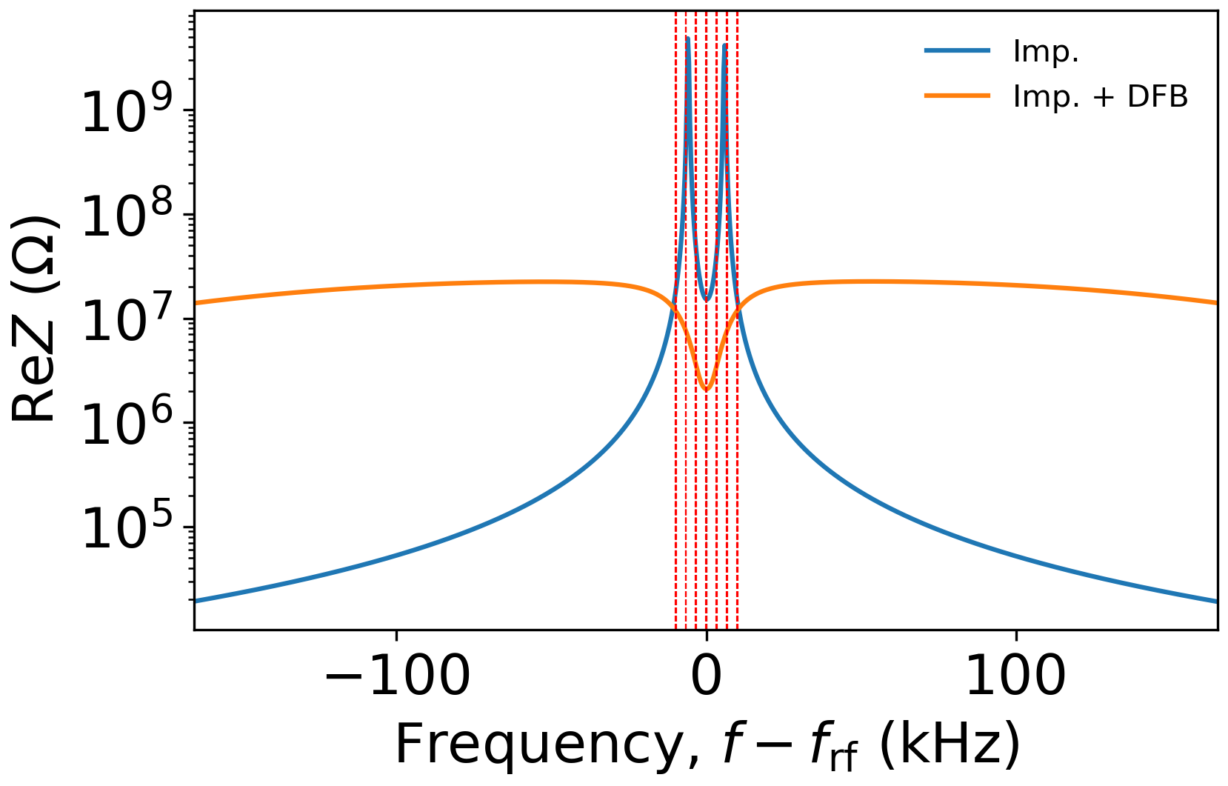
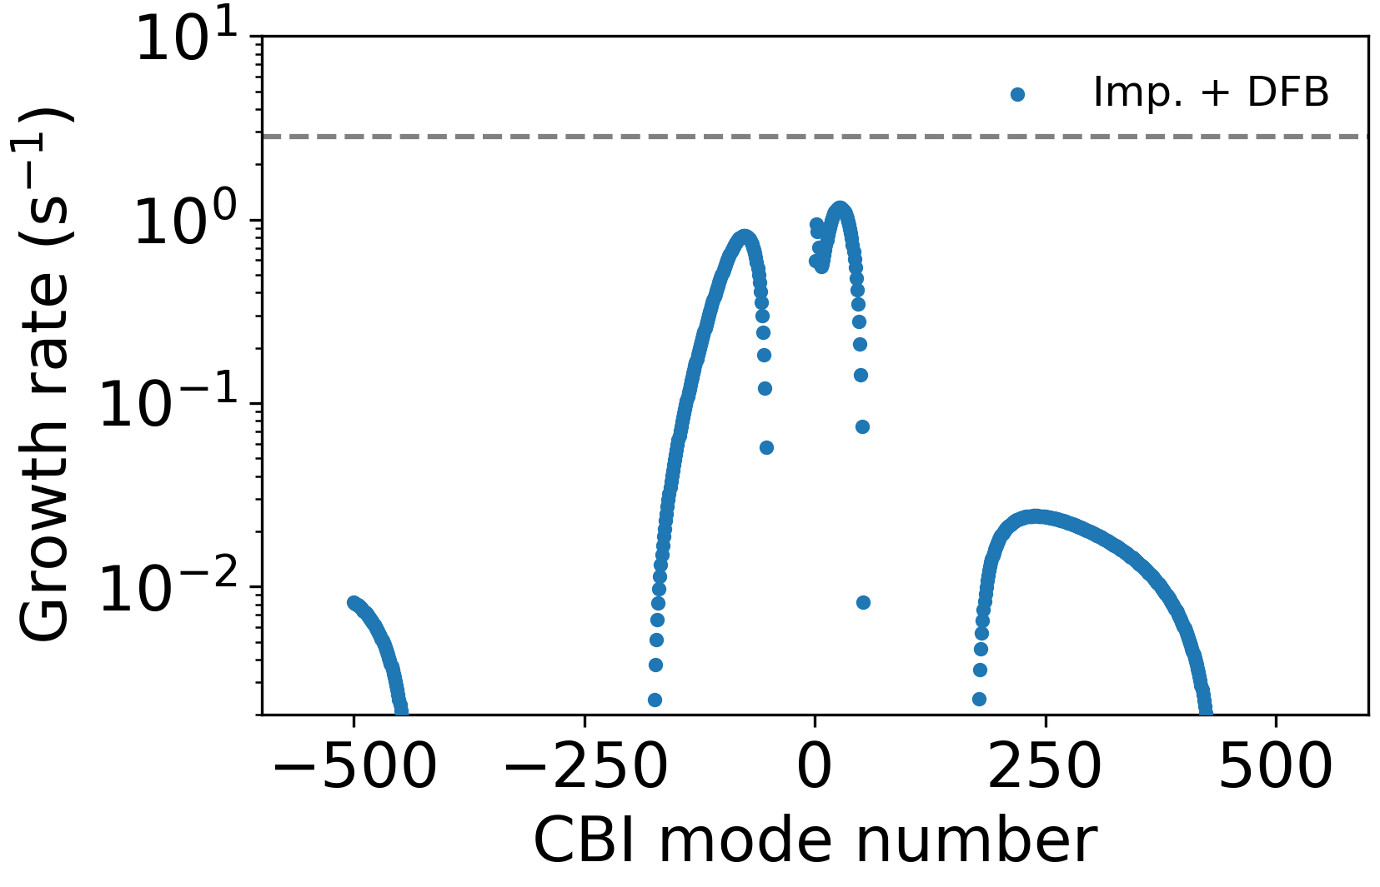
Setting adjustments for beam stability
132 2-cell cavities with RPO loop delay of $700$ ns, DFB gain 10
SR limit
$→$ Margin of 2.5 with RF voltage of 88 MV

Slide 15
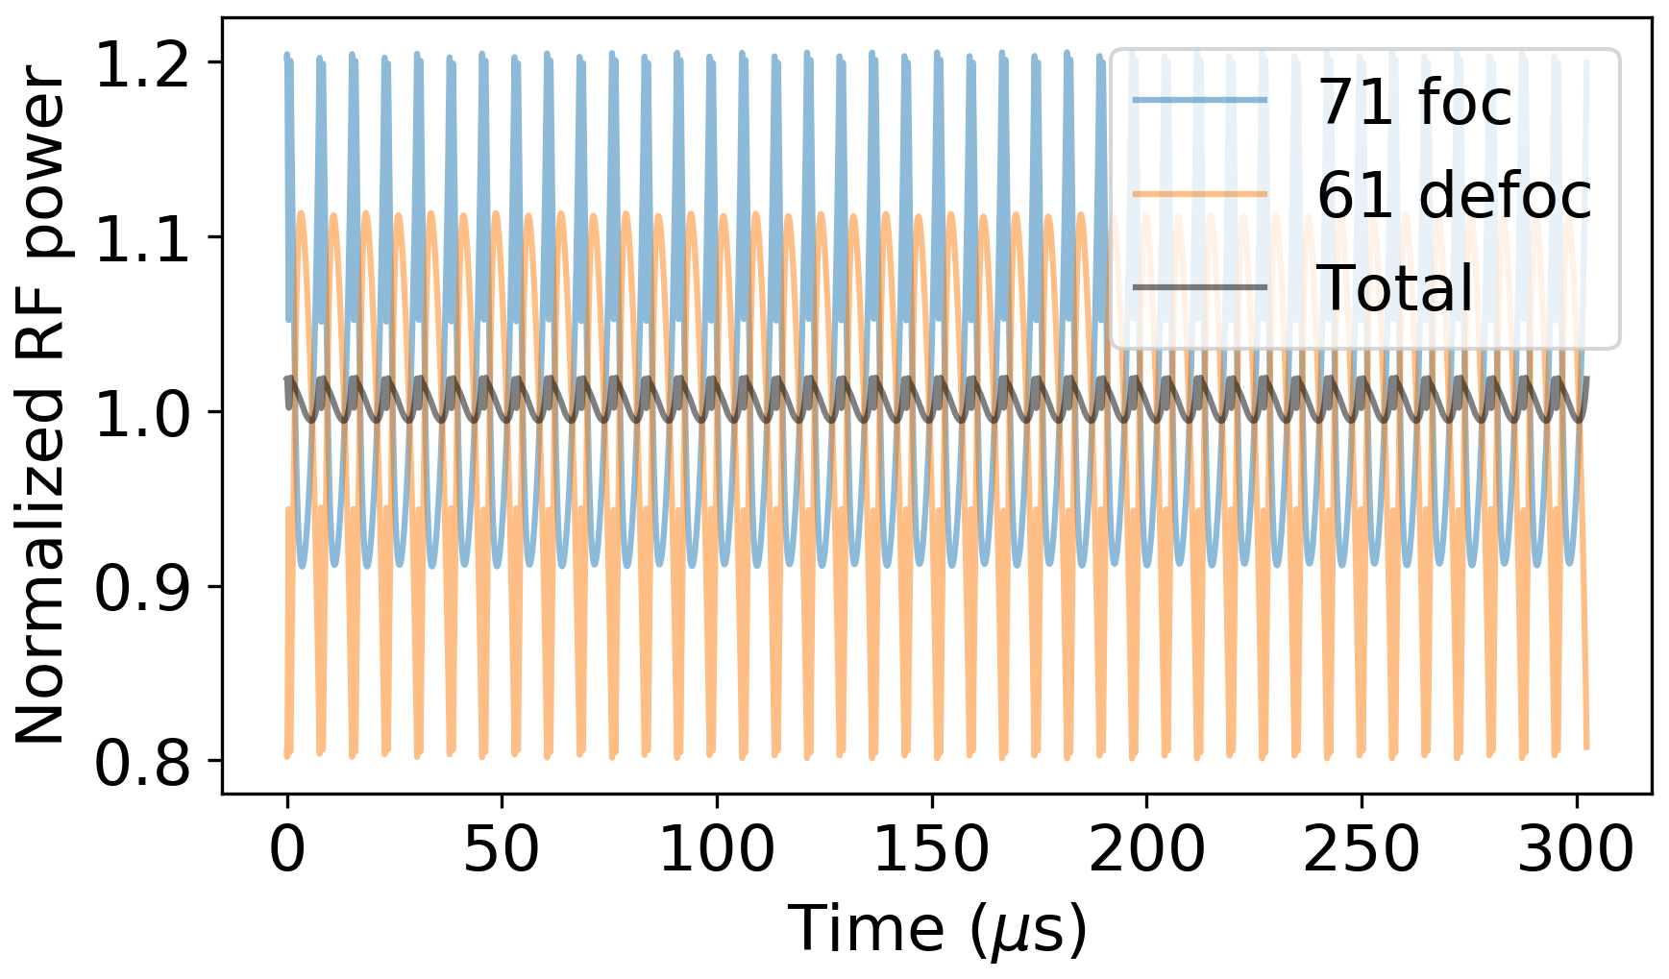
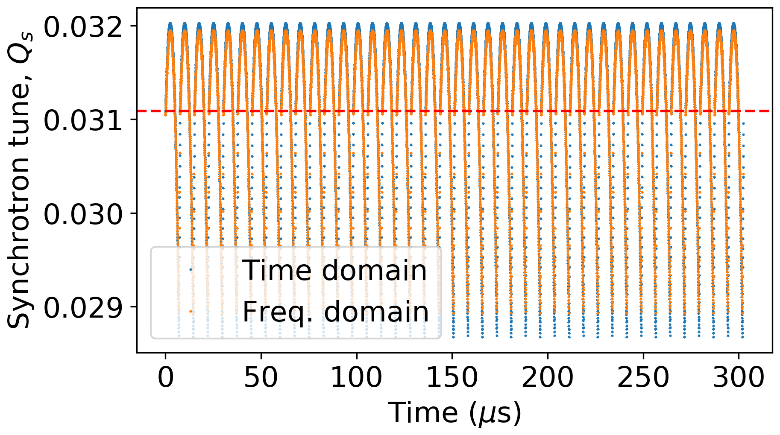
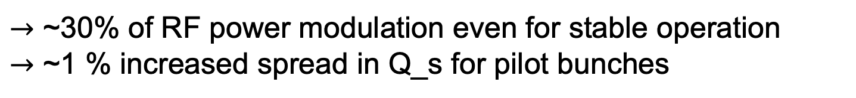
Impact of feedback
$→$ ~30% of RF power modulation even for stable operation
$→$ ~1 % increased spread in Q_s for pilot bunches

Slide 16
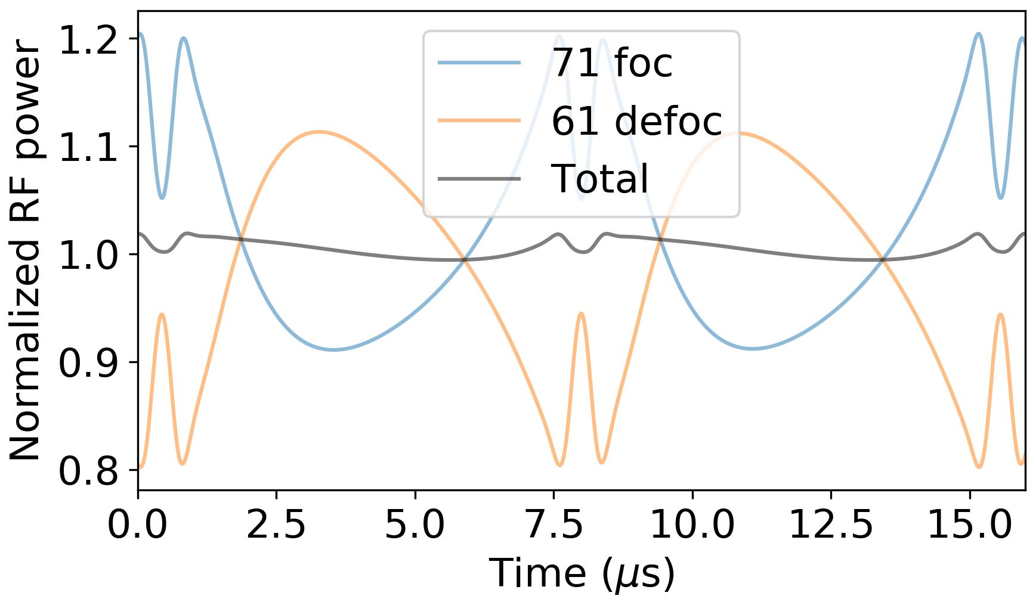
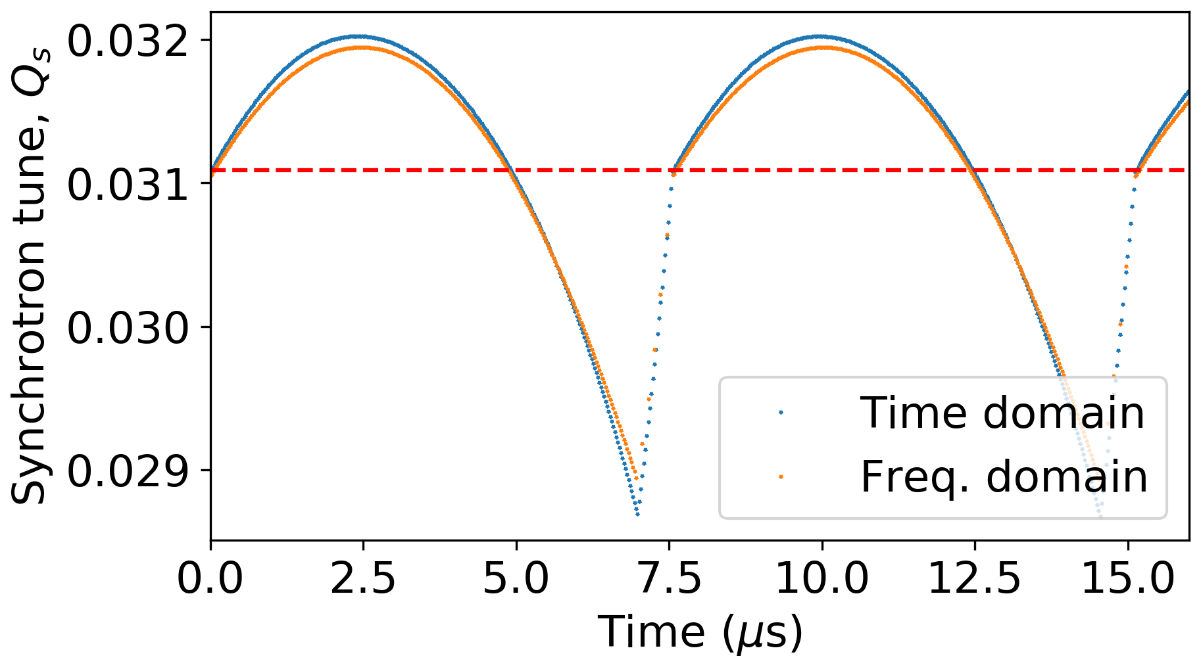
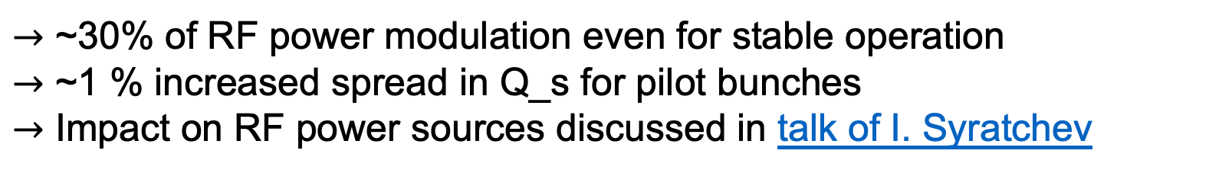
Impact of feedback
$→$ ~30% of RF power modulation even for stable operation
$→$ ~1 % increased spread in Q_s for pilot bunches
$→$ Impact on RF power sources discussed in talk of I. Syratchev

Slide 17
Summary
Beam stability constraints required further reduction of total RF voltage for Z mode with Reverse Phase Operation (RPO) mode
Presence of pilot bunches modifies the synchrotron frequency spread if some gaps remain empty
RF feedback with finite gain leads to a small increase of the spread and about 30% RF power transients
Thank you for your attention!

Slide 18
Backup slides

Slide 19
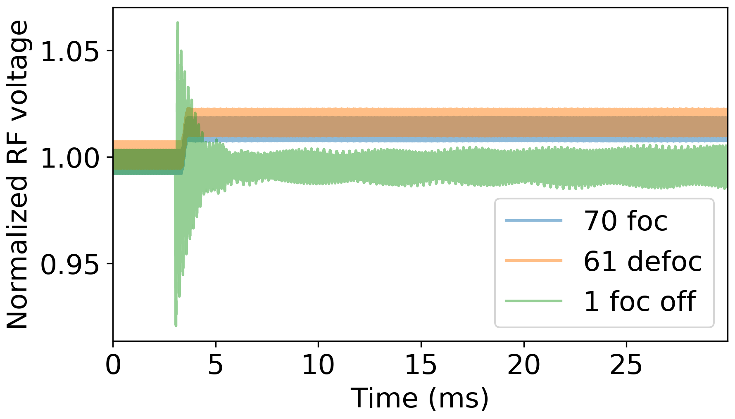
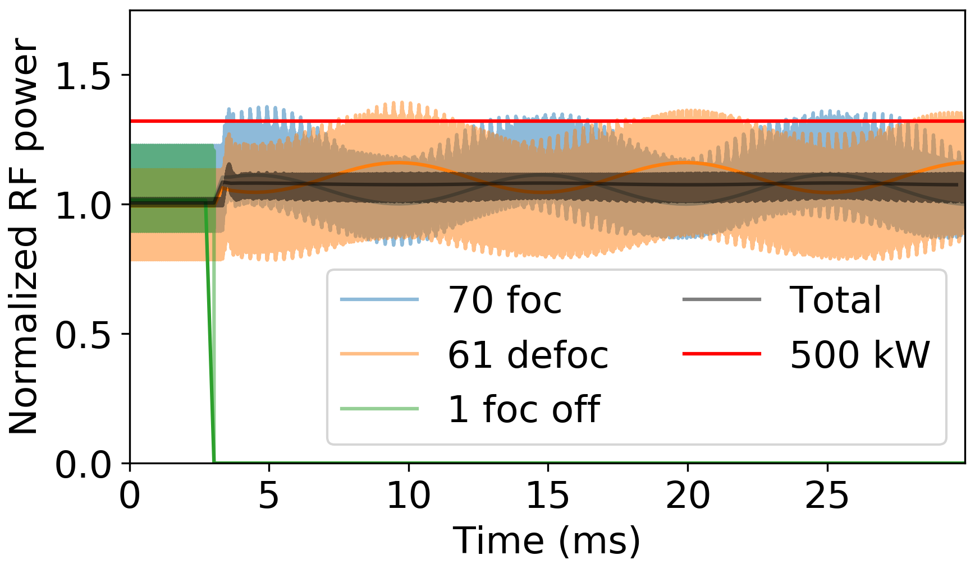
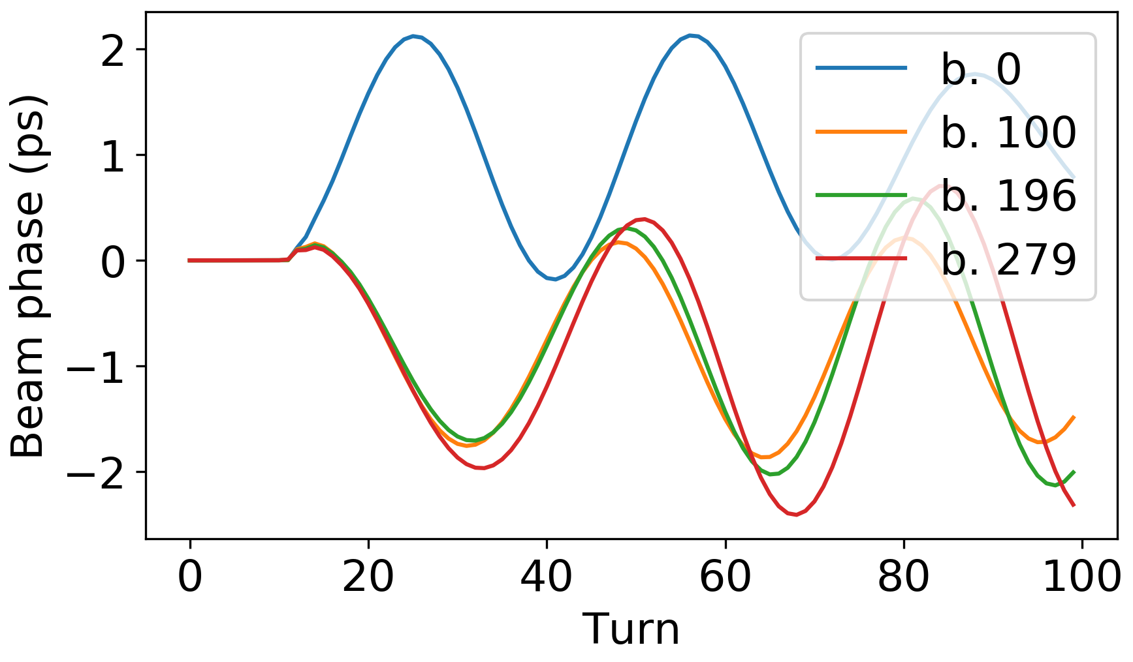

Trip of focusing cavity
Reaction time
Controlled voltage increase
Trip
Short RF voltage transients ~6%
Peak power of other cavities is modulated at synchrotron frequency (avg. <15%, peak <40%)
Initial bunch oscillation amplitude is <4% of rms bunch length
Beam is unstable without longitudinal damper due to uncompensated impedance
$σ_{z}$ ~ 48 ps

Slide 20
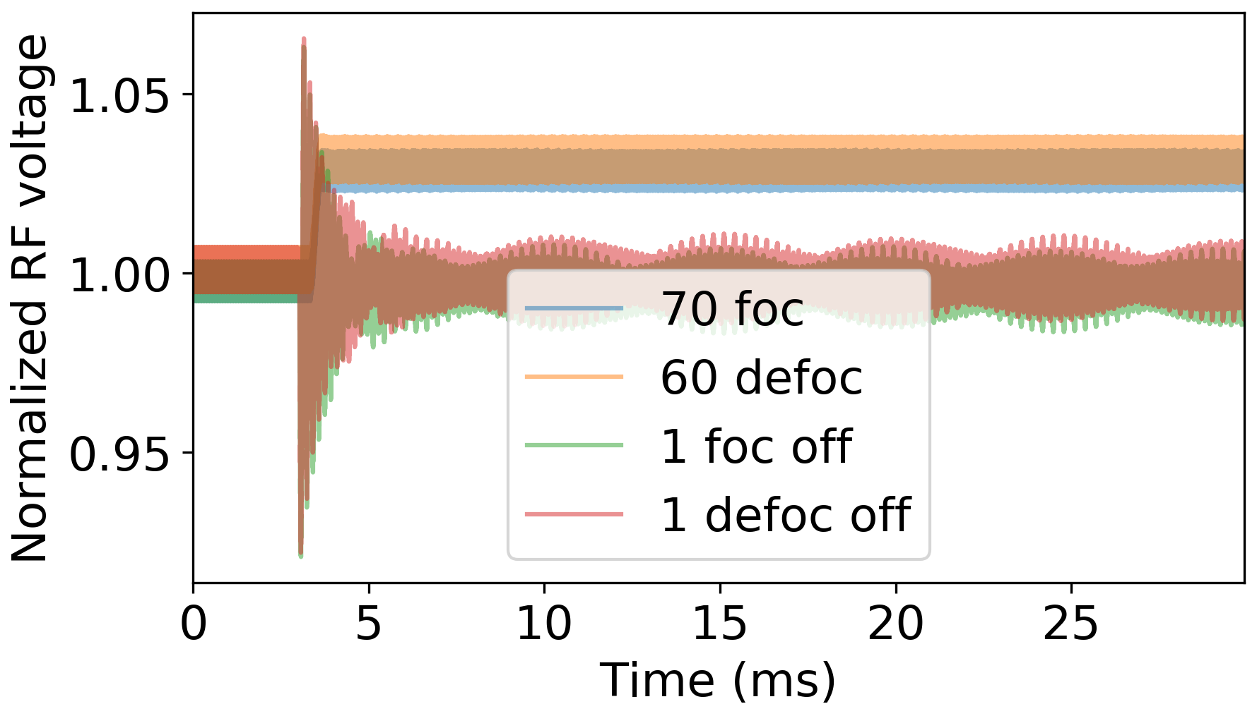
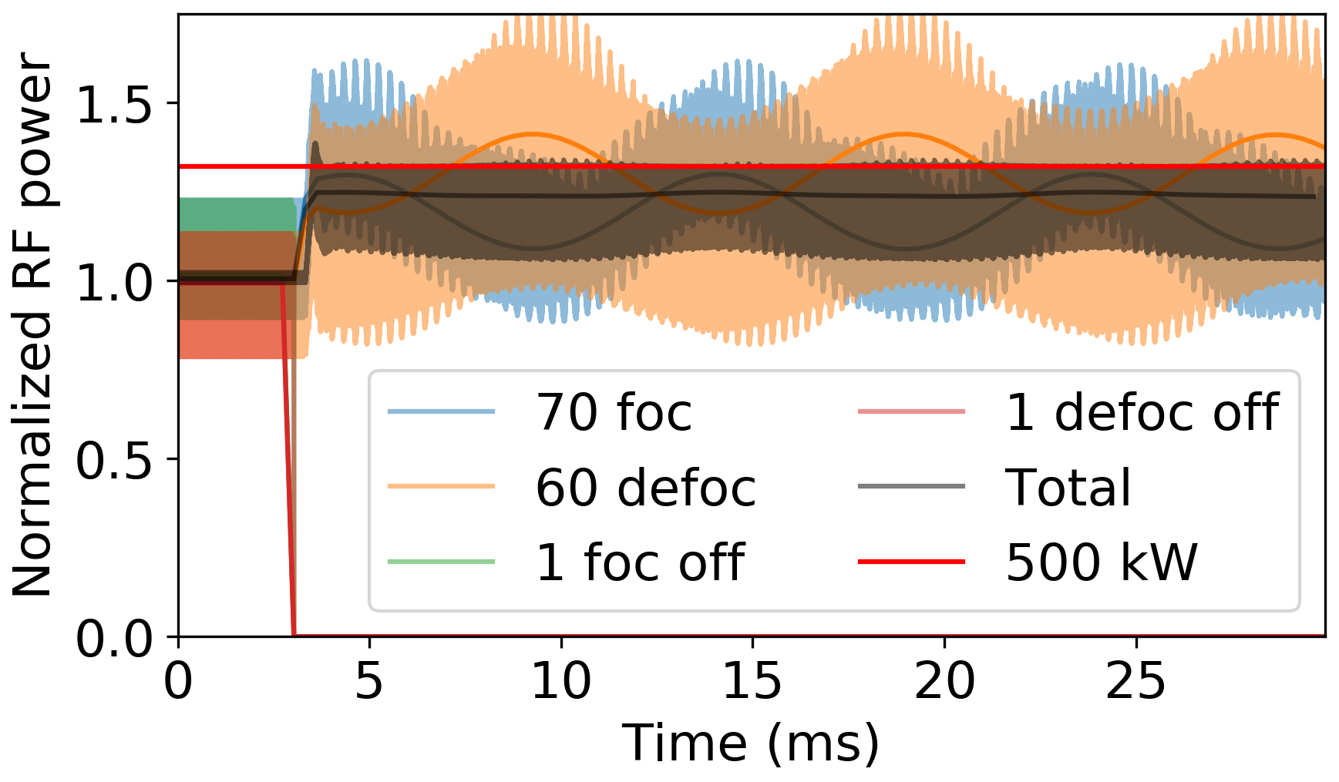
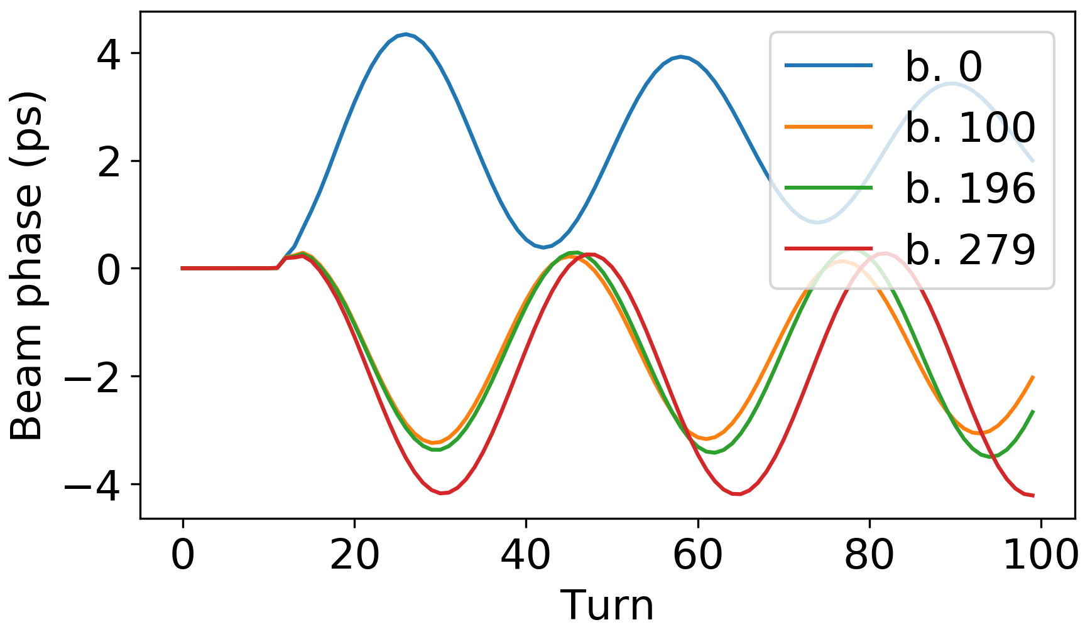

Trip of focusing and defocusing cavities
Reaction time
Controlled voltage increase
Trip
Short RF voltage transients ~6%
Peak power of other cavities is modulated at synchrotron frequency (avg. <45%, peak <80%)
Initial bunch oscillation amplitude is <8% of rms bunch length
Beam is unstable without longitudinal damper due to uncompensated impedance
$σ_{z}$ ~ 48 ps

