Slide 1
Top-up injection studies
Peter Kicsiny, X. Buffat, K. Le Nguyen Nguyen, T. Pieloni, M. Seidel
FCC-ee Accelerator Design Meeting
12/12/2024

Slide 2
What has been done:
Tracking with linear transfer map + beam-beam
  Single top-up injection of one beam
  Scan of injection offset
  Scan of bunch intensity asymmetry
  Scan of beam parameters at the IP (in backup slide)
What hasn’t been done:
Tracking & top-up with the full lattice
Optimization of booster parameters

Slide 3
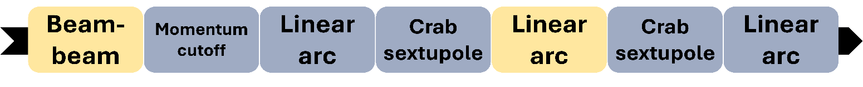
Simplified tracking setup
4 IP baseline design [1]
Iterate over ¼ superperiod of machine
radiation damping
quantum excitation
beamstrahlung
Nonlinear elements

Slide 4
Longitudinal top-up injection
N₀: nominal bunch intensity
N_{m}: # macroparticles
ε: bunch intensity asymmetry factor: e.g. ε=0.05 for 5% asym.: top-up beam from 0.95N₀ to 1.05N₀
w: “weight” of each macroparticle = # real charges represented by it
δ_{io}: injection offset in units of the rms rel. energy spread

Slide 5
Select N_{m,i} macroparticles
Longitudinal top-up injection
N₀: nominal bunch intensity
N_{m}: # macroparticles
ε: bunch intensity asymmetry factor: e.g. ε=0.05 for 5% asym.: top-up beam from 0.95N₀ to 1.05N₀
w: “weight” of each macroparticle = # real charges represented by it
δ_{io}: injection offset in units of the rms rel. energy spread

Slide 6
Select N_{m,i} macroparticles
Offset δ of these macroparticles
Longitudinal top-up injection
N₀: nominal bunch intensity
N_{m}: # macroparticles
ε: bunch intensity asymmetry factor: e.g. ε=0.05 for 5% asym.: top-up beam from 0.95N₀ to 1.05N₀
w: “weight” of each macroparticle = # real charges represented by it
δ_{io}: injection offset in units of the rms rel. energy spread

Slide 7
Select N_{m,i} macroparticles
Offset δ of these macroparticles
Update weight of all macroparticles
Longitudinal top-up injection
N₀: nominal bunch intensity
N_{m}: # macroparticles
ε: bunch intensity asymmetry factor: e.g. ε=0.05 for 5% asym.: top-up beam from 0.95N₀ to 1.05N₀
w: “weight” of each macroparticle = # real charges represented by it
δ_{io}: injection offset in units of the rms rel. energy spread

Slide 8
Strong-strong simulation of top-up injection
Track till equilibrium
Top-up perturbed bunch to 1.05N₀
Track till equilibrium
Fixed bunch: nominal parameters
Perturbed bunch: start with 0.95N₀ (ε=0.05, δ_{io}=7)
W±
Nominal rms bunch sizes from [1]
L₀: lumi per bunch crossing, from a single strong-strong collision simulation with Xsuite
Eq. reached in ~1.5 s (=5e3 turns)
Notes:
Equilibrium reached with a rate proportional to radiation damping time

Slide 9
Strong-strong simulation of top-up injection
Fix bunch intensity asymmetry to ε=0.05
Scan injection offset
Record equilibrium luminosity after top-up
No unexpected effects were observed
W±
Notes:
Trivial limit to injection efficiency is the momentum acceptance
No other limits observed

Slide 10
Quasi-strong-strong simulation of luminosity
(no top-up here)
Scan mean bunch intensity N₀
For each N₀ scan ΔN:
N± = N₀(1± ΔN)
Track beams till equilibrium
Comparison with analytical model [2]
Luminosity normalized to symmetric simulation (ΔN=0)

Slide 11
Summary
Several parameter scans have been done with linear tracking
Flip-flop mechanism results in new equilibrium with reduced luminosity
Reaching new equilibrium is fast (~synchrotron radiation damping rate)
No reduction of injection efficiency/beam loss was observed due to beam-beam
Simulation details can be found in [3]
Tracking with full lattice (proper DA) needs to be performed for more realistic beam dynamics during/after injection
Notes:
aperture is only longitudinal, need full lattice with proper DA

Slide 12
References
[1] K. Oide, FCC-ee collider optics, FCC week (2023)
https://indico.cern.ch/event/1202105/contributions/5408583/attachments/2659051/4608141/FCCWeek_Optics_Oide_230606.pdf
[2] Impact of bunch intensity asymmetry in colliders featuring strong beamstrahlung
K. Le Nguyen Nguyen, X. Buffat, P. Kicsiny, T. Pieloni, 2024
arXiv preprint https://arxiv.org/abs/2404.09012
[3] Impact of beam asymmetries at the Future Circular Collider 𝑒+𝑒−
P. Kicsiny, X. Buffat, K. Le Nguyen Nguyen, T. Pieloni, M. Seidel, 2024
Phys. Rev. Accel. Beams 27, 121001 https://doi.org/10.1103/PhysRevAccelBeams.27.121001

Slide 13
Backup

Slide 14
Simulation parameters
Slide # | 7 | 8 | 9 | 10
Machine setup | FCC 4 IP from 2023 FCC week, W | FCC 4 IP from 2023 FCC week, W | FCC 4 IP from 2023 FCC week | FCC 4 IP from 2023 FCC week
Lattice model | linear | linear | linear | linear
Beam-beam model | QSS f=100 (before top-up) SS f=1 (after top-up) | QSS f=100 (before top-up) SS f=1 (after top-up) | QSS f=100 | QSS f=100
# slices in beam-beam | 100 | 100 | 100 (200 for Z) | 100 (200 for Z)
# macroparticles | 1e5 | 1e5 | 1e5 (1e6 for Z) | 1e5 (1e6 for Z)
# turns | 1e4 each stage (4e4 superperiod iterations) | 1e4 each stage (4e4 superperiod iterations) | Z: 8e4, W: 4e4, H: 2e4, T: 2e4 superperiod iterations | Z: 8e4, W: 4e4, H: 2e4, T: 2e4 superperiod iterations
f: update frequency of stat. moments in beam-beam in every X superperiod iterations

Slide 15
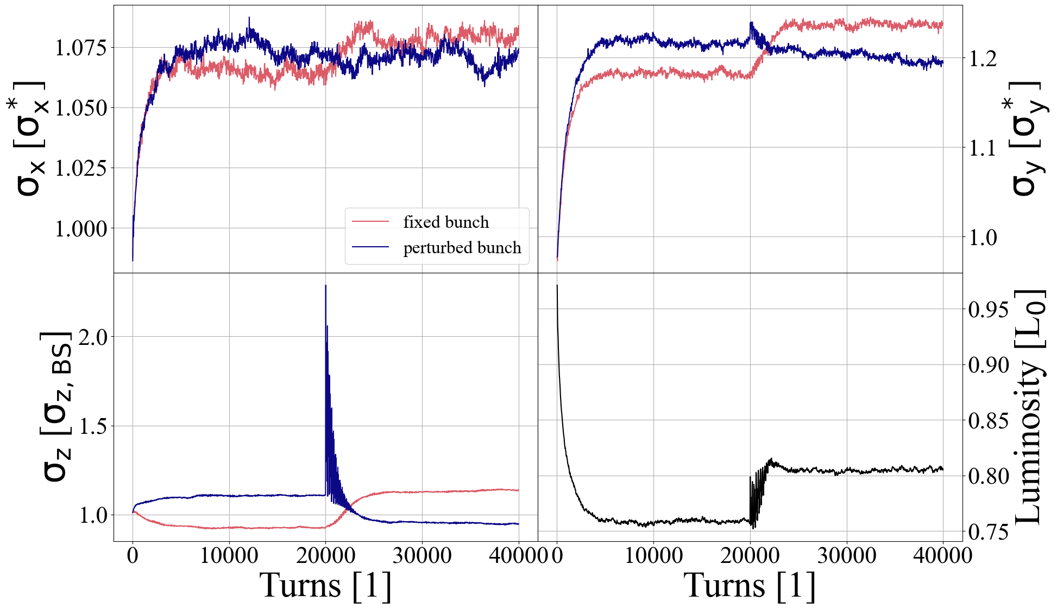
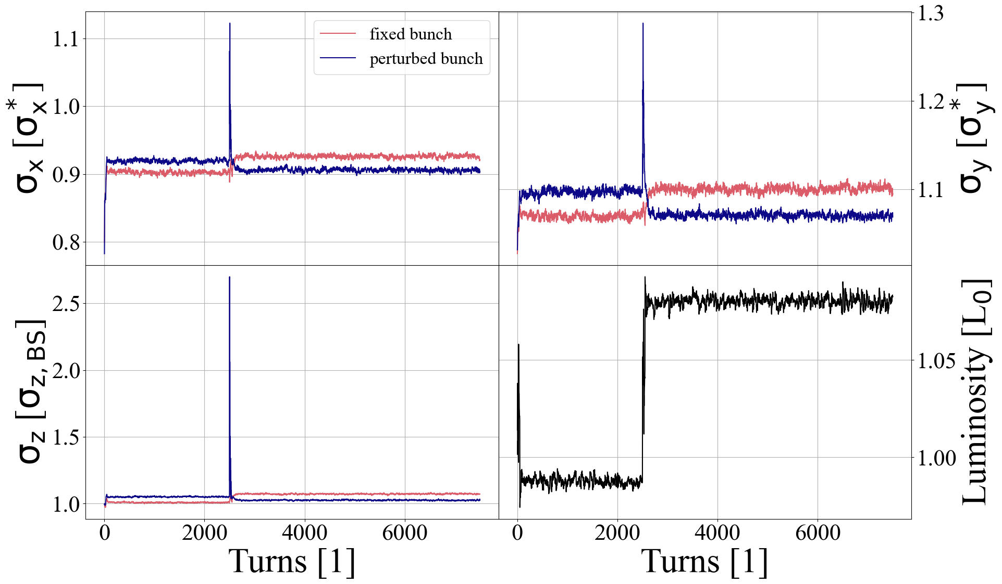
Strong-strong simulation of top-up injection
Equilibrium reached with a rate proportional to radiation damping time
Eq. reached in ~3 s (=1e4 turns)
Eq. reached in ~0.03 s (=100 turns)
Z
δ_{io}=7
tt
δ_{io}=10

Slide 16
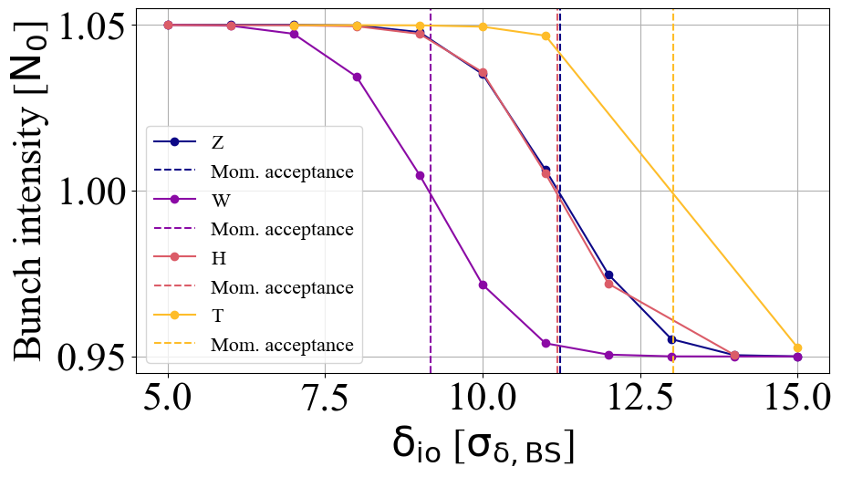
Strong-strong simulation of top-up injection
Trivial limit to injection efficiency is the momentum acceptance
No other limits observed

Slide 17
Equilibrium bunch length
W: significant vertical blowup due to 3D flip-flop

Slide 18
Quasi-strong-strong simulation of beam parameter perturbations
Fixed bunch: nominal parameters
Perturbed bunch: scan variable u (β_{x}, β_{y}, ε_{x}, ε_{y}) in range of 0.1-10x nominal value
All other parameters of the perturbed bunch kept at their nominal value
Track till euilibrium & observe vertical rms bunch size σ_{y} at IP of both beams
Threshold: σ_{y} < 1.5 σ_{y, nominal}

