Slide 1

RF sources and efficiency
I. Syratchev

Slide 2

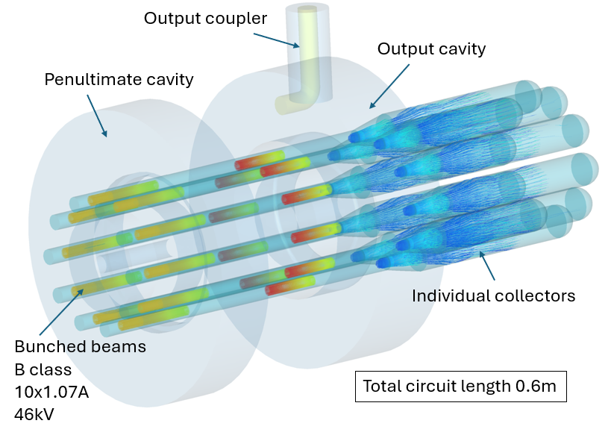
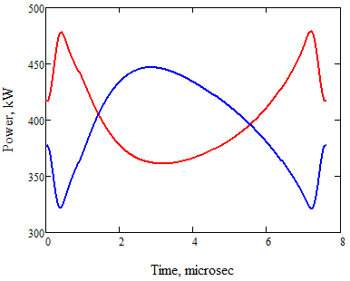
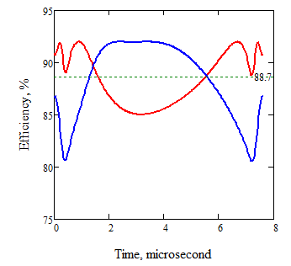
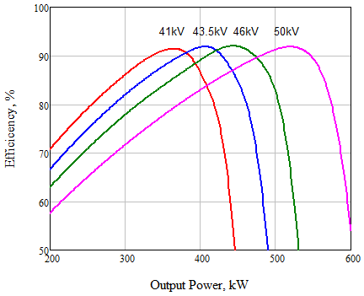
MB Tristron – a unique gridded tube for FCC_{ee} collider
Very efficient: >90%
Low Voltage: <50kV
Compact: ~ 1m³
Cost effective (compared to klystron)
No power consumption in sleeping mode (without RF)
Low power in collector (<50kW) and solenoid (3kW)
More reading:
https://indico.cern.ch/event/1449294/
400MHz, 0.5MW
Cavities RF power modulation, 88MV
Tristron transient efficiency
Tristron Efficiency vs. P out for different HV
Z, DeFOC,88MV
Z, FOC, 88MV
+/- 20% modulation depth
46kV
Z
For the required RF power modulation feedback (by LLRF only), the HV set point can be selected so that average efficiency will stay ultimately high: 88.7% (Z) and 91% (W,H). With HE TS klystron average efficiency will stay at 67% (Z).

Slide 3
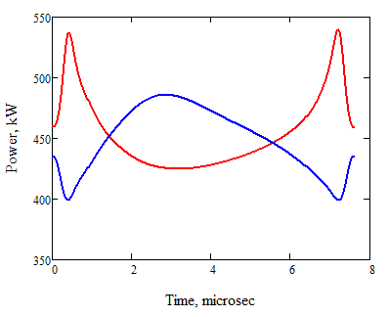
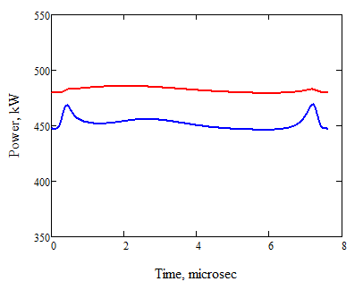
Issues with transient loading of the HV power supply
Common HV
Tristron#1
HV
Tristron
Tristron#2
Transient power drain from HV power supply
Transient power/2 drain from common HV power supply
50kV; 83%
46kV; 88.7%
46kV, 88MV
It will be hard to provide such a bandwidth in HV unit.
With this layout we can set HV point and negotiate modulator bandwidth vs. average efficiency.

Slide 4
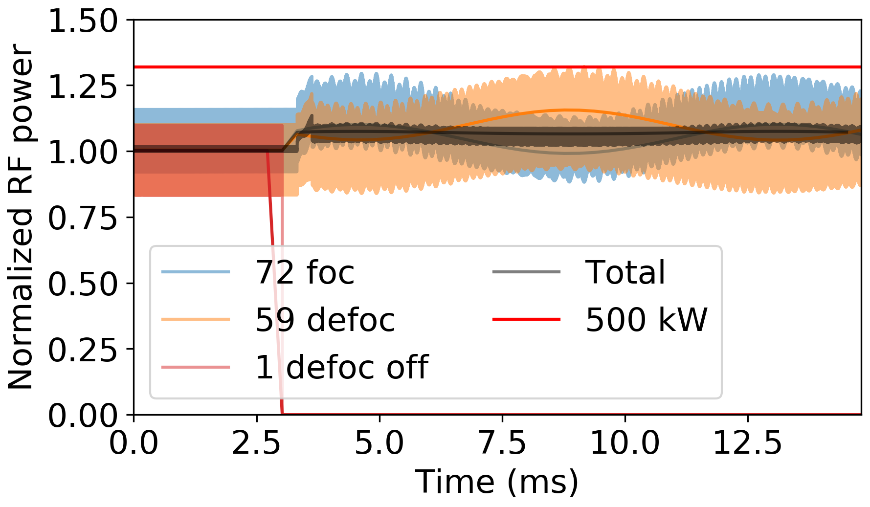
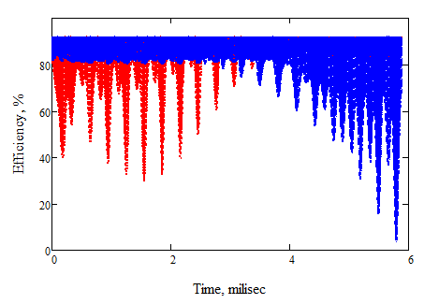
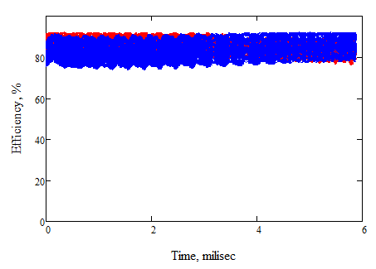
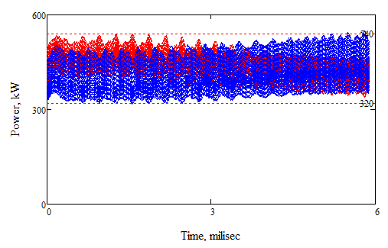
Failure mode mitigation
One cavity out of operation;103MV
46V
Tristron transient efficiency
46kV; 89%
50kV; 86%
50kV
RF power modulation; 88MV
Average efficiency 86%
Power sweep range: 320kW-540kW!
Working scenario: in the case of failure, slow (200-300 µsec) ramp up of the tristron modulator voltage from 46kV to ~50kV will provide efficient operation in the failure mode.

Slide 5
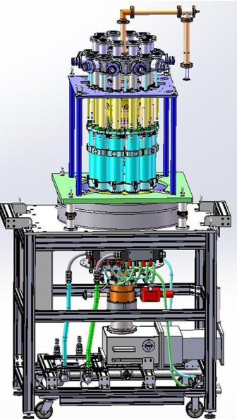
Tristron for FCC_{ee}. Implementation scenarios.
Technology demonstrator (low cost at short time): Retrofit upgrade of existing ESS 0.7GHz, 1.2 MW MB IOT, anticipating efficiency increase from 70% to ~85%.
Full recycling of the exiting components (gridded cavity, output cavity and collector).
RF circuit and optics design and optimization at CERN.
Tube refurbishment at Thales – introducing extra cavity and compact external solenoid.
Testing at ESS using existing facilities.
Estimated schedule is about 18 month.
* Potential candidate for the graceful replacement of ESS klystrons along accelerator life-time.
** Frequency is close to 800MHz needed for FCC.
FCC_{ee} 0.5 MW Tristron prototype at 400MHz.
RF circuit and optics design and optimization at CERN.
Common input cavity vs. clustered option design and cost optimization (Thales+ ? + CERN)
Tube fabrication at Thales+?.
Estimated schedule is about 36 month.

