Slide 1

CERN Venture Connect
Deep Tech Startup Programme by CERN

Slide 2


About CERN.
Home to the world’s largest experiment, pushing the boundaries of technology
The European Organization for Nuclear Research researches fundamental questions of the universe and the basic building blocks of matter.
Operating at -271°C - colder than outer space – CERN’s accelerator complex propels particles to 99.9999991% the speed of light, enabling up to 1 billion particle collisions per second. These events are monitored by massive detectors with over 100 million sensors, producing 1 petabyte of raw data daily, analyzed in the world's largest computing grid across 170 sites globally.
CERN's research has garnered multiple Nobel Prizes and led to innovations like the World Wide Web and the very first touchscreen.

Slide 3
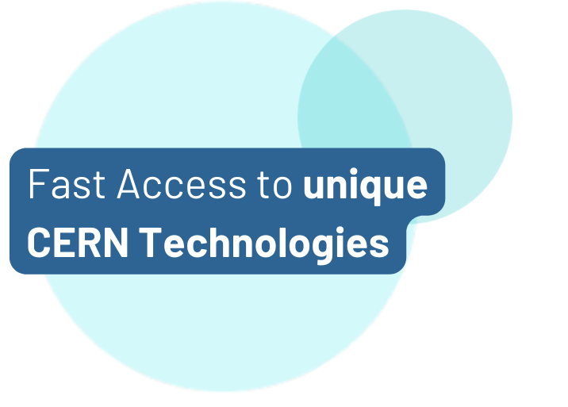
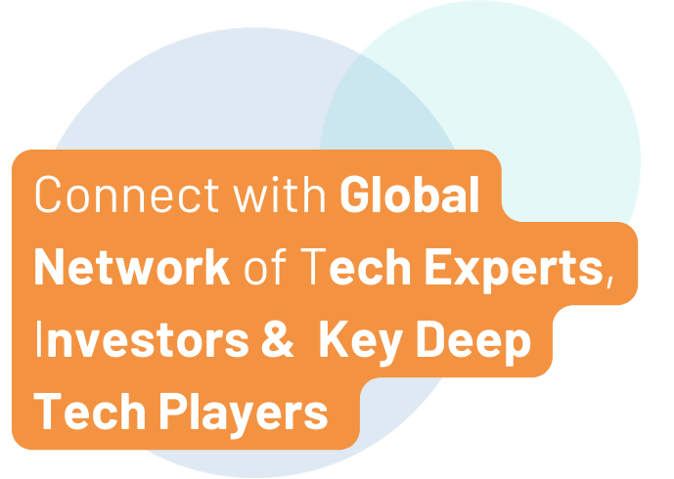
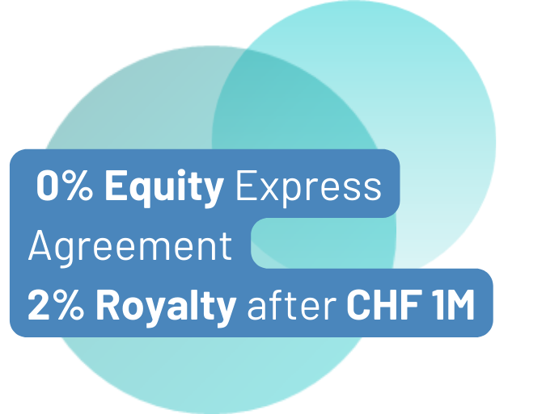
What We Do.
Fundamental research fuelling societal impact
Launched in 2023, CERN Venture Connect (CVC) bridges the gap between cutting-edge scientific research and commercial deep tech ventures.
Our community across 34 countries connects entrepreneurs, researchers and key deep tech partners to create innovative, high-impact startups.

Slide 4
Who We Support.
CERN Venture Connect supports Deep Tech Startups
CERNTREPRENEUR or EXTERNAL VISIONARY
Whether you are already part of the CERN community or an external entrepreneur, CVC provides you with valuable resources and connections.
From a seed-stage idea to a thriving scale-up that aims to solve a technological challenge, we support every step of your startup journey.
from ENTREPRENEUR to SCALE-UP

Slide 5


What We Offer.
Strategic partnership with CERN to advance your business
Engage with our deep tech community & expand your professional network.
Ecosystem
Support.
CERN Tech.
Receive a license for CERN’s cutting-edge tech & unlock expert support.
Workshops.
Participate in expert-led workshops tailored to enhance your skills.
Funding Opportunities.
Connect with your next investor among our network of 20+ deep tech VCs.
Talent.
Leverage the CERN Alumni pool to recruit top-tier talent for your team.

Slide 6


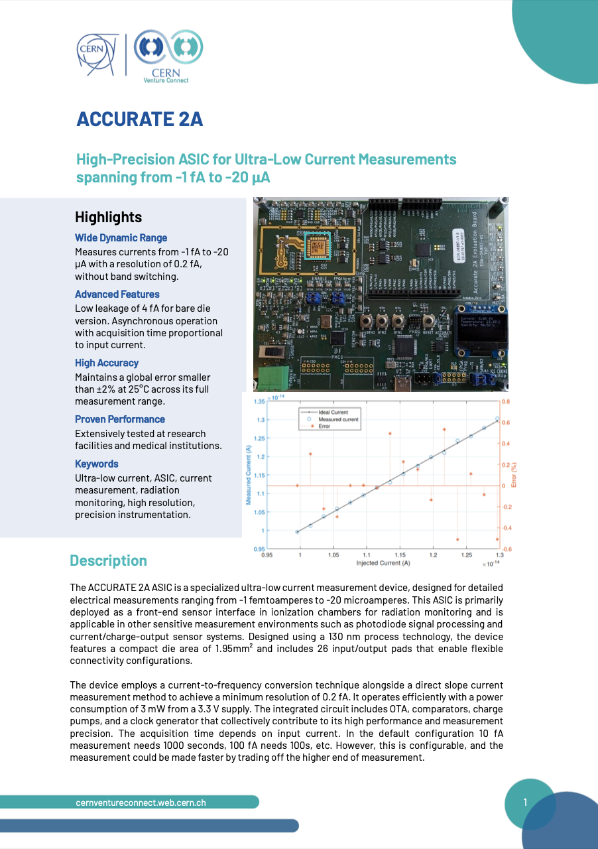



Our Technology Portfolio.
Seven startup-friendly technologies ready to use
ACCURATE 2A
Structured Laser
Beam
Single Frequency
Laser
AstroMesh
High-Precision ASIC measuring current at femtoampere levels
Satellite mesh networking with radiation monitoring
Collimation system for focused laser beams
Ultra-narrow, multi-wavelength laser system
CVC
Tech
Briefs
White Rabbit
Rucio
Ultralight Carbon
Coldplate
Sub-nano second time synchronization
Management of very large, distributed datasets
Lightweight thermal management
Learn about our CVC Tech here
Password: CVCTech

Slide 7
Our Terms and Conditions.
No-fuss express agreement with founder-friendly terms
2%
PROGRAMME FEE
Royalty-based fee for CERN tech-related revenue
applicable after exceeding CHF 1 million in annual sales.
Equity-free, non-exclusive worldwide license to commercialize the tech for 10 years
Exclusive access to technical support, resources and networking activities
Possibility for material transfer (where applicable)

Slide 8






How To Join.
Straight-forward selection process
Apply via ventureconnect.cern
Introductory Meeting
CERN Technology Matching
CERN Tech
Expert Consultation
Feasibility Assessment with CVC Prototype
Contract Signing
Deep tech startups, scaleups or entrepreneurs that are
based in one of CERN’s member states or associated member states*
driven by a passionate team with an ambitious vision
looking to leverage CERN technology to gain a competitive edge
operating in non-military and non-defense-related industries
Eligibility Criteria
No Deadlines
Applications considered
on a rolling basis
* List of CERN Member States

Slide 9






Our 2024 CVC startup cohort.
Selected from 40+ applications
Revolutionizing product marking with structured laser beams.
Automating risk analysis of complex engineering systems with Gen AI.
Regenerative farming using weed control robots.
Imaging technology for heritage objects using cosmic particles.
Open-source event management from CERN to the World.

Slide 10
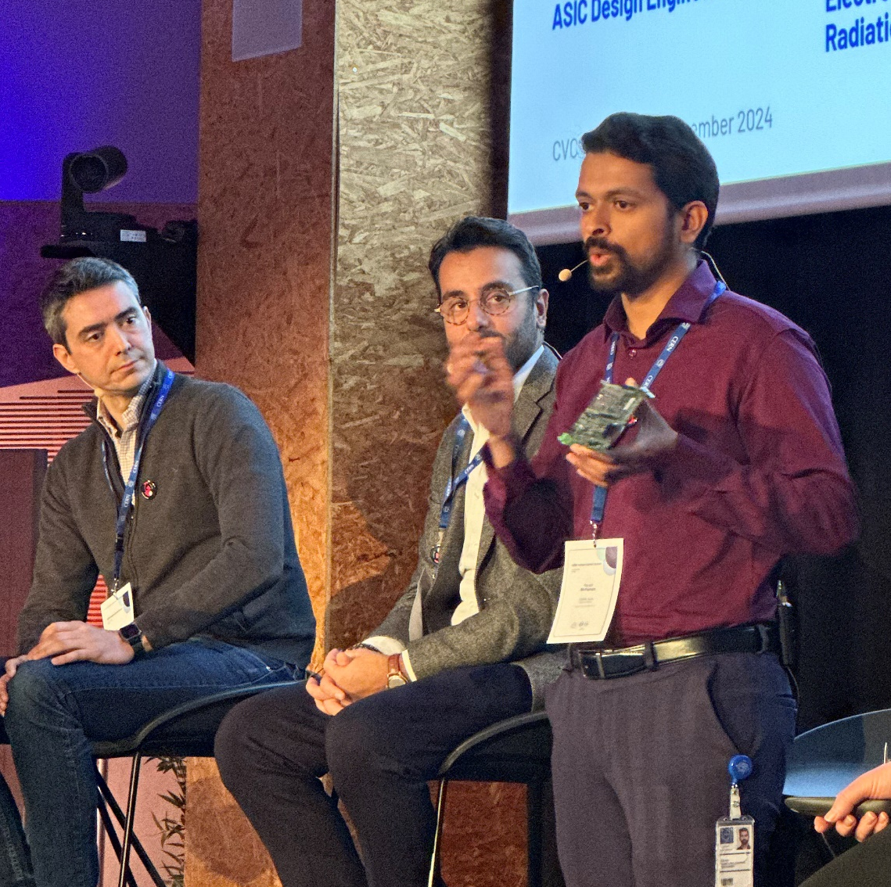
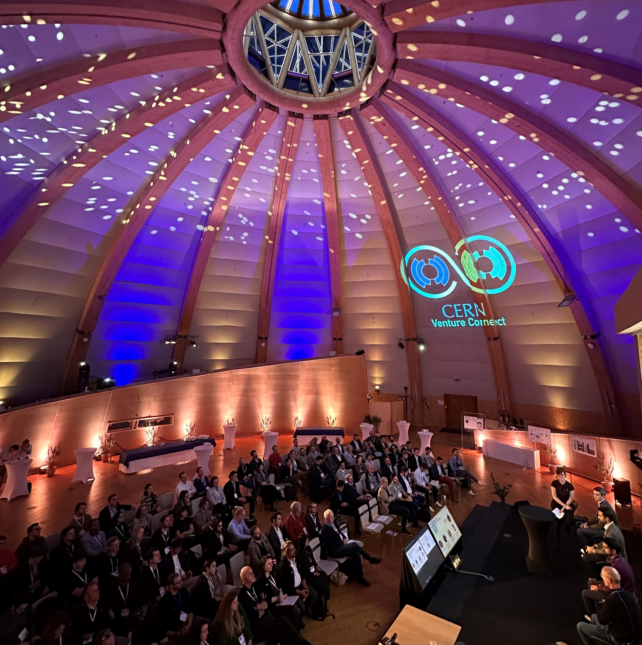
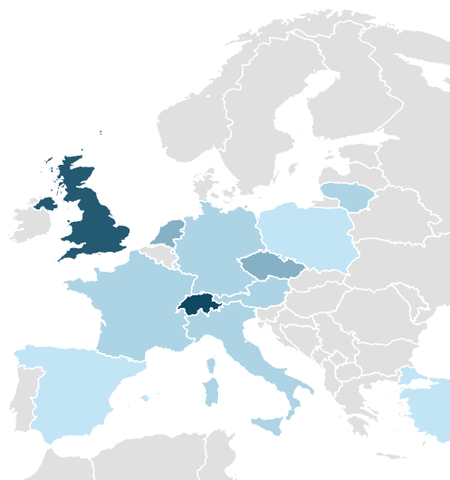
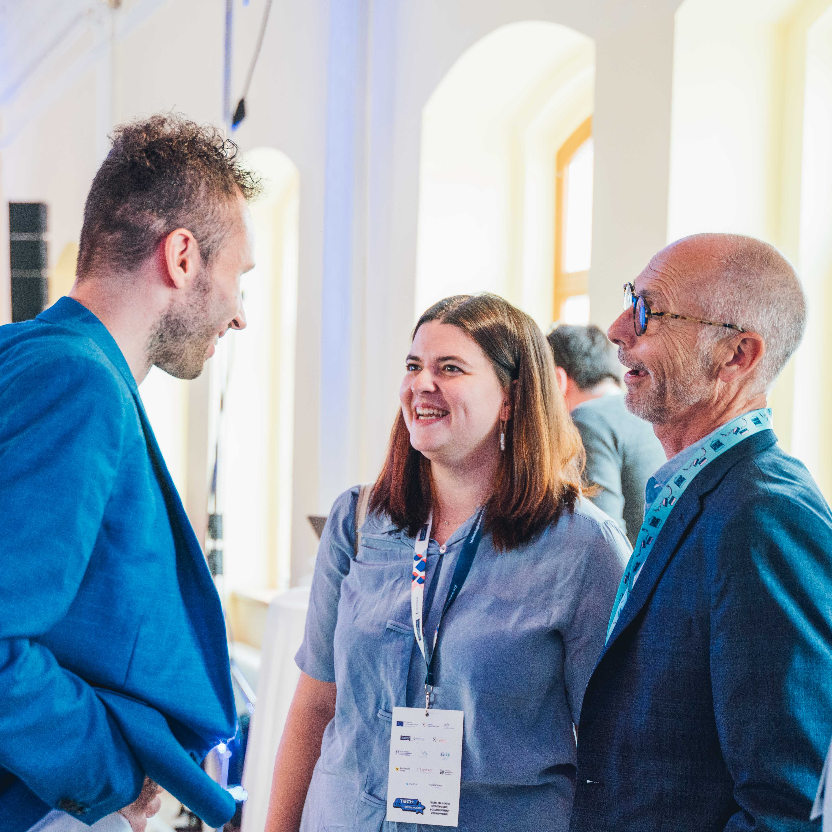
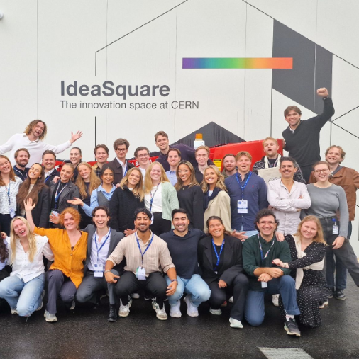

















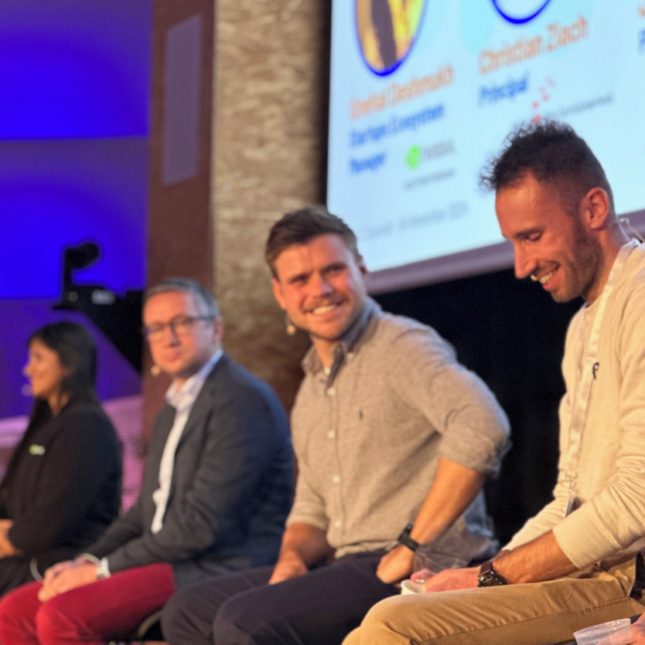































Become part of our community.
We organize regular events to facilitate connections
Join us and connect with our 50 partners globally. Whether you look for funding, lab space, legal advice, your first customers or industry expertise, our network has got you covered.

Slide 11



Ready to accelerate your business?
Hanaé Taxis
CVC Communications & Partnerships
Linn Kretzschmar
CVC Programme Lead
Hanae.Taxis@cern.ch
Linn.Kretzschmar@cern.ch
Learn more.
Get in touch.

