Slide 1
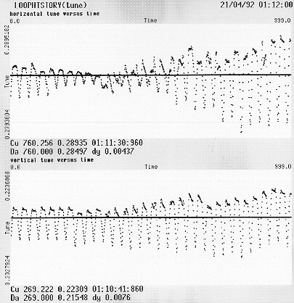
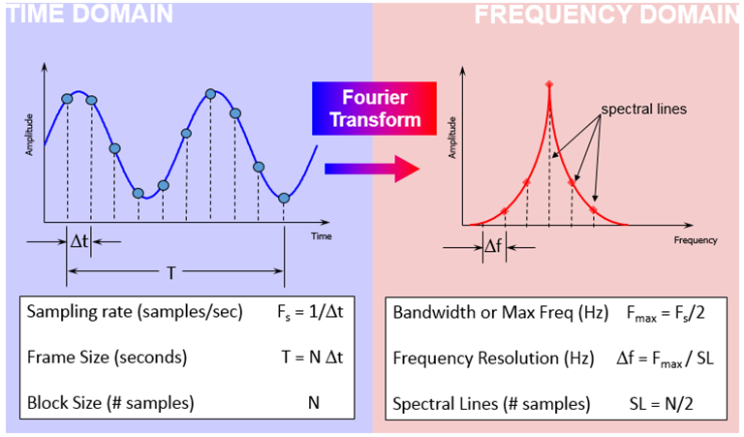
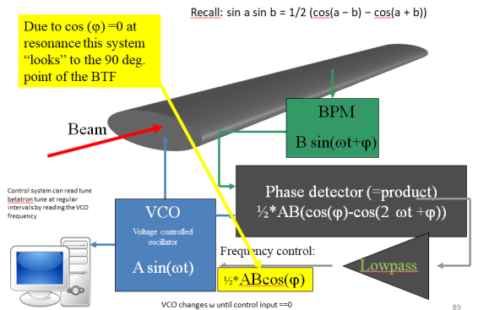
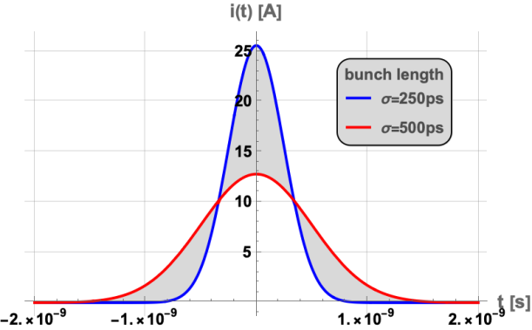
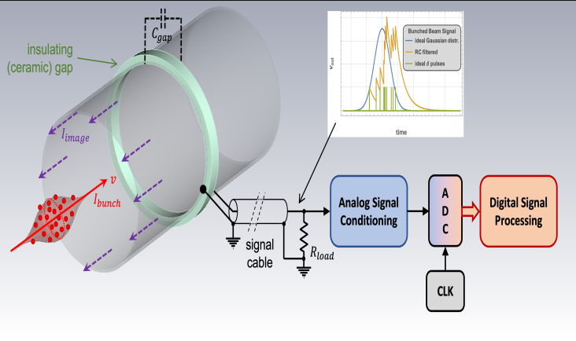
General Introductory Course, Santa Susanna (ES), 2025
Time & Frequency Domain Signals & Measurements
H.Schmickler, ex-CERN
With slides from:
M.Gasior, R.Jones, M.Wendt
(CERN)

Slide 2

Copyright statement and speaker’s release for video publishing
The author consents to the photographic, audio and video recording of this lecture at the CERN Accelerator School. The term “lecture” includes any material incorporated therein including but not limited to text, images and references.
The author hereby grants CERN a royalty-free license to use his image and name as well as the recordings mentioned above, in order to post them on the CAS website.
The author hereby confirms that to his best knowledge the content of the lecture does not infringe the copyright, intellectual property or privacy rights of any third party. The author has cited and credited any third-party contribution in accordance with applicable professional standards and legislation in matters of attribution. Nevertheless the material represent entirely standard teaching material known for more than ten years. Naturally some figures will look alike those produced by other teachers.

Slide 3
Part I
Introduction: What Is time domain and frequency domain?
Fourier synthesis and Fourier transform
Time domain sampling of electrical signals (→ ADCs)
Bunch signals in time and frequency domain a) single bunch single pass b) single bunch multi pass (circular accelerator) c) multi bunch multi pass (circular accelerator)
Oscillations within the bunch (head-tail oscillations) → advanced course

Slide 4
Part II
Fourier transform of time sampled signals a) basics
b) aliasing c) windowing
Methods to improve the frequency resolution a) interpolation b) fitting (the NAFF algorithm) c) influence of signal to noise ratio d) special case: no spectral leakage + IQ sampling
Analysis of non stationary signals/spectra: - STFT (:= Short time Fourier transform) (Gabor transform) also called: Sliding FFT, Spectrogram - multi-BPM combined signal analysis
- PLL tune tracking - wavelet analysis (if time permits, not really relevant for accelerators, but really cool stuff)

Slide 5
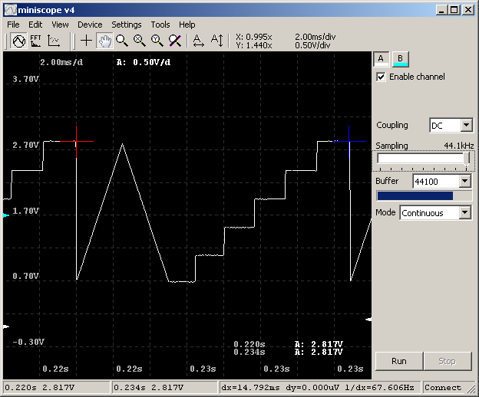
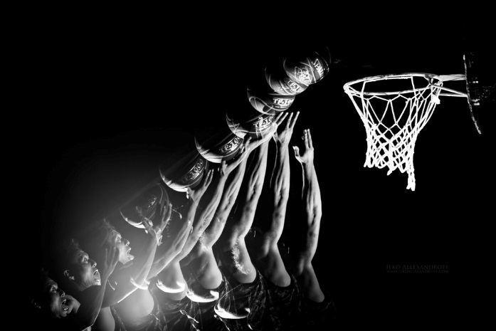
Introduction 1/3
At first: everything happens in time domain, i.e. we exist in a 4D world, where 3D objects change or move as a function of time.
And we have our own sensors, which can watch this time evolution: eyes → bandwidth limit: 1 Hz
For faster or slow processes we develop instruments to capture events and look at them: oscilloscopes, stroboscopes, cameras…

Slide 6
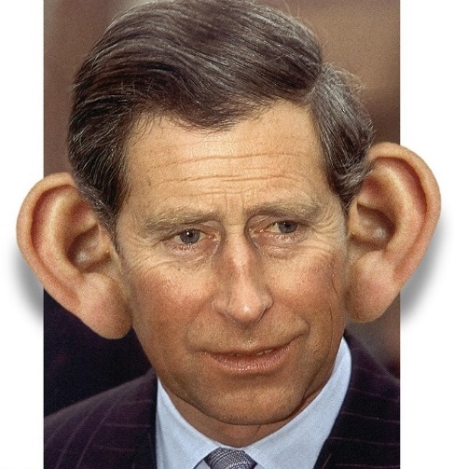
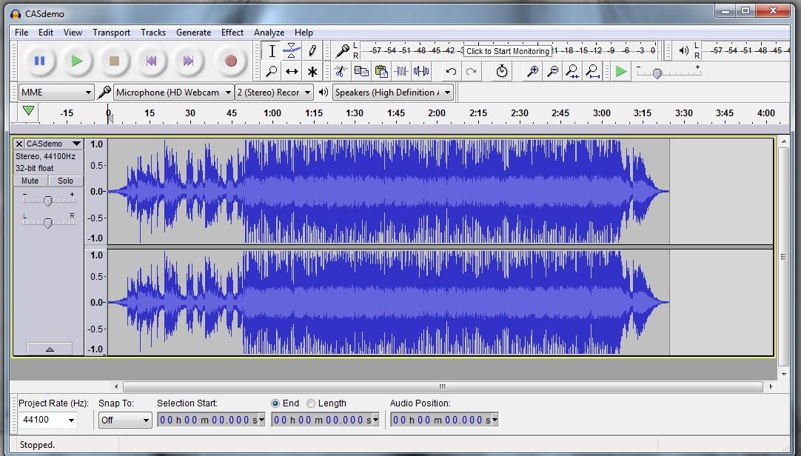
Introduction 2/3
But we have another sensor: ears
What is this?

Slide 7
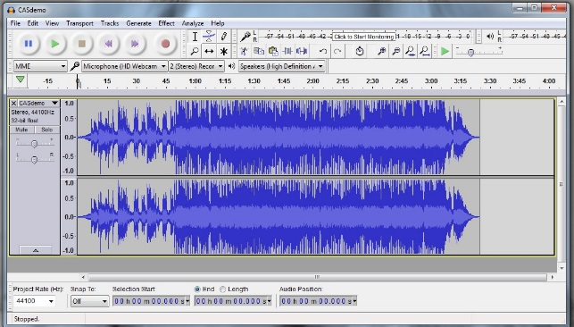

Introduction 3/3
Once we perceive the material in frequency domain (our brain does this for us), we can better understand the material.
Non matter whether we describe a phenomenon in time domain or in frequency domain, we describe the same physical reality. But the proper choice of description improves our understanding!

Slide 8
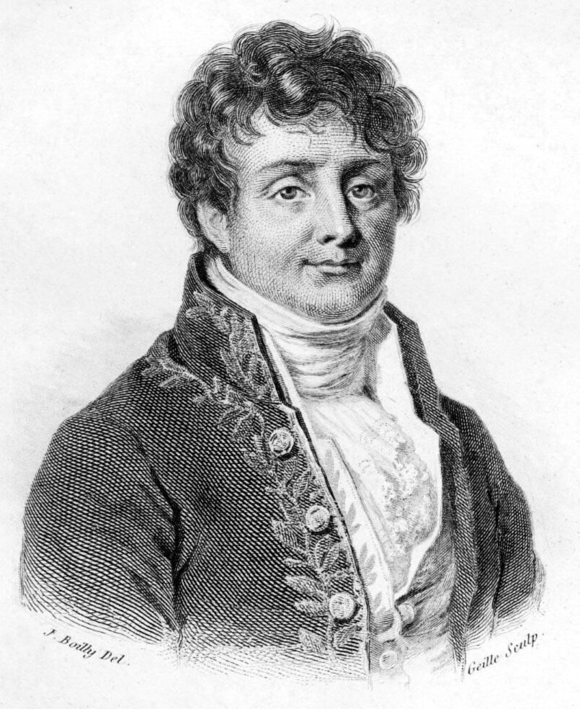
Jean Baptiste Joseph Fourier (1768-1830)
Had a crazy idea (1807):
→ Any periodic function can be rewritten as a weighted sum of Sines and Cosines of different frequencies
Don’t believe it?
Neither did Lagrange, Laplace, Poisson and other big wigs
Not translated into English until 1878!
But it’s true!
called Fourier Series
Possibly the greatest tool
used in Engineering

Slide 9
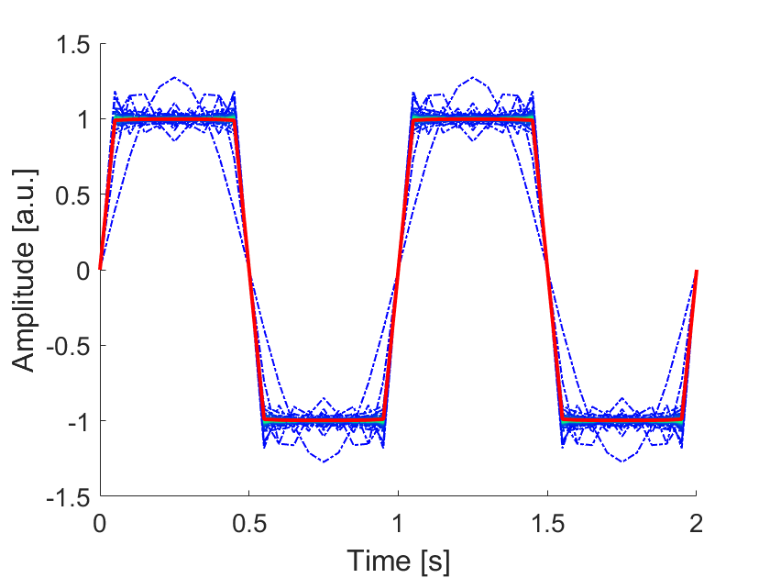

Fourier Series
A periodic function f(x) can be expressed as a series of harmonics, weighted by Fourier coefficients c_{n}
$$f\left(x\right)=\sum_{n=−∞}^{n=+∞}{c_{n}e^{−2iπ\frac{n}{T}x}} \\ c_{n}=\frac{1}{T}\int_{−\frac{T}{2}}^{+\frac{T}{2}}{f(x)e^{−2iπ\frac{n}{T}x}dx}$$

Slide 10
What about non-periodic functions ?
Mathematically this is « interesting »
Physicists « just assume it works »
1) In a time limited window any non periodic function can be expressed as Fourier series. Problem: Outside this window the function reproduces, since the sinus and cosinus functions are periodic and infinite.
2) In an infinite time window there are functions for which a Fourier series does not converge. But those seem to be irrelevant for the description of physical problems.
→ Just do it
The tool: Fourier Transforms of time domain functions (next slide)

Slide 11
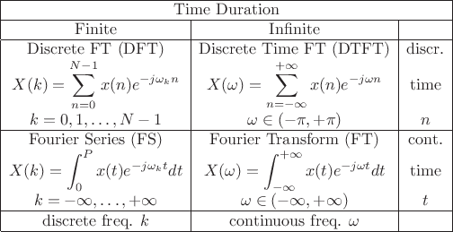
Fourier Transforms (FT)
Note:
There is also the term FFT := Fast Fourier Transform This is nothing else than a DFT with N=2^{m}; useful to speed up the computation

Slide 12
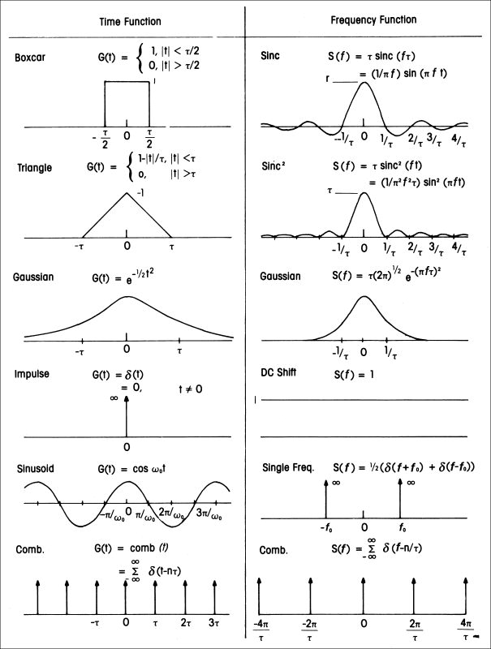
Fourier Transform Pairs
Will use this when we come to “windowing”
Gaussian gives a Gaussian!
Somewhat surprising!
Not surprising
Remember this when we will treat bunches!
Image taken from
https://wiki.seg.org/wiki/Dictionary:Fourier_transform

Slide 13
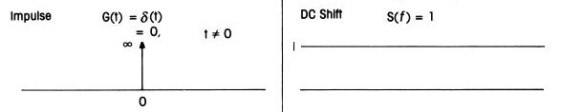
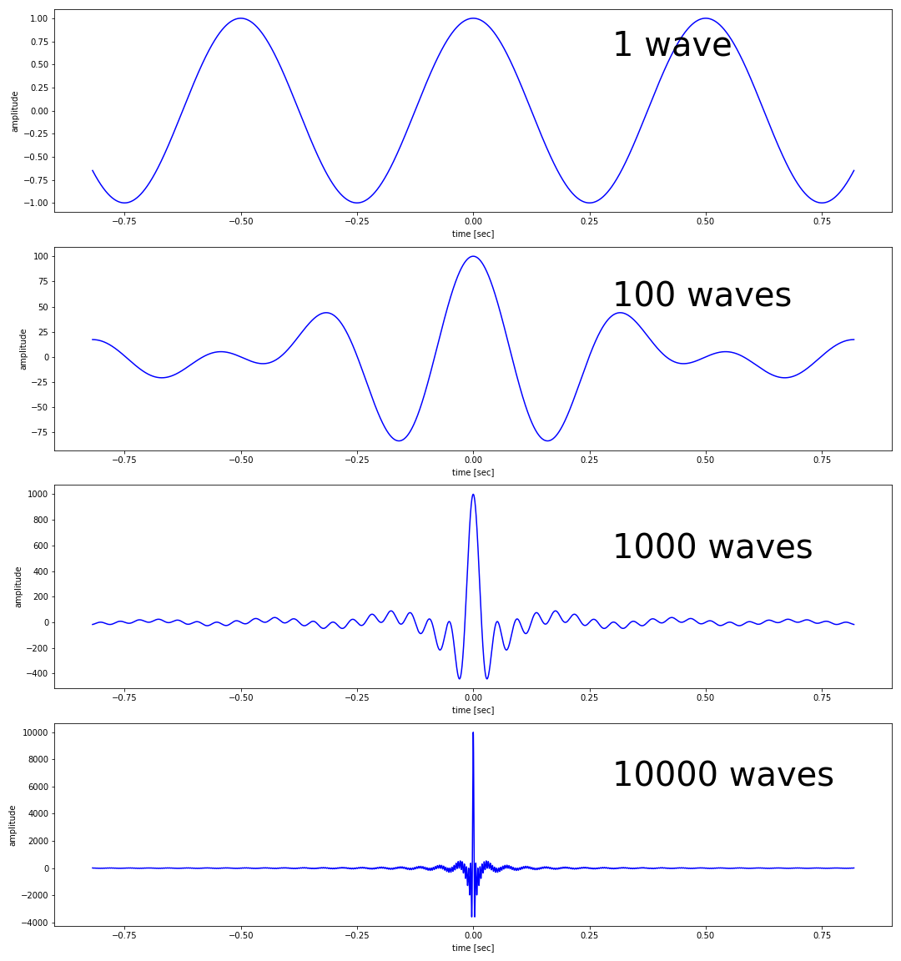
Time pulse = infinite spectrum of sin-waves
A pulse at t=0 corresponds to an overlap of an infinite number of sin-waves with all possible frequencies of infinite length!
In the example at left a base wave is generated and then new waves are added each time with a 1% higher frequency.
Nice example to show that a correct mathematical model not necessarily corresponds to reality!
Imagine an electrical pulse of a generator: The waves generated should already have existed before the generator was built!
So “infinity” is not always “infinity”

Slide 14
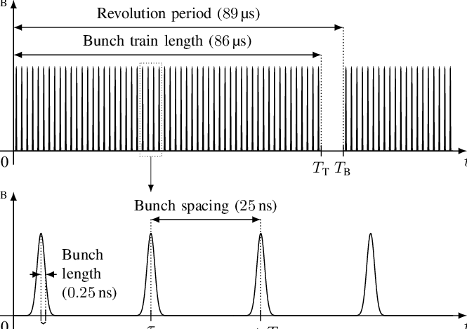
Now we need some definitions in order to treat particle bunches
In real accelerators not all available RF-buckets are filled with particle bunches. - a gap must be left for the injection/extraction kickers
- Physics experiments can impose a minimum bunch distance, which is larger than one RF period (i.e. LHC)
Revolution frequency: ω_{rev} = 2π f_{rev}
RF frequency: ω_{RF} = 2π f_{RF} = h* ω_{rev} (h=harmonic number)
Bunch Repetition frequency: ω_{rep} = 2π f_{rep} = ω_{RF} /n (n= number of RF buckets between bunches)
(f_{rep} = 1/bunch spacing)

Slide 15
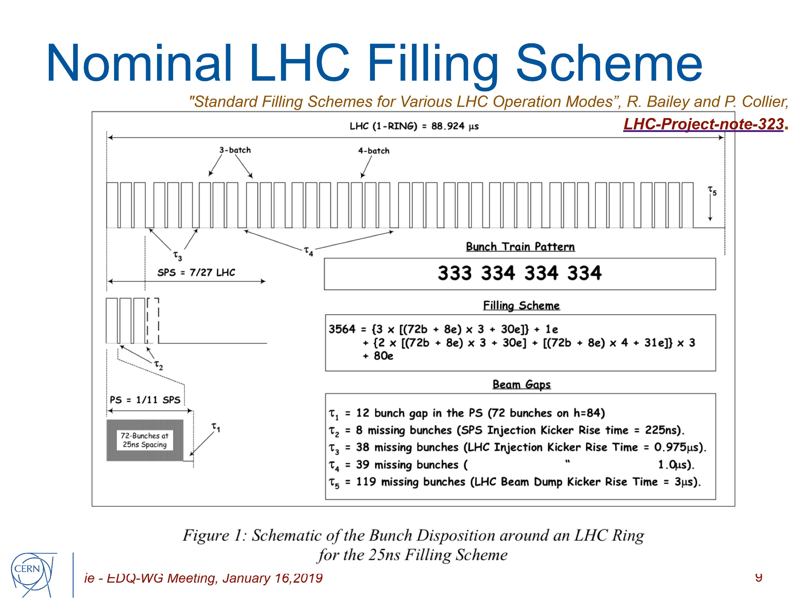
Example LHC beam

Slide 16
Single bunch single pass
Understanding beam signals in time and frequency domain
We start with:
Time and frequency domain description
Measurement of bunch length in time domain
→ Sampling electrical signals with ADCs
Measurement of bunch length in frequency domain

Slide 17
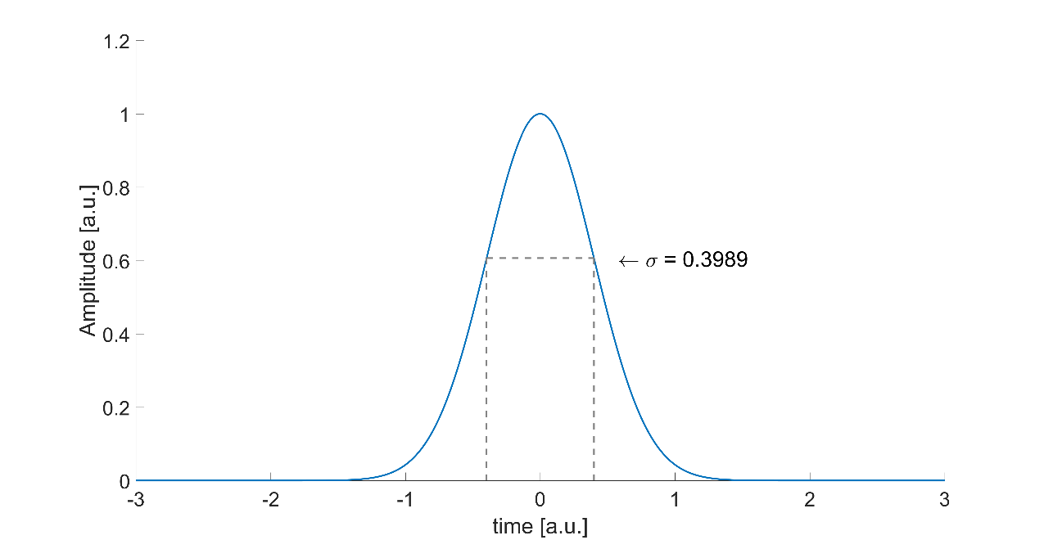
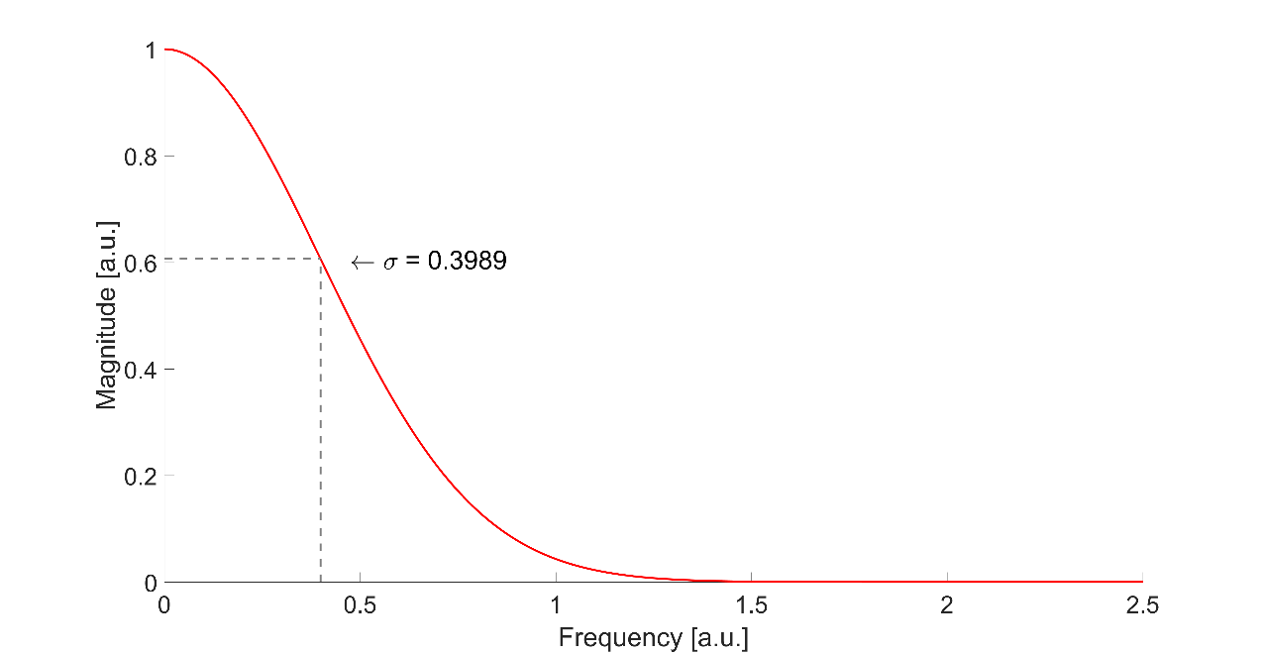


Particle beam with gaussian longitudinal distribution
Time domain
A₀, pick amplitude
$$f\left(t\right)=A_{0}\exp\left(−\frac{t^{2}}{2σ_{t}^{2}}\right)$$
$$area=\int_{−∞}^{+∞}{f\left(t\right)dt=}\sqrt{2π}A_{0}σ_{t}$$
σ_{t}
bunch length
Frequency domain
$$F\left(k\right)=\frac{A_{0}}{\sqrt{2π}σ_{f}} exp\left(−\frac{k^{2}}{2σ_{f}^{2}}\right)$$
$${ σ}_{f}^{ }=\frac{1}{2πσ_{t}}$$
$$F\left(0\right)=area=\frac{A_{0}}{\sqrt{2π}σ_{f}}=\sqrt{2π}A_{0}σ_{t}$$
σ_{f}

Slide 18
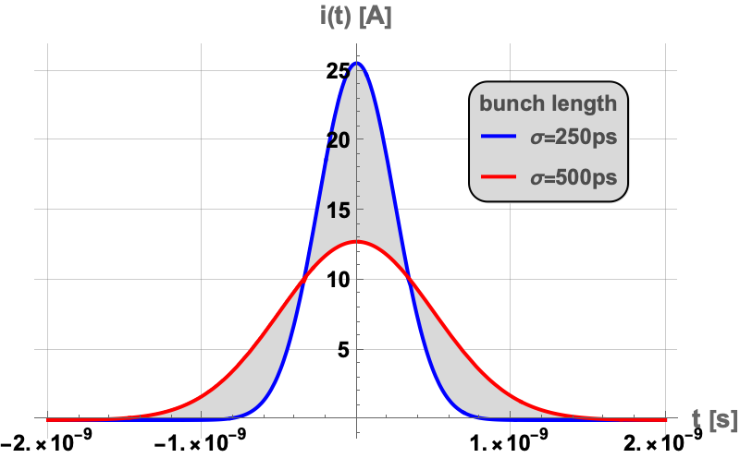
Bunched beam longitudinal signal shape I
In many cases the description of the longitudinal bunch signal as “Gaussian” is adequate and sufficient. Depending on the study, more sophisticated descriptions are needed (next slide).
Typical bunch length for circular (high energy accelerators):
Protons: ~50 ns…0.5 ns (LHC) electrons: 1ns … ~10 ps (LEP)…10 fs (FEL)

Slide 19
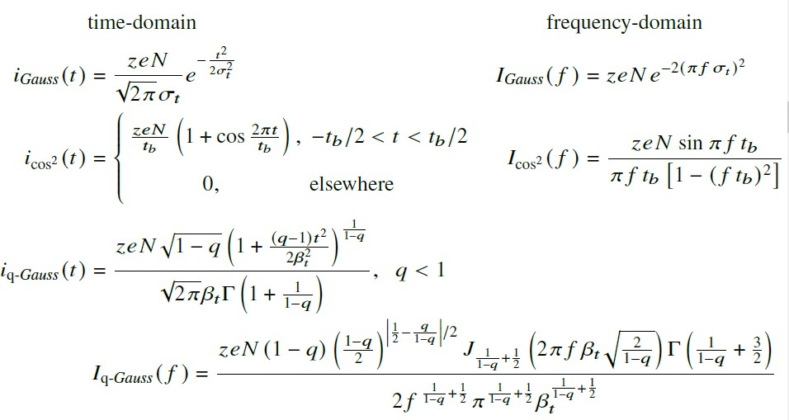
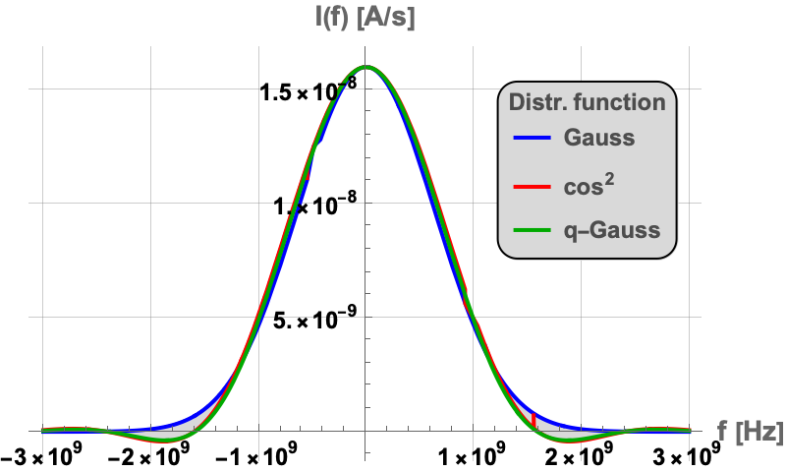
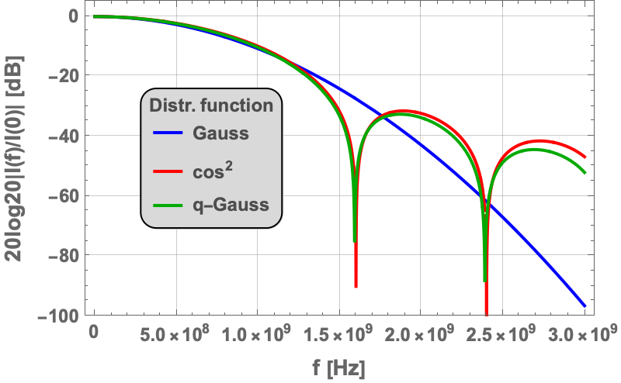
Bunched beam longitudinal signal shape II

Slide 20
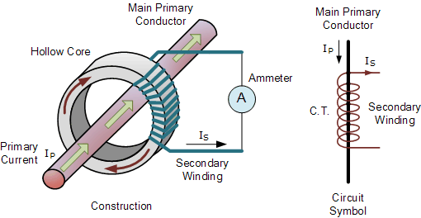
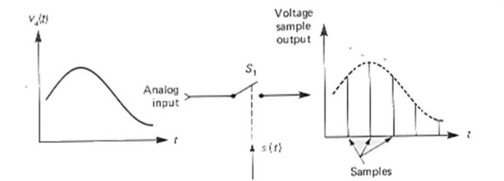
Beam Intensity Measurement in time domain
Sampling (=measurement) of an electrical signal in regular time intervals. The electrical signal is obtained from a monitor, which is sensitive to the particle intensity.

Slide 21
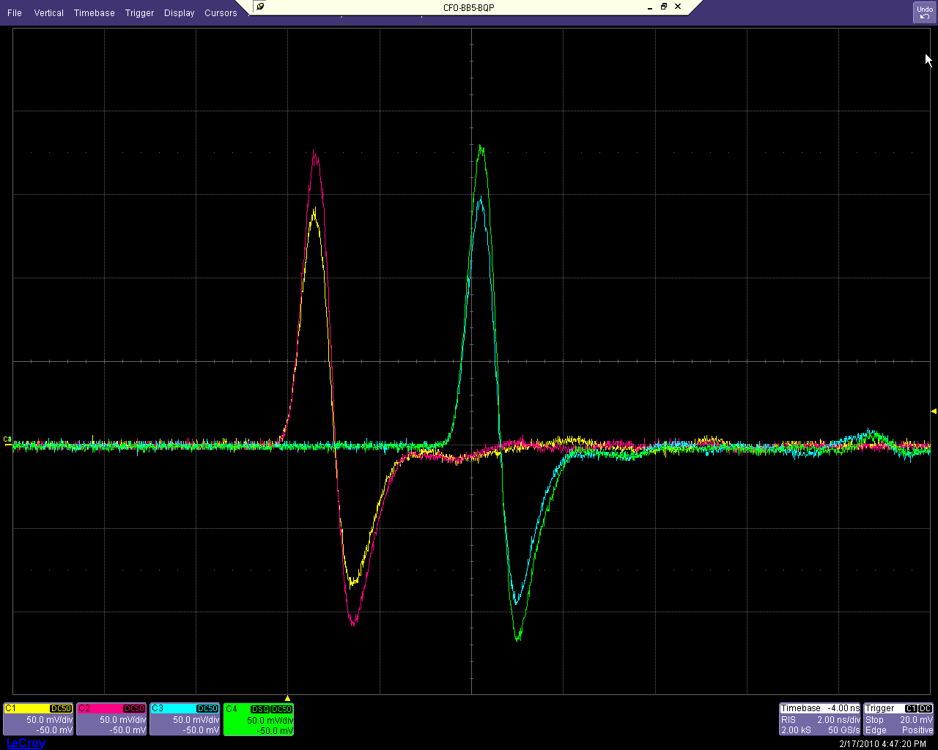
Time domain observation of a
“short” electrical pulse
Most often one uses an « oscilloscope », i.e. an electronic device that measures at a regular time-interval (called sampling-time) the applied voltage and converts it internally into a numerical sample. Keyword: ADC:= Analog Digital Converter
Example below: 4 « button » signals of a beam position monitor in the CERN SPS. Note the « red and yellow » signals have been artificially delayed in a cable for better visibility of the signals
Ver: 50 mV/div, Hor: 2 ns/div
2 pairs of 10 mm button electrodes

Slide 22
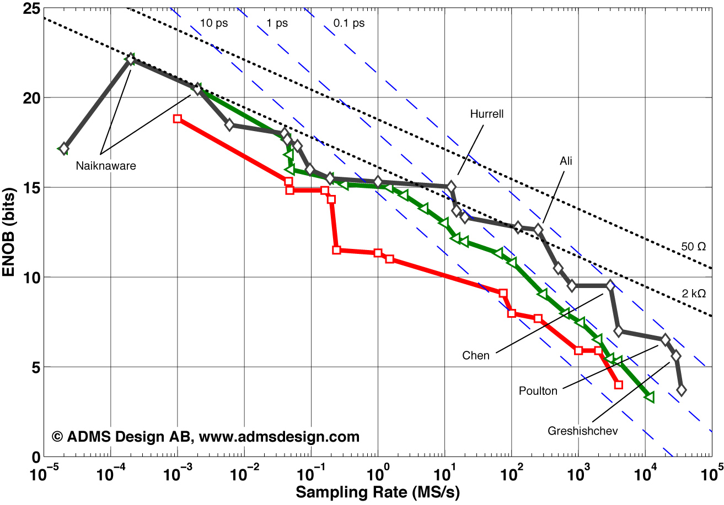
ADC performance chart (2015!!!)

Slide 23
Frequency domain measurement
Pulses (bunches) can become very short in electron linacs (as low as a few femto-seconds)
This corresponds to a frequency content in the THz domain
No way to mesure any time domain signal (see last chart)
Make use of electromagnetic radiation and try to get information through optical ( ex: streak camera) or RF signals
Next slide example of a linac with pulses in the ps domain

Slide 24
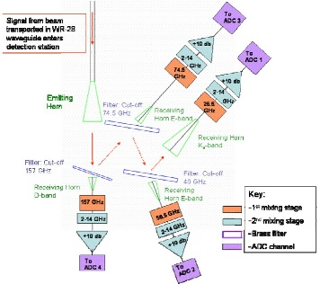
Frequency domain measurement of single bunch
Nice example from R&D work in CTF3 (CERN)
A.Dabrowski et al., Proc of PAC07, FRPMS045
Primary signal is EM wave of beam extracted through a thin window
Subdivision into 4 frequency bands
Measurement of rms amplitude in the 4 bands

Slide 25
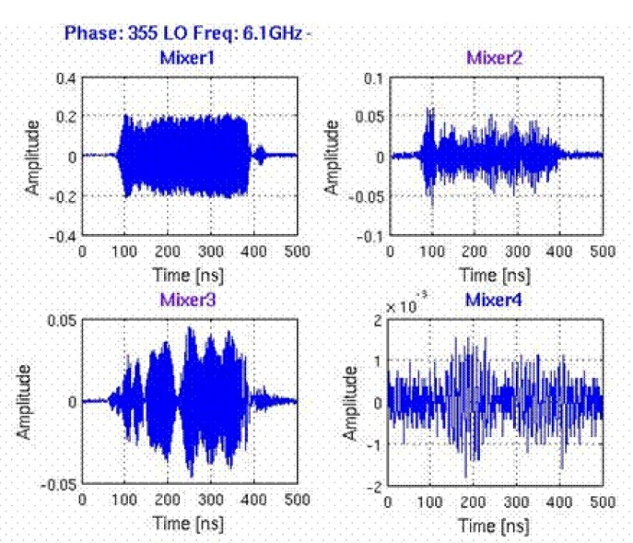
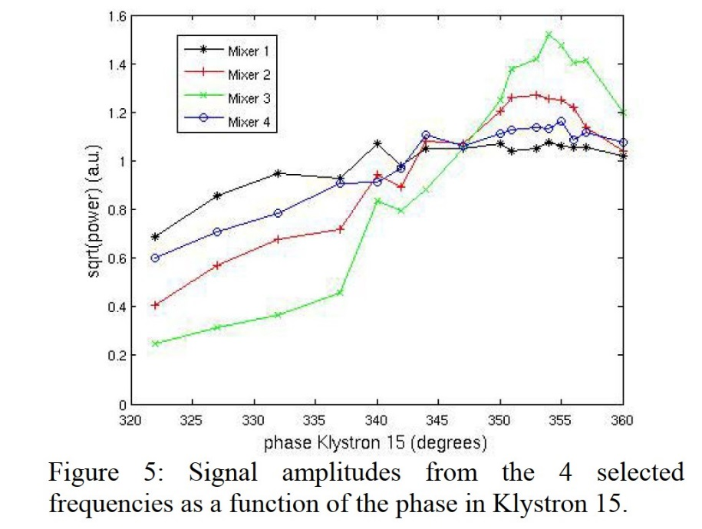
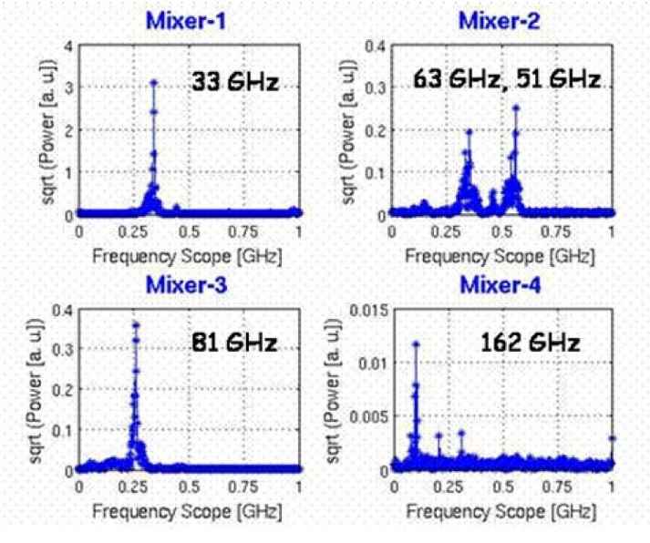
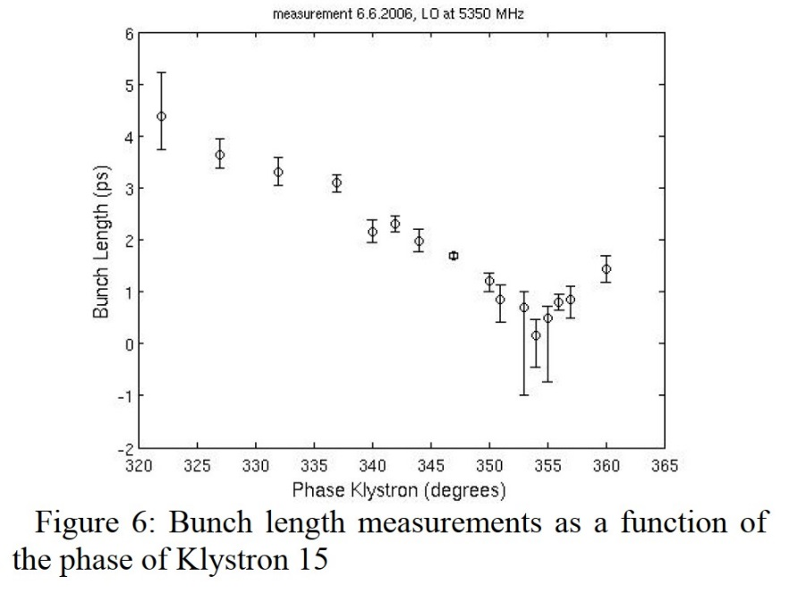
CTF3 results
Time domain measurements of 4 bands
fit
FFT of down-converted signals

Slide 26
Deeper Analysis of bunch signals
After these introductory remarks we shall look at signals produced in an accelerator and understand them:
Single bunch single passage: Already done
Now to come:
2. Single bunch - multi pass
3. Multi bunch – multi pass…is a bit mind boggling, but still very relevant → complete slides as appendix

Slide 27
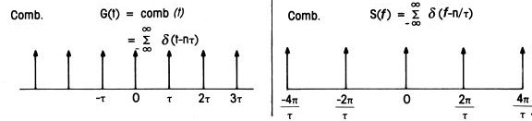
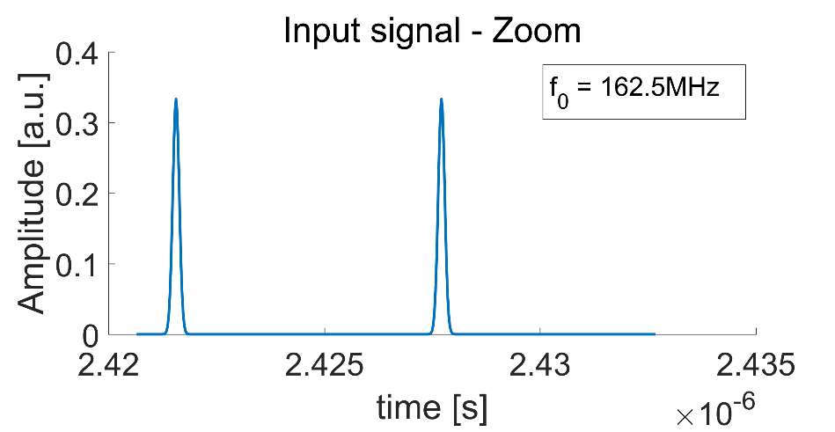
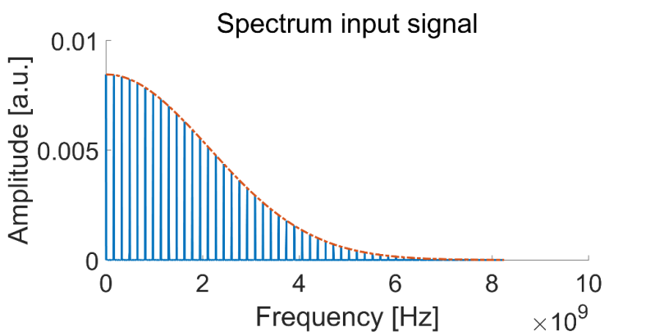
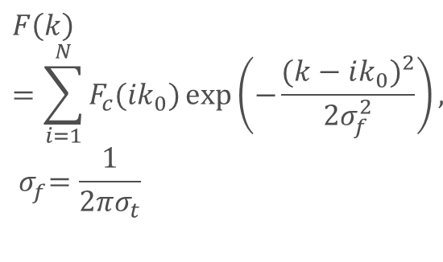
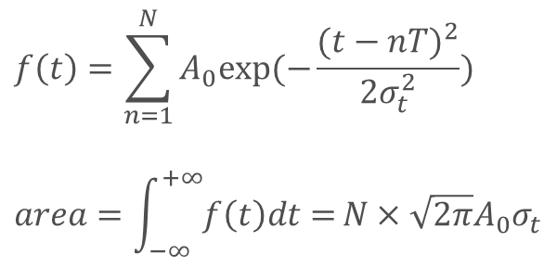
Single bunch multi pass (circular accelerator)
Remember:
Time domain
$$f\left(t\right)=\sum_{n=1}^{N}{A_{0}exp⁡(−\frac{{(t−nT)}^{2}}{2σ_{t}^{2}}) }$$
$$area=\int_{−∞}^{+∞}{f\left(t\right)dt=}N×\sqrt{2π}A_{0}σ_{t}$$
Frequency domain
f_{rev}
$$F\left(k\right)=\sum_{i=1}^{N}{F_{c}(ik_{0})}exp\left(−\frac{{(k−ik_{0})}^{2}}{2σ_{f}^{2}}\right),$$
$${ σ}_{f}^{ }=\frac{1}{2πσ_{t}}$$
2f_{rev}

Slide 28
Understanding the revolution harmonics
The continuous spectrum of a single bunch passage becomes a line spectrum.
The line spacing is f_{rev}= 1/T_{rev} . (T_{rev} = revolution time)
The amplitude envelope of the line spectrum is the “old” single pass frequency domain envelope of the single bunch.
Why? - short answer: Do the Fourier transform! - long answer: Understand in more detail 2,3,4…N consecutive bunch passages in time and frequency domain (next slides)

Slide 29
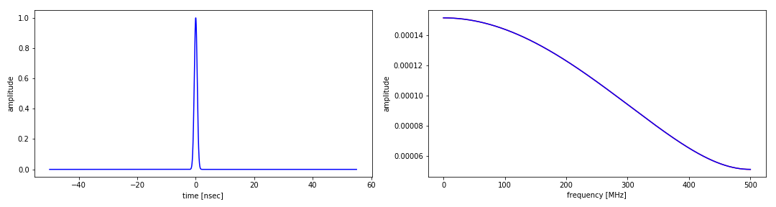
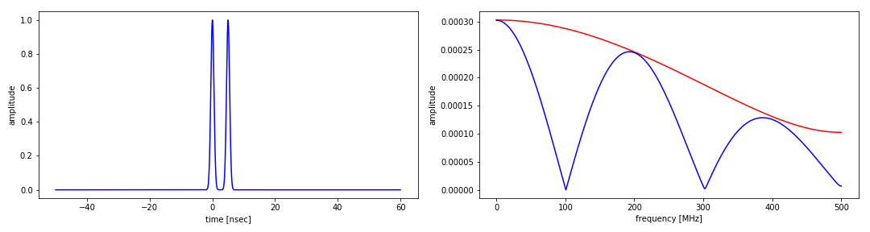
Bunch pattern simulations (1/4)
1 bunch 0.5 nsec
2 bunches
0.5 nsec
Δt = 5 nsec
Frequencies in this range make a constructive interference (no phase difference)
Frequencies in this range cancel each other (180⁰ phase difference)
Other frequencies intermediate summation/cancelation

Slide 30
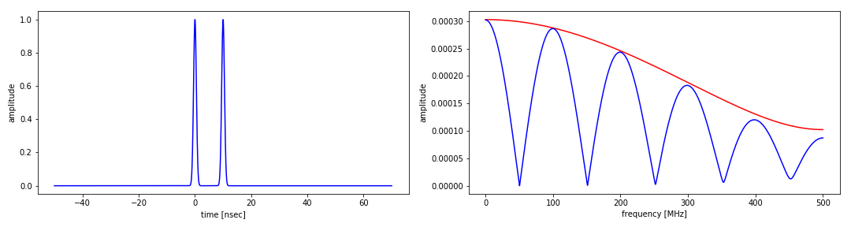
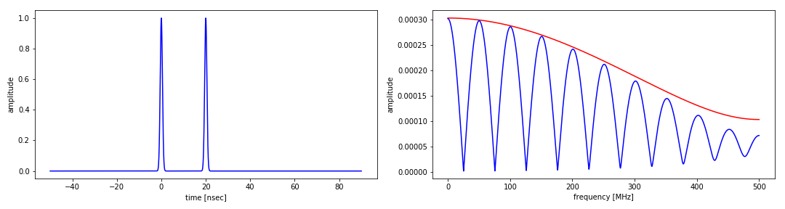
Bunch pattern simulations (2/4)
First harmonic @ 200 MHz
Δt= 5 nsec
First harmonic @ 100 MHz
Δt= 10 nsec
First harmonic @ 50 MHz
Δt= 20 nsec

Slide 31
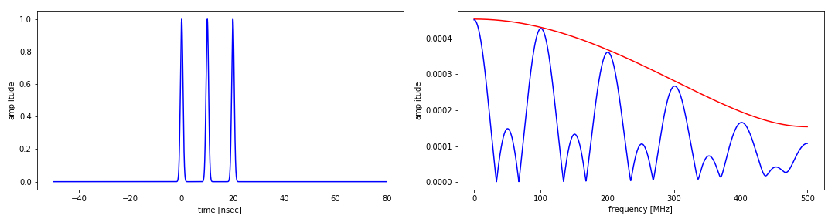
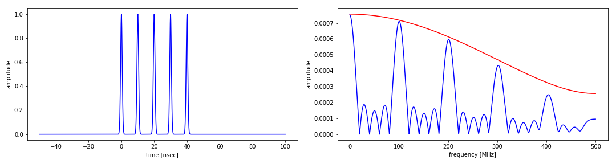
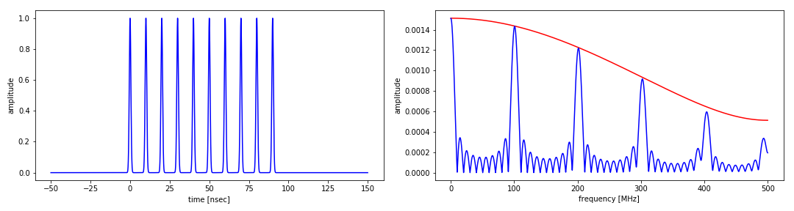
Bunch pattern simulations (3/4)
From top to bottom:
3, 5, 10 bunches (0.5nsec long, Δt = 10 nsec)

Slide 32
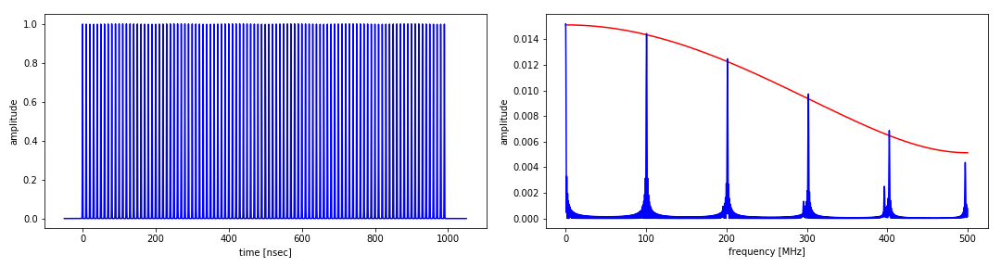
Last bunch pattern simulation
100 equidistant bunches (Δt = 10 nsec)
Resulting spectrum is a line spectrum with the fundamental line given by the inverse of the bunch distance

Slide 33

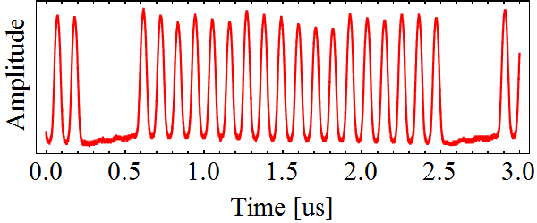
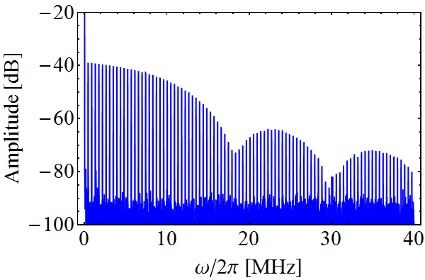


A Measured Longitudinal beam spectrum
Circular accelerator
Beam signal periodic with revolution frequency: ω_{rev}
Spectral components at:
Multi-bunch beam
Bunch not Gaussian.
Somewhat between triangular and parabolic
Spectrum of single bunch
ω_{rev}
ω_{RF}
2ω_{RF}
3ω_{RF}

Slide 34

LHC longitudinal frequency spectrum

Slide 35




And if this was not enough: amplitude modulation of bunch signals
Any amplitude modulation in time domain leads to sidebands in frequency domain
Using trigonometric identity:
m= modulation index 0…1 (V_{env} = V_{c})

Slide 36

Relevant example of amplitude modulation: stimulated betatron oscillation(or: tune measurement) this means an amplitude modulation of the intensity signal by transverse excursions
taken from R.Jones, proc. of BI-CAS 2018
Beam centre of charge makes small betatron oscillation around the closed orbit (- stimulated by an exciter or by a beam instability)
Depending on the proximity to an EM sensor the measured signal amplitude varies.

Slide 37


taken from R.Jones, proc. of BI-CAS 2018

Slide 38

One bunch/several bunches?
In the case of more than one bunch (N) in the accelerator (assume equal intensities filled at equal distances!) one cannot distinguish between - an accelerator with 1 bunch and a revolution time of t_{rev} ₋ an accelerator with N bunches and a revolution time of t_{rev} /N
!

Slide 39
Multi-bunch multi-pass
If one has N bunches of equal intensity circulating in an accelerator with T_{rev} and those bunches only move coherently without any phase difference, then this is undistinguishable from an accelerator with T_{rev}/N as revolution time and one bunch in this accelerator
In reality the oscillations of individual bunches are not correlated and in consequence the time domain and frequency domain signals get really mind-boggling.
The study of these oscillations is important in case of multi-bunch instabilities or in case of the design of transverse active feedback systems

Slide 40

Why do we worry about this?
The additional bunches will create additional spectral lines in frequency domain. Depending on the number of bunches the spacing between these lines can become so narrow, such that overlap of the beam spectral lines with the resonance of structures around the beam pipe (HOM modes of cavities for example) can excite the beam to oscillations.
This can lead to beam blow up or even particle losses.

Slide 41

Multi-bunch modes: 10 stable bunches
Ten identical equally-spaced stable bunches
Pickup
The spectrum is a repetition of frequency lines at multiples of the bunch repetition frequency: ω_{rep} = 10 ω_{rev} (bunch repetition frequency)
. . . . .
. . . . .
−3ω_{rep}
−2ω_{rep}
−ω_{rep}
0
ω_{rep}
2ω_{rep}
3ω_{rep}

Slide 42

Multi-bunch modes: 10 unstable bunches (m=0)
Ten identical equally-spaced unstable bunches oscillating at the tune frequency νω₀ (ν = 0.25)
M = 10 → there are 10 possible modes of oscillation
Ex.: mode #0 (m = 0) ΔΦ=0 all bunches oscillate with the same phase
m = 0, 1, .., M-1
Pickup
Mode#0
0
ω_{rev}
2ω_{rev}
3ω_{rev}
4ω_{rev}
ω_{rep}/2

Slide 43

Multi-bunch modes: 10 unstable bunches (m=1)
Ex.: mode #1 (m = 1) ΔΦ = 2π/10 (ν = 0.25)
Pickup
ω = pω_{rep} ± (ν+1)ω_{rev} -∞ < p < ∞
Mode#1
0
ω_{rev}
2ω_{rev}
3ω_{rev}
4ω_{rev}
ω_{rep}/2

Slide 44

Multi-bunch modes: summary (10 bunches)
0
9
1
8
2
7
3
6
4
5
5
4
6
3
7
2
8
1
9
0
0
ω_{rev}
2ω_{rev}
3ω_{rev}
4ω_{rev}
ω_{rep}/2
6ω_{rev}
7ω_{rev}
8ω_{rev}
9ω_{rev}
ω_{rep}
Lower sidebands of first revolution harmonics
$$ω=p Mωrev±\left(m+q\right)ωrev$$
If the bunches have not the same charge, i.e. the buckets are not equally filled (uneven filling), the spectrum has frequency components also at the revolution harmonics (multiples of ω_{rev}). The amplitude of each revolution harmonic depends on the filling pattern of one machine turn

Slide 45


Real example of multi-bunch modes
ELETTRA Synchrotron: f_{rf}=499.654 Mhz, bunch spacing≈2ns, 432 bunches, f₀ = 1.15 MHz
ν_{hor}= 12.30(fractional tune frequency=345kHz), ν_{vert}=8.17(fractional tune frequency=200kHz) ν_{long} = 0.0076 (8.8 kHz)
Rev. harmonic
Spectral line at 512.185 MHz
Lower sideband of 2f_{rf}, 200 kHz apart from the 443rd revolution harmonic
→ vertical mode #413
Vertical mode
#413
200 kHz
Spectral line at 604.914 MHz
Upper sideband of f_{rf}, 8.8kHz apart from the 523rd revolution harmonic
→ longitudinal mode #91
Rev. harmonic
Long. mode
#91
8.8kHz

Slide 46
Part II
Fourier transform of time sampled signals a) recap of basics
b) aliasing → limitation of usable bandwidth to 50% of sampling frequency c) windowing
Methods to improve the frequency resolution a) interpolation b) fitting (ex: NAFF algorithm) c) influence of signal to noise ratio
Analysis of non stationary signals/spectra: - STFT (:= Short time Fourier transform) (Gabor transform) also called: Sliding FFT, Spectrogram - multi-BPM combined signal analysis - PLL tune tracking - wavelet analysis (if time permits, not really relevant for accelerators, but really cool stuff)

Slide 47

Discrete Fourier Transforms
Discrete Fourier Transform basics
In general: We use DFTs of N equidistant time sampled signals; A FFT (Fast Fourier transform) is a DFT with N= 2^{k}

Slide 48


Aliasing
Periodic signals, which are sampled with at least 2 samples per period, can be unambiguously reconstructed from the frequency spectrum. (Nyquist-Shannon Theorem)
In other words, with a DFT one only obtains useful information up to half the sampling frequency.
Antialiasing filters need to be inserted upstream of the sampling in order to suppress unwanted higher spectral information.

Slide 49

Spectral leakage caused by windowing
By measuring a continuous signal only over a finite length, we apply a “data window” to signal, which leads to spectral artefacts in frequency domain.

Slide 50

Windowing = Convolution of continuous signal with window function
Recall: The Fourier transform of a product in time domain is the convolution of the individual Fourier transforms in Frequency domain

Slide 51

Rectangular window example
signal = amp1* sin (2π ω₁t) + amp2 * sin(2π ω₂t)
amp1 =1
amp2=0.01
ω₁₌ 2π * 9990 Hz
ω₂₌ 2π * 10010 Hz
FFT
The small signal component is completely masked by the sidelobe of the large signal
ZOOM

Slide 52


Applying the Blackman-Harris window
signal = window * amp1* sin (2π ω₁t) + amp2 * sin(2π ω₂t)
amp1 =1
amp2=0.01
ω₁₌ 2π * 9990 Hz
ω₂₌ 2π * 10010 Hz
FFT
The small signal component is nicely resolved
ZOOM

Slide 53



Popular window functions
The following link contains many frequently used window functions, their main features and application:
https://en.wikipedia.org/wiki/Window_function
The actual choice of the window depends on:
The signal composition
The required dynamic range
The signal to noise ration remark: every window except the rectangular window is linked to a loss in amplitude (we multiply many samples with almost “zero”) → reduced S/N up to 6 dB

Slide 54

Improving the frequency resolution of a DFT spectrum
Recall: basic frequency resolution: Δf = 2*f_{samp}/N_{samp}
We can interpolate between the frequency bin with maximum content and the left and right neighbouring bins
We limit the discussion to “three point interpolation methods”
The interpolation function is either:
A) a parabola of the measurements (:= parabolic interpolation) B) a parabola of the log of the measurements (:= Gaussian interpolation)
Can get up to 1/N² resolution
Details: https://mgasior.web.cern.ch/mgasior/pap/FFT_resol_note.pdf

Slide 55


Improving the frequency resolution of a DFT spectrum
$$Gain factor G≔ \frac{Δf}{2 x Error max.}$$
from: https://mgasior.web.cern.ch/mgasior/pap/FFT_resol_note.pdf

Slide 56

Even higher frequency resolution: fitting the data
Assume a model function for the data (sample _{1…N}) (i.e. in the most simple case a monochromatic sin wave), in general sample_{i} =f (i * Δt)
Get frequency and peak (or interpolated peak) from FFT: f_{max} and a_{max}
Minimize: $Σ=\sum_{i=0}^{N}{(samplei)}$² – (a_{max} * sin (2πf_{max} * Δt))² by varying a_{max} and f_{max} (→NAFF algorithm:= Numerical Analysis of Fundamental Frequencies → NAFF algorithm can get up to 1/N⁴ resolution)
Very good convergence for noise free data (i.e. predominantly in simulations)

Slide 57

A little summary on frequency resolution
1/N
1/N²
Taken from: R. Bartolini et al, Precise Measurement of the Betatron tune, Proceedings of PAC 1995, Vol. 55, pp 247-256
Frequency measurement error ε(N) as function of log (N) for different S/N ratios
Basic FFT resolution proportional to 1/N
Plot shows result for interpolation using Hanning window.
With interpolation and no noise proportional to 1/N²
Data fitting (NAFF algorithm ) also very sensitive to S/N

Slide 58


Special case: no spectral leakage
All pictures: M.Gasior
The FFT of the so called background signal has no spectral leakage!!!!

Slide 59

Special case continued:
In the shown example the following relation holds: $\frac{fbackground}{fsampling}= \frac{110}{1024}$ =$\frac{M}{N}$ (ratio of rational numbers)
This means that with the 1024 samples exactly 110 full periods of the background signals have been measured.
The mathematical equivalent is that we have not applied a window function (no truncation), we get as result of the FFT the pure sine wave corresponding to the background frequency.
In accelerators we often know the frequency of a signal for which we want to measure the amplitude (=multiple of RF frequency) → we can avoid spectral leakage.
Important application of 4: IQ-sampling at 4*f (next slide)

Slide 60


Slide 61

Other method: Network analysis
Excite beams with a sinusoidal carrier
Measure beam response
Sweep excitation frequency slowly through beam response

Slide 62
Analysis of non-stationary spectra
Stationary Signal
Signals with frequency content unchanged in time
All frequency components exist at all times → ideal situation for Fourier transform (FT) ( orthonormal base functions of Fourier transform are infinitely long, no time information when spectral component happens)
Non-stationary Signal
Frequency composition changes in time → need different analysis tools
Illustration on the 3 following slides

Slide 63

Example of non-stationary signals
Two stationary signals (single frequency) changing at one point in time.
Blue: lower freqeuncy first
Red: higher frequency first.
FT spectra identical; impossible to say which signal was first.

Slide 64

Sliding time window (and FT each time window advances)
Originally called Short Time Fourier Transform (STFT) or spectrograms

Slide 65

Spectrogram of two consecutive signals at two distinct frequencies

Slide 66


Short Time Fourier Analysis
In order to analyze small section of a signal, Dennis Gabor (1946), developed a technique, based on the FT and using windowing : Short Time Fourier Transform:= STFT
A compromise between time-based and frequency-based views of a signal.
both time and frequency are obtained in limited precision.
The compromise between time and frequency resolution is given by the length of the time window.
Usually one chooses a fixed length of the observation window during the analysis.

Slide 67

3D view
Not much readable information, but nice for publications

Slide 68

STFT Measurement examples I
A trace of a transverse tune signal over several seconds during the energy ramp of the CERN SPS proton accelerator.

Slide 69


STFT Measurement Examples II
Even older:
Left: horizontal and vertical tunes during LEP acceleration Right: Machine experiment: all 3 tunes and synchro-betatron coupling

Slide 70
Some more cool stuff:
Sampling in time and space in a circular accelerator + retransform of data as new set of samples only in time, but at a higher sampling frequency.
Phase locked loop measurements of a single frequency (this way “in the old days” a radio receiver worked); if you still now what this is?
Wavelet analysis; not really used in accelerators, but used for example to find oilfields!

Slide 71

A recent development: MultiBPM analysis
P.Zisopoulos et al, Phys. Rev. Acc.&Beams 22, 071002 (2019)
Refined betatron tune measurements by mixing BPM data
Basic idea: Create additional samples per turn by using data from neighbouring BPMs (up to 500 in the LHC) and transforming them from samples in space to samples in time.

Slide 72

MultiBPM: Result for CERN-PS
During the injection process into the CERN PS strong orbit deflectors are activated. In addition to the wanted orbit change this leads also to an unwanted tune change: Needs to be measured
Single BPM measurements do not have enough time resolution at high frequency resolution → use several BPMs
With remarkable resolution for 40 turns

Slide 73
recall: Network analysis (BTF:=Beam transfer function)
So far all methods use exclusively the amplitude information (BTW: in the case of self excited oscillations this is the only way!)
But if you drive a betatron oscillation of the beam oscillation through an external force, one can use the phase between the exciter and the beam response as observable
BTF

Slide 74


What is Wavelet Analysis ?
And…what is a wavelet…?
A wavelet is a waveform of effectively limited duration that has an average value of zero.
In a Fourier transform (FT) we represent the data by the weighted sum of infinite sine waves with different frequencies.
So the “signal analyzing” functions are infinite sine waves.
In the continuous wavelet transform (CWT) we represent the data by the weighted sum of appropriately scaled and shifted wavelets.
So instead of only infinite sine waves we take frequency dependent wavelets (by scaling) and time dependent wavelets (by shifting)
as “two dimensional set of analyzing functions”

Slide 75

Wavelet Scaling
Time stretching or frequency scaling:

Slide 76

Wavelet Shifting
Time shifting:

Slide 77

Wavelet Analysis by Shifting and Scaling

Slide 78
Historical Development of wavelet transforms (main contributors)
Pre-1930
Joseph Fourier (1807) with his theories of frequency analysis
The 1930^{s}
Using scale-varying basis functions; computing the energy of a function
1960-1980
Guido Weiss and Ronald R. Coifman; Grossman and Morlet
Post-1980
Stephane Mallat; Y. Meyer; Ingrid Daubechies; wavelet applications today

Slide 79

Various transforms
The variables in red are linked to frequency resolution,
the variables in blue to time resolution.

Slide 80

COMPARSION in terms of time and frequency resolution
From http://www.cerm.unifi.it/EUcourse2001/Gunther_lecturenotes.pdf, p.10

Slide 81

Example (STFT vs WT)
In a continuously sampled sine wave two artefacts (values set to 0) are introduced at two different times.
In the result of the STFT (top trace: Spectrogram) there is no effect visible,
In the result of the WT (bottom trace: Scalogram) the location of the irregularities can be spotted.

Slide 82
Which tool to use?
(Almost) Stationary Signals: windowed FFT with interpolation/fitting.
!!! Depending on the S/N the gain from very sophisticated methods needs to be evaluated!!!
Non stationary Signals: ω = f(t) - Good S/N + lots of data: STFT (spectrograms) i.e. most of the accelerator applications - Small S/N + few data: (typical examples: instabilities at threshold, effects of kickers, resonance crossing…)
→ sampling in time and space + FFT → tracking only the main beam resonance (tune) using phase-lock techniques)

Slide 83
Summary
Single beam passage in a detector produces a signal with a continuous frequency spectrum. The shorter the bunch, the higher the frequency content.
Repetitive bunch passages produce a line spectrum. The individual spectral lines are called revolution harmonics. Details of the bunch pattern, differences in bunch intensities etc. determine the final spectral distribution.
Transverse or longitudinal oscillations of the bunch around the equilibrium produce sidebands around all revolution harmonics.
These sidebands are used for the measurement of the betatron tunes and/or the synchrotron tune.
The standard tool for obtaining spectral information is a Fourier transform (FFT) of time sampled signals.
Windowing and interpolation allow measurements with higher frequency resolution.
Spectograms or STFTs are consecutive FFTs of larger datasets, which allow to follow time varying spectra. A compromise has to be found between time resolution and frequency resolution.
Phase locked loops can be used for continuous tune tracking, hence one obtains the time evolution of the main beam resonance (tune). No other spectral information!
Wavelet analysis instead of Spectograms are an alternative analysis tool.
This is really useful in the case of few time samples.

Slide 84
Appendix I: Python Code for bunch pattern display

Slide 85
Appendix Ia: Python code for bunch pattern simulation 1st part
import numpy as np
from numpy import fft
import matplotlib.pyplot as plt
N=16384
NBUNCH=100
sigmax = 0.5
deltax=10
T=1/N
NLEFT=-50
NRIGHT=50
x1= np.linspace(NLEFT,N-NLEFT,N)
xtime=np.linspace(NLEFT,NBUNCH*deltax + NRIGHT,N)
IB=0
y=NBUNCH*np.exp(-(x1*x1)/(2*sigmax*sigmax))
ytime=NBUNCH*np.exp(-(xtime*xtime)/(2*sigmax*sigmax))
y1=0
y2=0
y3=0
ytime=0
while True:
y1=y1+np.exp(-(x1-IB*deltax)*(x1-IB*deltax)/(2*sigmax*sigmax))
ytime=ytime+np.exp(-(xtime-IB*deltax)*(xtime-IB*deltax)/(2*sigmax*sigmax))
IB=IB+1
if IB==NBUNCH:
break

Slide 86
Appendix Ib: Python code for bunch pattern simulation 2nd part
ffty=(fft.fft(y))
ffty1=(fft.fft(y1))
x2=np.linspace(0.0,500,N/2)
y2=2.0*np.abs(ffty1[:N//2])/float(N)
y3=2.0*np.abs(ffty[:N//2])/float(N)
plt.rcParams["figure.figsize"] = [15,4]
plt.subplot(1,2,1)
plt.plot(xtime,ytime,'b-')
plt.ylabel('amplitude')
plt.xlabel('time [nsec]')
plt.subplot (1,2,2)
plt.plot (x2,y3,'r-')
plt.plot (x2,y2,'b-')
plt.ylabel('amplitude')
plt.xlabel('frequency [MHz]')
plt.tight_layout()
plt.savefig (‘whatever.png')
plt.show()

Slide 87
Appendix II
Tune tracking with PLL technique

Slide 88
recall: Network analysis (BTF:=Beam transfer function)
So far all methods use exclusively the amplitude information (BTW: in the case of self excited oscillations this is the only way!)
But if you drive a betatron oscillation of the beam oscillation through an external force, one can use the phase between the exciter and the beam response as observable
BTF

Slide 89

Principle of PLL tune measurements
Recall: sin a sin b = 1/2 (cos(a − b) − cos(a + b))
Due to cos (ϕ) =0 at resonance this system “looks” to the 90 deg. point of the BTF
BPM
B sin(ωt+ϕ)
Beam
Phase detector (=product)
½*AB(cos(ϕ)-cos(2 ωt +ϕ))
Control system can read tune betatron tune at regular intervals by reading the VCO frequency
VCO
Voltage controlled oscillator
A sin(ωt)
Frequency control:
½*ABcos(ϕ)
Lowpass
VCO changes ω until control input ==0

Slide 90
Illustration of PLL tune tracking
A
Single carrier PLL locks on 90⁰ point of BTF;
q
Φ
q

Slide 91


Q’ Measurement via RF-frequency modulation (momentum modulation)
Δ Q_{h}
Δ Q_{v}
Applied Frequency Shift Δ F (RF)
Amplitude & sign of chromaticity
calculated from continuous tune plot

Slide 92
Measurement example during changes on very strong quadrupoles in the insertion: LEP β-squeeze
qh
qv

Slide 93
Appendix III multibunch – multi passage

Slide 94
Multi-bunch multi-pass
If one has N bunches of equal intensity circulating in an accelerator with T_{rev} and those bunches only move coherently without any phase difference, then this is undistinguishable from an accelerator with T_{rev}/N as revolution time and one bunch in this accelerator
The time domain and frequency domain signals get really mind-boggling, if the bunches start to do individual uncorrelated betatron oscillations
The study of these oscillations is important in case of multi-bunch instabilities or in case of the design of transverse active feedback systems

Slide 95

Multi-bunch modes
Let us consider M bunches equally spaced around the ring
Any oscillation pattern of these bunches can be decomposed into a set of eigenmodes of oscillation, the so called multi-bunch modes.
Each multi-bunch mode is characterized by a bunch-to-bunch phase difference of:
m = multi-bunch mode number (0, 1, .., M-1)
Each multi-bunch eigenmode is characterized by a set of frequencies:
$$ω=p Mωrev±\left(m+ν\right)ωrev$$
Where:
p is and integer number -∞ < p < ∞ ; p=0 = baseband
ω_{rev} is the revolution frequency
Mω_{rev} = ω_{rep} is the bunch repetition frequency
ν is the tune
Hard to understand like this…needs some graphics

Slide 96

Multi-bunch modes: single stable bunch
Pickup position
transverse. One single stable bunch
Every time the bunch passes through the pickup ( ) placed at coordinate 0, a pulse with constant amplitude is generated. If we think it as a Dirac impulse, the spectrum of the pickup signal is a repetition of frequency lines at multiple of the revolution frequency: pω_{rev} for -∞ < p < ∞
. . . . .
. . . . .
−3ω_{rev}
−2ω_{rev}
−ω_{rev}
0
ω_{rev}
2ω_{rev}
3ω_{rev}

Slide 97

Multi-bunch modes: single oscillating bunch
One single unstable bunch oscillating at the tune frequency νω₀: for simplicity we consider a vertical tune ν < 1, ex. ν = 0.25. M = 1 → only mode #0 exists
Pickup
The pickup signal is a sequence of pulses modulated in amplitude with frequency νω₀
Two sidebands at ±νω₀ appear at each of the revolution harmonics
. . . . .
. . . . .
−3ω_{rev}
−2ω_{rev}
−ω_{rev}
0
ω_{rev}
2ω_{rev}
3ω_{rev}

Slide 98
Multi-bunch modes: 10 stable bunches
Ten identical equally-spaced stable bunches (M = 10)
Pickup
The spectrum is a repetition of frequency lines at multiples of the bunch repetition frequency: ω_{rep} = 10 ω_{rev} (bunch repetition frequency)
. . . . .
. . . . .
−3ω_{rep}
−2ω_{rep}
−ω_{rep}
0
ω_{rep}
2ω_{rep}
3ω_{rep}

Slide 99
Multi-bunch modes: 10 unstable bunches (m=0)
Ten identical equally-spaced unstable bunches oscillating at the tune frequency νω₀ (ν = 0.25)
M = 10 → there are 10 possible modes of oscillation
Ex.: mode #0 (m = 0) ΔΦ=0 all bunches oscillate with the same phase
m = 0, 1, .., M-1
Pickup
Mode#0
0
ω_{rev}
2ω_{rev}
3ω_{rev}
4ω_{rev}
ω_{rep}/2

Slide 100
Multi-bunch modes: 10 unstable bunches (m=1)
Ex.: mode #1 (m = 1) ΔΦ = 2π/10 (ν = 0.25)
Pickup
ω = pω_{rep} ± (ν+1)ω_{rev} -∞ < p < ∞
Mode#1
0
ω_{rev}
2ω_{rev}
3ω_{rev}
4ω_{rev}
ω_{rep}/2

Slide 101

Multi-bunch modes: 10 unstable bunches (m=2)
Ex.: mode #2 (m = 2) ΔΦ = 4π/10 (ν = 0.25)
Pickup
ω = pω_{rep} ± (ν+2)ω_{rev} -∞ < p < ∞
Mode#2
0
ω₀
2ω₀
3ω₀
4ω₀
ω_{rf}/2

Slide 102

Multi-bunch modes: 10 unstable bunches (m=3)
Ex.: mode #3 (m = 3) ΔΦ = 6π/10 (ν = 0.25)
Pickup
ω = pω_{rep} ± (ν+3)ω_{rev} -∞ < p < ∞
Mode#3
0
ω_{rev}
2ω_{rev}
3ω_{rev}
4ω_{rev}
ω_{rep}/2

Slide 103

Multi-bunch modes: 10 unstable bunches (m=5)
Ex.: mode #5 (m = 5) ΔΦ = π (ν = 0.25)
Pickup
ω = pω_{rep} ± (ν+5)ω_{rev} -∞ < p < ∞
Aliasing!!!
Mode#5
Mode#5
0
ω_{rev}
2ω_{rev}
3ω_{rev}
4ω_{rev}
ω_{rf}/2

Slide 104

Multi-bunch modes: 10 unstable bunches (m=6)
Ex.: mode #6 (m = 6) ΔΦ = 12π/10 (ν = 0.25)
Pickup
ω = pω_{rf} ± (ν+6)ω₀ -∞ < p < ∞
Mode#6
0
ω₀
2ω₀
3ω₀
4ω₀
ω_{rf}/2

Slide 105
Multi-bunch modes: summary (10 bunches)
0
9
1
8
2
7
3
6
4
5
5
4
6
3
7
2
8
1
9
0
0
ω_{rev}
2ω_{rev}
3ω_{rev}
4ω_{rev}
ω_{rep}/2
6ω_{rev}
7ω_{rev}
8ω_{rev}
9ω_{rev}
ω_{rep}
Lower sidebands of first revolution harmonics
$$ω=p Mωrev±\left(m+q\right)ωrev$$
If the bunches have not the same charge, i.e. the buckets are not equally filled (uneven filling), the spectrum has frequency components also at the revolution harmonics (multiples of ω_{rev}). The amplitude of each revolution harmonic depends on the filling pattern of one machine turn

Slide 106



Multi-bunch modes: coupled-bunch instability
One multi-bunch mode can become unstable if one of its sidebands overlaps, for example, with the frequency response of a cavity high order mode (HOM). The HOM couples with the sideband giving rise to a coupled‑bunch instability, with consequent increase of the sideband amplitude
Response of a cavity HOM
nω_{rev}
Effects of coupled-bunch instabilities:
increase of the transverse beam dimensions
increase of the effective emittance
beam loss and max current limitation
increase of lifetime due to decreased Touschek scattering (dilution of particles)
Synchrotron Radiation Monitor showing the transverse beam shape

Slide 107
Real example of multi-bunch modes
ELETTRA Synchrotron: f_{rf}=499.654 Mhz, bunch spacing≈2ns, 432 bunches, f₀ = 1.15 MHz
ν_{hor}= 12.30(fractional tune frequency=345kHz), ν_{vert}=8.17(fractional tune frequency=200kHz) ν_{long} = 0.0076 (8.8 kHz)
Rev. harmonic
Spectral line at 512.185 MHz
Lower sideband of 2f_{rf}, 200 kHz apart from the 443rd revolution harmonic
→ vertical mode #413
Vertical mode
#413
200 kHz
Spectral line at 604.914 MHz
Upper sideband of f_{rf}, 8.8kHz apart from the 523rd revolution harmonic
→ longitudinal mode #91
Rev. harmonic
Long. mode
#91
8.8kHz

