Slide 1
Linear Imperfections and Correction
Davide GAMBA Slides and material adapted from H. BARTOSIK, Y. PAPAPHILIPPOU, R. TOMAS, J. WENNINGER Beams Department CERN
September 2025 - CAS - Introduction to Accelerator Physics
Notes:
This lecture introduces the main sources and effects of linear imperfections in circular accelerators and transfer lines, with a focus on their impact on transverse beam dynamics. After recalling the basic accelerator lattice concepts, the discussion covers field and alignment errors in magnets, their consequences on closed orbit distortion, tune shifts, beta-beating and coupling, as well as the role of measurement and correction systems. Correction methods such as orbit bumps, MICADO and response matrix/SVD approaches are presented, along with examples from existing machines (e.g. SNS, PSB, LHC). The course highlights how misalignments, gradient errors and coupling sources perturb the optics, how these effects scale statistically across many elements, and how they can be mitigated through beam-based alignment and optics correction techniques. While the emphasis is on storage rings, the principles are directly relevant to linacs and transfer lines.

Slide 2
Pre-words
We will be discussing linear imperfections and their impact mainly on storage rings which can be easily transposed to transfer lines
These imperfections affect most importantly the transverse dynamics
i.e. we won’t treat errors or coupling to longitudinal plane
We will also assume fixed (and unique) beam energy
i.e. we won’t treat “chromatic” effects, treated in the Transverse Linear Beam Dynamics course
Selection of symbols used in this course:
… denoting the horizontal and vertical plane, respectively
… denoting either horizontal or vertical plane
… denoting the betatron phase advance in rad
… tune in 2𝝅 units
… circumference

Slide 3
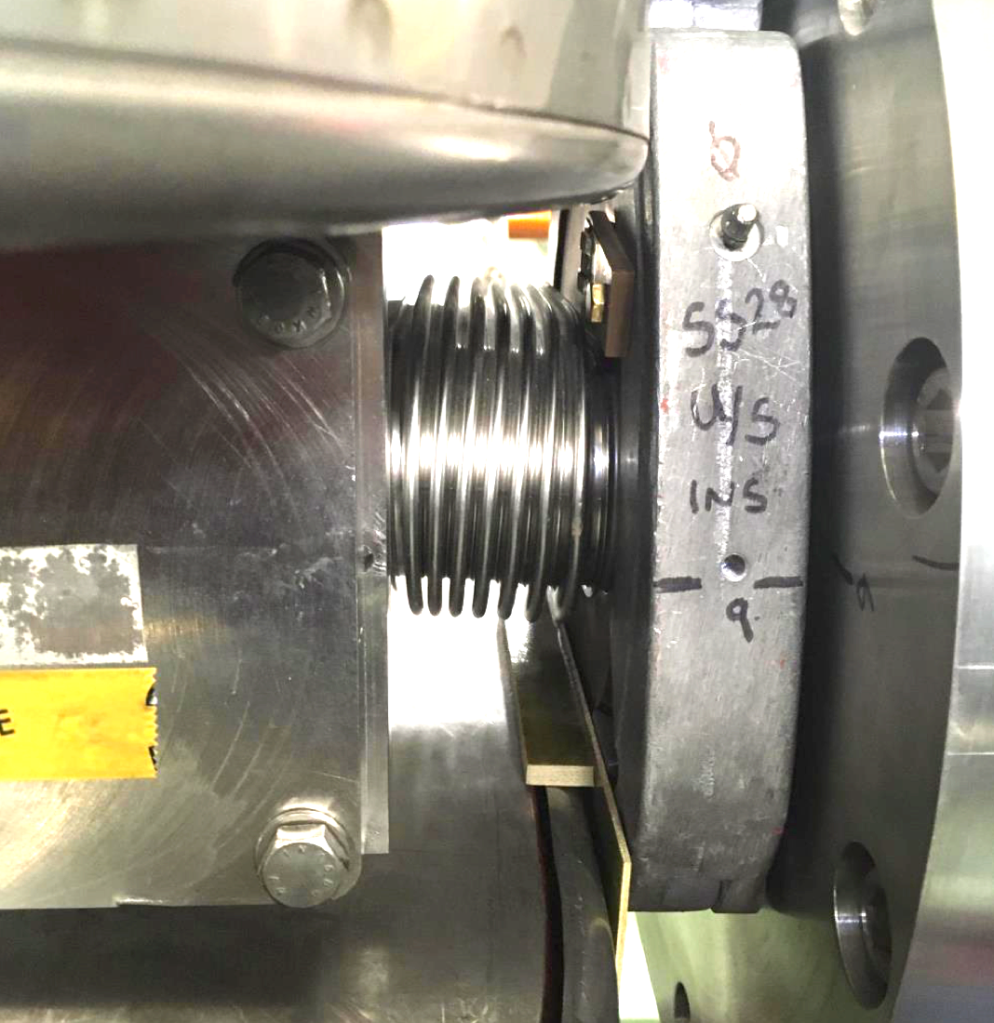
Outline
Introduction
Closed orbit distortion (steering error)
Beam orbit stability
Imperfections leading to closed orbit distortion
Effect of single and multiple dipole kicks
Closed orbit correction methods
Optics function distortion (gradient error)
Imperfections leading to optics distortion
Tune-shift and beta distortion due to gradient errors
Gradient error correction
Coupling error
Coupling errors and their effect
Coupling correction
Summary

Slide 4
Outline
Introduction
Closed orbit distortion (steering error)
Beam orbit stability
Imperfections leading to closed orbit distortion
Effect of single and multiple dipole kicks
Closed orbit correction methods
Optics function distortion (gradient error)
Imperfections leading to optics distortion
Tune-shift and beta distortion due to gradient errors
Gradient error correction
Coupling error
Coupling errors and their effect
Coupling correction
Summary

Slide 5
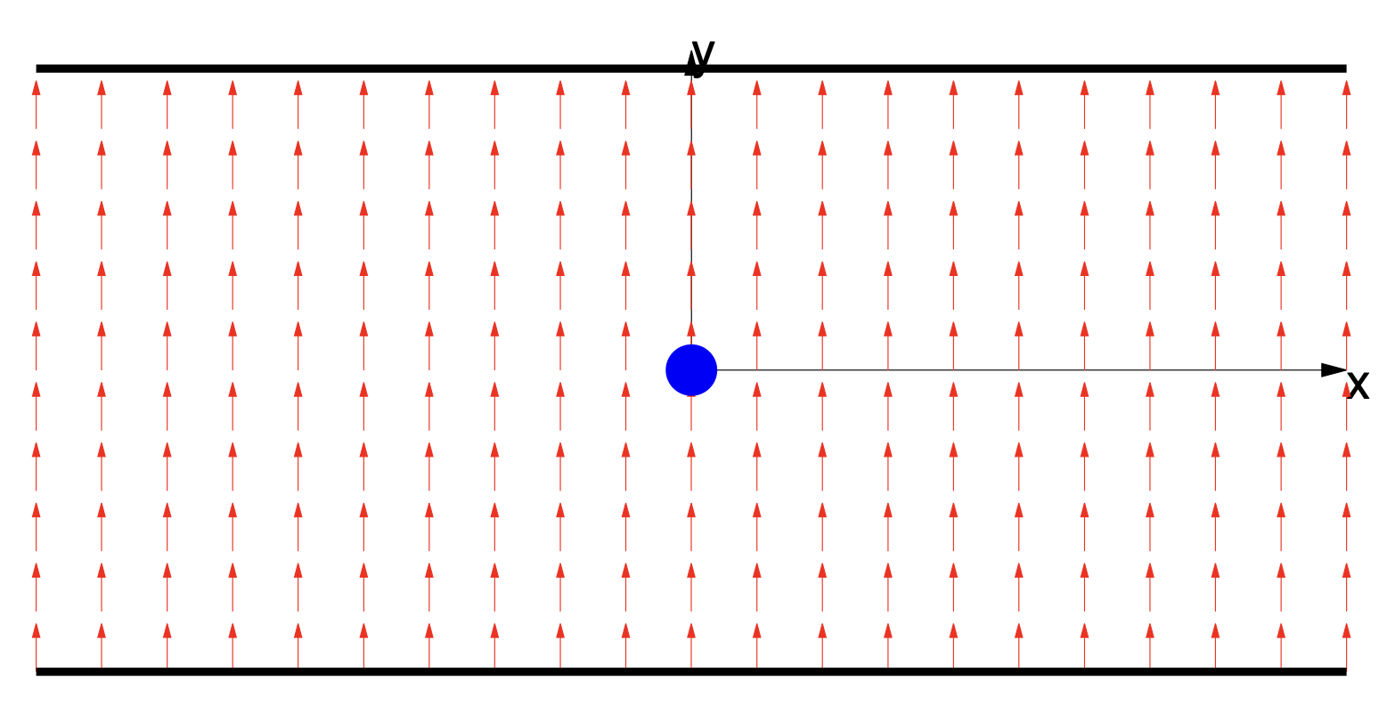
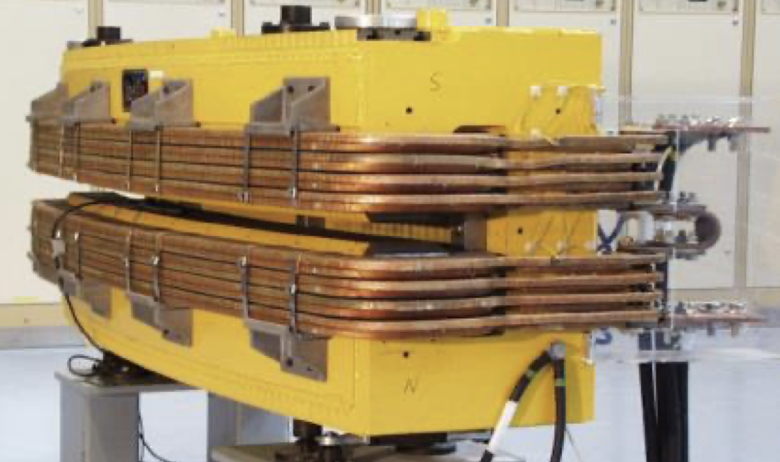
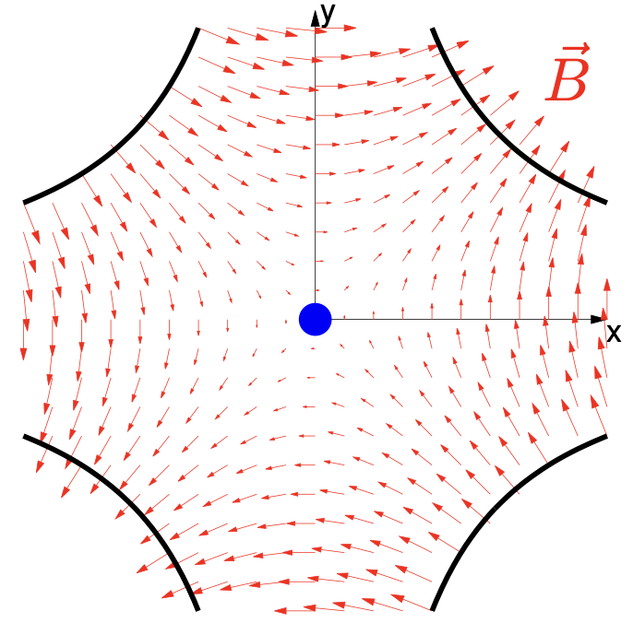
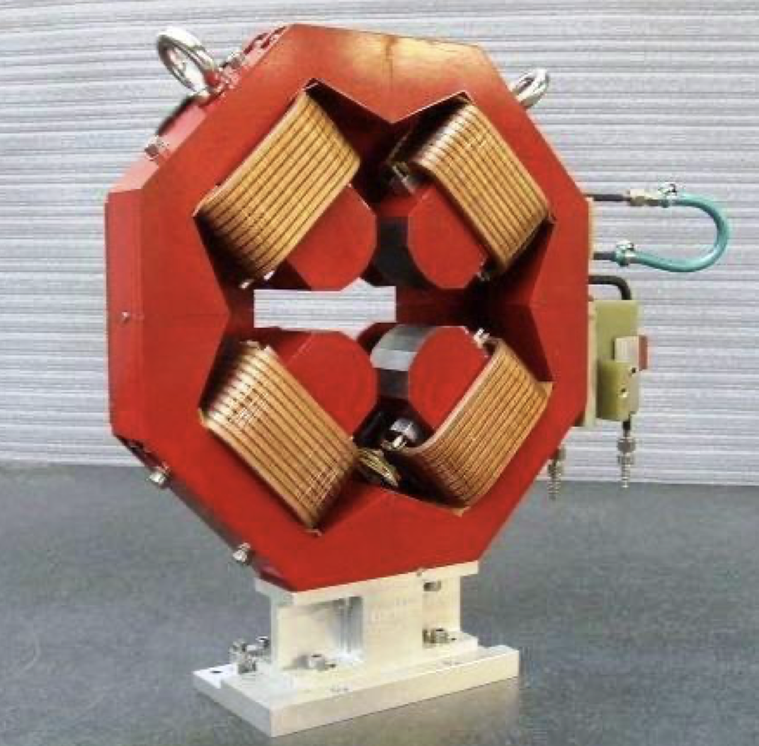
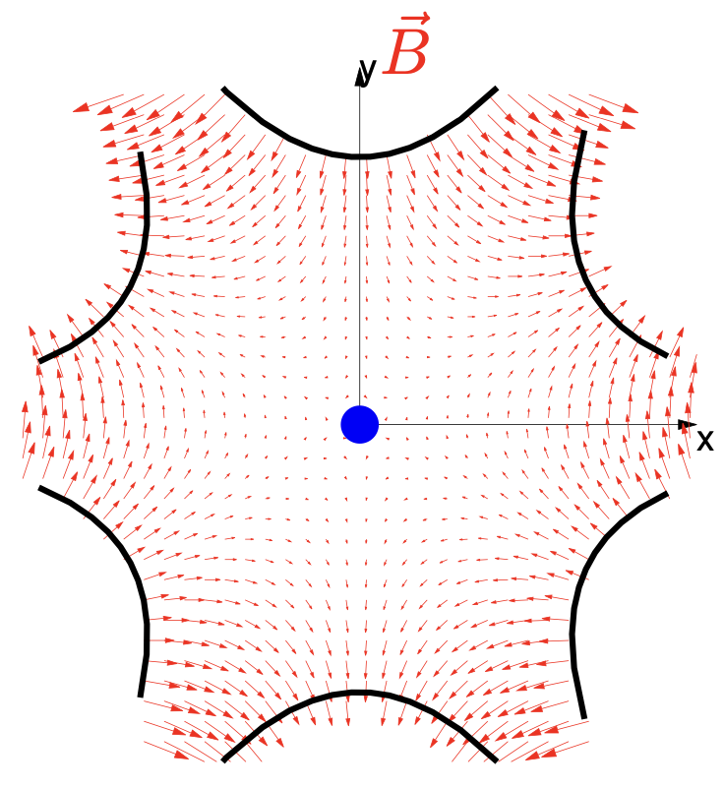
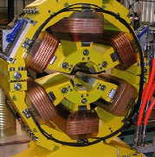
Basics: accelerator lattice
An accelerator is usually build using a repetition of basic ‘cells’
A simple FODO cell usually contains:
Dipole magnets to bend the beams
Quadrupole magnets to focus the beams
Beam position monitors (BPM) to measure the beam position
Small dipole corrector magnets for beam steering
(Sextupole magnets to control off-energy focusing)
Quadrupole (focussing)
Quadrupole (de-focussing)
Sextupole
Dipole corrector
Dipole
Dipole
beam
Beam position monitor
Schematic of a ½ cell (not to scale)

Slide 6
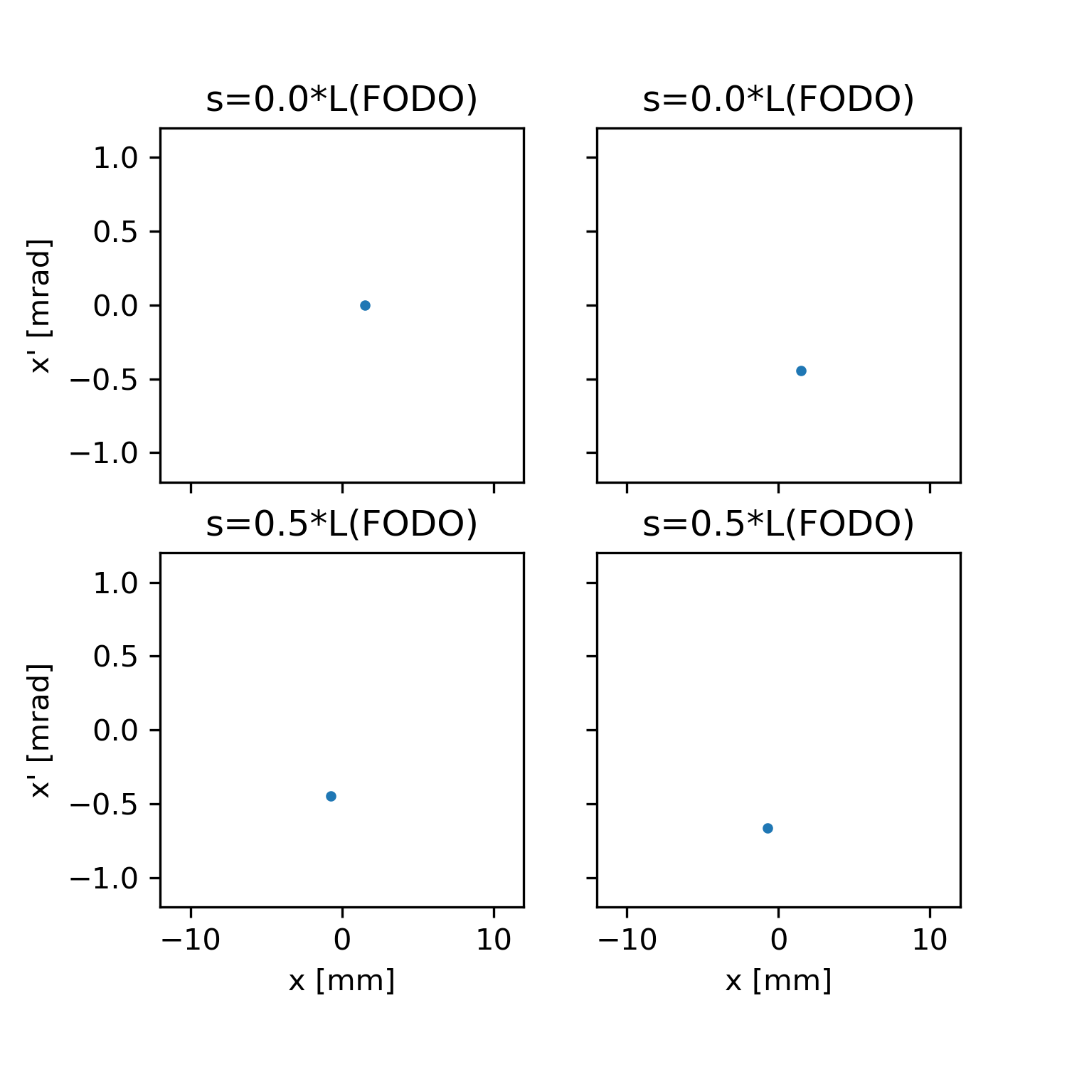
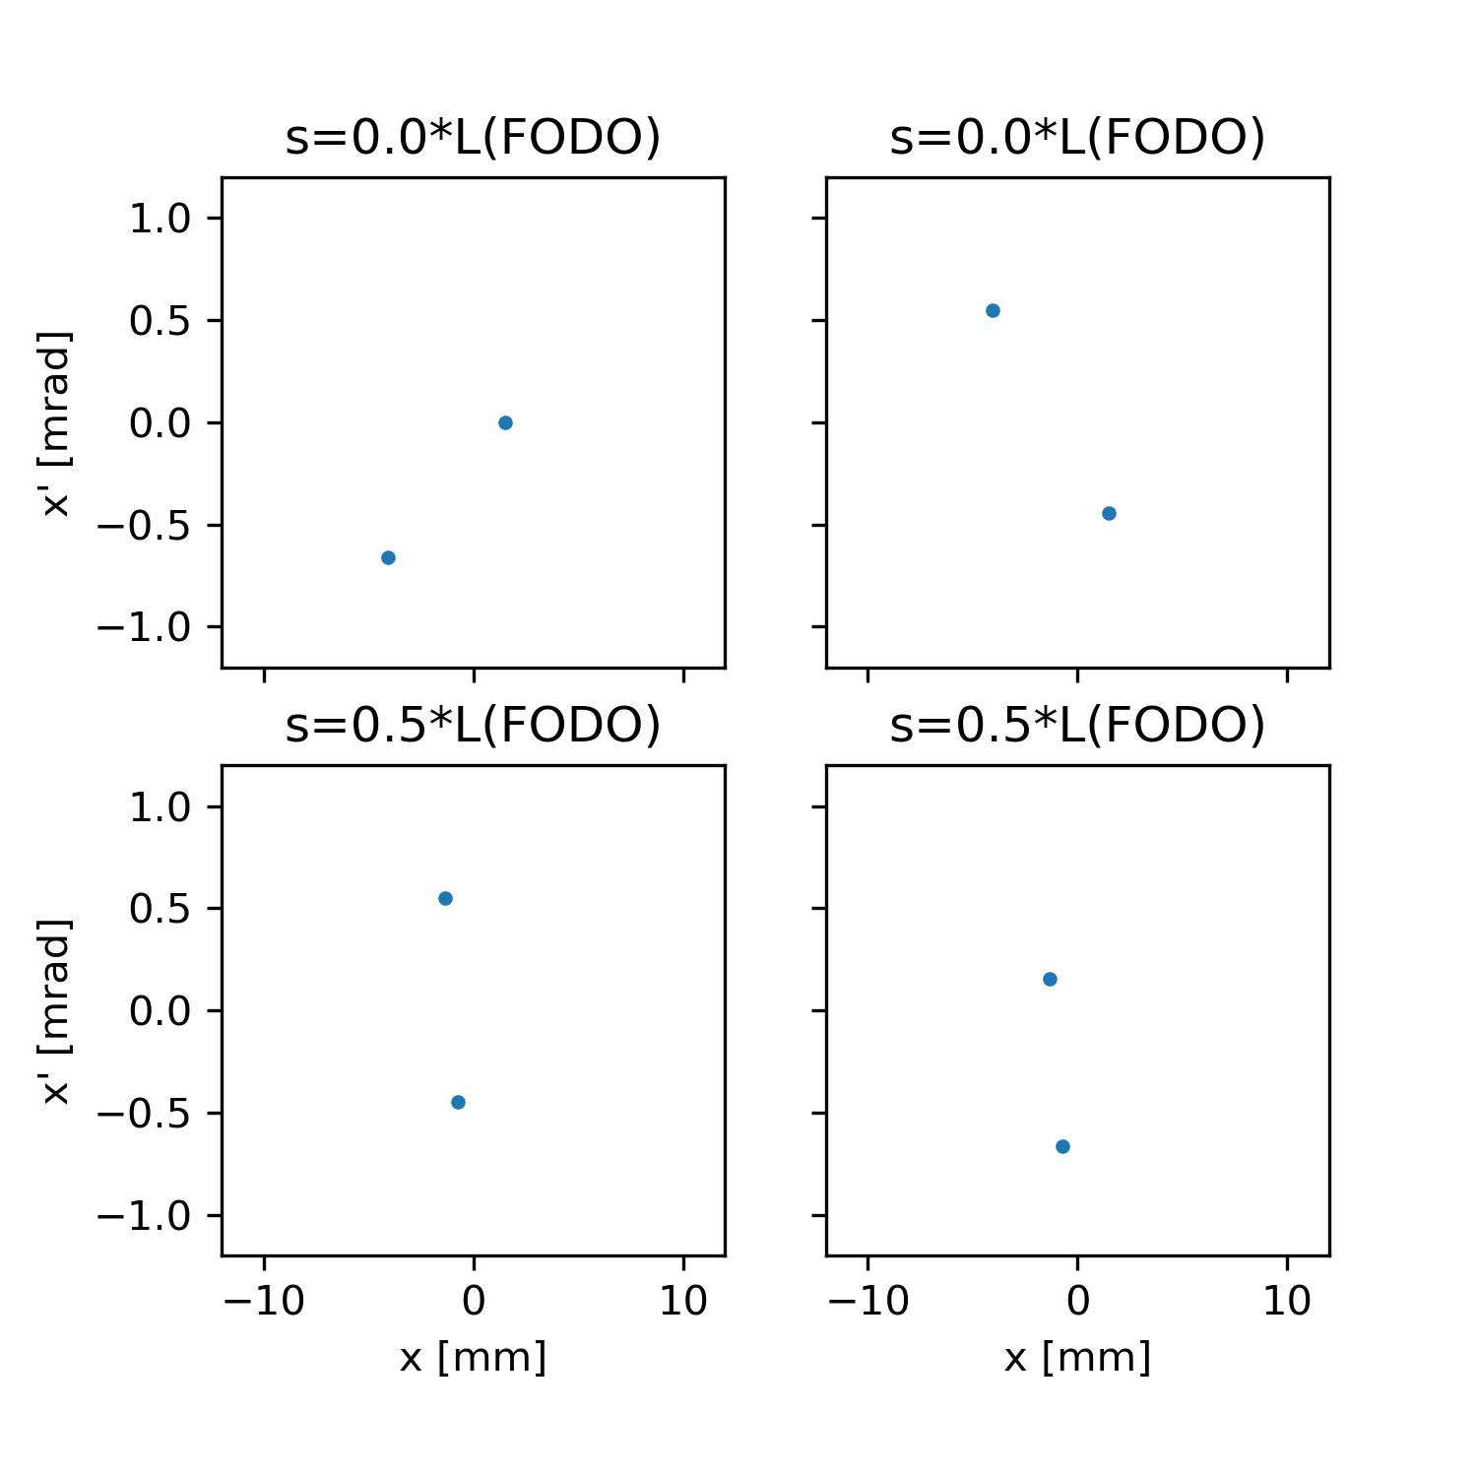
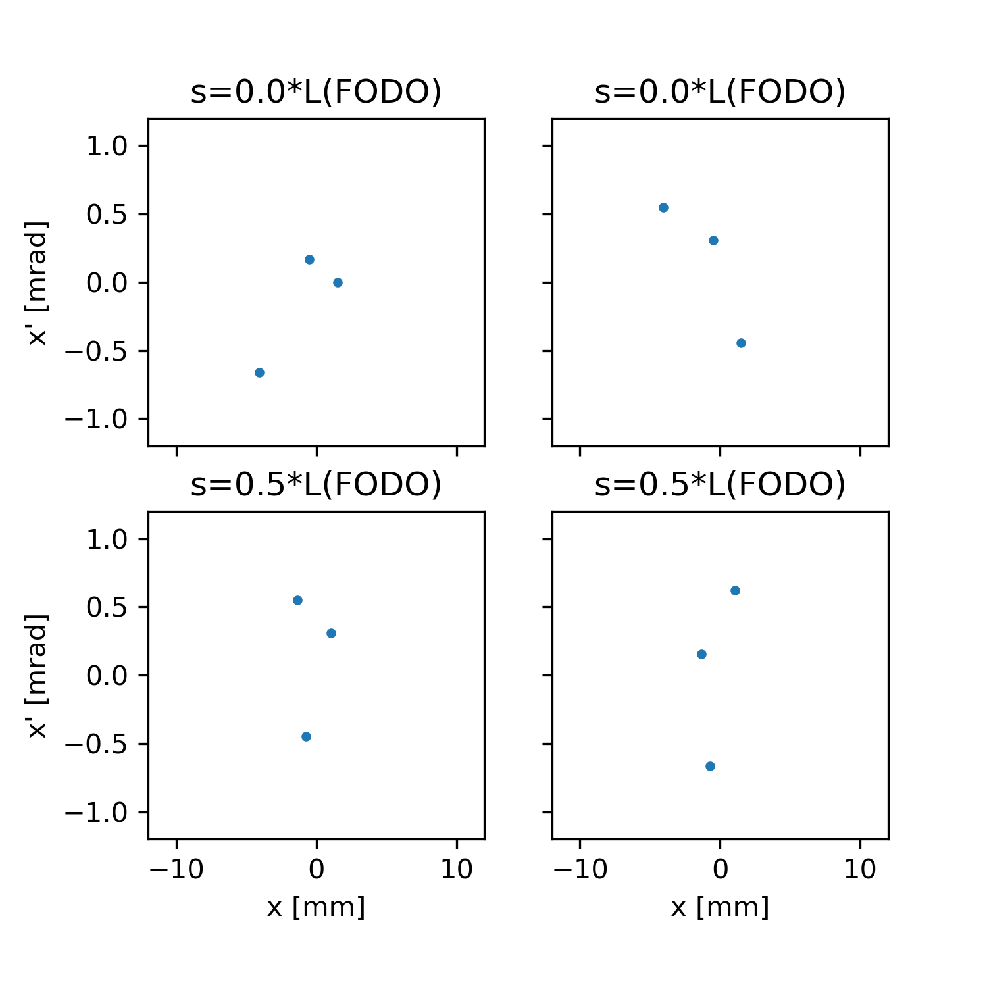
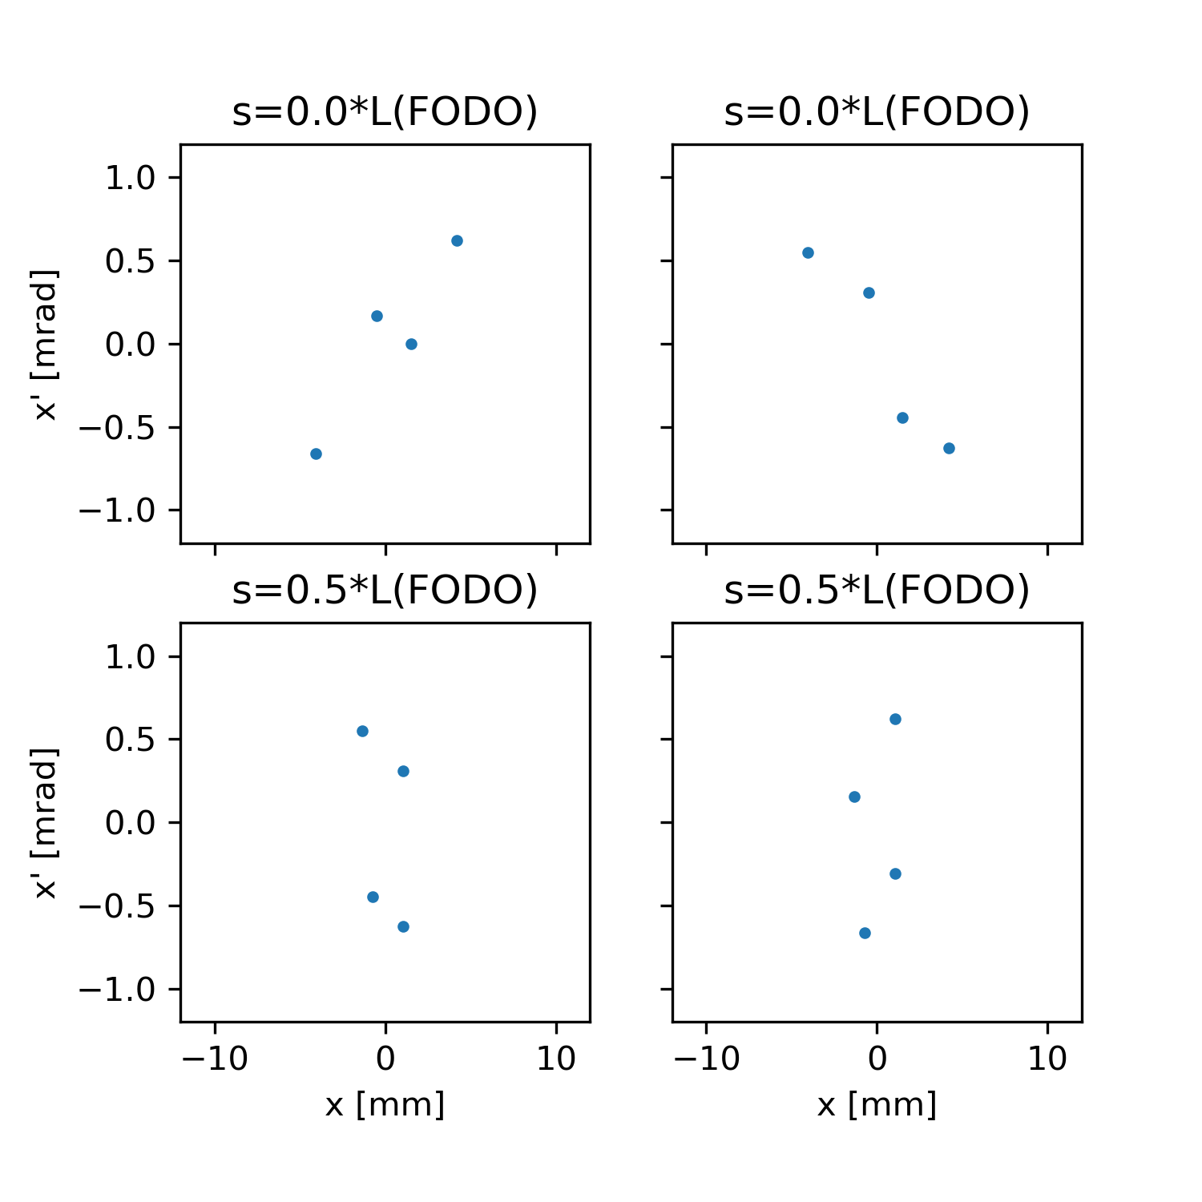
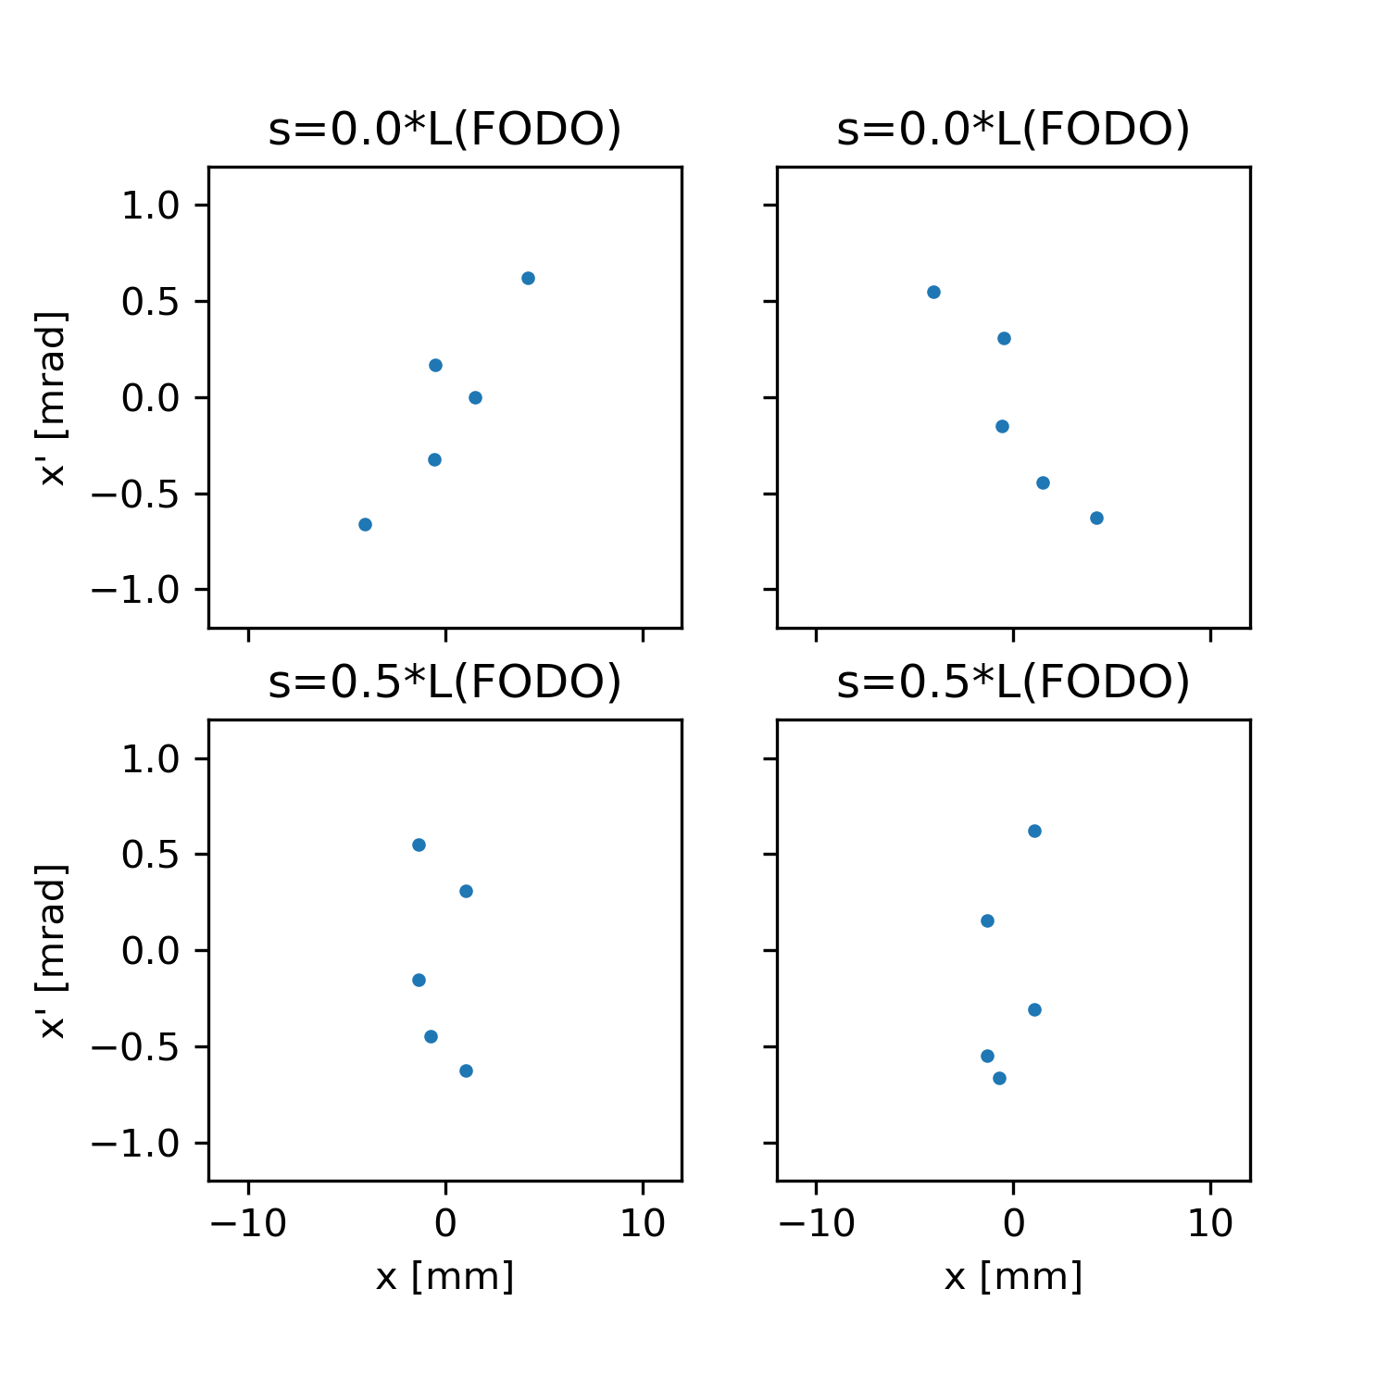
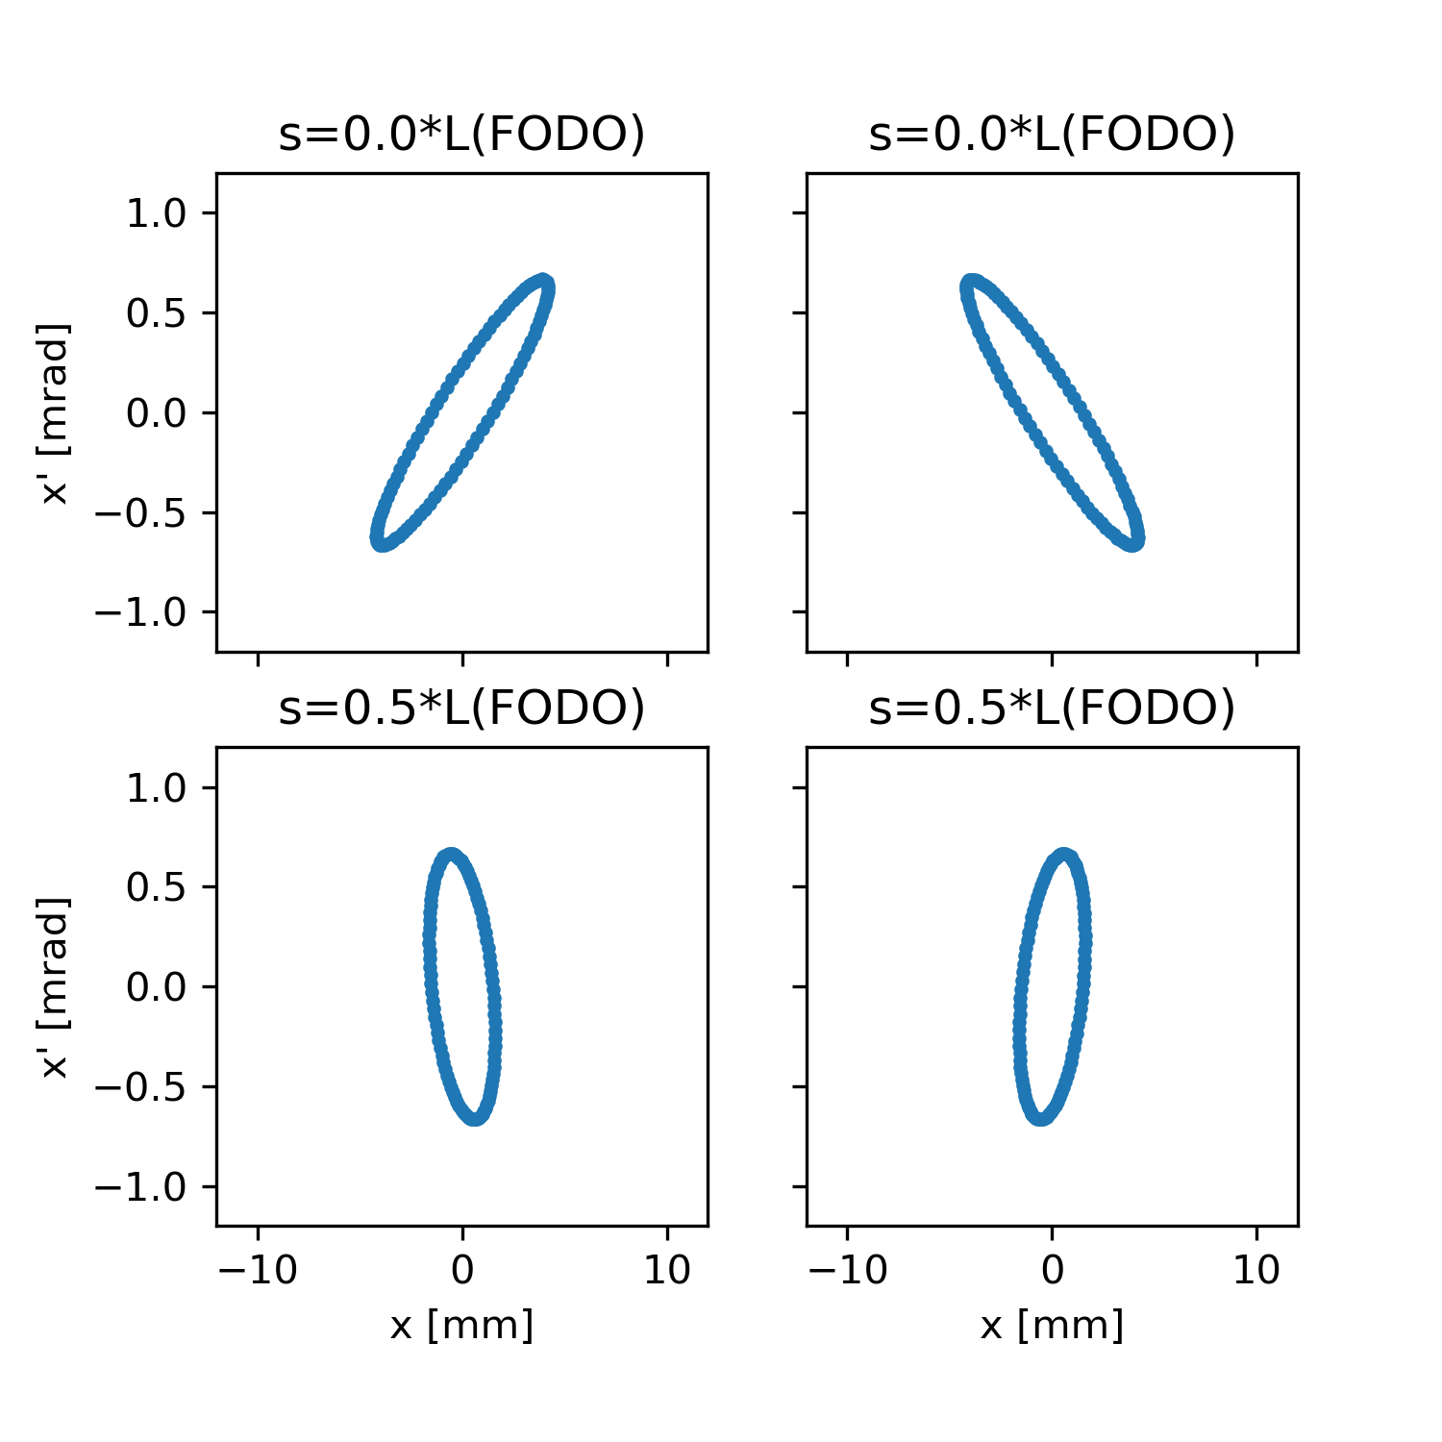
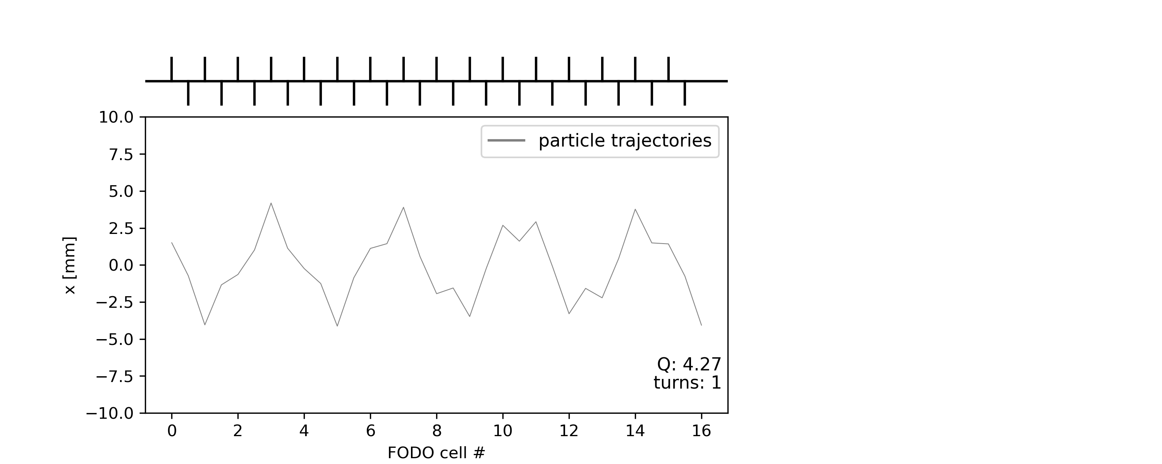
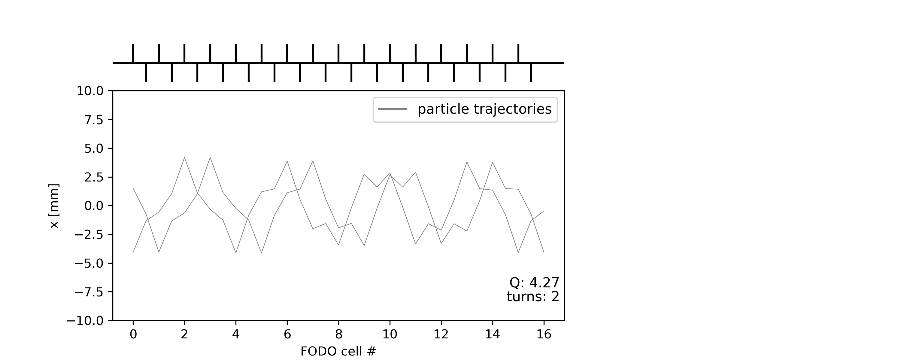

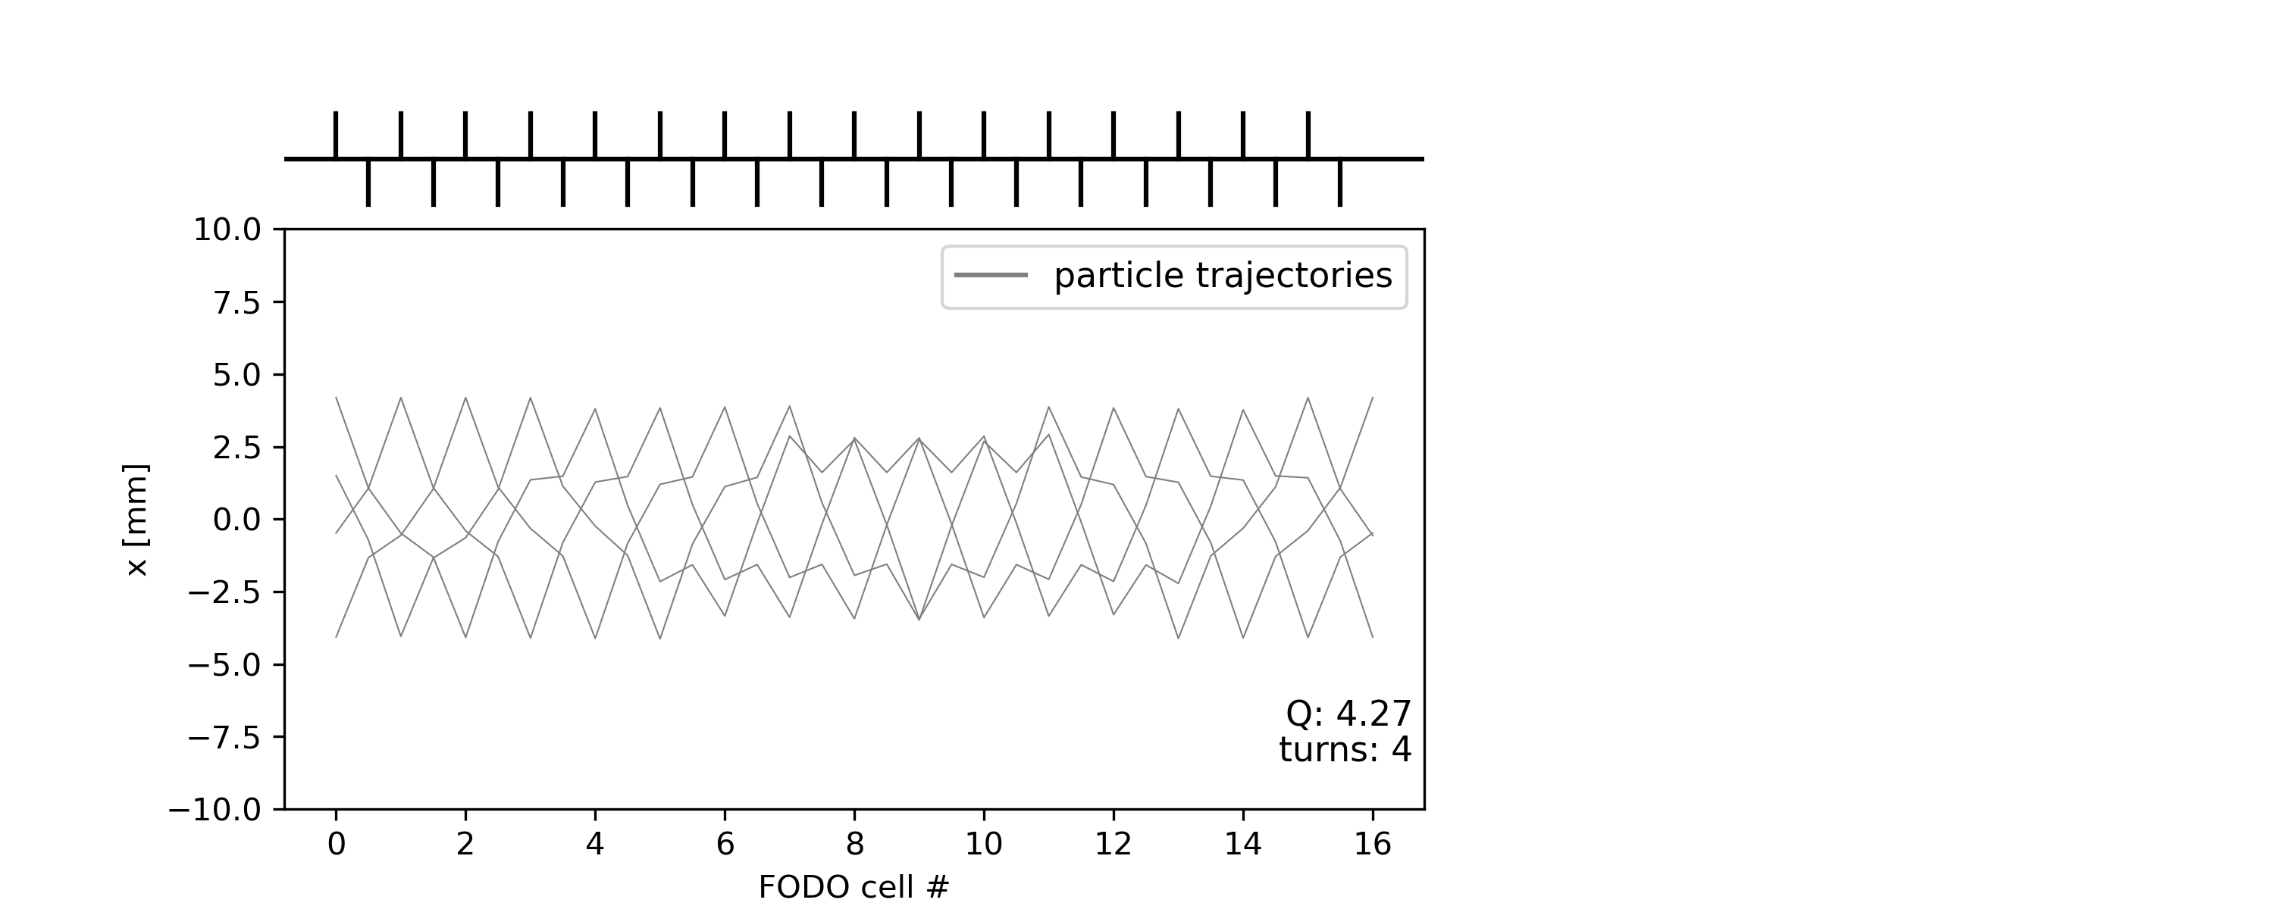

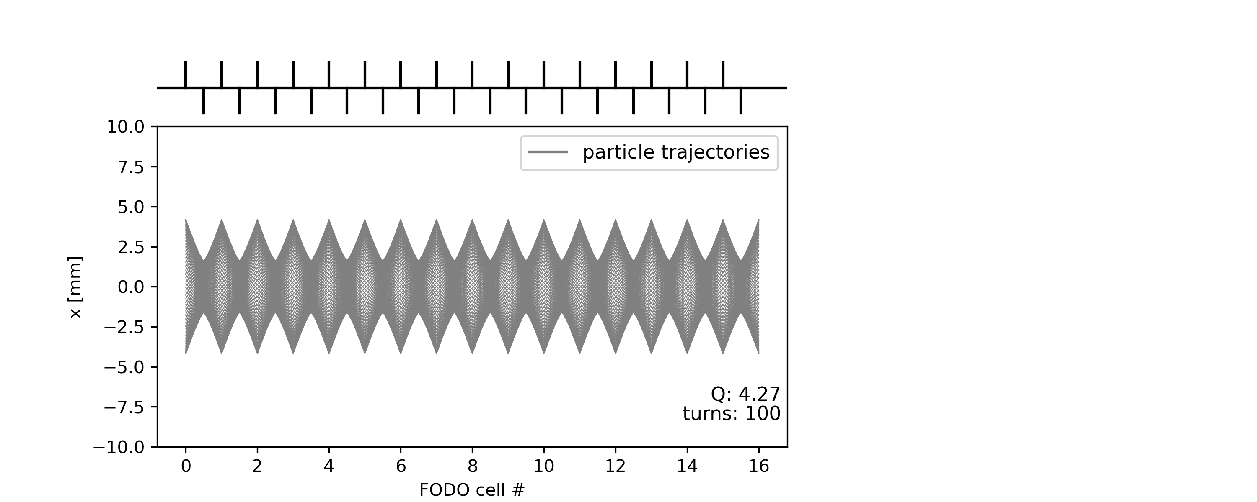
Recap: Toy FODO lattice with no errors
Tracking a single particle, for many turns
A)
B)
A) Before foc. quad.
B) After foc. quad.
C)
D)
Starting point
C) Before defoc. quad.
D) After defoc. quad.
Element by element “tracking” till completion of one turn…
… and start a new turn

Slide 7
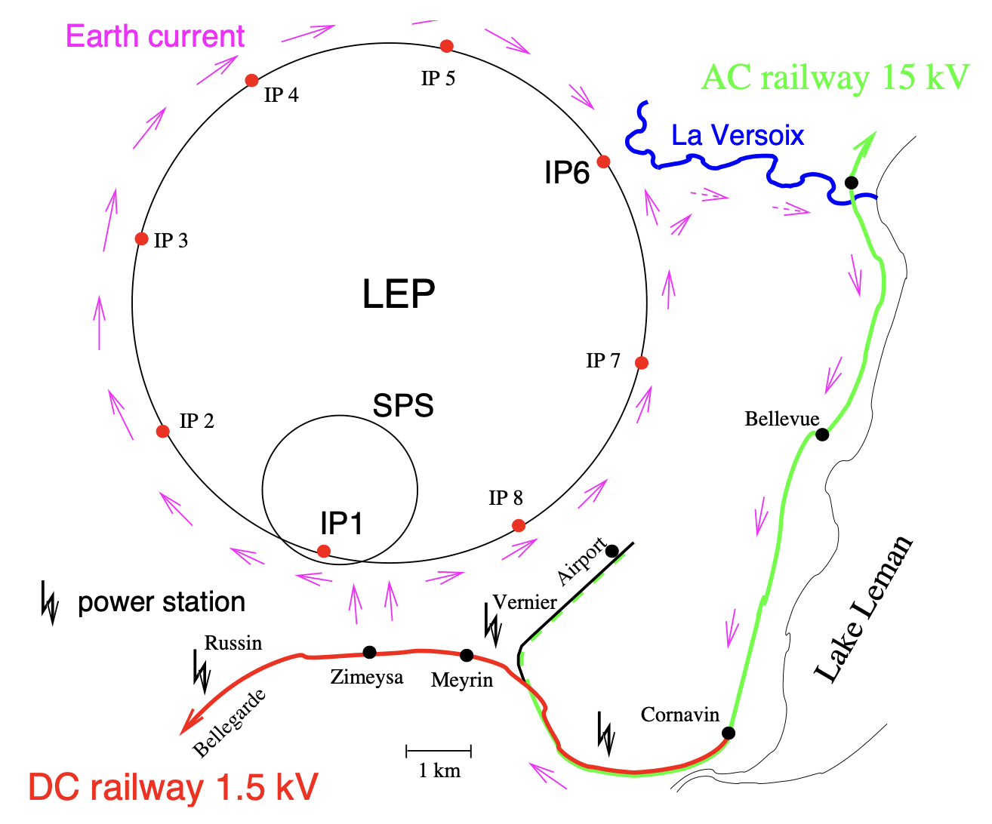
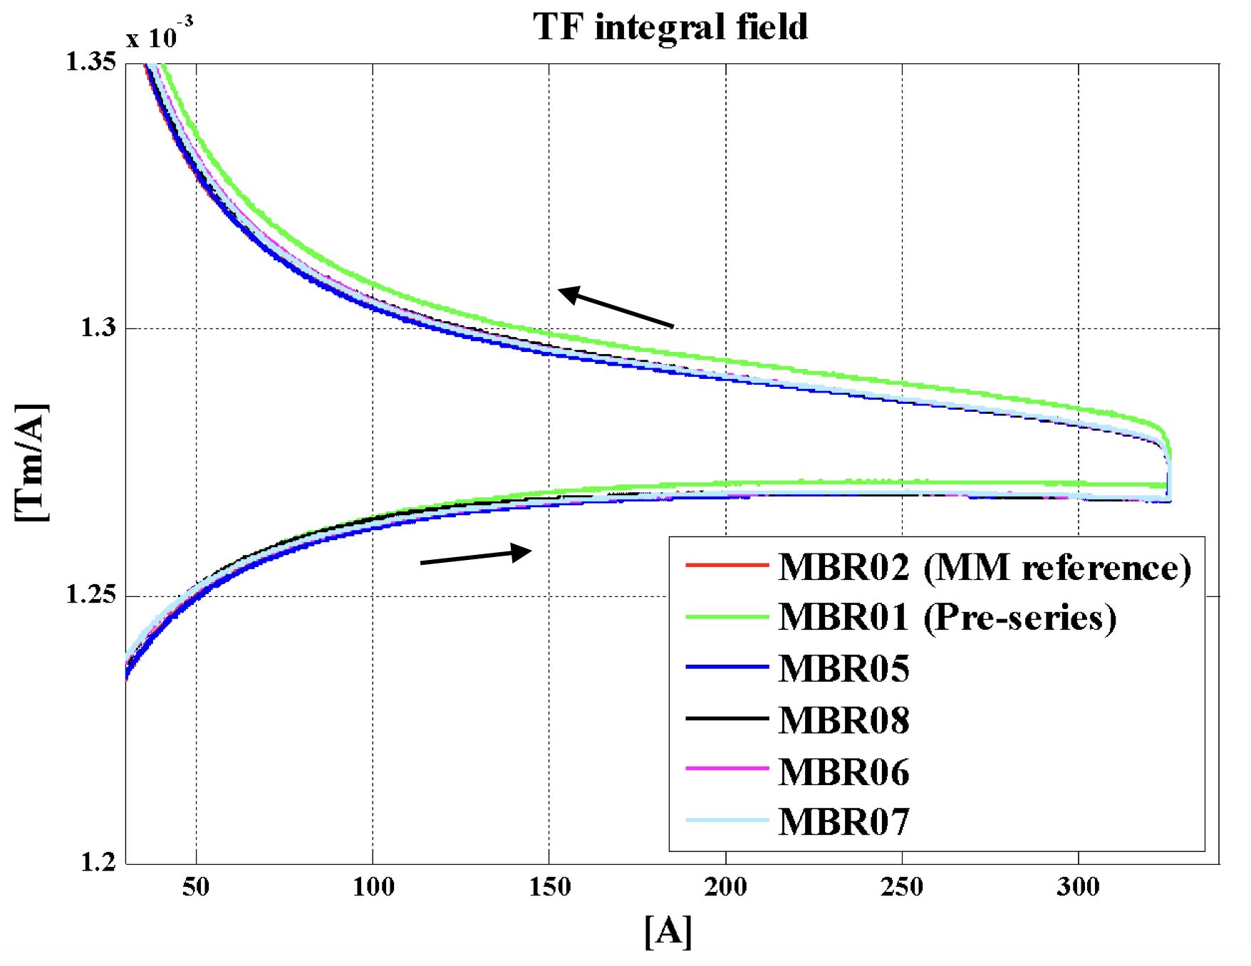
From model to reality - fields
The physical units of the machine model defined by the accelerator physicist must be converted into magnetic fields and eventually into currents for the power converters that feed the magnet circuits.
Imperfections (= errors) in the real accelerator optics can be introduced by uncertainties or errors
E.g., actual beam momentum, magnet calibration and hysteresis, power converter regulation, …
Magnet strength
Actual magnet current
Actual field seen by the beam
Magnetic field (gradient)
Requested current
Beam momentum
Magnet
Calibration/hysteresis curve (transfer function)
Power converter
Additional effects, e.g. eddy currents
Earth currents flowing over the LEP vacuum chamber that were generated by the DC railway line near Geneva
Example of the ELENA main dipoles hysteresis curve

Slide 8
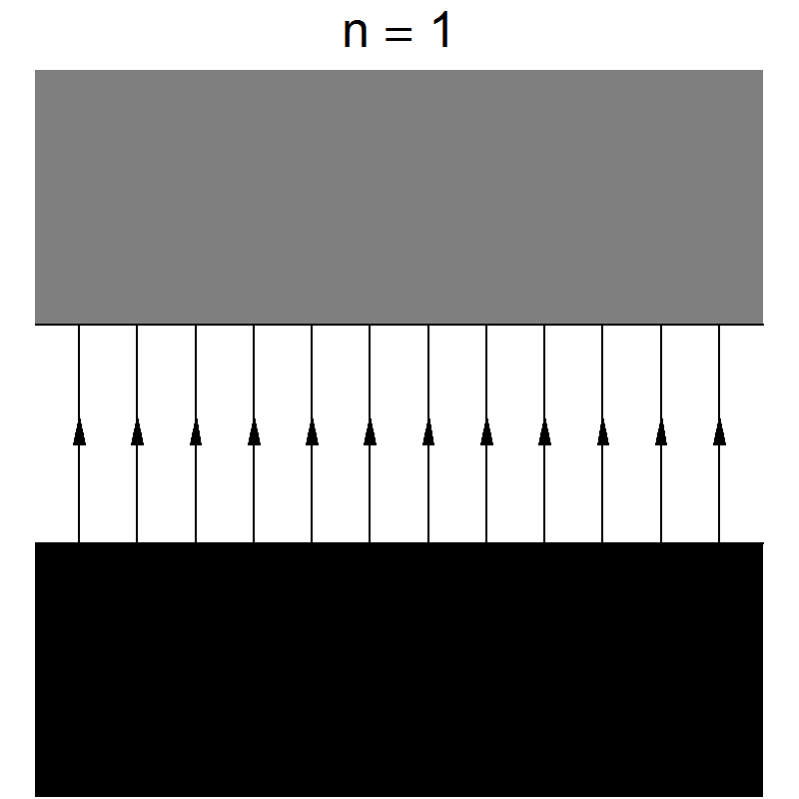
E.g. sources of unintended deflections
Field error (deflection error) of a dipole magnet
This can be due to an error in the magnet current or in the calibration table (measurement accuracy etc.)
The imperfect dipole can be expressed as the ideal one + a small error
By analogy: field errors on higher order magnets (e.g. quadrupoles, sextupoles…) can be treated as perturbation of the same order (e.g. ideal quadrupole + small quadrupole error…)
imperfect dipole
ideal dipole
small dipole
error
→ horizontal kick
=
+

Slide 9
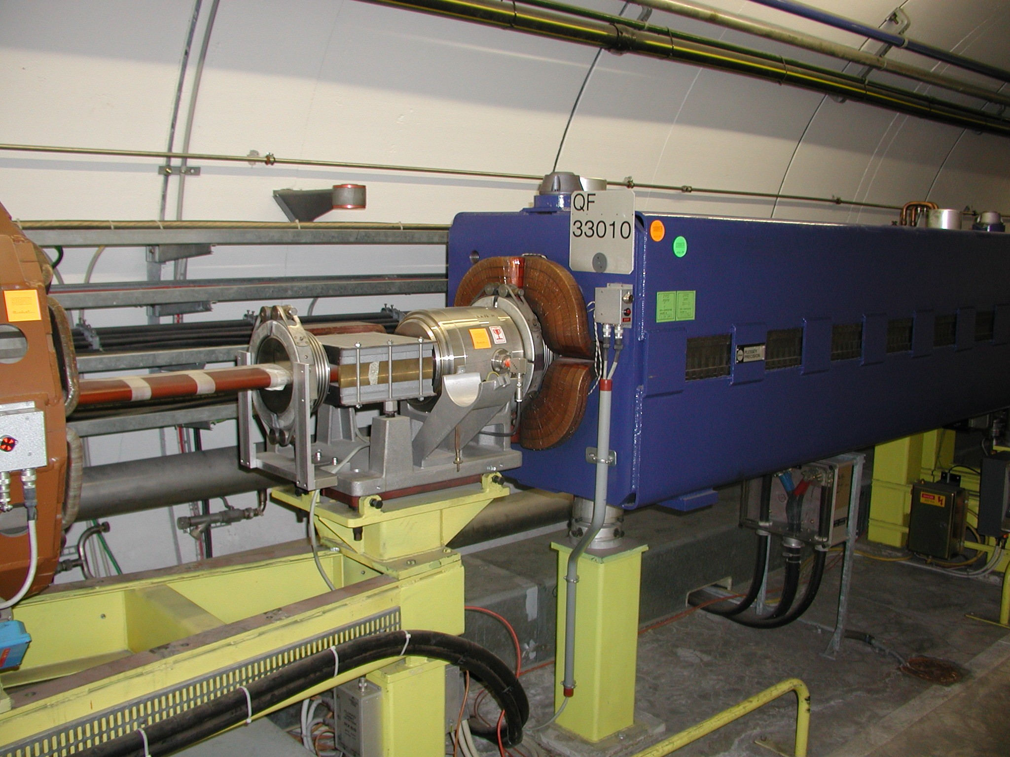
From model to reality - alignment
To ensure that the accelerator elements are in the correct position the alignment must be precise –
For CERN hadron machines we aim for accuracies of about 0.1 mm
To the level of nanometer for linear colliders, e.g. the CLIC final focusing !
The alignment process implies:
Precise measurements of the magnetic axis in the laboratory with reference to the element alignment markers used by the survey group.
Precise in-situ alignment (position and angle) of the element in the tunnel.
Alignment errors are a common source of imperfections

Slide 10
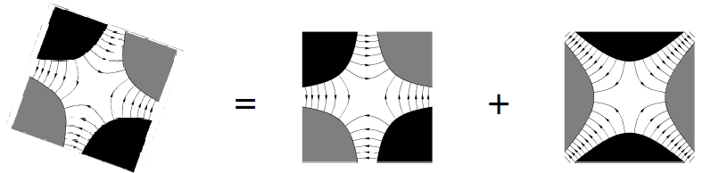
E.g. misalignments causing feed-down
Misalignment of a quadrupole magnet

Slide 11
E.g. misalignments causing feed-down
Misalignment of a quadrupole magnet
Equivalent to perfectly aligned quadrupole plus small dipole
By analogy: misalignment on higher order magnets (e.g. sextupoles…) produce perturbations of (all – see appendix!) lower orders (e.g. misaligned sextupole => small quadrupole + small dipole…)
=
+
quadrupole dipole
horizontal offset creates horizontal (normal) dipole

Slide 12
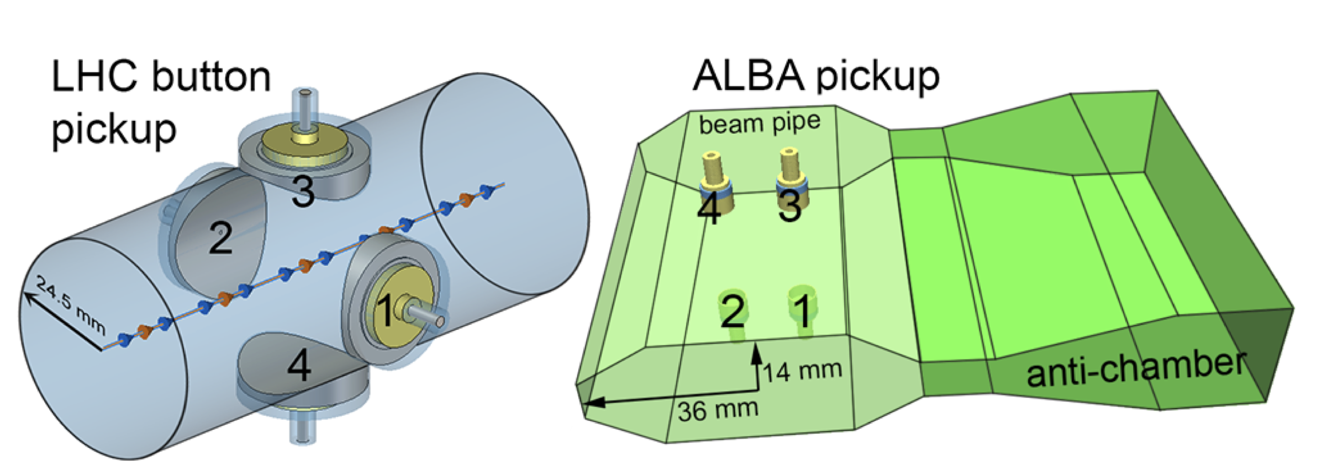
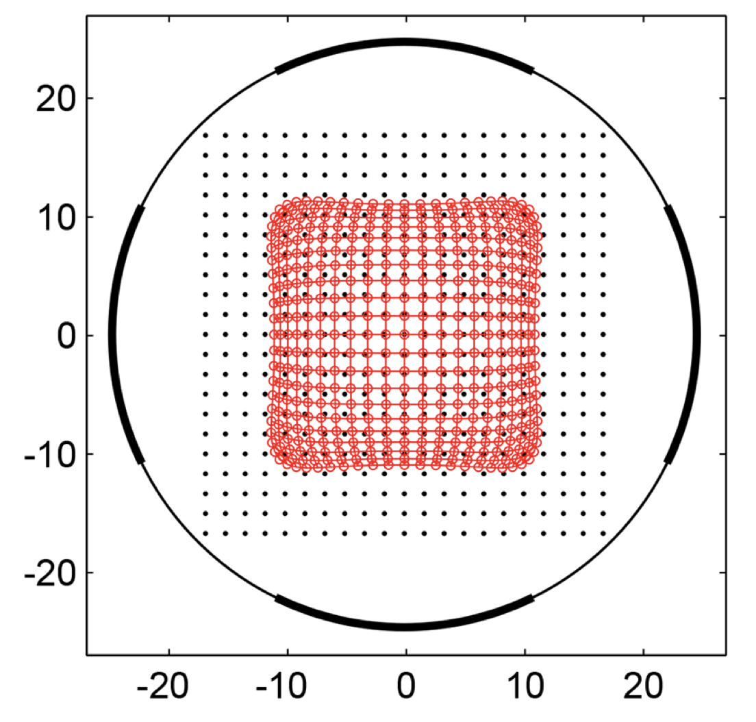
From model to reality – instrumentation
Most common instrument in a ring or beamline is some kind of “beam position monitor”
They can be misaligned or have calibration errors…
Or have more severe artifacts, e.g. see strong non-linearities at large beam offsets ! (they can be at least partially compensated)
Instrumentation errors won’t be treated in this lecture !
Assuming our instrumentation colleagues have done their best job (or, see Beam Diagnostics lectures!)
DoS response:
3
Beam envelope
2
1
Electrodes
grid of “simulated” beam position points
4
Plots from IBIC2014 - TUPF03
Notes:
\[
x = K_x \,\frac{V_1 - V_2}{V_1 + V_2 + V_3 + V_4},
\qquad
y = K_y \,\frac{V_3 - V_4}{V_1 + V_2 + V_3 + V_4}
\]
Difference-over-Sum (DoS) response of button BPMs: strong non-linearities at large beam offsets!

Slide 13
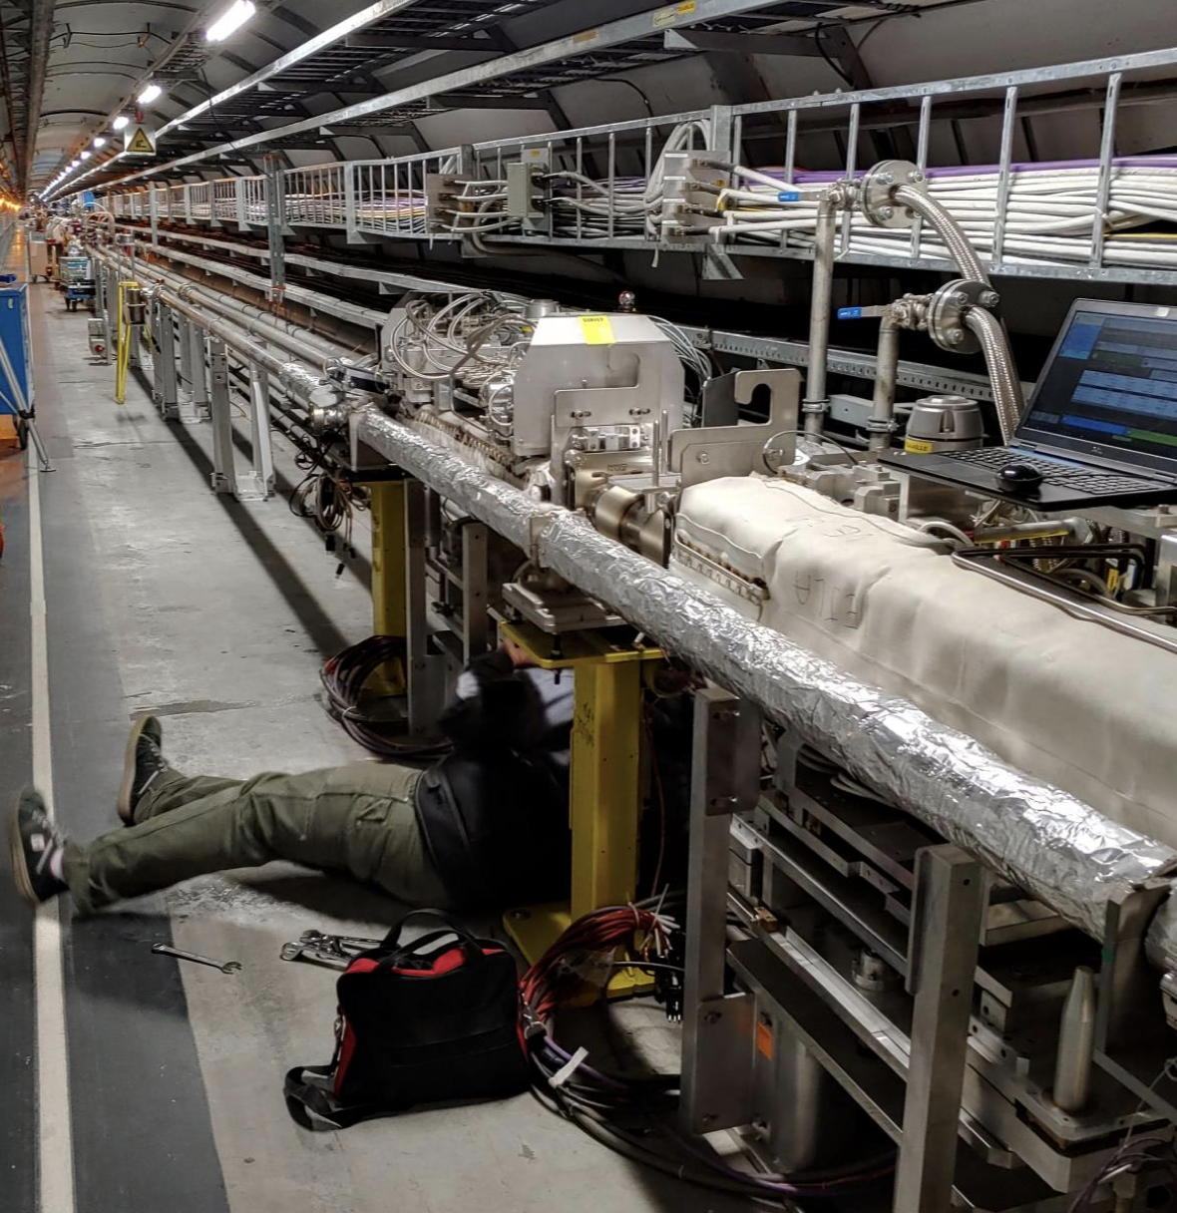
Outline
Introduction
Closed orbit distortion (steering error)
Beam orbit stability
Imperfections leading to closed orbit distortion
Effect of single and multiple dipole kicks
Closed orbit correction methods
Optics function distortion (gradient error)
Imperfections leading to optics distortion
Tune-shift and beta distortion due to gradient errors
Gradient error correction
Coupling error
Coupling errors and their effect
Coupling correction
Summary

Slide 14
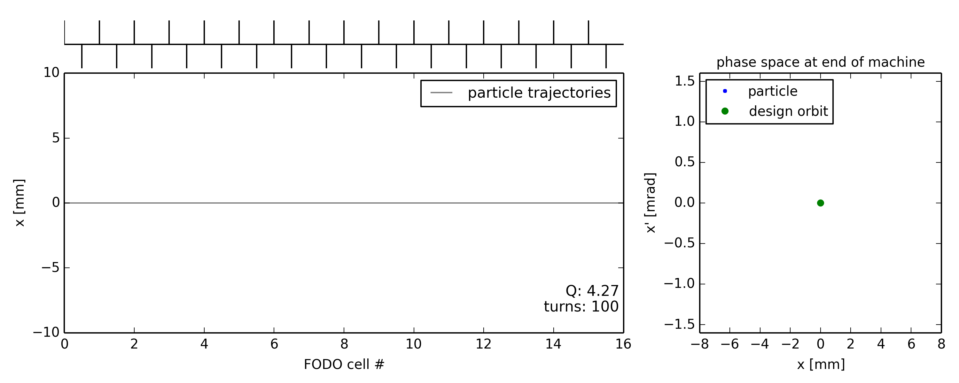
Illustration of closed orbit distortion
Ideal machine toy model (no errors)
Particle injected on the design (or reference) orbit … remains on the design orbit turn after turn
Starting point with (x=0, x’=0)

Slide 15
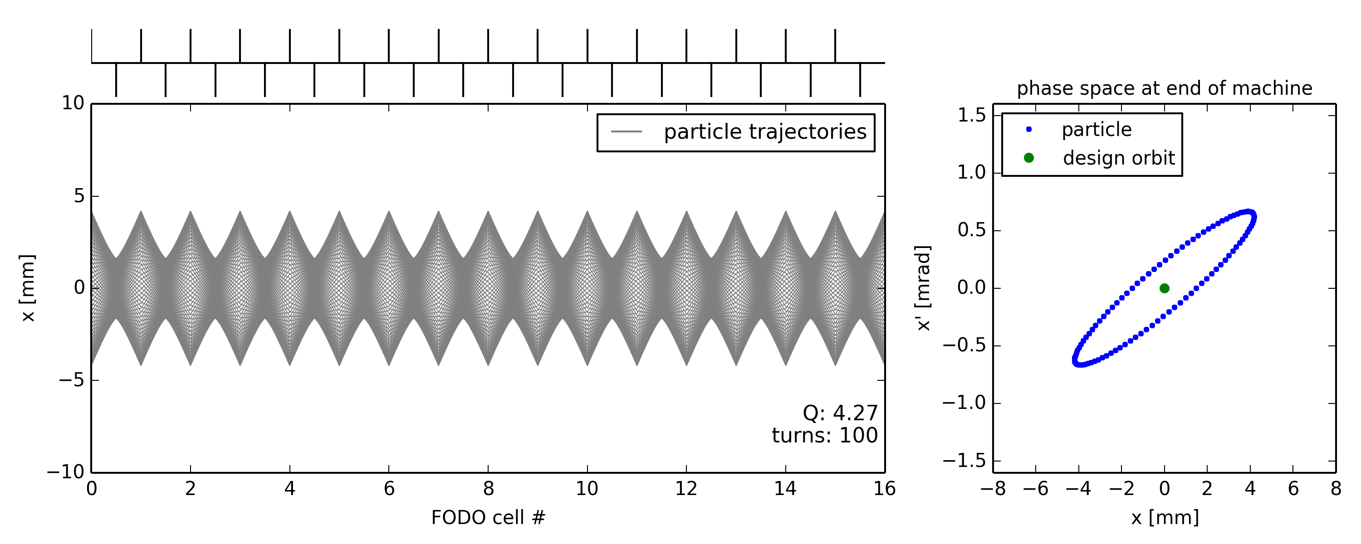
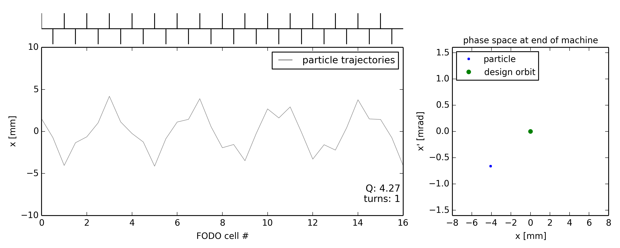
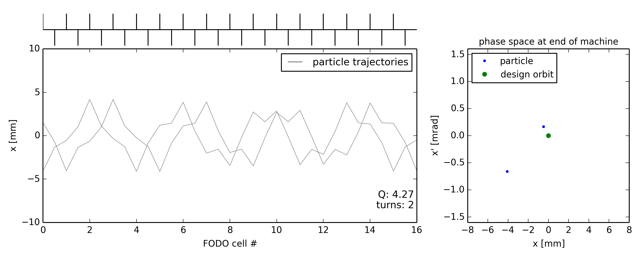
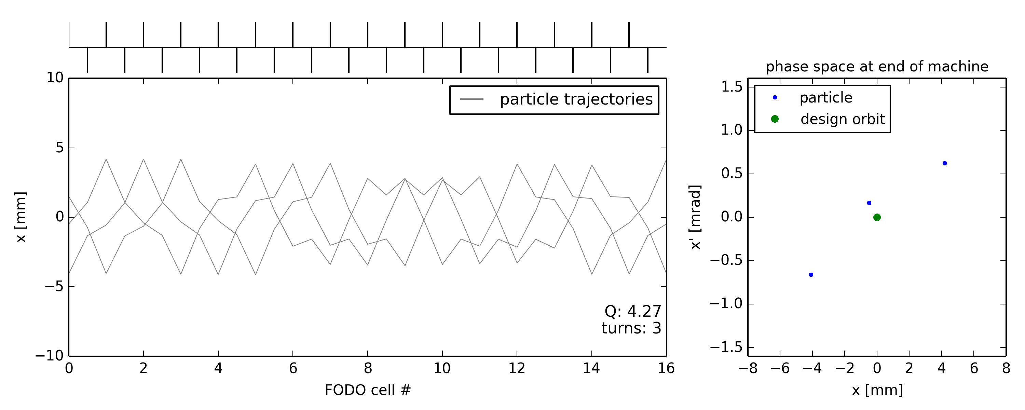
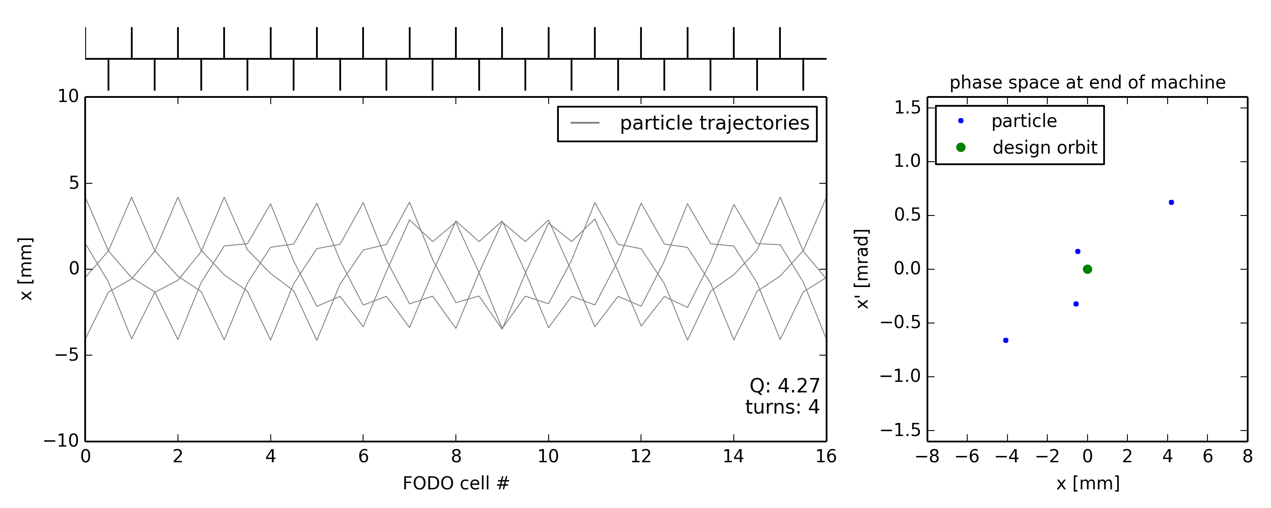

Illustration of closed orbit distortion
Ideal machine toy model (no errors)
Particle injected on the design (or reference) orbit … remains on the design orbit turn after turn
Particle injected with offset …

Slide 16
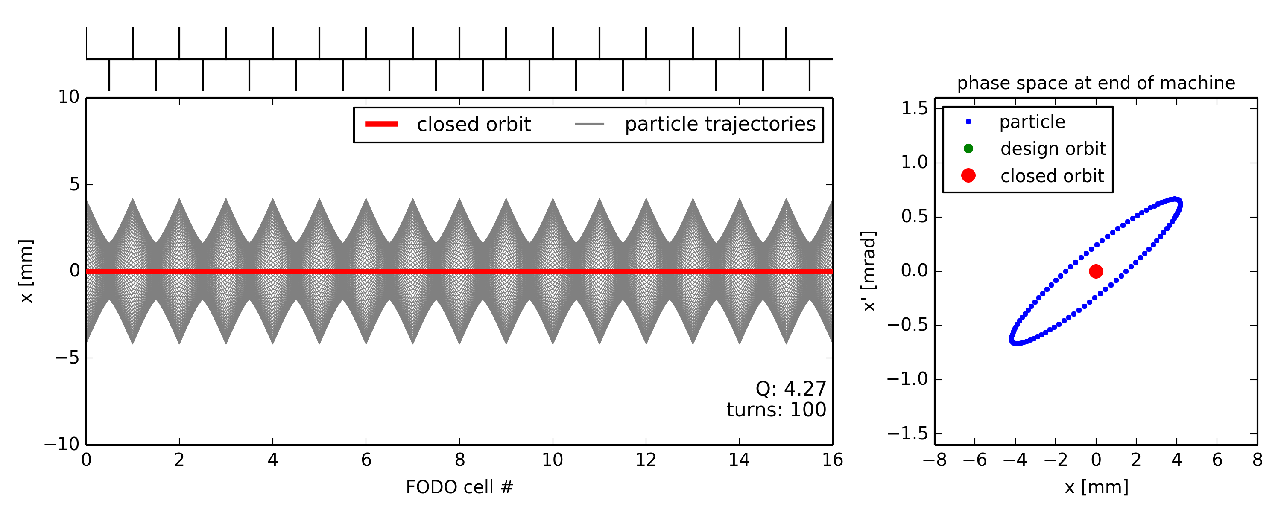
Illustration of closed orbit distortion
Ideal machine toy model (no errors)
Particle injected on the design (or reference) orbit … remains on the design orbit turn after turn
Particle injected with offset … performs betatron oscillations around the closed orbit which is the same as the design orbit as long as there are no imperfections

Slide 17
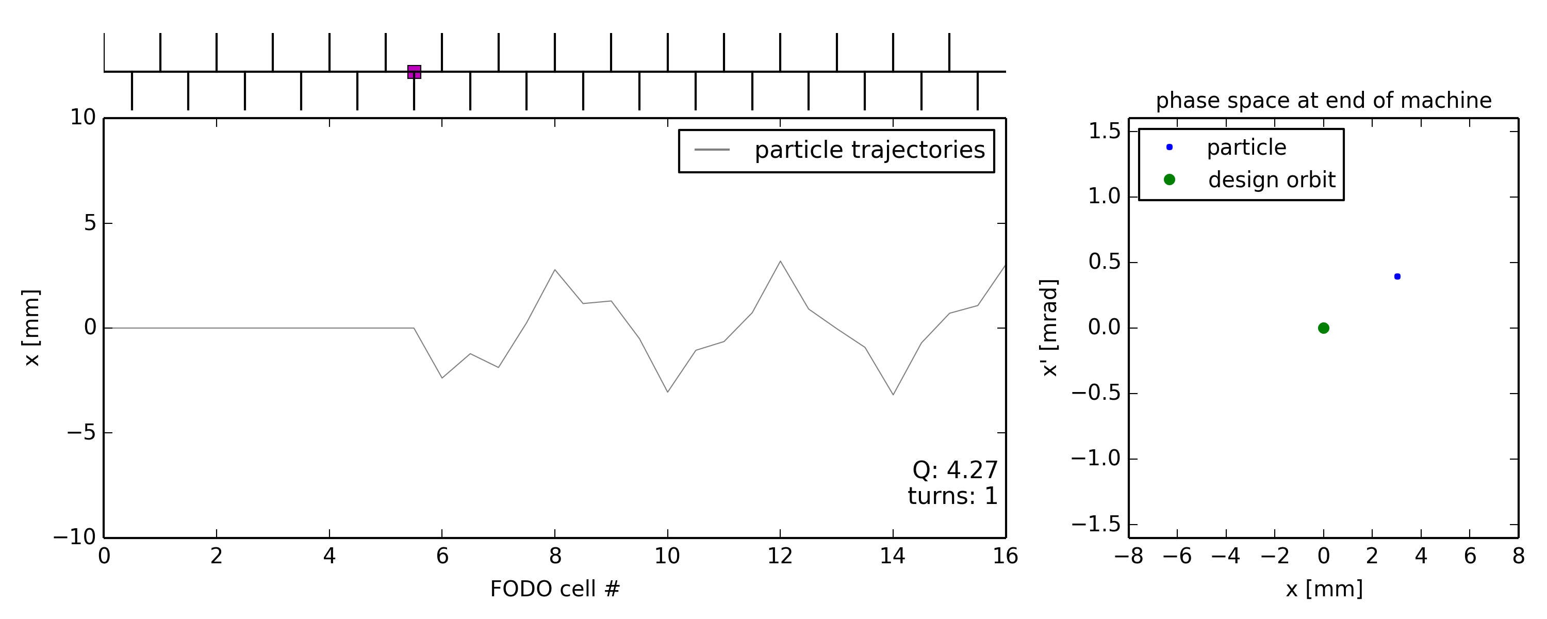

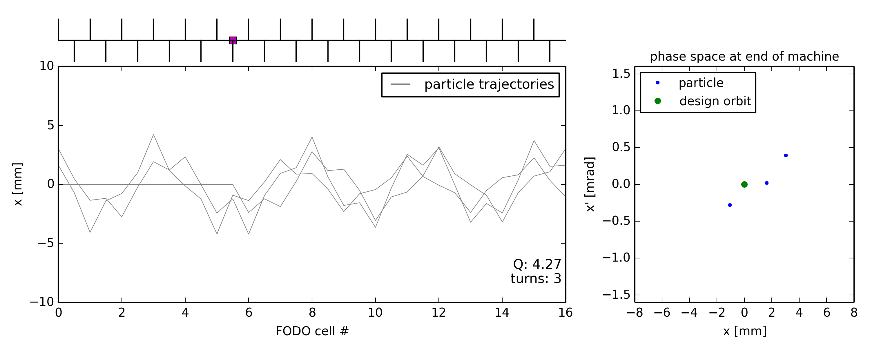
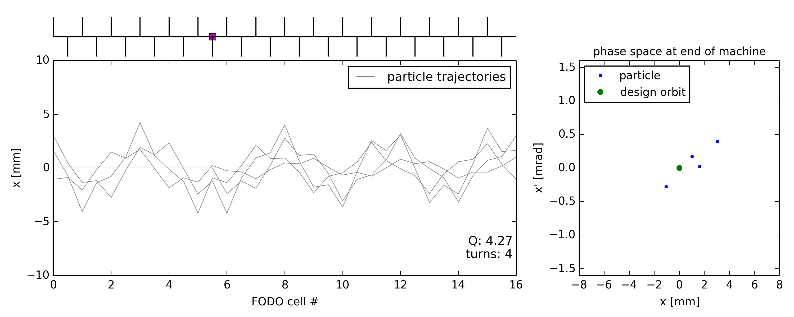
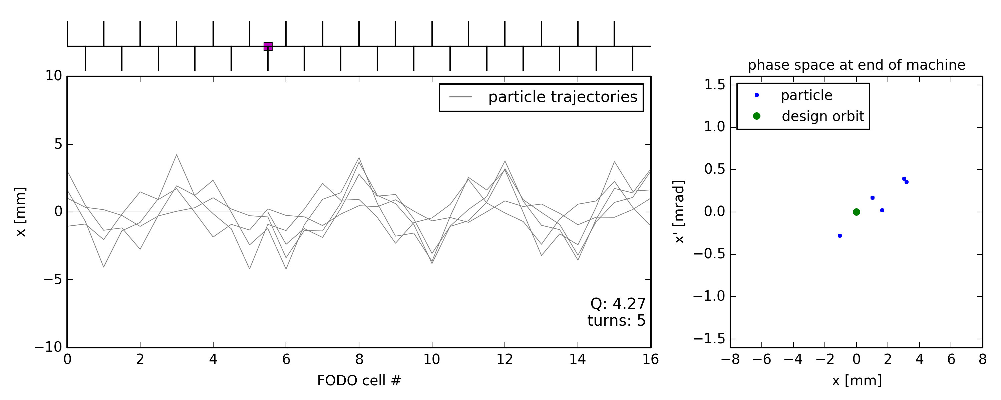
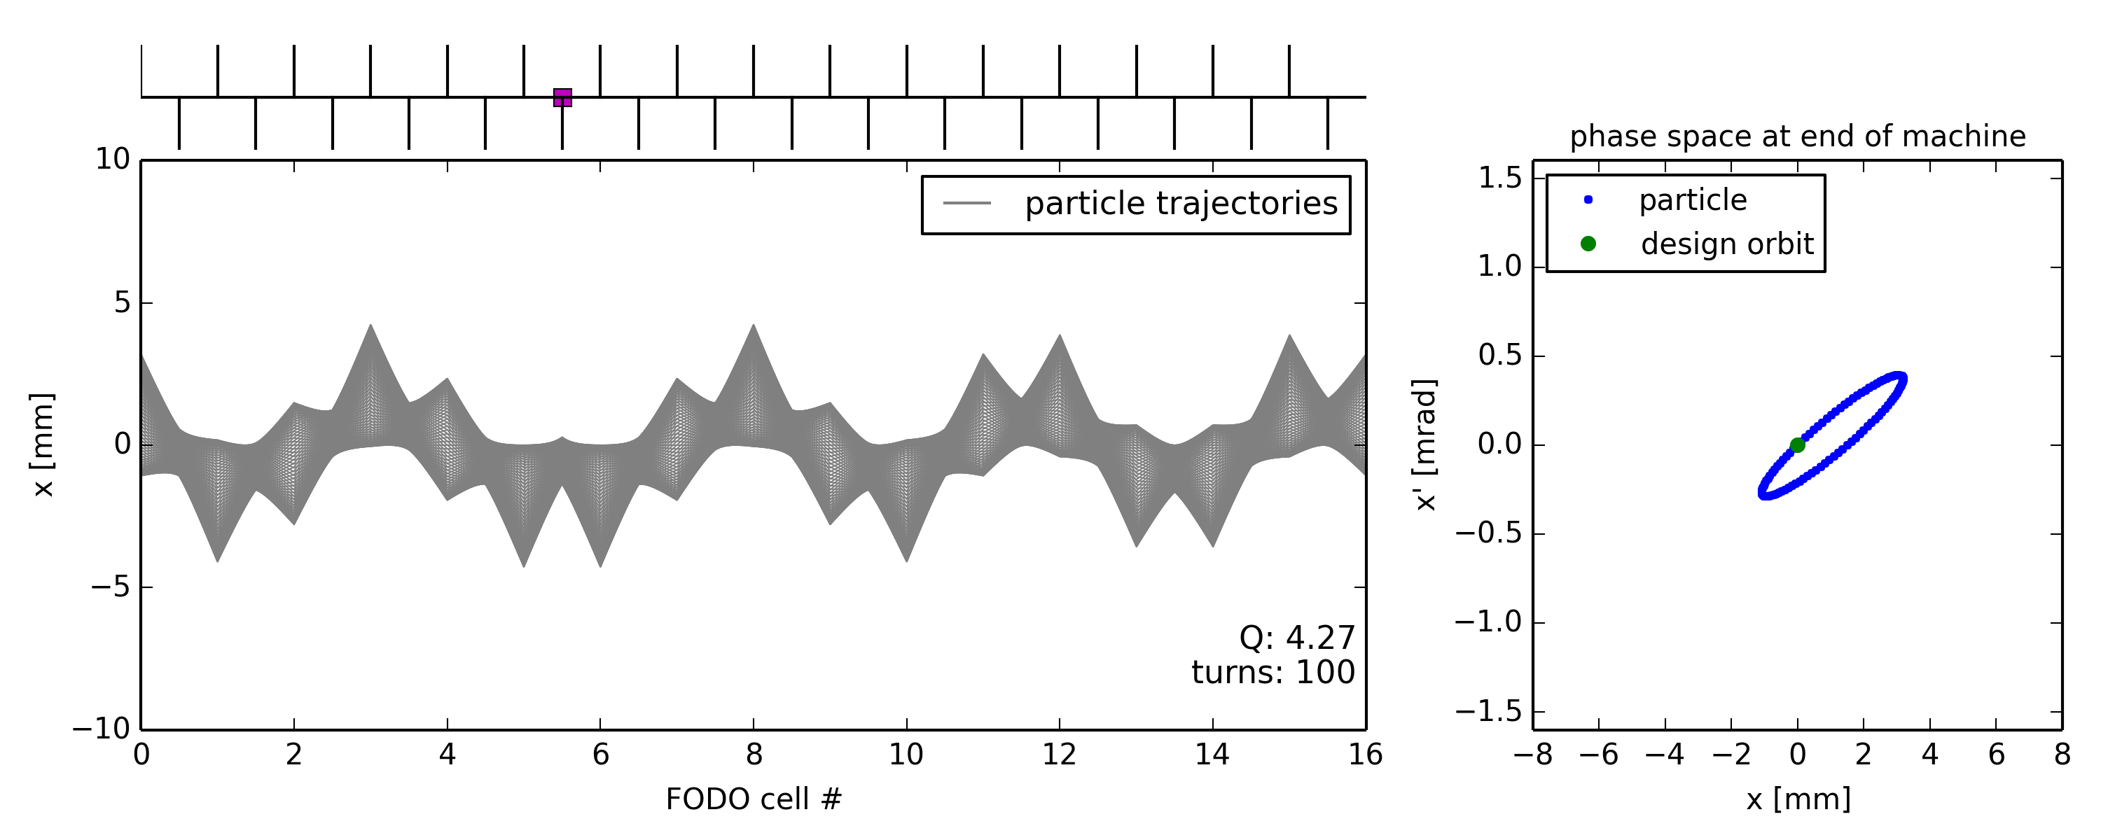
Illustration of closed orbit distortion
Ideal machine toy model with dipole error (unintended deflection) somewhere
Particle injected on the design orbit … receives dipole kick every turn …
Dipole error location

Slide 18
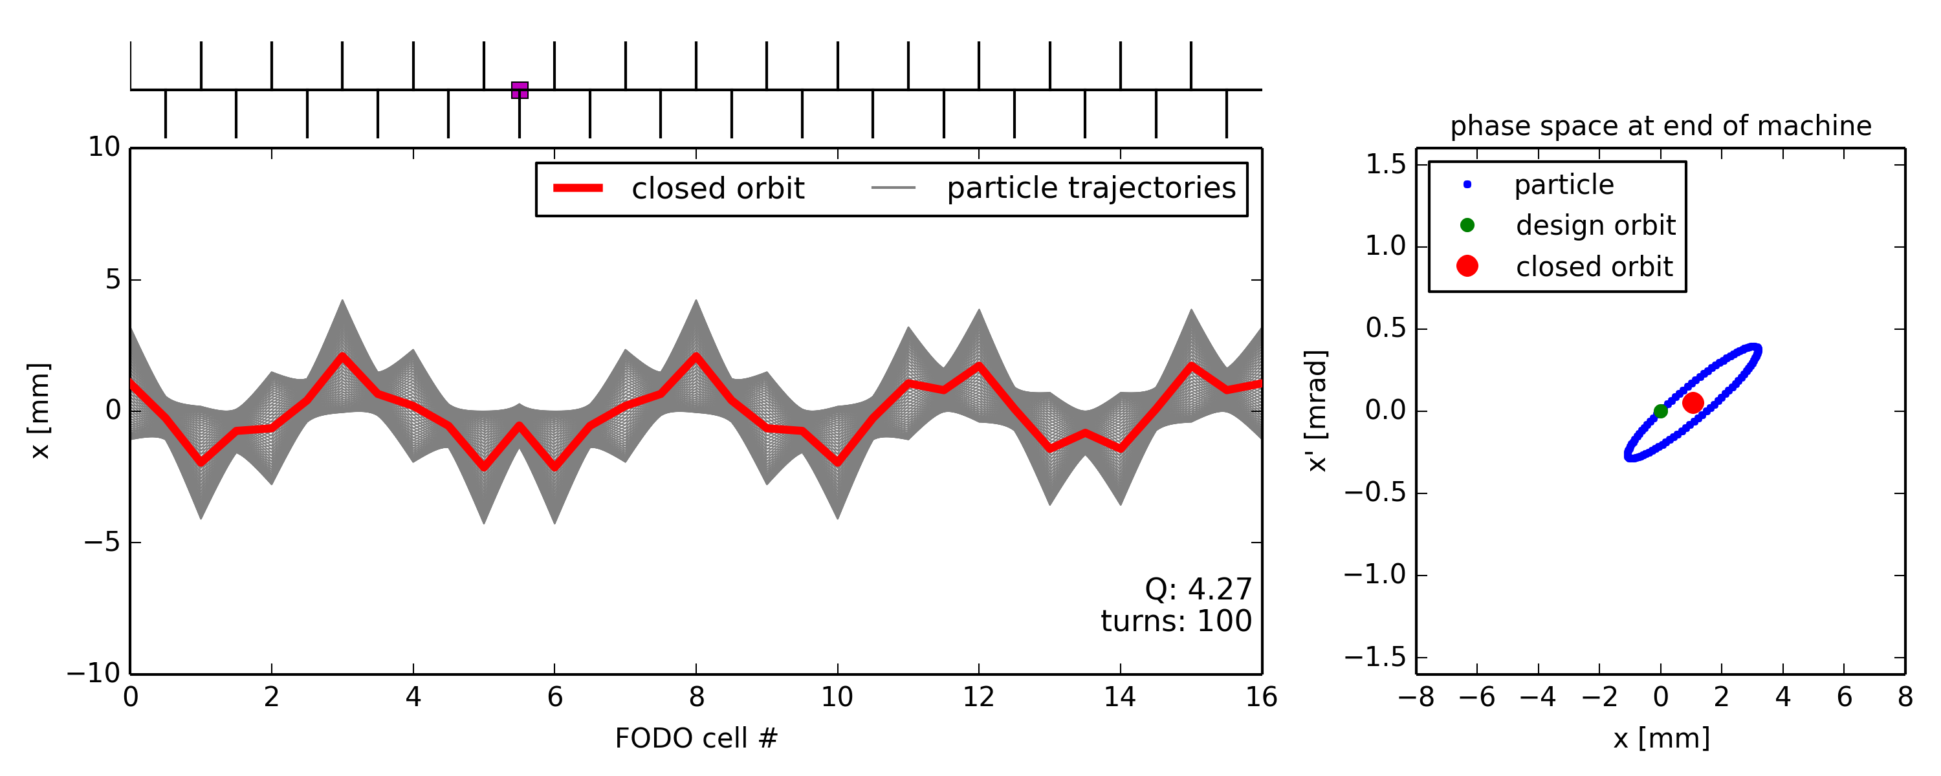
Illustration of closed orbit distortion
Ideal machine toy model with dipole error (unintended deflection) somewhere
Particle injected on the design orbit … receives dipole kick every turn … and consequently performs betatron oscillation around a “distorted” closed orbit
The closed orbit is NOT the “one passage” orbit generated during the “first turn”

Slide 19
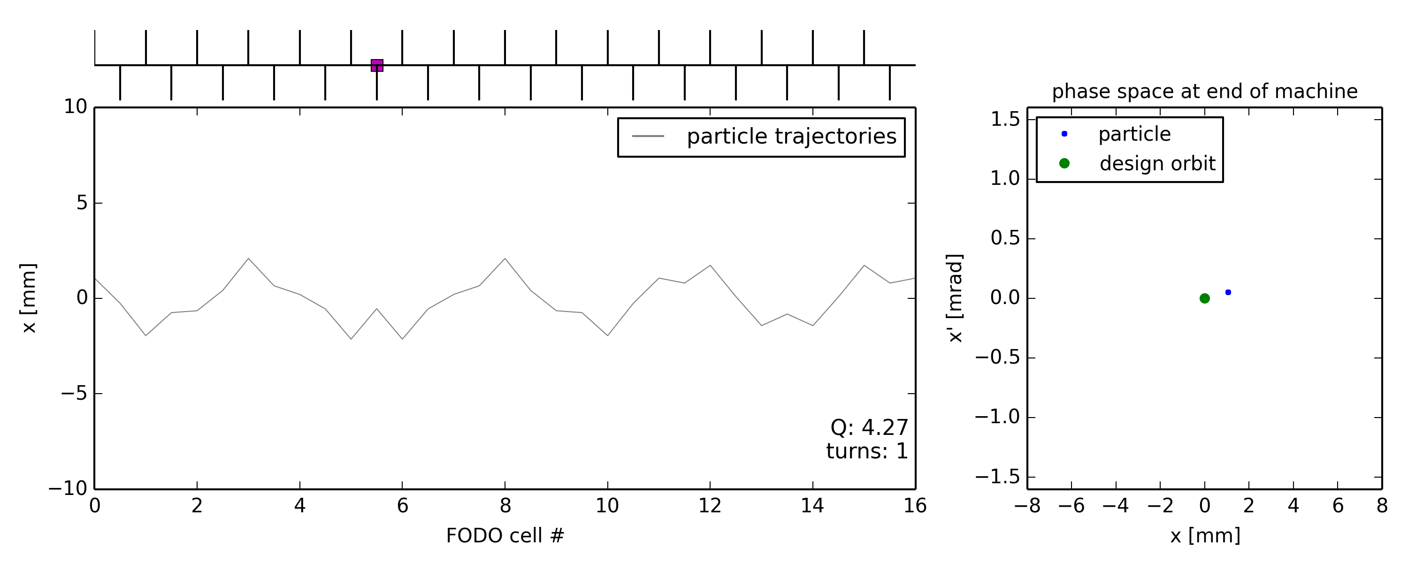
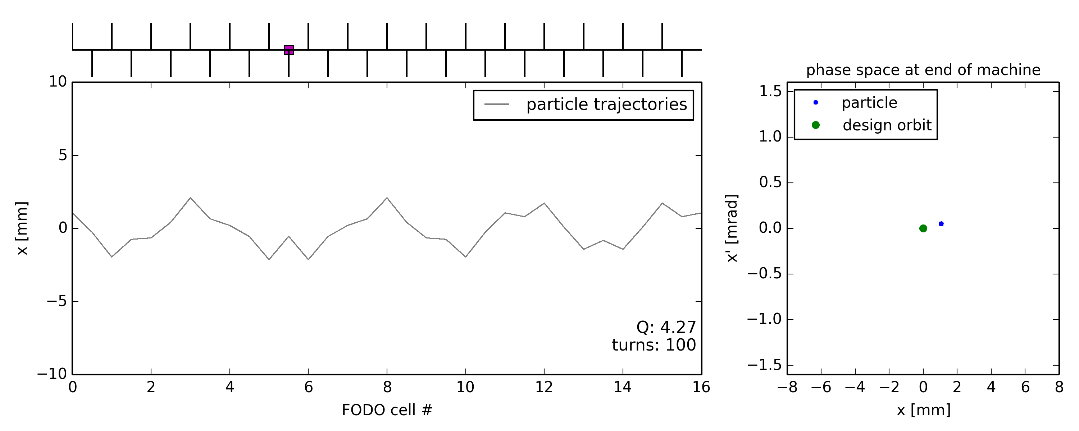
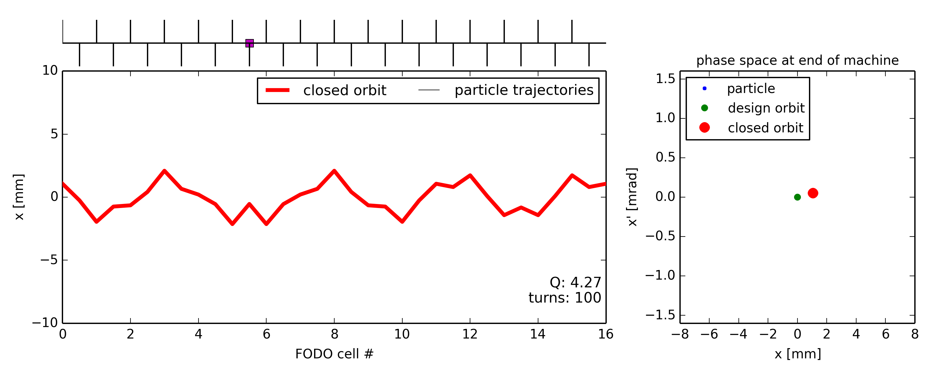
Illustration of closed orbit distortion
Ideal machine toy model with dipole error (unintended deflection) somewhere
Particle injected on the design orbit … receives dipole kick every turn … and consequently performs betatron oscillation around a “distorted” closed orbit
The closed orbit is NOT the “one passage” orbit generated during the “first turn”
Particle injected onto closed orbit remains on closed orbit
Starting point on closed orbit coordinates
Same particle coordinates after one(all) turn(s)

Slide 20
Let’s start simple… single passage!

Slide 21
Effect of single dipole kick
Consider a single dipole kick at s=s₀
The coordinates of a single particle (or centroid of a distribution!) at a downstream location s can be computed using the lattice Twiss parameters (see transverse dynamics course):
Solving the equation, one gets:
u
s₀
s
where
Notes:
\theta_0 = \delta u'_0 = \delta u'(s_0) = \frac{\delta (Bl)}{B\rho}
\mathbf{M_{{s_0}s}} &=
\begin{bmatrix}
\sqrt{\beta_s \beta_{s_0}} \sin \psi_{{s_0}s} \\
\sqrt{\frac{\beta_{s_0}}{\beta_s}} (\cos \psi_{{s_0}s} - \alpha_s \sin \psi_{{s_0}s})
\end{bmatrix}
\begin{pmatrix}
u_{s} \\
u_{s}'
\end{pmatrix}
&=
\mathbf{M_{{s_0}s}}
\begin{pmatrix}
0 \\
\theta
\end{pmatrix}
\mathbf{M_{{s_0}s}} &=
\begin{bmatrix}
\sqrt{\frac{\beta_s}{\beta_{s_0}}} (\cos \psi_{s_0 s} + \alpha_{s_0} \sin \psi_{{s_0}s}) & \sqrt{\beta_s \beta_{s_0}} \sin \psi_{{s_0}s} \\
\frac{\alpha_{s_0} - \alpha_s}{\sqrt{\beta_s\beta_{s_0}}}\cos \psi_{{s_0}s} - \frac{1+\alpha_s \alpha_{s_0}}{\sqrt{\beta_s \beta_{s_0}}}\sin \psi_{{s_0}s} & \sqrt{\frac{\beta_{s_0}}{\beta_s}} (\cos \psi_{{s_0}s} - \alpha_s \sin \psi_{{s_0}s})
\end{bmatrix}
\begin{bmatrix}
\cos{(2 \pi Q)} + \alpha_{0} \sin{(2 \pi Q)} & \beta_{0} \sin{(2 \pi Q)} \\
- \frac{1+\alpha_{0}^2}{\beta_{0}}\sin{(2 \pi Q)} & \cos{(2 \pi Q)} - \alpha_{0} \sin{(2 \pi Q)}
\end{bmatrix}
\begin{pmatrix}
u_{0} \\
u_{0}'
\end{pmatrix}
+
\begin{pmatrix}
0 \\
\theta
\end{pmatrix}
&=
\begin{pmatrix}
u_{0} \\
u_{0}'
\end{pmatrix}

Slide 22
Effect of single dipole kick: observations
u
s₀
s

Slide 23
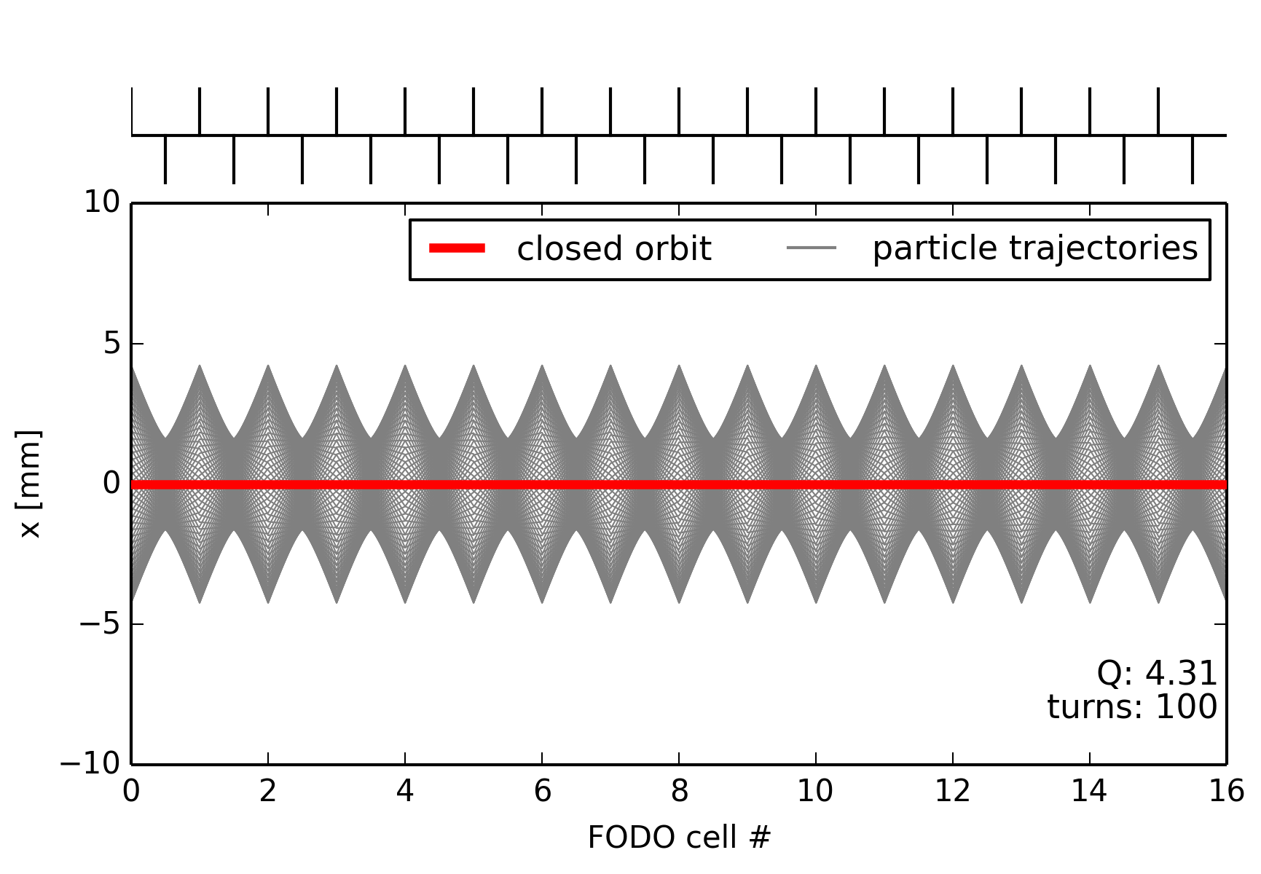
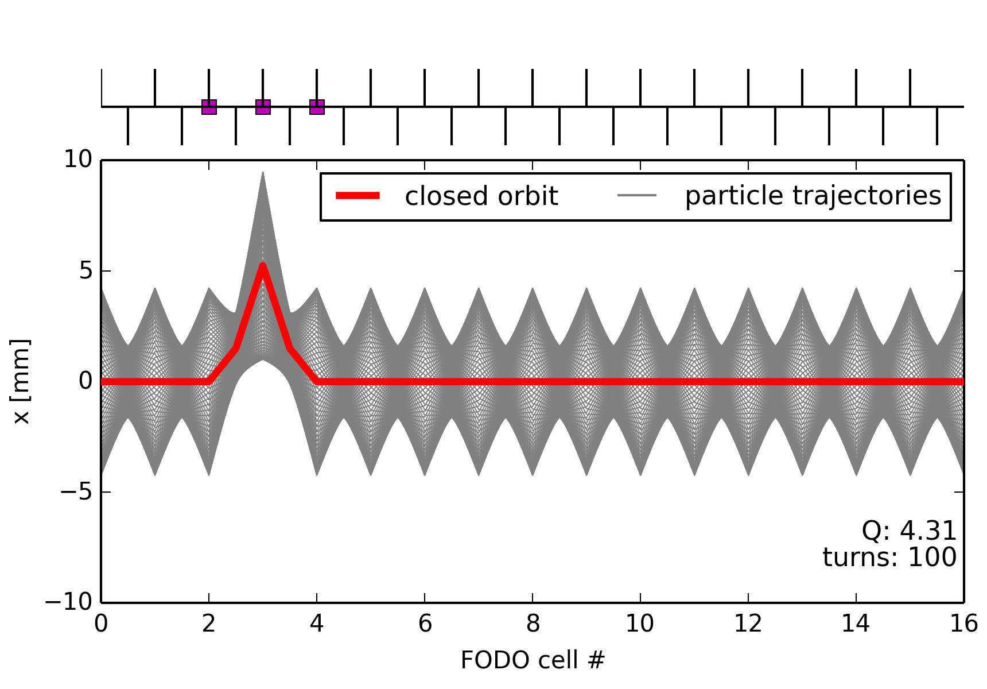
(Closed) orbit bumps
Often it is needed to steer the closed-orbit in a localized section of a line/synchrotron, e.g. for:
Injection / extraction
Local orbit correction (or steering around local aperture restrictions)
Standard “bump” configurations exist, using a limited number of correctors:
example of 2-corrector bump
example of 3-corrector bump
dipole
septum
fast kick
local orbit bump
extraction
dipole
unperturbed closed orbit

Slide 24
Orbit bumps: 2-corrector bump
x
QF
QF
QF
QF
QF
s
θ₁
θ₂
dipole corrector
QD
QD
dipole corrector
QD
QD
Consider a cell in which correctors are placed close to the focusing quads
The orbit shift at the 2nd corrector is
This orbit bump can be closed by choosing a phase advance equal to 𝜋 between correctors
=> this is often called a “𝜋-bump”
The second kick should satisfy the following equation:

Slide 25
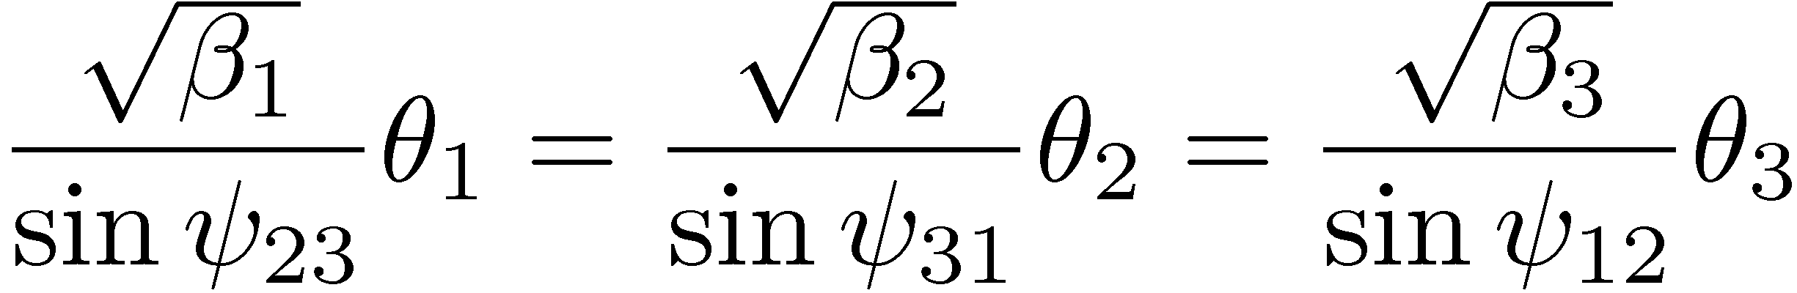
Orbit bumps: 3-corrector bump
x
QF
QF
QF
QF
QF
s
θ₁
θ₂
θ₃
QD
dipole corrector
QD
dipole corrector
QD
dipole corrector
QD
Works for any phase advance if the three correctors satisfy
Note: The angle of the closed orbit in the center of the bump is defined by the above condition, i.e. it cannot be adjusted independently of bump amplitude

Slide 26
Digression: normalised phase space
The coordinates of a single particle at a downstream location s can be computed from its coordinates at the initial location s₀ using the lattice Twiss parameters (see transverse dynamics course):
One can observe that by applying the transformation to one obtains a simple rotation :
Hence, one can rewrite the initial equation as:
Where are normalized coordinate in a space in which a beamline acts as a simple clockwise rotation by an angle equal to the phase advance!
where
Notes:
T(s) \mathbf{M_{{s_0}s}} T^{-1}(s_0)

Slide 27
Visualisation of simplest orbit bumps
Let’s consider normalised phase-space where phase spaces are simple circles:
This representation can be used to build up all sort of bumps !
pi-bump
3 corrector-bump
u’
u’
u
u
e.g., using “law of sines” in triangles

Slide 28
Orbit bumps: 4-corrector bump
x’_{b}
x
QF
QF
x_{b}
QF
QF
QF
s_{b}
s
θ₁
θ₂
θ₃
θ₄
dipole corrector
QD
dipole corrector
QD
dipole corrector
QD
dipole corrector
QD
Works for any phase advance
Position x_{b} and angle x’_{b} of the bump at location s_{b} can be adjusted independently
Can be used for aperture scanning, extraction bumps, …

Slide 29
What about the ring closed orbit?

Slide 30
Closed orbit from single dipole kick (1/3)
u
We start again from the general equation to transport particle coordinates along a lattice:
But now computing the coordinates after having done a full one turn in the machine
Where Q is the “tune” or “one-turn-phase advance” of the synchrotron under consideration (in units of 2𝜋)
𝜃
s₀
s
where
where
Notes:
Add explicit formula for computing u and u’… with matrix…
\Delta u_{s} &=
\theta_{s_0} \frac{\sqrt{\beta_{s}\beta_{s_0}}} {2\sin(\pi Q)} \cos(\pi Q - \psi_{s_0s})
\Delta u_{s}' &= \frac{\theta_{s_0}}{2\sin{\pi Q_u}}\sqrt{\frac{\beta_{s_0}}{\beta_s}}\sin(\pi Q_u - 2\pi\phi_{s_0s}) - \frac{\alpha_s}{\beta_s}\Delta u_{s}
\psi_{s_0s} &=
\begin{cases}
\psi_{s} - \psi_{s_0}, & \text{if}\ (\psi_{s} - \psi_{s_0}) \ge 0 \\
\psi_{s} - \psi_{s_0} + 2\pi Q, & \text{otherwise.}
\end{cases}
#### Most compact form:
\Delta u_{s} &=
\theta_{s_0} \frac{\sqrt{\beta_{s}\beta_{s_0}}} {2\sin(\pi Q)} \cos(\pi Q - |\psi_{s} - \psi_{s_0}|)

Slide 31
Closed orbit from single dipole kick (2/3)
u
If we want that the orbit closes on itself after one turn, then we must solve to find such that
… which one can solve inverting:
… For you to compute tonight, remembering that for and …
𝜃
s₀
s
Notes:
Add explicit formula for computing u and u’… with matrix…
\Delta u_{s} &=
\theta_{s_0} \frac{\sqrt{\beta_{s}\beta_{s_0}}} {2\sin(\pi Q)} \cos(\pi Q - \psi_{s_0s})
Det = (C – 1)^2 – a^2 S^2 + S^2 (1 + a^2)
= (C-1)^2 + S^2 = C^2 + 1 – 2C + S^2= 2 - 2 * C = 2 (1 – C)
\Delta u_{s}' &= \frac{\theta_{s_0}}{2\sin{\pi Q_u}}\sqrt{\frac{\beta_{s_0}}{\beta_s}}\sin(\pi Q_u - 2\pi\phi_{s_0s}) - \frac{\alpha_s}{\beta_s}\Delta u_{s}
\psi_{s_0s} &=
\begin{cases}
\psi_{s} - \psi_{s_0}, & \text{if}\ (\psi_{s} - \psi_{s_0}) \ge 0 \\
\psi_{s} - \psi_{s_0} + 2\pi Q, & \text{otherwise.}
\end{cases}
#### Most compact form:
\Delta u_{s} &=
\theta_{s_0} \frac{\sqrt{\beta_{s}\beta_{s_0}}} {2\sin(\pi Q)} \cos(\pi Q - |\psi_{s} - \psi_{s_0}|)

Slide 32
Closed orbit from single dipole kick (3/3)
u
… and find the initial conditions of the closed orbit at the location of the kick are obtained as
... and at any location s around the ring, the closed orbit distortion 𝛥u generated by a kick 𝛳 in s₀ is
Note: this derivation is fully linear, i.e. allow me to add a ∆ to indicate this is a closed orbit variation, with respect to a potentially already non-zero closed orbit…
𝜃
s₀
s
…
Notes:
Add explicit formula for computing u and u’… with matrix…
\Delta u_{s} &=
\theta_{s_0} \frac{\sqrt{\beta_{s}\beta_{s_0}}} {2\sin(\pi Q)} \cos(\pi Q - \psi_{s_0s})
\Delta u_{s}' &= \frac{\theta_{s_0}}{2\sin{\pi Q_u}}\sqrt{\frac{\beta_{s_0}}{\beta_s}}\sin(\pi Q_u - 2\pi\phi_{s_0s}) - \frac{\alpha_s}{\beta_s}\Delta u_{s}
\psi_{s_0s} &=
\begin{cases}
\psi_{s} - \psi_{s_0}, & \text{if}\ (\psi_{s} - \psi_{s_0}) \ge 0 \\
\psi_{s} - \psi_{s_0} + 2\pi Q, & \text{otherwise.}
\end{cases}
#### Most compact form:
\Delta u_{s} &=
\theta_{s_0} \frac{\sqrt{\beta_{s}\beta_{s_0}}} {2\sin(\pi Q)} \cos(\pi Q - |\psi_{s} - \psi_{s_0}|)

Slide 33
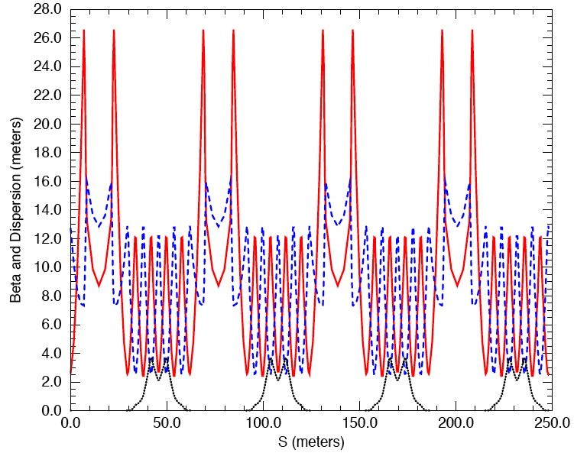
Example: Max orbit distortion in SNS?
In the SNS accumulator ring, the beta function is about 6 m in the dipoles and the tune is 6.2
Consider a kick of 1 mrad in a single dipole
What is maximum orbit distortion at dipoles? :
In quadrupoles, beta ~30 m: what is the maximum orbit distortion at quadrupoles?
β_{x}
β_{y}
D_{x}
maximum orbit distortion amplitude
Notes:
Explain better… maybe change example…. Add explicit formula instead of calculation only…

Slide 34
All clear so far?

Slide 35
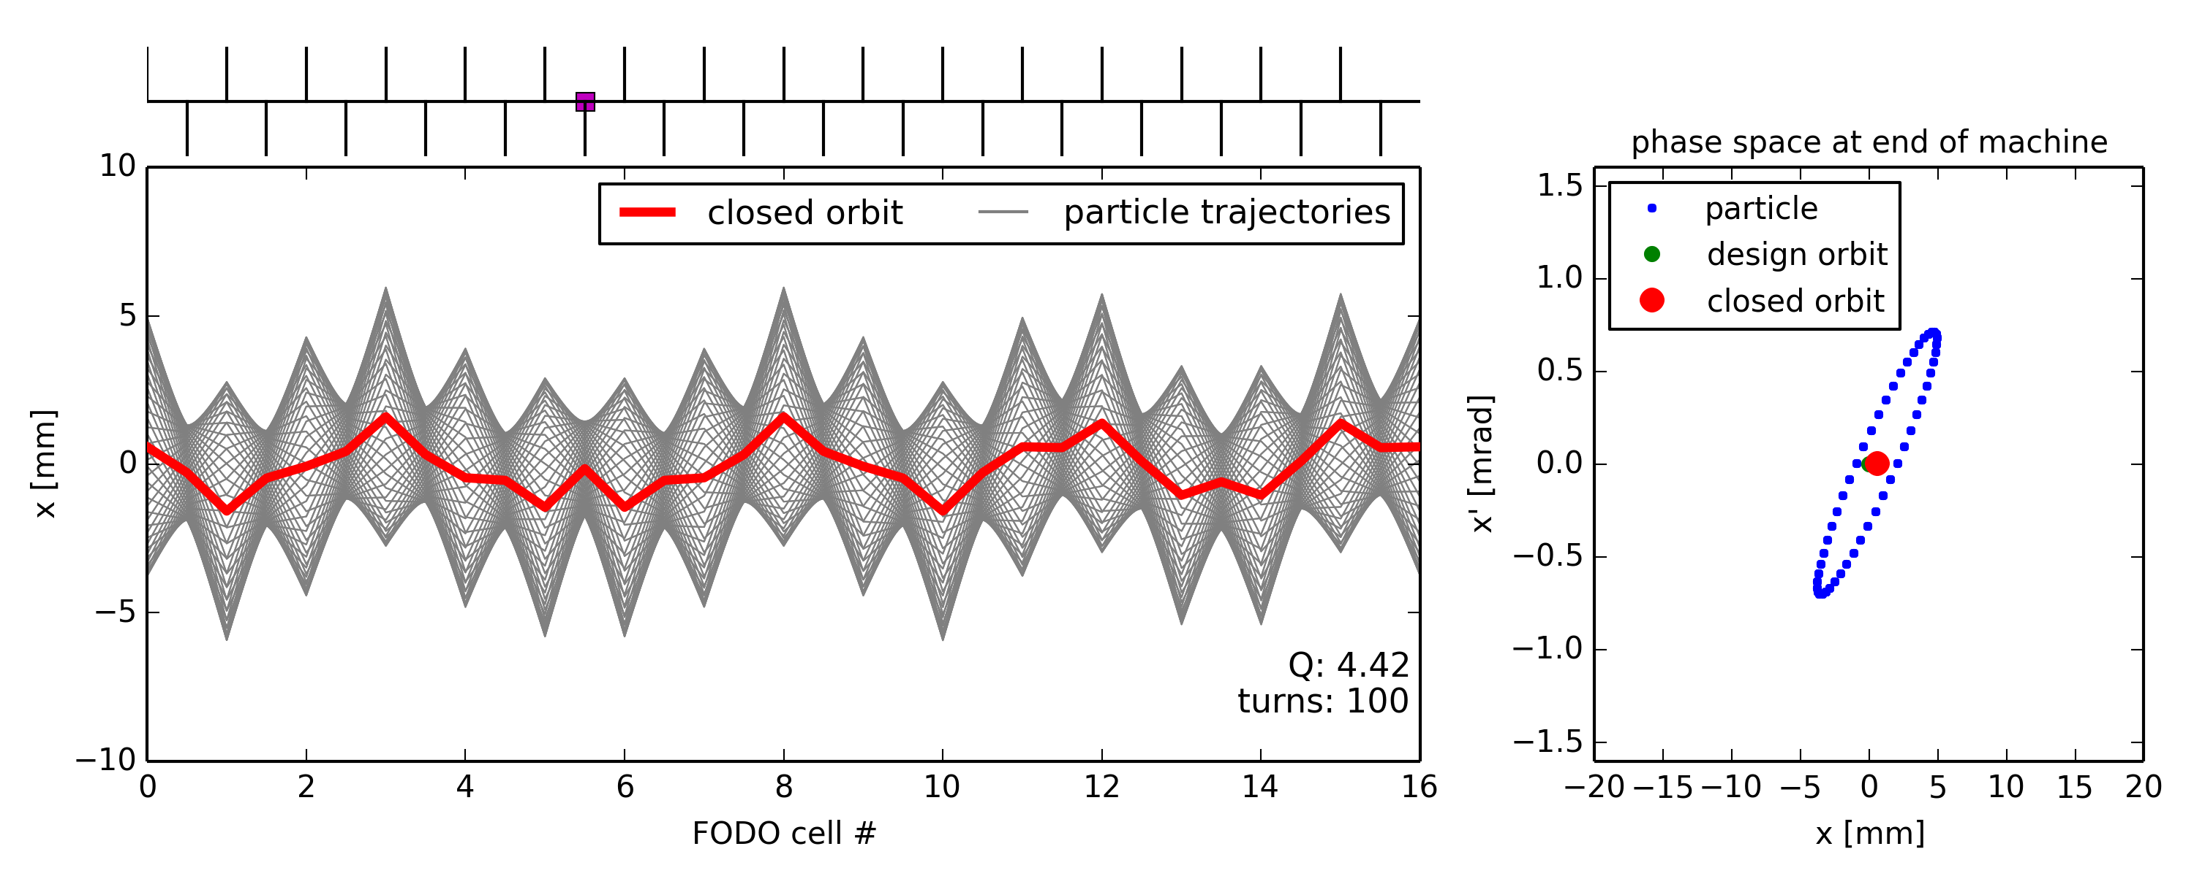
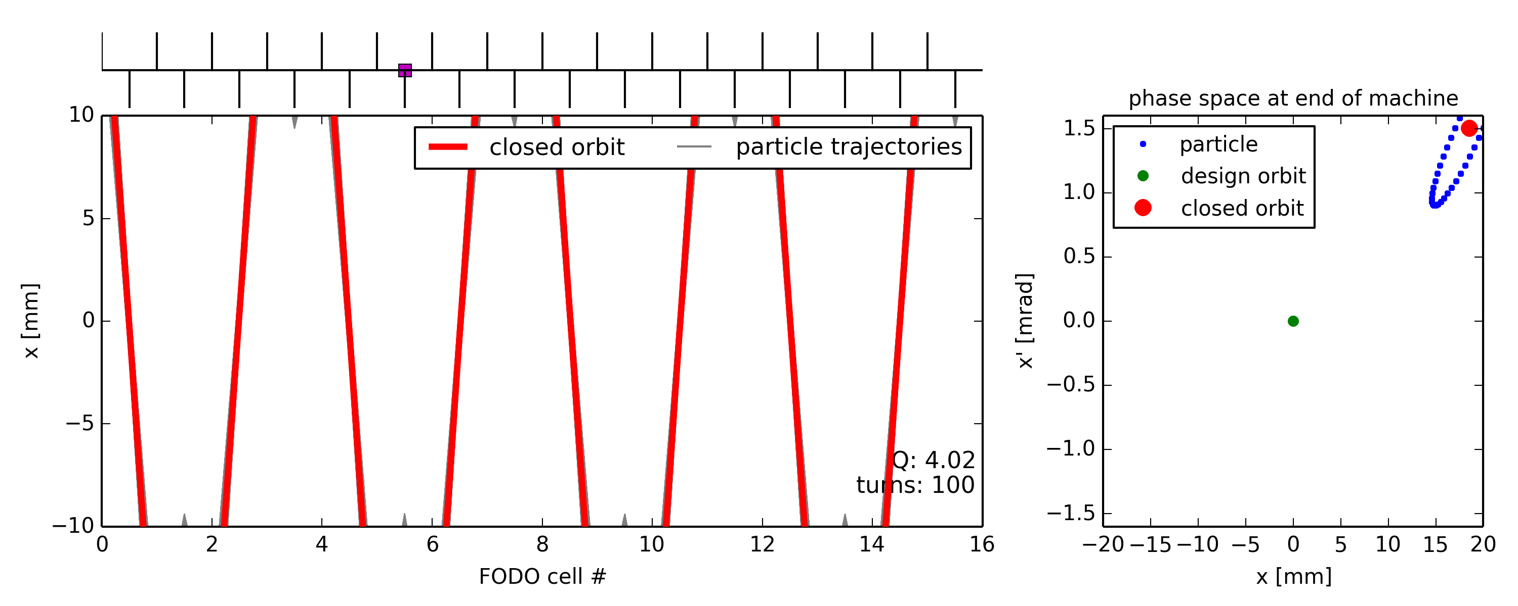
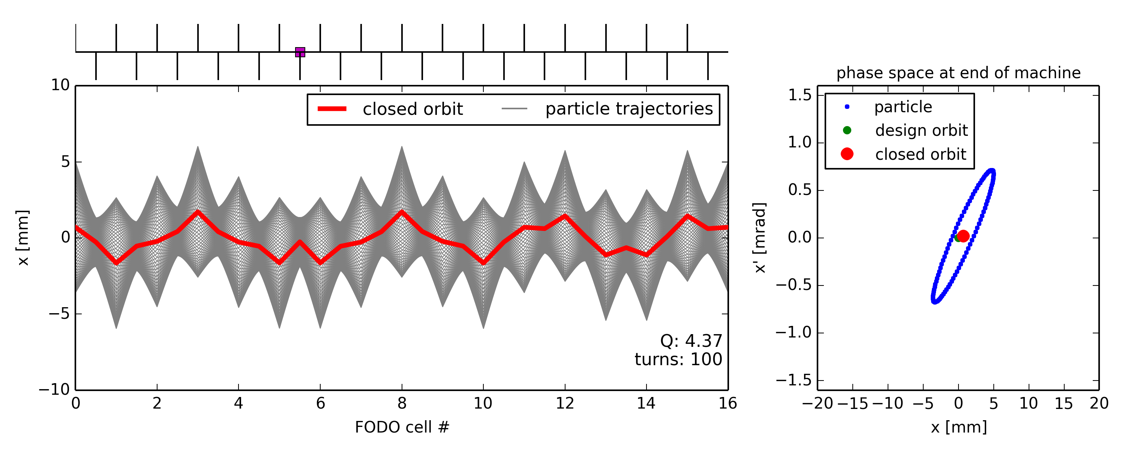
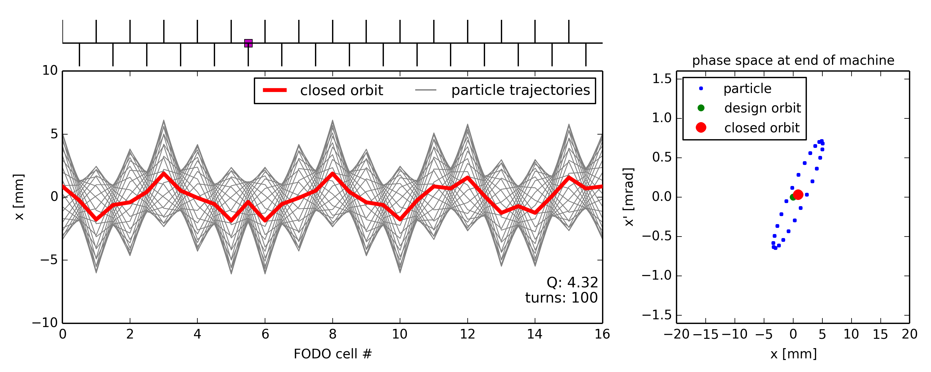
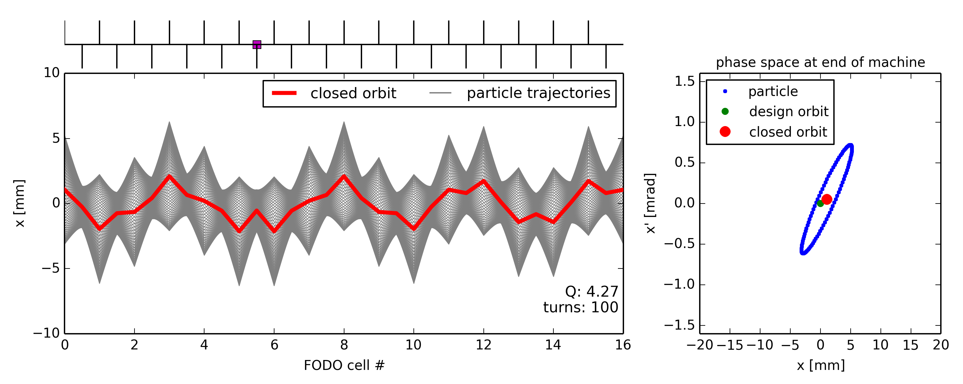




Single dipole kick vs. tune
Note: the closed orbit distortion propagates with the betatron phase advance (e.g. single kick induces 4 oscillations for a tune of Q=4.x)
Closed orbit distortion is most critical for tunes close to integer → closed orbit becomes unstable (but beam size not affected)

Slide 36





Single dipole kick vs. tune
Closed orbit is still “well” defined for half-integer tunes, but each single particle keeps “jumping” in phase space between two “meta-stable” points

Slide 37

Integer and half-integer resonance
Dipole kicks add-up in consecutive turns for Q = n
Integer tune excites orbit oscillations (resonance)
orbit becomes unstable!
Dipole kicks get cancelled in consecutive turns for Q = n+1/2
Half-integer tune cancels orbit oscillations
u'
u'
u
u

Slide 38

Example: a deflection at the LHC
In the example below for the 26.7km long LHC, there is one undesired deflection, leading to a perturbed closed orbit.
Beam position x (mm)
Beam Position Monitor index along the LHC circumference
Where is the location of the deflection?

Slide 39

Example: a deflection at the LHC
To make our life easier we divide the position by and replace the BPM index by its phase
→ transform into pure sinusoidal oscillation… with a kink!
Beam position
Betatron phase
Can you localize the deflection now?
Notes:
\frac{\Delta u_{s}}{\sqrt{\beta_{s}}} &=
\theta_{s_0} \frac{\sqrt{\beta_{s_0}}} {2\sin(\pi Q)} \cos(\pi Q - |\psi_{s} - \psi_{s_0}|)

Slide 40





Global orbit distortion
Orbit distortion due to many errors:
By approximating the errors as delta functions in n locations, the orbit distortion at the i^{th} observation points (Beam Position Monitors) is
with the kicks produced by the j^{th} error, e.g.:
Courant and Snyder, 1957
Integrated dipole field error
Dipole roll
Quadrupole displacement
𝜙_{j}

Slide 41



Statistical estimation of orbit errors
Consider random distribution of errors in N magnets
By squaring the orbit distortion expression and averaging over the angles (considering uncorrelated errors), the expectation (rms) value is given by
Example:
In the SNS (Q=6.2), there are 32 dipoles (β=6m) and 54 quadrupoles (β=30m). Assuming 1 mrad rms kicks either at dipoles or at quadrupoles, one obtains:
The rms orbit distortion in the dipoles
In the quadrupoles, for equivalent kick
horizontal rms CO
vertical rms CO

Slide 42
All clear so far?

Slide 43

Correcting closed orbit distortion
Horizontal/Vertical dipole correctors and BPMs close to focusing/defocusing quads
Highest sensitivity / effect on closed orbit due to beta-function maxima
Measure orbit in BPMs and minimize orbit distortion
Locally
Using closed orbit bumps
Globally
MICADO: finding the most efficient corrector for minimizing the rms orbit
Least square minimization using orbit response matrix of correctors (typically using Singular Value Decomposition (SVD))
(other, e.g.: Harmonic analysis: minimizing components of orbit frequency response from Fourier analysis)
H/V-BPM: H or V Beam Position Monitor
DH, DV: H or V orbit correctors
quadrupole
BPM
corrector
SPS
DH

Slide 44



Response from dipole correctors
Each dipole corrector has its own effect on closed orbit, which can be computed or measured
Orbit induced by first orbit corrector
Orbit induced by second orbit corrector
Orbit induced by third orbit corrector
…

Slide 45

Response Matrix approach – how does it work?
Computes (or measures) the orbit response for each orbit corrector, and stores them as columns of a matrix A such that the closed orbit variation induced by a linear combination of corrector strength variations can be computed as:
i.e. the matrix element A_{i,j} of the matrix A is the closed orbit variation in the i-th monitor due to a unit kick from the j-th corrector, and can be computed from the optics as:
or
Orbit induced by second orbit corrector
Orbit induced by third orbit corrector
A =
Orbit induced by first orbit corrector
…
( in this case by construction )
Single passage (transfer line) case
Ring (closed orbit) case

Slide 46
Response Matrix approach – how does it work?
One can then invert the problem and find the orbit corrector variation needed to implemented a desired orbit variation:
Typically, the desired orbit variation is where is the measured closed orbit deviation with respect to an ideal reference, i.e. such that:
or with respect to a “golden orbit” : an orbit that “works” well, or has some specific features one needs (e.g. an injection bump…), i.e. such that:
Warning: the matrix inversion is not always possible (e.g. not-square matrix) ! So?
Notes:
Maybe add a nice picture of a golden orbit in LHC?!? … to be found…

Slide 47

Matrix inversion using Singular Value Decomposition
N monitors and N correctors (e.g. N=72)
In most cases the one must perform a matrix pseudo-inversion, for example using the “Singular Value Decomposition (SVD)”, and use which find solution that minimize
Note: during inversion, one can also “filter out” the number of singular values, which effectively reduces the corrector strength “inefficiently used”.
Monitors
N monitors and M correctors (e.g. N=72; M=36)

Slide 48

Closed orbit correction: MICADO
The problem of correcting the orbit deterministically came up a long time ago in the first CERN machines.
B. Autin and Y. Marti published a note in 1973 describing an algorithm that is still in use today (but in JAVA/C/C++ instead of FORTRAN) at ALL CERN machines: MICADO*
(Minimization of the quadratic orbit distortions)

Slide 49

MICADO – how does it work?
MICADO compares the response of every corrector with the raw orbit in the machine
MICADO picks the corrector that has the best match with the raw orbit, i.e. that will give the largest improvement to the rms orbit deviation
The procedure can be iterated to the second-best corrector and so on, until the orbit is good enough (or as good as it can be)
Orbit induced by first orbit corrector
Orbit induced by second orbit corrector
Orbit induced by third orbit corrector
…

Slide 50
Some remarks about orbit correction
Remark 1: the main difference between MICADO and Response Matrix is that the first uses the minimum number of correctors, while the second “tries” to use all correctors “less”.
Remark 2: the correction strategy to adopt (e.g. local bumps, then MICADO with very few correctors, then Response Matrix retaining only few singular values, …) strongly depend on the specific case and operation needs.
Remark 3: Both correction methods can be used for any (quasi-)linear problems, e.g. for beta-beating correction when using ∆β/β as “observable” and quadrupole strengths as “correctors”…

Slide 51



LHC Orbit Correction Example
The raw orbit at the LHC can have huge errors, but the correction (based partly on MICADO) brings the deviations down by a factor 20
Uncorrected horizontal orbit of ring 1
LHC vacuum chamber
50 mm
34 mm
MICADO & Co
Corrected horizontal orbit of ring 1
44 mm
50 mm
At the LHC a good orbit correction is vital !

Slide 52
Final words on beam orbit stability
Beam orbit stability is very critical
Injection and extraction efficiency of synchrotrons
Stability of collision point in colliders
Stability of the synchrotron light spot in the beam lines of light sources
Consequences of orbit distortion
Modification of optics functions, resonance excitation, aperture limitations, lifetime reduction, coupling, poor injection/extraction efficiency
Sources for closed orbit drifts
Long term (years - months): ground settling, season changes, …
Medium term (days - hours): sun and moon, day-night variations (thermal), rivers, rain, wind, refills and start-up, instrumentation errors, drift of electronics, local machinery, filling patterns, …
Short term (minutes - seconds): ground vibrations, power supply ripples, air conditioning, refrigerators/compressors, …

Slide 53

Outline
Introduction
Closed orbit distortion (steering error)
Beam orbit stability
Imperfections leading to closed orbit distortion
Effect of single and multiple dipole kicks
Closed orbit correction methods
Optics function distortion (gradient error)
Imperfections leading to optics distortion
Tune-shift and beta distortion due to gradient errors
Gradient error correction
Coupling error
Coupling errors and their effect
Coupling correction
Summary

Slide 54


Illustration of optics distortion
Ideal machine toy model with regular FODO lattice and quadrupole error at the end of circumference
Particle injected with offset performs betatron oscillations but gets additional focusing from quadrupole error
There is a tune-shift (additional de-/focusing)
Beam envelope is distorted around the machine … “beta-beating”
Quadrupole error location
Note the change of the ellipse shape!
Note the change of the actual machine tune!

Slide 55
Gradient error and optics distortion in Rings
Optics functions perturbation can induce aperture restrictions
Tune perturbation can lead to reduced beam stability (dynamic aperture)
Broken super-periodicity → excitation of all resonances (see non-linear dynamics lecture)
In a ring made of N identical cells, only resonances with harmonics being integer multiples of N can be excited
Sometimes control of optics is critical for machine performance
Beta functions at collision points or at collimators (e.g. LHC)
Sources
Errors in quadrupole strengths (random and systematic)
Injection elements
Feed-down effects from higher-order multi-pole magnets and errors
Observables
Tune-shift
Beta-beating
Excitation of integer and half-integer resonances, beam losses

Slide 56
Gradient error: some math…
Consider the 1-turn transfer matrix from a reference position 0 (where the error will be placed):
Consider a gradient error in a quad, located at position 0. We can take the error into account by adding a thin lens quadrupole to the one turn matrix. The new 1-turn matrix is
which yields:

Slide 57





Gradient error and tune-shift
Can also be written as a new matrix with a new tune
The traces of the two matrices describing the 1-turn should be equal, i.e. which gives:
Developing the right-hand side:
Which finally gives:
I.e., for one quadrupole of length L the tune shift is:
For distributed quadrupole errors, the tune shift is:
≈
≈
Notes:
Cos 2piQ = sin(2piQ) * (dK ds beta - 2 pi dQ)
\widetilde{M_0^{\star}} =

Slide 58
Gradient error and beta distortion (or beta-beating) 1/2
Split the unperturbed one-turn transfer matrix in two (from observation point (s) to error location (0) and back from 0 to s: with
Introduce a gradient perturbation at the location (0), i.e. between the two matrices:
Recall that and write the perturbed term as:
where we used and and
a)
Notes:
Add drawings!

Slide 59

Gradient error and beta distortion (or beta-beating) 2/2
On the other hand
Equating the two terms
using yields:
In general, for distributed errors around the machine:
b)
a) = b)
Recall impact on tune:
Notes:
Add drawings!

Slide 60






Optics distortion vs. tune
For which machine tune quadrupole errors have the biggest impact on optics?
Close to integer and half-integer tunes → envelope (or beam size) becomes unstable

Slide 61

Quadrupole error in phase space
Therefore, integer tunes and half-integer tunes need to be avoided for machine operation to avoid beam envelope becoming unstable due to quadrupole errors
Recall: for integer tunes dipole errors drive the closed orbit unstable, but for half-integer tunes they have minimum effect
Q = n (integer)
→ kicks from quadrupoles add up (same as for kicks from dipoles)
Q = n/2 (half-integer)
→ kicks from quadrupoles also add up (while kicks from dipoles cancel)

Slide 62


Optics distortion characteristics
Let’s take a look at the LHC …
Example: one quadrupole gradient is incorrect
Nominal optics
Perturbed optics
Zoom into a subsection

Slide 63
Optics distortion characteristics
The local beam optics perturbation
… note the oscillating pattern
Nominal optics
Perturbed optics

Slide 64

Optics distortion characteristics
The error is easier to analyse and diagnose if one considers the ratio of the betatron function perturbed over design one
The ratio reveals an oscillating pattern called the betatron function beating (‘beta-beating’).
Note: the amplitude of the perturbation is the same all over the ring!

Slide 65

Optics distortion characteristics
The beta-beating pattern comes out even more clear if we replace the longitudinal coordinate with the betatron phase advance
The result is very similar to the case of the closed orbit kick, the error reveals itself by a kink!
If you watch closely, you will observe that there are two oscillation periods per 2π (360 deg) phase. The beta-beating frequency is twice the frequency of the orbit!

Slide 66



Example: Gradient error in SNS
Consider 18 focusing quads in the SNS ring with 0.01 T/m systematic gradient error (wrt to nominal 5 T/m). In this location β = 12 m. The length of the quads is 1 m, the magnetic rigidity is 5.6567 Tm, and the tune is Q = 6.2
The tune-shift is:
For a random distribution of gradient errors of 1% of the nominal gradient, the beta beating is:
Optics functions beating ~20% by 1% random errors (1% of gradient) !
Notes:
\delta Q =
\frac{1}{4 \pi} \sum_i \delta k_i(s) \beta_i(s) =
\frac{1}{4 \pi} 18 \cdot 12 \frac{0.01}{5.6567} 1 = 0.03
Tune-shift: 1/(4*p) * 18*12*0.01/5.6567 * 1
This time assume 1%
Beta-beating: 1/(2*sqrt(2)*s(2*p*6.2)) * sqrt(18)*0.05/5.6567*1*12

Slide 67
All clear so far?

Slide 68
Gradient error correction
Quadrupole correctors
Individual correction magnets
Windings on the core of the quadrupoles (trim windings)
Pairs of correctors at well-chosen locations for minimizing resonance
Methods & approaches
Measure tune-shift and optics beta function distortion
Move working point close to integer and half-integer resonance to increase sensitivity
Minimize beta wave or quadrupole resonance width with trim windings
Individual powering of trim windings can provide flexibility and beam-based alignment of BPM
Modern methods of response matrix analysis (LOCO) can fit optics model to real machine and correct optics distortion

Slide 69


Example: LHC optics corrections
At β*=40cm, the bare machine has a β-beating of more than 100%
After global and local corrections, β-beating was reduced to few %
R. Tomas et al.
before and after local correction
after final corrections

Slide 70






Example: PSB half-integer resonance correction
Compensation of quadrupole errors at half-integer Q_{y}=4.5
PSB has 16-fold symmetry
2 families of normal quadrupole correctors
+QNO4 and –QNO12 with Δμ_{y} = 2.25 * 2π
+QNO8 and –QNO16 with Δμ_{y} = 2.25 * 2π
Due to opposite polarity within each family, their contribution on beta-beating adds up (beta-beat frequency is twice the tune!) while there is no change of tune (same change of focusing & defocusing)
The two families are orthogonal with respect to each other: (i.e. every phase is achievable)
QNO8L3 +
–
QNO12L3
QNO4L3
+
– QNO16L3

Slide 71

Example: PSB half-integer resonance correction
Experimental data!
dynamic resonance crossing
– bare machine
– correction
F. Asvesta

Slide 72



Optics distortion in LINACs and Transfer Lines (notes only)
Typically, less stringent requirements as no closed solution needed (single passage)
Please, don’t mention this to my colleagues designing the ~2 km long CLIC Final Focusing System… e.g. Phys. Rev. Accel. Beams 23, 051002 (2020)
Can be very important for matching next machine’s closed solution: why?
Measuring methods and correction (not covered here ☹):
quadrupole scan, transverse tomography, phase-space painting, …
Optics “rematching”…
Filamentation! => see transverse dynamics
Example quad-scan: beam size vs. quad field

Slide 73

Outline
Introduction
Closed orbit distortion (steering error)
Beam orbit stability
Imperfections leading to closed orbit distortion
Effect of single and multiple dipole kicks
Closed orbit correction methods
Optics function distortion (gradient error)
Imperfections leading to optics distortion
Tune-shift and beta distortion due to gradient errors
Gradient error correction
Coupling error
Coupling errors and their effect
Coupling correction
Summary

Slide 74

Coupling errors
Coupling may result from rotation of a quadrupole, so that the field contains a skew quadrupole component
A systematic vertical offset in a sextupole also generates a skew quadrupole component
For a sextupole with a displacement of the field becomes
tilted quadrupole
normal quadrupole
skew quadrupole
φ
skew quadrupole

Slide 75


Normal vs. skew quadrupole
normal quadrupole
horizontal force depends on horizontal position (and likewise for vertical)
skew quadrupole
Horizontal force depends on vertical position (and vice versa)
→ resulting forces couples the motion in the two planes

Slide 76
Digression: eigen-value/vector decomposition
Let’s consider again the one turn matrix for a given plane u.
By definition, is symplectic (see linear dynamics lectures), and as such can be diagonalized in a matrix with elements equal its eigenvalues , which must fulfill , in particular:
and, with a transformation E_{u} built by the normalised eigenvectors of M_{u} one can diagonalise the latter: which is equal to the diagonalized version of a simple rotation (recall the normalized phase-space!)
Note: this is the case only because M_{u} is by construction representing a lattice which has a closed solution!
For a generic symplectic matrix , the eigenvalues could be real, representing an un-bounded lattice!
which satisfy

Slide 77
4x4 Matrices - uncoupled
So far, we considered each plane independently, i.e. the coordinates of a particle at a given location are transported from turn (n) to the turn after (n+1) as follows:
We can also merge the two 2x2 independent matrices M_{u} in a 4x4 block matrix M:
The matrix M must also be symplectic, hence can be diagonalized in its eigenvalues, which, by virtue of the block composition of M, are equal to the eigenvalues of the individual M_{u} :
and
where
Uncoupled motion: no cross-talk between planes
Rotation in x plane
Rotation in y plane

Slide 78
4x4 Matrices – with one skew quadrupole (1/2)
Let’s now introduce one skew quadrupole, represented by M_{sq}
The new symplectic(!) matrix can be diagonalised in its eigenvalues 𝜆_{j} which must also come in pairs such that 𝜆₁ 𝜆₂ = 1 and 𝜆₃ 𝜆₄ = 1, hence, for example, 𝜆₁ + 1/𝜆₁ = 𝜆₁ + 𝜆₂
Solving one can get (see D. A. Edwards, M. J. Syphers):
Note:
Matrix M_{sq} built in analogy to normal quadrupole matrix
These terms couple the motion in the two planes!!!

Slide 79
4x4 Matrices – with one skew quadrupole (2/2)
IF the motion is still bounded (not necessarily the case!) 𝜆 must assume the form , i.e.:
In analogy with the un-coupled case, one can compute the transformation that diagonalises the coupled matrix in two independent “tunes” which depend on the two un-coupled tunes
Note 1: in the limit where one finds that and if is small, one can easily prove that , hence:
Note 2: in a region “close to” one gets unstable motion! e.g. for :
where
Minimum separation between eigenvalues!
No Real solution for μ!
Notes:
\mu \in \mathbb
{R}
Q_x + Q_y = n \text{where} n \in \mathbi{N}

Slide 80



Example: eigen-mode tunes computation
Let’s assume to insert the skew quadrupoles at a location where and
By computing the eigenvalues as a function of varying for different values of one obtains:
Note the minimum distance between eigenvalues is indeed realized for and follows
Skew quad. strength
Eigen-mode tunes
For increasing skew quadrupole strength, the distance between the two eigen-mode tunes increases!

Slide 81



Example: unbounded working point region
Let’s assume to insert the skew quadrupoles at a location, where
By computing the amplitude of the eigenvalues of as a function of for different and look for regions where at least one eigenvalue has amplitude > 1, i.e. where motion is not stable:
Note: the “unstable” band around becomes larger for higher coupling error strength!
Bare working point with unstable coupled lattice

Slide 82

Multiple coupling sources…
No unique treatment of this complex problem is available in literature, yet
Most important parameter remains the estimate of the coupling coefficient
A recent overview of different estimates is available in CERN-ACC-NOTE-2021-0022:
(MADX)
Some more references:
M. Hofer et al., Effect of local linear coupling on linear and nonlinear observables in circular accelerators - PRSTAB 23, 094001 (2020)
T. Persson et al., Improved control of the betatron coupling in the Large Hadron Collider – PRSTAB 17, 051004 (2014)
For a linear-algebra-based treatment of coupling, see A. Wolski book or lectures
Main formalism typically used for treating coupling are Mais-Ripken and Edwards-Teng
Notes:
E.J. Høydalsvik et al., Evaluation of the closest tune approach and its MAD-X implementation - CERN-ACC-NOTE-2021-0022

Slide 83
Coupling in practice: tune observation
The simplest method to determine if there is coupling is to excite a beam oscillation in one plane (by kicking the beam), and then observe the oscillations or the frequency content
If there is coupling, then for a horizontal kick there will be a vertical oscillation (and vice-versa).
Example from the LHC

Slide 84


Closest tune approach
Coupling makes it impossible to approach the measured tunes closer than , where is referred to as the coupling coefficient
can be measured by trying to approach the tunes and measure their minimum distance
programmed Q_{y}
minimum tune separation
measured
e.g. in the CERN PS
programmed Q_{x}
programmed Q_{y}
minimum tune separation
programmed Q_{x}
(recall )

Slide 85
Linear coupling correction
Coupling correctors
Introduce skew quadrupoles into the lattice
If skew quadrupoles are not available, one can make vertical closed orbit bumps in sextuple magnets (used in JPARC main ring until installation of skew quadrupole correctors)
Methods & approaches
Correct globally/locally coupling coefficient (or resonance driving term – see non-linear effects course)
Correct optics distortion (e.g. vertical dispersion)
Move working point close to coupling resonances and repeat
Remarks
Correction is especially important for beams with unequal emittances “flat beams” (coupling leads to emittance exchange)
The vertical orbit correction may be critical for reducing coupling (e.g. due to feed-down sextupoles, normally there for correcting chromaticity)

Slide 86

Outline
Introduction
Closed orbit distortion (steering error)
Beam orbit stability
Imperfections leading to closed orbit distortion
Effect of single and multiple dipole kicks
Closed orbit correction methods
Optics function distortion (gradient error)
Imperfections leading to optics distortion
Tune-shift and beta distortion due to gradient errors
Gradient error correction
Coupling error
Coupling errors and their effect
Coupling correction
Summary

Slide 87
Summary of linear imperfections
Linear imperfections, such as magnet misalignments and field errors, are unavoidable in a real accelerator, but they can be corrected to some extent as summarized in this table:
Error | Effect | Cure
fabrication imperfections | unwanted multipolar components | better fabrication / multipolar correctors coils
transverse misalignments | feed-down effect | better alignment / correctors
dipole kicks | orbit distortion / residual dispersion | corrector dipoles
quadrupole field errors | tune shift, beta-beating | Special trim quadrupoles
quadrupole tilts | coupling x − y | better alignment / skew quads
power supplies | closed orbit distortion / tune shift / modulation | improve power supplies and their calibration

Slide 88


A few useful formulas
Beam Rigidity
Closed orbit variation due to single kick
rms orbit due to rms kicks
3-bump kicks
Kicks from field error/misalignments
Tune change due to quad error
Integrated dipole field error
Dipole roll
Quadrupole displacement
𝜙_{j}
Minimum tune approach due to skew error
Beta beat due to several quad errors
Rms beta beating
Notes:
B \rho &= 3.3356 \, p/q \\
&= 3.3356 \, \beta_r E/q \\

Slide 89
APPENDIX
Recap on kicks in constant magnetic (and electrostatic) fields
Effect of misalignments
Multiple expansion of magnetic fields
Quadrupole scan

Slide 90
(Optional recap): kick in a constant magnetic field
Consider a charged particle entering into a region with a constant magnetic field perpendicular to its motion…
From geometric considerations:
Multiplying by the magnetic field B:
Assuming small angles:
Equating Lorentz force and centripetal force yields:
Putting everything together:
Local integrated magnetic field
“Constant” of the particle

Slide 91
(Optional² recap): kick in a constant electric field
Consider a charged particle entering a region with a constant electric field perpendicular to its motion…
The increase in transverse momentum is approximately
The angle is approximately (assuming small kicks)
Mind that there is a small boost in total p, here neglected, which is not there in the magnetic field case!

Slide 92
Sources of unintended deflections
Field error (deflection error) of a dipole magnet
This can be due to an error in the magnet current or in the calibration table (measurement accuracy etc.)
The imperfect dipole can be expressed as the ideal one + a small error
A small rotation (misalignment) of a dipole magnet has the same effect, but (mostly) in the “other” plane
imperfect dipole
ideal dipole
small dipole
error
→ horizontal kick
=
+
tilted dipole
ideal dipole
small dipole
error
→ vertical kick
𝜙
=
+

Slide 93
Misalignments causing feed-down
Horizontal misalignment of a quadrupole magnet
Equivalent to perfectly aligned quadrupole plus small dipole

Slide 94
Misalignments causing feed-down
Horizontal misalignment of a quadrupole magnet
Equivalent to perfectly aligned quadrupole plus small dipole
=
+
quadrupole dipole
horizontal offset creates horizontal (normal) dipole

Slide 95
Misalignments causing feed-down
Vertical misalignment of a quadrupole magnet
Equivalent to perfectly aligned quadrupole plus small dipole
=
+
quadrupole dipole
vertical offset creates vertical (skew) dipole

Slide 96

Digression: multipole expansion
Multipole expansion of transverse magnetic field
Start from the general expression for the transverse magnetic field in terms of multipole coefficients
Normal components (“upright” magnets)
Skew components (magnets rotated by )
Note that: and:
e.g. The magnetic field of a normal sextupole is
…
…
Notes:
\mathbf{B}(x, y) &= B_y(x, y) + i B_x (x, y) \\
&= \sum_{n=0}^{\infty}(B_n + i A_n)(x+i y)^n

Slide 97
Feed-down from multipoles
Let’s explicitly write the vertical/horizontal field as the sum of all multipole components
A horizontal offset (-𝛿x) in a normal(skew) magnet of order n creates normal(skew) feed-down components at y=0 of all lower orders!:
normal
skew
dipole quadrupole sextupole octupole
(normal)
2(n+1)-pole 2(n+1)-pole 2n-pole 2(n-1)-pole dipole
(skew)
Notes:
B_y = B_0 + B_1x - A_1y + B_2(x^2-y^2) - 2A_2 xy + B_3(x^3-3 xy^2) - A_3 (- y^3 + 3x^2y) + \dots
B_x = A_0
+ A_1x + B_1y
+ A_2(x^2-y^2) + 2B_2 xy
+ A_3(x^3-3 xy^2) + B_3 (-y^3 + 3x^2y) + \dots
B_y(y\!=\!0) = B_n \bar{x}^n = B_n(x+\delta x)^n = B_n (x^n +n\delta x x^{n-1} + \tfrac{n(n-1)}{2}\delta x^2 x^{n-2} +\dots + (\delta x)^n)
B_x(y\!=\!0) = 0
B_x(y\!=\!0) = A_n \bar{x}^n = A_n(x+\delta x)^n = A_n (x^n +n\delta x x^{n-1} + \tfrac{n(n-1)}{2}\delta x^2 x^{n-2} +\dots + (\delta x)^n)
B_y(y\!=\!0) = 0

Slide 98
Feed-down from multipoles
Let’s explicitly write the vertical/horizontal field as the sum of all multipole components
A vertical offset (-𝛿y) in normal(skew) magnets of order n results in alternating skew(normal) and normal(skew) feed-down components for x=0 of all lower orders!, as can be worked out looking at n-order terms are defined (for x=0):
E.g. n even, normal magnet:
normal
skew
dipole quadrupole sextupole octupole
for n = even for n = odd
Odd exponent,
i.e. it must be a skew component
normal
Even exponent, i.e. a normal component again …
Notes:
B_y(y\!=\!0) = B_n \bar{x}^n = B_n(x+\delta x)^n = B_n (x^n +n\delta x x^{n-1} + \tfrac{n(n-1)}{2}\delta x^2 x^{n-2} +\dots + (\delta x)^n)
B_x(y\!=\!0) = A_n \bar{x}^n = A_n(x+\delta x)^n = A_n (x^n +n\delta x x^{n-1} + \tfrac{n(n-1)}{2}\delta x^2 x^{n-2} +\dots + (\delta x)^n)
B_y(x\!=\!0) = i^n B_n (y+\delta y)^n =
i^n B_n (y^n +n\delta y y^{n-1} + \tfrac{n(n-1)}{2}\delta y^2 y^{n-2} +\dots + (\delta y)^n)

Slide 99
Digression: multipole normalized components
In some cases, it is more convenient to use “normalized” components, defined as magnetic field B derivatives normalized by the magnetic rigidity Bρ:
Remember: if particle total energy, E, is given in GeV, (or the particle momentum, p, in GeV/c) and q=Ze is the particle charge, then the magnetic rigidity in Tesla-metres is: where β_{r} is the relativistic factor, e is the elementary charge, and Z is the charge state (e.g. Z=1 for protons)
Normalized normal components
Normalized skew components
Such that:

Slide 100
Quadrupole Scan
Transport of Twiss parameters follows:
Which can be re-written as:
We can only measure beam size, so keeping the first “row”:
Repeating for many quadrupole settings, and inverting:
0
s
Remembering:

