Slide 1
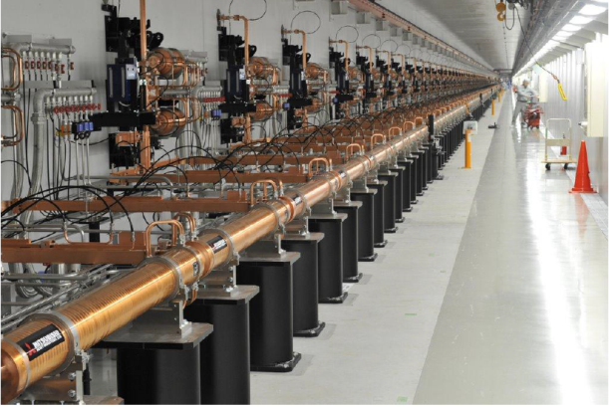
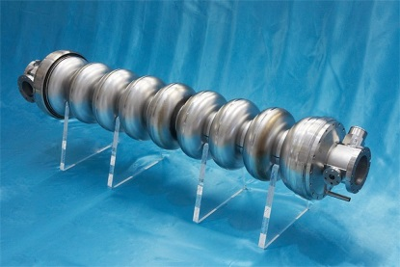

Linear Accelerators
David Alesini
(INFN-LNF, Frascati, Rome, Italy)

Slide 2

Copyright statement and speaker’s release for video publishing
The author consents to the photographic, audio and video recording of this lecture at the CERN Accelerator School. The term “lecture” includes any material incorporated therein including but not limited to text, images and references.
The author hereby grants CERN a royalty-free license to use his image and name as well as the recordings mentioned above, in order to post them on the CAS website.
The author hereby confirms that to his best knowledge the content of the lecture does not infringe the copyright, intellectual property or privacy rights of any third party. The author has cited and credited any third-party contribution in accordance with applicable professional standards and legislation in matters of attribution. Nevertheless the material represent entirely standard teaching material known for more than ten years. Naturally some figures will look alike those produced by other teachers.

Slide 3
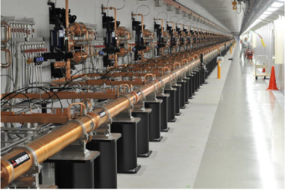
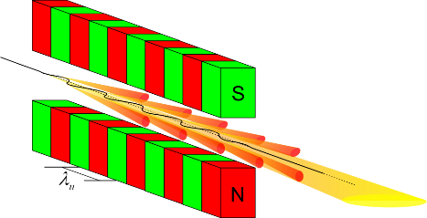
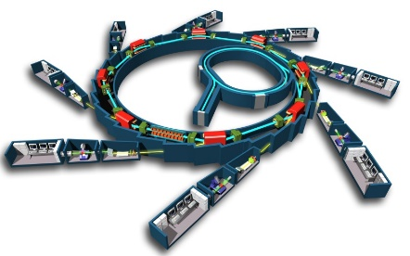
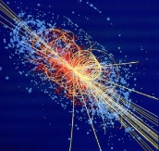
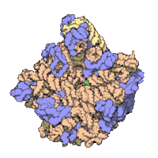
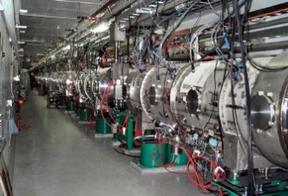
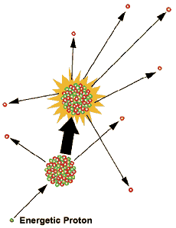
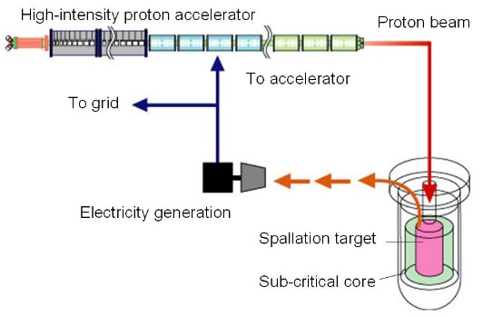
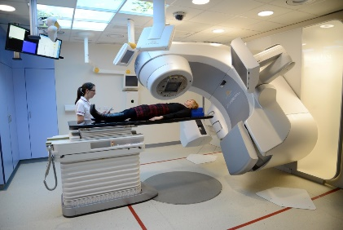
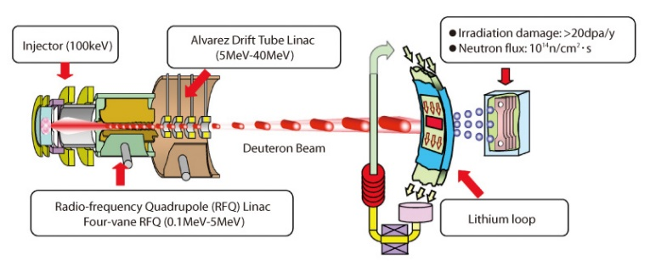
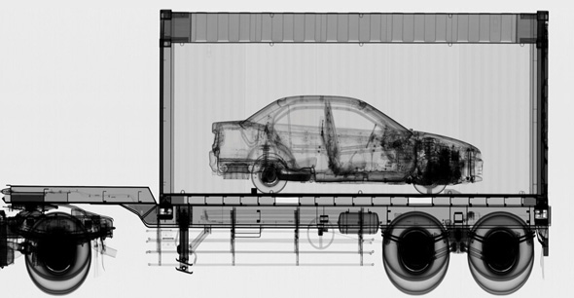
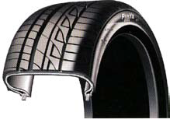


LINAC APPLICATIONS
∼10⁴ LINACs operating around the world
Free Electron Lasers
Injectors for synchrotrons
Spallation sources for neutron production
Nuclear waste treatment and controlled fission for energy production (ADS)
Medical applications: radiotherapy
Industrial applications
Material testing for fusion nuclear reactors
National security
Material treatment
Ion implantation
Material/food sterilization

Slide 4
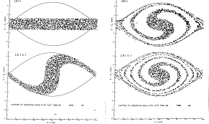
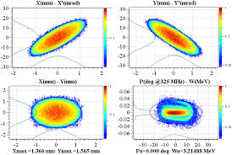
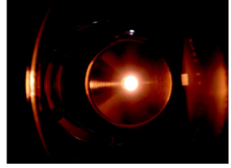
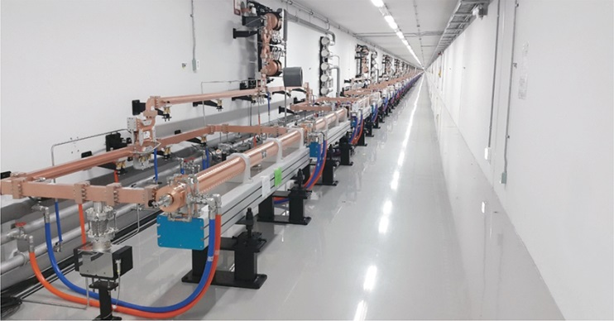
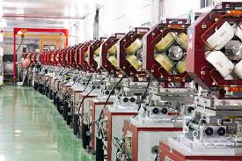
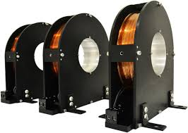
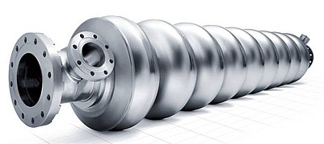
LINAC: BASIC DEFINITION AND MAIN COMPONENTS
LINAC (linear accelerator) is a system that allows to accelerate charged particles through a linear trajectory by electromagnetic fields.
2nd PART OF THE LECTURE
Longitudinal dynamics of accelerated particles
Transverse dynamics of accelerated particles
LINAC BEAM DYNAMICS
Particle source
Accelerated beam
1st PART OF THE LECTURE
Focusing elements: quadrupoles and solenoids
Accelerating structures
LINAC COMPONENTS AND TECHNOLOGY

Slide 5
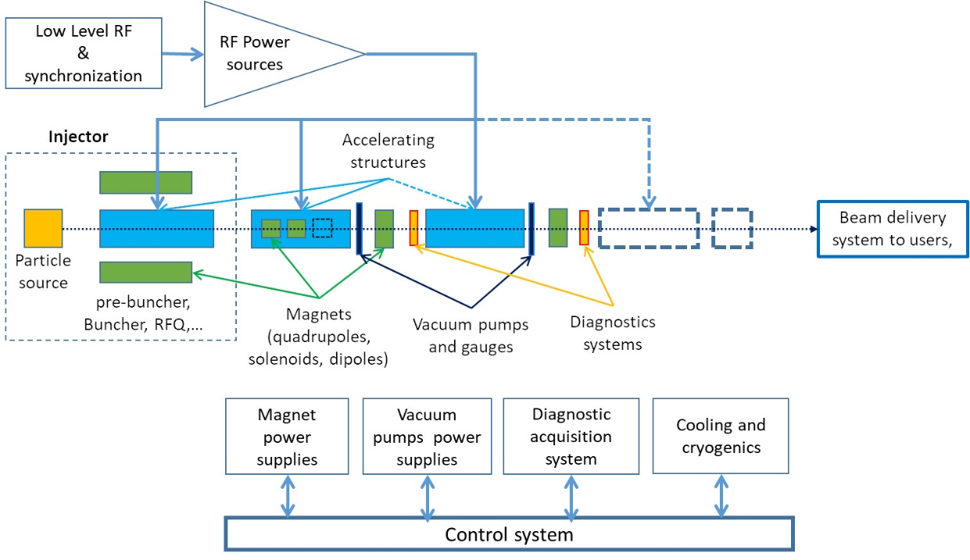
LINAC TECHNOLOGY
The overall LINAC has to be designed to obtain the desired beam parameters in term of:
-output energy/energy spread
-beam current (charge)
-long. and transverse beam dimensions/divergence (emittance)
…
Having, in general, constraints in term of:
-space
-cost
-power consumption
-available power sources
…

Slide 6
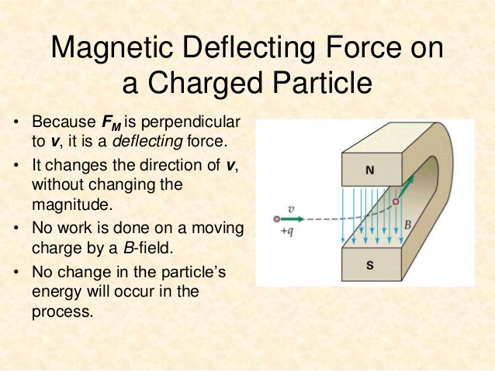
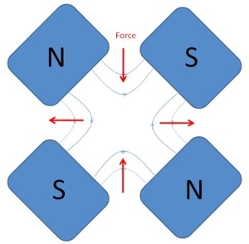
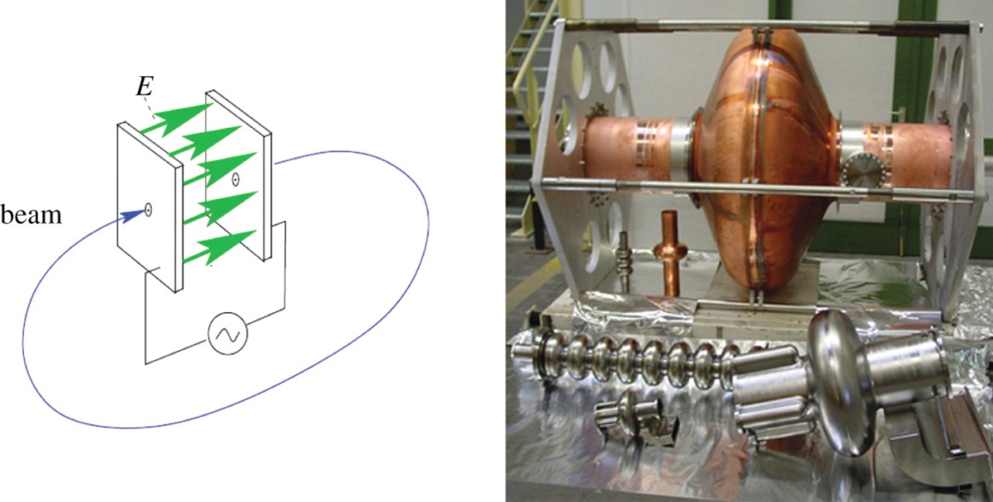
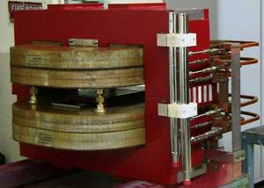
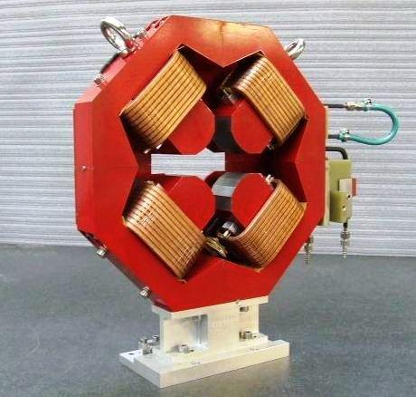

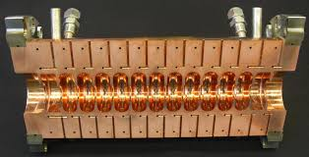
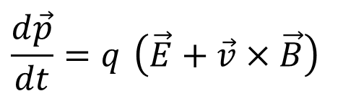
LORENTZ FORCE: ACCELERATION AND FOCUSING
The basic equation that describes the acceleration/bending/focusing processes is the Lorentz Force.
Particles are accelerated through electric fields and are bended and focused through magnetic fields.
$$\frac{d\vec{p}}{dt}=q \left(\vec{E}+\vec{v}×\vec{B}\right)$$
BENDING AND FOCUSING
ACCELERATION
To accelerate, we need a force in the direction of motion
2nd term always perpendicular to motion => no energy gain
Longitudinal Dynamics
Transverse Dynamics

Slide 7
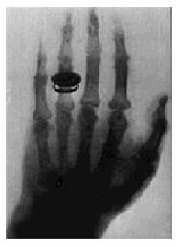

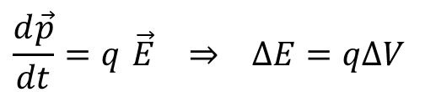
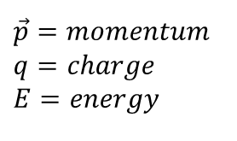
ACCELERATION: SIMPLE CASE
The first historical linear particle accelerator was built by the Nobel prize Wilhelm Conrad Röntgen (1900). It consisted in a vacuum tube containing a cathode connected to the negative pole of a DC voltage generator. Electrons emitted by the heated cathode were accelerated while flowing to another electrode connected to the positive generator pole (anode). Collisions between the energetic electrons and the anode produced X-rays.
Electric field
Anode
Cathode
+
Voltage ΔV
The energy gained by the electrons travelling from the cathode to the anode is equal to their charge multiplied the DC voltage between the two electrodes.
Particle energies are typically expressed in electron-volt [eV], equal to the energy gained by 1 electron accelerated through an electrostatic potential of 1 volt:
1 eV=1.6x10⁻¹⁹ J
$$\frac{d\vec{p}}{dt}=q \vec{E} ⇒ ΔE=qΔV$$
$$\vec{p}=momentum \\ q=charge \\ E=energy$$

Slide 8
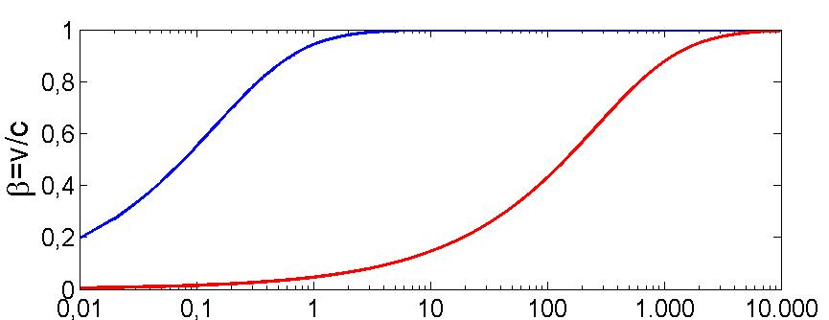
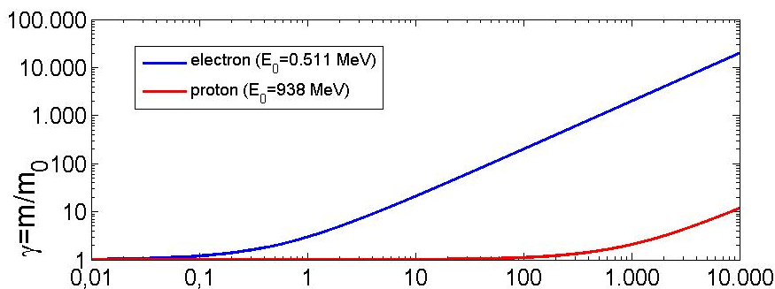
PARTICLE VELOCITY VS ENERGY: LIGHT AND HEAVY PARTICLES
rest mass m₀
rest energy E₀ (=m₀c²)
total energy E
relativistic mass m
velocity v
momentum p (=mv)
Kinetic energy W=E-E₀
Relativistic factor β=v/c (<1)
Single particle
Relativistic factor γ=E/E₀ (≥1)
+
β
1
p⁺
⇒Light particles (as electrons) are practically fully relativistic (β≅1, γ>>1) at relatively low energy and reach a constant velocity (∼c). The acceleration process occurs at constant particle velocity
⇒Heavy particles (protons and ions) are typically weakly relativistic and reach a constant velocity only at very high energy. The velocity changes a lot during the acceleration process.
e⁻
Light particles
Heavy particles
Kin. Energy [MeV]
⇒This implies important differences in the technical characteristics of the accelerating structures. In particular for protons and ions we need different types of accelerating structures, optimized for different velocities and/or the accelerating structure has to vary its geometry to take into account the velocity variation.

Slide 9
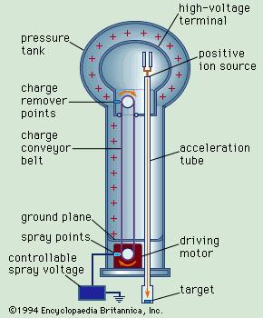
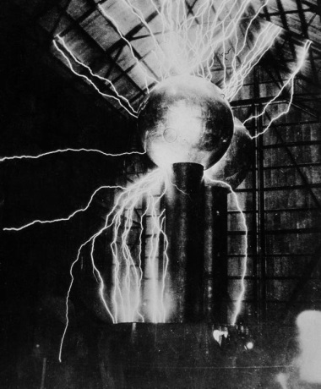
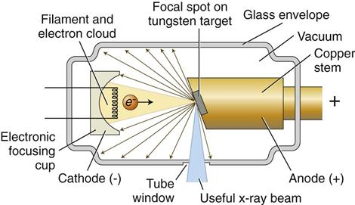
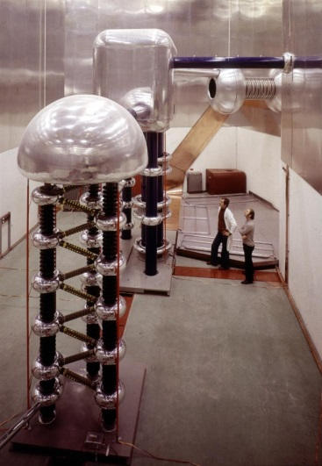
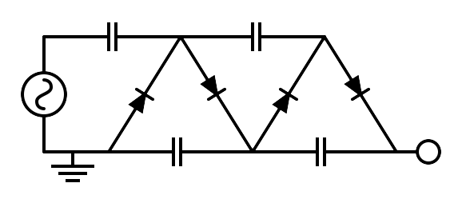
ELECTROSTATIC ACCELERATORS
To increase the achievable maximum energy, Van de Graaff invented an electrostatic generator based on a dielectric belt transporting positive charges to an isolated electrode hosting an ion source. The positive ions generated in a large positive potential were accelerated toward ground by the static electric field.
LIMITS OF ELECTROSTATIC ACCELERATORS
DC voltage as large as ∼10 MV can be obtained (E∼10 MeV). The main limit in the achievable voltage is the breakdown due to insulation problems.
APPLICATIONS OF DC ACCELERATORS
DC particle accelerators are in operation worldwide, typically at V<15MV (E_{max}=15 MeV), I<100mA.
They are used for:
⇒ material analysis
⇒ X-ray production,
⇒ ion implantation for semiconductors
⇒ first stage of acceleration (particle sources)
750 kV Cockcroft-Walton
Linac2 injector at CERN from 1978 to 1992

Slide 10
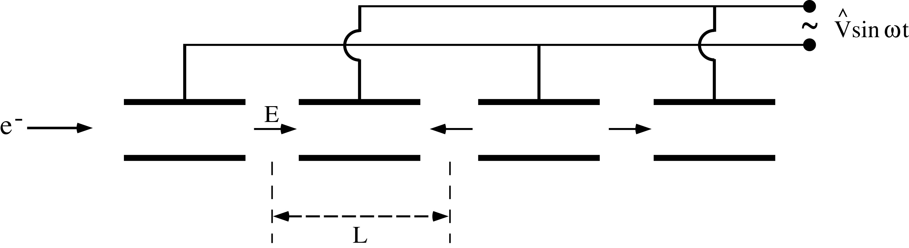
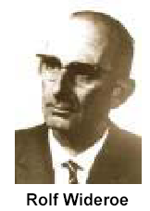
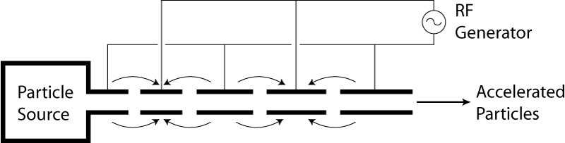
RF Accelerators : Wideröe “Drift Tube LINAC” (DTL)
(protons and ions)
Basic idea: the particles are accelerated by the electric field in the gap between electrodes connected alternatively to the poles of an AC generator. This original idea of Ising (1924) was implemented by Wideroe (1927) who applied a sine-wave voltage to a sequence of drift tubes. The particles do not experience any force while travelling inside the tubes (equipotential regions) and are accelerated across the gaps. This kind of structure is called Drift Tube LINAC (DTL).
⇒If the length of the tubes (or, equivalently, the distances between the centers of the accelerating gaps) increases with the particle velocity during the acceleration such that the time of flight between gaps is kept constant and equal to half of the RF period, the particles are subject to a synchronous accelerating voltage and experience an energy gain of ∆E=q∆V at each gap crossing.
⇒In principle a single RF generator can be used to indefinitely accelerate a beam, avoiding the breakdown limitation affecting the electrostatic accelerators.
⇒The Wideroe LINAC is the first RF LINAC
L₁
L_{n}

Slide 11
DC ACCELERATION: ENERGY GAIN
We consider the acceleration between two electrodes in DC.
+
ΔV
-
E_{z}
source
z (direction of acceleration)
gap
ΔE
E_{z}
t
z
Energy-momentum relation
Lorentz force
W=E-E₀
rate of energy gain per unit length
energy gain per electrode pair

Slide 12

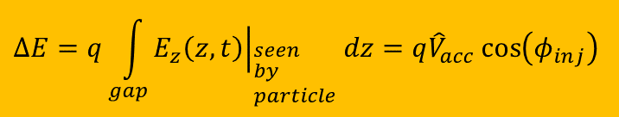
RF ACCELERATION: BUNCHED BEAM
We consider now the acceleration between two electrodes fed by an RF generator
E_{z}
Only these particles are accelerated
source
z
ΔE
gap
t_{inj}
z
$$ΔE=q\int_{gap}{{\left.E_{z}\left(z,t\right)\right|}_{\begin{aligned}&seen \\ &by \\ &particle\end{aligned}}dz}=q{\hat{V}}_{acc}\cos\left(φ_{inj}\right)$$
These particles are not accelerated and basically are lost during the acceleration process
DC acceleration
RF acceleration
$$ω_{RF}t_{inj}$$
charge
charge
Bunched beam (in order to be synchronous with the external AC field, particles have to be gathered in non-uniform temporal structure)
t
RF period
t

Slide 13
RF ACCELERATION: ENERGY GAIN
We consider now the acceleration between two electrodes fed by an RF generator
gap
E_{z}
source
z
-L/2
+L/2
z
Hyp. of symmetric accelerating field
t=z/v
Injection phase
Peak gap voltage
T<1
Transit time factor
Average accelerating field in the gap
Average accelerating field seen by the particle

Slide 14
DRIFT TUBE LENGTH AND FIELD Synchronization
(protons and ions or electrons at extremely low energy)
If now we consider a DTL structure, we have that at each gap the maximum energy gain is ΔE_{n}=qV_{acc} and the particle increase its velocity accordingly to the previous relativistic formulae. It is convenient to refer to the center of each gap as follows:
-
+
+
-
v_{n}
Gap n+1
v_{n+1}
Gap n
E_{z}
E_{z}
L_{n}
L_{n+1}
L_{n+2}
L_{n}
L_{n+1}
L_{n+2}
z
z
E
qV_{acc}
⇒ In order to be synchronous with the accelerating field at the center of each gap, the distance between the centers of the gaps (L_{n}) has to be increased as:
E_{n+1}
E_{n}
z
=average particle velocity between the gap n and n+1
v
⇒The energy gain per unit length (i.e. the average accelerating gradient times q) is given by:
v_{n+1}
v_{n}
[eV/m]
z

Slide 15
ACCELERATION WITH HIGH rf FREQUENCIES: RF CAVITIES
There are two important consequences of the previous obtained formulae:
The condition L_{n}<<λ_{RF} (necessary to model the tube as an equipotential region) requires β<<1. ⇒The Wideröe technique can not be applied to relativistic particles.
Moreover when particles get high velocities the drift spaces get longer and one looses on the efficiency. The average accelerating gradient (E_{acc} [V/m]) increase pushes towards small λ_{RF} (high frequencies).
⇒The solution consists of enclosing the system in a cavity which resonant frequency matches the RF generator frequency.
High frequency, high power sources became available after the 2nd world war pushed by military technology needs (such as radar). Moreover, the concept of equipotential DT can not be applied at small λ_{RF} and the power lost by radiation is proportional to the RF frequency.
As a consequence we must consider accelerating structures different from drift tubes.
⇒Each cavity can be independently powered from the RF generator
waveguide
E_{z}
E_{z}

Slide 16
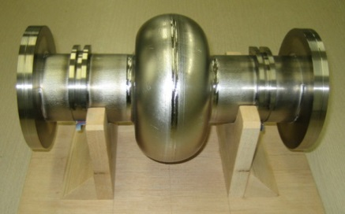
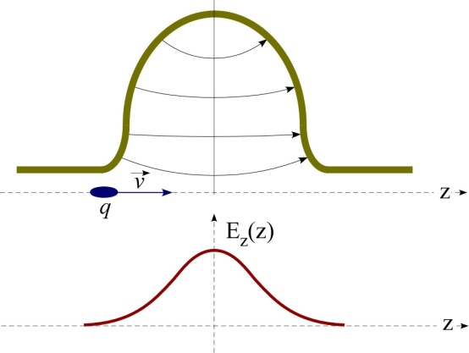
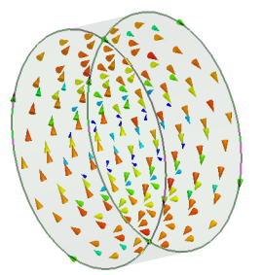
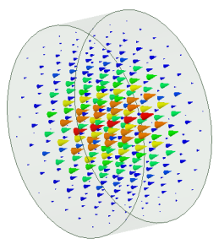
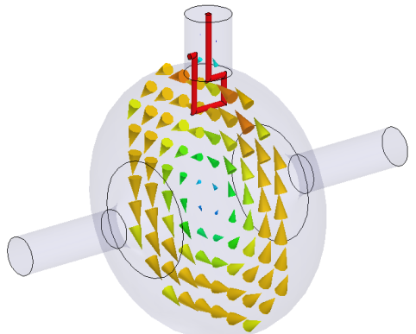
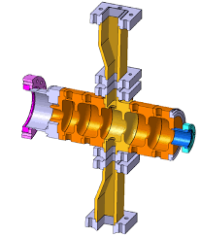
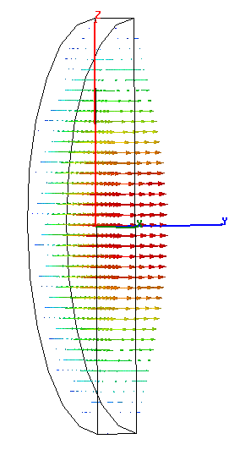

RF CAVITIES
⇒High frequency RF accelerating fields are confined in cavities.
⇒The cavities are metallic closed volumes were the e.m fields has a particular spatial configuration (resonant modes) whose components, including the accelerating field E_{z}, oscillate at some specific frequencies f_{RF} (resonant frequency) characteristic of the mode.
⇒The modes are excited by RF generators that are coupled to the cavities through waveguides, coaxial cables, etc…
⇒The resonant modes are called Standing Wave (SW) modes (spatial fixed configuration, oscillating in time).
⇒The spatial and temporal field profiles in a cavity have to be computed (analytically or numerically) by solving the Maxwell equations with the proper boundary conditions.
B
E
Courtesy E. Jensen

Slide 17



ALVAREZ STRUCTURES
Alvarez's structure can be described as a special DTL in which the electrodes are part of a resonant macrostructure.
(protons and ions)
© Encyclopaedia Britannica, inc
⇒The DTL operates in 0 mode for protons and ions in the range β=0.05-0.5 (f_{RF}=50-400 MHz, λ_{RF}=6-0.7 m) 1-100 MeV;
⇒The beam is inside the “drift tubes” when the electric field is decelerating. The electric field is concentrated between gaps;
⇒The drift tubes are suspended by stems;
⇒Quadrupole (for transverse focusing) can fit inside the drift tubes.
⇒In order to be synchronous with the accelerating field at each gap the length of the n-th drift tube L_{n} has to be:
E_{z}
z

Slide 18


ALVAREZ STRUCTURES: EXAMPLES
Ion species H-
Output energy 160 MeV
Bunch frequency 352.2 MHz
Max. rep.-rate 2 Hz
Beam pulse length 400 s
Max. beam duty cycle 0.08%
Linac current 40mA
Average current 0.032mA
CERN LINAC 4: 352 MHz frequency, Tank diameter 500 mm, 3 resonators (tanks), Length 19 m, 120 Drift Tubes, Energy: 3 MeV to 40 MeV, β=0.08 to 0.31 → cell length from 68mm to 264mm.

Slide 19



HIGH β cavities: CYLINDRICAL STRUCTURES
(electrons or protons and ions at high energy)
⇒When the β of the particles increases (>0.5) one has to use higher RF frequencies (>400-500 MHz) to increase the accelerating gradient per unit length
⇒the DTL structures became less efficient (effective accelerating voltage per unit length for a given RF power);
Cylindrical single (or multiple cavities) working on the TM₀₁₀-like mode are used
For a pure cylindrical structure (also called pillbox cavity) the first accelerating mode (i.e. with non zero longitudinal electric field on axis) is the TM₀₁₀ mode. It has a well known analytical solution from Maxwell equation.
Real cylindrical cavity
(TM₀₁₀-like mode because of the shape and presence of beam tubes and couplers)
E
H

Slide 20




SW CAVITIES PARAMETERS: R, Q
Z₀
1:n
I_{g}
Z₀
ρ_{in}
R/2
C
L
V_{acc}
V_{acc}
Matched source
High power transfer line
coupler
cavity
ACCELERATING VOLTAGE (V_{acc})
DISSIPATED POWER (P_{diss})
STORED ENERGY (W)
SHUNT IMPEDANCE
QUALITY FACTOR
The shunt impedance is the parameter that qualifies the efficiency of an accelerating mode. The higher is its value, the larger is the obtainable accelerating voltage for a given power. Traditionally, it is the quantity to optimize in order to maximize the accelerating field for a given dissipated power:
SHUNT IMPEDANCE PER UNIT LENGTH
NC cavity Q∼10⁴
SC cavity Q∼10¹⁰
NC cavity R∼1MΩ
SC cavity R∼1TΩ
Example:
R∼1MΩ
P_{diss}=1 MW
V_{acc}=1MV
For a cavity working at 1 GHz with a structure length of 10 cm we have an average accelerating field of 10 MV/m

Slide 21




MULTI-CELL SW CAVITIES
P_{in}
(electrons or protons and ions at high energy)
P_{in}
R
.
nR
In a multi-cell structure there is one RF input coupler. As a consequence the total number of RF sources is reduced, with a simplification of the layout and reduction of the costs;
The shunt impedance is n time the impedance of a single cavity
They are more complicated to fabricate than single cell cavities;
The fields of adjacent cells couple through the cell irises and/or through properly designed coupling slots.

Slide 22


MULTI-CELL SW CAVITIES: π MODE STRUCTURES
(electrons or protons and ions at high energy)
0 mode
The N-cell structure behaves like a system composed by N coupled oscillators with N coupled multi-cell resonant modes.
The modes are characterized by a cell-to-cell phase advance given by:
.
E_{z}
The multi cell mode generally used for acceleration is the π, π/2 and 0 mode (DTL as example operate in the 0 mode).
The cell lengths have to be chosen in order to synchronize the accelerating field with the particle traveling into the structure at a certain velocity
z
π mode
EXAMPLE: 4 cell cavity operating on the π-mode
E_{z}
⇒For ions and protons the cell lengths have to be increased along the linac that will be a sequence of different accelerating structures matched to the ion/proton velocity.
⇒For electron, β=1, d=λ_{RF}/2 and the linac will be made of an injector followed by a series of identical accelerating structures, with cells all the same length.
z
$$d=\frac{βc}{2f_{RF}}=\frac{βλ_{RF}}{2}$$

Slide 23






π MODE STRUCTURES: EXAMPLES
LINAC 4 (CERN) PIMS (PI Mode Structure) for protons: f_{RF}=352 MHz, β>0.4
100 MeV
12 tanks
1.28 m
1.55 m
160 MeV
European XFEL (Desy): electrons
Each module has 7 identical cells
All identical β=1
Superconducting cavities

Slide 24


MULTI-CELL SW CAVITIES: π/2 MODE STRUCTURES
(electrons or protons and ions at high energy)
f_{res}
Dispersion curve
⇒It is possible to demonstrate that over a certain number of cavities (>10) working on the π mode, the overlap between adjacent modes can be a problem (as example the field uniformity due to machining errors is difficult to tune).
⇒The criticality of a working mode depend on the frequency separation between the working mode and the adjacent mode
⇒the π/2 mode from this point of view is the most stable mode. For this mode it is possible to demonstrate that the accelerating field is zero every two cells. For this reason, the empty cells are put of axis and coupling slots are opened from the accelerating cells to the empty cells.
⇒this allow to increase the number of cells to >20-30 without problems
Δf_{res_π}
Δf_{res_π/2}
Multi cell cavity modes
0 mode
π/2 mode
π mode
Phase advance per cell
Side Coupled Cavity (SCC)
Axial coupled
E_{z}
z
f_{RF}=800 - 3000 MHz for proton (β=0.5-1) and electrons

Slide 25


TRAVELLING WAVE (TW) STRUCTURES
(electrons)
P _{RF in}
⇒To accelerate charged particles, the electromagnetic field must have an electric field along the direction of propagation of the particle.
⇒The field has to be synchronous with the particle velocity.
⇒Up to now we have analyzed the standing standing wave (SW) structures in which the field has basically a given profile and oscillate in time (as example in DTL or resonant cavities operating on the TM₀₁₀-like).
E_{z}
Direction of propagation
Time oscillation
z
field profile
P _{RF in}
P _{RF out}
P _{RF TW}
⇒There is another possibility to accelerate particles: using a travelling wave (TW) structure in which the RF wave is co-propagating with the beam with a phase velocity equal to the beam velocity.
⇒Typically these structures are used for electrons because in this case the phase velocity can be constant all over the structure and equal to c. On the other hand it is difficult to modulate the phase velocity itself very quickly for a low β particle that changes its velocity during acceleration.
E_{z}
z

Slide 26

TW CAVITIES: CIRCULAR WAVEGUIDE AND DISPERSION CURVE
(electrons)
In TW structures an e.m. wave with E_{z}≠0 travel together with the beam in a special guide in which the phase velocity of the wave matches the particle velocity (v). In this case the beam absorbs energy from the wave and it is continuously accelerated.
ω=2πf (f=RF generator frequency)
CIRCULAR WAVEGUIDE
Dispersion curve
ω_{RF_2}
ω_{RF}
ω_{cut-off}
As example if we consider a simple circular waveguide the first propagating mode with E_{z}≠0 is the TM₀₁ mode.
Nevertheless by solving the wave equation it turns out that an e.m. wave propagating in this constant cross section waveguide will never be synchronous with a particle beam since the phase velocity is always larger than the speed of light c.
(propagation constant)
tan(α)=v_{ph}
k*
k₂*
k
E_{z}
z

Slide 27


TW CAVITIES: IRIS LOADED STRUCTURES
(electrons)
In order to slow-down the wave phase velocity, iris-loaded periodic structure have to be used.
CIRCULAR WAVEGUIDE
IRIS LOADED STRUCTURE
Metal irises
Beam direction
D
MODE TM₀₁
MODE TM₀₁-like
Periodic (in z) wih period D (from Floquet theorem)
⇒The field in this type of structures is that of a special wave travelling within a spatial periodic profile.
ω
ω_{RF}
⇒The structure can be designed to have the phase velocity equal to the speed of the particles.
⇒This allows acceleration over large distances (few meters, hundred of cells) with just an input coupler and a relatively simple geometry.
⇒They are used especially for electrons (constant particle velocity→constant phase velocity, same distance between irises, easy realization)
k*
π/D
k

Slide 28



TW CAVITIES PARAMETERS: r, α, v_{g}
Similarly to the SW cavities it is possible to define some figure of merit for the TW structures
Shunt impedance per unit length [Ω/m]. Similarly to SW structures the higher is r, the higher the available accelerating field for a given RF power.
Field attenuation constant [1/m]: because of the wall dissipation, the RF power flux and the accelerating field decrease along the structure.
Group velocity [m/s]: the velocity of the energy flow in the structure (∼1-2% of c).
Working mode [rad]: defined as the phase advance over a period D. For several reasons the most common mode is the 2π/3

Slide 29

TW CAVITIES: EQUIVALENT CIRCUIT AND FILLING TIME
(electrons)
In a TW structure, the RF power enters into the cavity through an input coupler, flows (travels) through the cavity in the same direction as the beam and an output coupler at the end of the structure is connected to a matched power load.
If there is no beam, the input power, reduced by the cavity losses, goes to the power load where it is dissipated.
In the presence of a large beam current, however, a fraction of the TW power is transferred to the beam.
In a purely periodic structure, made by a sequence of identical cells (also called “constant impedance structure”), α does not depend on z and both the RF power flux and the intensity of the accelerating field decay exponentially along the structure :
It is possible to demonstrate that, in order to keep the accelerating field constant along the structure, the iris apertures have to decrease along the structure.
The filling time is the time necessary to propagate the RF wave-front from the input to the end of the section of length L is:
L

Slide 30


LINAC TECHNOLOGY: MATERIALS

Slide 31







ACCELERATING CAVITY TECHNOLOGY
⇒The cavities (and the related LINAC technology) can be of different material:
copper for normal conducting (NC, both SW than TW) cavities;
Niobium for superconducting cavities (SC, SW);
⇒We can choose between NC or the SC technology depending on the required performances in term of:
accelerating gradient (MV/m);
RF pulse length (how many bunches we can contemporary accelerate);
Duty cycle (see next slide): pulsed operation (i.e. 10-100 Hz) or continuous wave (CW) operation;
Average beam current.
…
Dissipated power into the cavity walls is related to the surface currents
NIOBIUM
COPPER
Frequency [GHz]
Between copper and Niobium there is a factor 10⁵-10⁶

Slide 32


RF STRUCTURE AND BEAM STRUCTURE: NC vs SC
The “beam structure” in a LINAC is directly related to the “RF structure”. There are two possible type of operations:
CW (Continuous Wave) operation ⇒ allow, in principle, to operate with a continuous (bunched) beam
PULSED operation ⇒ there are RF pulses at a certain repetition rate (Duty Cycle (DC)=pulsed width/period)
RF power
RF pulses
time
Bunch spacing
⇒SC structures allow operation at very high Duty Cycle (>1%) up to a CW operation (DC=100%) (because of the extremely low dissipated power) with relatively high gradient (>20 MV/m). This means that a continuous (bunched) beam can be accelerated.
⇒NC structures can operate in pulsed mode at very low DC (10⁻²-10⁻¹ %) (because of the higher dissipated power) with, in principle, larger peak accelerating gradient(>30 MV/m). This means that one or few tens of bunches can be, in general, accelerated. NB: NC structures can also operate in CW but at very low gradient because of the dissipated power.
Amplitude
10³-10⁸ RF periods
t

Slide 33








EXAMPLE: SWISSFEL LINAC (PSI)

Slide 34






EXAMPLES: EUROPEAN XFEL

Slide 35
LINAC: BASIC DEFINITION AND MAIN COMPONENTS
LINAC (linear accelerator) is a system that allows to accelerate charged particles through a linear trajectory by electromagnetic fields.
Longitudinal dynamics of accelerated particles
Transverse dynamics of accelerated particles
LINAC BEAM DYNAMICS
Particle source
Accelerated beam
Focusing elements: quadrupoles and solenoids
Accelerating structures
LINAC COMPONENTS AND TECHNOLOGY

Slide 36


SYNCHRONOUS PARTICLE/PHASE
⇒Let us consider a SW linac structure made by accelerating gaps (like in DTL) or cavities.
⇒In each gap we have an accelerating field oscillating in time and an integrated accelerating voltage (V_{acc}) still oscillating in time than can be expressed as:
$$V_{acc}={\hat{V}}_{acc}\cos\left(ω_{RF}t\right)$$
⇒Let’s assume that the “perfect” synchronism condition is fulfilled for a phase φ_{s} (called synchronous phase). This means that a particle (called synchronous particle) entering in a gap with a phase φ_{s} (φ_{s}=ω_{RF}t_{s}) with respect to the RF voltage receive an energy gain (and a consequent change in velocity) that allow entering in the subsequent gap with the same phase φ_{s} and so on.
⇒for this particle the energy gain in each gap is:
V_{acc}
V_{acc_s}
φ_{s}
φ_{s}*
t
$$ΔE=q\underset{V_{acc_s}}{\underbrace{{\hat{V}}_{acc}\cos\left(φ_{s}\right)}}=qV_{acc_s}$$
⇒obviously both φ_{s} and φ_{s}* are synchronous phases.
T_{RF}

Slide 37


LINAC-SYNCHROTRON Phase Conventions FOR BEAM DYNAMICS CALCULATIONS
For circular accelerators, the origin of time is taken at the zero crossing of the RF voltage with positive slope
For linear accelerators, the origin of time is taken at the maximum of the positive crest of the RF voltage
circular accelerators
linear accelerators
V_{acc}
V_{acc}
φ_{s}
t
φ_{s}
t
$$V_{acc}={\hat{V}}_{acc}\sin\left(ω_{RF}t\right)$$
$$V_{acc}={\hat{V}}_{acc}\cos\left(ω_{RF}t\right)$$

Slide 38
PRINCIPLE OF PHASE STABILITY
(protons and ions or electrons at extremely low energy)
V_{acc}
⇒Let us consider now the first synchronous phase φ_{s} (on the positive slope of the RF voltage). If we consider another particle “near” to the synchronous one that arrives later in the gap (t₁>t_{s}, φ₁>φ_{s}), it will see an higher voltage, it will gain an higher energy and an higher velocity with respect to the synchronous one. As a consequence its time of flight to next gap will be shorter, partially compensating its initial delay.
⇒Similarly if we consider another particle “near” to the synchronous one that arrives before in the gap (t₁<t_{s}, φ₁<φ_{s}), it will see a smaller voltage, it will gain a smaller energy and a smaller velocity with respect to the synchronous one. As a consequence its time of flight to next gap will be longer, compensating the initial advantage.
⇒On the contrary if we consider now the synchronous particle at phase φ_{s}* and another particle “near” to the synchronous one that arrives later or before in the gap, it will receive an energy gain that will increase further its distance form the synchronous one
φ₂
φ_{s}
φ₁
φ_{s}*
t
⇒The choice of the synchronous phase in the positive slope of the RF voltage provides longitudinal focusing of the beam: phase stability principle.
⇒The synchronous phase on the negative slope of the RF voltage is, on the contrary, unstable
⇒Relying on particle velocity variations, longitudinal focusing does not work for fully relativistic beams (electrons). In this case acceleration “on crest” is more convenient.

Slide 39







ENERGY-PHASE EQUATIONS (1/2)
(protons and ions or electrons at extremely low energy)
In order to study the longitudinal dynamics in a LINAC, the following variables are used, which describe the generic particle phase (time of arrival) and energy with respect to the synchronous particle:
ΔL (accelerating cell length)
Arrival time (phase) of a generic particle at a certain gap (or cavity)
Arrival time (phase) of the synchronous particle at a certain gap (or cavity)
$$\left\{\begin{aligned}&φ=φ−φ_{s}=ω_{RF}\left(t−t_{s}\right) \\ &w=E−E_{s}\end{aligned}\right.$$
Energy of the synchronous particle at a certain position along the linac
Energy of a generic particle at a certain position along the linac
$$V_{acc}={\hat{V}}_{acc}\cos\left(ω_{RF}t\right)$$
z
The energy gain per cell (one gap + tube in case of a DTL) of a generic particle and of a synchronous particle are:
$$\left\{\begin{aligned}&ΔE_{s}=q{\hat{V}}_{acc}\cos{φ_{s}} \\ &ΔE=q{\hat{V}}_{acc}\cos{φ}=q{\hat{V}}_{acc}\cos\left(φ_{s}+φ\right)\end{aligned}\right.$$
Dividing by the accelerating cell length ΔL and assuming that:
Average accelerating field over the cell (i.e. average accelerating field)
$$\frac{{\hat{V}}_{acc}}{ΔL}={\hat{E}}_{acc}$$
subtracting
$$\frac{Δw}{ΔL}=q{\hat{E}}_{acc}\left[\cos\left(φ_{s}+φ\right)−\cos{φ_{s}}\right]$$
$$Δw=ΔE−ΔE_{s}=q{\hat{V}}_{acc}\left[\cos\left(φ_{s}+φ\right)−\cos{φ_{s}}\right]$$
Approximating
$$\frac{Δw}{ΔL}≈\frac{dw}{dz}$$
$$\frac{dw}{dz}=q{\hat{E}}_{acc}\left[\cos\left(φ_{s}+φ\right)−\cos{φ_{s}}\right]$$

Slide 40






ENERGY-PHASE EQUATIONS (2/2)
(protons and ions or electrons at extremely low energy)
On the other hand we have that the phase variation per cell of a generic particle and of a synchronous particle are:
$$\left\{\begin{aligned}&Δφ_{s}=ω_{RF}Δt_{s} \\ &Δφ=ω_{RF}Δt\end{aligned}\right.$$
Δt is basically the time of flight between two accelerating cells
v, v_{s} are the average particles velocities
subtracting
$$\frac{Δφ}{ΔL}=ω_{RF}\left(\frac{Δt}{ΔL}−\frac{Δt_{s}}{ΔL}\right)=ω_{RF}\left(\frac{1}{v}−\frac{1}{v_{s}}\right)⥂\underset{MAT}{\underbrace{≅}}−\frac{ω_{RF}}{cE_{0}β_{s}^{3}γ_{s}^{3}}w$$
$$Δφ=ω_{RF}\left(Δt−Δt_{s}\right)$$
Dividing by the accelerating cell length ΔL
Approximating
$$\frac{Δφ}{ΔL}≅\frac{dφ}{dz}$$
$$\frac{dw}{dz}=q{\hat{E}}_{acc}\left[\cos\left(φ_{s}+φ\right)−\cos{φ_{s}}\right]$$
This system of coupled (non linear) differential equations describe the motion of a non synchronous particles in the longitudinal plane with respect to the synchronous one.
$$\frac{dφ}{dz}=−\frac{ω_{RF}}{cE_{0}β_{s}^{3}γ_{s}^{3}}w$$
MAT
$$ω_{RF}\left(\frac{1}{v}−\frac{1}{v_{s}}\right)=ω_{RF}\left(\frac{v_{s}−v}{vv_{s}}\right)⥂\underset{\begin{aligned}&vv_{s}≅v_{s}^{2} \\ &v−v_{s}≅Δv\end{aligned}}{\underbrace{≅}}−\frac{ω_{RF}}{v_{s}^{2}}Δv=−\frac{ω_{RF}}{c}\frac{Δβ}{β_{s}^{2}} \text{remembering} \text{that} β=\sqrt{1−1/{γ^{2}}}⇒βdβ={dγ}/{γ^{3}}⇒−\frac{ω_{RF}}{c}\frac{Δβ}{β_{s}^{2}}≅−\frac{ω_{RF}}{c}\frac{Δγ}{β_{s}^{3}γ_{s}^{3}}=−\frac{ω_{RF}}{c}\frac{\overset{w}{\overbrace{ΔE}}}{E_{0}β_{s}^{3}γ_{s}^{3}}$$

Slide 41






SMALL AMPLITUDE ENERGY-PHASE OSCILLATIONS
(protons and ions or electrons at extremely low energy)
$$\left\{\begin{aligned}&\frac{dw}{dz}=q{\hat{E}}_{acc}\left[\cos\left(φ_{s}+φ\right)−\cos{φ_{s}}\right] \\ \\ & \\ & \\ & \\ &\frac{dφ}{dz}=−\frac{ω_{RF}}{cE_{0}β_{s}^{3}γ_{s}^{3}}w→cE_{0}β_{s}^{3}γ_{s}^{3}\frac{dφ}{dz}=−ω_{RF}w\end{aligned}\right.$$
Deriving both terms with respect to z
$$cE_{0}β_{s}^{3}γ_{s}^{3}\frac{d^{2}φ}{dz^{2}}+cE_{0}\frac{dβ_{s}^{3}γ_{s}^{3}}{dz}\frac{dφ}{dz}=−ω_{RF}\frac{dw}{dz}$$
$$\frac{d^{2}φ}{dz^{2}}+\underset{Ω_{s}^{2}}{\underbrace{q\frac{ω_{RF}{\hat{E}}_{acc}\sin\left(−φ_{s}\right)}{cE_{0}β_{s}^{3}γ_{s}^{3}}}}φ=0$$
General non linear differential equation that gives the phase evolution
$$cE_{0}β_{s}^{3}γ_{s}^{3}\frac{d^{2}φ}{dz^{2}}+cE_{0}\left(\frac{dβ_{s}^{3}γ_{s}^{3}}{dz}\right)\frac{dφ}{dz}=−ω_{RF}q{\hat{E}}_{acc}\left[\cos\left(φ_{s}+φ\right)−\cos{φ_{s}}\right]$$
Assuming small oscillations around the synchronous particle
⇒The condition to have stable longitudinal oscillations and acceleration at the same time is:
Deriving both terms with respect to z and assuming an adiabatic acceleration
$\frac{dβ_{s}^{3}γ_{s}^{3}}{dz}$<<1
The angular frequency is simply: Ω_{T}= Ω_{s}β_{s}c;
The angular frequency scale with 1/γ^{3/2} that means that for ultra relativistic electrons shrinks to 0 (the beam is frozen)
$$\left.\begin{aligned}&Ω_{s}^{2}>0⇒\sin\left(−φ_{s}\right)>0 \\ &V_{acc}>0⇒\cos{φ_{s}}>0\end{aligned}\right\}⇒−\frac{π}{2}<φ_{s}<0$$
V_{acc}
if we accelerate on the rising part of the positive RF wave we have a longitudinal force keeping the beam bunched around the synchronous phase.
V_{acc_s}
φ_{s}
t
$$\left\{\begin{aligned}&φ=\hat{φ}\cos\left(Ω_{s}z\right) \\ &w=\hat{w}\sin\left(Ω_{s}z\right)\end{aligned}\right.$$

Slide 42
COMPARISON LINAC-SYNCHROTRON FREQUENCY
Below transition
Synchrotron length

Slide 43
ENERGY-PHASE OSCILLATIONS IN PHASE SPACE
(protons and ions or electrons at extremely low energy)
Gain energy with respect to the synchronous one
w
move forward
The energy-phase oscillations can be drawn in the longitudinal phase space:
move backward
Loose energy
ϕ
Synchronous particle
w
⇒The trajectory of a generic particle in the longitudinal phase space is an ellipse.
⇒The maximum energy deviation is reached at ϕ=0 while the maximum phase excursion corresponds to w=0.
⇒the bunch occupies an area in the longitudinal phase space called longitudinal emittance and the projections of the bunch in the energy and phase planes give the energy spread and the bunch length.
w
Longitudinal emittance is the phase space area including all the particles
0
ϕ
Energy spread
Number of particles
Bunch length
ϕ
0

Slide 44



LARGE OSCILLATIONS AND SEPARATRIX (SMOOTH APPROX)
To study the longitudinal dynamics at large oscillations, we have to consider the non linear system of differential equations without small oscillation approximations (but with adiabatic acceleration approximation). It is possible to easily obtain the following relation between w and ϕ (that is the Hamiltonian of the system related to the total particle energy):
$$\frac{1}{2}\frac{ω_{RF}}{cE_{0}β_{s}^{3}γ_{s}^{3}}w^{2}+q{\hat{E}}_{acc}\left[\sin{φ}−φ\cos{φ_{s}}\right]=H$$
⇒For each H we have different trajectories in the longitudinal phase space
⇒the oscillations are stable within a region bounded by a special curve called separatrix: its equation is:
⇒the region inside the separatrix is called RF bucket. The dimensions of the bucket shrinks to zero if φ_{s}=0.
⇒trajectories outside the RF buckets are unstable.
⇒we can define the RF acceptance as the maximum extension in phase and energy that we can accept in an accelerator:
φ_{s}
-φ_{s}
φ
$$\frac{1}{2}\frac{ω_{RF}}{cE_{0}β_{s}^{3}γ_{s}^{3}}w^{2}+q{\hat{E}}_{acc}\left[\sin{φ}+\sin{φ_{s}}−\left(φ+φ_{s}\right)\cos{φ_{s}}\right]=\text{0}$$
φ
Small amplitude oscillations
φ
RF bucket

Slide 45










ADIABATIC DAMPING
$$\frac{1}{2}\frac{ω_{RF}}{cE_{0}β_{s}^{3}γ_{s}^{3}}w^{2}+q{\hat{E}}_{acc}\left[\sin\left(φ_{s}+φ\right)−\left(φ_{s}+φ\right)\cos{φ_{s}}\right]=H$$
For small amplitude oscillations around the synchronous phase we have
$$\frac{1}{2}\frac{ω_{RF}}{cE_{0}β_{s}^{3}γ_{s}^{3}}w^{2}+q{\hat{E}}_{acc}\left[\cos\left(φ_{s}\right)φ−\frac{1}{2}sin\left(φ_{s}\right)φ^{2}−\left(φ_{s}+φ\right)cos{φ_{s}}\right]=H$$
$$\frac{1}{2}\frac{ω_{RF}}{cE_{0}β_{s}^{3}γ_{s}^{3}}w^{2}−\frac{1}{2}q{\hat{E}}_{acc}\sin\left(φ_{s}\right)φ^{2}=H$$
A particle with some initial conditions will perform an ellipse in the phase space. Its maximum energy w_{max} is obtained when φ= φ_{s} (i.e. $φ=0$) and correspondingly its maximum phase excursion is obained when w=0. Then:
$$φ=0→\frac{1}{2}\frac{ω_{RF}}{cE_{0}β_{s}^{3}γ_{s}^{3}}w_{max}^{2}=H$$
This ratio decrease during acceleration while the area of the ellipse should remain unchanged because there are only conservative forces (Liouville). This means that the bunch reduce its length and increase its energy spread
$$\frac{φ_{max}^{}}{w_{max}^{}}=\sqrt{\frac{ω_{RF}}{−q{\hat{E}}_{acc}sin\left(φ_{s}\right)cE_{0}β_{s}^{3}γ_{s}^{3}}}$$
$$w=0→−\frac{1}{2}q{\hat{E}}_{acc}\sin\left(φ_{s}\right)φ_{max}^{2}=H$$
$$w$$
$$w$$
$$φ$$
$$φ$$

Slide 46


LONGITUDINAL DYNAMICS OF LOW ENERGY ELECTRONS
⇒This is the case of electrons whose velocity is always close to speed of light c even at low energies.
⇒Accelerating structures are designed to provide an accelerating field synchronous with particles moving at v=c. like TW structures with phase velocity equal to c.
From previous formulae it is clear that there is no motion in the longitudinal phase plane for ultrarelativistic particles (γ>>1).
It is interesting to analyze what happen if we inject an electron beam produced by a cathode (at low energy) directly in a TW structure (with v_{ph}=c) and the conditions that allow to capture the beam (this is equivalent to consider instead of a TW structure a SW designed to accelerate ultrarelativistic particles at v=c).
E_{acc}
Particles enter the structure with velocity v<c and, initially, they are not synchronous with the accelerating field and there is a so called slippage.
z
After a certain distance they can reach enough energy (and velocity) to become synchronous with the accelerating wave. This means that they are captured by the accelerator and from this point they are stably accelerated.
If this does not happen (the energy increase is not enough to reach the velocity of the wave) they are lost

Slide 47

LONGITUDINAL DYNAMICS OF LOW ENERGY ELECTRONS: PHASE SPLIPPAGE
The accelerating field of a TW structure can be expressed by
The equation of motion of a particle with a position z at time t accelerated by the TW is then
It is useful to find which is the relation between β and φ from an initial condition (in) to a final one (fin)
Should be in the interval [-1,1] to have a solution for φ_{fin}
Suppose that the particle reach asymptotically the value β_{fin}=1 we have:
This limits the possible injection phases (i.e. the phase of the electrons that is possible to capture)
This quantity is >0
We always have that
E_{acc}
E_{acc}
z
φ_{in}
β_{in}
φ_{fin}
β_{fin}=1
φ

Slide 48
APPENDIX: PHASE SPLIPPAGE CALCULATIONS
The accelerating field of a TW structure can be expressed by
The equation of motion of a particle with a position z at time t accelerated by the TW is then
This is the phase of the TW wave seen by the particle at a certain time t and position z
The phase motion during acceleration is then
It is useful to find which is the relation between β and φ
The phase of the wave “seen” by the particle always increase because β<1.
We can integrate both sides between the initial and the final condition to find the dependence of phase on velocity during the acceleration process (using, as example, the new variable β=cosα)

Slide 49

LONGITUDINAL DYNAMICS OF LOW ENERGY ELECTRONS: CAPTURE EFFICIENCY AND BUNCH COMPRESSION
During the capture process, as the injected beam moves up to the crest, the beam is also bunched, which is caused by velocity modulation (velocity bunching). This mechanism can be used to compress the electron bunches (FEL applications).
BUNCH COMPRESSION
CAPTURE EFFICIENCY
All particles are captured
β_{in}=0.01
β_{fin}≅1
β_{in}=0.01
β_{fin}≅1
β_{in}<1
β_{fin}=1
Bunch lenght variation
E_{z}
φ
These particle are lost during the capture process
Depending on the injection phase we can have bunch compression or expansion

Slide 50
BUNCHER AND CAPTURE SECTIONS
(electrons)
Once the capture condition E_{RF}>E_{RF_MIN} is fulfilled the fundamental equation of previous slide sets the ranges of the injection phases φ_{in} actually accepted. Particles whose injection phases are within this range can be captured the other are lost.
In order to increase the capture efficiency of a traveling wave section, pre-bunchers are often used. They are SW cavities aimed at pre-forming particle bunches gathering particles continuously emitted by a source.
Drift L
Thermionic
Gun
Pre-Buncher
(SW Cavity)
Buncher and accelerating sections
(SW or TW)
Continuous beam
Continuous beam
with velocity modulation
Bunched beam
Bunched and captured beam
I
v∝ΔE
T_{RF}
I
I
t
v
t
T
RF
t
T
RF
t
t
⇒Bunching is obtained by modulating the energy (and therefore the velocity) of a continuous beam using the longitudinal E-field of a SW cavity. After a certain drift space the velocity modulation is converted in a density charge modulation. The density modulation depletes the regions corresponding to injection phase values incompatible with the capture process
⇒A TW accelerating structure (capture section) is placed at an optimal distance from the pre-buncher, to capture a large fraction of the charge and accelerate it till relativistic energies. The amount of charge lost is drastically reduced, while the capture section provide also further beam bunching.

Slide 51







SW AS A SUM OF TWO TW: RF NON-SYNCRONOUS HARMONICS
Let us consider the case of a multi-cell SW cavity working on the π-mode. The Accelerating field can be expressed as:
The accelerating field seen by the particle is given by (t=z/c):
$${\left.E_{z}\right|}_{\begin{aligned}&seen \\ &by \\ &particle \\ &z=ct\end{aligned}}={\hat{E}}_{RF}\cos\left(kz\right)\cos\left(ω_{RF}\frac{z}{c}\right)={\hat{E}}_{RF}\cos^{2}\left(kz\right)=\frac{{\hat{E}}_{RF}}{2}+\frac{{\hat{E}}_{RF}}{2}\cos\left(2kz\right)$$
P _{RF in}
Oscillating term that has an average value equal to 0
On the other hand we can the SW can be written as the sum of two TWs in the form:
E_{z}
Direction of propagation
Synchronous wave co-propagating with beam
NON-Synchronous wave (called RF non-synchronous harmonic) counter-propagating with beam (opposite direction)
z
The accelerating field seen by the particle is given by ${{k=ω}_{RF}}/c$:
$$d$$
$${\left.E_{z}\right|}_{\begin{aligned}&seen \\ &by \\ &particle \\ &z=ct\end{aligned}}=\frac{{\hat{E}}_{RF}}{2}\cos\left(ω_{RF}\frac{z}{c}−kz\right)+\frac{{\hat{E}}_{RF}}{2}\cos\left(ω_{RF}\frac{z}{c}+kz\right)=\frac{{\hat{E}}_{RF}}{2}+\frac{{\hat{E}}_{RF}}{2}\cos\left(2kz\right)$$
In order to have synchronism between the accelerating field and and ultrarelativistic particle we have to satisfy the following relation (supposing electrons $β$=1):
Oscillating field that does not contribute to acceleration but that gives RF focusing
$$d=\frac{c}{2f_{RF}}=\frac{λ_{RF}}{2}$$
t=z/c
$$k=\frac{2π}{2d}=\frac{2π}{λ_{RF}}=\frac{ω_{RF}}{c}\text{, }λ_{RF}=cT_{RF}$$
Synchronous wave: acceleration

Slide 52
LINAC: BASIC DEFINITION AND MAIN COMPONENTS
LINAC (linear accelerator) is a system that allows to accelerate charged particles through a linear trajectory by electromagnetic fields.
Longitudinal dynamics of accelerated particles
Transverse dynamics of accelerated particles
LINAC BEAM DYNAMICS
Particle source
Accelerated beam
Focusing elements: quadrupoles and solenoids
Accelerating structures
LINAC COMPONENTS AND TECHNOLOGY

Slide 53

RF TRANSVERSE FORCES
The RF fields act on the transverse beam dynamics because of the transverse components of the E and B field
⇒According to Maxwell equations the divergence of the field is zero and this implies that in traversing one accelerating gap there is a focusing/defocusing term
r
θ
z
f_{RF}=350 MHz
β=0.1
L=3cm

Slide 54







RF TRANSVERSE FORCES IN MULTI-CELL STRUCTURES: CONTRIBUTION OF THE FORWARD AND BACKWARD WAVES
For a multi-cell structure let us suppose that the field can be written as:
$$E_{z}=\underset{E_{RF}\left(z\right)}{\underbrace{{\hat{E}}_{RF}\cos\left(kz\right)}}\cos\left(ω_{RF}t\right)$$
The Lorentz force is then given by the two contributions
To have synchronism
${\left.F_{r}\right|}_{E}=−q\frac{r}{2}\frac{∂E_{RF}\left(z\right)}{∂z}\cos\left(ω_{RF}\frac{z}{βc}+φ_{inj}\right)=q\frac{r}{2}{\hat{E}}_{RF}\sin\left(kz\right)\cos\left(ω_{RF}\frac{z}{βc}+φ_{inj}\right)=$ $q\frac{r}{2}\frac{ω_{RF}}{βc}{\hat{E}}_{RF}\sin\left(ω_{RF}\frac{z}{βc}z\right)\cos\left(ω_{RF}\frac{z}{βc}+φ_{inj}\right)=$ $q\frac{r}{4}\frac{ω_{RF}}{βc}{\hat{E}}_{RF}\left[\sin\left({−φ}_{s}\right)+cos\left({2ω}_{RF}\frac{z}{βc}+φ_{inj}\right)\right]$
$$d=\frac{βc}{2f_{RF}}=\frac{{βλ}_{RF}}{2}$$
$$k=\frac{2π}{2d}=\frac{2π}{{βλ}_{RF}}\text{=}\frac{ω_{RF}}{βc}\text{, }λ_{RF}=cT_{RF}$$
${\left.F_{r}\right|}_{B}=q\frac{r}{2}ω_{RF}\frac{β}{c}{\hat{E}}_{RF}\cos\left(kz\right)\sin\left(ω_{RF}\frac{z}{βc}+φ_{inj}\right)$= $q\frac{r}{4}ω_{RF}\frac{β}{c}{\hat{E}}_{RF}\left[\sin\left(φ_{s}\right)+cos\left({2ω}_{RF}\frac{z}{βc}+φ_{inj}\right)\right]$
$${\left.{{\left.F_{r}\right|}_{E}+F}_{r}\right|}_{B}=q\frac{r}{2}\frac{π{\hat{E}}_{RF}}{λ_{RF}βγ^{2}}\sin\left({−φ}_{inj}\right)+q\frac{r}{2}\frac{π{\hat{E}}_{RF}}{λ_{RF}}\left(\frac{β^{2}+1}{β}\right)\cos\left({2ω}_{RF}\frac{z}{βc}+φ_{inj}\right)$$
Positive term (i.e. defocusing force) because$φ_{inj}$<0. This term is given by the synchronous harmonic (forward wave)
The average integrated effect is zero. This term is given by the non synchronous harmonic (backward wave). In electron linacs this gives a focusing force

Slide 55

RF DEFOCUSING
From previous formulae it is possible to calculate the transverse momentum increase due to the RF transverse forces. Assuming that the velocity and position changes over the gap are small we obtain to the first order:
Transverse momentum increase
Defocusing force since sinφ<0
Gap length
Defocusing effect
φ_{s}
t
${\hat{E}}_{acc}$= ${\hat{E}}_{RF} /2$
transverse defocusing scales as ∼1/γ² and disappears at relativistic regime (electrons). In this case we have a compensation between the electric deflection and the magnetic one.
At relativistic regime (electrons), moreover, we have, in general, φ=0 for maximum acceleration and this completely cancel the defocusing effect
Also in the non relativistic regime for a correct evaluation of the defocusing effect we have to:
take into account the velocity change across the accelerating gap
the transverse beam dimensions changes across the gap (with a general reduction of the transverse beam dimensions due to the focusing in the first part)
Both effects give a reduction of the defocusing force

Slide 56


RF FOCUSING IN ELECTRON LINACS
MECHANISM
-RF defocusing is negligible in electron linacs.
-There is a second order effect due to the non-synchronous harmonics of the accelerating field that give a focusing effect. These harmonics generate a ponderomotive force i.e. a force in an inhomogeneous oscillating electromagnetic field.
The Lorentz force is linear with the particle dispacemement
Transverse equation of motion (a_{r}=F_{r}/m)
$$\ddot{r}=\frac{1}{γm_{0}}r\sum_{n}{a_{n}}\cos\left(nω_{RF}t\right)$$
RF harmonics
r
This generate a global focusing force
Particle trajectory
NON-SYNCHRONOUS RF HARMONICS: SIMPLE CASE OF SW STRUCTURE
z
E_{z}
Direction of propagation
P _{RF in}
Is equivalent to the superposition of two counterpropagating TW waves
z
Average focusing force
E_{z}
Direction of propagation
The forward wave only contribute to the acceleration (and does not give transverse effect).
The backward wave does not contribute to the acceleration but generates an oscillating transverse force (ponderomotive force)
$${\bar{F}}_{r}=−rq\frac{{\hat{E}}_{acc}^{2}}{8γ{m_{0}c^{2}}/e}η\left(φ\right)$$
z
With accelerating fileds of few tens of MV/m can easily reach the level of MV/m²

Slide 57



COLLECTIVE EFFECTS: SPACE CHARGE AND WAKEFIELDS
Collective effects are all effects related to the number of particles and they can play a crucial role in the longitudinal and transverse beam dynamics of intense beam LINACs
SPACE CHARGE
⇒ Effect of Coulomb repulsion between particles (space charge).
⇒ These effects cannot be neglected especially at low energy and at high current because the space charge forces scales as 1/γ² and with the current I.
EXAMPLE: Uniform and infinite cylinder of charge moving along z
E_{r}
r
B_{θ}
R_{b}
r_{q}
I
z
WAKEFIELDS
w_{T}
Several approaches are used to absorb these field from the structures like loops couplers, waveguides, Beam pipe absorbers
The other effects are due to the wakefield. The passage of bunches through accelerating structures excites electromagnetic field. This field can have longitudinal and transverse components and, interacting with subsequent bunches (long range wakefield), can affect the longitudinal and the transverse beam dynamics. In particular the transverse wakefields, can drive an instability along the train called multibunch beam break up (BBU).
z

Slide 58



MAGNETIC FOCUSING AND CONTROL OF THE TRANSVERSE DYNAMICS
⇒Defocusing RF forces, space charge or the natural divergence (emittance) of the beam need to be compensated and controlled by focusing forces.
This is provided by quadrupoles along the beam line.
At low energies also solenoids can be used
⇒Quadrupoles are focusing in one plane and defocusing on the other. A global focalization is provides by alternating quadrupoles with opposite signs
F
D
F
D
F
x
s
⇒In a linac one alternates accelerating structures with focusing sections.
⇒The type of magnetic configuration and magnets type/distance depend on the type of particles/energies/beam parameters we want to achieve.

Slide 59

TRANSVERSE OSCILLATIONS AND BEAM ENVELOPE
Due to the alternating quadrupole focusing system each particle perform transverse oscillations along the LINAC.
The equation of motion in the transverse plane is of the type:
Term depending on the magnetic configuration
RF defocusing/focusing term
Focusing period (L_{p})= length after which the structure is repeated (usually as Nβλ).
Space charge term
The single particle trajectory is a pseudo-sinusoid described by the equation:
Characteristic function (Twiss β-function [m]) that depend on the magnetic and RF configuration
The final transverse beam dimensions (σ_{x,y}(s)) vary along the linac and are contained within an envelope
Depend on the initial conditions of the particle
Transverse phase advance per period L_{p}. For stability should be 0<σ<π

Slide 60
SMOOTH APPROXIMATION OF TRANSVERSE OSCILLATIONS
⇒In case of “smooth approximation” of the LINAC (we consider an average effect of the quadrupoles and RF) we obtain a simple harmonic motion along s of the type (β is constant):
L_{p}
l
G=quadrupole gradient [T/m]
l=quadrupole length
Phase advance per unit length (σ/L_{p})
Magnetic focusing elements (for a FODO)
RF defocusing term
NB: the RF defocusing term ∝f sets a higher limit to the working frequency
If we consider also the Space Charge contribution in the simple case of an ellipsoidal beam (linear space charges) we obtain:
I= average beam current (Q/T_{RF})
r_{x,y,z}=ellipsoid semi-axis
f= form factor (0<f<1)
Z₀=free space impedance (377 Ω)
Space charge term
For ultrarelativistic electrons RF defocusing and space charge disappear and the external focusing is required to control the emittance and to stabilize the beam against instabilities.

Slide 61


GENERAL CONSIDERATIONS ON LINAC OPTICS DESIGN (1/2)
PROTONS AND IONS
Beam dynamics dominated by space charge and RF defocusing forces
Focusing is usually provided by quadrupoles
Phase advance per period (σ) should be, in general, in the range 30-80 deg, this means that, at low energy, we need a strong focusing term (short quadrupole distance and high quadrupole gradient) to compensate for the rf defocusing, but the limited space (βλ) limits the achievable G and beam current
As β increases, the distance between focusing elements can increase (βλ in the DTL goes from ∼70mm (3 MeV, 352 MHz) to ∼250mm (40 MeV), and can be increased to 4-10βλ at higher energy (>40 MeV).
A linac is made of a sequence of structures, matched to the beam velocity, and where the length of the focusing period increases with energy. As β increases, longitudinal phase error between cells of identical length becomes small and we can have short sequences of identical cells (lower construction costs).
Keep sufficient safety margin between beam radius and aperture
Courtesy A. Lombardi

Slide 62


GENERAL CONSIDERATIONS ON LINAC OPTICS DESIGN (2/2)
ELECTRONS
Space charge only at low energy and/or high peak current: below 10-20 MeV (injector) the beam dynamics optimization has to include emittance compensation schemes with, typically solenoids;
At higher energies no space charge and no RF defocusing effects occur but we have RF focusing due to the ponderomotive force: focusing periods up to several meters
Optics design has to take into account longitudinal and transverse wakefields (due to the higher frequencies used for acceleration) that can cause energy spread increase, head-tail oscillations, multi-bunch instabilities,…
Longitudinal bunch compressors schemes based on magnets and chicanes have to take into account, for short bunches, the interaction between the beam and the emitted synchrotron radiation (Coherent Synchrotron Radiation effects)
All these effects are important especially in LINACs for FEL that requires extremely good beam qualities
Courtesy C. Vaccarezza
Courtesy M. Ferrario

Slide 63





RADIO FREQUENCY QUADRUPOLES (RFQ)
At low proton (or ion) energies (β∼0.01), space charge defocusing is high and quadrupole focusing is not very effective. Moreover cell length becomes small and conventional accelerating structures (DTL) are very inefficient. At this energies it is used a (relatively) new structure, the Radio Frequency Quadrupole (1970).
Electrodes
Courtesy M. Vretenar
These structures allow to simultaneously provide:
Transverse Focusing
Acceleration
Bunching of the beam

Slide 64






RFQ: PROPERTIES
1-Focusing
The resonating mode of the cavity (between the four electrodes) is a focusing mode: Quadrupole mode (TE₂₁₀). The alternating voltage on the electrodes produces an alternating focusing channel with the period of the RF (electric focusing does not depend on the velocity and is ideal at low β)
2-Acceleration
The vanes have a longitudinal modulation with period = βλ_{RF} this creates a longitudinal component of the electric field that accelerate the beam (the modulation corresponds exactly to a series of RF gaps).
3-Bunching
The modulation period (distance between maxima) can be slightly adjusted to change the phase of the beam inside the RFQ cells, and the amplitude of the modulation can be changed to change the accelerating gradient. One can start at -90° phase (linac) with some bunching cells, progressively bunch the beam (adiabatic bunching channel), and only in the last cells switch on the acceleration.
The RFQ is the only linear accelerator that can accept a low energy continuous beam.
Courtesy M. Vretenar and A. Lombardi
Courtesy A. Lombardi

Slide 65






RFQ: EXAMPLES
The 1st 4-vane RFQ, Los Alamos
1980: 100 KeV - 650 KeV, 30 mA , 425 MHz
The CERN Linac4 RFQ
45 keV – 3 MeV, 3 m
80 mA H-, max. 10% duty cycle
TRASCO @ INFN Legnaro
Energy In: 80 keV
Energy Out: 5 MeV
Frequency 352.2 MHz
Proton Current (CW) 30 mA

Slide 66
THE CHOICE OF THE ACCELERATING STRUCTURE
In general the choice of the accelerating structure depends on:
⇒ Particle type: mass, charge, energy
⇒ Beam current
⇒ Duty cycle (pulsed, CW)
⇒ Frequency
⇒ Cost of fabrication and of operation
Moreover a given accelerating structure has also a curve of efficiency (shunt impedance) with respect to the particle energies and the choice of one structure with respect to another one depends also on this.
As example a very general scheme is given in the Table (absolutely not exhaustive).
Cavity Type | β Range | Frequency | Particles
RFQ | 0.01– 0.1 | 40-500 MHz | Protons, Ions
DTL | 0.05 – 0.5 | 100-400 MHz | Protons, Ions
SCL | 0.5 – 1 | 600 MHz-3 GHz | Protons, Electrons
SC Elliptical | > 0.5-0.7 | 350 MHz-3 GHz | Protons, Electrons
TW | 1 | 3-12 GHz | Electrons

Slide 67


STRUCTURE PARAMETERS SCALING WITH FREQUENCY
We can analyze how all parameters (r, Q) scale with frequency and what are the advantages or disadvantages in accelerate with low or high frequencies cavities.
linear dimensions f-1
frequency f
⇒r/Q increases at high frequency
⇒for NC structures also r increases and this push to adopt higher frequencies
⇒for SC structures the power losses increases with f² and, as a consequence, r scales with 1/f this push to adopt lower frequencies
⇒On the other hand at very high frequencies (>10 GHz) power sources are less available
⇒Beam interaction (wakefield) became more critical at high frequency
⇒Cavity fabrication at very high frequency requires higher precision but, on the other hand, at low frequencies one needs more material and larger machines
⇒short bunches are easier with higher f
parameter | NC | SC
R_{s} | ∝ f^{1/2} | ∝ f²
Q | ∝ f^{-1/2} | ∝ f⁻²
r | ∝ f^{1/2} | ∝ f⁻¹
r/Q | ∝ f
w// | ∝ f²
w┴ | ∝ f³
Wakefield intensity: related to BD issues
SW SC: 500 MHz-1500 MHz
TW NC: 3 GHz-6 GHz
SW NC: 0.5 GHz-3 GHz
Compromise
between several requirements

Slide 68






THANK YOU FOR YOUR ATTENTION
Medical applications
Neutron spallation sources
Security: Cargo scans
FEL
Injectors for colliders and synchrotron light sources
Industrial applications:
Ion implantation for semiconductors

Slide 69
LINAC: BASIC DEFINITION AND MAIN COMPONENTS
LINAC (linear accelerator) is a system that allows to accelerate charged particles through a linear trajectory by electromagnetic fields.
Longitudinal dynamics of accelerated particles
Transverse dynamics of accelerated particles
LINAC BEAM DYNAMICS
Particle source
Accelerated beam
Accelerating structures
Focusing elements: quadrupoles and solenoids
LINAC COMPONENTS AND TECHNOLOGY

Slide 70





ELECTRON SOURCES: RF PHOTO-GUNS
RF guns are used in the first stage of electron beam generation in FEL and acceleration.
Multi cell: typically 2-3 cells
SW π mode cavities
operate in the range of 60-120 MV/m cathode peak accelerating field with up to 10 MW input power.
Typically in L-band- S-band (1-3 GHz) at 10-100 Hz.
Single or multi bunch (L-band)
Different type of cathodes (copper,…)
cathode
The electrons are emitted on the cathode through a laser that hit the surface. They are then accelerated trough the electric field that has a longitudinal component on axis TM₀₁₀.

Slide 71




RF PHOTO-GUNS: EXAMPLES
LCLS
Frequency = 2,856 MHz
Gradient = 120 MV/m
Exit energy = 6 MeV
Copper photocathode
RF pulse length ∼2 μs
Bunch repetition rate = 120 Hz
Norm. rms emittance
0.4 mm⋅mrad at 250 pC
PITZ L-band Gun
Frequency = 1,300 MHz
Gradient = up to 60 MV/m
Exit energy = 6.5 MeV
Rep. rate 10 Hz
Cs₂Te photocathode
RF pulse length ∼1 ms
800 bunches per macropulse
Normalized rms emittance
1 nC 0.70 mm⋅mrad
0.1 nC 0.21 mm⋅mrad
Solenoids field are used to compensate the space charge effects in low energy guns. The configuration is shown in the picture

Slide 72
REFERENCES
Reference Books:
T. Wangler, Principles of RF Linear Accelerators (Wiley, New York, 1998).
P. Lapostolle, A. Septier (editors), Linear Accelerators (Amsterdam, North Holland, 1970).
CAS Schools
D. Alesini, Linac, Proceedings of the CERN–Accelerator–School course on Introduction to Accelerator Physics, arXiv:2103.16500 [physics.acc-ph]
D. Alesini, Power coupling, in Proceedings of the CAS–CERN Accelerator School: RF for Accelerators, Ebeltoft, Denmark, 8–17 June 2010, CERN-2011-007 (CERN, Geneva, 2010), pp.125–147, arXiv:1112.3201.
D. Alesini, Linear Accelerator Technology, Proceedings of the CAS-CERN Accelerator School on Free Electron Lasers and Energy Recovery Linacs, Vol. 1 (2018), DOI: https://doi.org/10.23730/CYRSP-2018-001.
S. Turner (ed.), CAS School: Cyclotrons, Linacs and their applications, CERN 96-02 (1996).
M. Weiss, Introduction to RF Linear Accelerators, in CAS School: Fifth General Accelerator Physics Course, CERN-94-01 (1994), p. 913.
N. Pichoff, Introduction to RF Linear Accelerators, in CAS School: Basic Course on General Accelerator Physics, CERN-2005-04 (2005).
M. Vretenar, Differences between electron and ion linacs, in CAS School: Small Accelerators, CERN-2006-012.
M. Vretenar, Low-beta Structures, in CAS RF School, Ebeltoft 2010
J. Le Duff, High-field electron linacs, CAS School: Fifth Advanced Accelerator Physics Course, CERN 95-06, 1995.
J. Le Duff, Dynamics and acceleration in linear structures, CAS School: Fifth General Accelerator Physics Course, CERN 94-01, 1994.

Slide 73
ACKNOWLEDGEMENTS
Several pictures, schemes, images and plots have been taken from papers and previous presentations of the following authors that I would like to thank.
I would like to acknowledge in particular the following authors:
A. Gallo, E. Jensen, A. Lombardi, F. Tecker and M. Vretenar
I would like also to acknowledge the following authors:
Hans Weise, Sergey Belomestnykh, Dinh Nguyen, John Lewellen, Leanne Duffy, Gianluigi Ciovati, Jean Delayen, S. Di Mitri, R. Carter, G. Bisoffi, B. Aune, J. Sekutowicz, H. Safa, D. Proch, H. Padamsee, R. Parodi, Paolo Michelato, Terry Garvey, Yujong Kim, S. Saitiniyazi, M. Mayierjiang, M. Titberidze, T. Andrews, C. Eckman, Roger M. Jones, T. Inagaki, T. Shintake, F. Löhl, J. Alex, H. Blumer, M. Bopp, H. Braun, A. Citterio, U. Ellenberger, H. Fitze, H. Joehri, T. Kleeb, L. Paly, J.Y. Raguin, L. Schulz, R. Zennaro, C. Zumbach. Detlef Reschke, David Dowell, K. Smolenski, I. Bazarov, B. Dunham, H. Li, Y. Li, X. Liu, D. Ouzounov, C. Sinclair

