Slide 1

XRootD File Cloning
David Smith on behalf of the EOS Team - CERN IT Storage Group
24 March 2025

Slide 2
Overview
Reminder of EC layout
The problem
Solution? - cloning
What’s first?
XRootD changes
Status (I/II/III)
XRootD client visible changes
Example: whole file duplication
Example: range cloning
Summary

Slide 3
Header
Header
Header
Header
Header
0 – 1 MiB
1 – 2 MiB
2 – 3 MiB
…
Pairty I
Parity II
4 – 5 MiB
5 – 6 MiB
6 – 7 MiB
…
Pairty I
Parity II
…
…
…
…
…
host1.cern.ch:/data10/000092d6/1667dd5c
host2.cern.ch:/data04/000092d6/1667dd5c
host3.cern.ch:/data36/000092d6/1667dd5c
host4.cern.ch:/data56/000092d6/1667dd5c
host5.cern.ch:/data71/000092d6/1667dd5c
XrdCl Client
user-machine
‘I/O gateway’

Slide 4
The problem
Update of Erasure Coded files: usually we don’t allow this
  Updating needs modification of each of the parity stripes (as well as the data block)
  several ways any of these updates can fail during writing
    May leave partly updated parity
    difficult to recover and reason about consistent content of the file
  an effective fast copy would allow updates to happen on copies of stripes
  Once update is finalised there is a smaller problem of swapping in the updated stripes.
Also useful for updates of the replica layout
  similar logic, update onto copies

Slide 5
Solution? - cloning
Concerns the ioctl() with FICLONE and FICLONERANGE requests*.
Some filesystems can share physical storage between multiple files
  enabling a very quick copy. Writes to shared regions un-share the region, i.e. copy-on-write
FICLONE clones whole file, FICLONERANGE can share portions of a file into another.
  Files to be on the same filesystem.
  For ranges offsets & lengths may need to be aligned with the filesystem’s block size.
Supported by XFS when the ‘reflink’ feature has been enabled at filesystem creation
* ioctl_ficlone man page

Slide 6
What’s first?
Motivation is for EOS
To use it internally (not necessarily to offer as a user facing feature)
Most of the remainder of this talk is about XRootD
XRootD is the first place we plan to have the cloning facility
There is should exist as a standalone feature that may be generally useful

Slide 7
XRootD changes
EOS will trigger/manage the cloning process via XRootD protocol. EOS also uses the XRootD software. Therefore:
Introduce suitable flags and requests to the XRootD protocol
Adjust the XRootD client (XrdCl) to allow passing the new flags and triggering the new cloning actions.
Add the receiving/decoding of the flags & calls in the XRootD server
  EOS is based on XRootD and will use this; receiving the new commands and sending them to the lower EOS specific layers
  Also add the functionality to the lower layers native in XRootD (i.e. XrdOfs and XrdOss) to make it available as a general feature

Slide 8
Status
XRootD protocol was adapted last year by the project architect
  See the protocol documentation (v5.2.0) on xrootd.org under docs
  new request type kXR_clone, new flags for open kXR_dup, kXR_samefs and some use of the previously reserved fields to accommodate these new flags and other new information need in the open request.
  Initial code to receive, decode and dispatch the new calls in the XRootD server was added in a branch R6-ficlone on the github xrootd project repository last year.

Slide 9
Status II
Recently work has
  Complete call dispatching in XRootD
  Add the ioctl clone calls in native Ofs and Oss levels
  Calls have been added to the XrdCl interface that
    Implement samefs functionality at file creation
    Allows both whole file duplication or range clone from multiple source files.
  Open() samefs has needed special care to reuse the dataserver connection of the template file
    This is required at protocol level
  Clone() (new call for ranges)

Slide 10
Status III
Ongoing or upcoming
  simplify the new client interface
  Review we have what we need for EOS
  Further testing, particular for multiple filesystem XRootD servers.
  Consider the necessary FST requirements on the XrdCl interface
  Eventually review and merge into XRootD development branch and release
EOS changes as a next activity

Slide 11
XRootD client visible changes (may change)
New bit flags to pass to Open(), OpenFlags::Dup & OpenFlags::SameFs. This necessitated changing the flags argument of Open() from uint16_t to uint32_t.
  In several places, e.g. the XrdClPluginInterface too.
New methods of XrdCl::File
  SetOpenFileTemplate( File &file );
  Clone( const CloneLocations &locs, uint16_t timeout = 0 );
  (and async version of Clone)
New supporting types
  CloneLocations

Slide 12
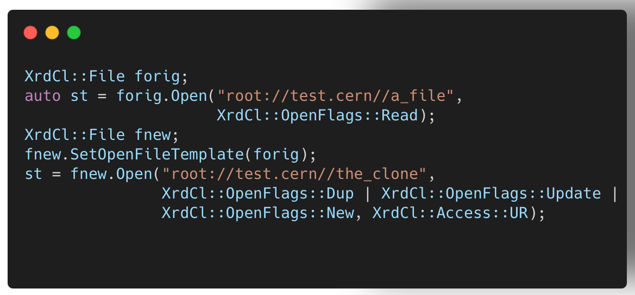
Example: whole file duplication (may change)

Slide 13
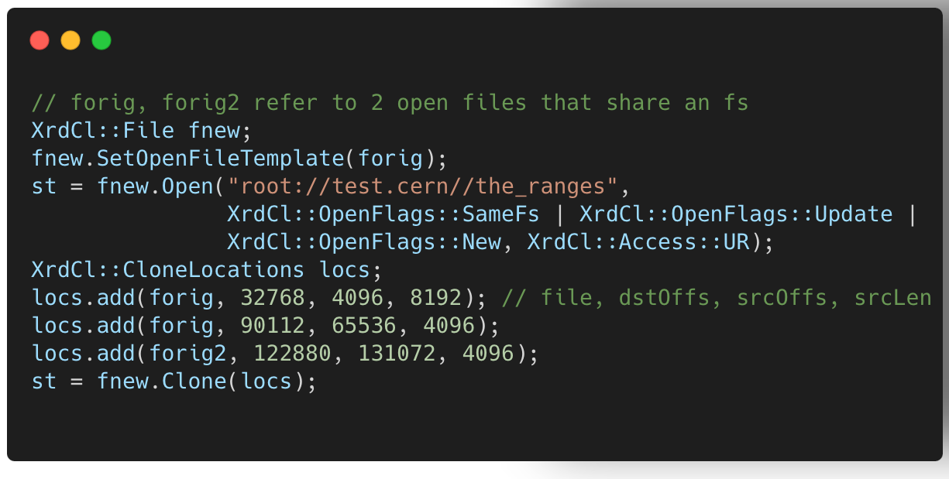
Example: range cloning (may change)

Slide 14
Summary
EOS could make use of fast copies within a filesystem to enable more robust updates of files
It was decided to add this functionality first in XRootD via filesystem facilitated file duplication and range cloning.
Have mostly completed the XRootD changes (but not yet final, nor available yet)
Next steps will likely be reimplementing cloning functionality in EOS specific parts
Then utilising the new functionality within EOS for updates
At this stage cloning files is not planned as an end user visible feature for EOS

Slide 15
Thank you!

