Slide 1


EOS Status at IHEP
Yujiang Bi
On behalf of IHEP Computing Center
Mar 25, 2025
Notes:
I’m xiaowei , come from IHEP, Chinese Academy of Sciences. I do this report on behalf of system group. I will talk about a

Slide 2
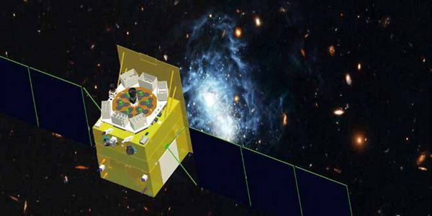
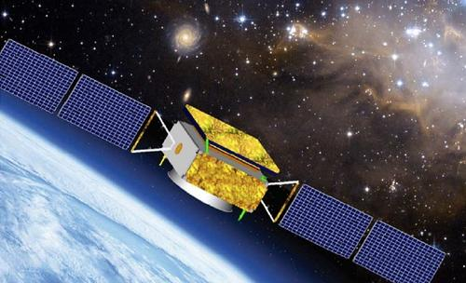
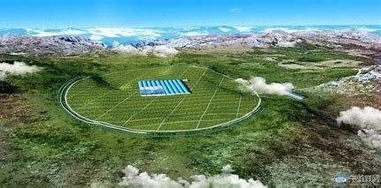
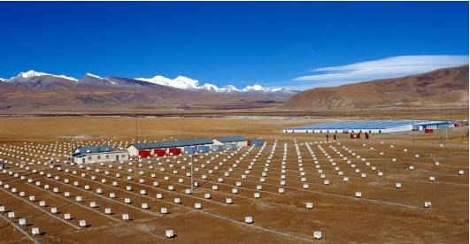
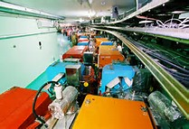
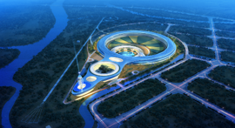
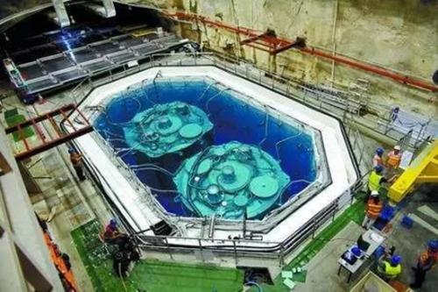
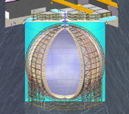
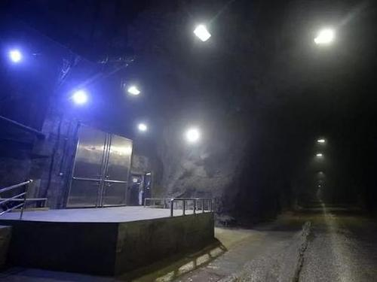
IHEP Overview
A primary research institute with large scientific experiment facilities in China
  Focusing on particle and astroparticle physics, accelerator physics, synchrotron radiation...
Constructed and manages several HEP experiments
  Beijing Electron Positron Collider BEPCII/BESIII
    ~1PB/year
  Jiangmen Underground Neutrino Observatory JUNO
    ~ 3PB/year
  Large High Altitude Air Shower Observatory LHAASO
    ~10PB/year
  High Energy Synchrotron Radiation Light Source (HEPS)
    ~300PB/year
  High-Energy Space Astronomy Experiment Satellites
    GeCAM, HXMT, EP, HERD, eXTP…
    ~ 10PB/year
Participates in international HEP experiments
  CMS, ATLAS, LHCb, Alice, BelleII, etc.
Space astronomy
satellite
（HXMT, HERD, EP）
~550KM
High Altitude Cosmic
Ray Observatory
（LHAASO, YBJ）
~4400M
Particle collider
（BEPCII, HEPS,CSNS）
~-5M
-2500M
~-300M
Underground Neutrino
Experiment
（JUNO, Dayabay）

Slide 3
EOS @ IHEP
One of the dominant storage systems and the only one for tape storage
  LHAASO、JUNO、HXMT、WLCG T1 and T2 sites, IHEPBox and CTA
  Manages about 100 PB data
Started since 2016, and 14 instances
  5 instances for CTA
  8 instances for experiments like LHAASO
  1 for public IHEPBox
Most instances with EOS 5.1.x/5.2.x
Using cases
  XRootD/HTTP for batched jobs or grid
  Fusex endpoint at login nodes
Instance | OS | Version | Capacity | Nodes
LHAASO | Alma 9 | 5.2.24 | 54PB | 120
Daocheng | Alma 9 | 5.2.24 | 5.31PB | 12
JUNO | Alma 9 | 5.2.24 | 7.96PB | 14
HXMT | Alma 9 | 5.2.24 | 806TB | 2
LHCb T1 | CentOS 7/Alma 9 | 5.2.21/5.2.24 | 25.10PB | 28
WLCG T2 | CentOS 7 | 5.2.22 | 3.45PB | 8
Alice T2 | Alma 9 | 5.2.24 | 1.68PB | 2
IHEPBox | CentOS 7 | 4.8.40 | 239TB | 6
LHCb T2 | CentOS 7 | 5.2.27 | 3.41PB | 6

Slide 4
Updates in 2024 – Local Sites
Capacity expansion
  6 nodes and 3 arrays added, expansion of 7.2PB for LHAASO
Enable KRB5 auth for LHAASO, JUNO
  Supporting remote site read/write with krb5 tickets
EOS upgraded to 5.2.24
Evaluation of HA setup for MGM (under going)
  With keepalived and virtual IPs

Slide 5
Updates in 2024 – OS Migration
Most of local instances upgraded from CentOS 7 to AlmaLinux 9
  LHAASO, JUNO, HXMT and Daocheng, about 120 nodes
  EOS for IHEPBox unchanged
  Time cost about one day
Problems during OS migration
  New OS installed into data disks for some nodes
  Partition tables of all disks cleared by accident
    Recovered with tool testdisk and no data loss
  Some disk arrays not recognized under AlmaLinux9
    Hardware problem： SAS cable, SAS HBA card
Data recovery cost about 4 days

Slide 6
Updates in 2024 - LHCb T1
Scitokens partially support added for disk and tape instances
  Scopes was not supported by EOS 5.1.x - 5.2.24
EOS upgraded from 5.1 to 5.2
Data challenge for LHCb T1 passed at 06/2024
GEO-based sub-site deployment strategy due to limited room space
  One MGM + groups at Beijing site + groups at Huairou site
  File replicas located at either Beijing or Huairou, not both Beijing and Huairou
  No large eos traffic between two subsites
Capacity expansion
  FST nodes from 8 to 28, capacity from 3.2PB to 25.10PB

Slide 7



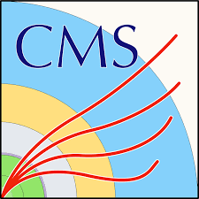
Updates in 2024 - T2 sites
New EOS instance for Alice T2
  Deployed at Huairou site
  One MGM & two FST nodes, 84 HDD disks, 1.62 PB in capacity
  Currently in 2-replica mode in production
New EOS instance for LHCb T2
  Deployed at Lanzhou University, managed by IHEP
  One MGM & 6 FST nodes with 3 disk arrays, 3.41PB in capacity
  Currently in one replica mode
EOS for CMS, Atlas and Belle2
  Upgraded from 5.1 to 5.2
  Two nodes replaced for Atlas, and two added for CMS
  Capacity expanded to 1.25PB for Atlas, to 1.93PB for CMS

Slide 8
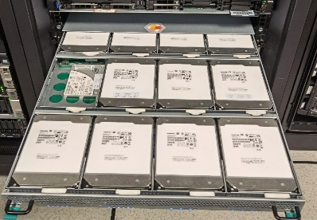
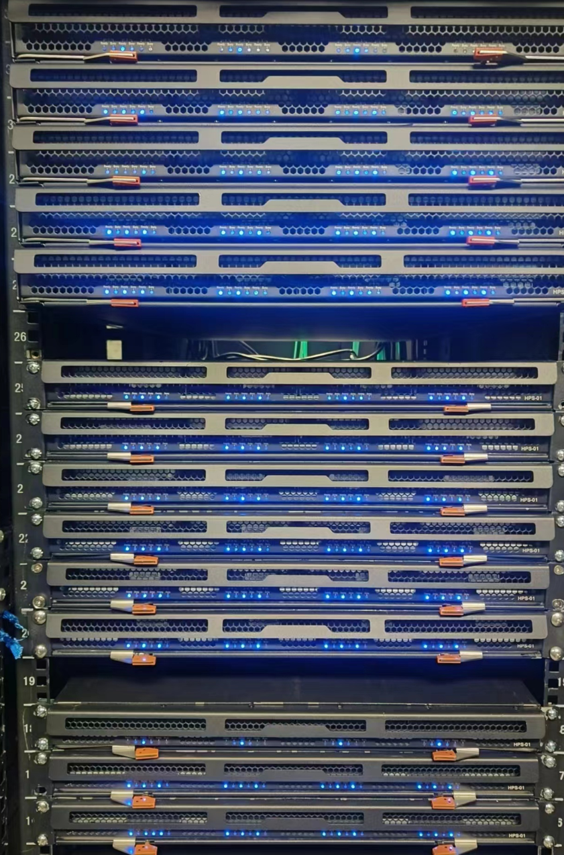
Updates in 2024 - ARM Cluster
ARM EOS in Production since Oct. 2023
  OS: Ubuntu 18.04.6 with kernel 5.4.47
  EOS: 5.1.27 compiled for ubuntu
  Hardware
    CPU: 4C 1.8GHz ARM Cortex-A72
    NIC: 10 Gbps
    Disk: 12 x 16TB HDDs
Updates in 2024
  Up to 23 ARM nodes
  Capacity from 2PB to 3.82PB, used 1.45PB
  Mainly for LHAASO raw data real-time decoding

Slide 9
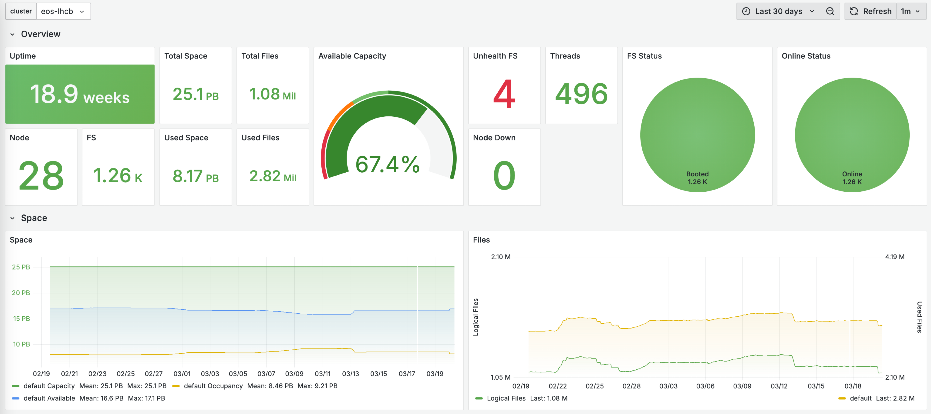
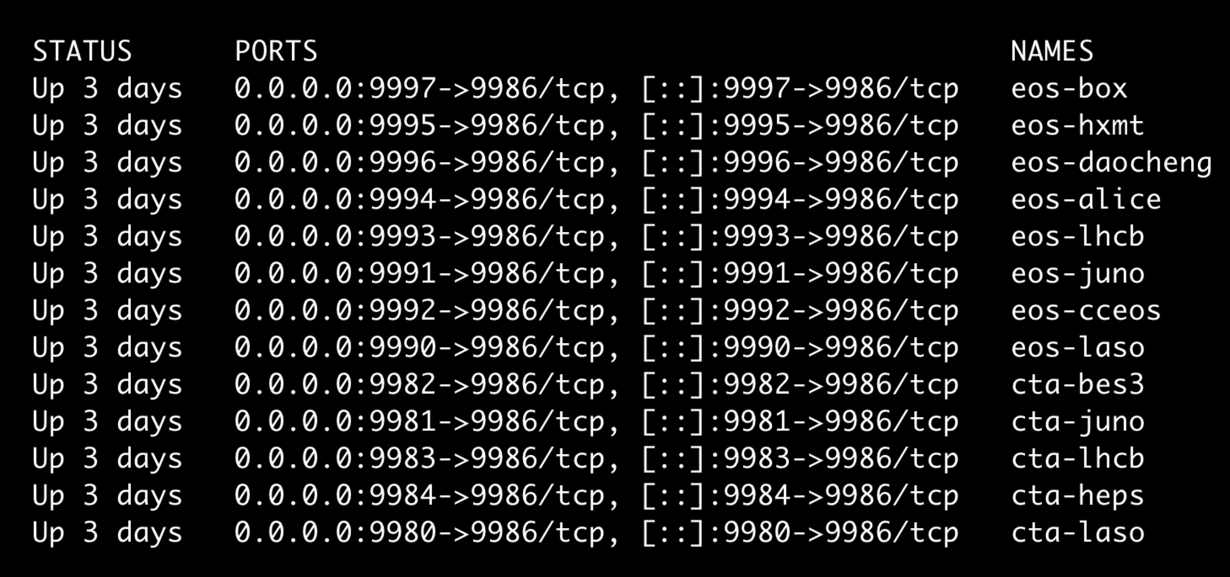
EOS Monitor
A new grafana dashboard for storage including disk and tape
Centralized eos-exporter services in containers within one VM

Slide 10
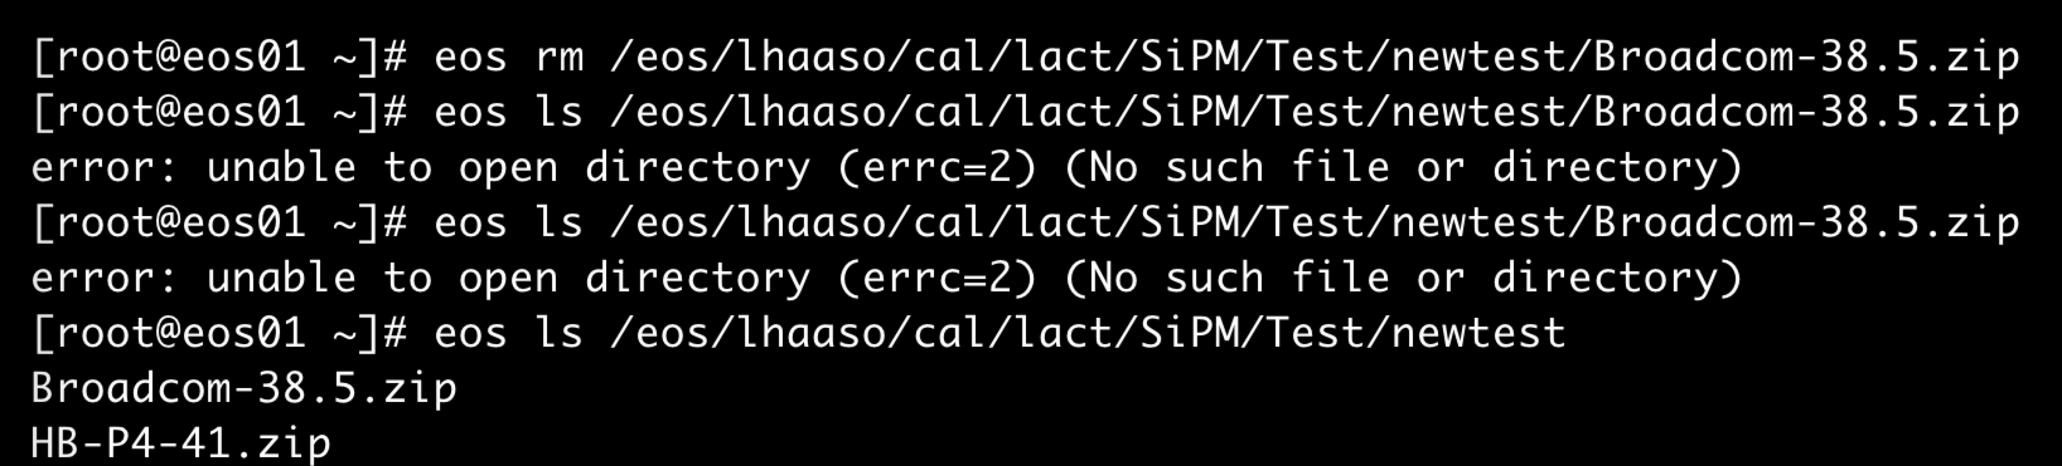
Problems
gfal-ls doesn’t work for a routed directory link in EOS
  xrdfs ls works as expected
Cannot delete some problematic files/directories
  eos ls dir shows the file still exists, while eos ls file shows the file is deleted
FST doesn’t response any requests and clients get stuck
  The fst process exists and port is open to accept connection
  but is dead already and cannot response any read/write requests
Client disconnected from server frequently, caused of many failed writing
  Long distance and low bandwidth between src and dst EOSs

Slide 11
Plans in 2025
Upgrade all EOS instances to EOS 5.2.28 or above
Migrate to T1 & T2 sites to Alma Linux 9.5
  Using XRootD 5.7.x/5.8.x to support Scitokens scopes and SciTags
A new EOS instance for JUNO experiment for only raw data
  Ensure stable data transmission from DAQ to raw EOS
  Using eos route link to leave directory structure on current EOS unchanged
    gfal-ls problem should be solved
Capacity expansion as needed for local & Grid instances
Evaluation EC mode as an alternative layout choice
MGM HA Setup for LHAASO、JUNO and other experiments
Evaluating EOS on RHEL/AlmaLinux 10?

Slide 12
Summary
EOS has become one of the dominant storage systems at IHEP
  LHAASO, JUNO, WLCG SE, CTA …
ARM cluster plays an important role in LHAASO raw decoding workflow
A simple EOS storage monitor added and needed to be optimized
More efforts needed to provides stable and efficient storage service
  HA Setup, EC layout, management…
Thanks for great support from the CERN EOS & CTA team!

Slide 13
Q & A
Thanks!

