Slide 1
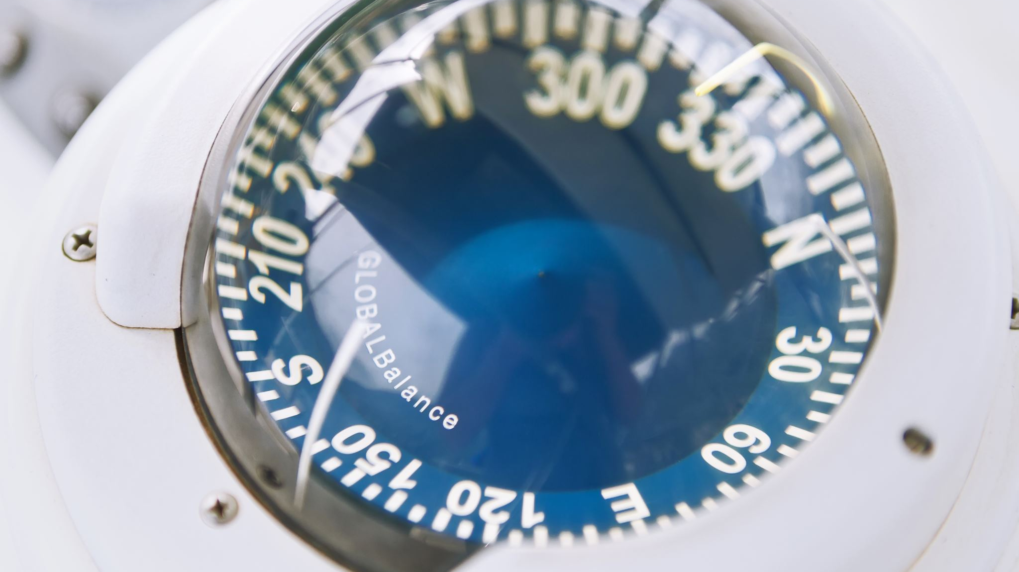
SHIP spectrometer magnet protection
F. J. Mangiarotti

Slide 2
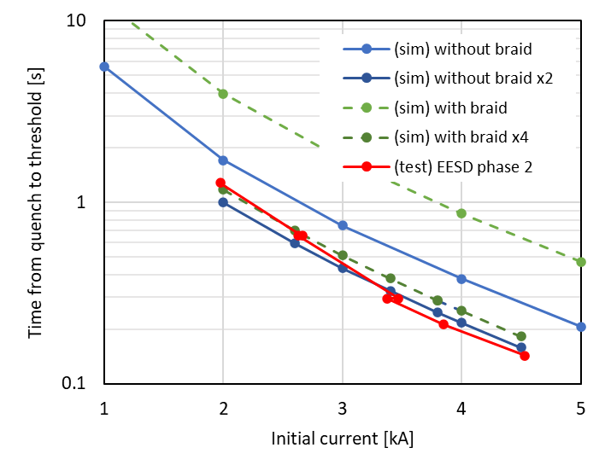
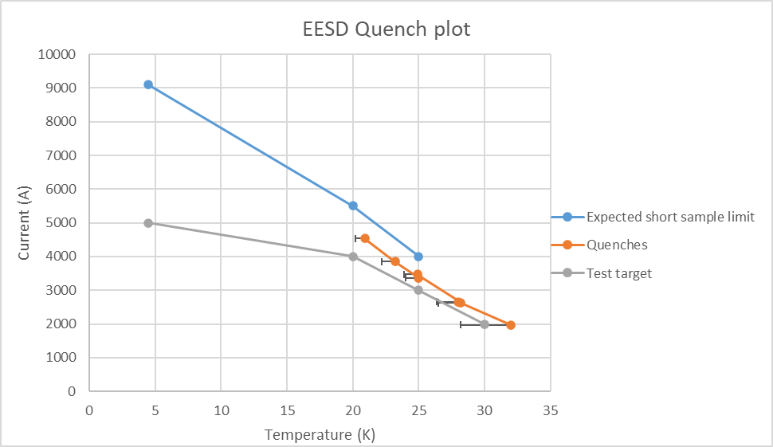
A look at the EESD quench data
The time from quench to threshold (10 mV) was shorter than expected
Test + new simulations
expected

Slide 3
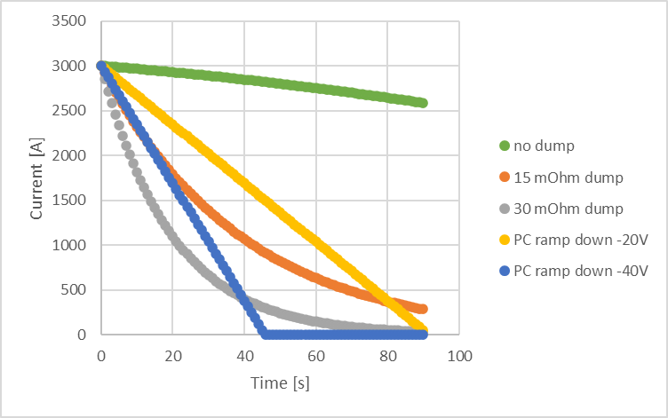
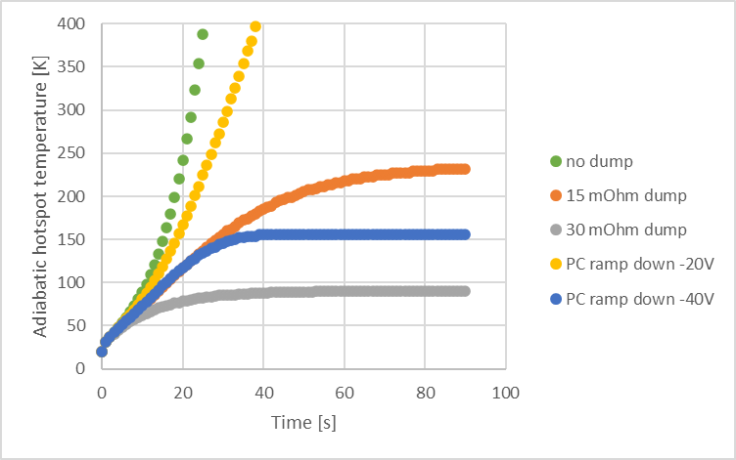
Would the SHIP magnet be self-protected?
No (see green curves)
~30 mOhm dump seems enough (<100 K hotspot temperature)
To investigate: PC ramp down instead of dump (recover energy)

Slide 4
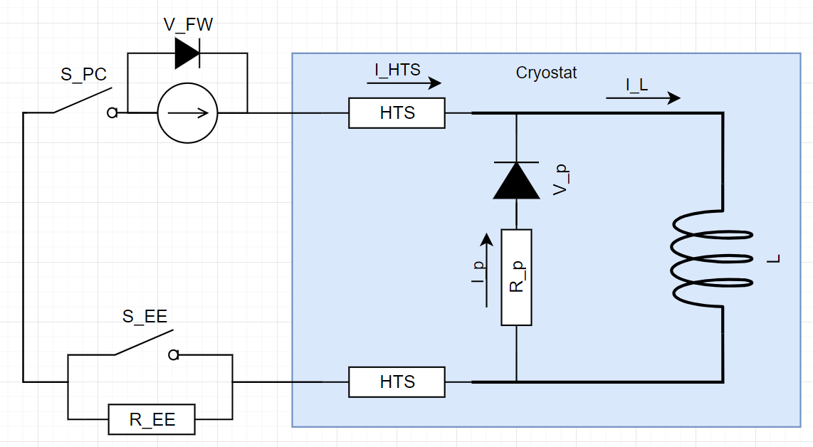
Thoughts about protection of HTS leads (1/2)
If the magnet quenches: open S_EE, extract most of the energy.
If the HTS leads quench: open S_PC, let the parallel resistor dissipate the magnet energy.
R_EE and R_p must be optimized based on peak magnet voltage, ratio of energy dissipated, and hotspot temperature

Slide 5
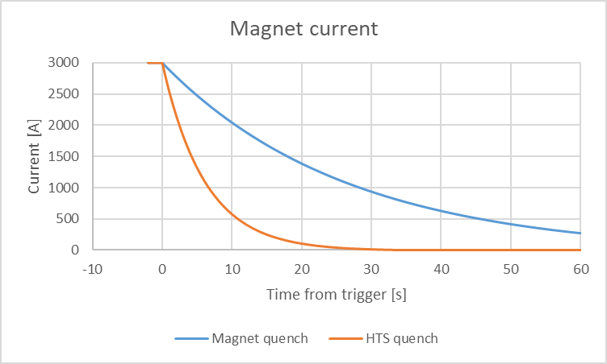
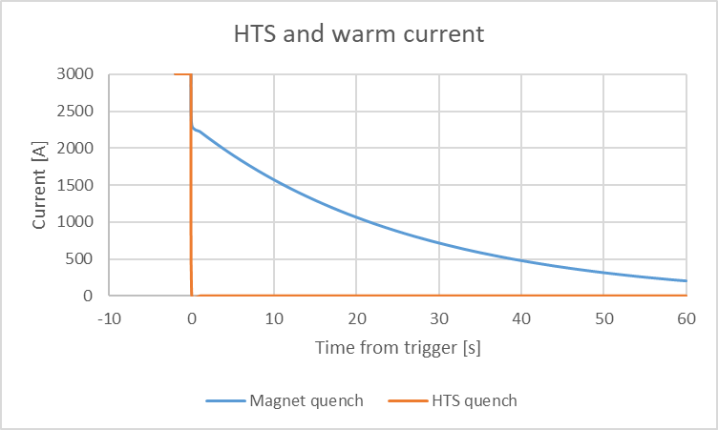
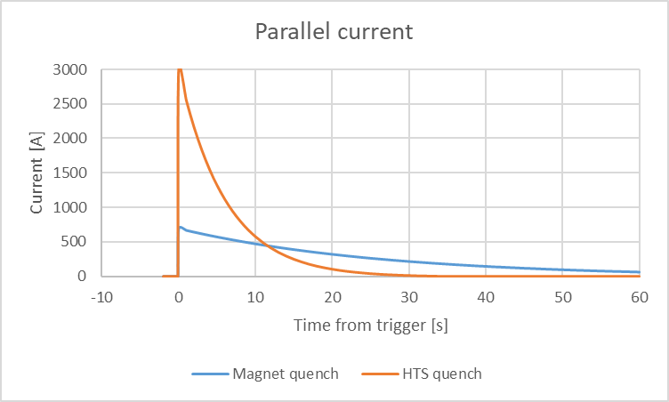
Thoughts about protection of HTS leads (2/2)
Parameters:
R_EE = 30 mOhm
R_p = 100 mOhm
 | Magnet quench | HTS quench
max V_{L} | 70 V | 300 V
E_{dis} | 630 kJ (24%) | 2750 kJ (100%)
E_{ext} | 2100 kJ (76 %) | 0
T_{hotspot} | 120 K | 45 K
There is a small inconsistency in the energy numbers, coming from my very rough numerical calculation

Slide 6
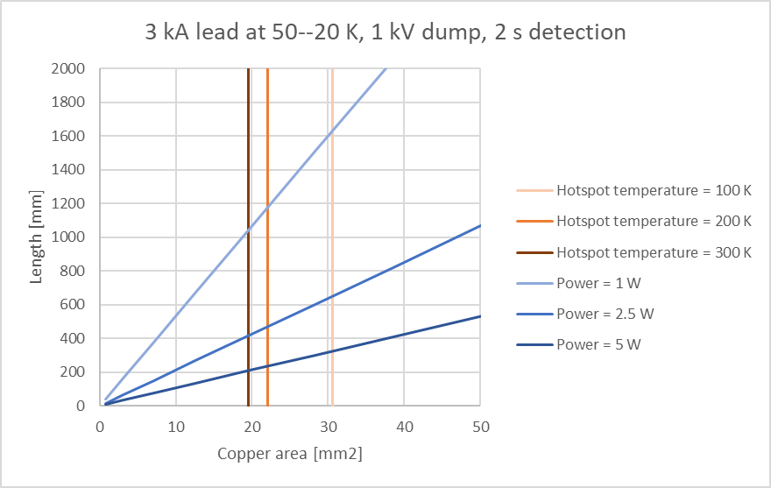
Added after email 27/11/2024
I increased the maximum dump voltage to 1000 V (reducing the discharge time constant to ~2 seconds), assumed that the HTS part would go from 50 to 20 K, and that a quench could be detected in 2 seconds. If my calculations are right, it doesn’t seem too difficult to have enough copper to protect the current leads during the dump.
See the plot of heating power per lead (from 50 to 20 K) and expected hotspot temperature in case of quench, as function of the length and area of the copper in the leads.

