Slide 1
Technical Meeting on MQXFB08 :
Assembly and Pre-load target
Susana Izquierdo Bermudez, Penelope Quassolo on behalf of MQXF team
03/12/2024
Technical Meeting MQXFB08 Assembly (December 3, 2024) · Indico

Slide 2
Shimming plan

Slide 3
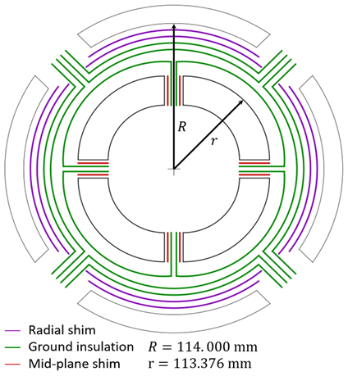
Shimming strategy -
Mid-plane and radial shims
Strategy: coils with different azimuthal sizes are shimmed to match the largest one. If all coils are smaller than nominal size, they are shimmed to match the latter value. Shimming is placed on the mid-plane.
The resulting variation of outer radius is compensated by adding/removing radial shims*.
0.125 mm of radial shims are removed systematically to improve contact on the mid-plane between collar and coil → experience from LARP and MQXF short models
  So-called “LQ effect”
*The ground insulation layers must be respected. Targeting as a baseline to remove at least one of the radial shims, coil average size is exceeded when L+R_{average} > 200 µm. Non-optimal contact with the collars.

Slide 4
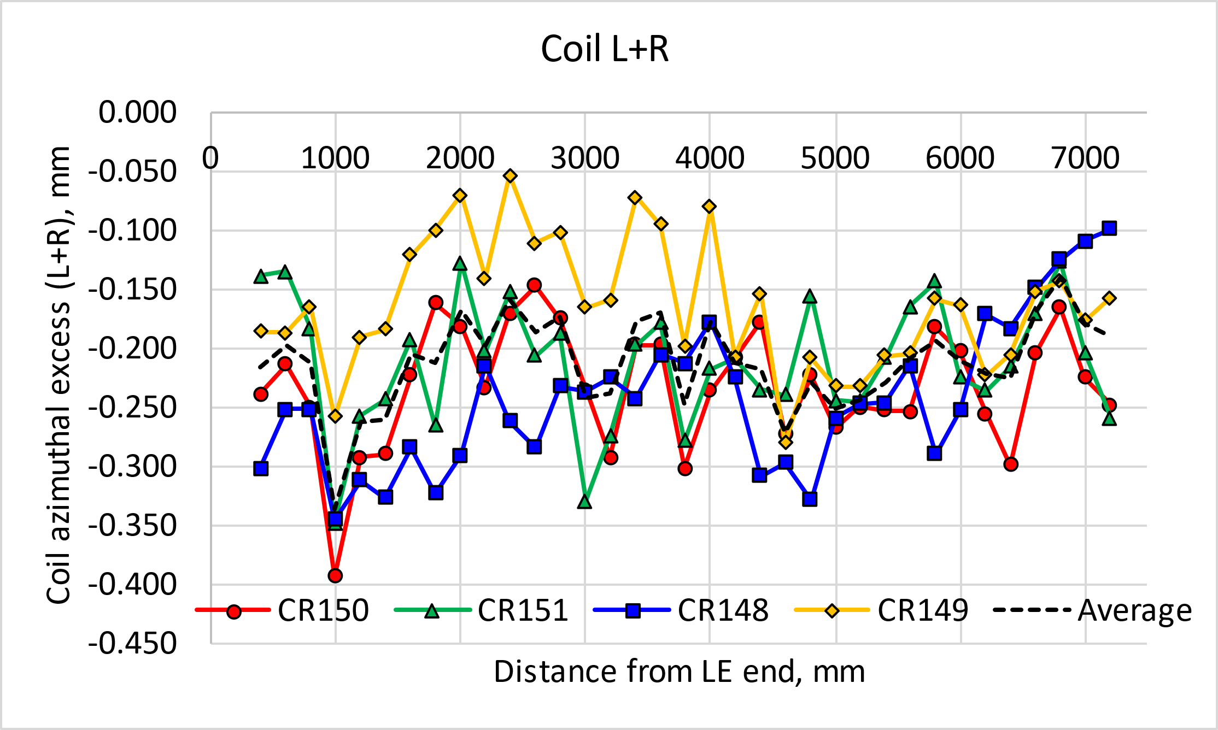
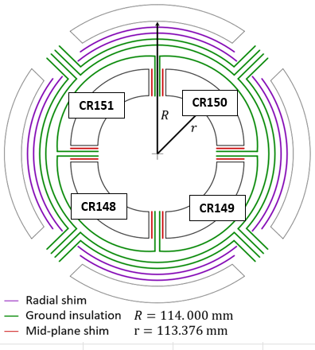
MQXFB08: Coil Size
 |  | Average (Excluding ends) | Rounded value
Azimuthal excess L+R [µm] | CR150 | -231 | -200
 | CR151 | -211 | -150
 | CR148 | -242 | -200
 | CR149 | -163 | -100
MQXFB08 largest coil (CR149) is smaller than the nominal azimuthal size, so all the coils are shimmed to the nominal azimuthal size. CR148 is the smallest.
 | Shim
CR150 | 200
CR151 | 150
CR148 | 200
CR149 | 100

Slide 5
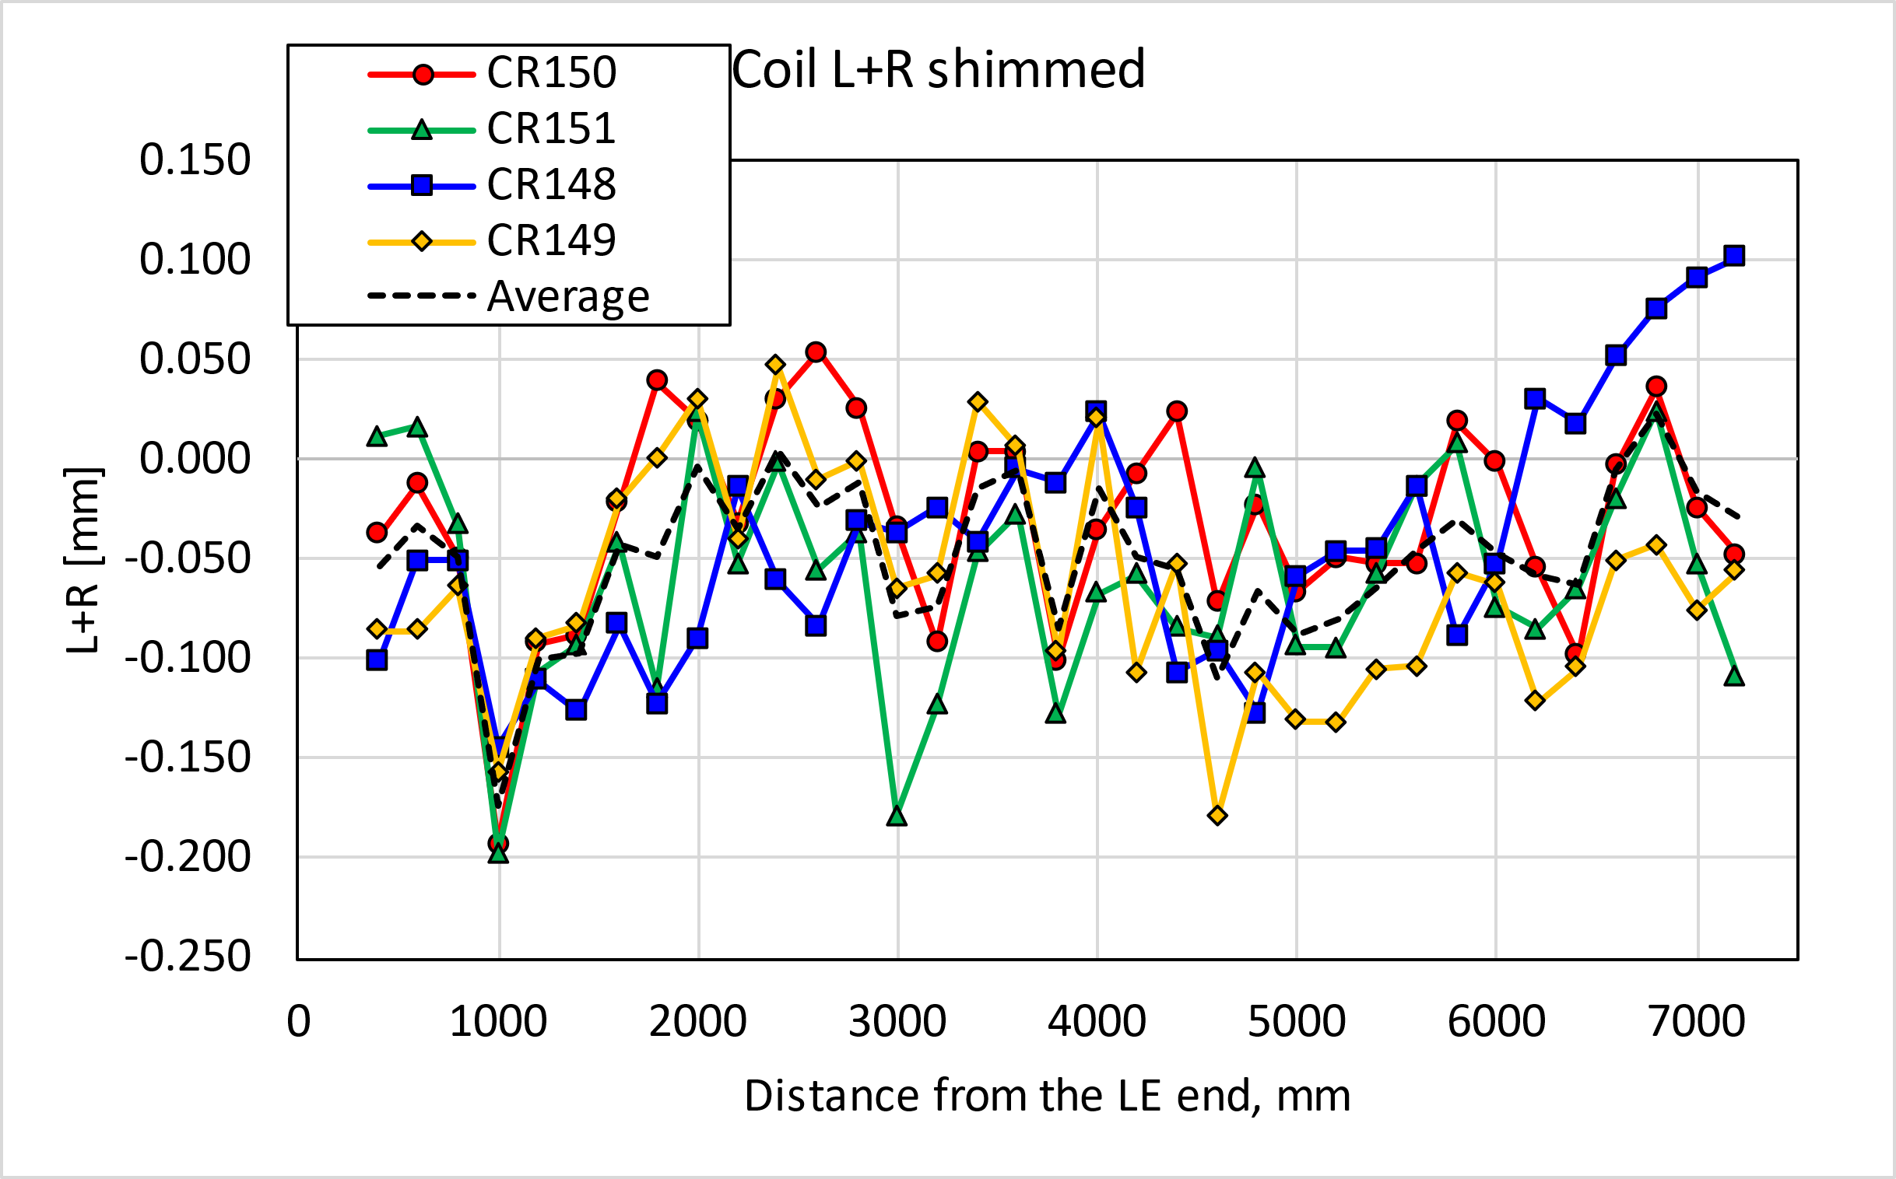
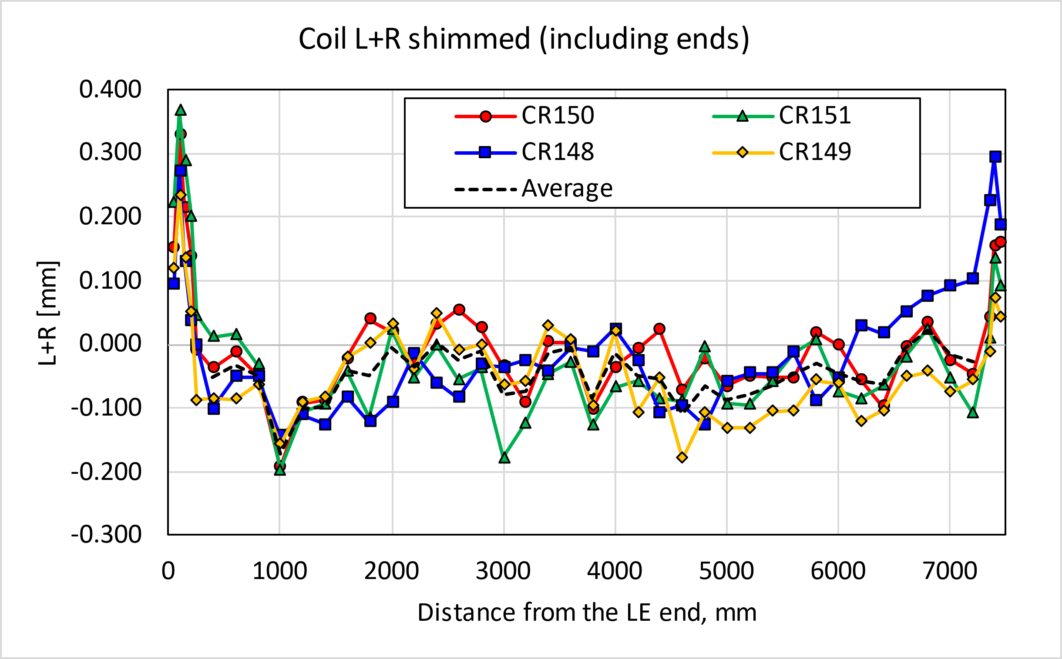
MQXFB08

Slide 6
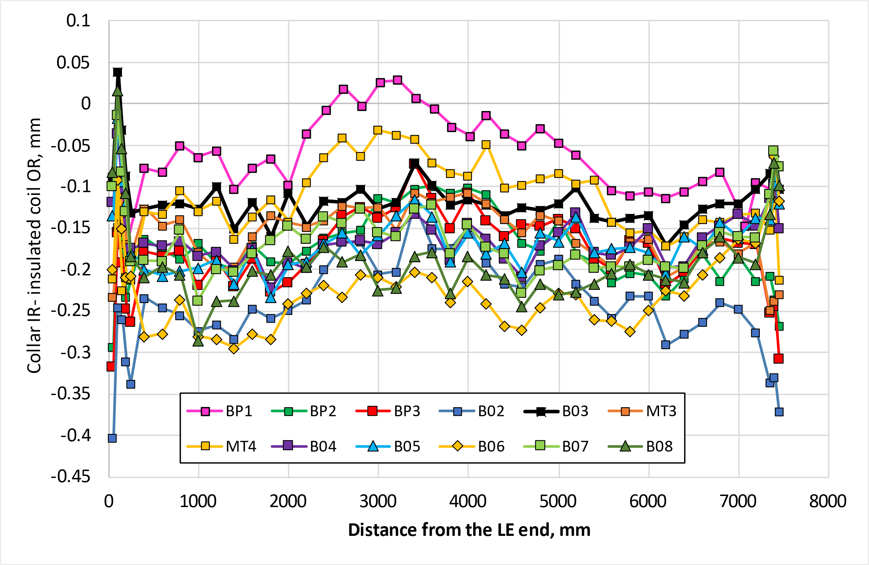
MQXFB08 -175 um shimming plan
Radial size and comparison to previous magnets
The radial shim is defined in order to have a coil pack dimensions slightly smaller* to B04/B05/B07 but bigger than B06. The ends have a similar size to previous magnets.
*The keys kits are slightly bigger than nominal. To have an easier insertion (difficult in B07) of the last keys, B08 coil pack will be a bit smaller

Slide 7
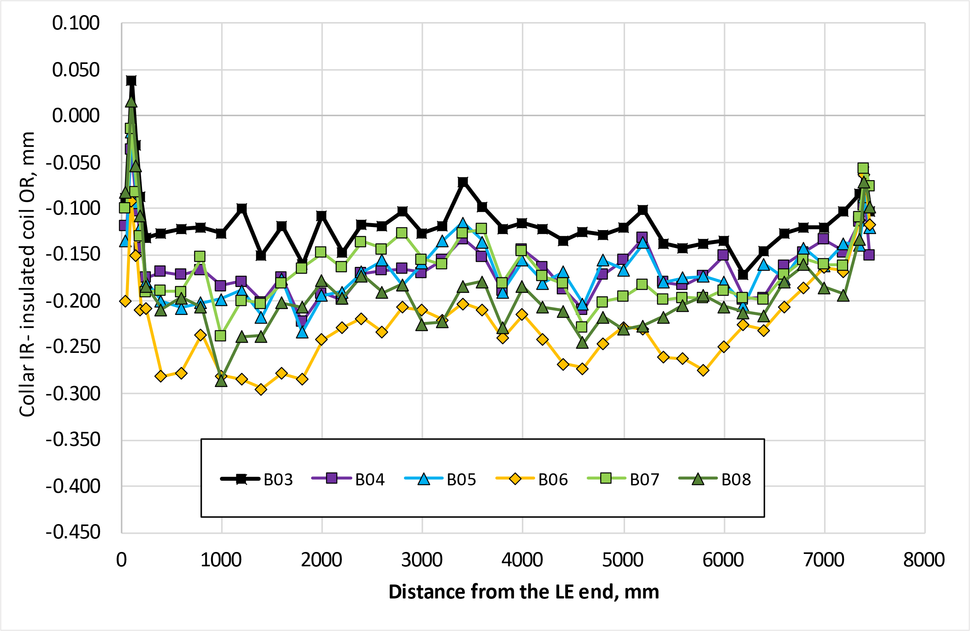
MQXFB08 -175 um shimming plan
Radial size and comparison to previous magnets
The radial shim is defined in order to have a coil pack dimensions slightly smaller* to B04/B05/B07 but bigger than B06. The ends have a similar size to previous magnets.
*The keys kits are slightly bigger than nominal. To have an easier insertion (difficult in B07) of the last keys, B08 coil pack will be a bit smaller

Slide 8
Pre-load targets

Slide 9
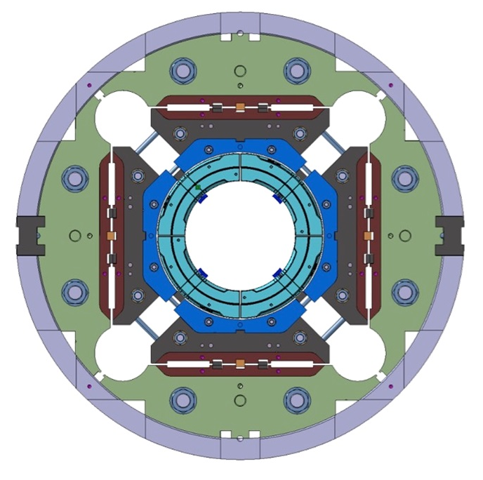
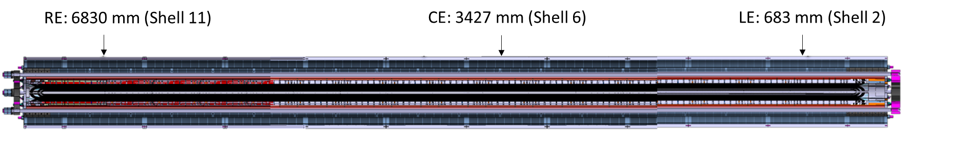
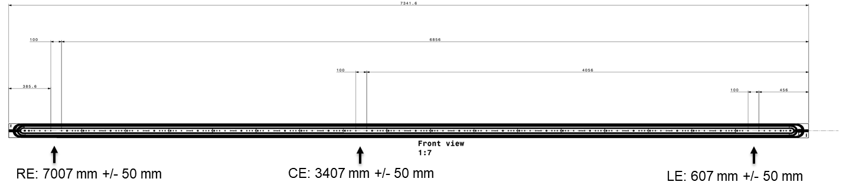
Instrumentation overview
Magnet component | Number & Directions | Bridge configuration | Type
SHELL | 12 (Θ) 12 (Z) | SG quarter bridge + thermal compensator | Cr – Ni / Polyimide HBM LC11-6/350
COILS | 12 (Z) 12 (Θ) | FBG (+ temperature sensor to compensate T effect) | FemtoSecond® 4 arrays with 2 FBG
Rod C
Rod A
Coil
Coil
Coil
Coil
Rod D
Rod B
Coil and shell are instrumented in three axial locations (LE (lead), CE (center), RE (Return))

Slide 10
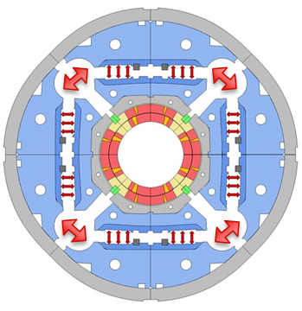
Azimuthal pre-load target (from B03 on)
The allowable peak stress in the coil during loading is -110 MPa, achievable thanks to the new loading procedure with auxiliary bladders (AUP has -135 MPa as maximum allowable stress).
The target room temperature preload from MQXFB03 is:
  Average shell stress: 58 ± 6 MPa;
  Average pole coil stress: -80 ± 10 MPa
  Rod strain: 650 µε
  This is a target not a requirement, and in case the maximum allowable peak stress in the conductor (110 MPa) is reached, the average pre-load will be lowered accordingly to fulfill the peak stress requirement
With the new welding procedure (applied from MQXFBP3), we expect no increase on the azimuthal stress of the coils during welding

Slide 11
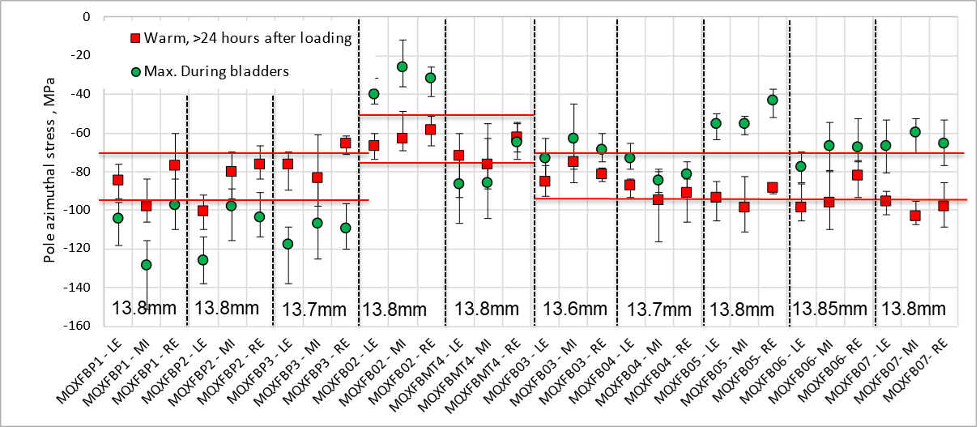
RT: Targets vs achieved

Slide 12
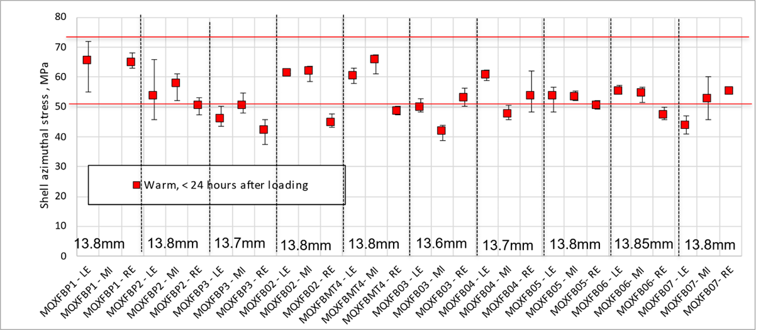
RT: Targets vs achieved

Slide 13
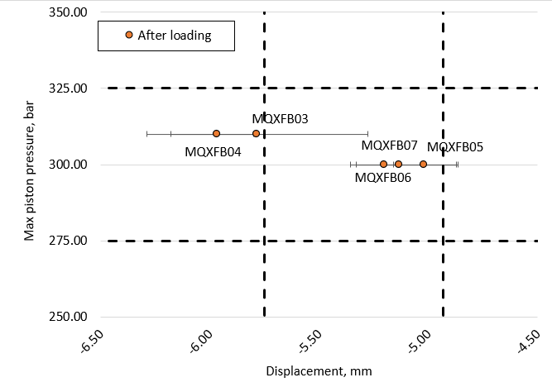
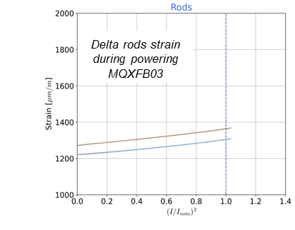
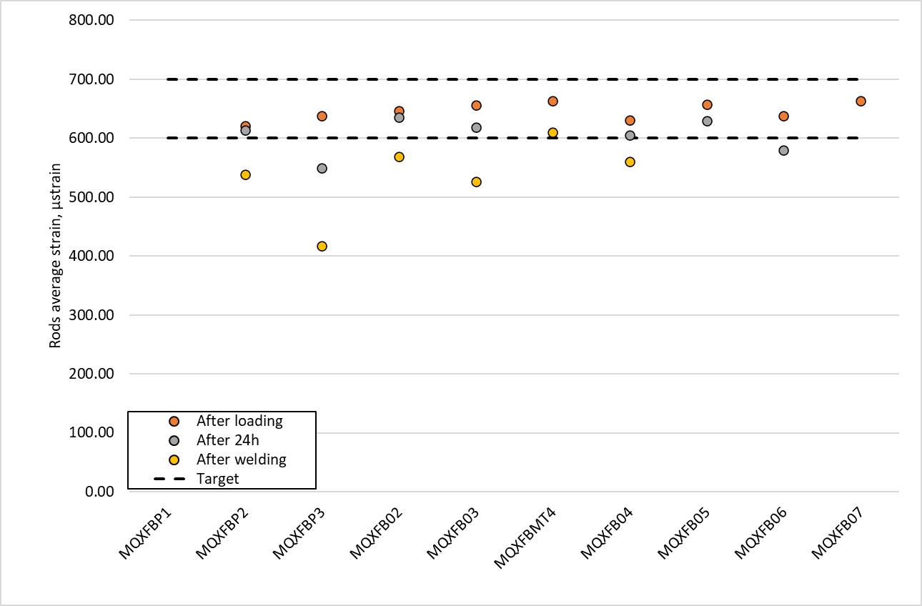
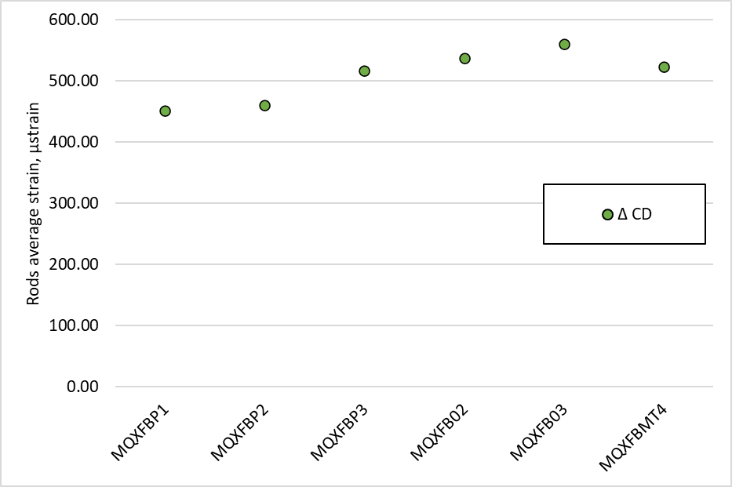
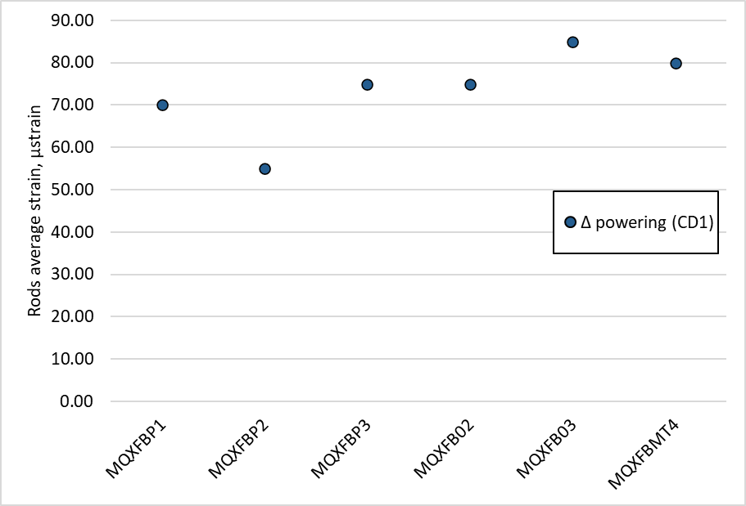
Axial pre-load
Small change of strain on the rods during powering → longitudinal stiffness of the structure is as expected, and overall behaviour is like what we have seen in MQXFS and MQXFA
From BP2, all magnets loaded so far with the same axial pre-load (at RT), 650 ± 50 µstrain after loading.
The equivalent targets for pressure and displacement to guarantee the same axial pre-load are:
  Pressure target: 300 ± 25 bar
  Displacement target: -5.33 ± 0.4 mm
  This was proved with B05 and B07, where the displacement instrumentation was correctly place. From MQXFB08 we will not have rods instrumentation.
During cooldown the delta strain is in between 450 µstrain and 550 µstrain for all the magnet
During powering the delta strain is in between 75 µstrain and 85 µstrain from magnet BP3.
MQXFB03 (last magnet with instrumentation at cold) has similar behaviour to the previous magnets, although now the magnet is mostly quenching in the ends

Slide 14
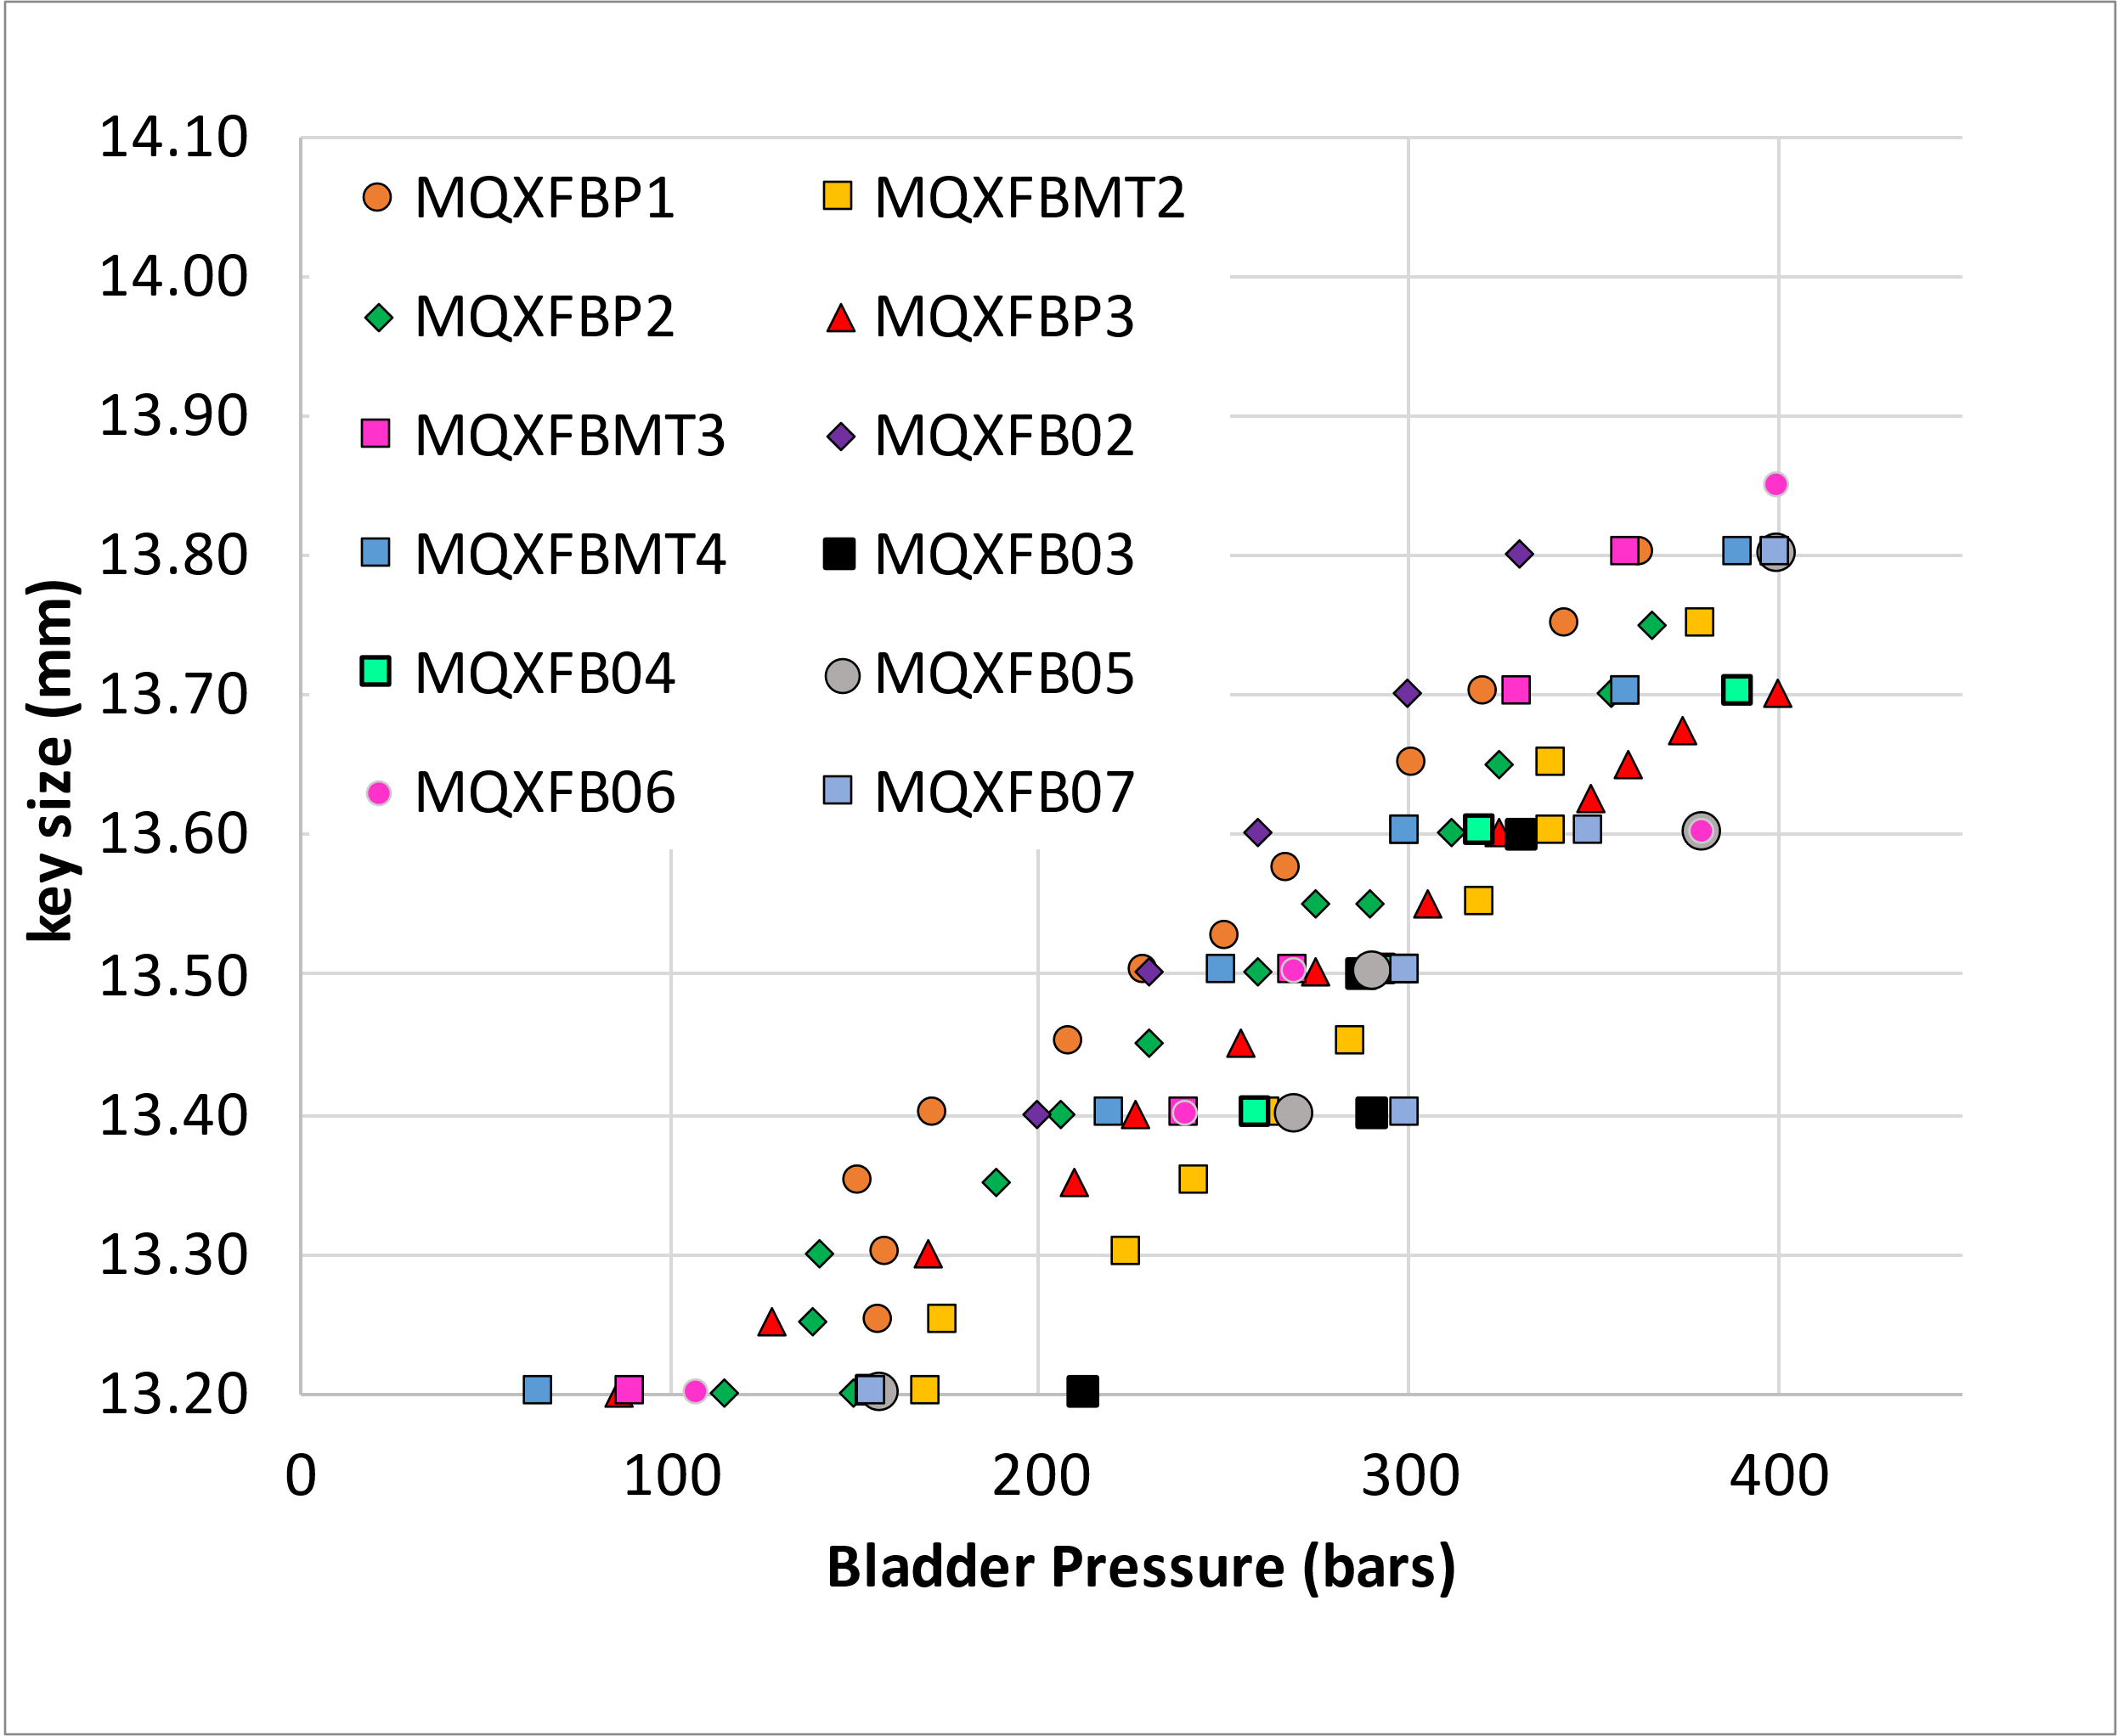
Bladder pressure
The other observable we have during assembly is the bladder pressure
  Assembly tolerances play a role, on some occasions, you need 20-30 bars to overcome a singularity in the structure
  Requirement: never exceed 400 bars

Slide 15
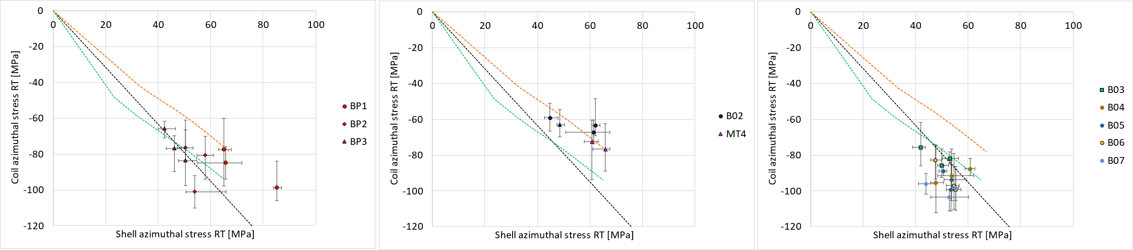
RT transfer function
So far, relatively good agreement between expected transfer function and measured transfer function
In B02/MT4 we show the change of slope due to the new loading procedure (orange dashed line)
From B03 we are closer to the original slope (black dashed line) due to the ‘new coil geometry’ (green dashed line)
Looking at the averages stress after loading (table), they are rather unifirom, but there is a spread of +-20 MPa in the coil, +- 10 MPa in the shell
*Delta = Stress loading – Stress centering
 | Shell avg. [Mpa] | Delta* shell [Mpa] | Coil avg. [Mpa] | Delta* coil [Mpa]
B07 | 51 | 44 | -99 | -87
B06 | 53 | 46 | -91 | -87
B05 | 55 | 49 | -92 | -88
B04 | 55 | 38 | -91 | -76

Slide 16
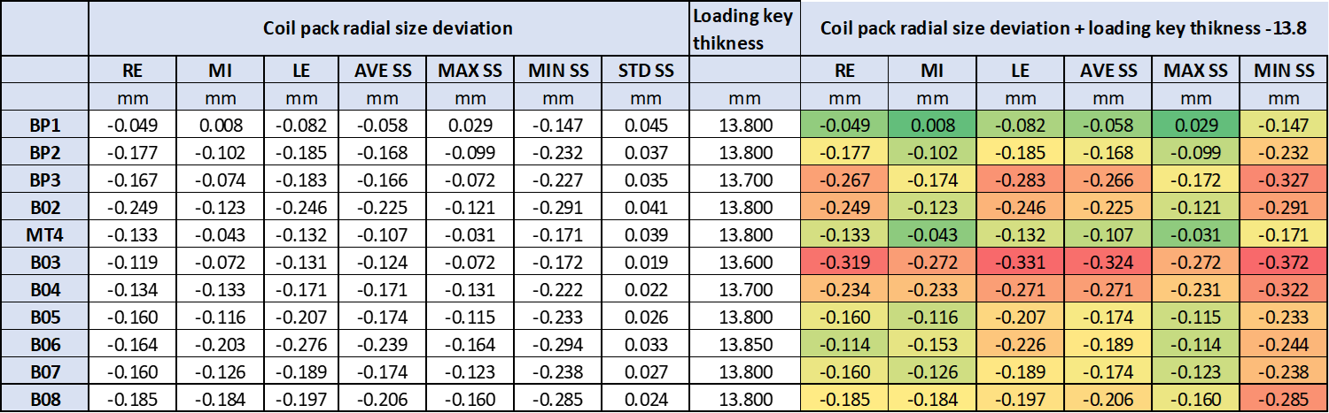
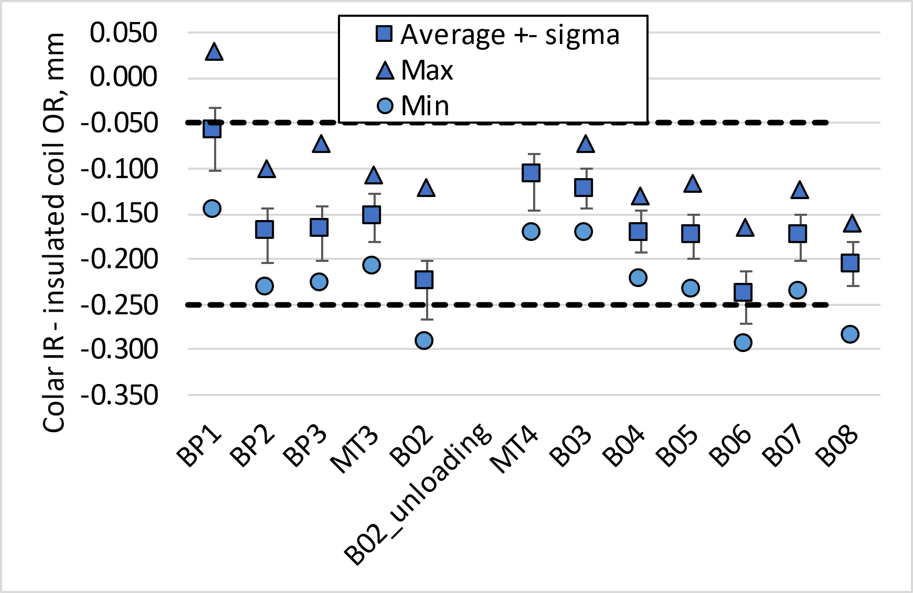
Loading key target
The target is to have a key 13.8 mm
  At CERN we don’t have finer granularity
‘Straight section’ only, i.e., from 400 mm to 7200 mm

Slide 17
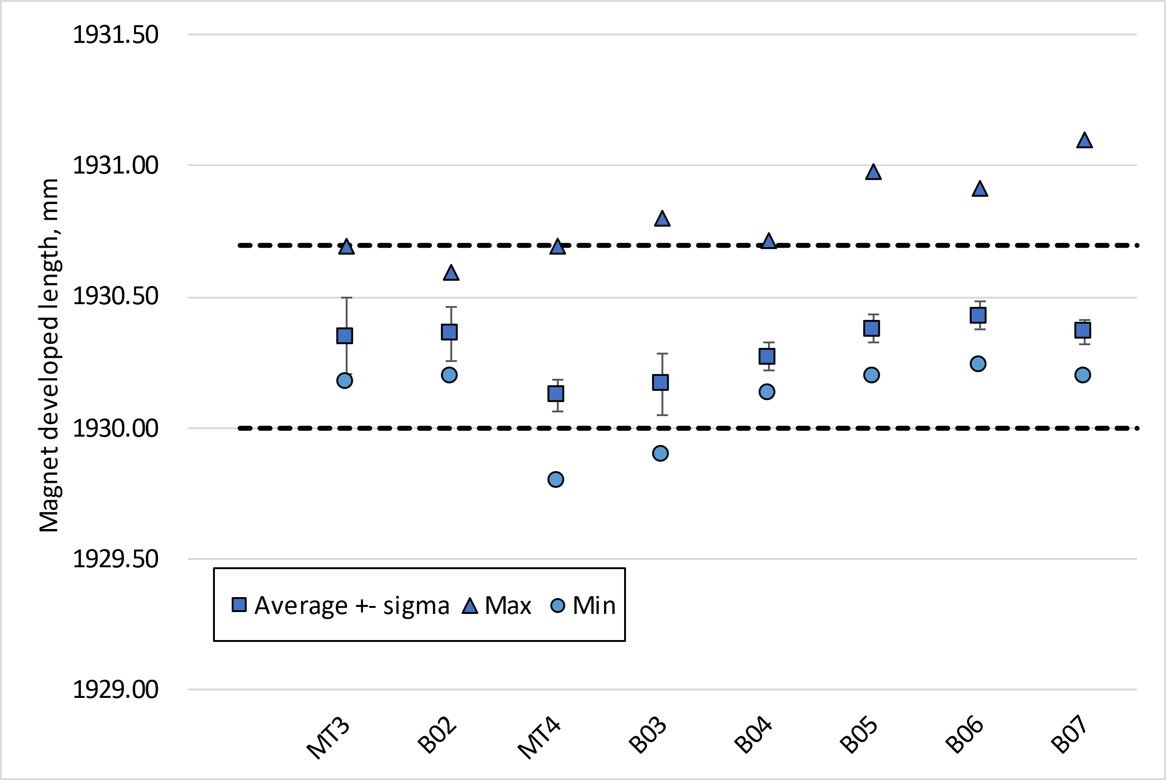
Magnet outer developed length
In the middle of the aluminium shells, the developed length after loading shall be 1930.2 mm +0.5/-0.2 mm
  For a pole pre-stress of 80 MPa, the expected increase of circumference is 1.2 mm in the middle of the aluminium shells, 1.6 mm in the extremities
  Remark: these measurements are done with a pi-tape, precision ≈ 0.2 mm
  This info is used for the pairing for the stainless steel shells for welding (see for example MQXFBMT4, EDMS 2847270)

Slide 18
Summary
Target for MQXFB08: reproduce MQXFB07 pre-load conditions (see EDMS 3173102)
The target loading key thickness is 13.8 mm
The target room temperature preload:
  Average shell stress: 58 ± 6 MPa;
  Average pole coil stress: - 80 ± 10 MPa
  Rod strain: 650 µε
  This is a target not a requirement, and in case the maximum allowable peak stress in the conductor (110 MPa) is reached, the average pre-load will be lowered accordingly to fulfill the peak stress requirement
Based on the experience gained with MQXFB assemblies, a series of observables are monitored along the assembly and compared to previous magnets to verify at every step that we reach our targets (EDMS 2872430)
  Here we focus on geometrical and strain measurements, but field quality is also closely monitored, see additional slides.

Slide 19
Thank you!

Slide 20
Additional slides

Slide 21
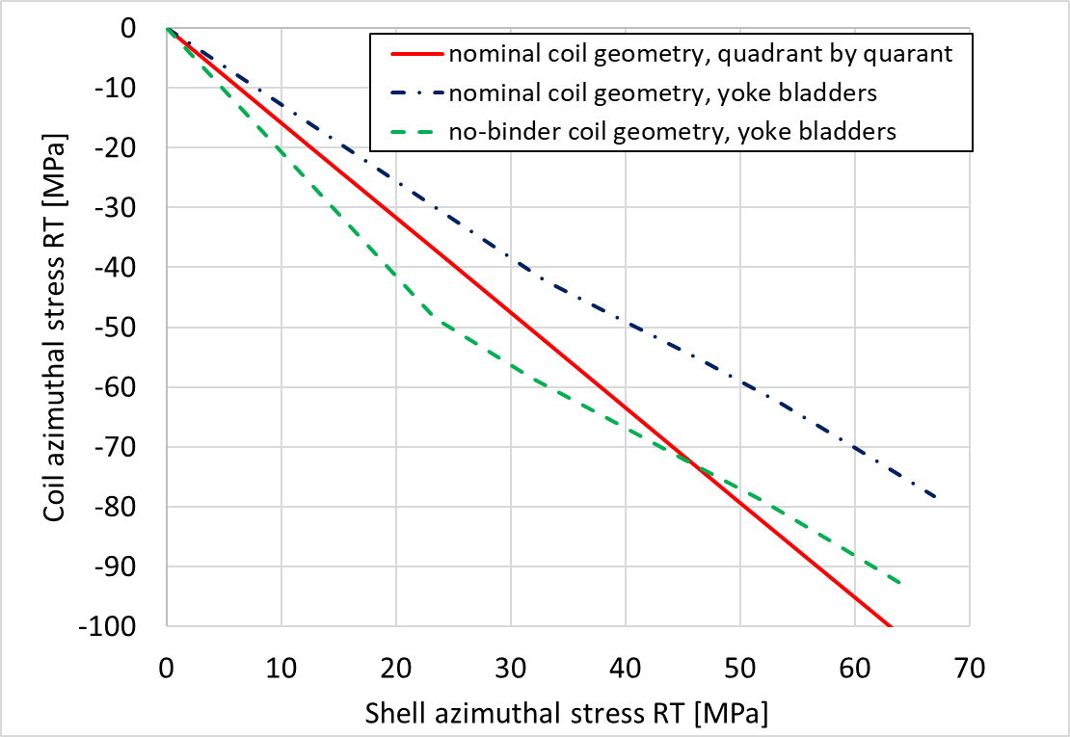
Reminder of impact on modifications in the TF
With the new loading procedure (yoke bladders), we expect less pole stress at RT for the same shell stress → we modified the loading target in B02 to 70 +- 10 MPa (before it was 80 +- 10 MPa) (see https://indico.cern.ch/event/1158577/)
With the new coil geometry (wedged mid-plane due to no binder in the OL), we expect 15-20 MPa more in the pole for the same shell stress (see https://indico.cern.ch/category/10520/)

Slide 22
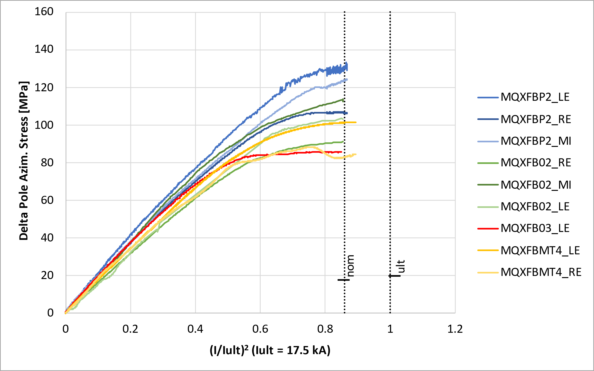
Cold: Targets vs achieved
At cold, MQXFB02 had 90-110 MPa pole azimuthal compression, corresponding to a pole un-loading around nominal current
For MQXFB03, we only have ‘clean’ measurements from the LE end, 85 MPa.
Data courtesy EN-MME

Slide 23
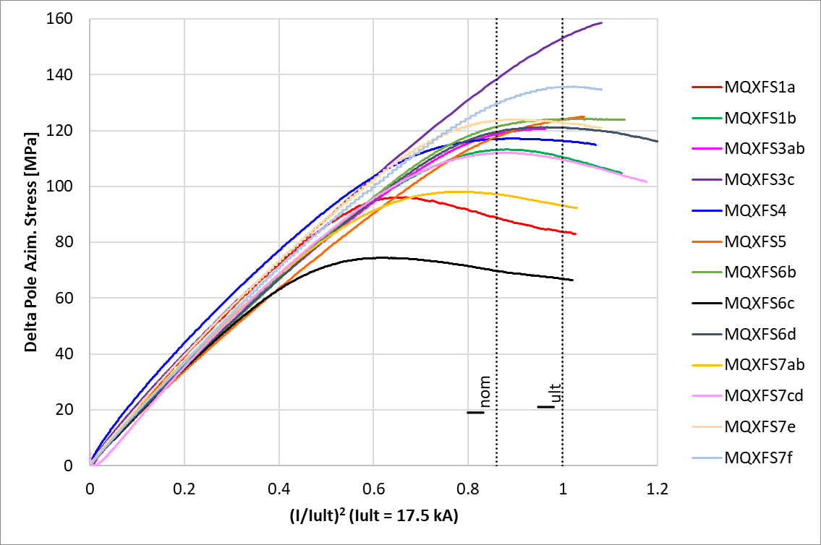
Cold: Targets vs achieved
MQXFS explored a wide range of pre-load, with magnets reaching performance requirements with a pole azimuthal compression at cold of 70-180 MPa.
  Low pre-load does not seem to be a limitation for performance, but might have an impact on the training (AUP has some evidences that magnets with higher pre-load train less, see Structure WG re MQXFA13 analysis and preload targets (September 5, 2023) · INDICO-FNAL (Indico))
Data courtesy EN-MME

Slide 24
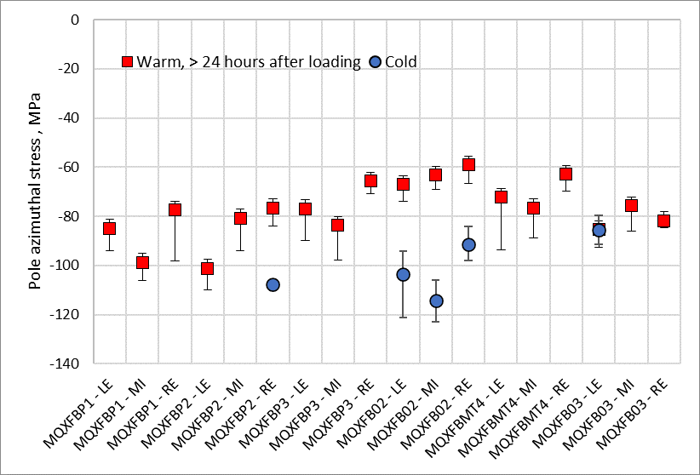
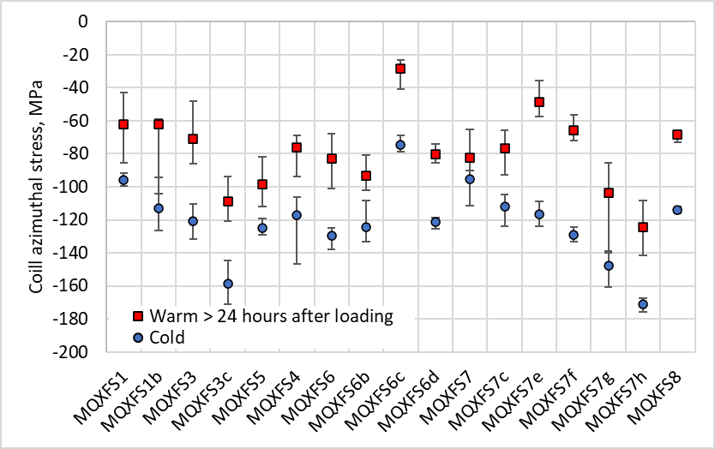
Cold: Targets vs achieved
So far, we have very little data from B03, but we see basically no increase of the azimuthal pre-compression with the cool down (when deriving the pole compression from the delta powering)
MQXFS explored a wide range of pre-load, with magnets reaching performance requirements with a pole azimuthal compression at cold of 70-180 MPa.
Estimated pole stress from delta powering, MPa
MQXFB03 - LE | C129 | C130 | C131 | C128 | AVE
Peak during magnet assembly | -87 | -80 | -63 | -65 | -74
> 24 hours after loading | -87 | -92 | -77 | -86 | -85
Cold | -80 | -91 |  |  | -85

Slide 25
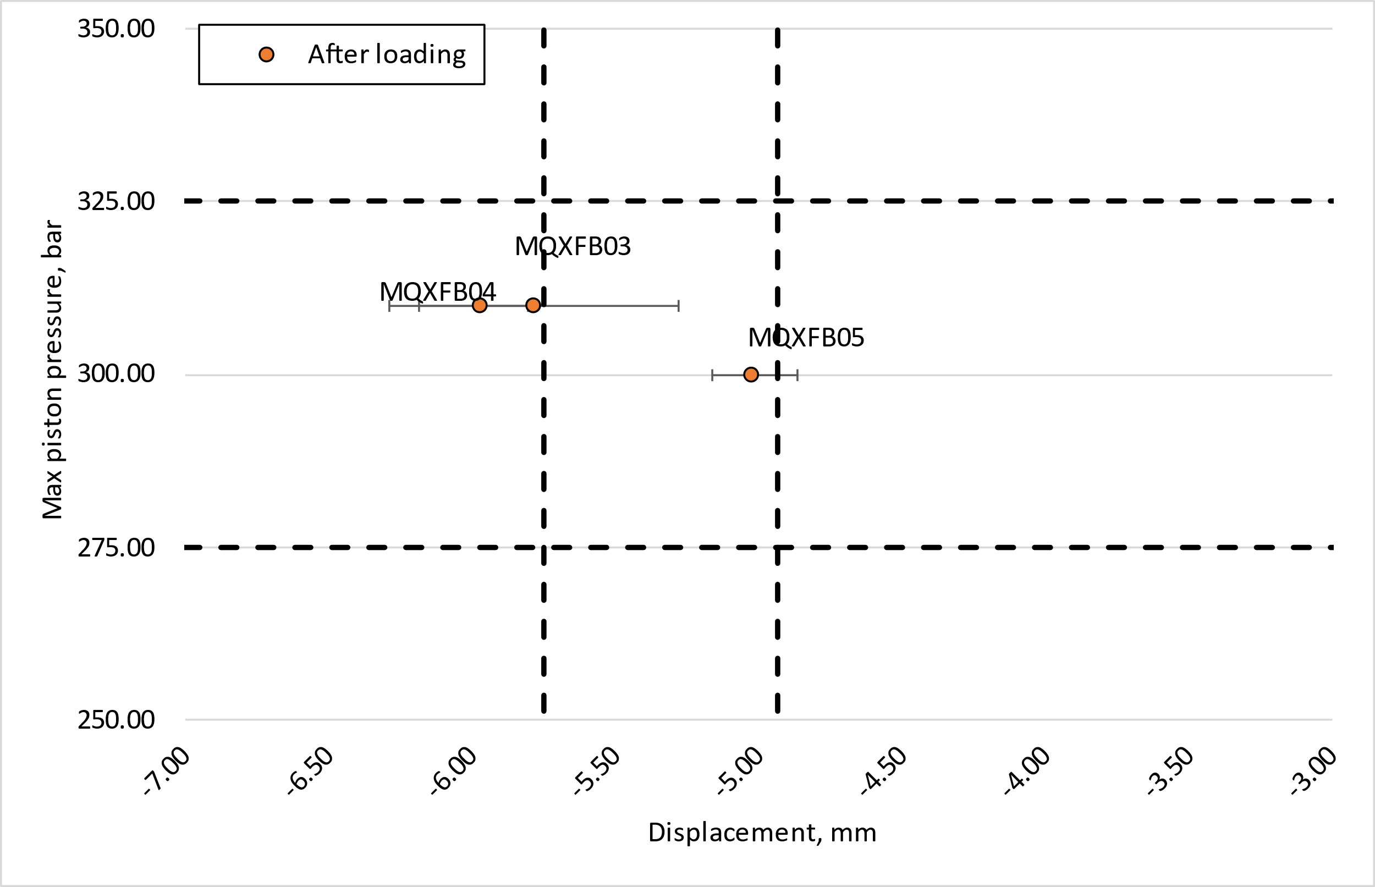
Axial pre-load
Instrumentation overview:
Strain gauges placed on the rods
LVDT used to monitor the rods displacement, they are a combination of LVDT used the rods and for end-plates and yoke. The combination of this measures is giving the actual rods displacement
Pressure sensor to monitor the piston pressure during loading
Strain target: 650 ± 50 µstrain after loading for MQXFB (for all the magnets we are in the ± 50 µstrain windows).
Do I need to always look at the strain data or can I relay on the other measures?
It’s interesting to have equivalent targets for pressure and displacement to guarantee 650 ± 50 µstrain :
Pressure target: 300 ± 25 bar (B03, B04 and B05)
Displacement target: -5.33 ± 0.4 mm (LVDT for B03 and B04 are not perfectly in contact, B05 is the first representative measurement)
Combing the targets of pressure and displacement, we can identify a ‘safe’ window to guarantee the strain target.
Conclusions:
We have a really good correlation between the expected values of rods strain and displacement and the measured one for the last 3 magnets (B03, B04,B05)
Rods instrumentation will be present in magnet B06 to confirm the data on the displacement
For future assemblies, it will be sufficient to guarantee the strain target looking at the pressure and the displacement graph

