Slide 1
Technical Meeting on MQXFB08:
Assembly Observables
Susana Izquierdo Bermudez, Penelope Quassolo on behalf of MQXF team
03/12/2024
Technical Meeting MQXFB08 Assembly (December 3, 2024) · Indico

Slide 2
Outline
Yoke shell sub-assembly
  Vertical sub-assembly (yoke-shell modules)
  Horizontal sub-assembly
Coil pack sub-assembly
  Radial coil pack size
  Pole-key gap
  Coil pack squareness
  Magnetic measurements after coil pack insertion

Slide 3
Outline
Yoke shell sub-assembly
  Vertical sub-assembly (yoke-shell modules)
  Horizontal sub-assembly
Coil pack sub-assembly
  Radial coil pack size
  Pole-key gap
  Coil pack squareness
  Magnetic measurements after coil pack insertion
Completed

Slide 4
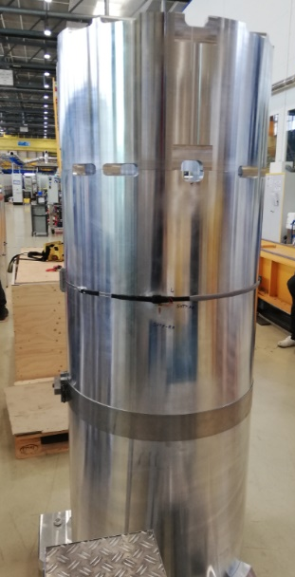
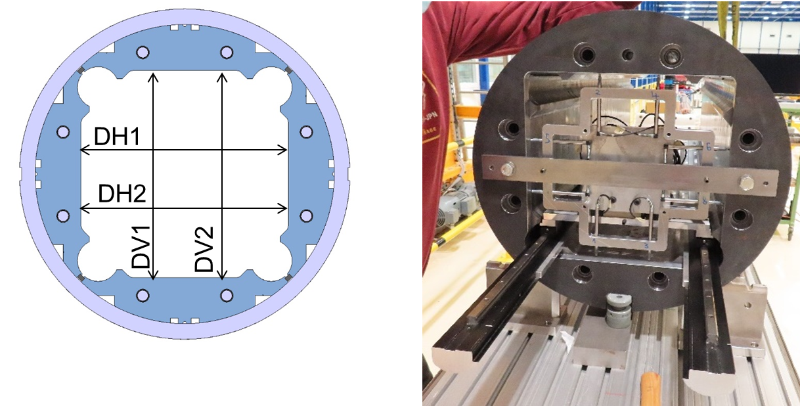
Yoke-shell modules
Monitored parameters:
  Shell strain
  Bladder pressure
  Yoke cavity size, defined as the average of the horizontal (DH1 + DH2)/2 or the vertical (DV1 + DV2)/2 dimensions
  Yoke uniformity, defied as the average of the vertical or horizontal cavity dimension in each cross-section with respect to the measured average vertical or horizontal dimension of the entire yoke shell module
  Yoke squareness, defied as the difference between the left and right (DV1 – DV2) or top and bottom (DH1 – DH2) dimensions

Slide 5
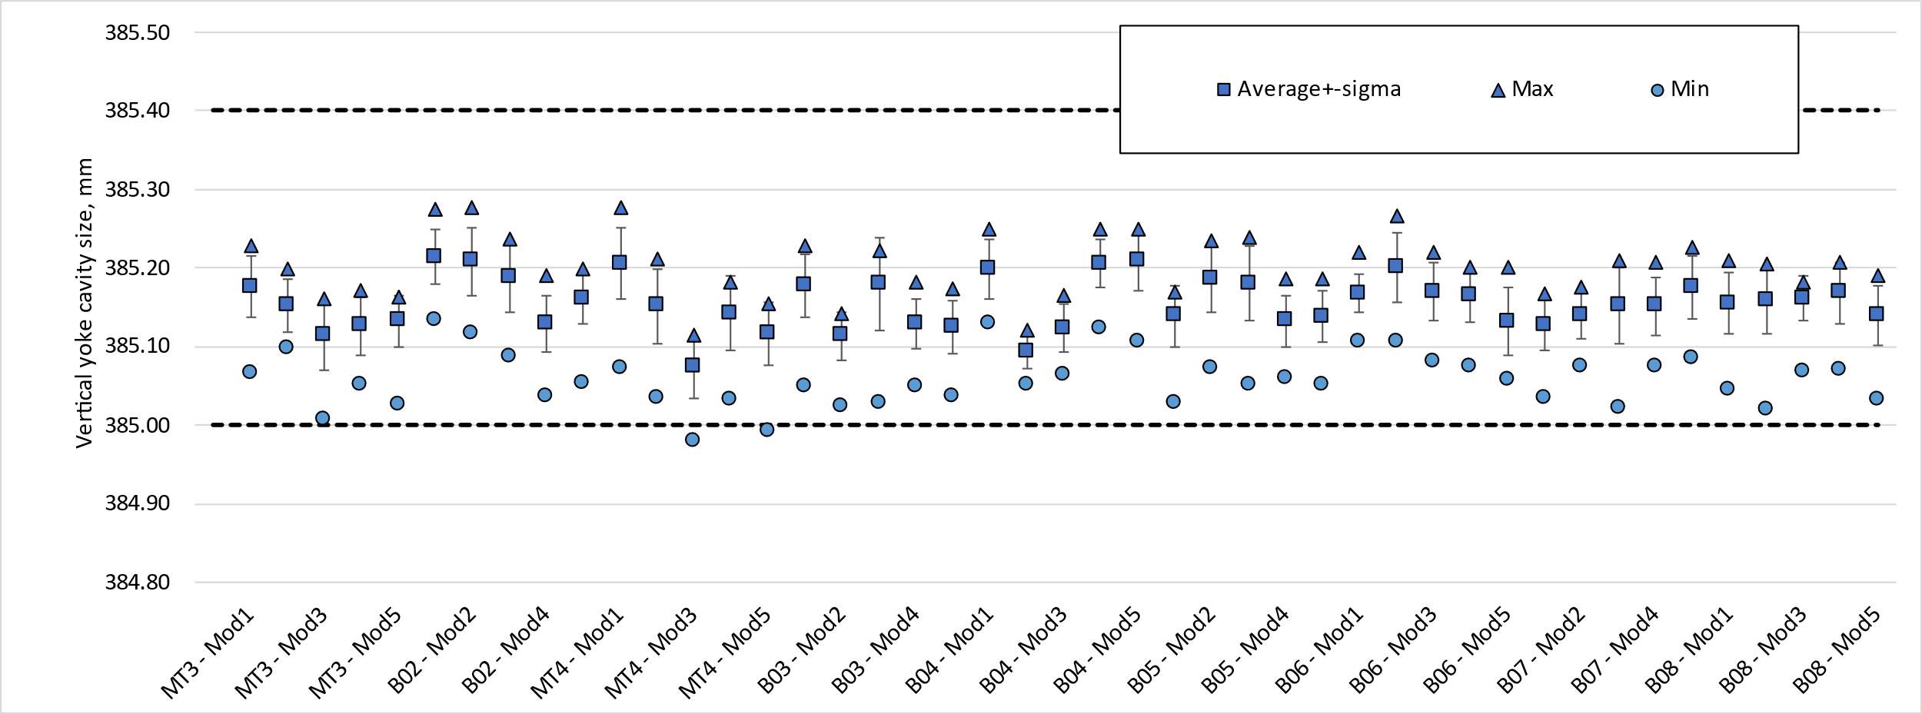
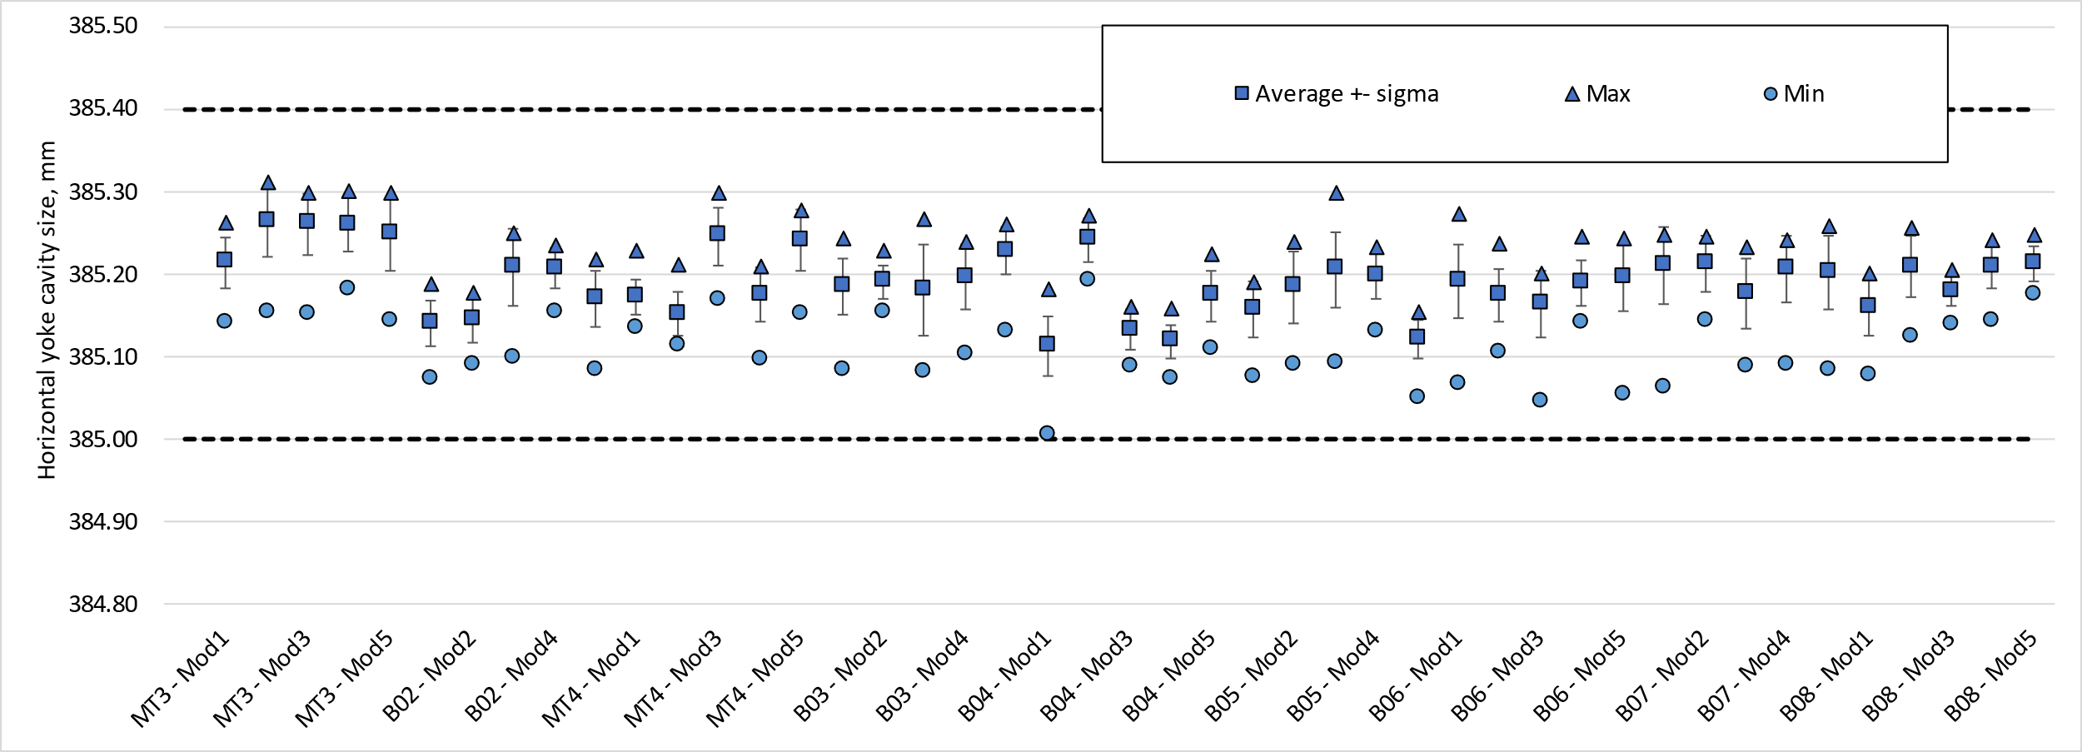
Yoke cavity size (vertical sub-assembly)
Yoke cavity size within targets
  The average vertical and horizontal yoke cavity dimensions at each cross-section shall be within +385.125 -0.125/+0.275 mm along the module length.

Slide 6
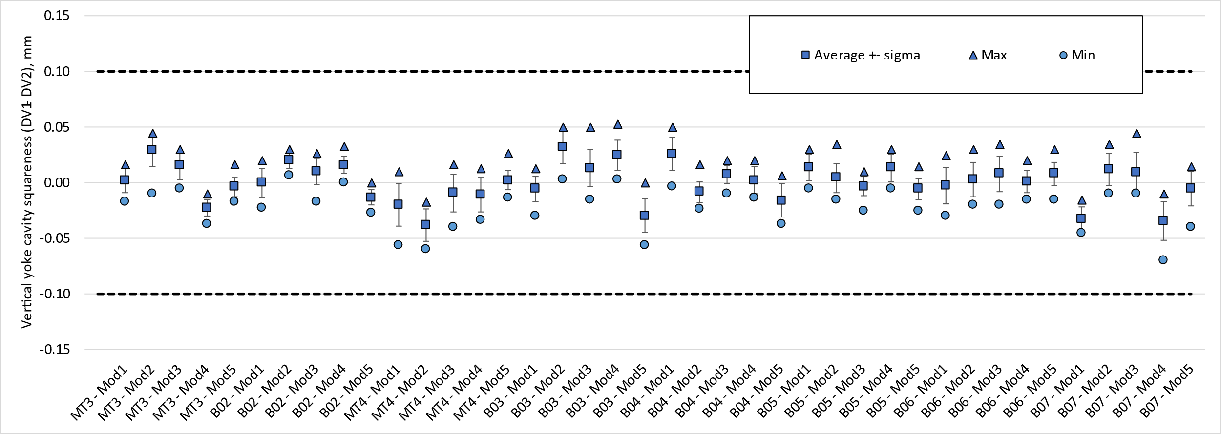
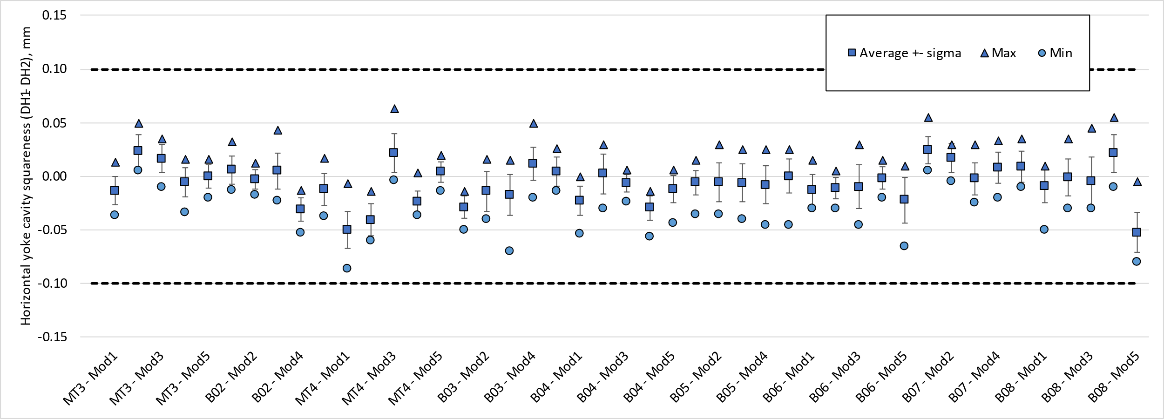
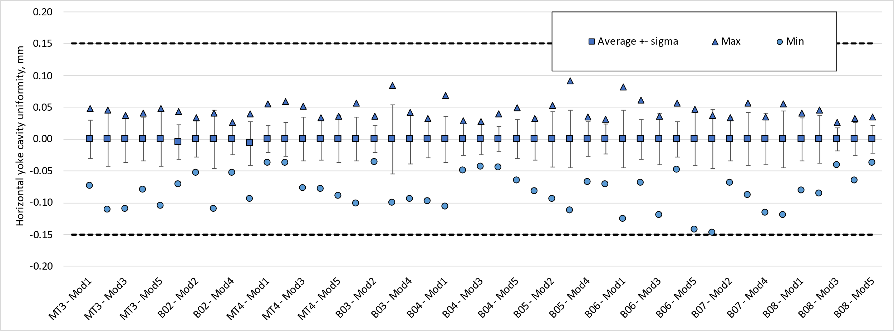
Yoke cavity size (vertical sub-assembly)
Squareness and uniformity
  The average vertical and horizontal uniformity at each cross-section shall be within -0.15/+0.15 mm.
  The average vertical and horizontal squareness at each cross-section shall be within -0.10/+0.10 mm.
DV1-DV2
DH1-DH2
Squareness
(DV1 + DV2)/2 – ave((DV1 + DV2)/2 )
(DH1 + DH2)/2 – ave((DH1 + DH2)/2 )
Uniformity

Slide 7
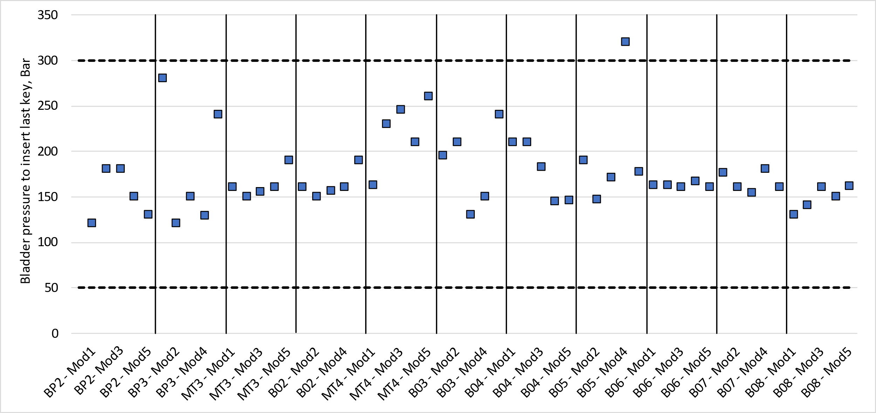
Vertical yoke-shell sub-assembly
Strain and bladder pressure within targets
  Yoke keys were 12.1 mm thick in all the cases below

Slide 8
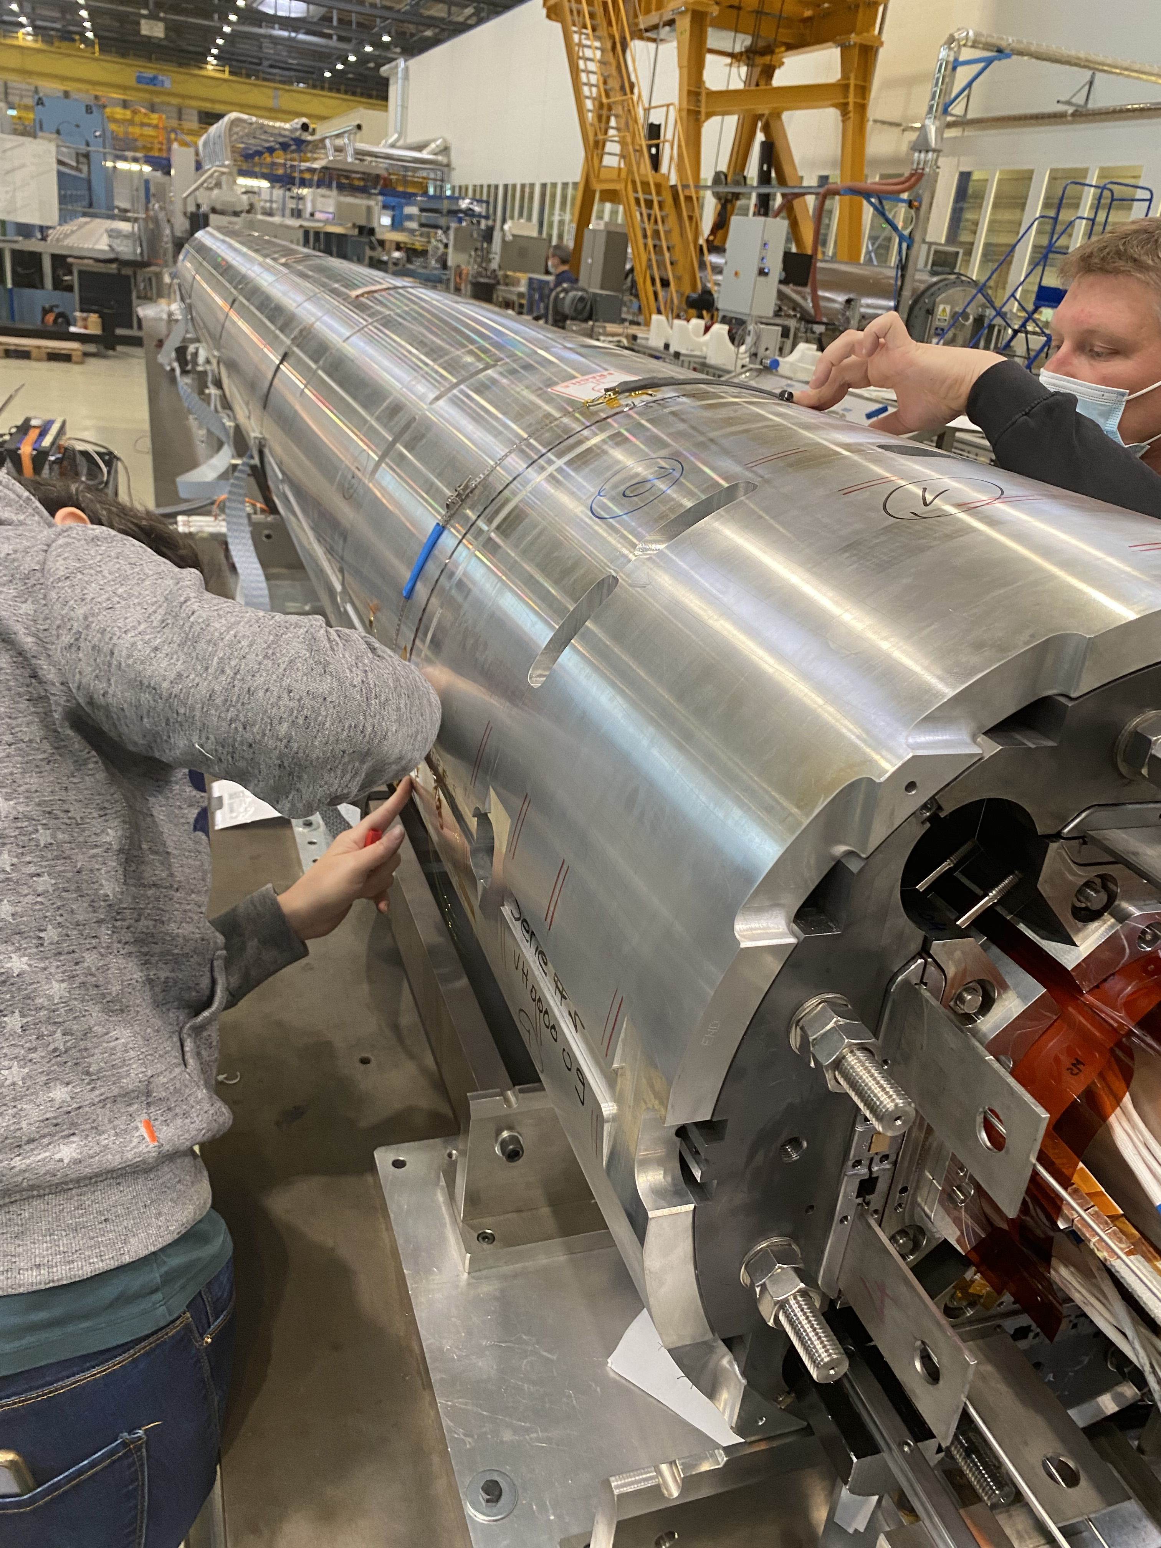
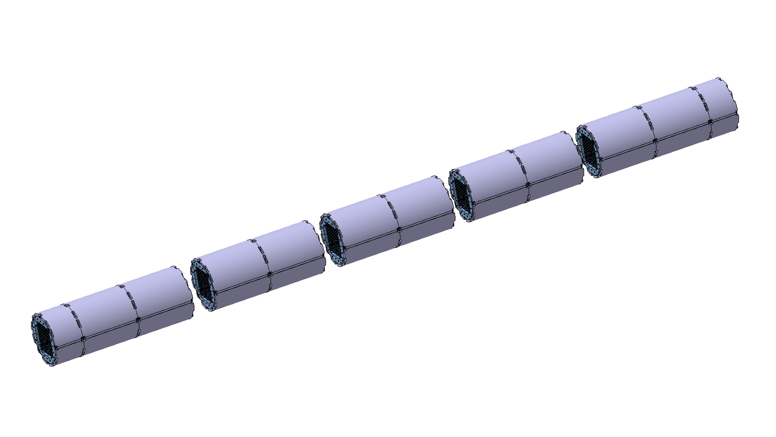
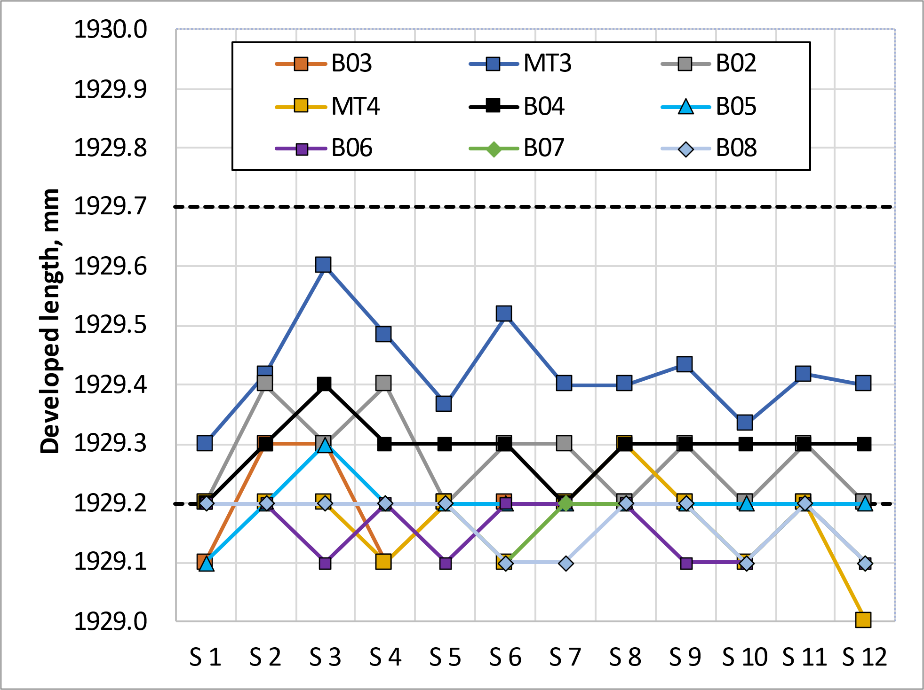
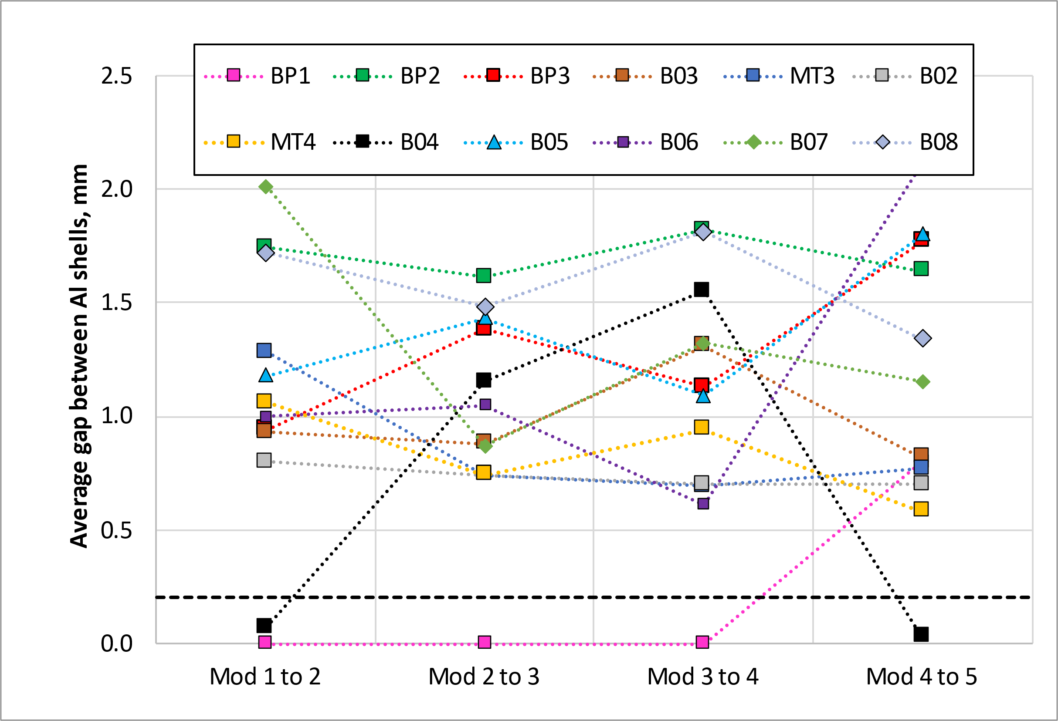
Horizontal yoke-shell assembly
The average developed length in the middle of each shell shall be 1929.4 -0.2/+0.3 mm.
  The developed length in relax state is 1928.9^{-0/+0.3} mm and the increase of circumference for 12.1 mm yoke key is 0.4 mm.
The minimum average gap between aluminium shells of adjacent modules shall be 0.2 mm
Yoke cavity is measured again once the modules are assembled, and shall be consistent with the vertical yoke-shell subassembly measurements
The total length of the structure shall be 7521 ± 5 mm

Slide 9
Outline
Yoke shell sub-assembly
  Vertical sub-assembly (yoke-shell modules)
  Horizontal sub-assembly
Coil pack sub-assembly
  Radial coil pack size
  Pole-key gap
  Coil pack squareness
  Magnetic measurements after coil pack insertion
Completed

Slide 10
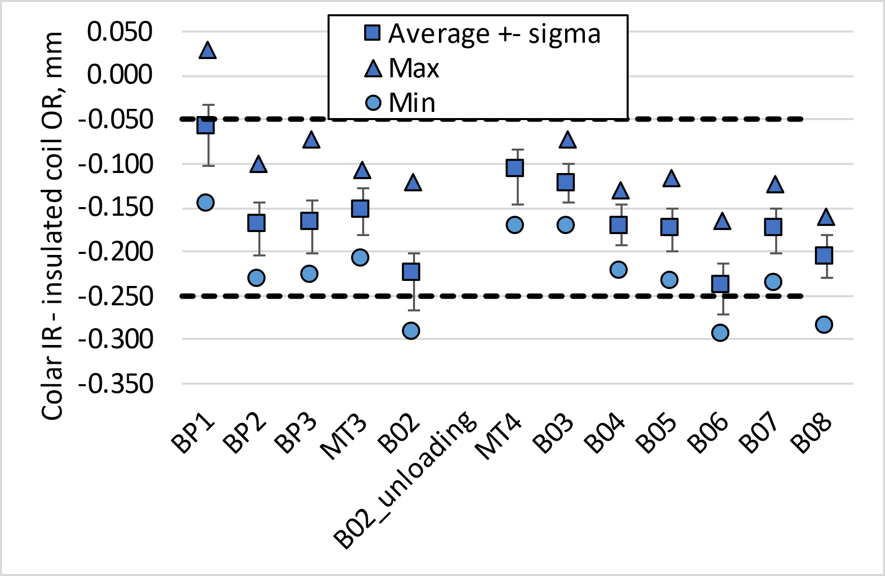
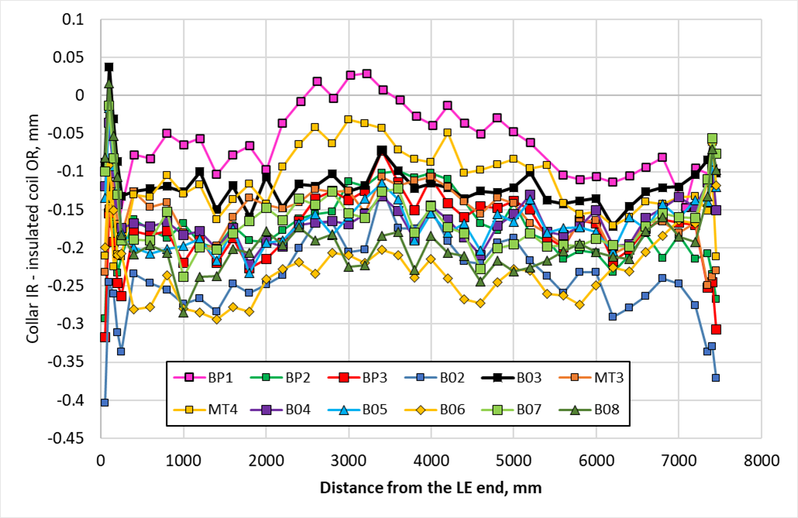
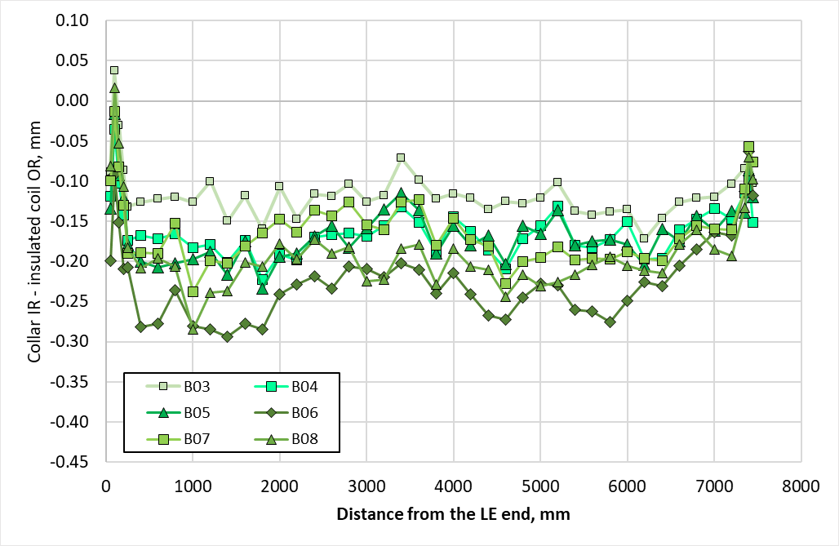
Coil pack radial size
The gap between collars and insulated coils with respect to the nominal dimension, considering for each z location the average among the four coils, shall be -0.125 mm -0.125 / +0.075 mm.
The coil pack size is smaller than B07 because the key 13.8 mm that need to be inserted during loading are all bigger than nominal.

Slide 11
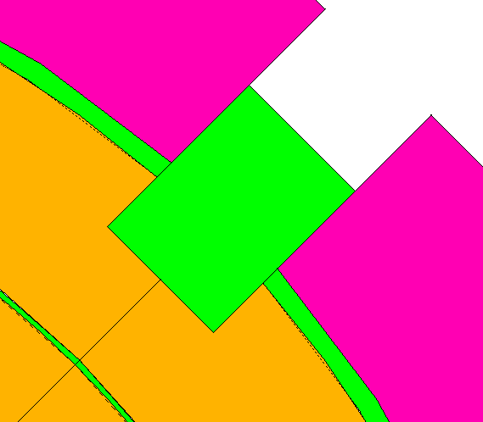
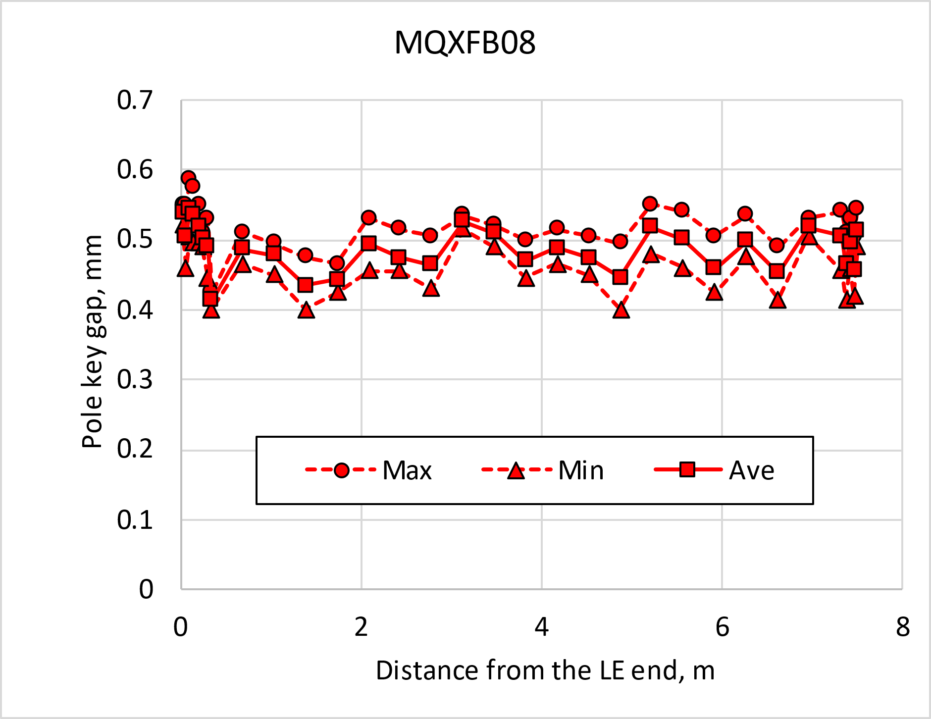
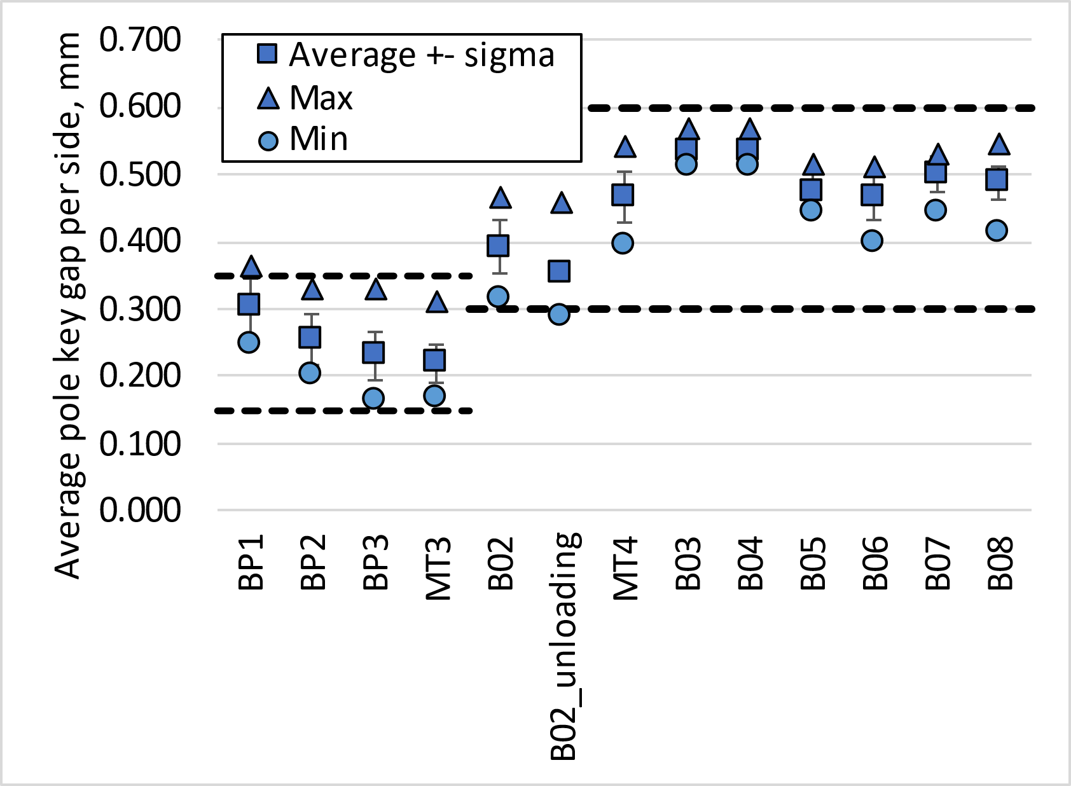
Pole-key gap
The average pole key gap (per side) along the magnet length shall be +0.400 ±0.100 mm in each quadrant.
The minimum pole key gap (per side) in any quadrant and in any longitudinal location shall be > +0.300 mm.
  From MQXFB02, pole keys are machined removing 250 µm on each side from the original key (lessons learnt from A07&A08)
  We have a more uniform pole key gap along the length than in previous assemblies (no coil belly)

Slide 12
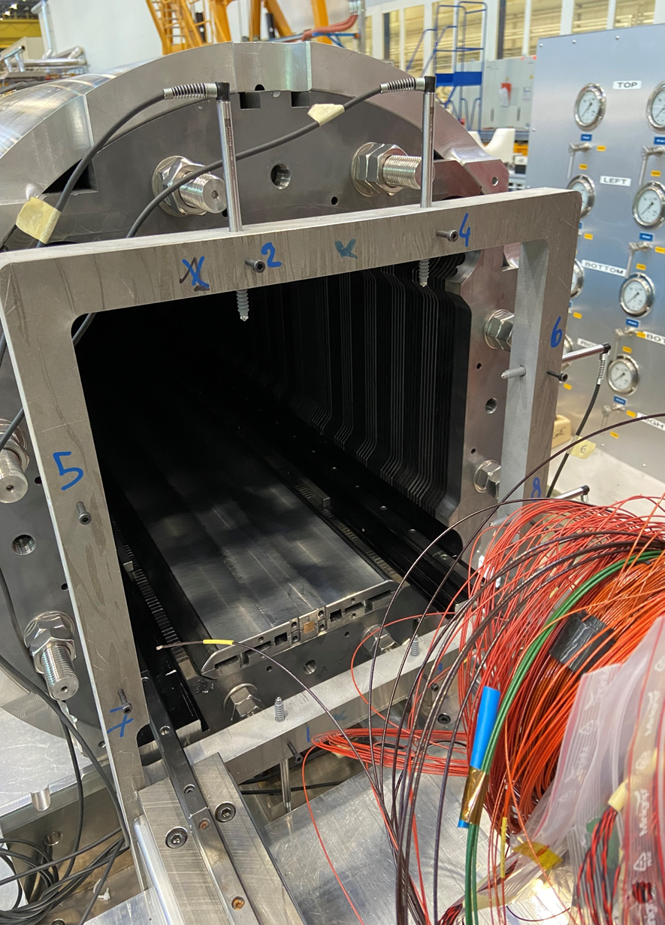
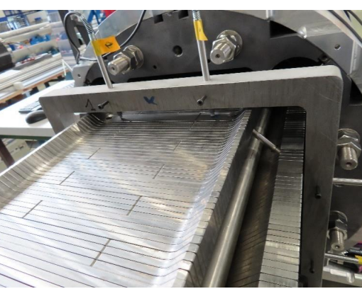
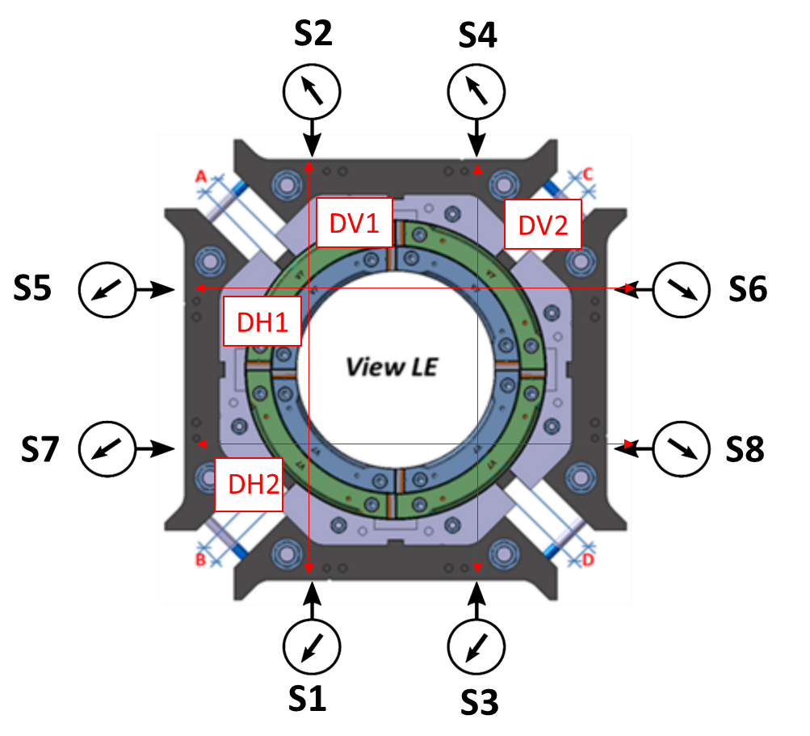
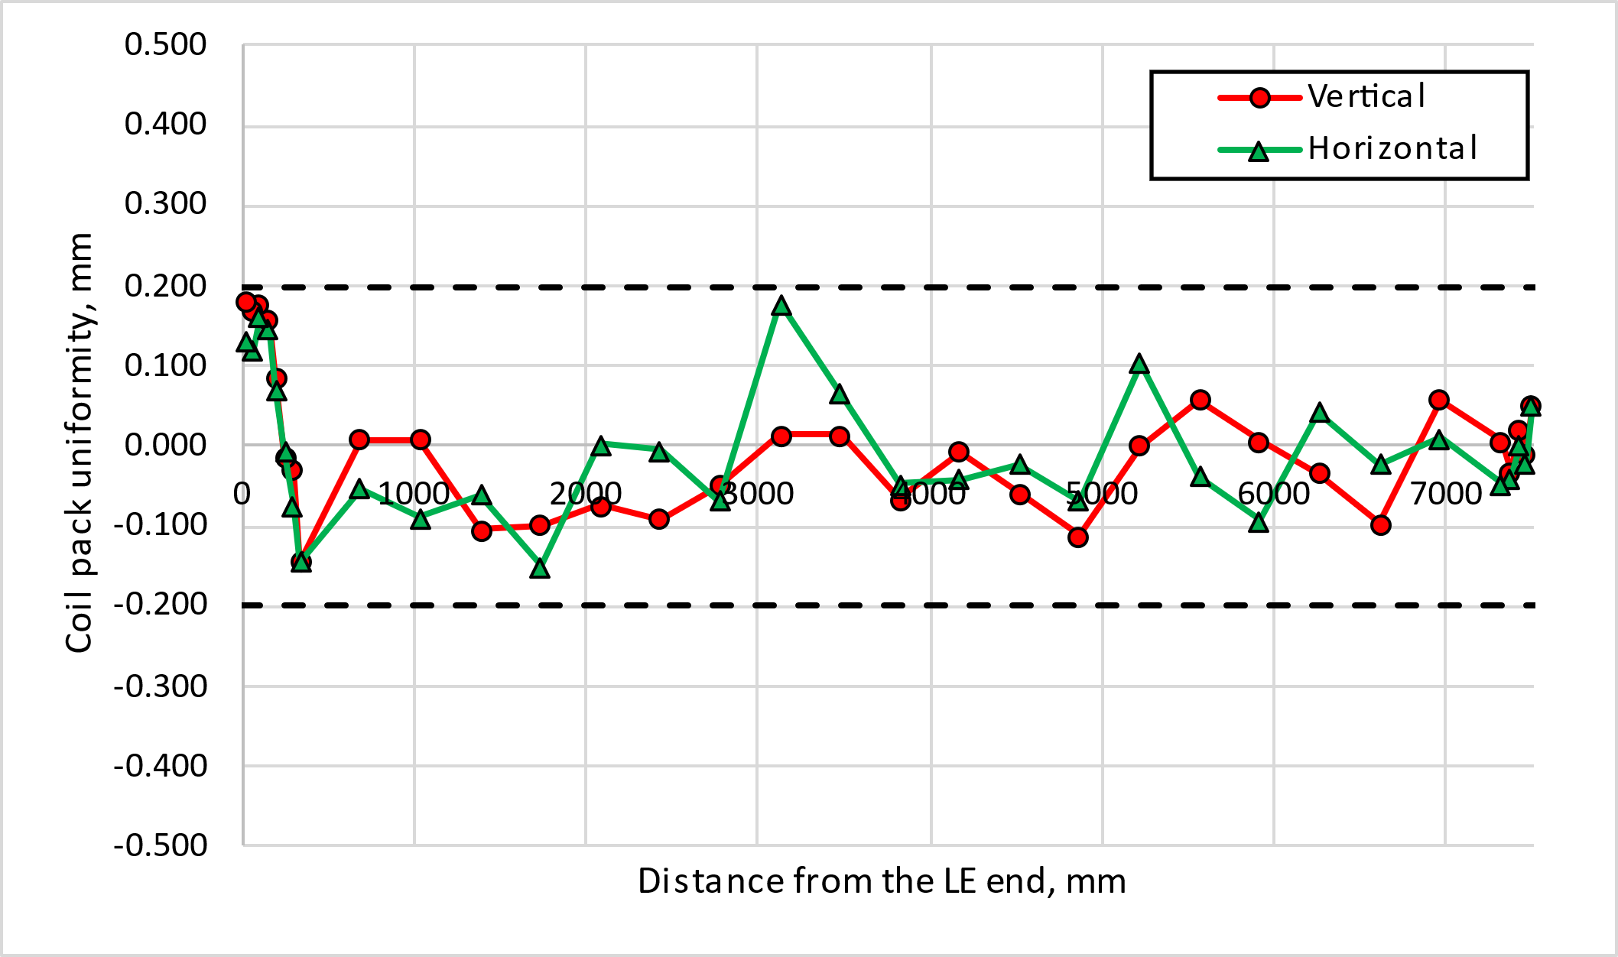
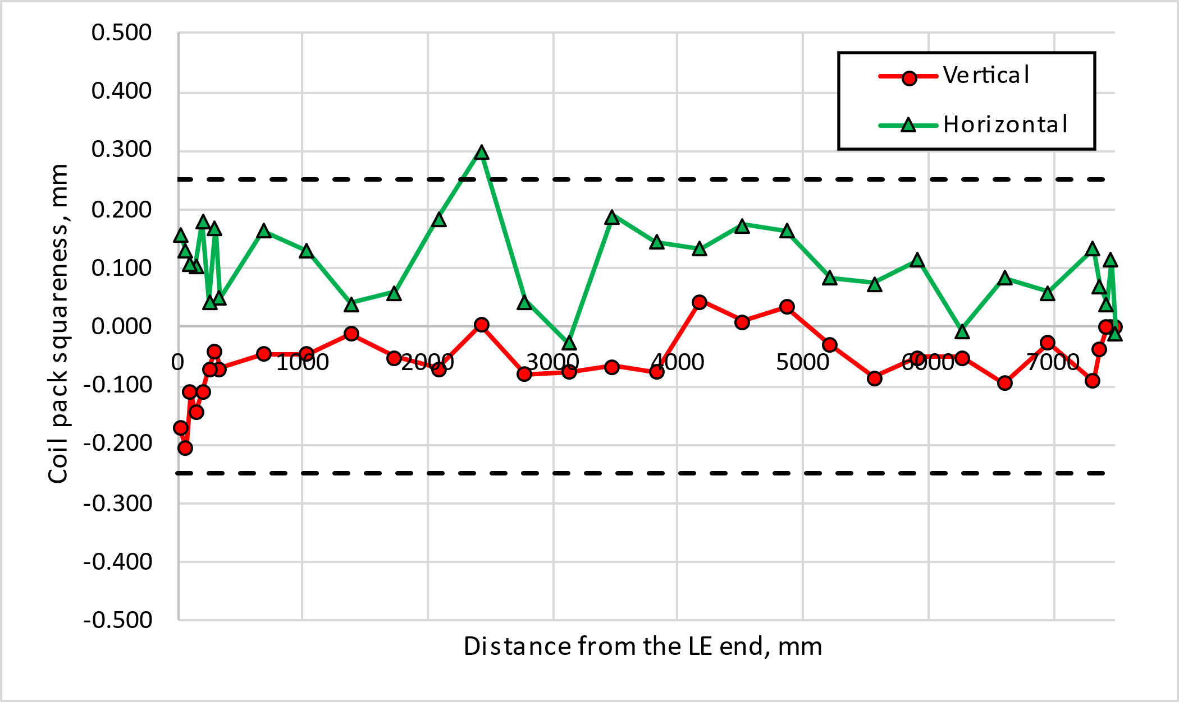
Coil pack geometrical measurements
For the coil-pack size, uniformity, and squareness the following ranges are set:
  The average vertical and horizontal dimension of the coil pack along the z axis shall be within 318.75 mm ± 0.250 mm
  The uniformity of the vertical and horizontal dimensions along the z axis shall be within ±0.200 mm
  The squareness of the vertical and horizontal dimensions along the z axis shall be within±0.250 mm

Slide 13
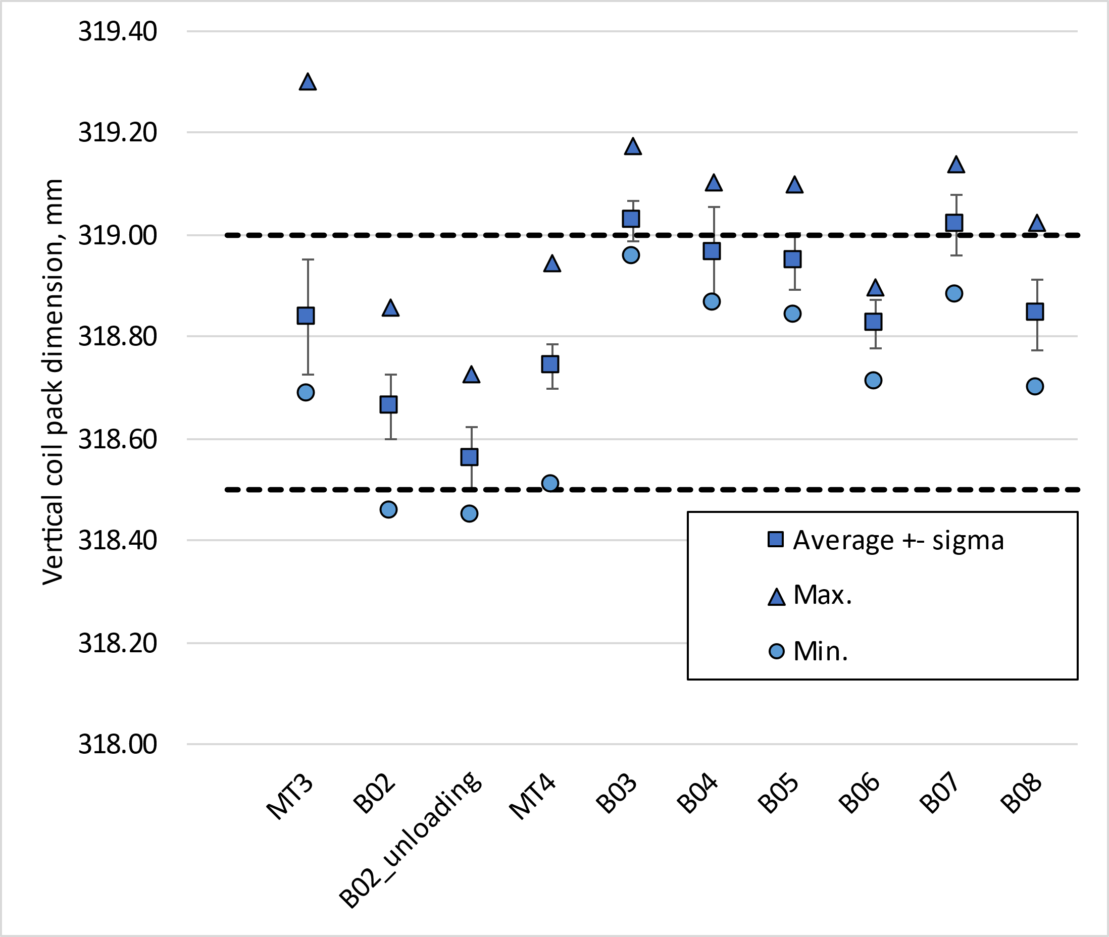
Coilpack external measurements
Comparison
B08 dimensions are smaller than B04/B05 as prevued by the shimming plan.

Slide 14
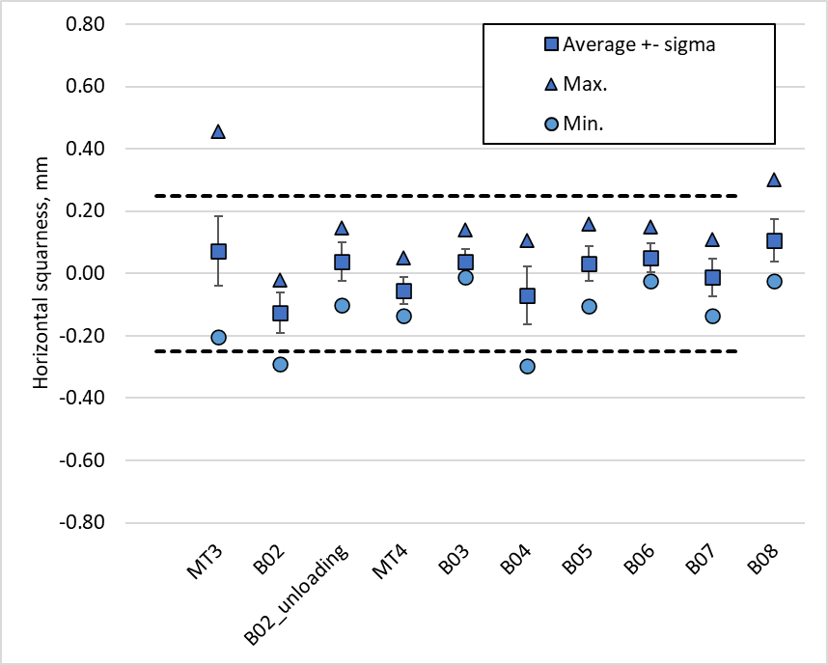
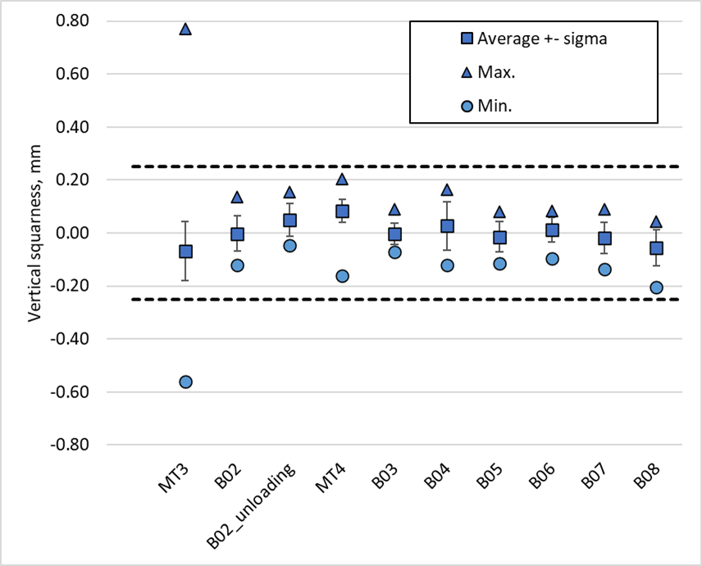
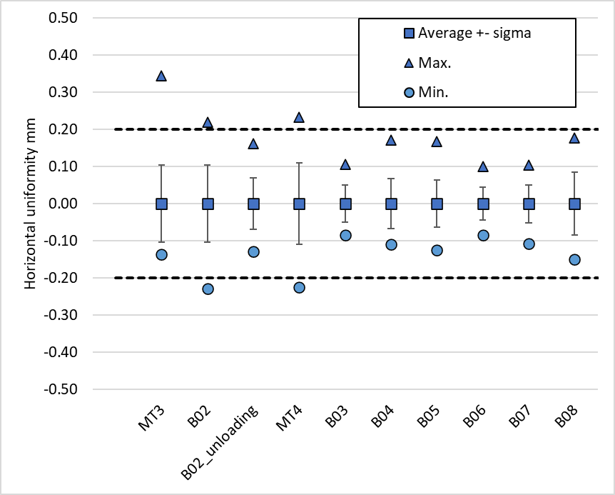
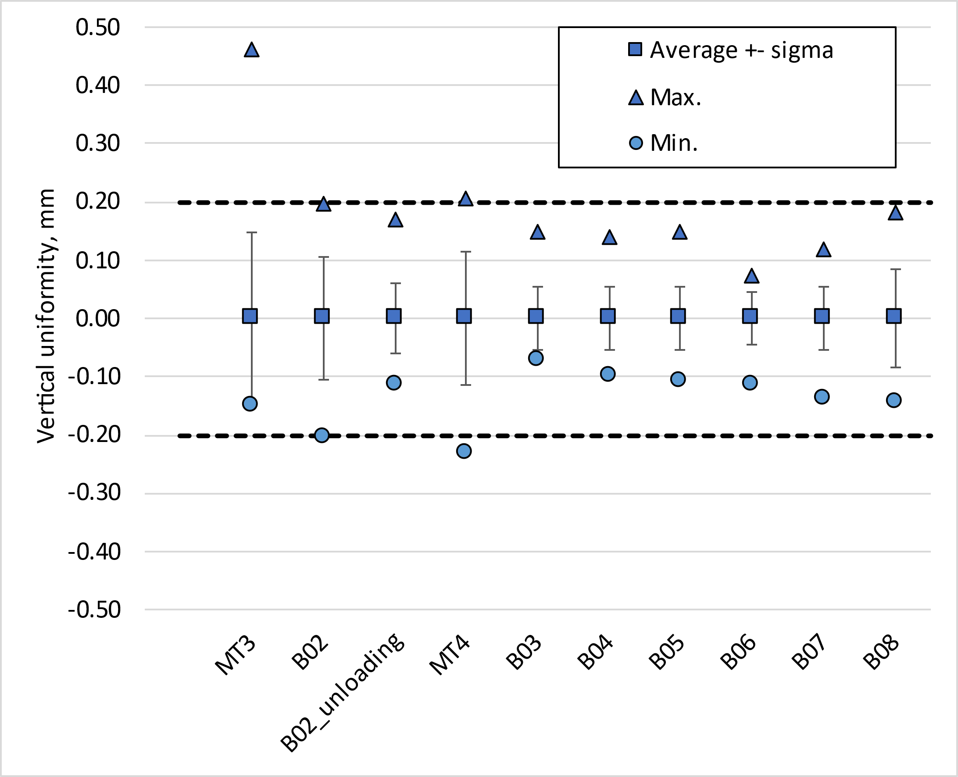
Coilpack external measurements
Comparison

Slide 15
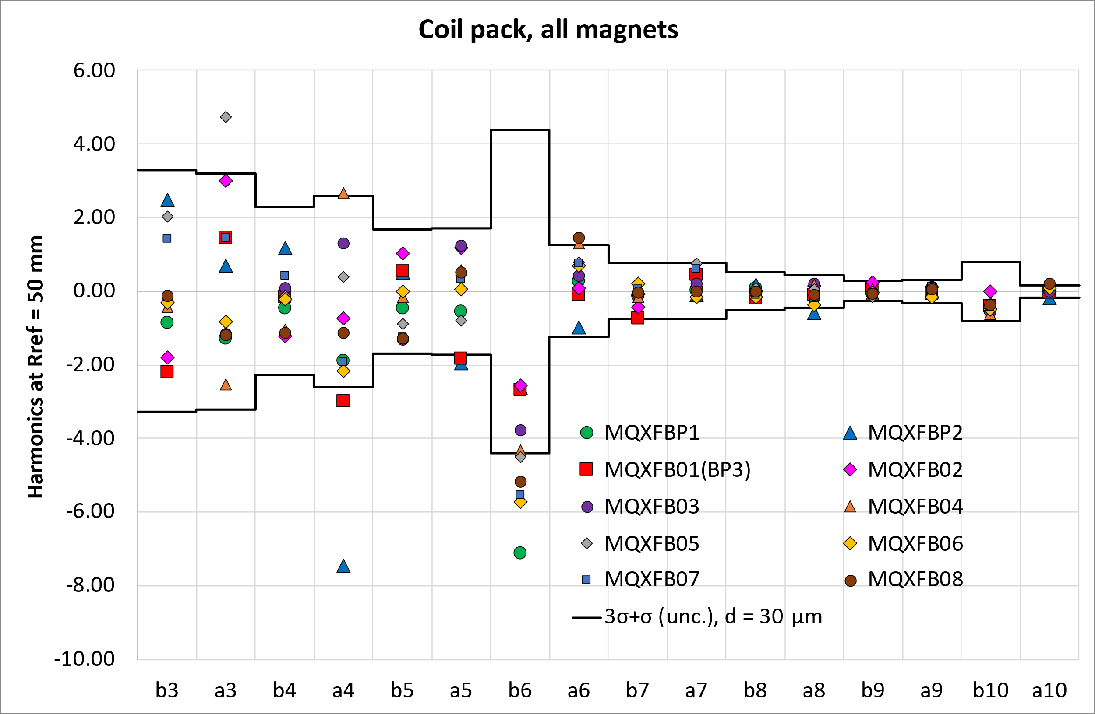
Magnetic measurements after coil pack insertion

Slide 16
Thank you!

