Slide 1
Impedance modelling and equipment design
Chiara Antuono, Michela Neroni on behalf of
H. Bursali, E. De La Fuente, M. Diaz, G. Favia, L. Giacomel, I. Karpov, P. Krkotic, A. Lasheen, N. Mounet, B. Salvant, L. Sito, C. Vollinger, M. Zampetakis, C. Zannini.
Many thanks to: W. Andreazza, M. Barnes, G. Bregliozzi, S. Calatroni, A. Perillo Marcone, D. Mirarchi, C. Pasquino, R. Seidenbinder, J. A. Ferreira Somoza, R. Franqueira Ximenes.
11th December 2024, JAP Workshop, Montreux

Slide 2
Introduction

Slide 3
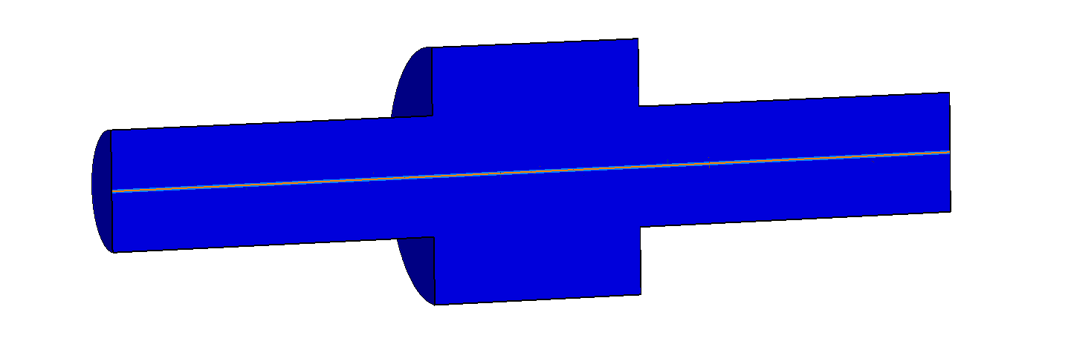
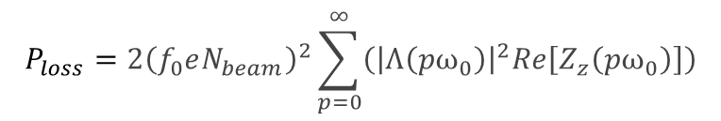

Introduction
When facing cross section variations of the vacuum chamber wall, as well as its finite resistivity, charged particles travelling in the accelerator, induce electromagnetic fields mainly left behind the source particle.
➔ Wakefield
FFT
Effect can be quantified through
Beam coupling impedance $Z\left(f\right)$
Impedance-induced effects
Equipment degradation or damage due to beam induced heating and/or sparking
Beam quality degradation and beam instabilities
Total accelerator impedance
Dependent on beam spectrum
Can be triggered by
$$P_{loss}=2{\left(f_{0}eN_{beam}\right)}^{2}\sum_{p=0}^{∞}{\left({\left|Λ\left(pω_{0}\right)\right|}^{2}Re\left[Z_{z}\left(pω_{0}\right)\right]\right)}$$
Impedance of single a component
Accurate and up-to-date accelerator impedance model is crucial

Slide 4
Methodology
New equipment design
Ʃ
Impedance modelling of each component and optimization
Beam dynamics simulations
Accelerator impedance model
Beam dynamics observations and accelerator upgrades
Electromagnetic simulations
CST Studio Suite®
Bench measurements
➔ Needed for validation of component before any installation
Accurate prediction of accelerator performance
It requires close collaboration between impedance team and equipment owners to allocate time needed for impedance validation.

Slide 5
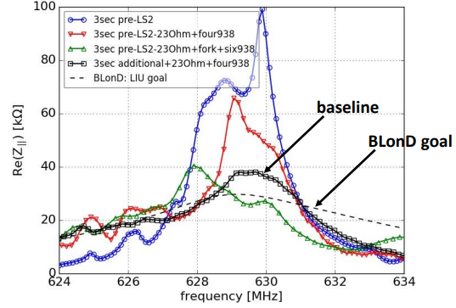
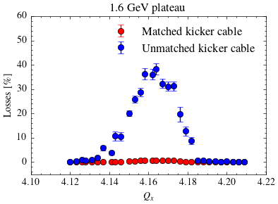
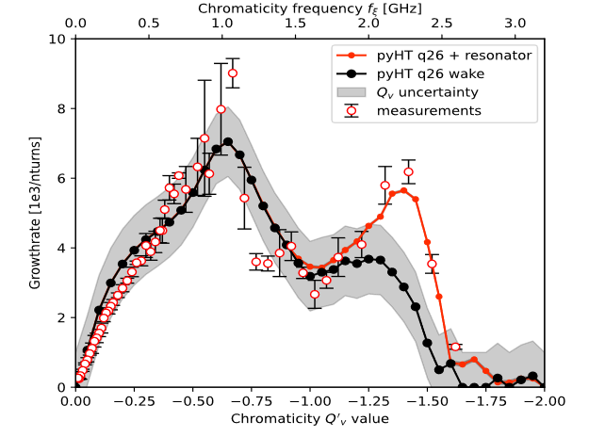

Methodology
Complex loads installation on 630 MHz HOM-couplers - SPS 200 MHz cavity
PSB horizontal instability post LIU
P. Kramer, PhD Thesis
Beam dynamics observations and accelerator upgrades
SPS dark impedance
C. Antuono, et al., IPAC24
New region explored
E. De La Fuente, et al., HB2023

Slide 6
Impedance studies in the CERN complex
Impedance modelling is a constant work on going and it often requires dedicated students' projects.
Here covering impedance related studies and observations in the CERN complex for 2023-24.
 | 2023 | 2024
Unshielded pumping manifold
Rotary wire scanners
Injection kicker MKI-cool
TDIS
Vacuum modules
PS
Not limited beam operation with no hardware failure
SPS
Limited beam operation with no hardware damage
Limited beam operation with hardware damage
Close to limit, requires impedance optimization
LHC
Many other accelerator components to be followed up…
➔ Complete overview for 2025 and HL-LHC in conclusions

Slide 7
Impedance-related observations in the CERN complex in 2023/24

Slide 8
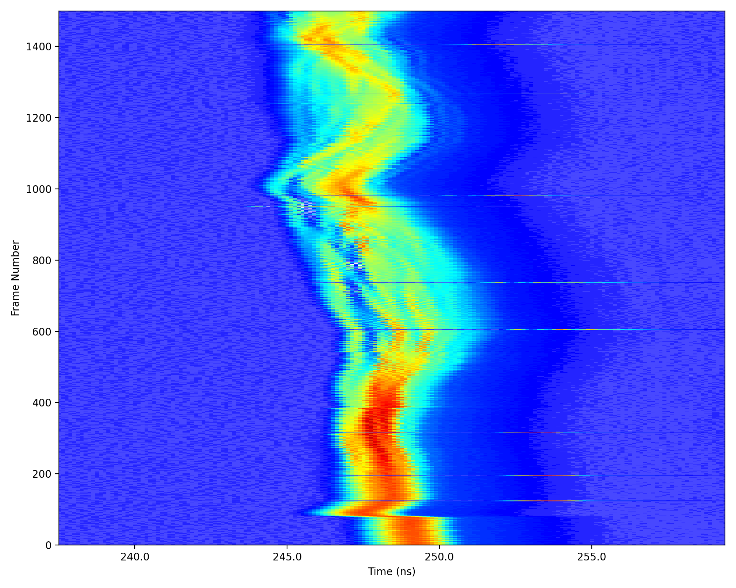
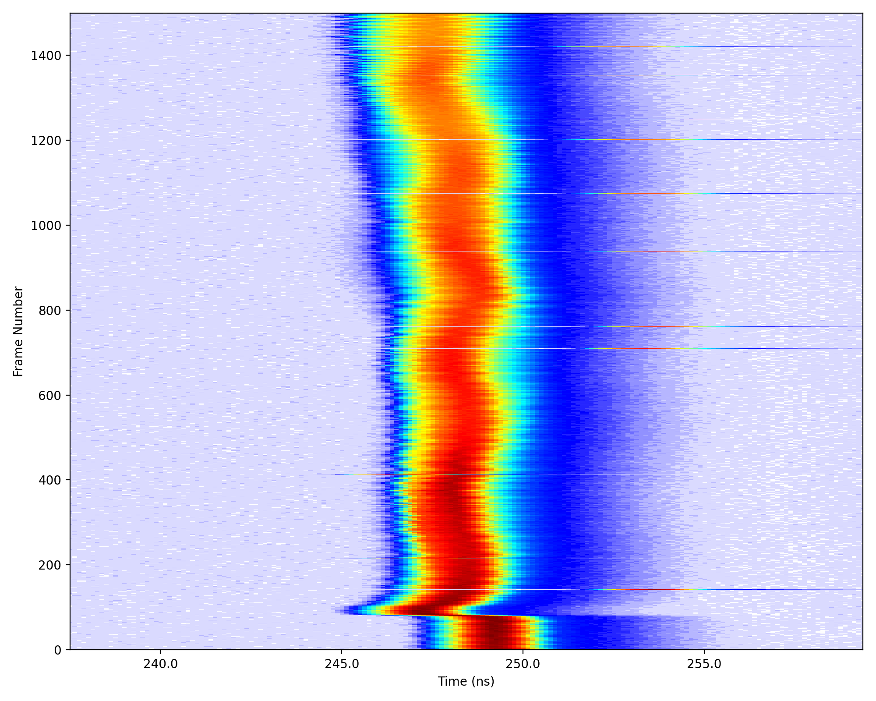
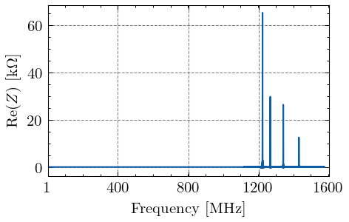
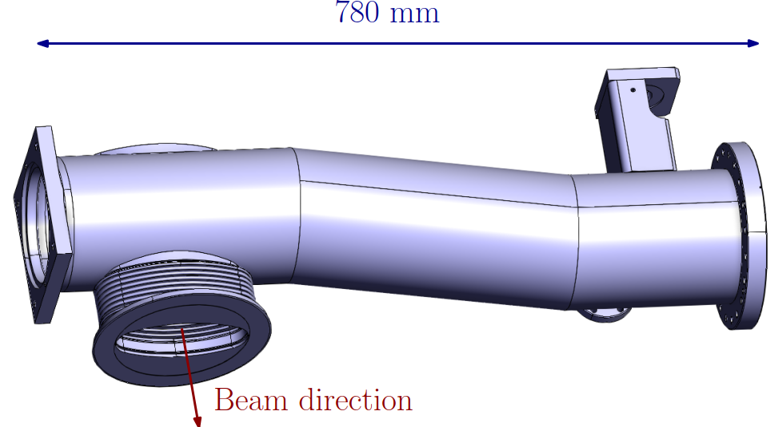
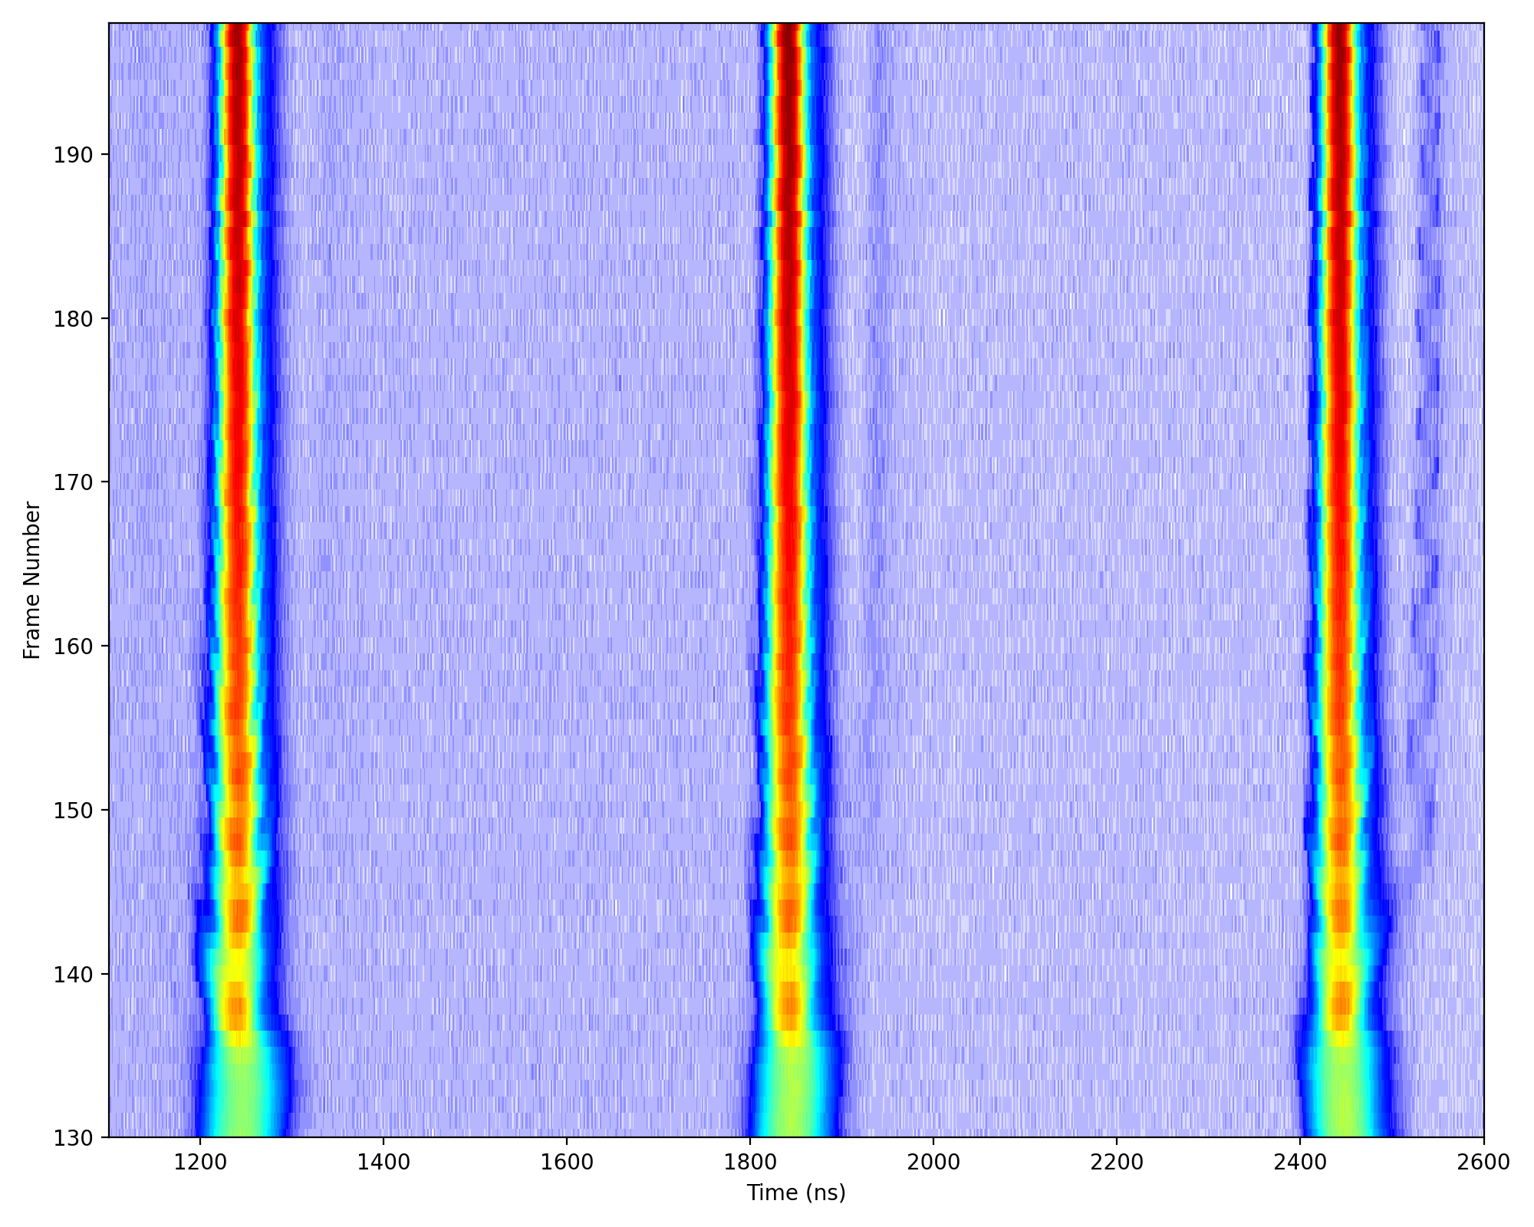
Unshielded pumping manifold (PS)
Observations in 2023 and 2024 of high frequency modulation at transition crossing for ion and proton beams (AWAKE)*.
E. Vinten, et al., IPAC23
ILHC75ns#3b
28/11/2024
Impedance source identified in high frequency range (1.2 GHz) ➔ vacuum equipment: unshielded pumping manifold.
➔ Follow up for prototype shield ongoing
Avoided through emittance blow up
However, uncaptured beam observed at flat top.
Close to longitudinal stability limit also for AWAKE beam: about 15-20% margin in longitudinal emittance (~7.5-10% bunch length from linear scaling).
See talk by A. Lasheen at IPP
Current operational conditions close to the instability limit. Further improvements in beam quality or performance requires impedance optimization.
Combined impedance and beam dynamics study necessary for a full understanding of limitations and possible future bottlenecks.
Courtesy of J. Flowerdew
* Impact on other beams to be evaluated.

Slide 9
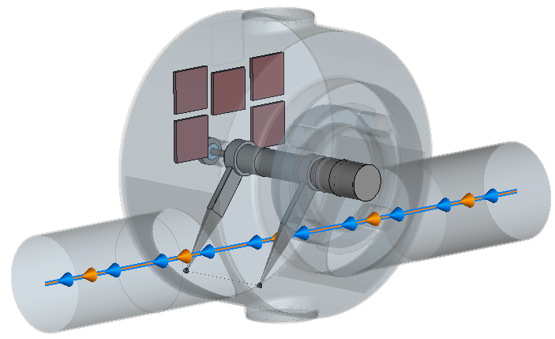
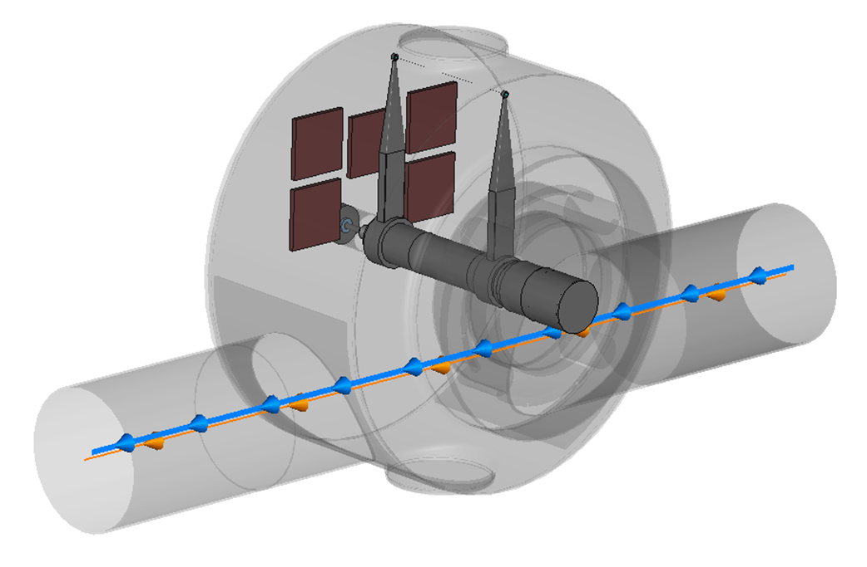
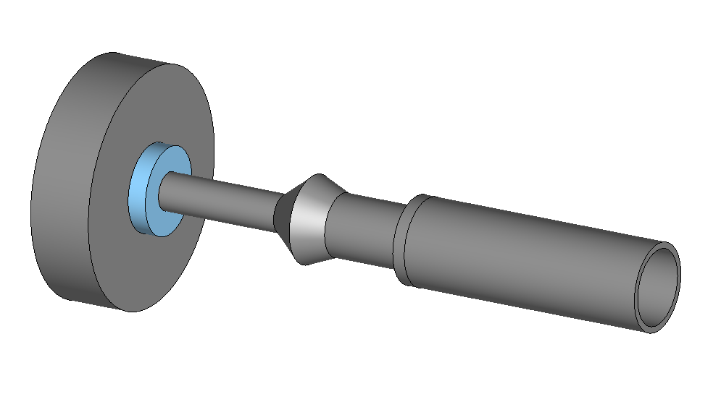
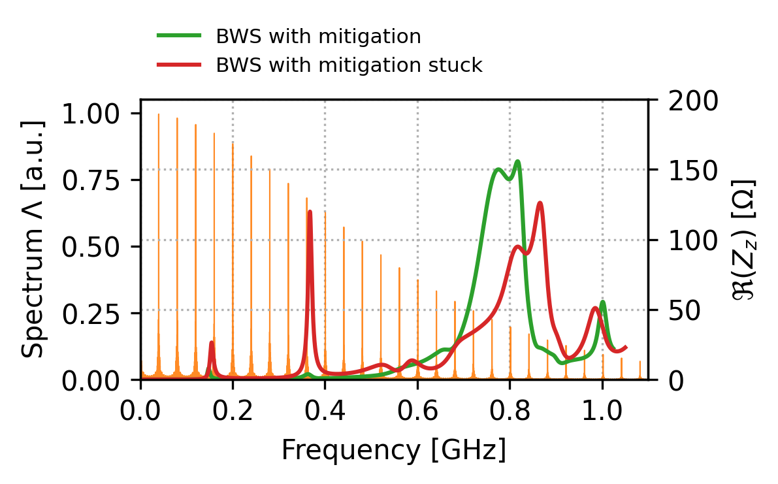
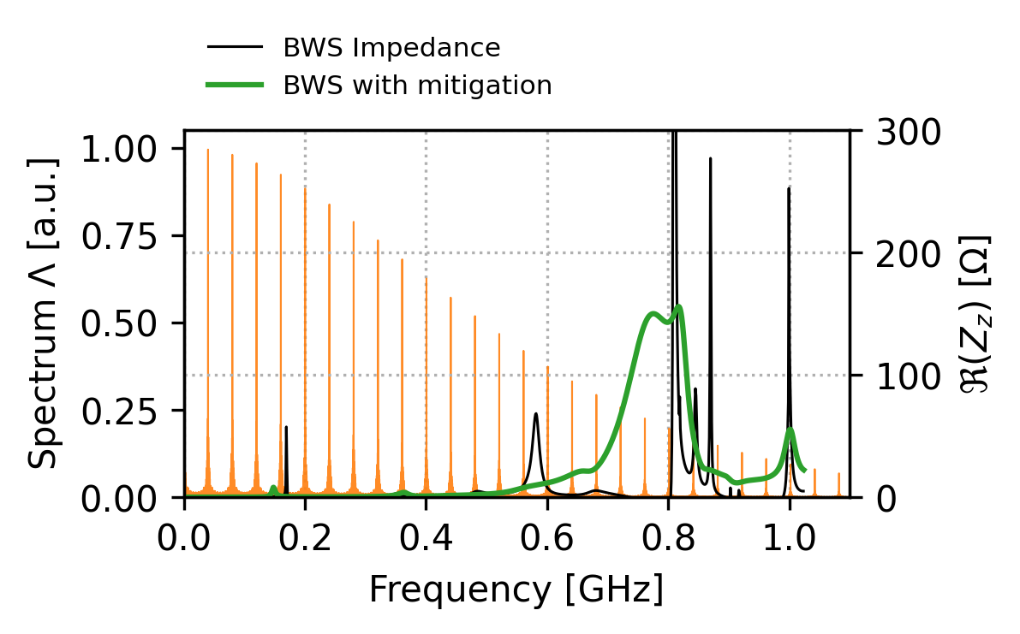
Rotary wire scanners (SPS)
Fork in parking position
Observations in 2024 run:
Task force impedance study 2023:
RF feedthrough
Fork in stuck configuration in July 2024 for one wire scanner (more info on control of fork positioning in BI talk).
Following the failure of 4 wire scanners in April 2023, impedance mitigation was put in place with 5 ferrite tiles and RF feedthrough.
strong resonance at 380 MHz, lead to 70% power dissipated on the wire
Up to 10 kΩ
Wire breakage happened with 4x72b, Nb~1.6e11 p/b ➔ was predicted with accurate impedance simulations and beam induced heating calculations*.
➔ No limitations foreseen if the fork in parking position, thanks to task force study element is fully mitigated.
*L. Sito, ABP meeting
*E. De La Fuente, IPP

Slide 10
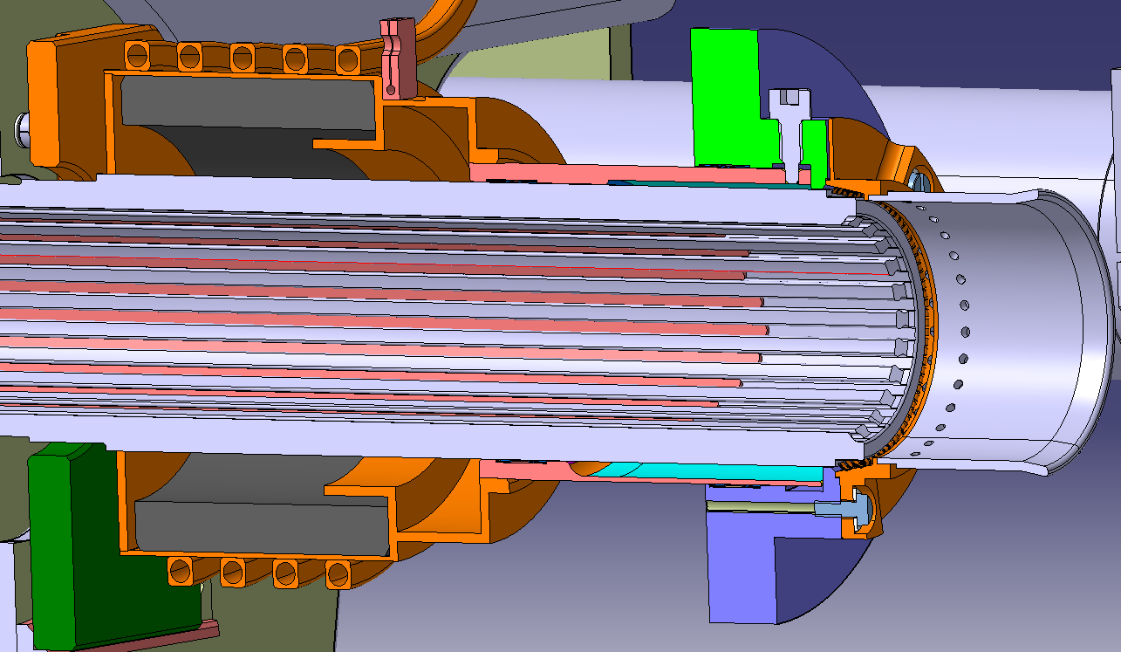
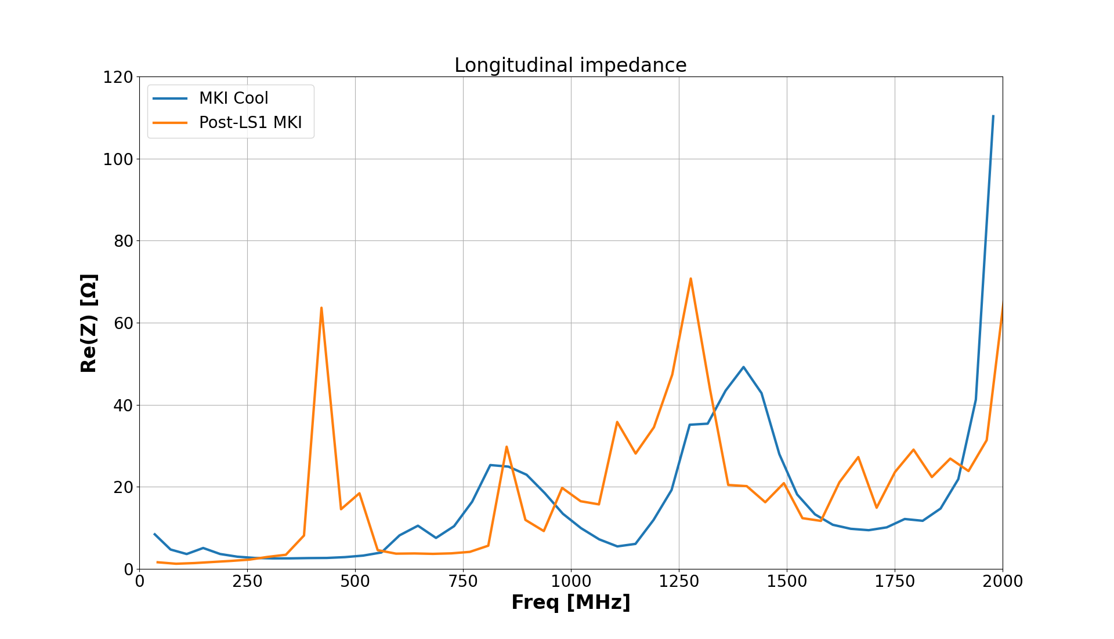
LHC injection kickers - MKI-cool
MKI-cool:
water cooling of RF damper was necessary in view of HL-LHC beams
Metallization
Cooling pipes
Reduction of beam induced heating in view of HL-LHC beams required an impedance optimization of the design* verified with simulations and benchmarked through stretched wire measurements.
Beam
Screen conductors
Alumina tube
RF Damper
(ferrite ring)
Magnet
2 MKI-cool already installed and successfully tested in 2023 and 2024 in Point 8 (more info in G. Favia talk, “ABT Equipment: Operational Insights and Future Perspective”).
2 more MKI-cool to be installed in Point 8 during YETS24/25.
Full upgrade of Point 2 with 4 MKI-cool foreseen for LS3 (plus 4 additional spares)
Courtesy of G. Favia
* M. J. Barnes, et al., IPAC18
* H. Day, PhD Thesis

Slide 11
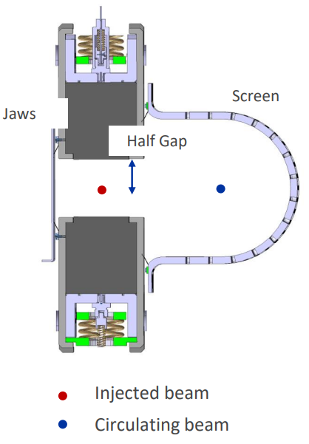
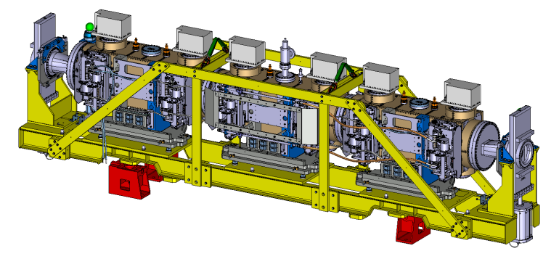
TDIS high temperature readings
In the LHC injection beam dumps protection elements are installed, particularly two Target Dump Injection Segmented (TDIS):
TDIS002 in point 2
TDIS001 in point 8
Module A
Module B
Module C
Carbajo Perez, David, et al. at IPAC2021
5.8 m
For each TDIS module:
6 temperature probes : 2 on screen and 4 on jaws
2023: Unexplained high temperature signals in the RF screen: caused interlocks and limited LHC filling

Slide 12
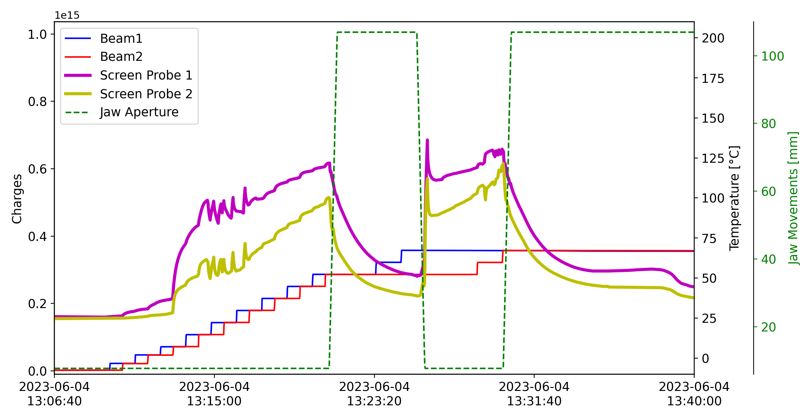
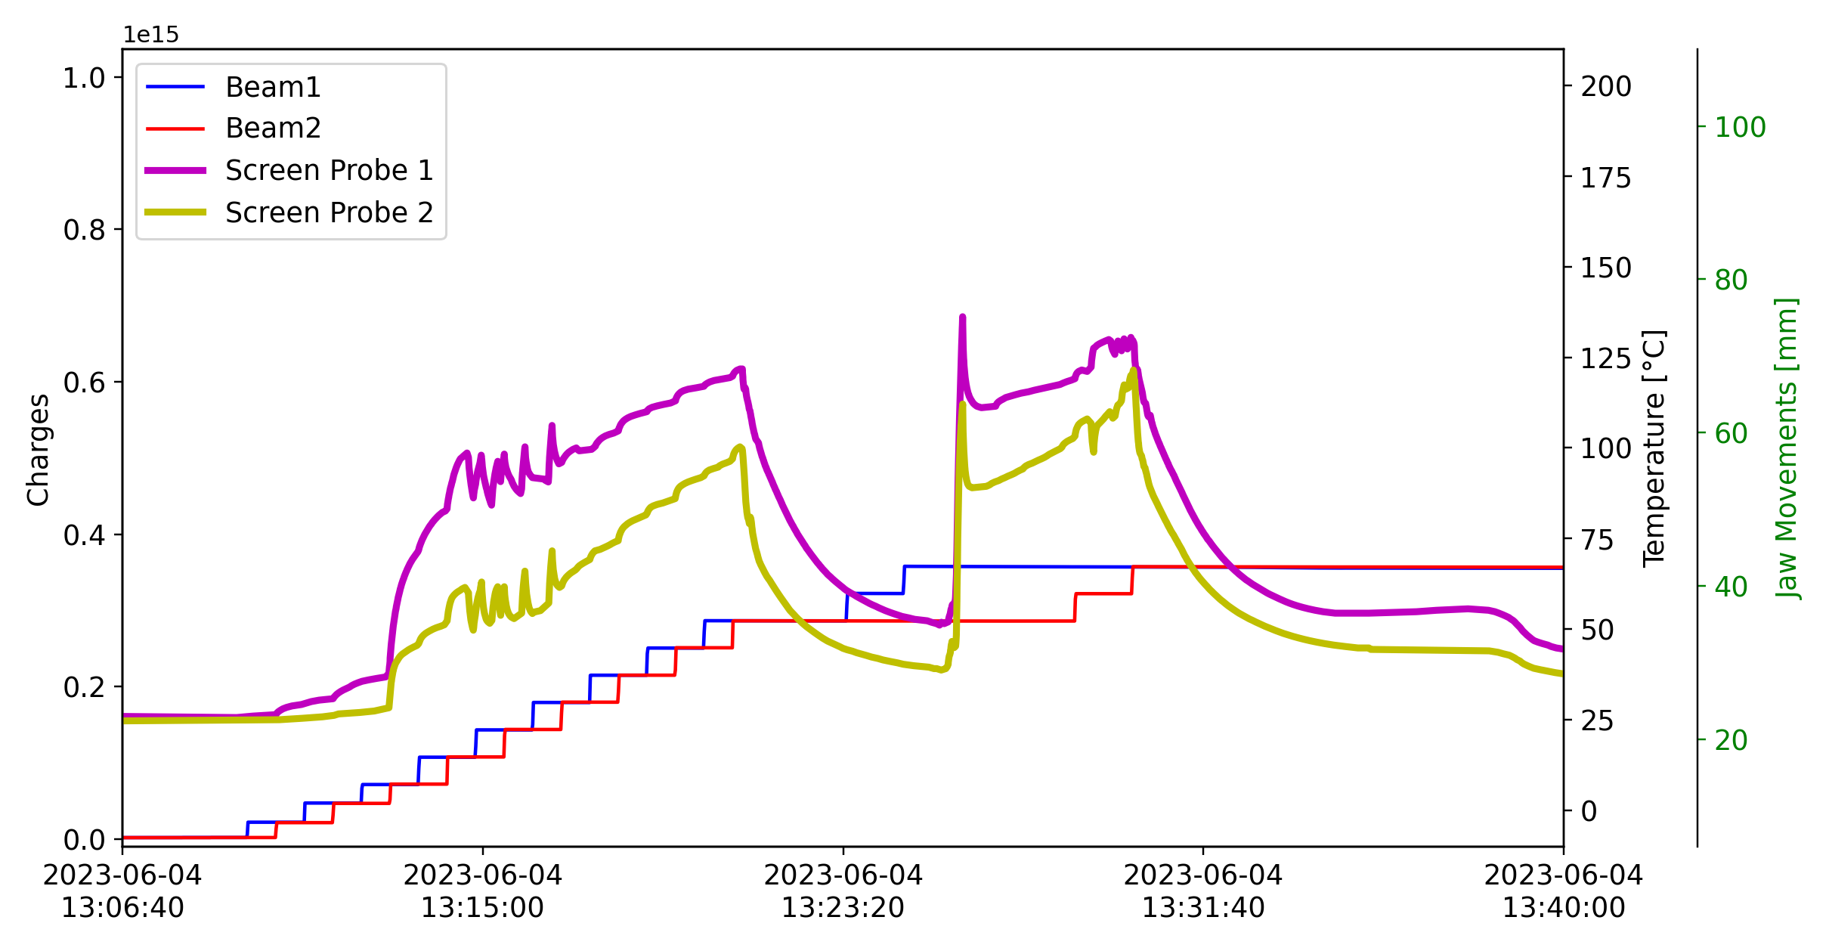
TDIS high temperature readings
2023: Unexplained high temperature signals in the: caused interlocks and limited LHC filling
Fast temperature decrease when opening jaws
Closed jaw
Closed jaw

Slide 13
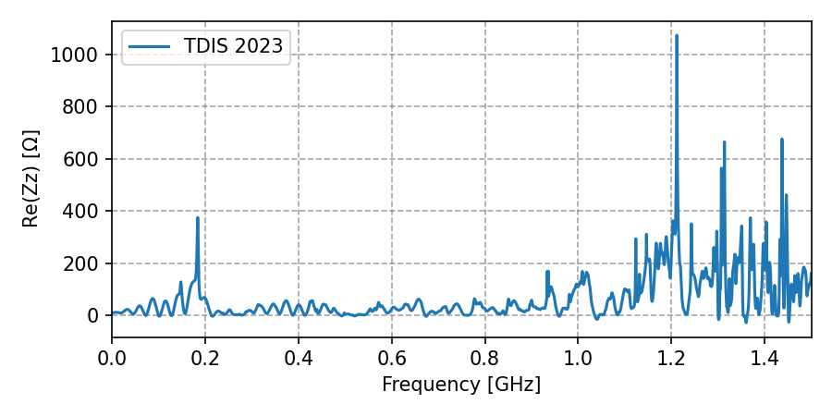
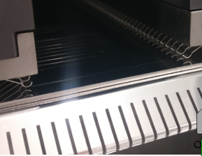
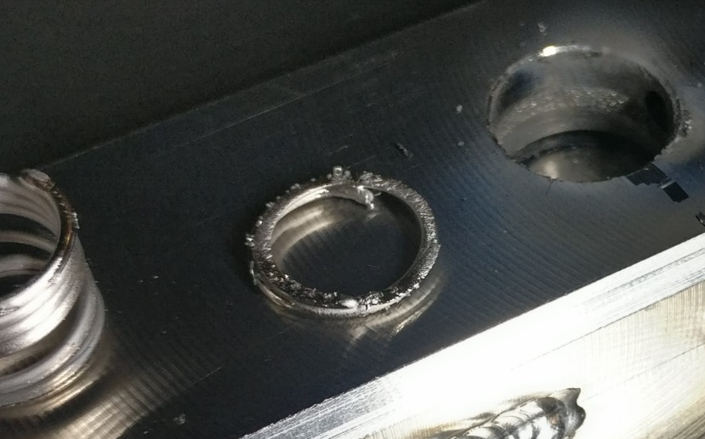
TDIS : correlations with impedance measurements
Impedance measurements*:
Electro Magnetic (EM) coupling with probes
Correlations with temperature readings:
Em coupling higher with closed jaws
Em coupling higher with screen probes (interlock)
Em coupling significantly higher for TDIS in point 8 (interlock)
Unexpected low frequency resonance detected
Visual inspection:
Presence of non-conformities :
Partially lost finger contact
melted spring
L. Giacomel et al. at the 81st IWG
L. Sito et al. at the 92nd IWG

Slide 14
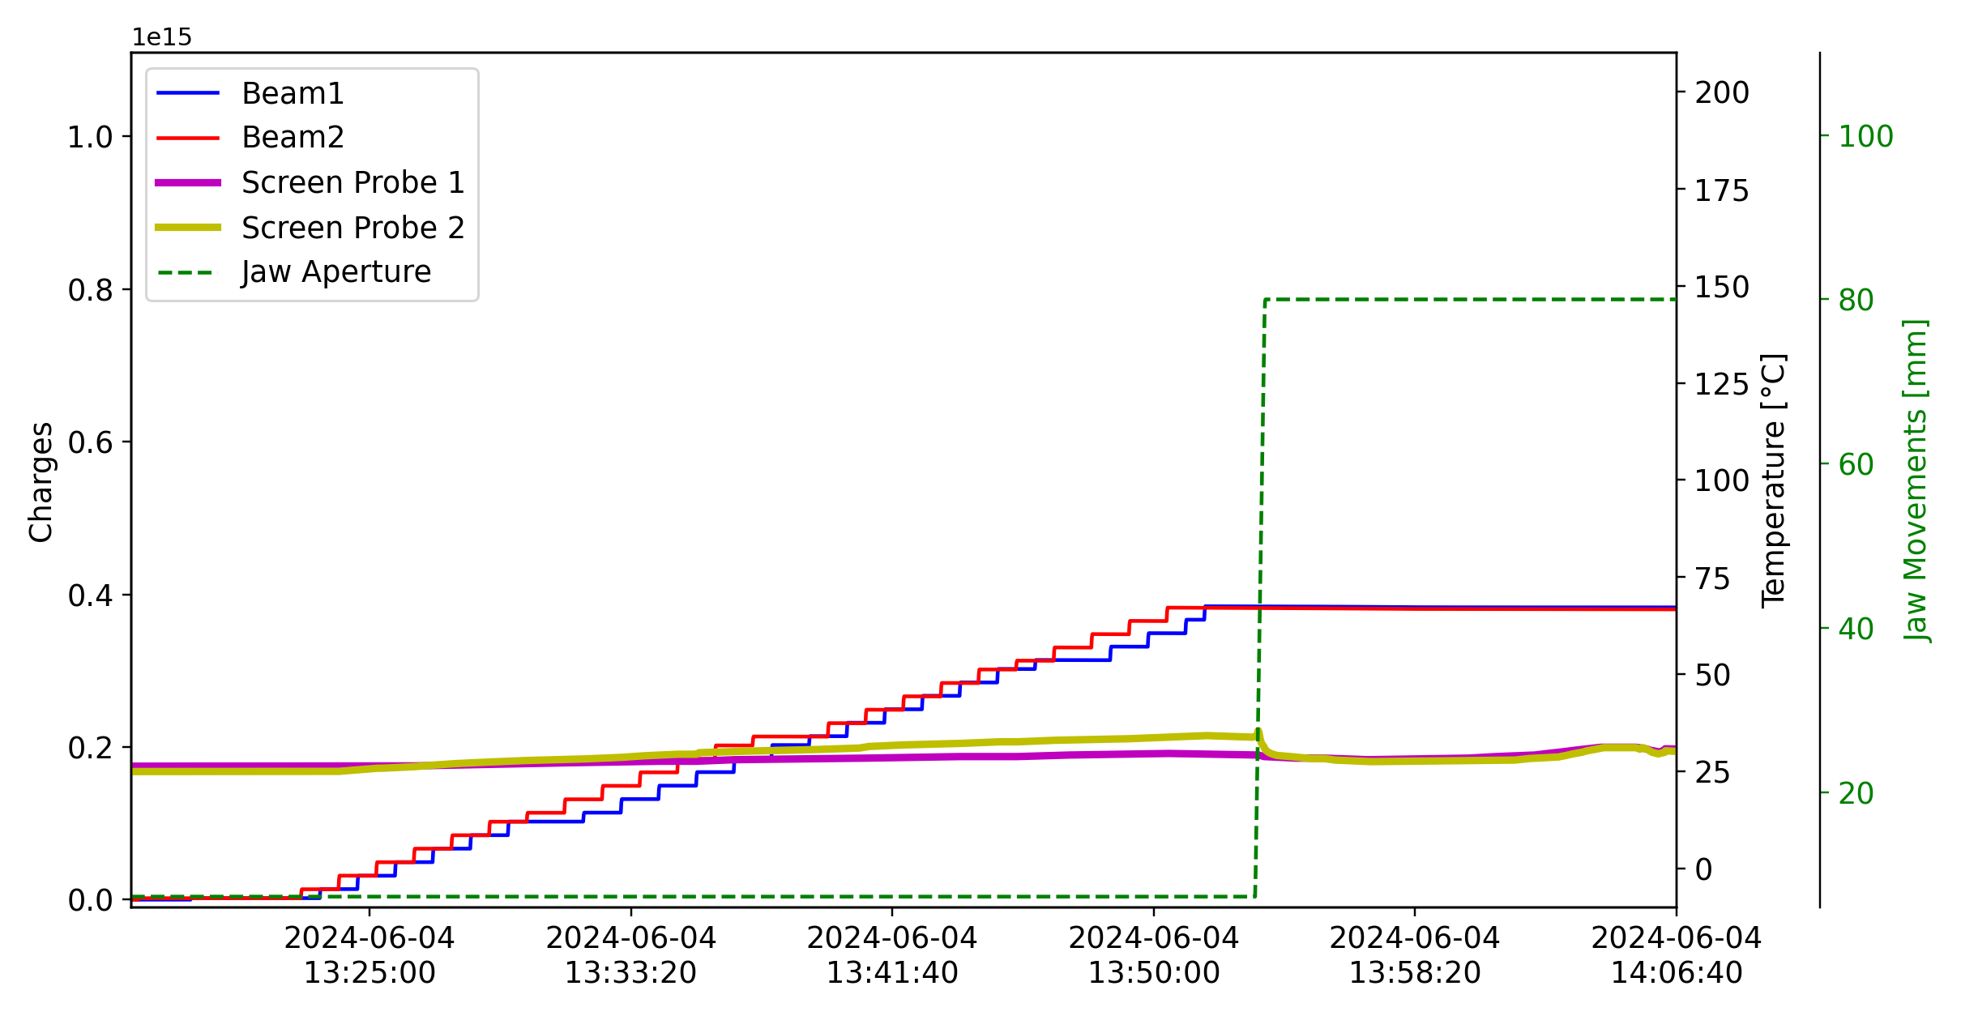
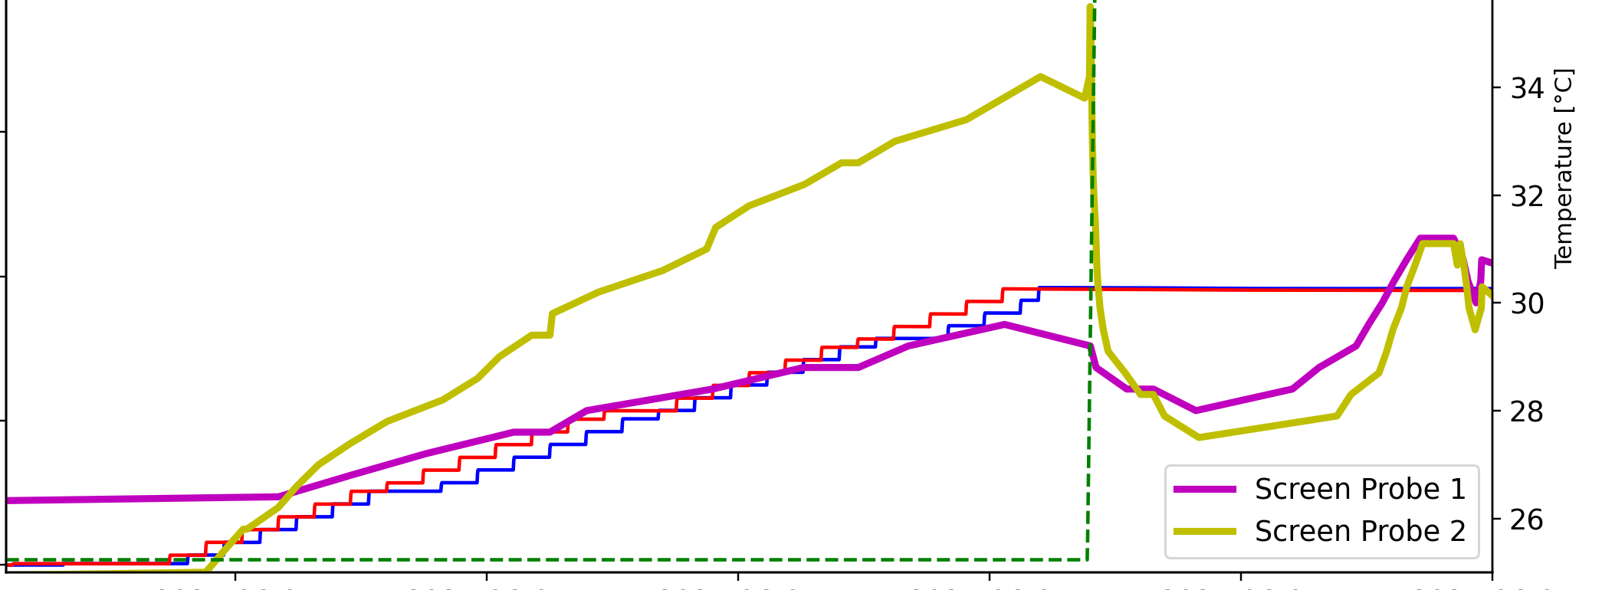
TDIS: 2023 Vs 2024
2023: Unexplained high temperature signals in the RF screen: caused interlocks and limited LHC filling
2024: significantly lower temperature signals in the RF screen: no limitations in the LHC operation
2023 TDIS: presence of non-conformities:
Partially lost finger contact
Spare TDIS were installed:
supposed to be identical to old 2023 TDIS
Different temperature readings behavior might come from non-conformity observed on 2023 TDIS

Slide 15
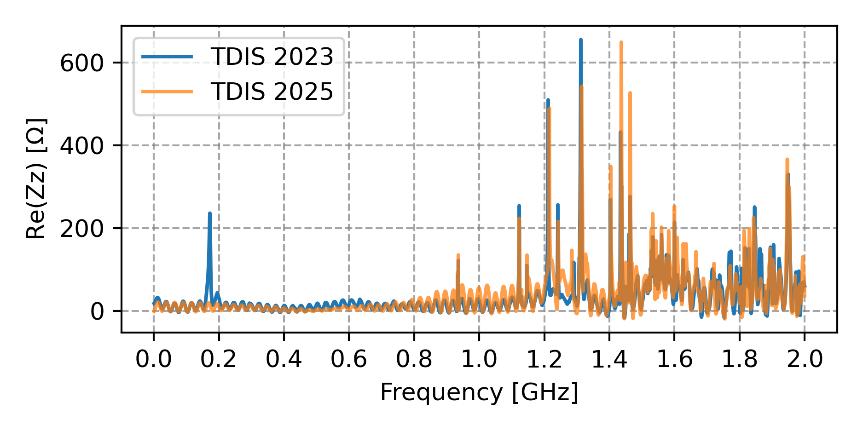
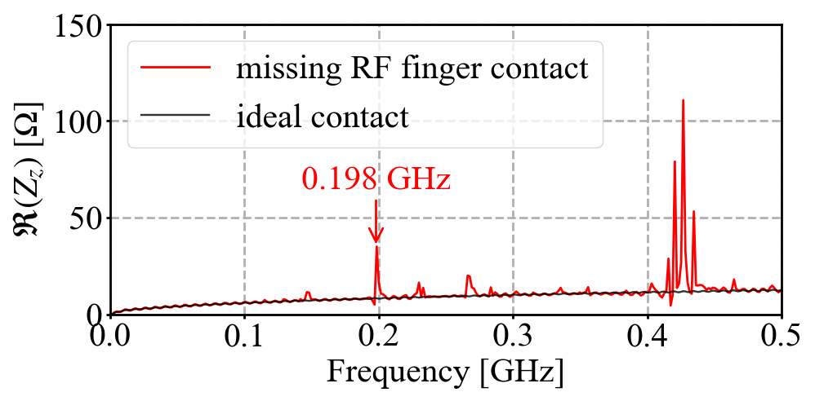

TDIS in 2025 Run
Impedance measurements
2025 TDIS will benefit of several improvements
Improved shielding of existing screen temperature probes
Two additional fully shielded screen temperature probes (same as MKIs)
Impedance measurements*:
Contrary to 2023, no correlations with jaw aperture, probe type and TDIS device
Moreover, the unexpected low frequency resonance not detected
Development of an accurate impedance model ongoing to investigate the issue (fine details such as RF fingers etc..)
Preliminary impedance studies in case of finger contact missing:
Presence of low frequency resonances
Beam induced power on the probe: factor 4 higher with missing contact
Preliminary model results
Courtesy of J. Li
Given the findings so far, the issue in 2023 seems to be correlated with the observed non-conformities
For conformal TDIS no impedance induced issues are expected
* L. Sito, TDIS impedance measurements presented at the 92nd IWG meeting

Slide 16
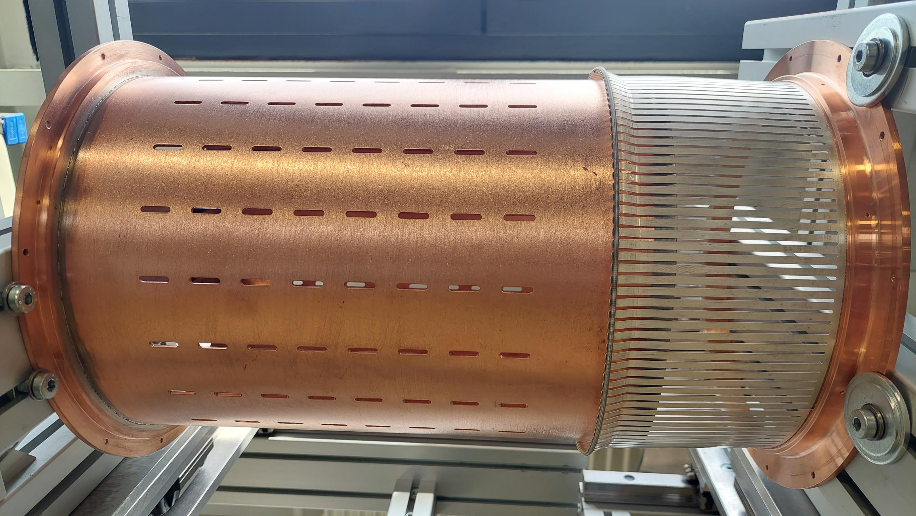
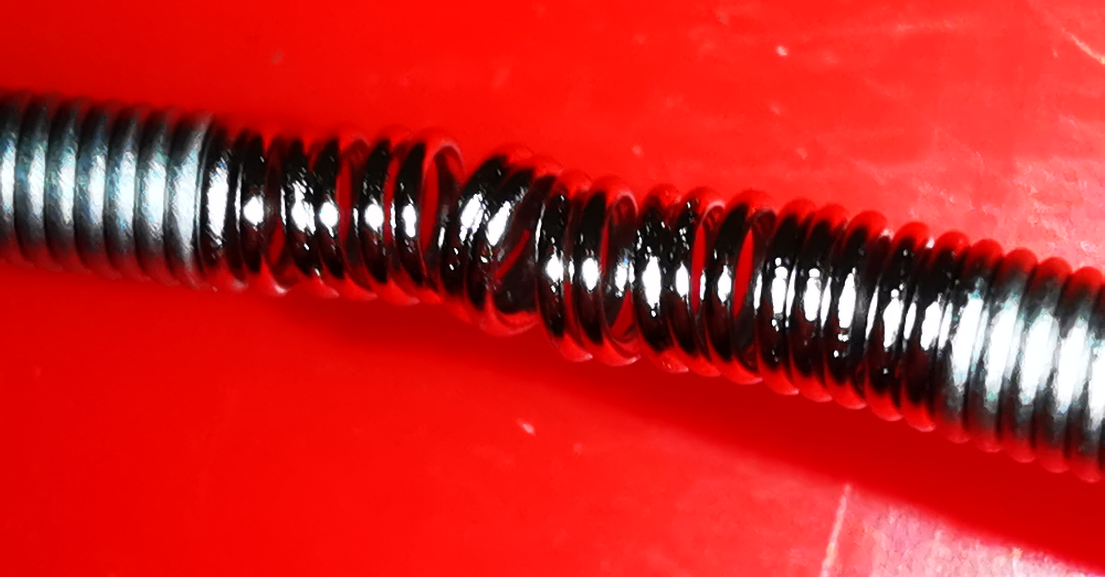
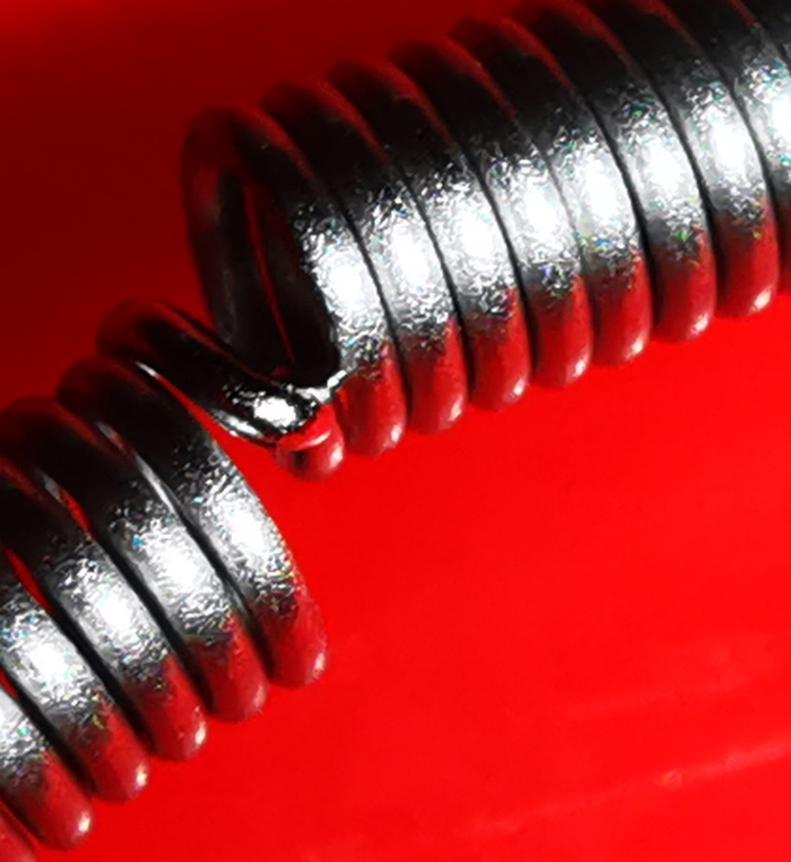
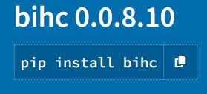
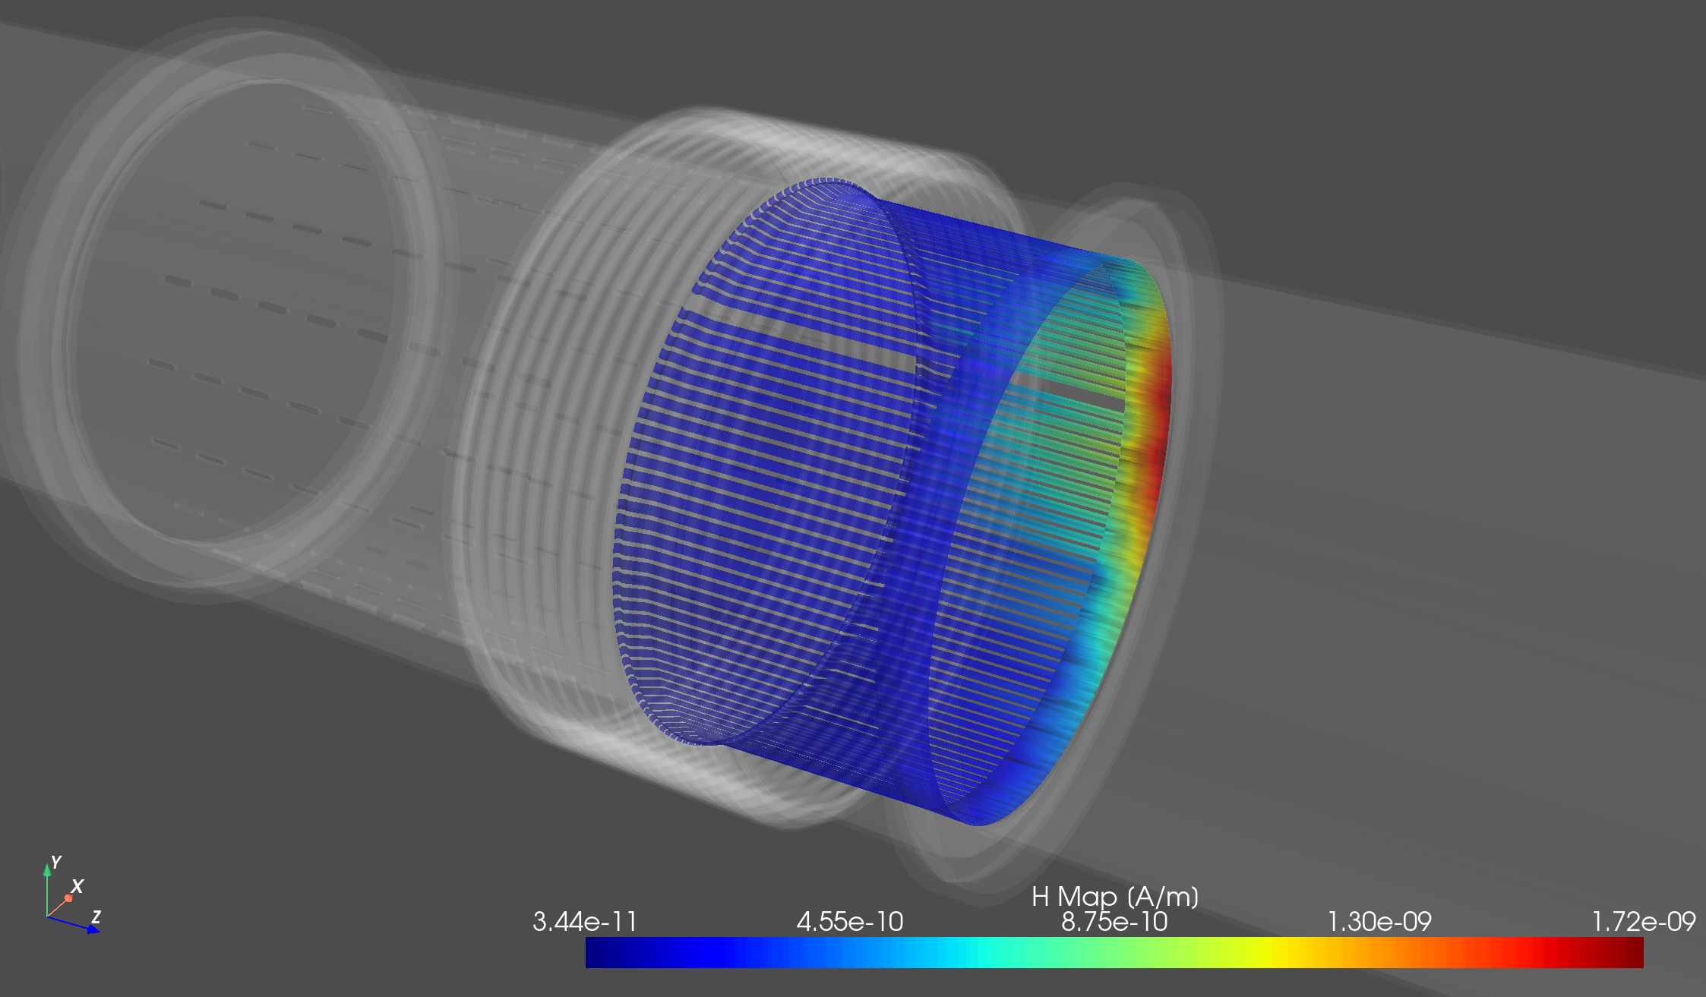

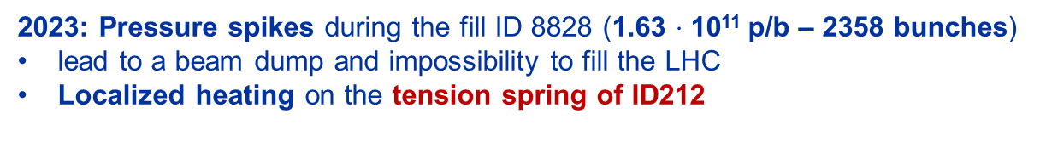
LHC vacuum module: incident and impedance understanding
2023: Pressure spikes during the fill ID 8828 (1.63 $⋅$ 10¹¹ p/b – 2358 bunches)
lead to a beam dump and impossibility to fill the LHC
Localized heating on the tension spring of ID212
ID212
Tension spring
RF fingers
1 week downtime for LHC
Pipe tube
Big effort to build an accurate impedance model to address the issue
impedance bench measurements
impedance simulations
Analytical computations*
2023 JAP talk, C.Antuono & P.Krkotic
Impedance studies revealed EM field leakage inducing localized heating on the spring compatible with the spring breakage
Presence of two beams
beam offset
defects/irregularities finger spacing
non ideal contact fingers/tube
In presence of
More info at the 2023 JAP talk-C.Antuono and P.Krkotic
beam
Intensity limitation posed to 1.6 $⋅$ 10¹¹ p/b
*E. de la Fuente et al. , A Python package for Beam Induced Heating

Slide 17
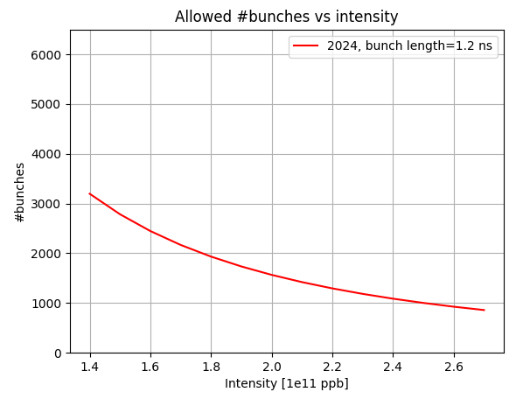

LHC vacuum module in 2024 Run
Deformable RF fingers (DRF)
Transformed anchored solution
Optimized unshielded bellows
Mitigation strategy:
beam operation:
intensity limitation at 1.6e11 p/b
interlock for bunch length lower than 1.2 ns (never achieved)
Replace/transform the 71 modules in the ID212 spring+fingers with newly designed modules wherever it is possible
More info at the 2023 JAP talk-C.Antuono and P.Krkotic
2023 Run…
YETS 23/24
YETS 24/25
71 ID212 modules
2024 run
24 ID212 with spring+fingers design
Calculations consider the failure reference heating given by the ID212 modules
2358
Intensity limitation posed to 1.6 $⋅$ 10¹¹ p/b
No pressure spikes or failure in 2024

Slide 18
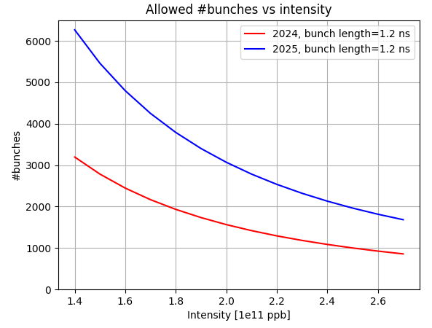
LHC vacuum module in 2025 Run
2023 Run…
YETS 23/24
YETS 24/25
71 ID212 modules
2025 run
4 modules with original spring+finger design of ID212
1 beam and smaller offset
Beam induced heating at least halved compared to the failure heating of the ID212

Slide 19
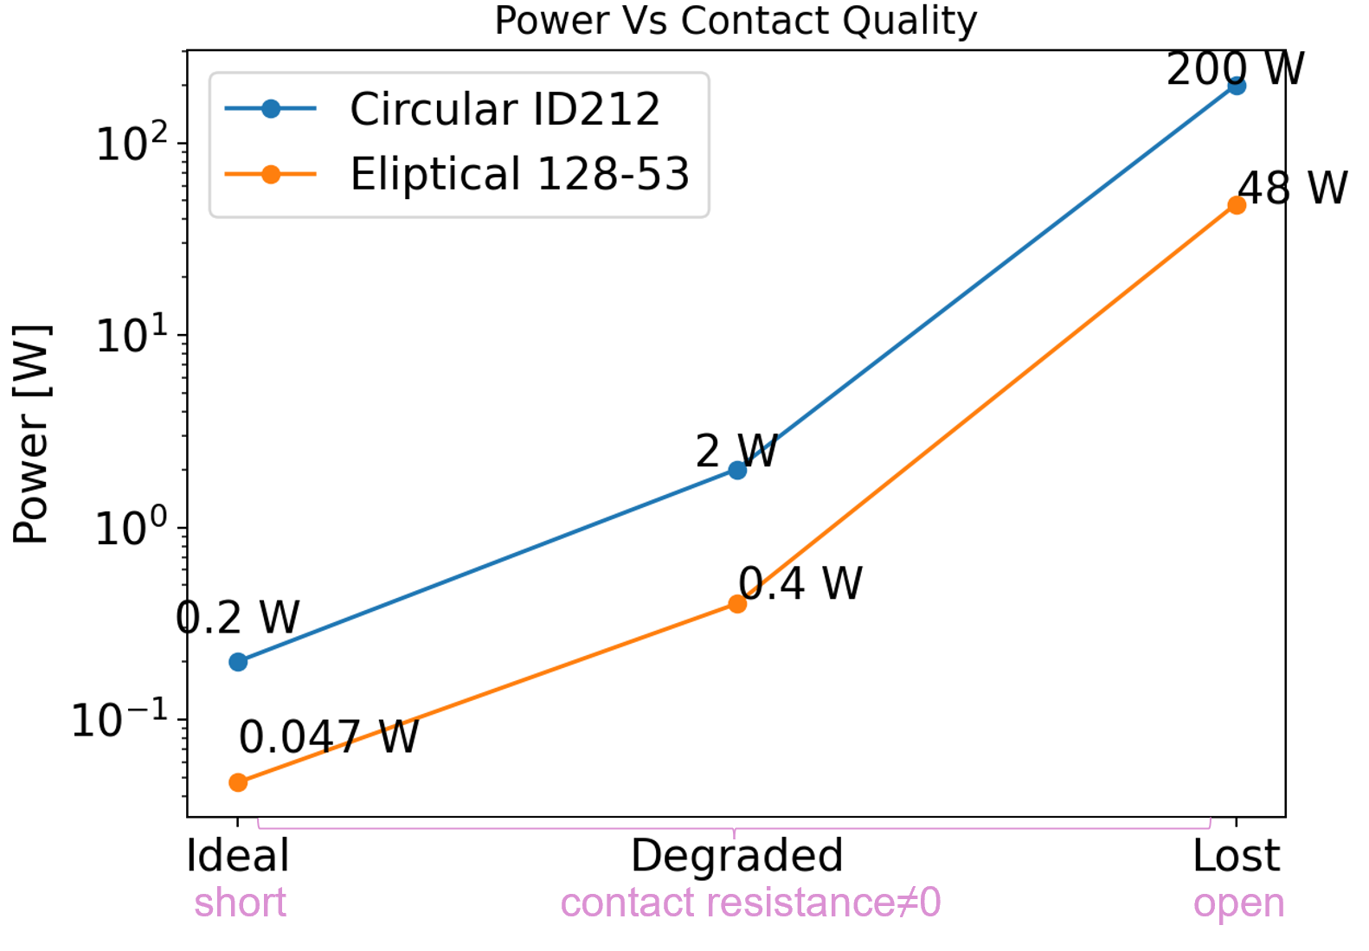
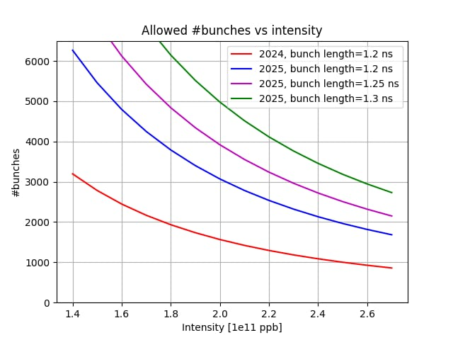
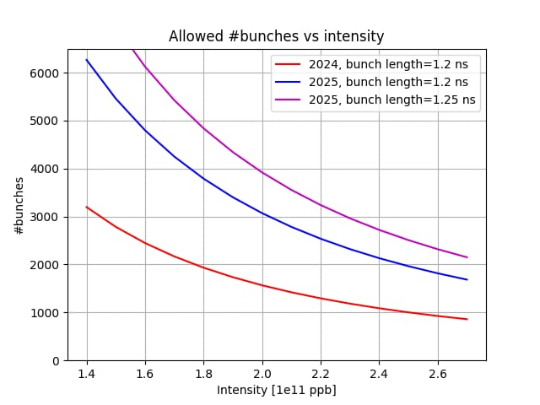
LHC vacuum module in 2025 Run
Do we expect failures from different modules in the critical design spring+fingers?
Smaller ID expected to be less critical (C. Zannini talk at Chamonix ‘24)
The most critical elliptical modules (bigger apertures 128-53)
significantly less critical compared to circular ID212
failure can still be reached depending on the contact quality
Expected failure range
The bottleneck is the circular ID212
These curves can be lifted up by removing the remained 4 ID212
2023 Run…
YETS 23/24
YETS 24/25
2700
71 ID212 modules
2025 run
2400
4 modules with original spring+finger design of ID212
1 beam and smaller offset
Beam induced heating at least halved compared to the failure heating of the ID212

Slide 20
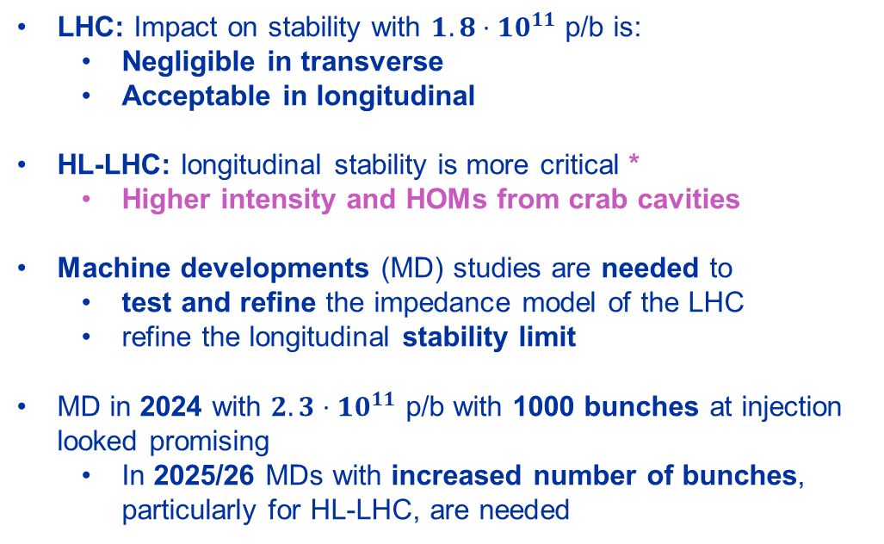
Impact on LHC impedance
Devices to be installed during YETS 24-25
LHC: Impact on stability with $1.8⋅10^{11}$ p/b is:
Negligible in transverse
Acceptable in longitudinal
HL-LHC: longitudinal stability is more critical *
Higher intensity and HOMs from crab cavities
Machine developments (MD) studies are needed to
test and refine the impedance model of the LHC
refine the longitudinal stability limit
MD in 2024 with $2.3⋅10^{11}$ p/b with 1000 bunches at injection looked promising
In 2025/26 MDs with increased number of bunches, particularly for HL-LHC, are needed
 | Longitudinal | Transverse
Unshielded bellows
DRFs
TWO CRYST
Rotated Roman Pots
CMS Double bellows
MKIs-cool
Vacuum module consolidation
Double crystal experiment in IR3
In only for low Intensity-MDs
In only with stable beams
To be filled, ongoing
*M. Zampetakis's talk at the HiLumi annual meeting
*C. Lannoy’s talk at the HiLumi annual meeting

Slide 21
Conclusions
Beam impedance limitations observed in the LHC and injectors during RUN 3
 | 2023
Unshielded pumping manifold
Rotary wire scanners
Vacuum module
TDIS
2023
2024
PS
Not limited beam operation with no hardware damage
SPS
Limited beam operation with no hardware damage
LHC
Limited beam operation with hardware damage

Slide 22
Conclusions
Beam impedance limitations observed in the LHC and injectors during RUN 3
Most of them have been addressed, particularly thanks to the development of accurate impedance models
 | 2023
Unshielded pumping manifold
Rotary wire scanners
Vacuum module
TDIS
2024
PS
Not limited beam operation with no hardware damage
SPS
Limited beam operation with no hardware damage
LHC
Limited beam operation with hardware damage

Slide 23
Conclusions
Beam impedance limitations observed in the LHC and injectors during RUN 3
Most of them have been addressed, particularly thanks to the development of accurate impedance models
 | 2023 | 2024
Unshielded pumping manifold
Rotary wire scanners
Vacuum module
TDIS
2025/26
PS
Not limited beam operation with no hardware damage
SPS
Limited beam operation with no hardware damage
LHC
Limited beam operation with hardware damage
Others… | 2023 | 2024 | 2025/26
Extraction kicker KFA14
MKP-S
Beam Gas Ionization (BGI)
MKDH
IR7 crystal goniometers
Injection kicker MKI-cool
TCLD
Not expected limitations for 1.8e11 p/b
PSB
Not expected limitations for MDs with 2.3e11 p/b at inj.
SPS
To be followed up for Run 3
To be followed up for HL
LHC
- Mitigation studies (e.g. hardware modifications etc.)
- Continuous monitoring
- Finalizing understanding
- Finalizing installations
The release of $1.8⋅10^{11}$ p/b is a key step to further exploit possible limitations during the remaining time of Run 3
MDs with $2.3⋅10^{11}$ p/b at injection provide valuable input for refining impedance models and stability limit
Step forward the readiness of HL-LHC

Slide 24
Backup

Slide 25
Backup

Slide 26
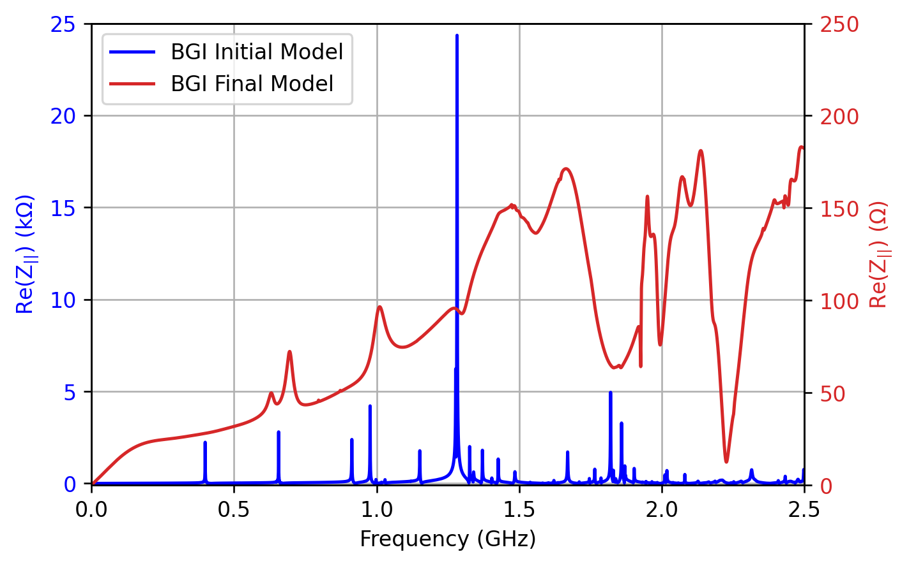
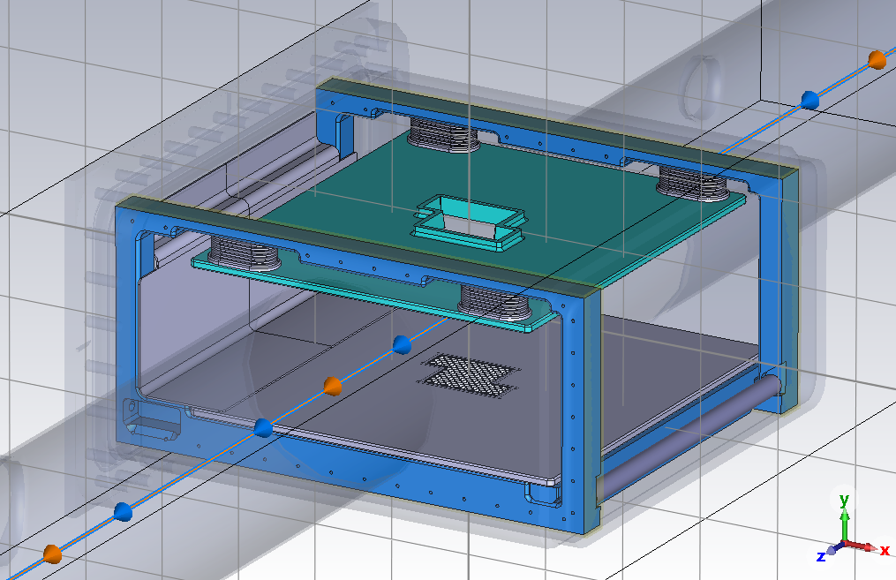
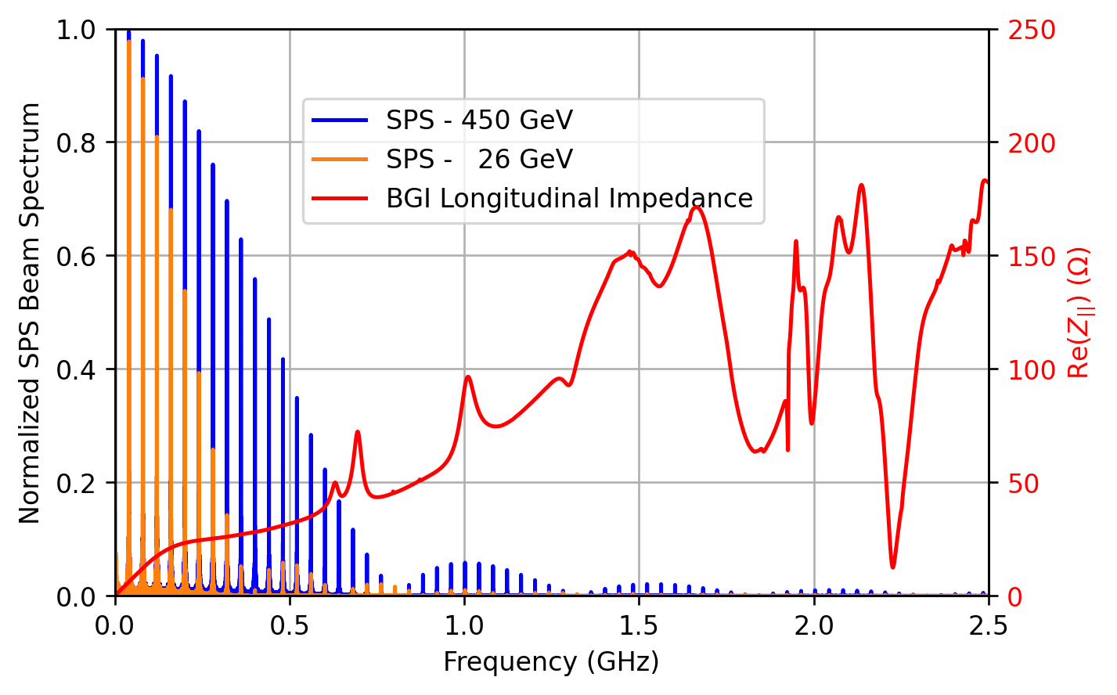
SPS-BGI Impedance Study
NEG coated ceramic cathode
Titanium coated ceramic rod
Info from BI team
Impedance reduction of the beam gas ionization monitors for the CERN SPS
Simulation and RF Measurement Report to Determine the Longitudinal Beam Coupling Impedance in the SPS-BGI
Courtesy of H. Bursali and J. Storey

Slide 27

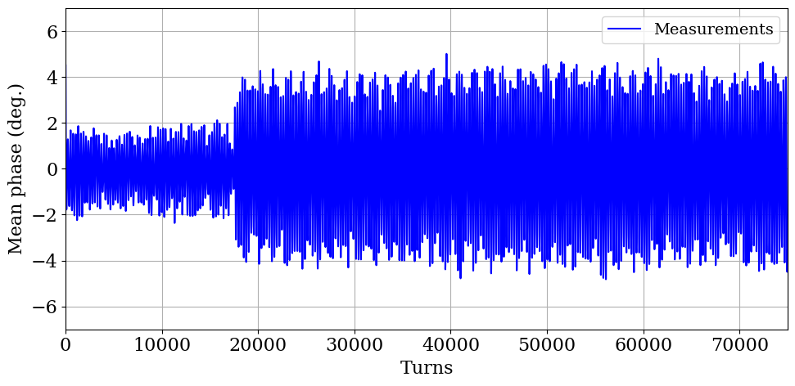
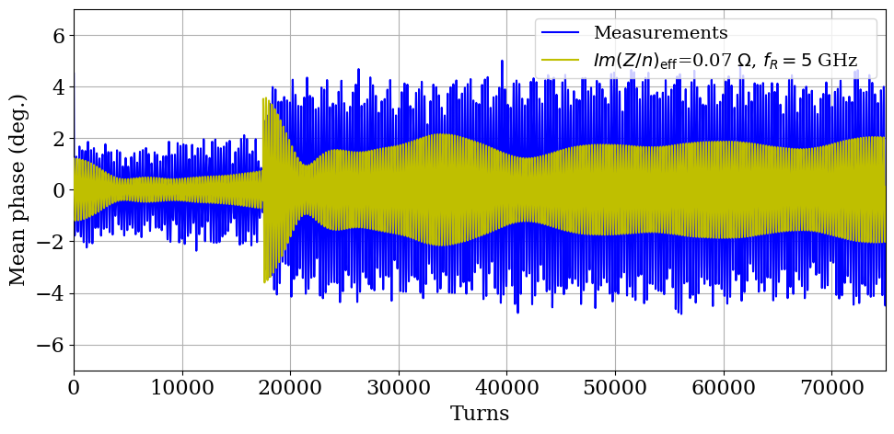
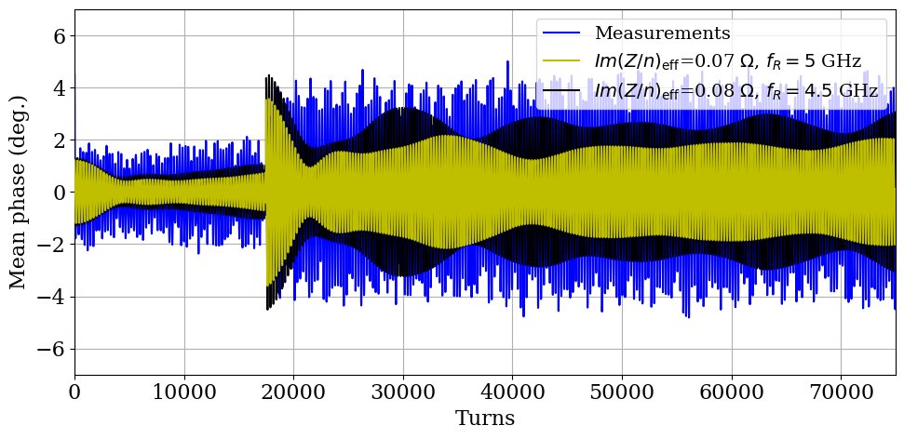
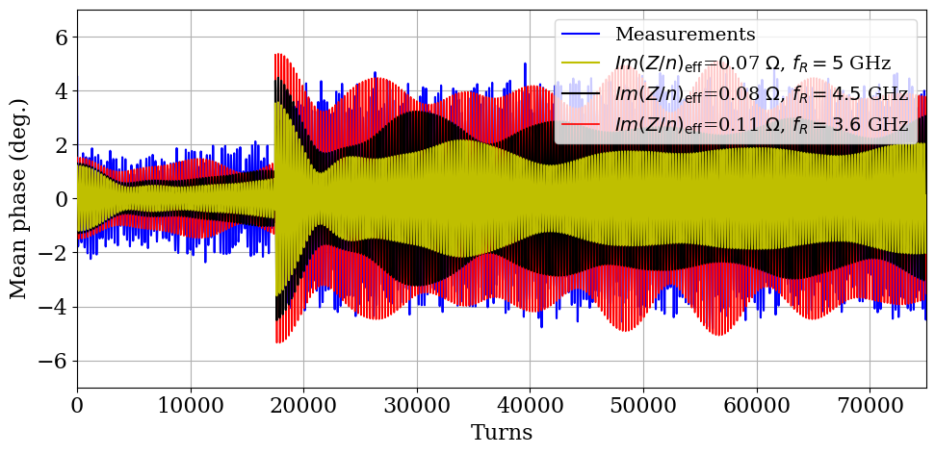
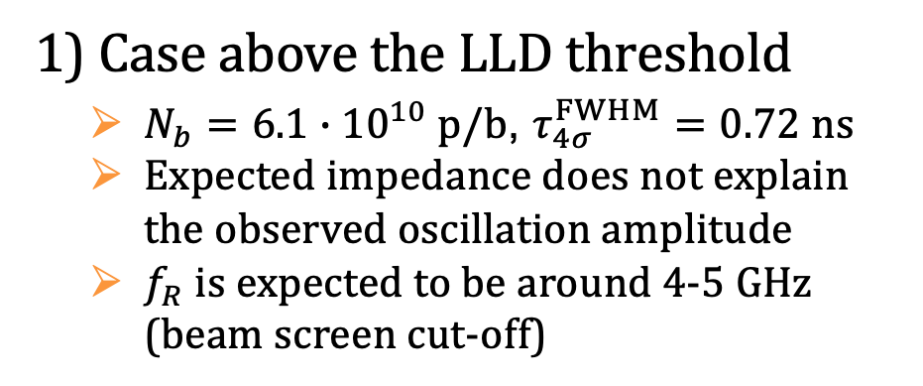
Comparison with simulations
1) Case above the LLD threshold
$N_{b}=6.1∙{10}^{10} p/b$, $τ_{4σ}^{FWHM}=0.72 ns$
Expected impedance does not explain the observed oscillation amplitude
$f_{R}$ is expected to be around 4-5 GHz (beam screen cut-off)
Courtesy of M. Zampetakis

