Slide 1
BGI AOB:
Awake and LHC25ns beam spectrum
IWG #95
Elena, Leo, Benoit, Carlo

Slide 2
SPS beam parameters
LHC25NS:
  4x72 bunches (288)
  Intensity per bunch: e.g., 2.1e11 p/b
  Total intensity ~ 6e13 p
  Bunch length: 1.65 @FlatTop,
    Shape Gaussian/q-Gaussian(q<1)
AWAKE*:
  Single bunch
  Intensity: 3e11 p
  Bunch length:
    Injection: 4ns, shape gaussian(?)
    No bunch rotation: 1.5 ns
    Bunch rotation: 0.8 ns, shape parabolic
LHC3 (operational):
  3x36 bunches (108)
  Intensity per bunch 1.7e11 p/b
  Total intensity ~ 1.8e13 p
  Bunch length: 1.65 @FlatTop,
    Shape: Gaussian/q-Gaussian(q<1)
SFTPRO**:
  4200 bunches in 5ns slots
  Intensity per bunch: 6e9 p/b
  Total intensity ~ 2.5e13 p
  Bunch length: 1ns @FlatTop, shape parabolic
*Based on: I. Karpov's presentation https://indico.cern.ch/event/1434561/ , to be confirmed
**Discussed with Ingrid, to be confirmed

Slide 3
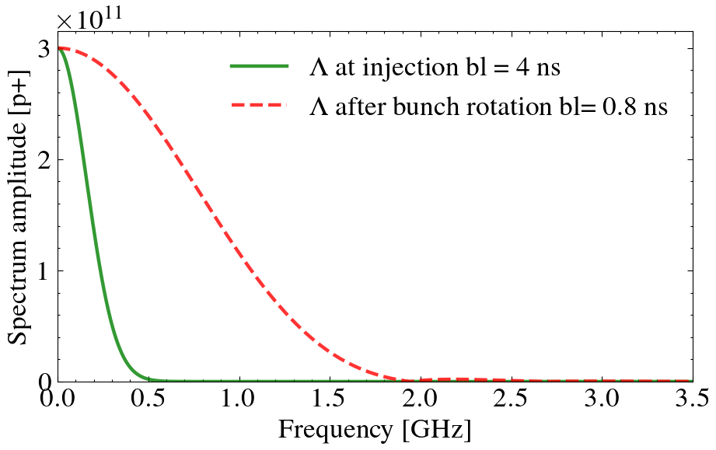
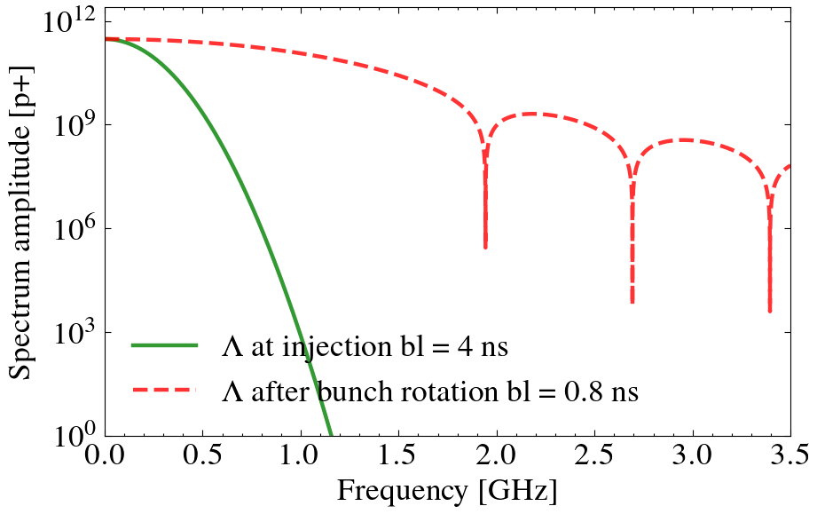
AWAKE injection and after bunch rotation
Linear scale
Log scale

Slide 4
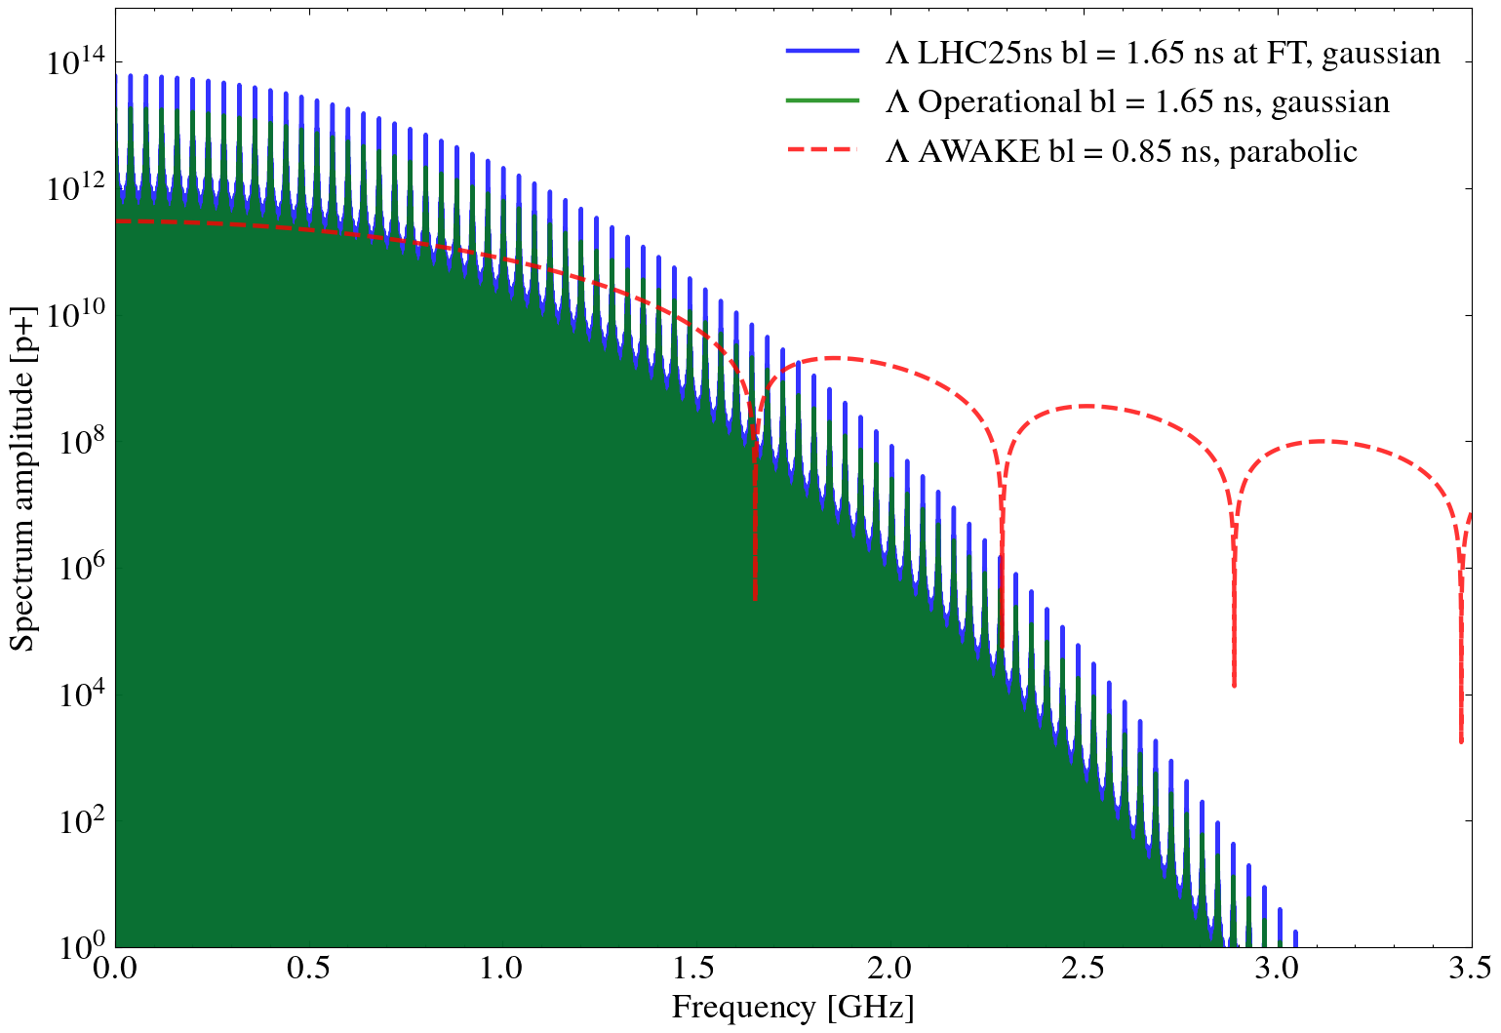
LHC25ns vs Operational vs AWAKE

Slide 5
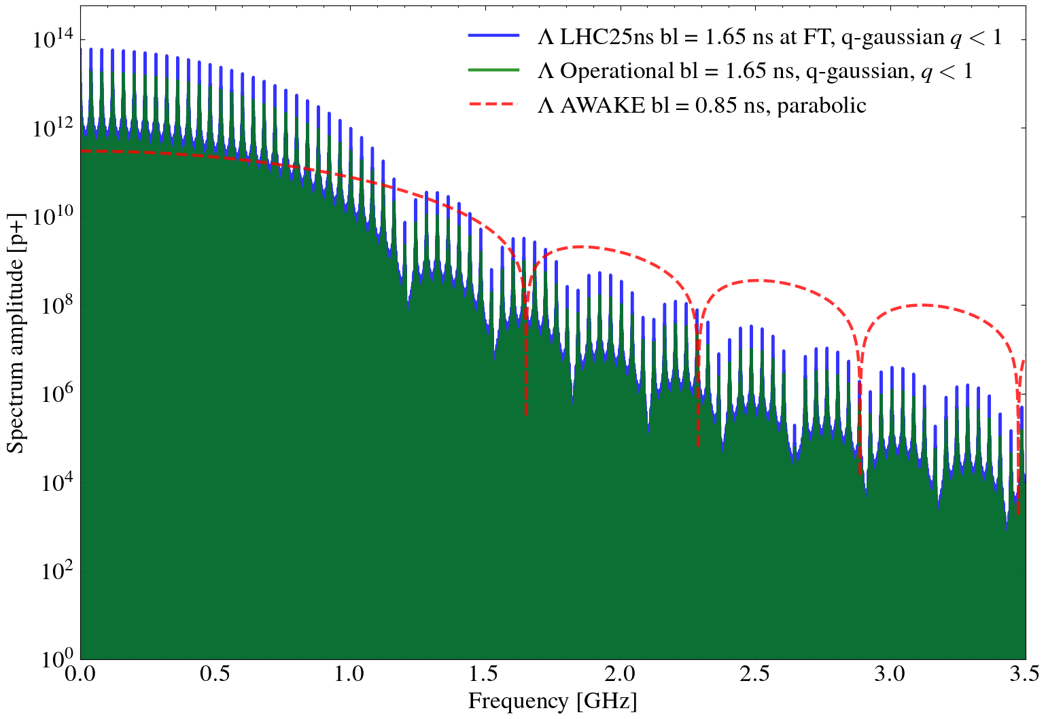
LHC25ns vs Operational vs AWAKE

Slide 6
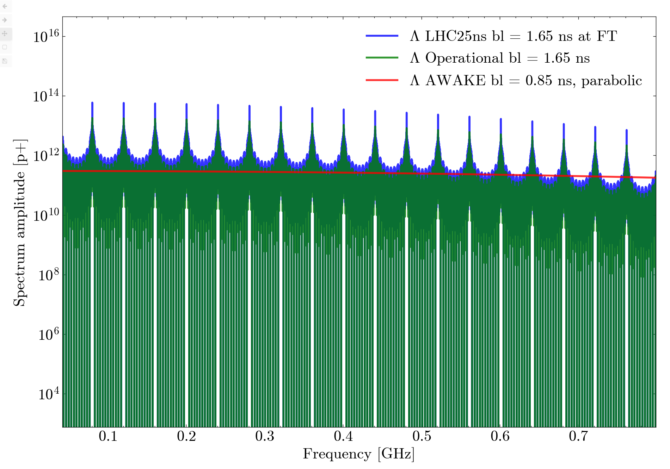
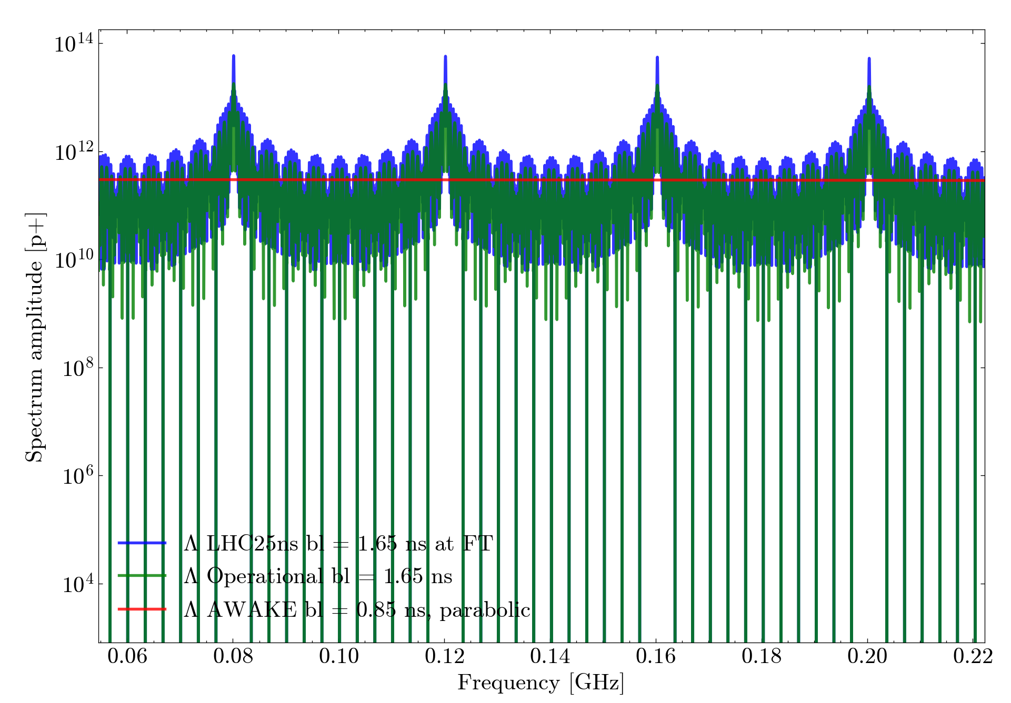
Extra: Zooms on the spectral lines

Slide 7
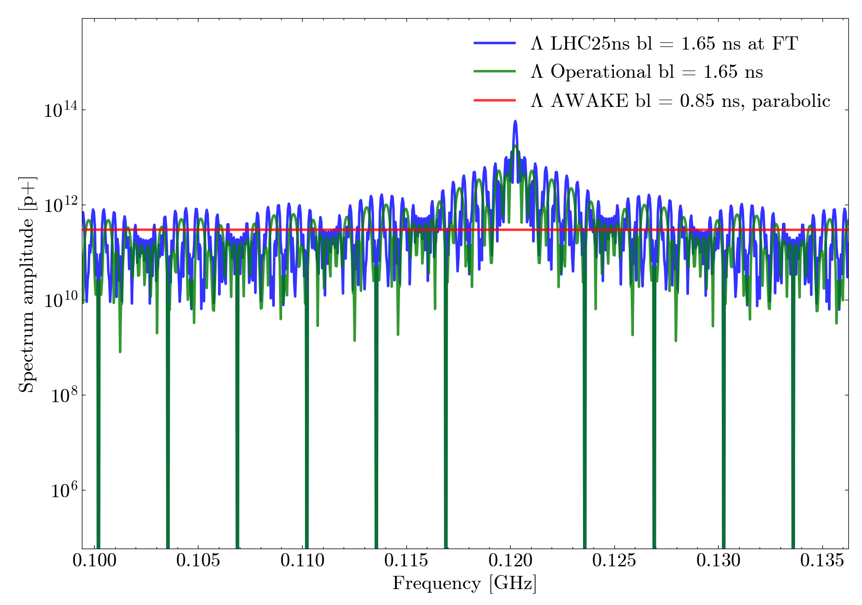
Extra: Zooms on the spectral lines

