Slide 1




Emittance Tuning of the FCC-ee high energy booster
Q. Bruant, B. Dalena, T. Da Silva, A. Chancé (CEA irfu and Paris-Saclay University)
A. Ghribi (GANIL, CNRS)
A. Mash’al (IPM)
Thanks to: J.Dilly, R. Tomas, K. Oide, M. Hostettler, D. Gamba, E. Fol
 |  | FCCIS – The Future Circular Collider Innovation Study. This INFRADEV Research and Innovation Action project receives funding from the European Union’s H2020 Framework Programme under grant agreement no. 951754.

Slide 2
Outline
Emittance Tuning Strategy
Errors assignments (with girders)
Results
Conclusion & further steps

Slide 3
Correction Strategy
Orbit (LHC-like scheme):
if MQ (de)foc -> BPM reads in horizontal (vertical) and CORR corrects in horizontal (vertical)
CORRs & BPMs of the arcs and few more CORRs& BPMs of the straight sections used for the segment by segment (=SbS, done arc by arc)
Procedure:
Sextupoles turned OFF
  SbS
  We use 2 iterations of orbit correction in line on all arcs
  Iteration of orbit correction in ring mode
  Coupling (f1001, f1010) and Dy correction with 568 skew quad placed at sextupoles (superKEKB)
Phase advances and tunes correction correction with 560 quad placed at F2D2 families of the arcs
Sextupoles turned ON
  1 iteration of orbit correction in ring
  4 iterations:
    Orbit correction in ring mode
    Coupling (f1001, f1010) and Dy correction
    Phase advances and tunes correction

Slide 4
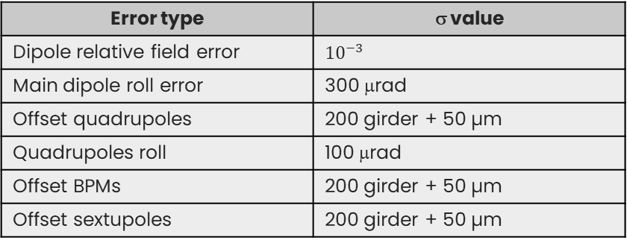
Errors
Error type | σ value
Dipole relative field error | $${10}^{−3}$$
Main dipole roll error | 300 μrad
Offset quadrupoles | 200 girder + 50 µm
Quadrupoles roll | 100 μrad
Offset BPMs | 200 girder + 50 µm
Offset sextupoles | 200 girder + 50 µm
All errors are randomly distributed with ± 3 Gaussian rms.
BPM
MS
MQ
= skew quad corrector
= normal quad corrector (trim)

Slide 5
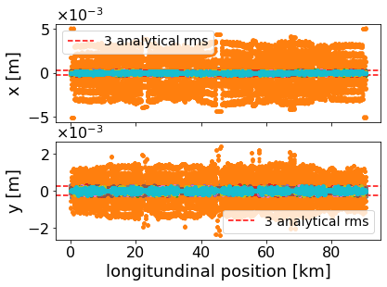
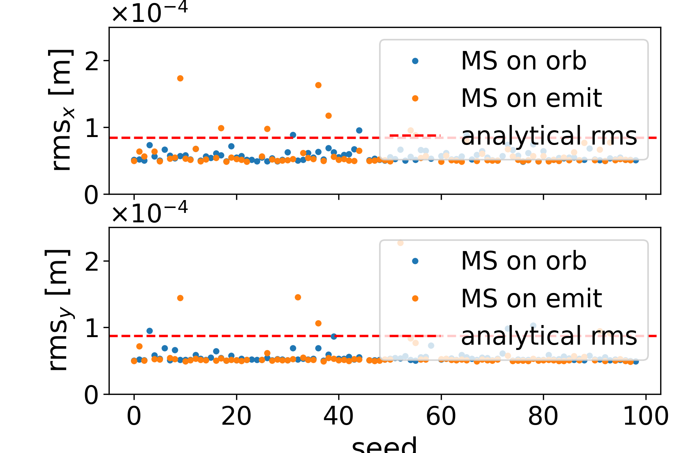
Orbit
SEED
80 successful seeds

Slide 6
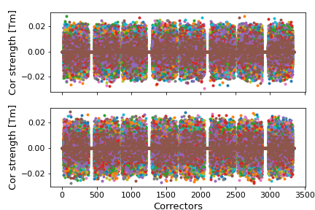
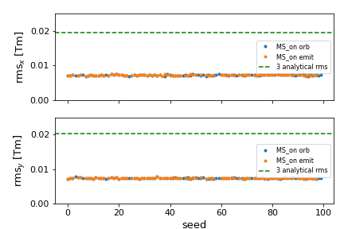
Correctors strength
80 successful seeds

Slide 7
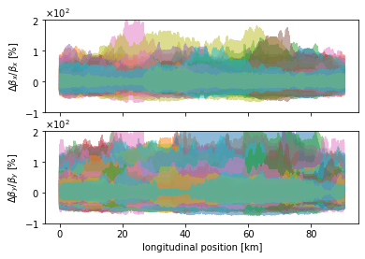
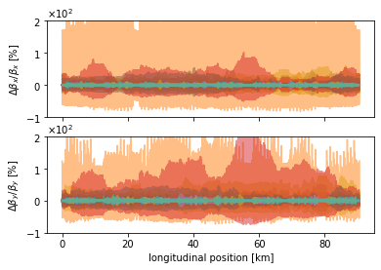
Beta-beating
80 successful seeds

Slide 8
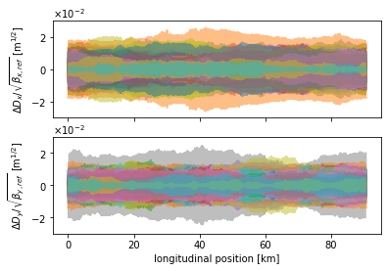
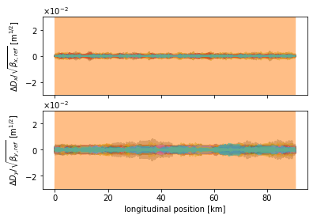
Normalized dispersion
80 successful seeds

Slide 9
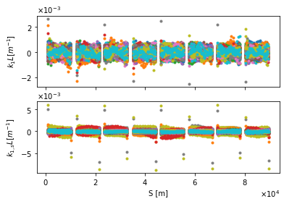
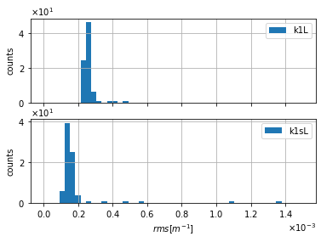
Normal and skew correctors strength

Slide 10
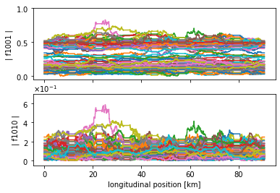
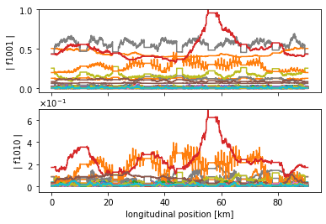
RDTs

Slide 11
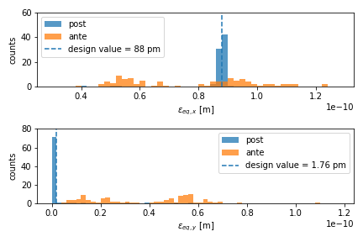
Equilibrium Emittance
80 successful seeds

Slide 12
Conclusion and perspectives
Main results:
The correction via iteration of the response matrix proved to be powerful but lack of stability (80 seeds out of 100)
The coupling is corrected for most of the 80 seeds
Equilibrium emittance is brought back to the target values for almost all the 80 seeds
The orbit excursions is worst for few seeds, after the emittance tuning.
Perspectives:
Ramping the sextupoles' strength instead of ON/OFF
Improve the correctors positions, numbers, etc...
Speed up the computation of response matrix (parallelisation, analytic computation, …)
Detect and use correlations between correctors to limit the problem's dimensionality

Slide 13
Thank you for your attention....

