Slide 1


Elliptical cavities simulations for MuCol
Sophie Pierron
Dec. 10th 2024

Slide 2
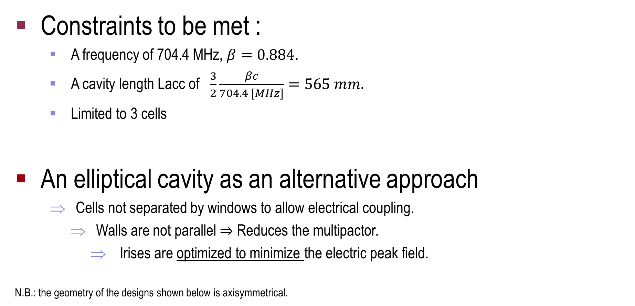
Elliptical cavities simulations for MuCol
Constraints to be met :
  A frequency of 704.4 MHz, $β=0.884$.
  A cavity length Lacc of $\frac{3}{2}\frac{βc}{704.4 [MHz]}=565 mm.$
  Limited to 3 cells
An elliptical cavity as an alternative approach
Cells not separated by windows to allow electrical coupling.
Walls are not parallel $⇒$ Reduces the multipactor.
Irises are optimized to minimize the electric peak field.
N.B.: the geometry of the designs shown below is axisymmetrical.

Slide 3
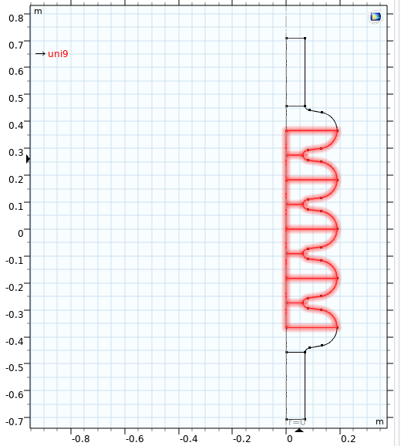
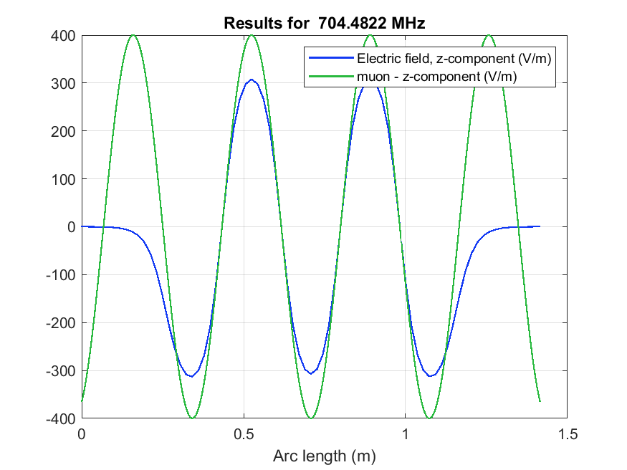
Design ESS, a 5 cells cavity – as reference
an alternative approach
β= 0.86 and the resonant frequency is closed to 704 MHz.
ESS cavities designed to minimize Epeak/Eacc .
Elliptical cells (walls are not parallel):
ESS | Comsol
frequency [MHz] | 704.48 MHz
High beta, β | 0.86
Q0 | Not simulated
Epeak/Eacc | 1,89990683
Bpeak/Eacc | 4.36 E-09 s/m
R/Q [Ω] | 455.84896
cavity end
inner_rint = 62 mm
end_rint = 70 mm
rext = 189 mm
Lacc = 915.05
cavity center
cavity end
N.B.: rint for the inside radii of the cavity,
rext, for the extrern ones.

Slide 4
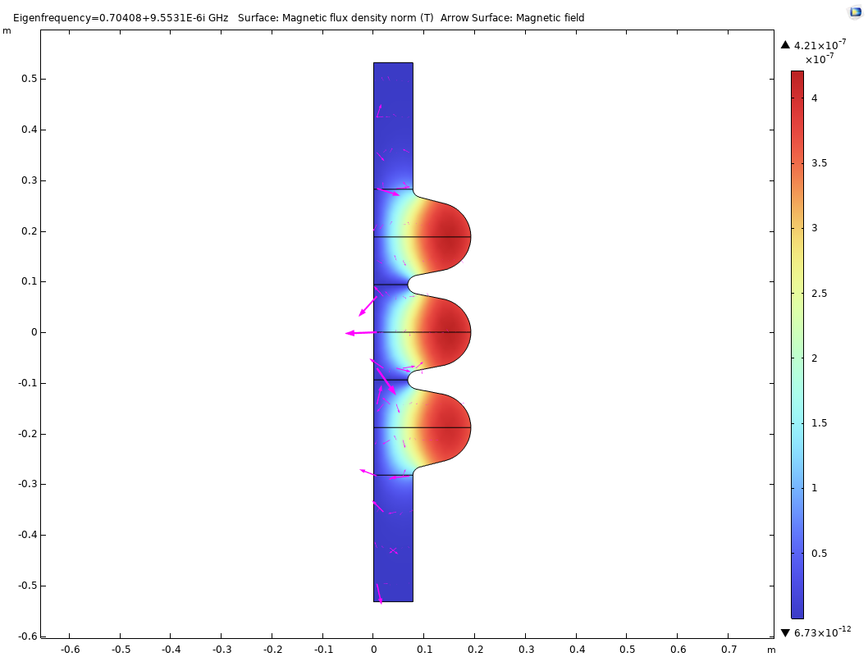
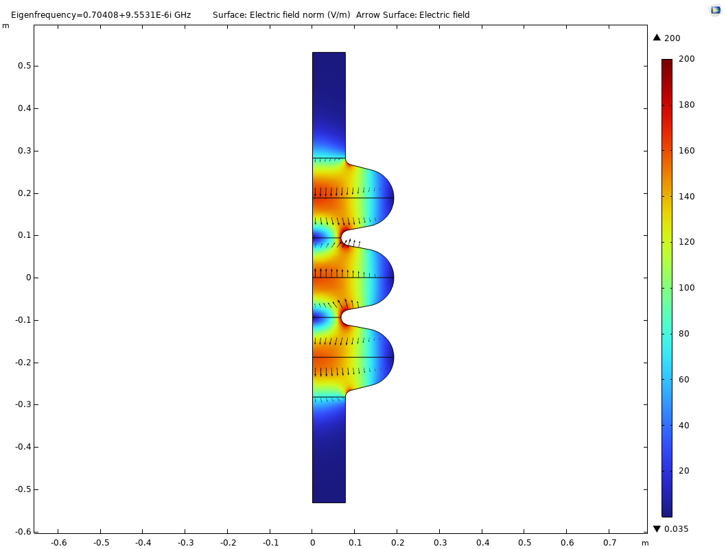
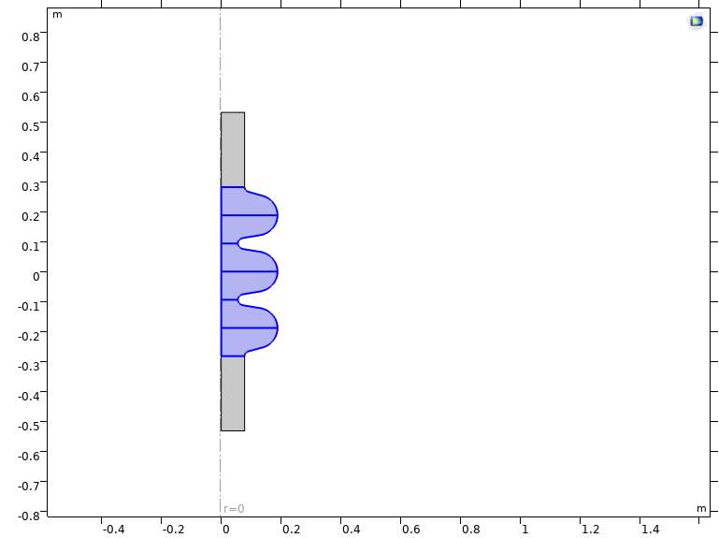
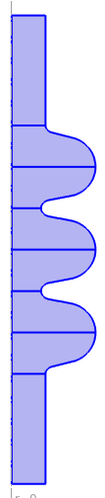
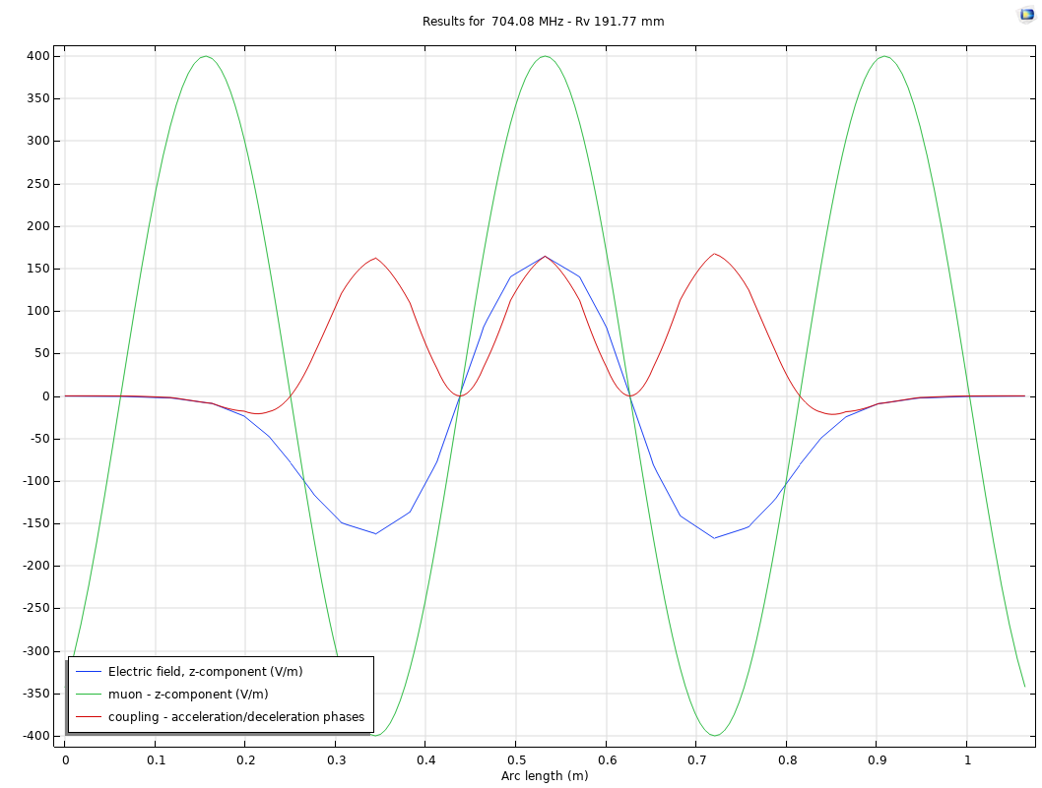

Design with a 3 cells cavity
an alternative approach
- Same elliptical cavity, with β= 0.884, only 3 cells.
With tubes at both ends:
inner_rint = 62.72 mm
end_rint = 77.5 mm
rext = 191.77 mm
Lacc = 3Lcell
where Lcell = $\frac{1}{2}$ $\frac{\text{β}\text{∗}\text{c}}{\text{704}\text{.}\text{4} \text{MHz} }$
Magnetic field (T)
Electric field (V/m)
MuCol 3cells | Comsol
frequency [MHz] | 704.08 MHz
High beta, β | 0.884
Q0 | Not simulated
Epeak/Eacc | 1.9366
Bpeak/Eacc [s/m] | 4. 463 E-09
R/Q [Ω] | 274.1516
N.B.: This is an axisymmetric geometry.
- The walls are in copper.

Slide 5
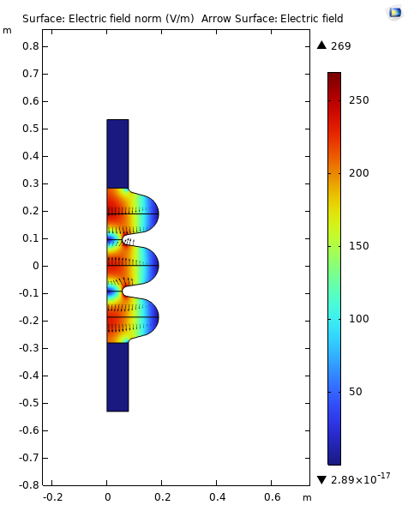
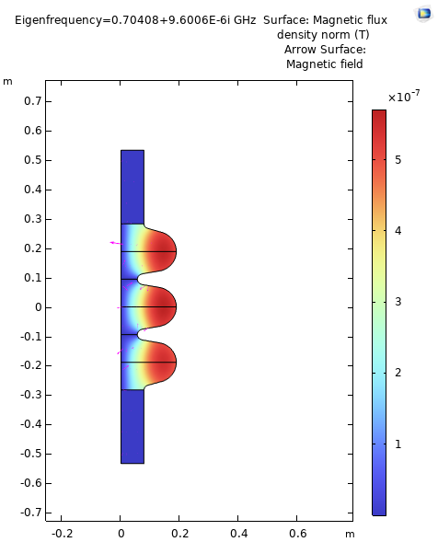
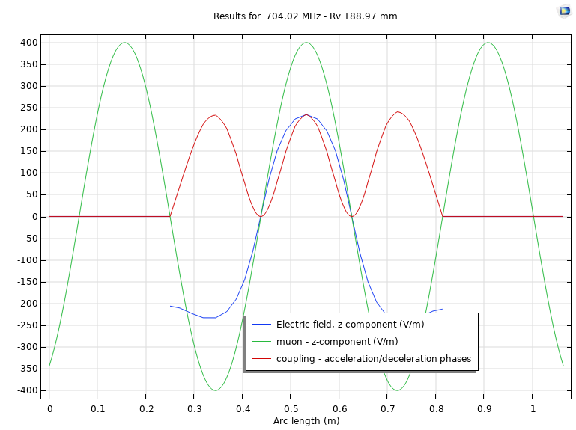

Design with a 3 cells cavity + Windows
an alternative approach
- Same elliptical cavity, with β= 0.884 and 3 cells but
closed by two windows in Al.
Without tube:
inner_rint = 55.5 mm
end_rint = 78 mm
rext = 188 mm
Lacc = 3 Lcell
where Lcell = $\frac{1}{2}$ $\frac{\text{β}\text{∗}\text{c}}{\text{704}\text{.}\text{4 }}$
Magnetic field (T)
Electric field (V/m)
MuCol 3cells | Comsol
frequency [MHz] | 704.08 MHz
High beta, β | 0.884
Q0 | Not simulated
Epeak/Eacc | 1.8822
Bpeak/Eacc [s/m] | 4. 01 E-09
R/Q [Ω] | 349.41
N.B.: This is an axisymmetric geometry.
The walls are in copper
If the tubes still exist, the RF cavity is enclosed by two Al windows (at either end).

Slide 6
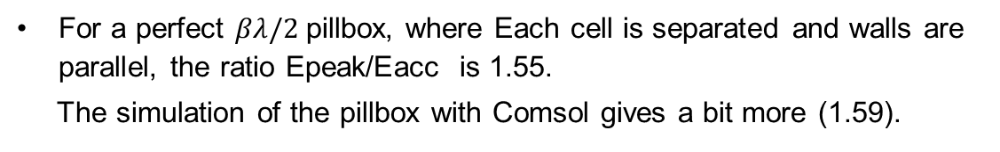
Comparative work
an alternative approach
Comsol | Epeak/Eacc
1 cell pillbox | 1.59
ESS 5 cells | 1.8999
3 cells w. tubes | 1.9366
3 cells w.o. tube | 1.8822
For a perfect $βλ/2$pillbox, where Each cell is separated and walls are parallel, the ratio Epeak/Eacc is 1.55.
The simulation of the pillbox with Comsol gives a bit more (1.59).
In an electrically coupled system, the Epeak/Eacc ratio increases compared with a pillbox cavity, which however does not allow electrical coupling.
Enclosing the 3 cells reduces this ratio from 19.4% to 18.8%.
So, for an electrically coupled system, the 3-cell elliptical cavity with windows gives a “good” Epeak/Eacc ratio.

Slide 7
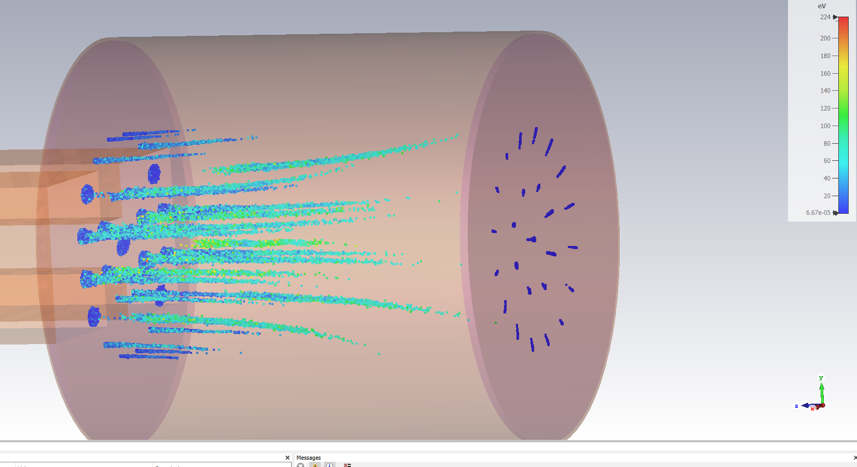
Simulation of field emission/breakdown
Next step: Simulating the field emission with an elliptical 3 cells cavity and a pillbox cavity.
We are working with CST to simulate flows of particles.
Simulation of electrons with constant DC E field.
Simulation of electrons in an ECR ion source at 2.45 GHz.

Slide 8
Questions?
…

