Slide 1


FoCal-H cooling system
Maciej Czarnynoga
on behalf of ALICE-FoCal collaboration
19/12/2024

Slide 2
System structure
FoCal cooling system
FoCal-E cooling system
FoCal-H cooling system
FoCal-E active volume cooling system
FoCal-E readout electronics cooling system
Electronics cooling system
SiPMs thermal stabilization system
FoCal-E pixel Readout crates cooling system

Slide 3
Basic design requirements for electronics CS
Remove all heat generated by FoCal-Hfront-end electronics,
Electronics should stay on ambient temperature ≈20 °C,
System works with overpressure coolant and is a part of the focal cooling plant,
High reliability,
The system should be easy to assemble,
Minimization the numer of active components of the system,
Minimization the number of sensors needed to monitor the system - details need to be decided,
Standardization of cooling elements (e.g. for bPOL),

Slide 4
Design assumption-heat generation
To calculated 800W, we added an additional 400W to account for a secondary system or potential changes to the current system. For further calculation, we assume 1200W must be removed by the cooling system.

Slide 5
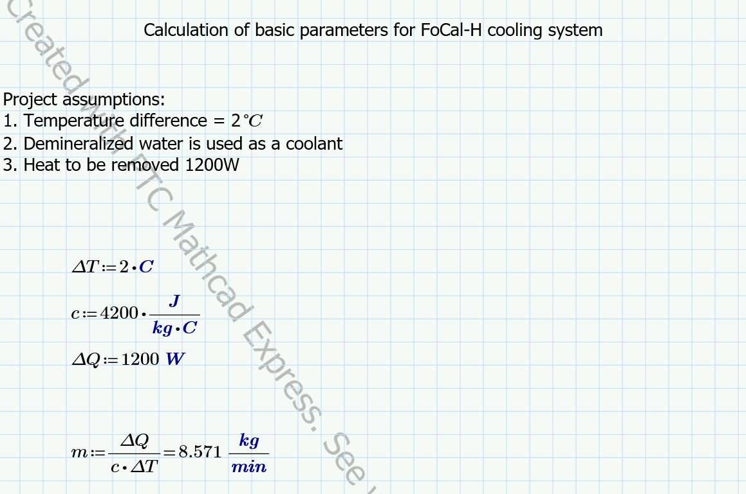
System working parameters - request coolant flow

Slide 6
System working parameters
Flow = 8.5 l/min
Inlet water temperature = the same as for FoCal-E (not below the dew point)
Pressure drop = the parameter not defined yet - below 1 bar for "laminar flow system”.

Slide 7
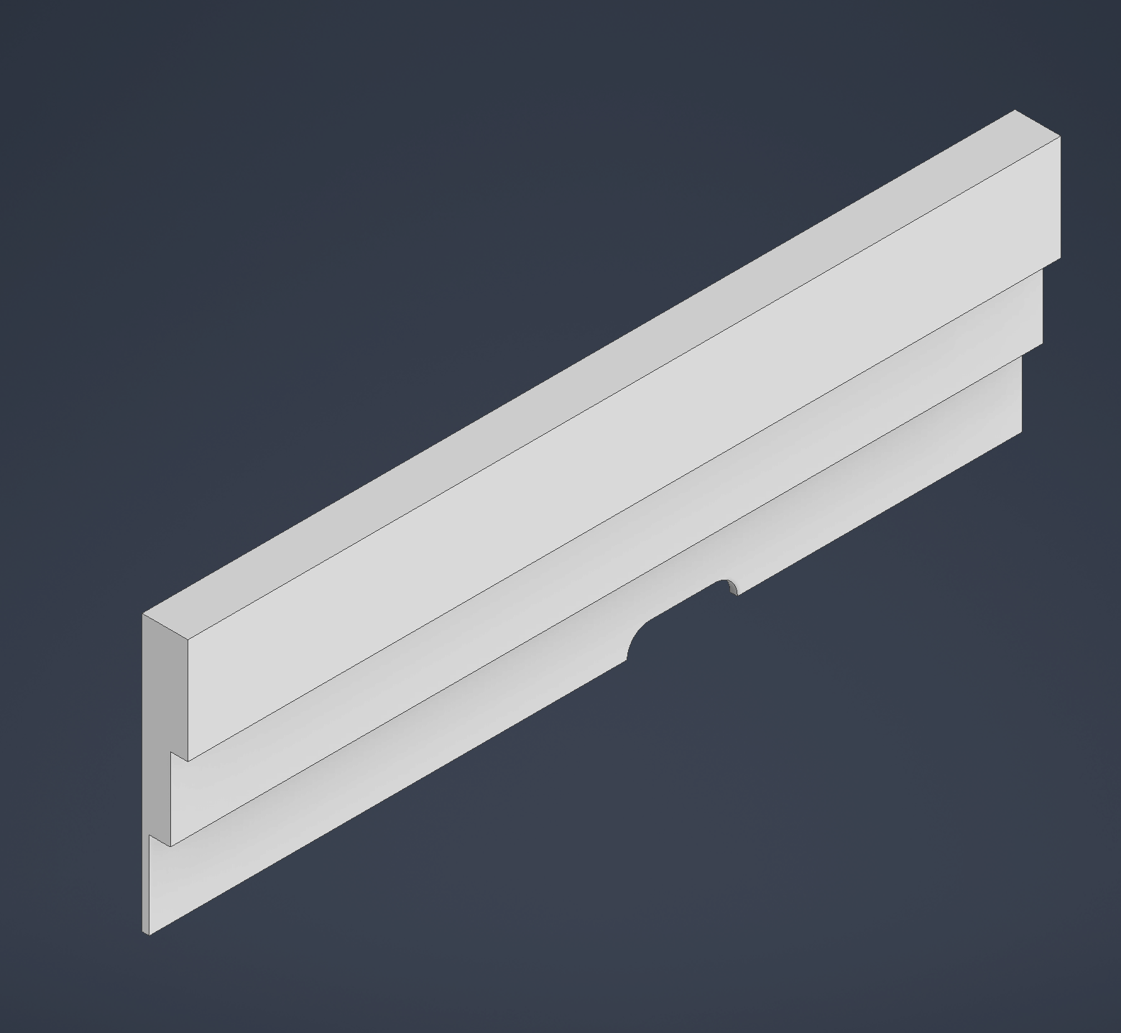
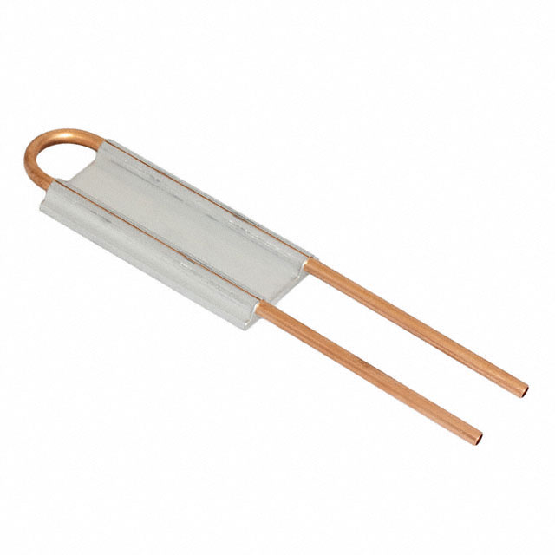
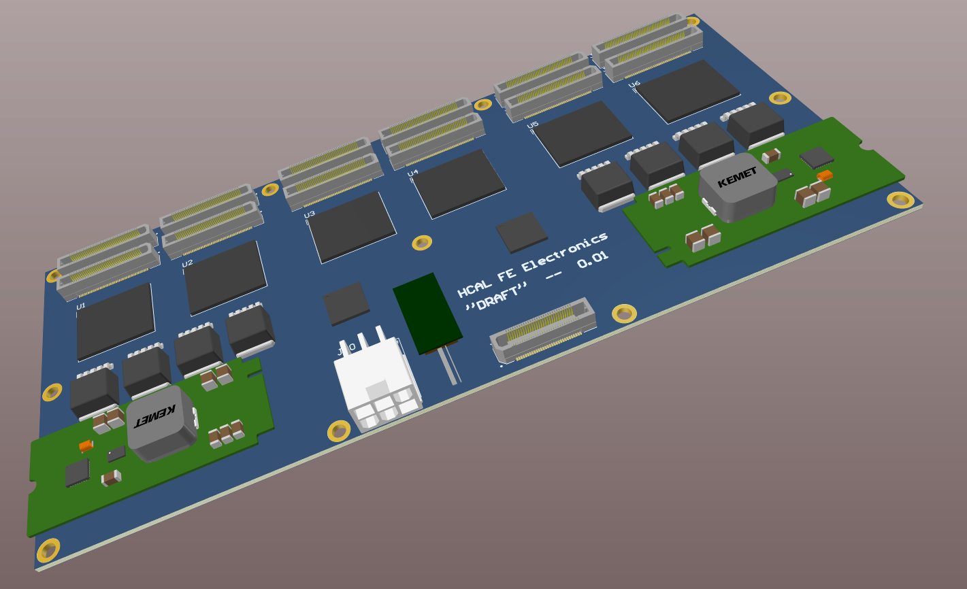
Cooling for the electronic - concept
PCB
Standard water cooling block
commercial product
Custom aluminum adapter

Slide 8
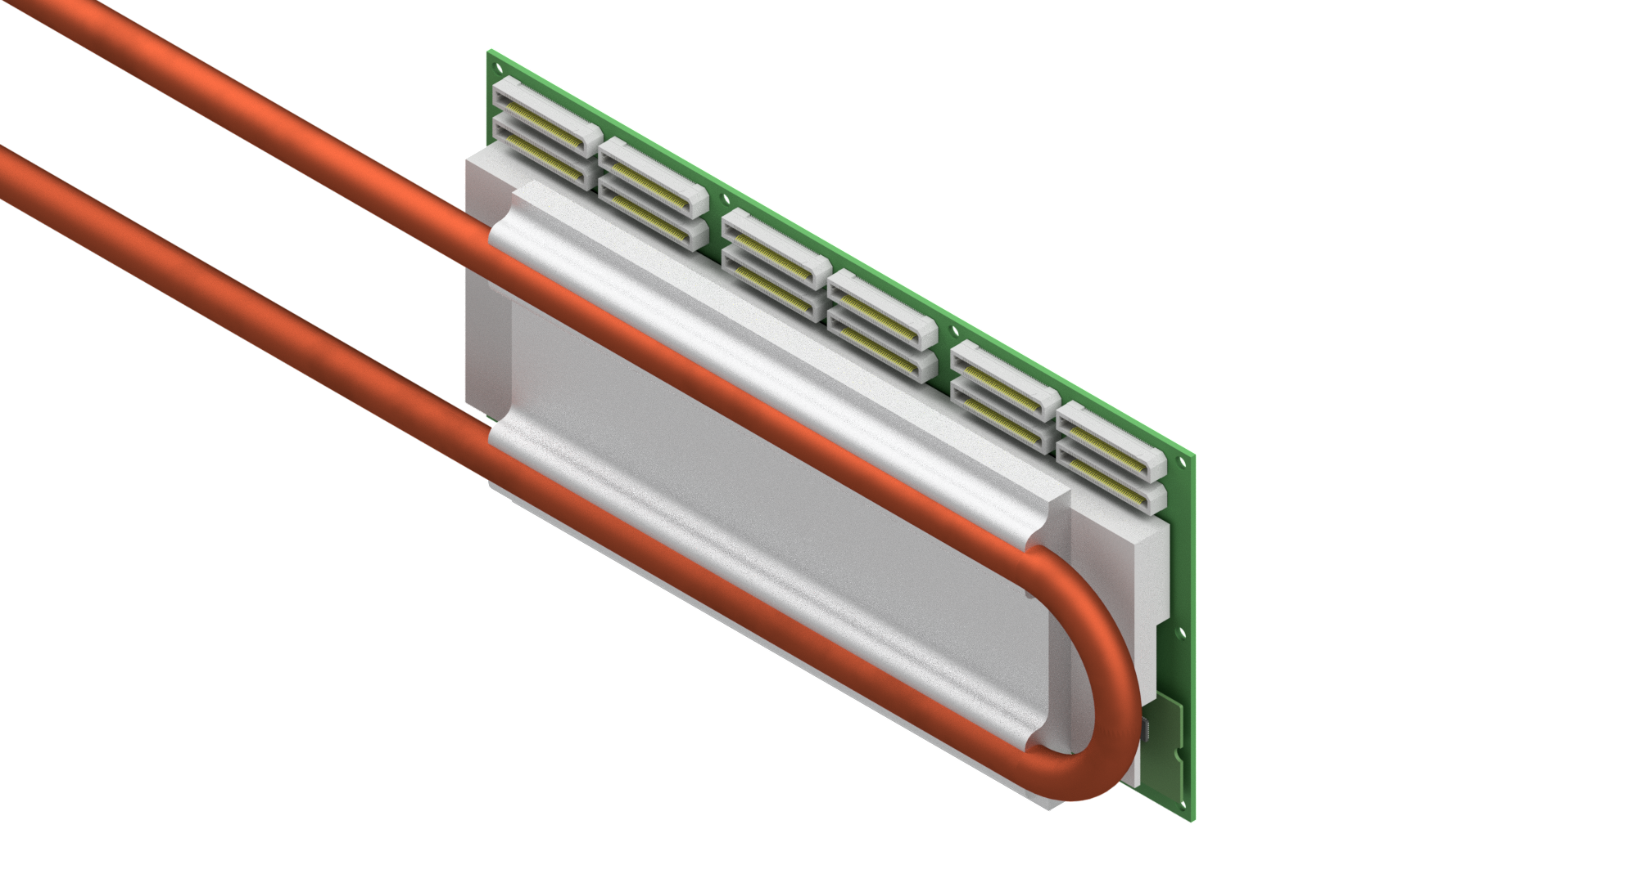
Cooling for the electronic - concept

Slide 9
Cooling for the electronic - concept
Pros:
High reliability of standard cooling block -tests done by the manufacturer, high max operating pressure, low risk of a leak, repeatability of performance,
Modular construction - the adapter can be easily optimized to follow design changes on the electronic side.
Cons:
Water block assembled from two parts (cooling block + adapter) - lower thermal performance (resistance of the interface cooling block-adapter),
More material, more weight - compared to single-part solution (cooling block + adapter).

Slide 10
Cooling for the electronic - concept
Flow – 8.5 l/min,
The inlet water temperature the same as for the rest of the system,
Pressure drop-calculation needed ASAP.
SiPMs thermal stabilization system still has to be designed

Slide 11


Author:
Maciej Czarnynoga
Email:
maciej.czarnynoga@pw.edu.pl
maciej.marek.czarnynoga@cern.ch

