Slide 1
Fostering Open and FAIR Educational Resources in Danish University Libraries
Hazel Engelsmann, Information Specialist
Aarhus University Library/The Royal Danish Library

Slide 2
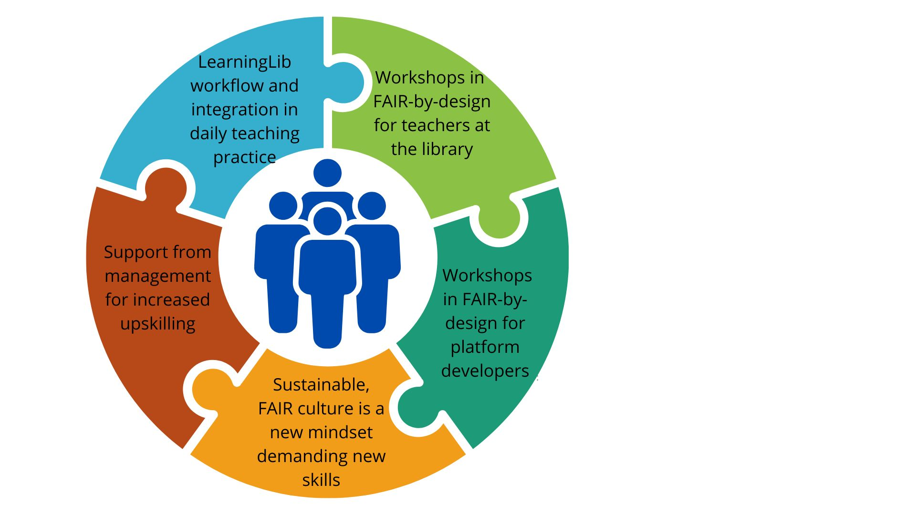
Fostering Open and FAIR practices requires technical knowledge of how FAIR OER workflows, didactics/pedagogy, how our learners learn and how our teachers teach
Synchronous collaboration with LearningLib ensures platform development and commitment to FAIR OER.
Support from library management is essential for teachers to commit to FAIR-by-Design
04.
Find me at Poster #176 to hear more
©[5 process puzzle, Lorna Wilgaard] via Canva.com

