Slide 1
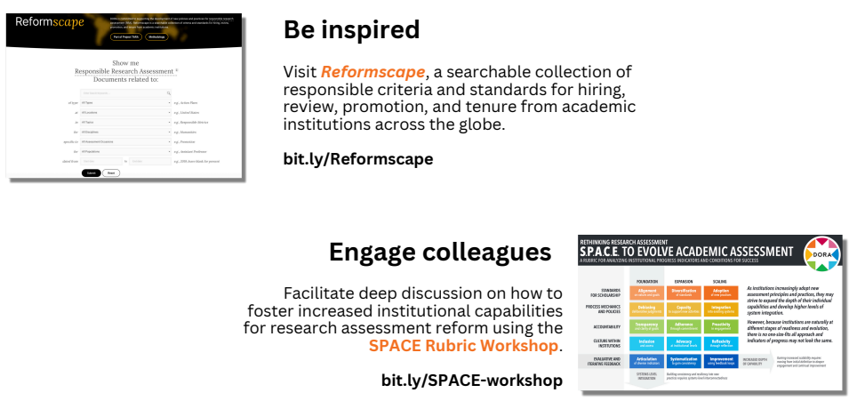
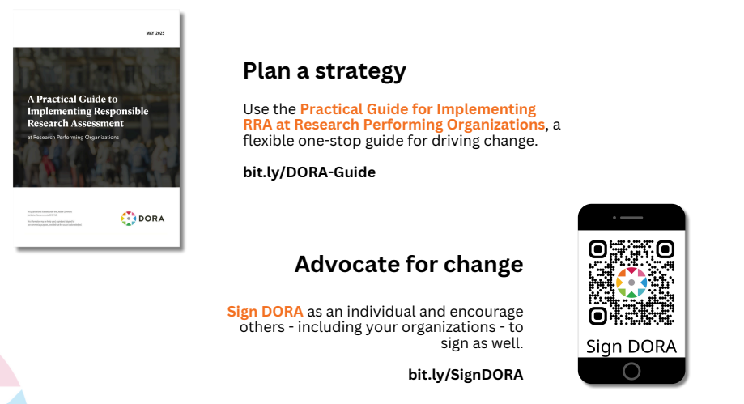



BEYOND METRICS: CATALYSING RESEARCH ASSESSMENT FOR OPEN SCIENCE

