Slide 1
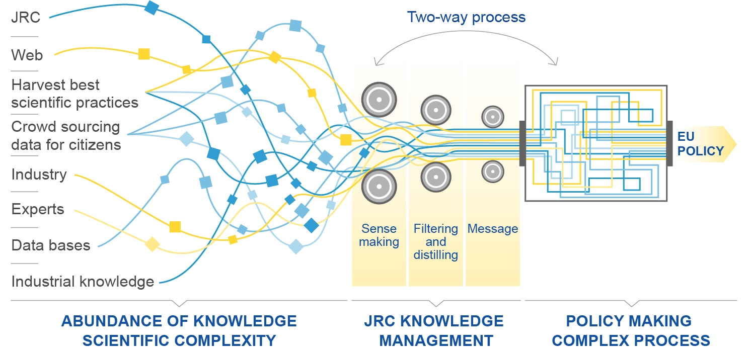
Supporting policy processes by assuring high quality open science
Notes:
Visualisation of Knowledge Management
Today we have access to a unique vast amount of information
The information comes from many sources from crowd sourcing to universities and industry to individual experts
Within the Commission there is a need/wish to manage this information
The added value of the JRC is to perform this task through our expertise and the development of Knowledge Management procedures. Including sense making / filtering / visualisation of data
Furthermore, it should be noted that the process is 2-way and dynamic both in the information and policy making domains

