Slide 1
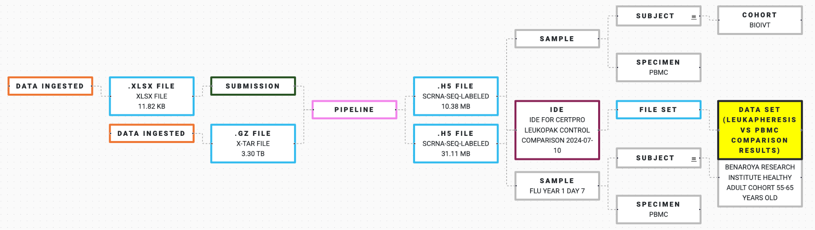
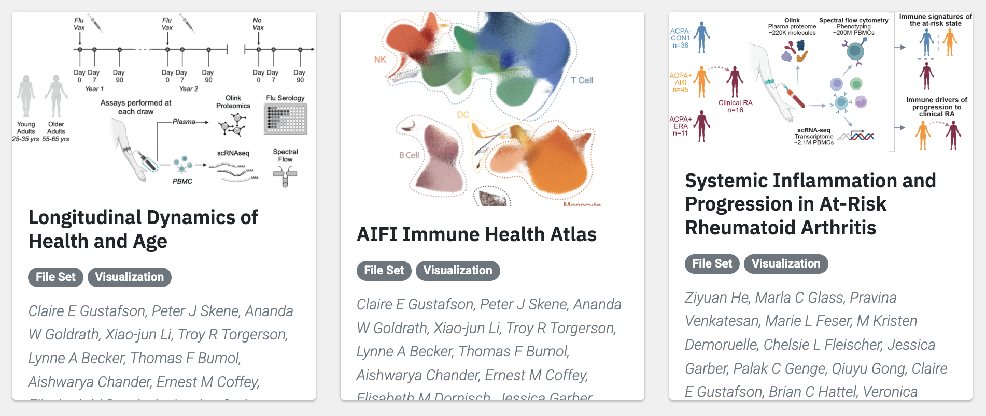
From Reproducible Research to
Open Science Dissemination
A Computing Platform-Centric Approach
Paul Meijer
Senior Director, Scientific Software Engineering

Slide 2
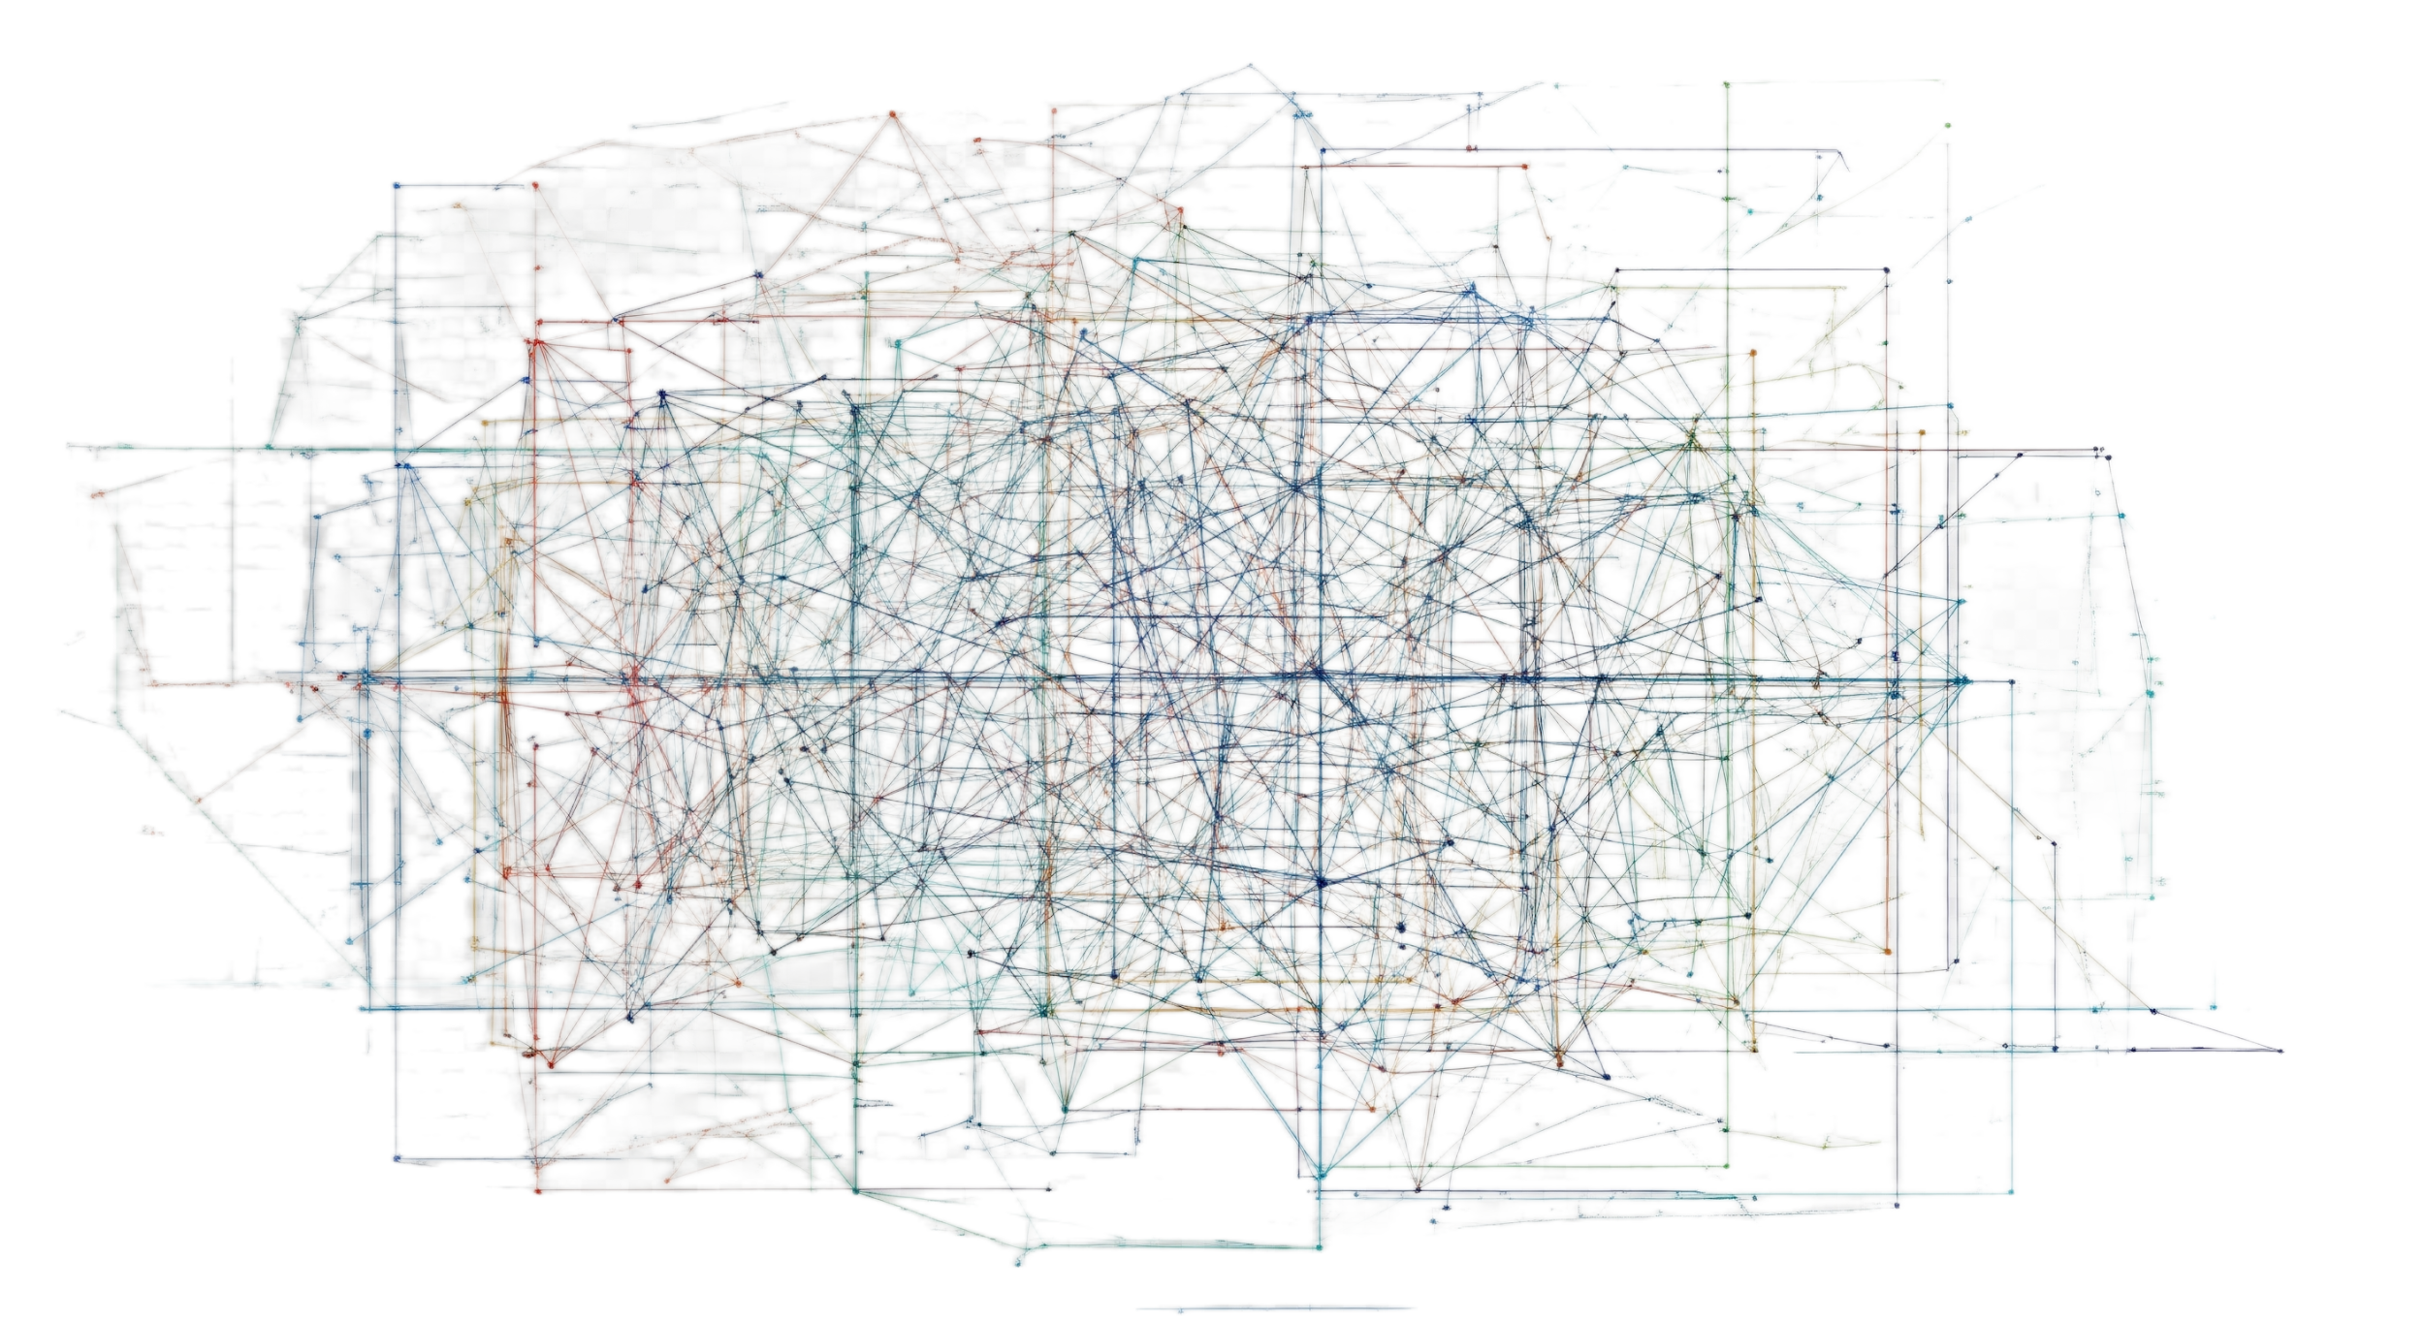
Large Scale Research Presents Transparency and Reproducibility Challenges
Store, categorize and find large amounts of data
Prepare data for transformation and analysis
Keep track of complex multi-step analyses
Support interdisciplinary team collaboration
Enable transparent research for ongoing review
Share the data, analysis, and results to the open science community
Ensure analysis reproducibility of shared results
Keep research available, affordable, and sustainable

Slide 3
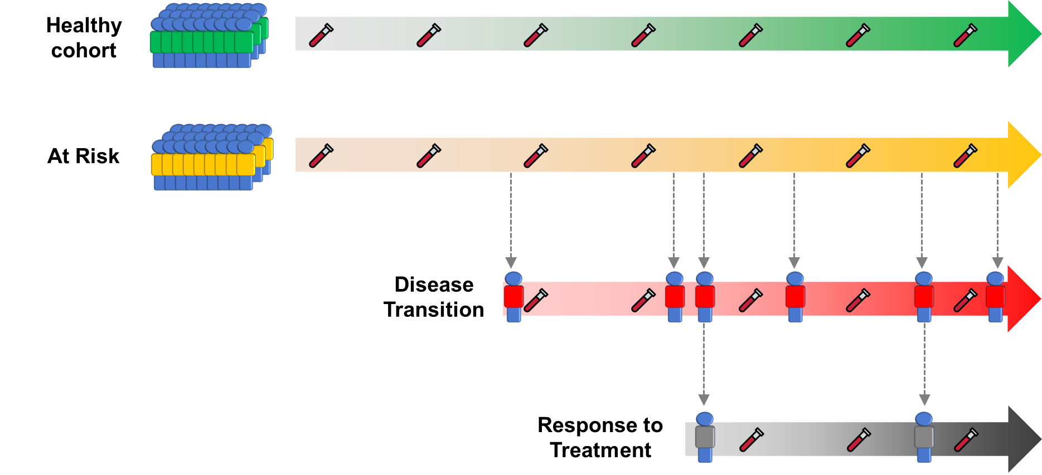
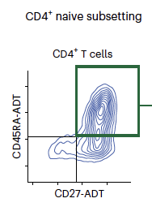
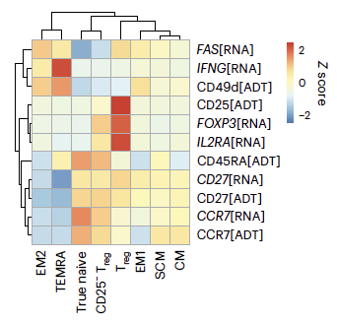
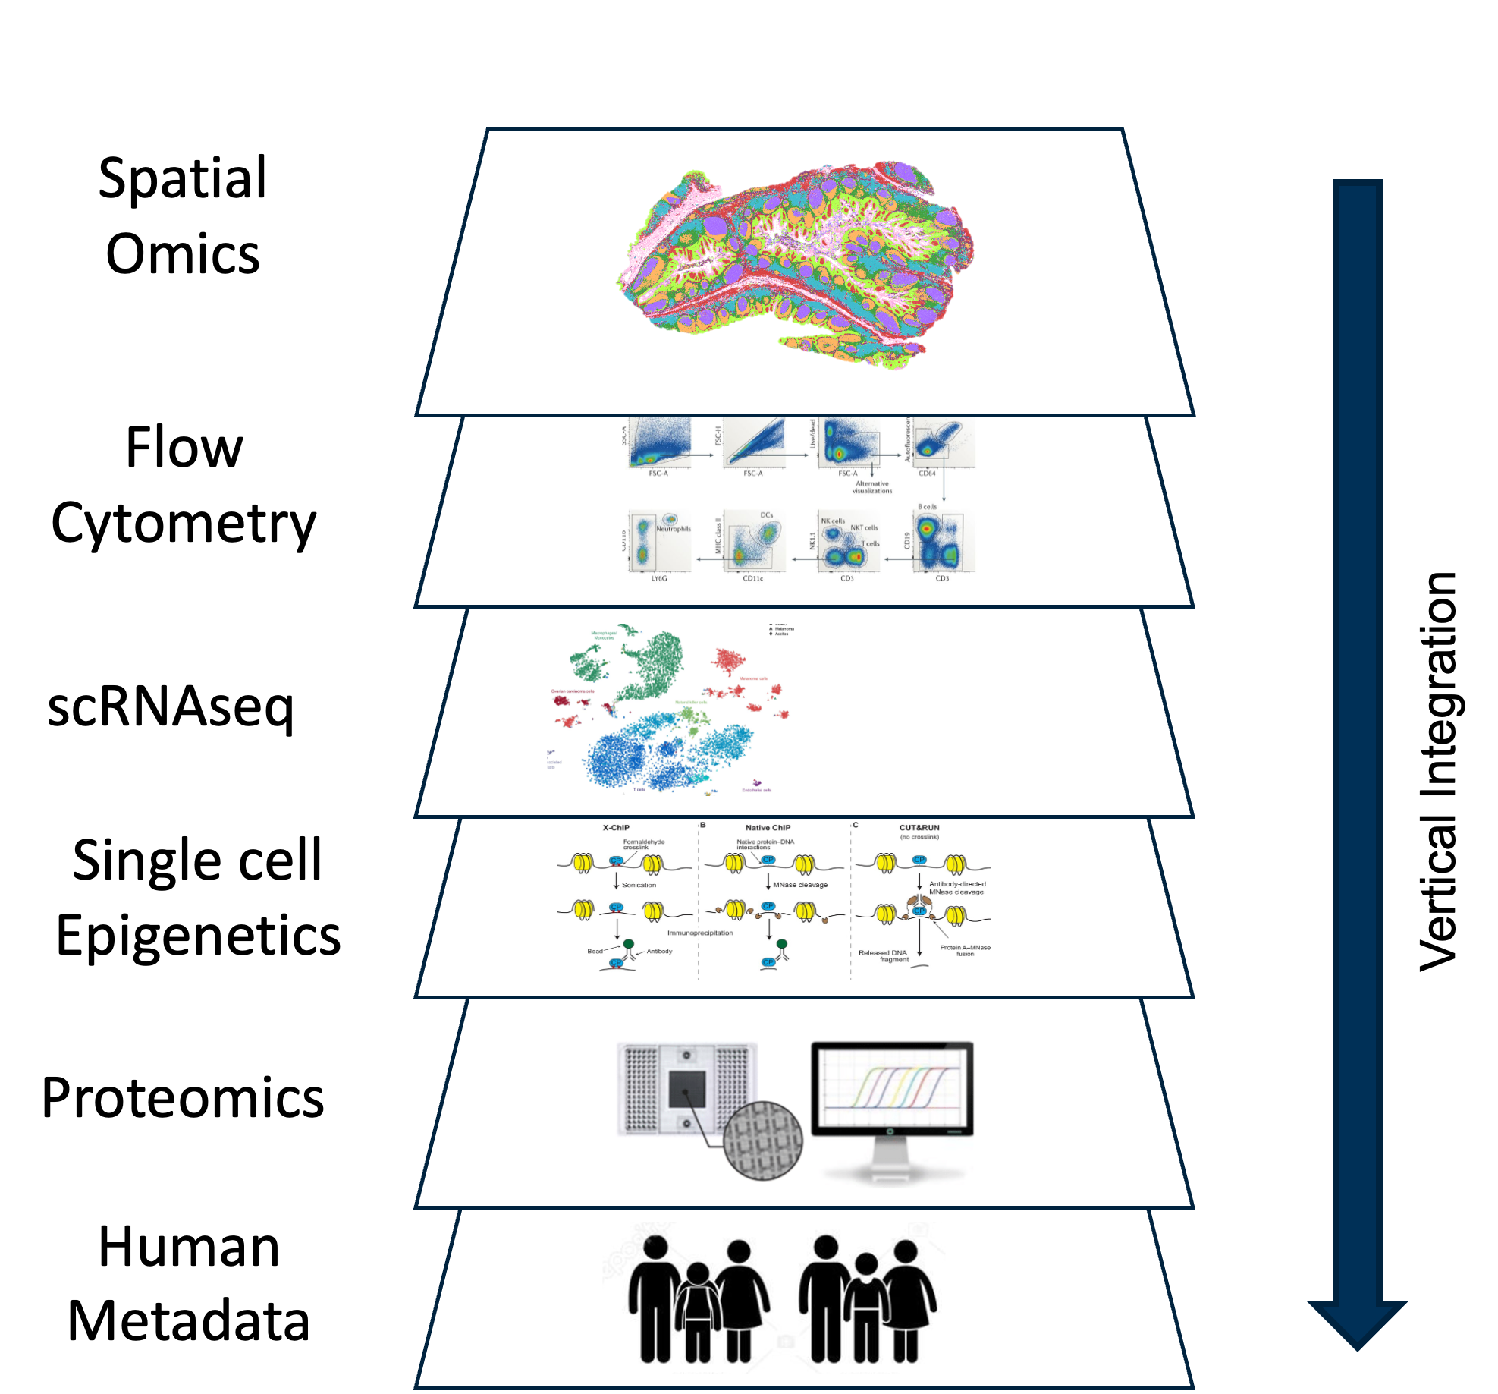

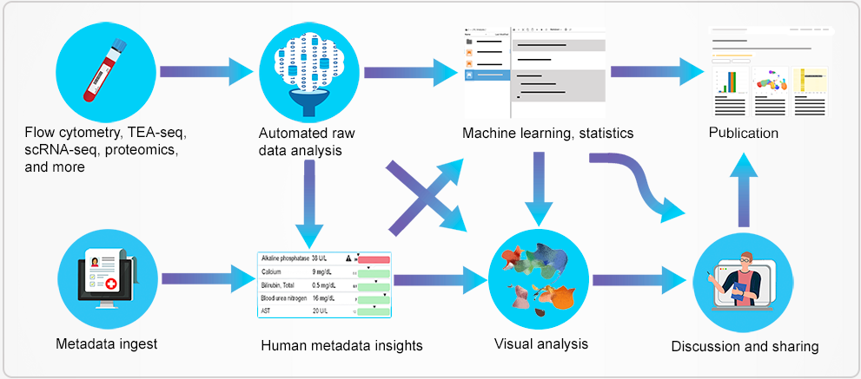
Use Case: Large-Scale Human Immunology Research…
Longitudinal studies
Wet-bench
(validation, follow-up, etc.)
Multi-omic data
Scientific Computing

Slide 4
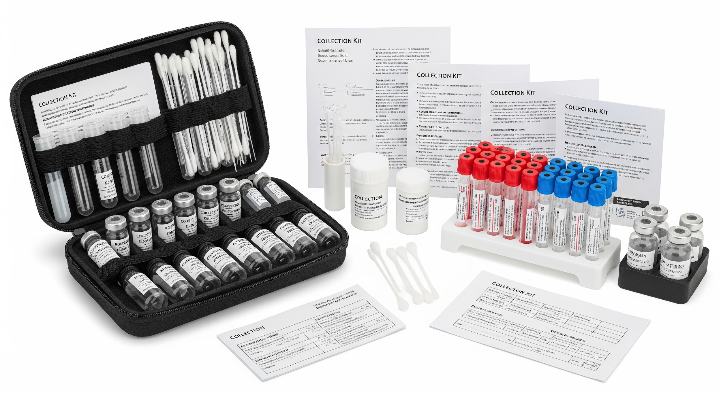
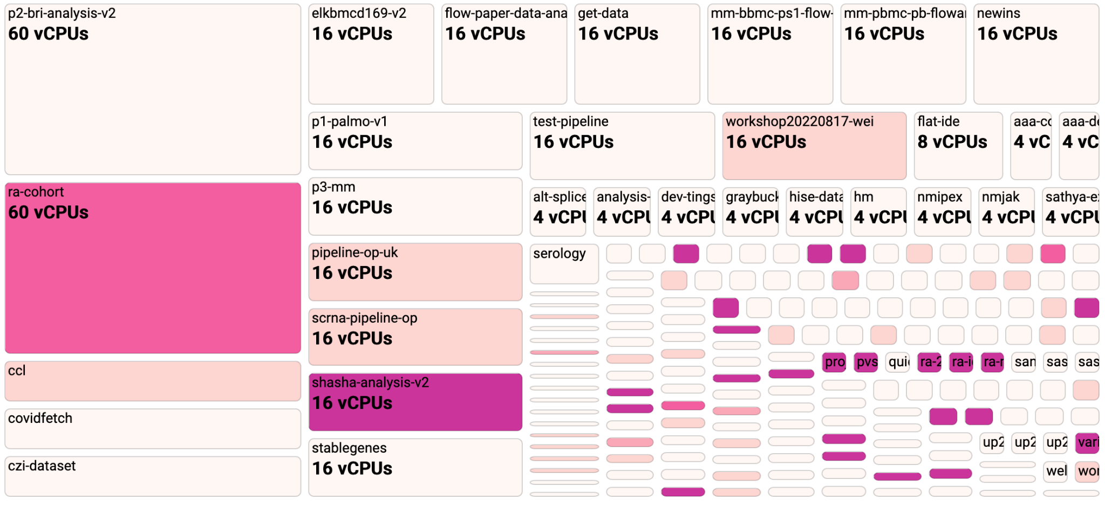
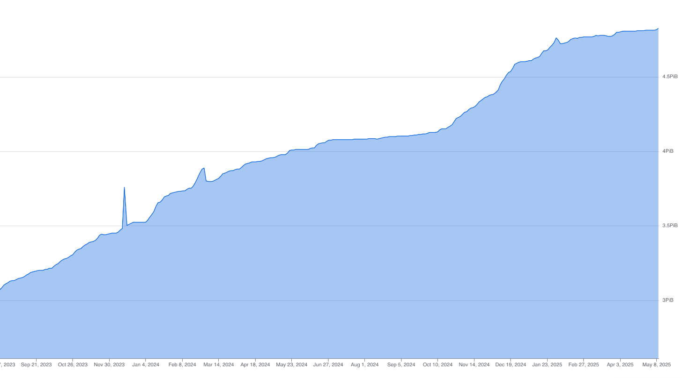
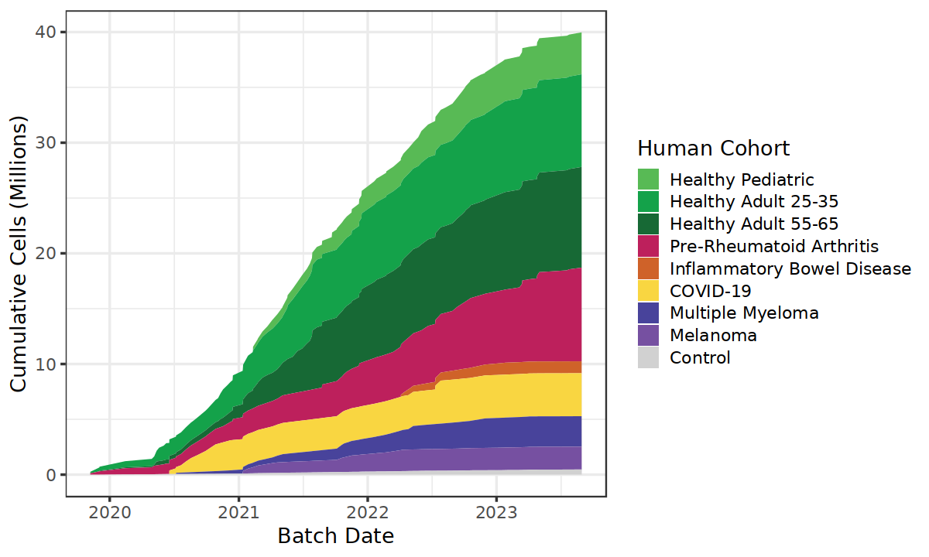
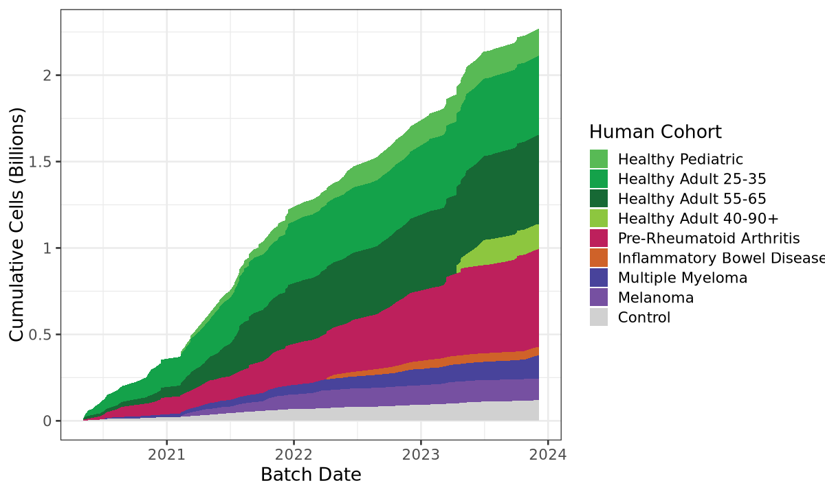
Generates Lots of Research Assets… Large-Scale Human Immunology Research
350+ subjects
A large concurrent computing footprint
2500+ collection kits
~5 petabytes of assay data
single cell RNA-seq
~55M cells
Flow Cytometry
~2.5B cells

Slide 5
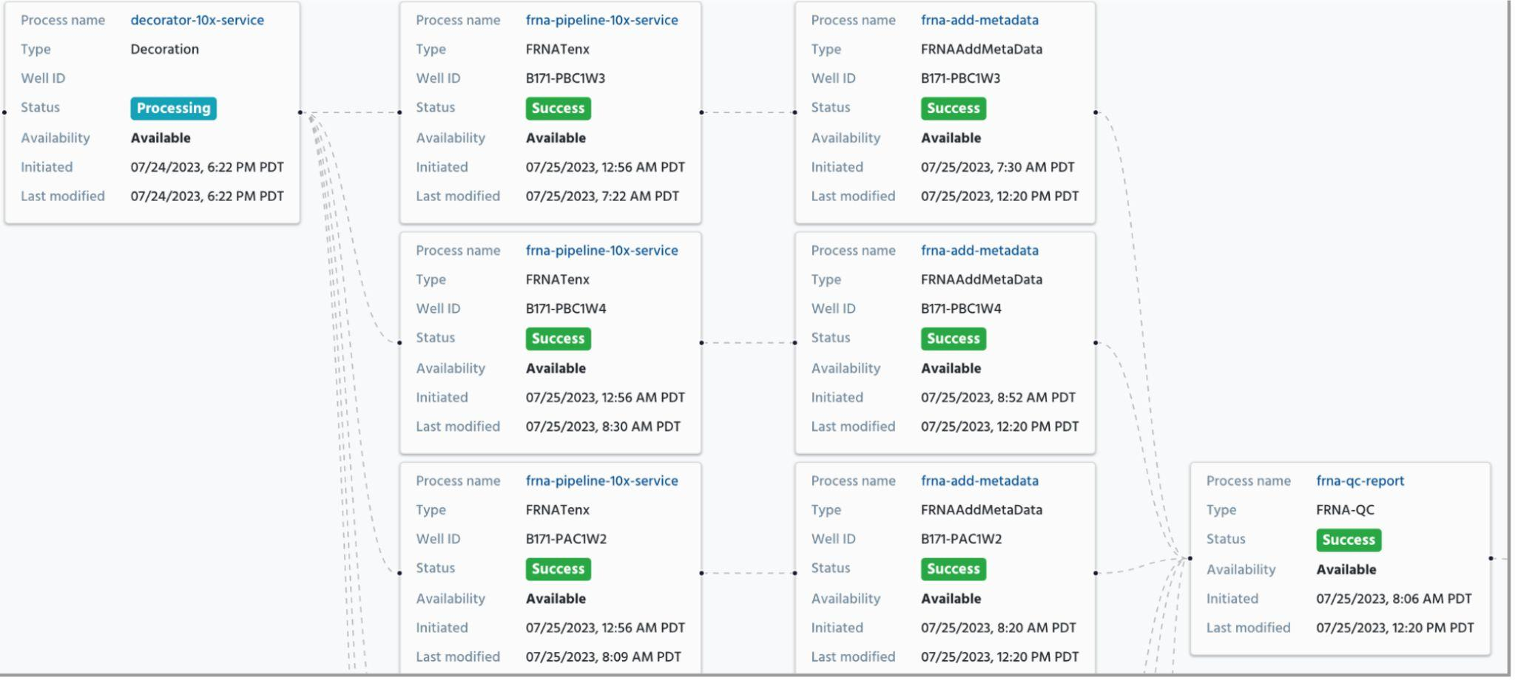
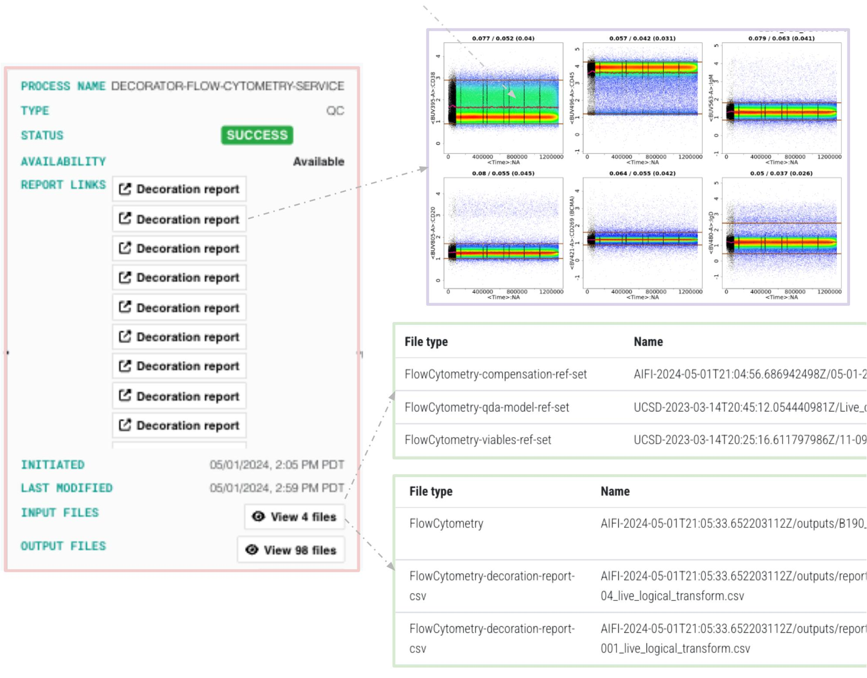
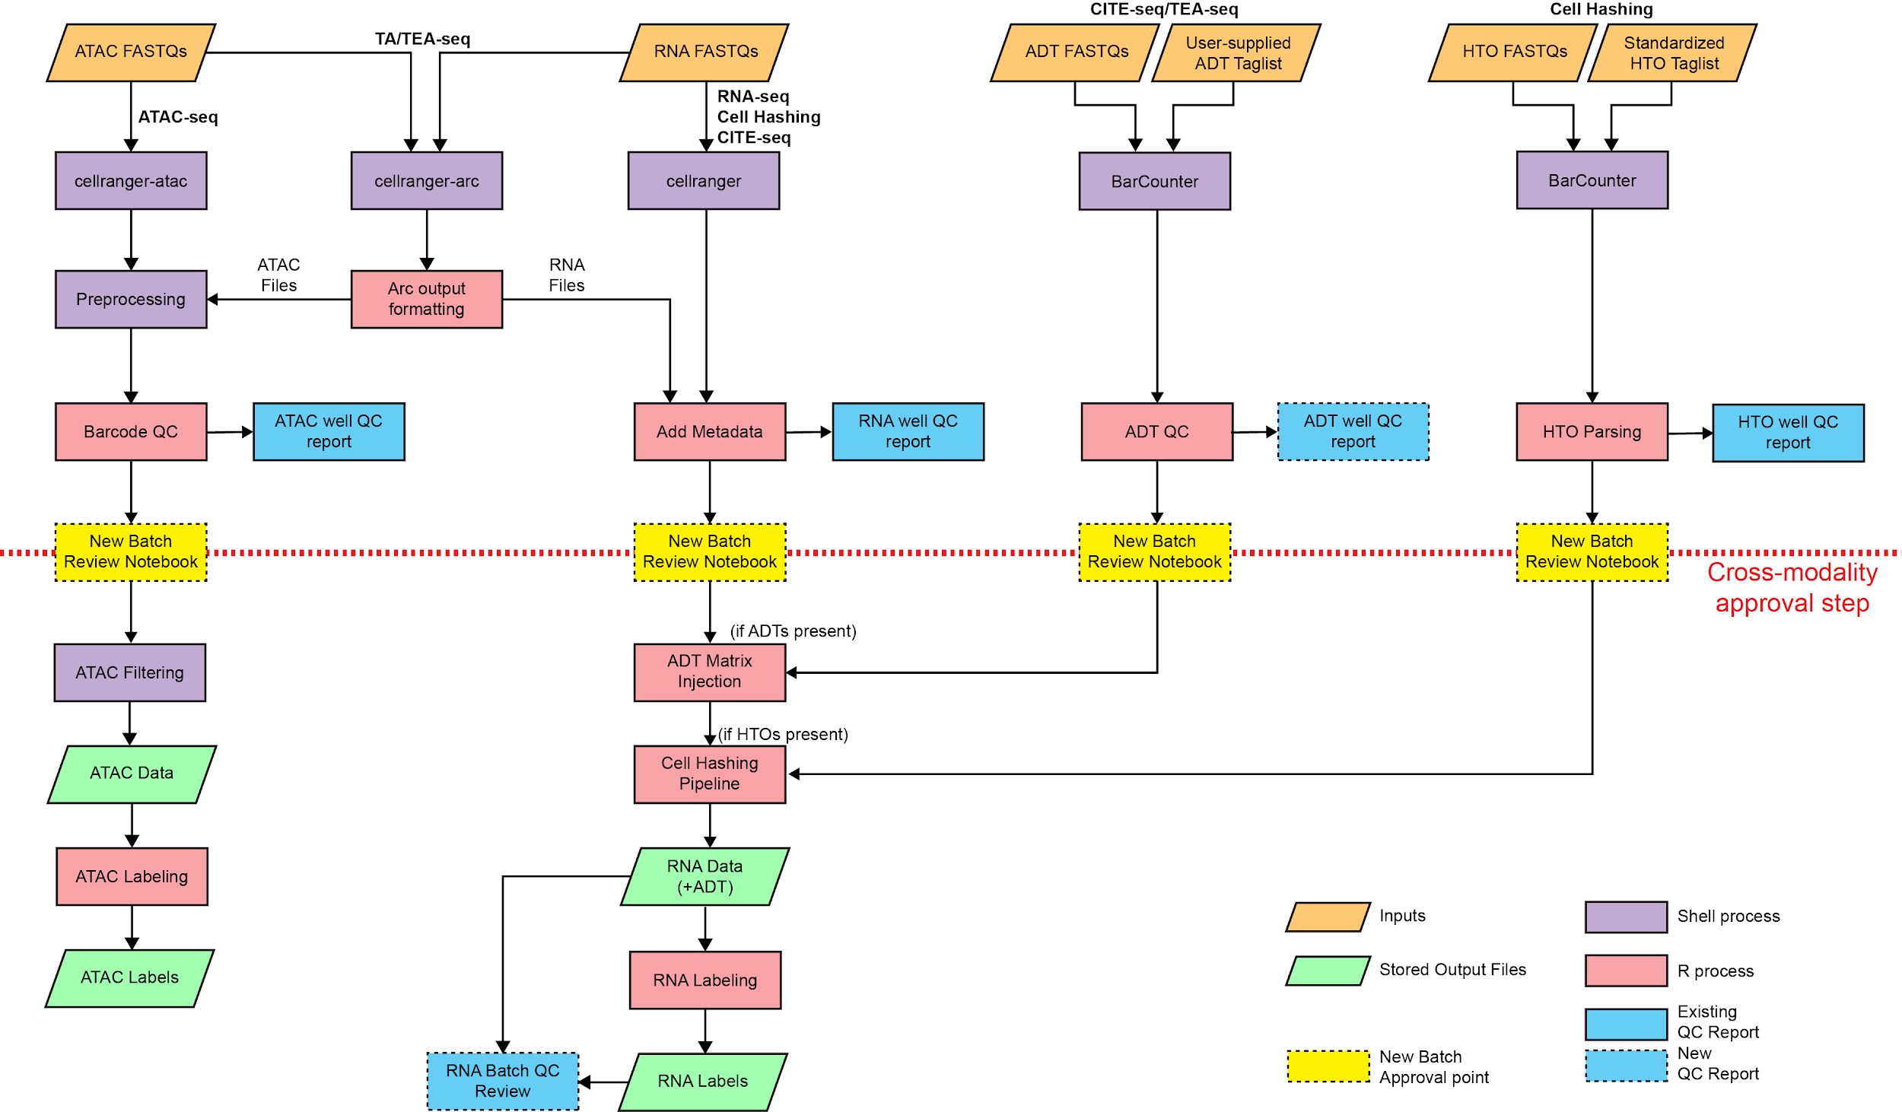
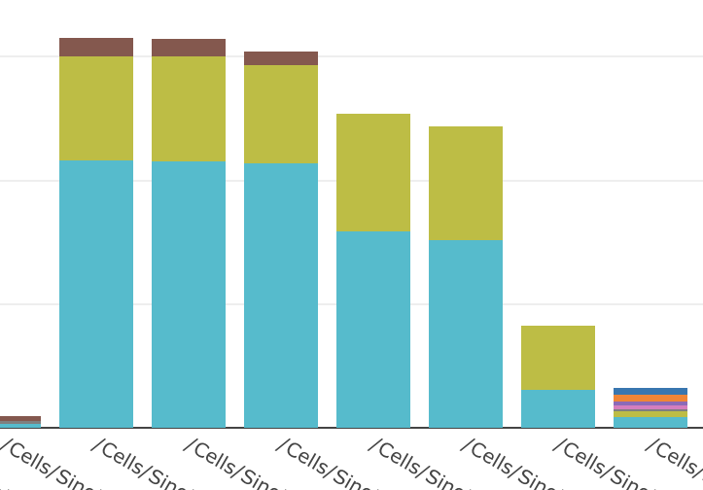
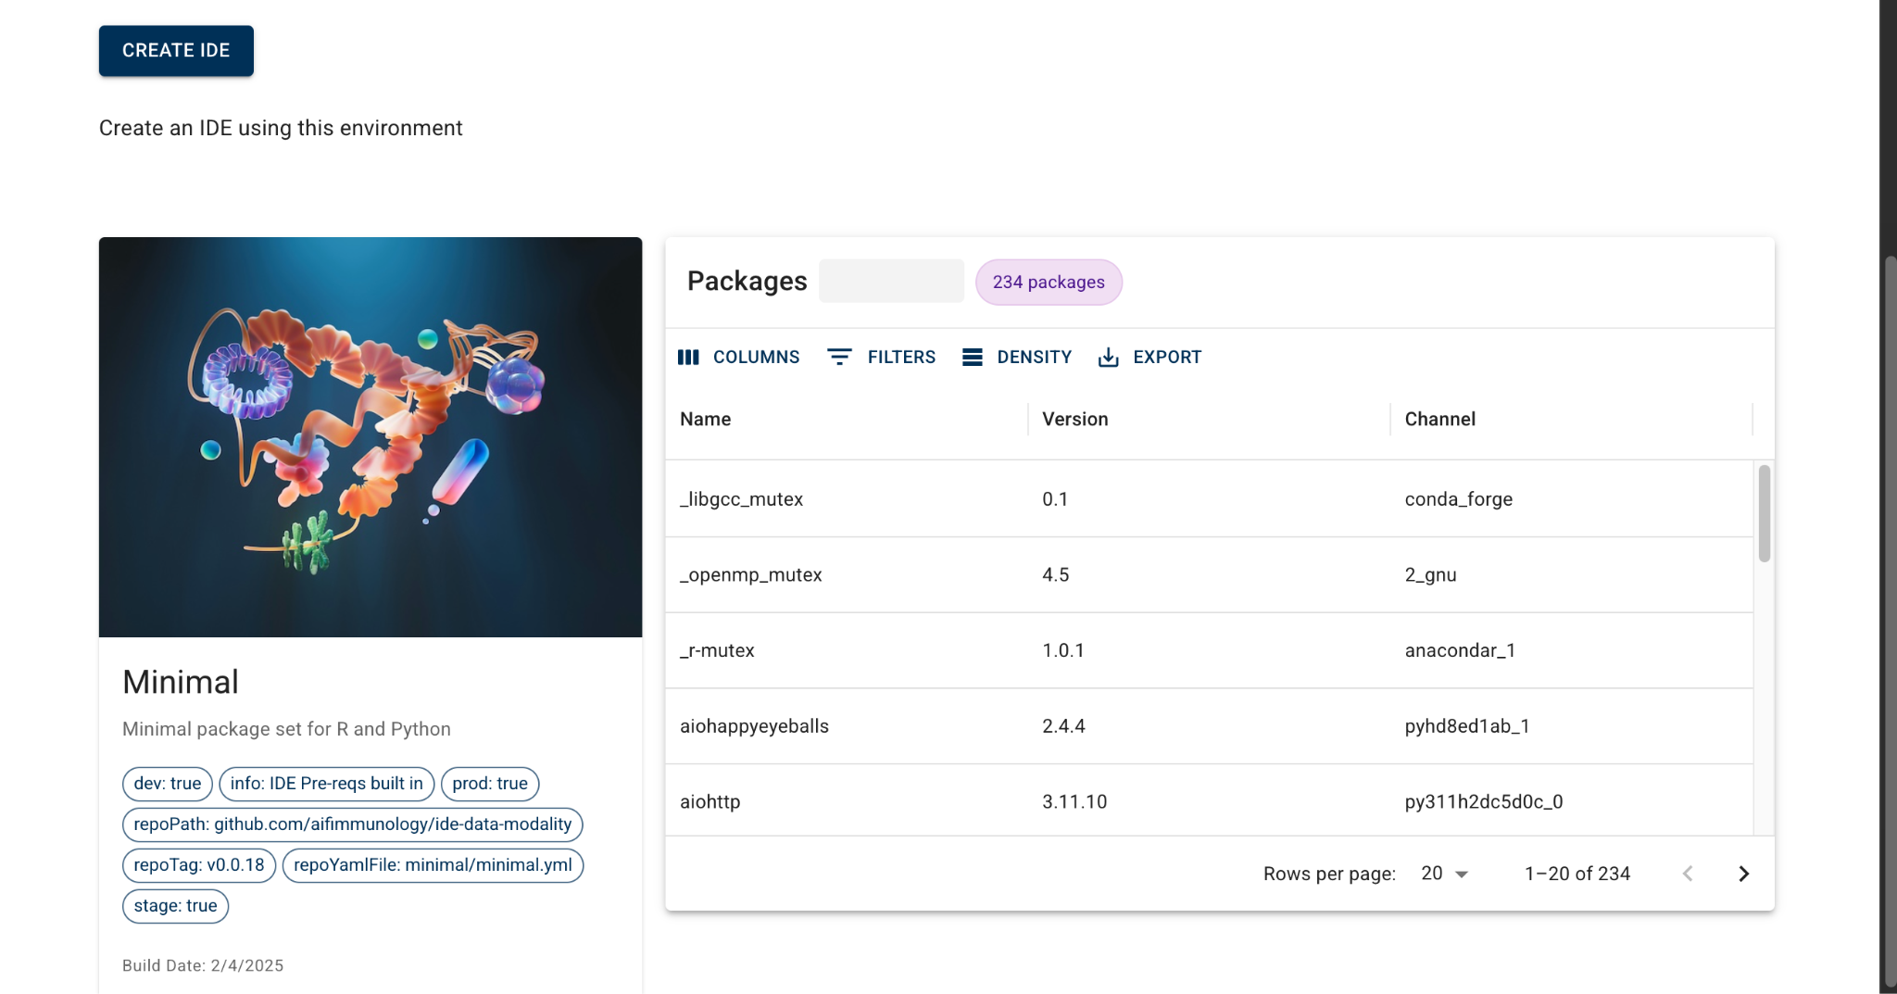
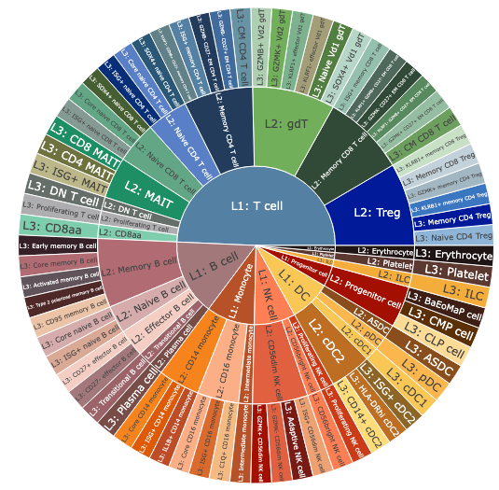
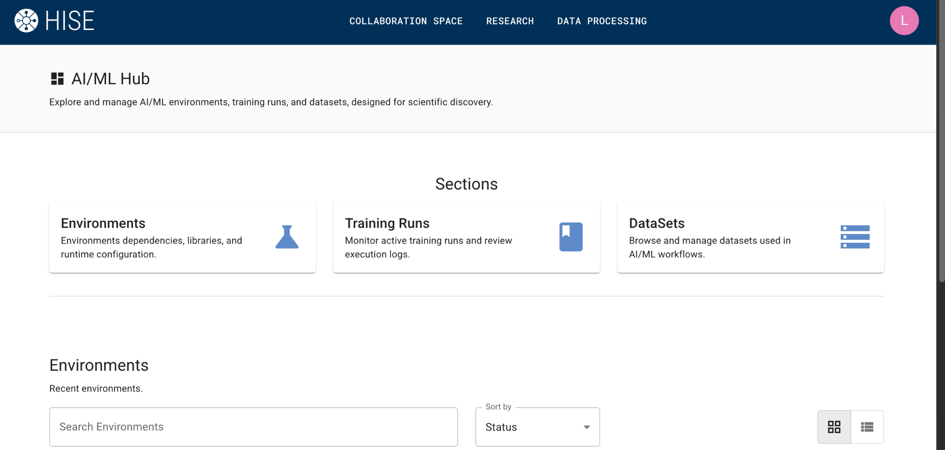
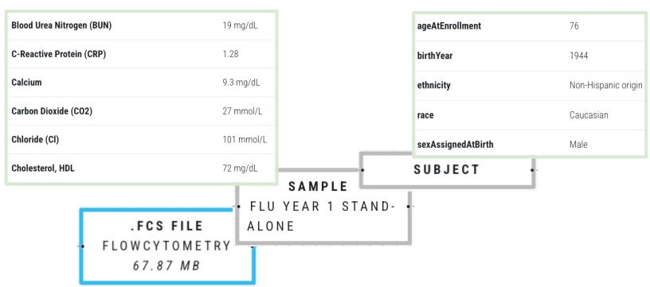
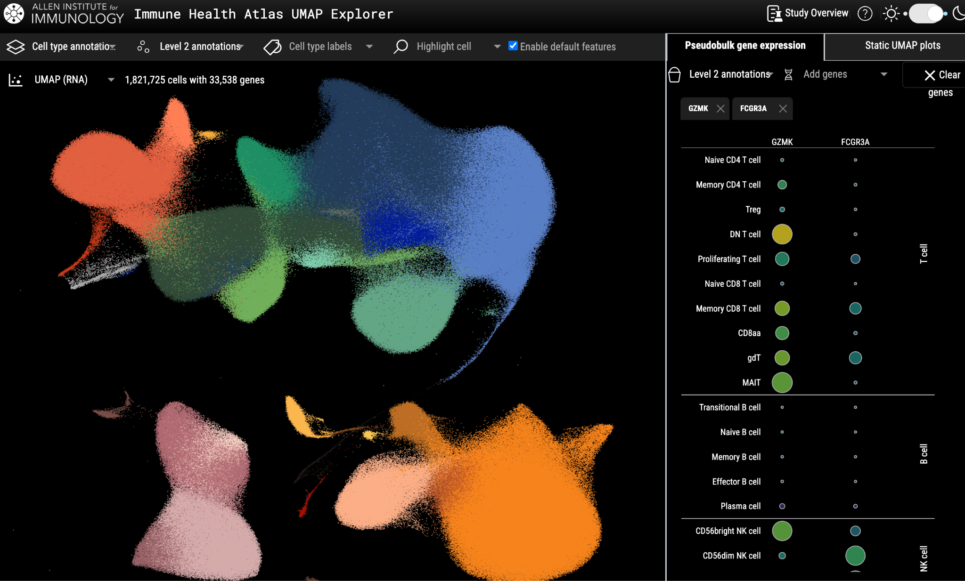
Across Intricate, Multi-Step Workflows Large-Scale Human Immunology Research

Slide 6
Our Solution: A Comprehensive Platform Built for Reproducibility and Openness
research
traceability
governance
reproducibility
complex multi-step analyses → capture research as it unfolds
transparent ongoing review → enable exact re-execution of steps
team collaboration → trace all tools and transformations
share data, analysis and results → directly from the computing platform
analysis reproducibility → share the research trace of the results
available, affordable, sustainable → ongoing usage guides governance

Slide 7

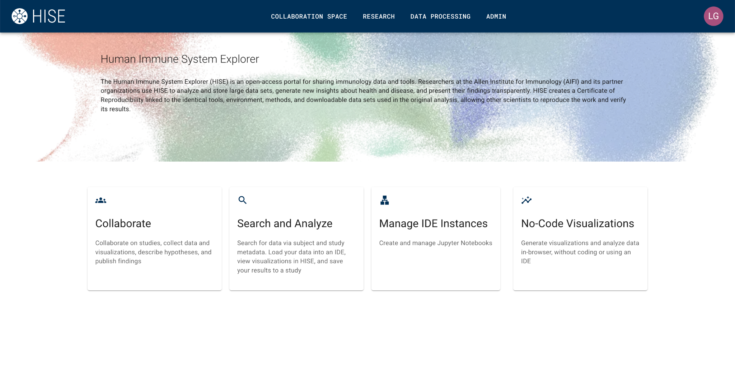
A Computing Platform for Large, Complex Research…
processing pipelines
teamwork
data search
analysis
visualization

Slide 8
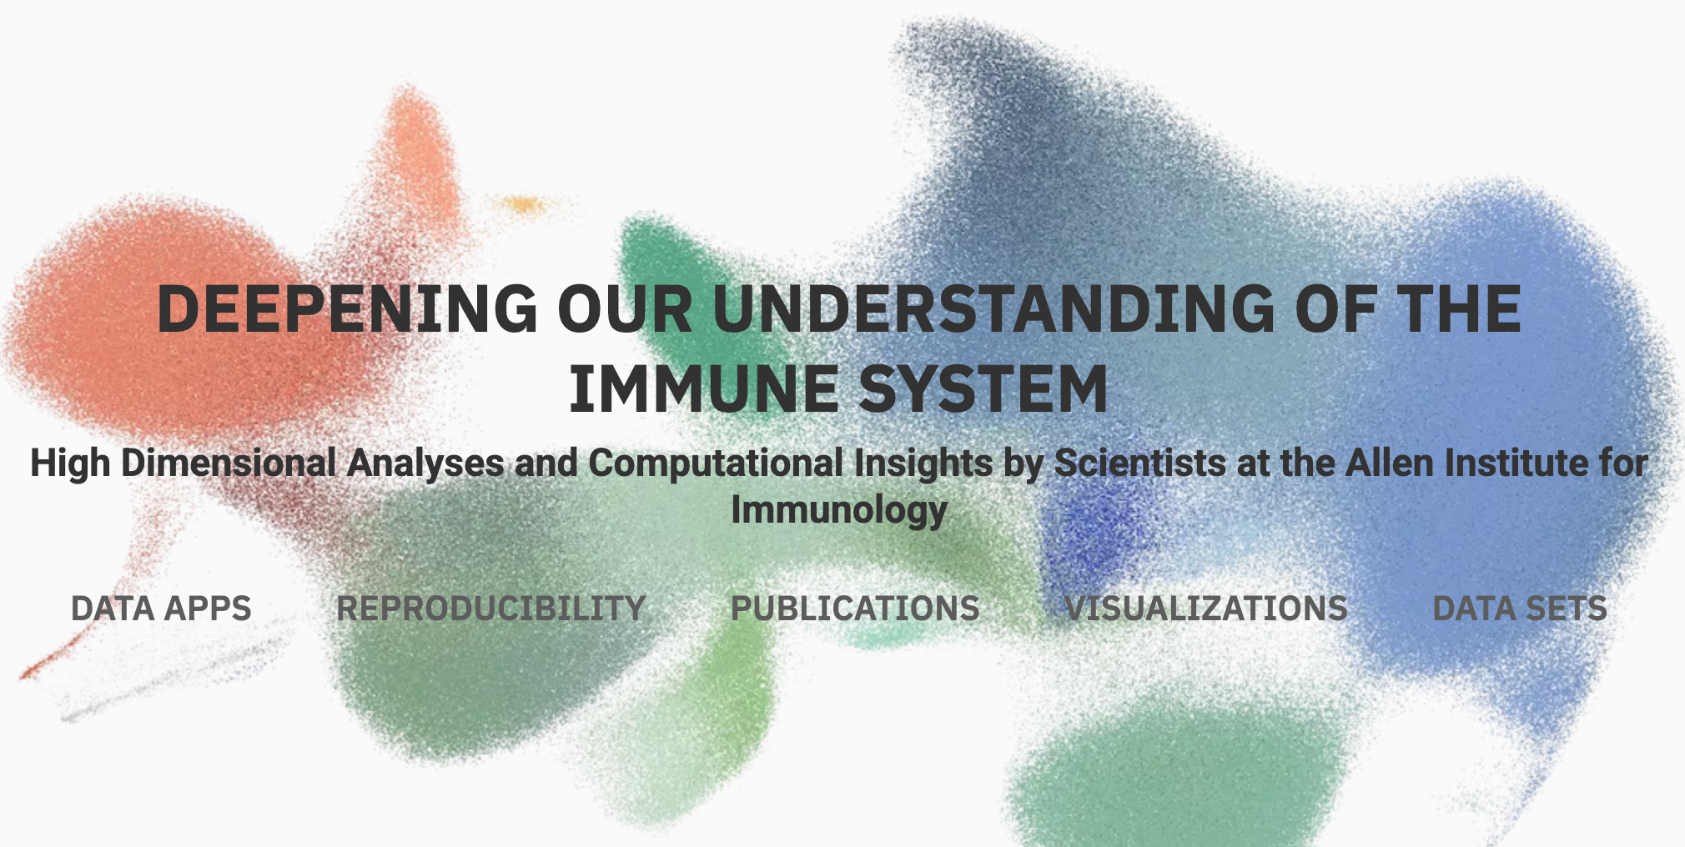

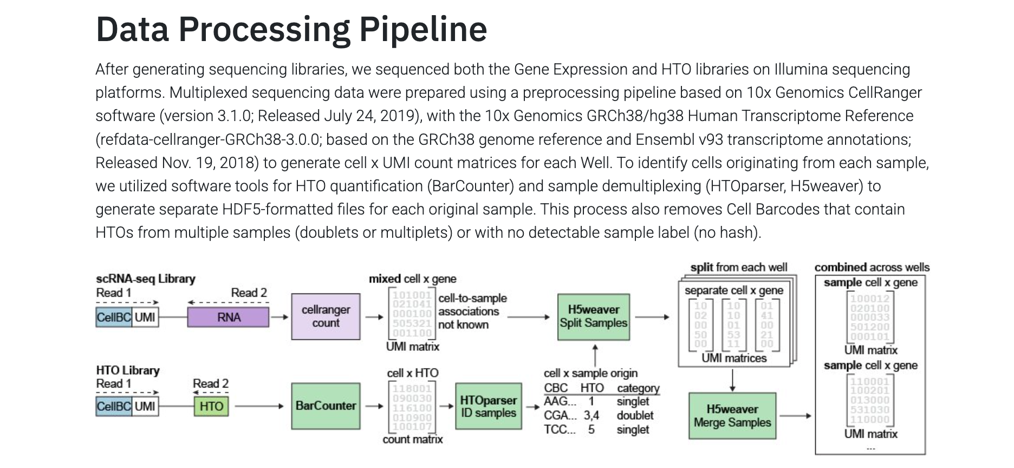
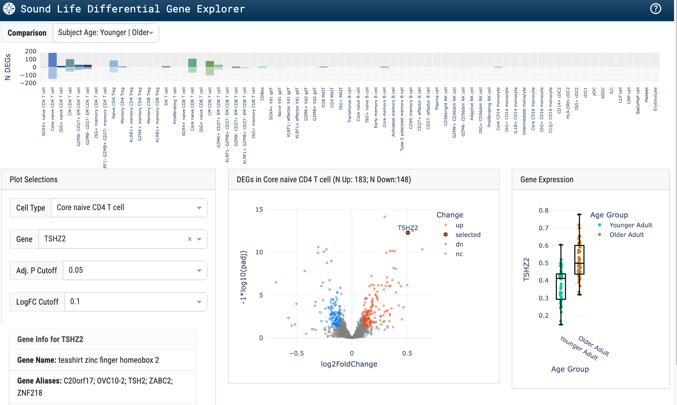
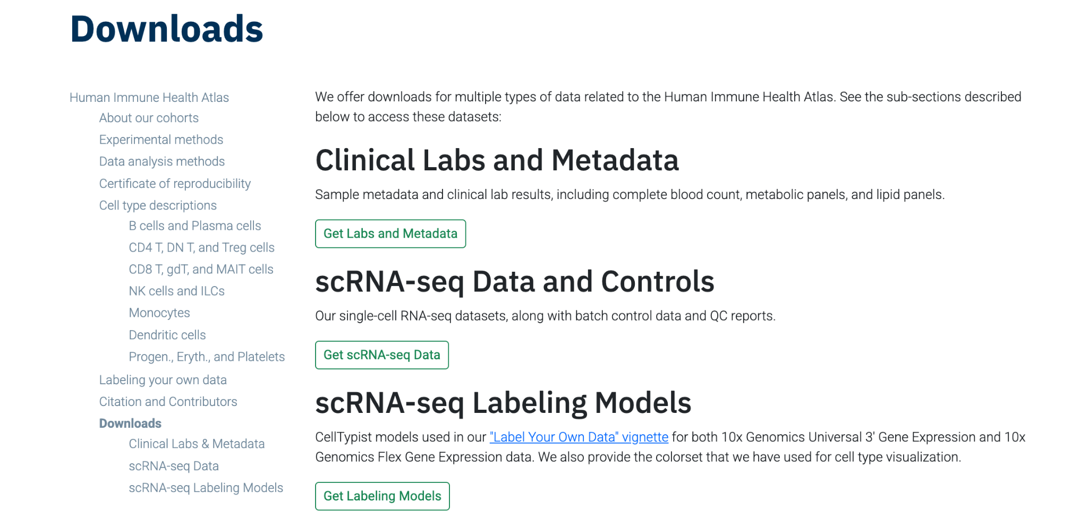
…and Open Science Dissemination and Interaction
explore.allenimmunology.org

Slide 9
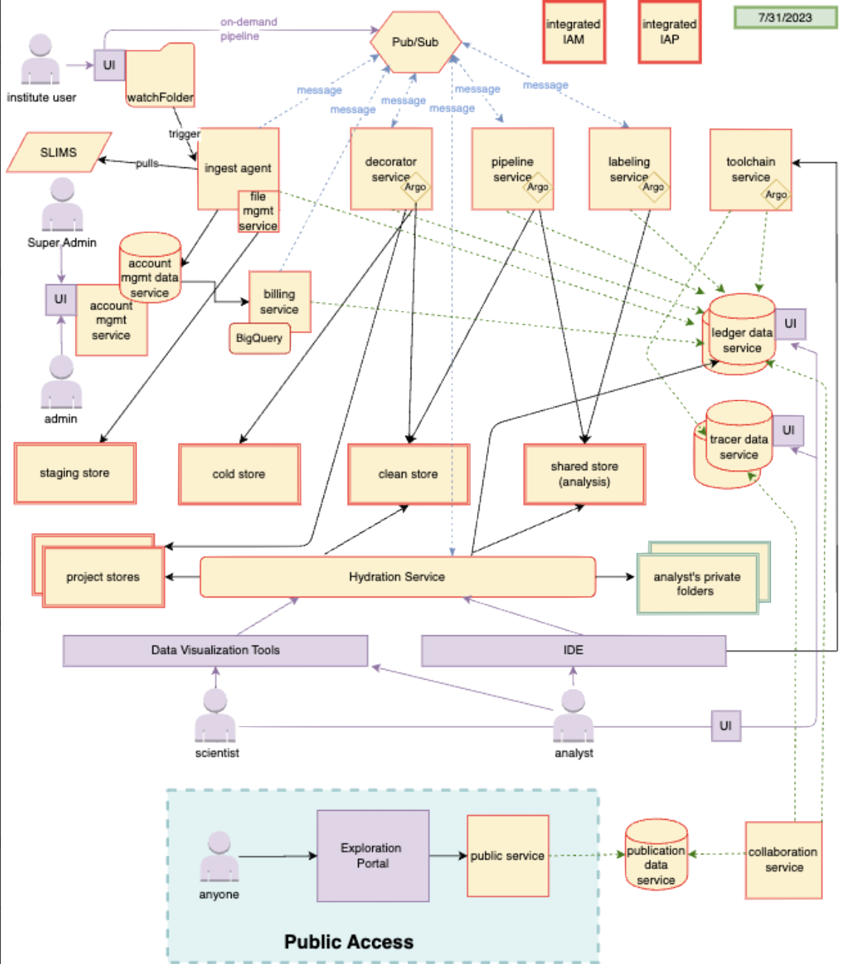
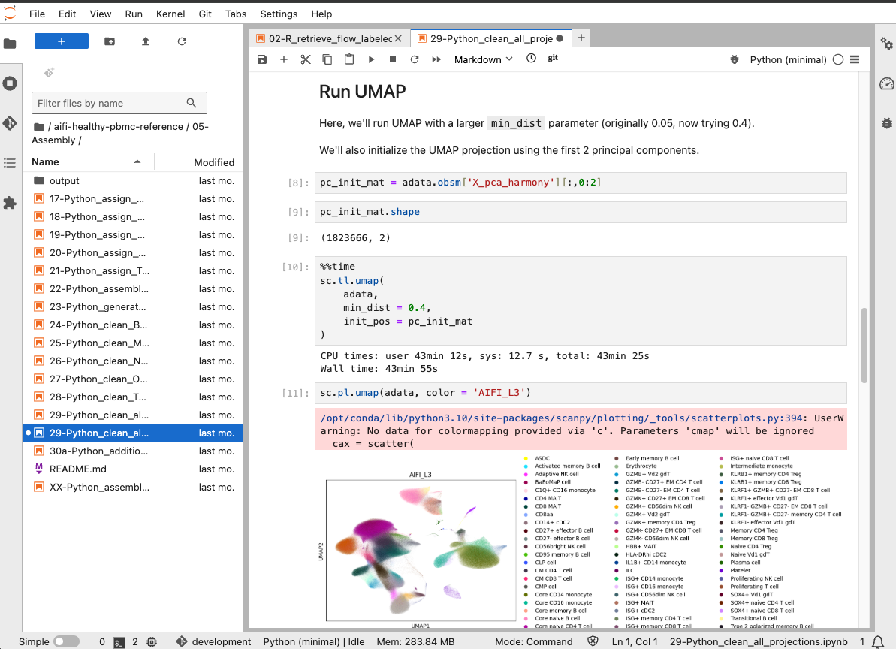

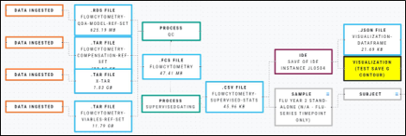
How it Works: Trace-Driven Architecture Tracks all Data and Transformations
Register data, code, and analysis environment details
Publish data, code, and tools for interactive inspection and reproducibility
An analysis platform designed for traceability
IDE
Conda environment
JupyterLab
Input files
Output files
Jupyter Notebook
Incrementally build a graph showing each step

Slide 10
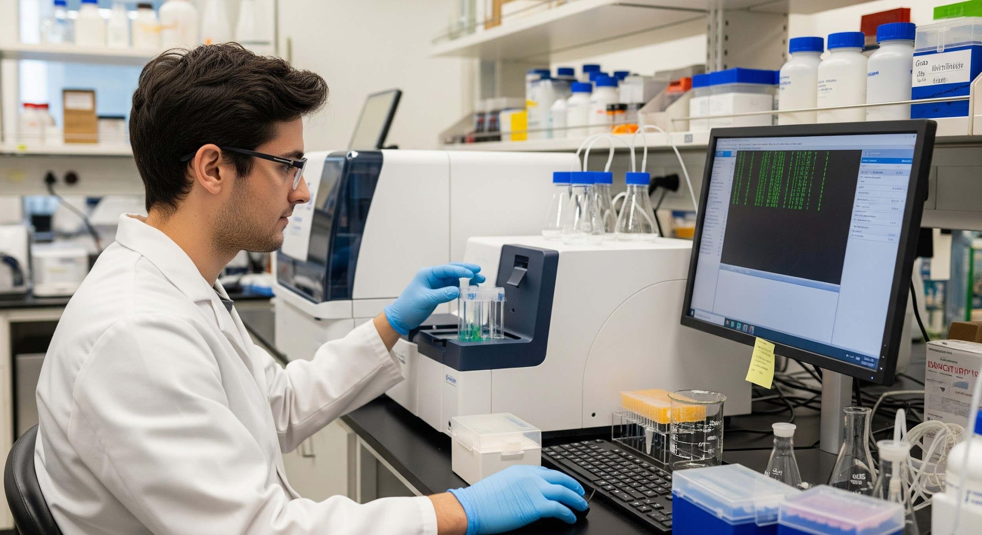
Proactively Capture the Research Trace
wet lab data generation
lab metadata details

Slide 11

Proactively Capture the Research Trace
clinical metadata collection

Slide 12

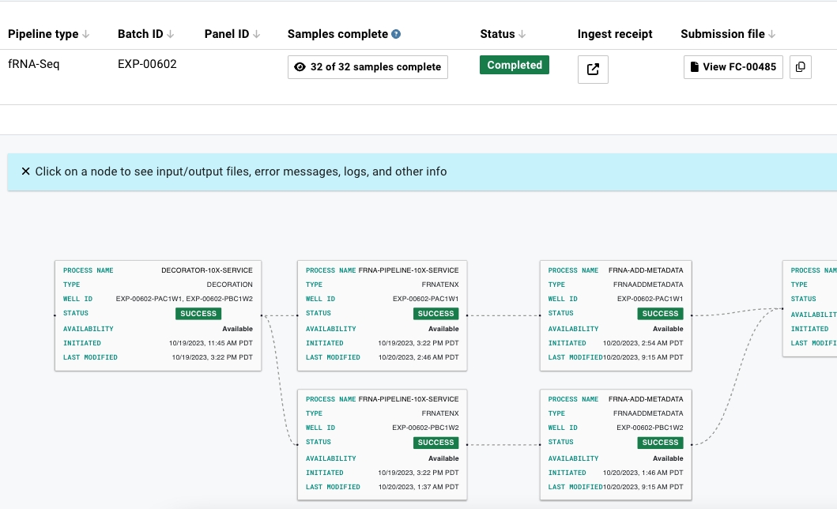
Proactively Capture the Research Trace
automated analysis and verification

Slide 13

Proactively Capture the Research Trace
secondary analysis
results generation

Slide 14
Proactively Capture the Research Trace
ongoing review

Slide 15

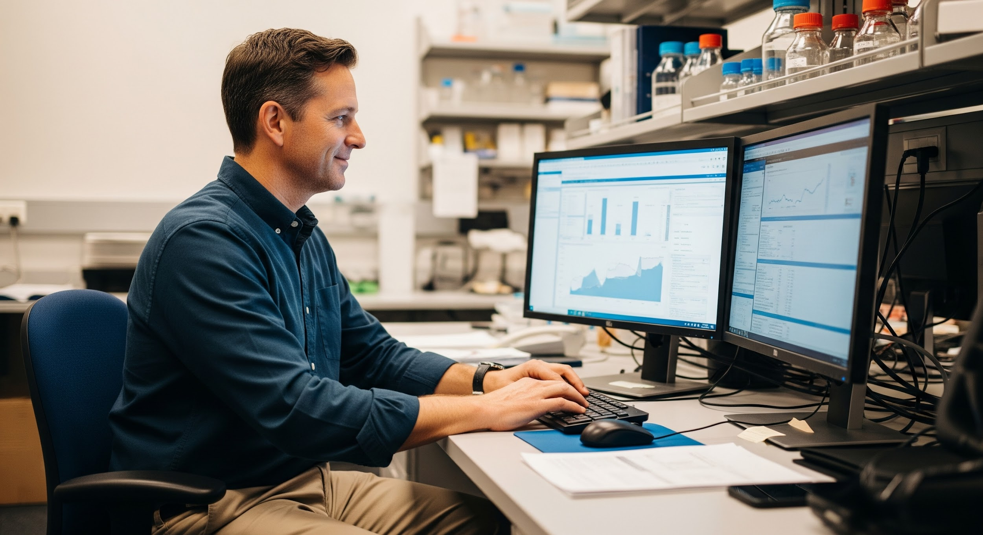


Published Research Trace: Certificate of Reproducibility
rerun pipelines
download data
verify analysis
interpret results

Slide 16
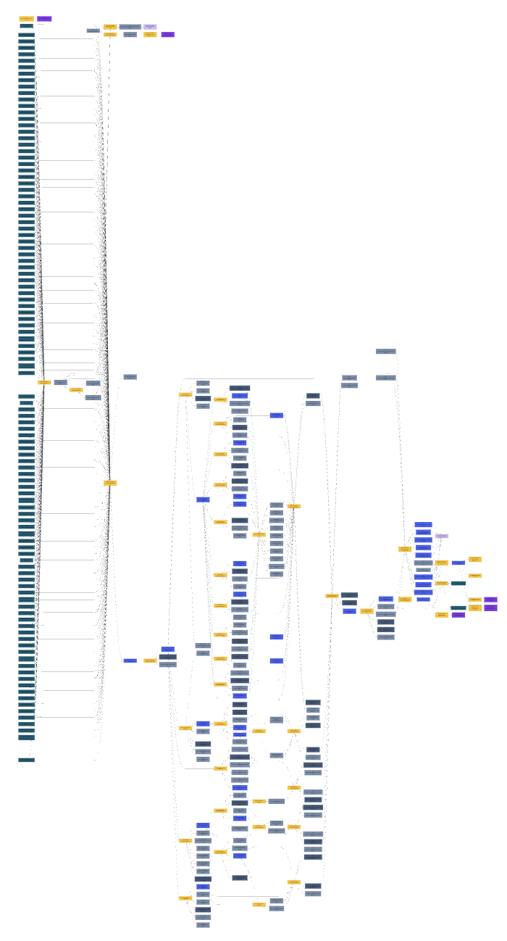
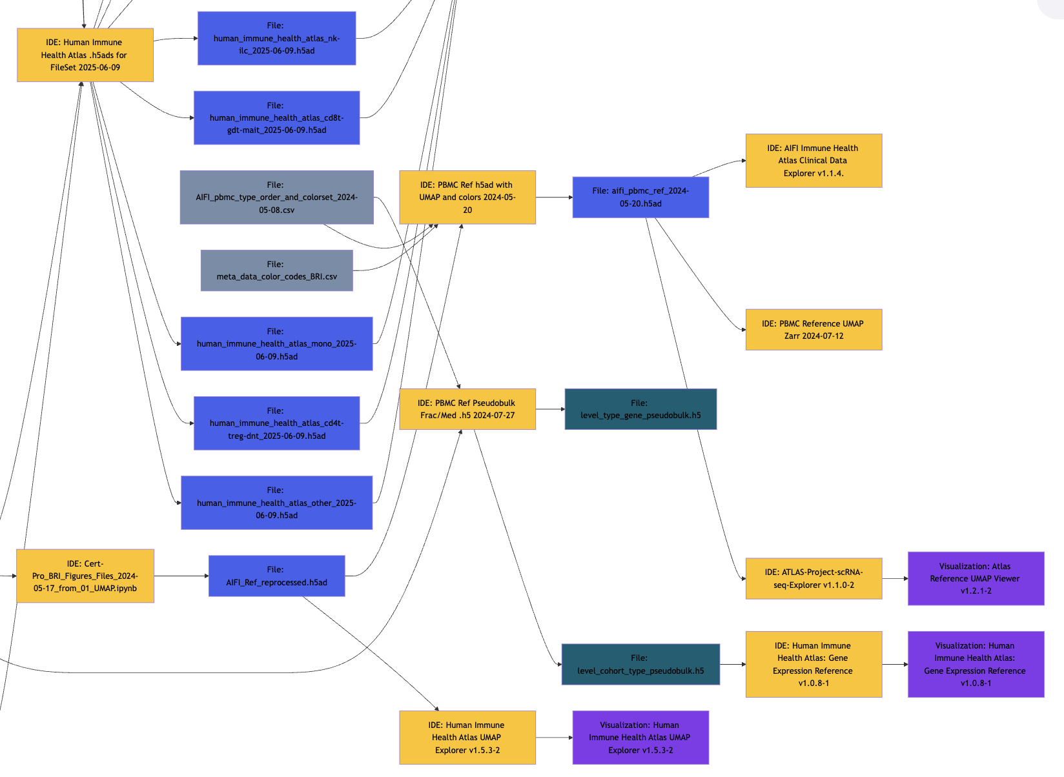

Certificates of Reproducibility: The Reality
Certificate trace from the Human Immune Health Atlas
92 automated pipeline runs
47 analysis steps
182 output files
results for 108 wet lab samples
More in our paper in Royal Academy Open Science:
Meijer P, Howard N, Liang J, Kelsey A, Subramanian S, Johnson E, et al.
Provide proactive reproducible analysis transparency with every publication.
R Soc Open Sci. 2025;12: 241936. doi:10.1098/rsos.241936
https://tinyurl.com/repro-article

Slide 17
Our Solution: A Comprehensive Platform Built for Reproducibility and Openness
research
traceability
governance
reproducibility
✔
✔
✔
✔
✔
complex multi-step analyses → capture research as it unfolds
transparent ongoing review → enable exact re-execution of steps
team collaboration → trace all tools and transformations
share data, analysis and results → directly from the computing platform
analysis reproducibility → share the research trace of the results
available, affordable, sustainable → ongoing usage guides governance

Slide 18
Available, Affordable, and Sustainable Research
What Does That Mean?
Data
Tools
Available
Keep data that is used for new studies or by the open science community
Available
Containerize tools and algorithms so they continue to run
Affordable
Archive all other data - abandoned analysis paths, data that has lost interest
Affordable
Discontinue tools along abandoned research traces
Sustainable
Evaluate data retention against regeneration via modern methods
Sustainable
Manage and upgrade containerized tools and algorithms with continued usage

Slide 19
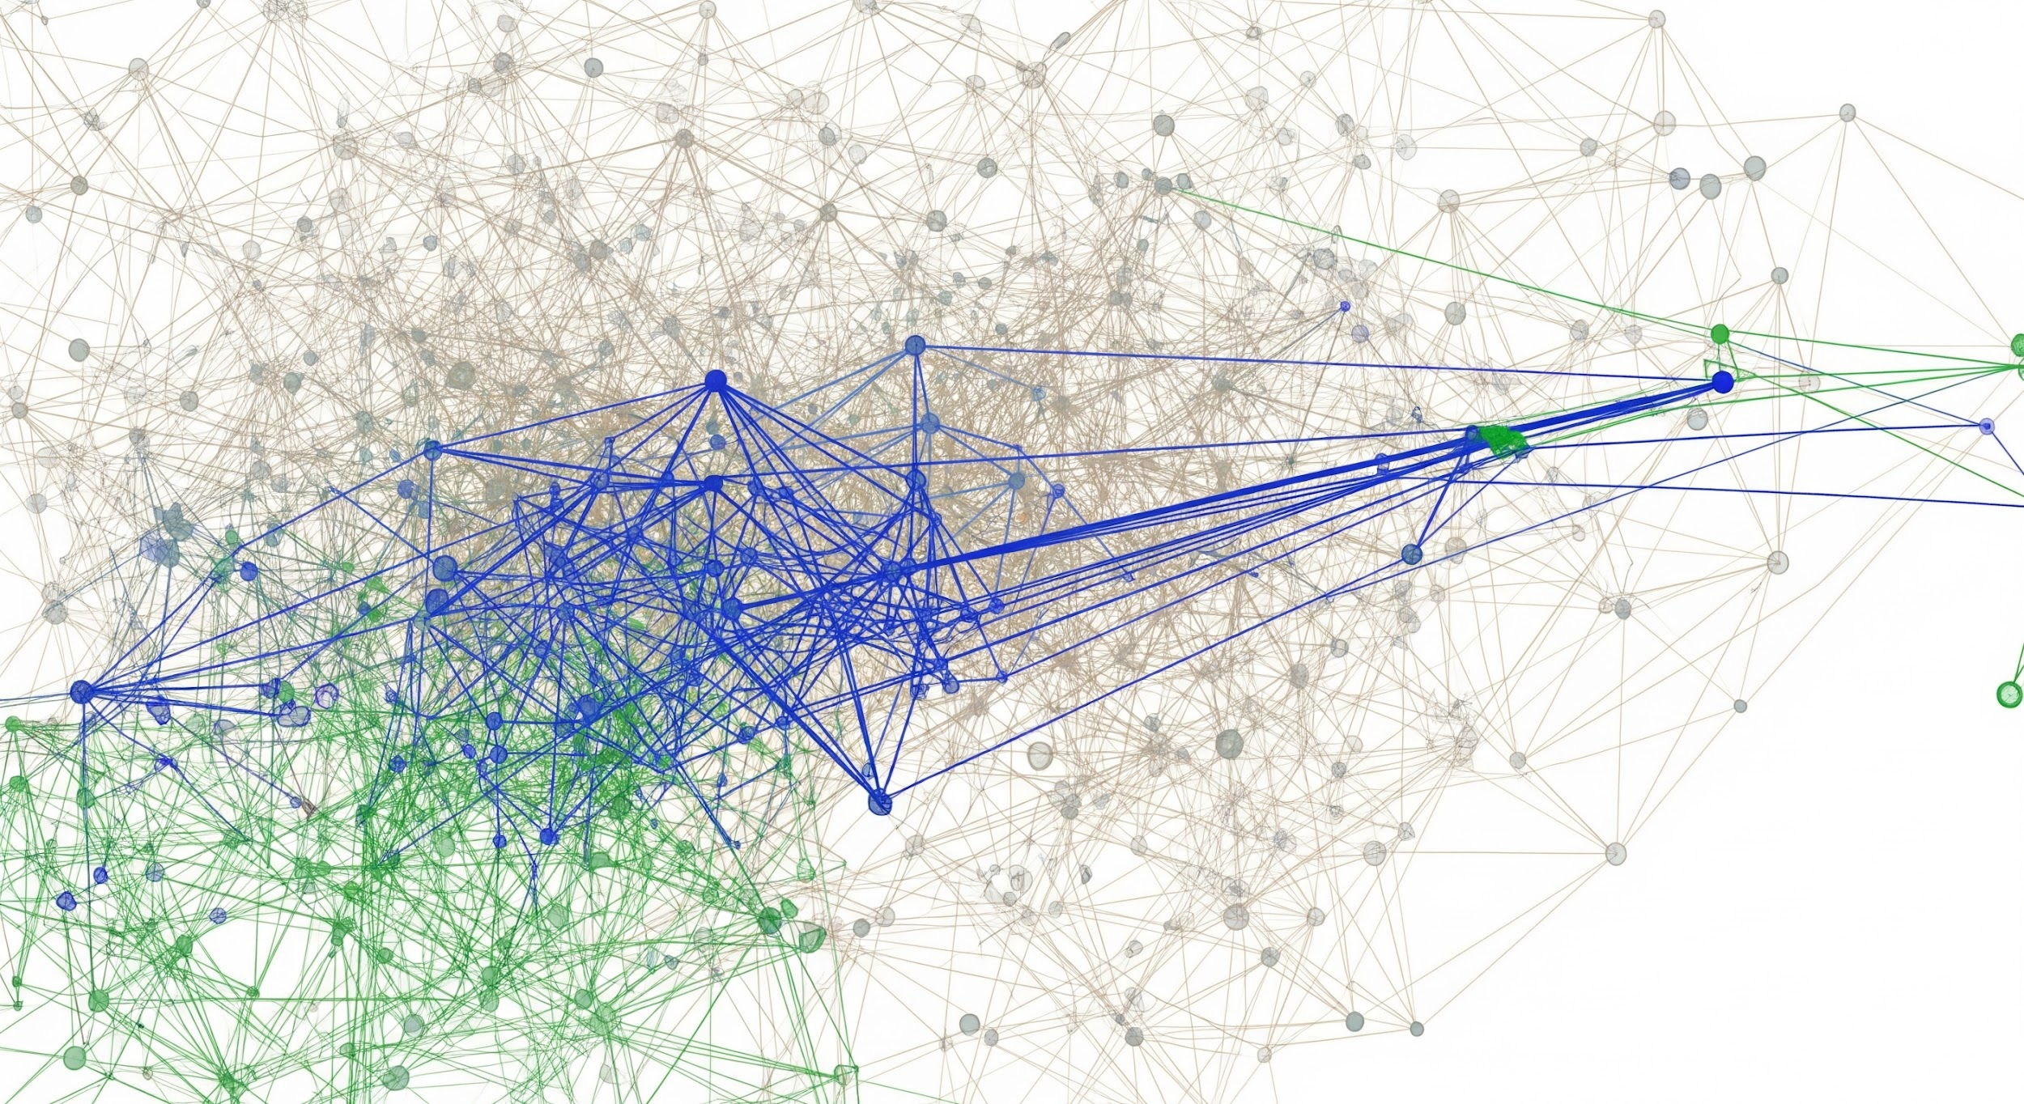
Not All Research Traces Are Published
archive data
discontinue tool
incomplete data
data quality issues
mistakes in analysis
tool execution failures
abandoned data explorations
unclear results
archive data
archive data

Slide 20
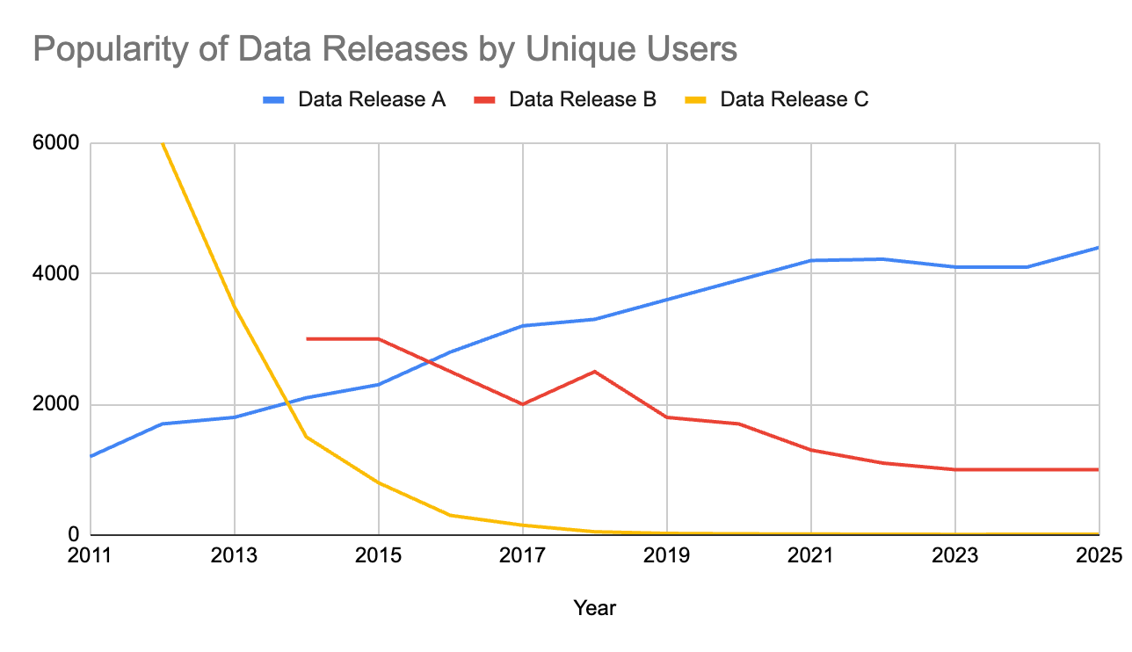
Not All Data Releases Remain Relevant
consider data archival savings
evaluate cost of tool maintenance

Slide 21
Research Traces Inform Sophisticated Data and Tool Governance Policies
Data age and size are arbitrary metrics for governance
Research traces reveal the true relevance of data and tools
collection
data ingest
data transformation
tool generation
storage
data persistence
tool containerization
utility
data usage
data archival
data deletion
tool execution
tool upgrade
tool removal

Slide 22

A Holistic View Of Sustainable Research
Enable Original Research
New hypotheses
Innovative data generation techniques
Novel algorithmic approaches
Support Open Science
Reproducibility and verification
Availability of reference data sets
Tool democratization
More in our paper in the Harvard Data Science Review:
Meijer, P. et al. (2025). Research Lifecycle Management: Using Analysis
Reproducibility Research Software to Define Contextual Data Governance Policies.
Harvard Data Science Review, 7(3). doi:10.1162/99608f92.08da1513.
https://tinyurl.com/reproGov
A Sustainable Approach To Science
Requires balancing financial health, infrastructure, and the expertise vital to both launch new research and promote robust open science engagement

Slide 23
In Summary: Transparent Interdisciplinary Analysis Drives Reproducible and Sustainable Research
Large scale, compute intense interdisciplinary research inherently requires...
Proactive traceability of analysis as it unfolds. Capturing every step enables…
Understanding the usage patterns of trace data and tools informs retention governance, optimizing resource allocation, allowing for more….
Releasing data with its research trace to ensure reproducibility, a cornerstone of scientific validity.

Slide 24
