Slide 1


Closing Thoughts on the Collective Intelligence of the 2025 Open Science Fair
Closing Keynote
17 September 2025
1615 - 1700
Auditorium A
Dr. Christopher Steven Marcum
https://orcid.org/0000-0002-0899-6143
Senior Fellow Center for Data Policy, Data Foundation

Slide 2
Closing Keynote
Disclosures
Ideas are my own unless otherwise stated. Slides are CC-BY.
Affiliated with PREreview, AGU, Data Foundation
but not representing them. No longer at White House.
Notes:
Throughout, I’ll highlight contributions from this meeting – including a selection of panels, posters, and interactions – if I don’t reference your work here, maybe I missed it or didn’t have room, and you think it’s relevant please reach out after and we can discuss integrations

Slide 3
Closing Keynote
Themes of this talk
Program review
Fusing forces
Collective intelligence
Notes:
Throughout, I’ll highlight contributions from this meeting – including a selection of panels, posters, and interactions – if I don’t reference your work here, maybe I missed it or didn’t have room, and you think it’s relevant please reach out after and we can discuss integrations

Slide 4
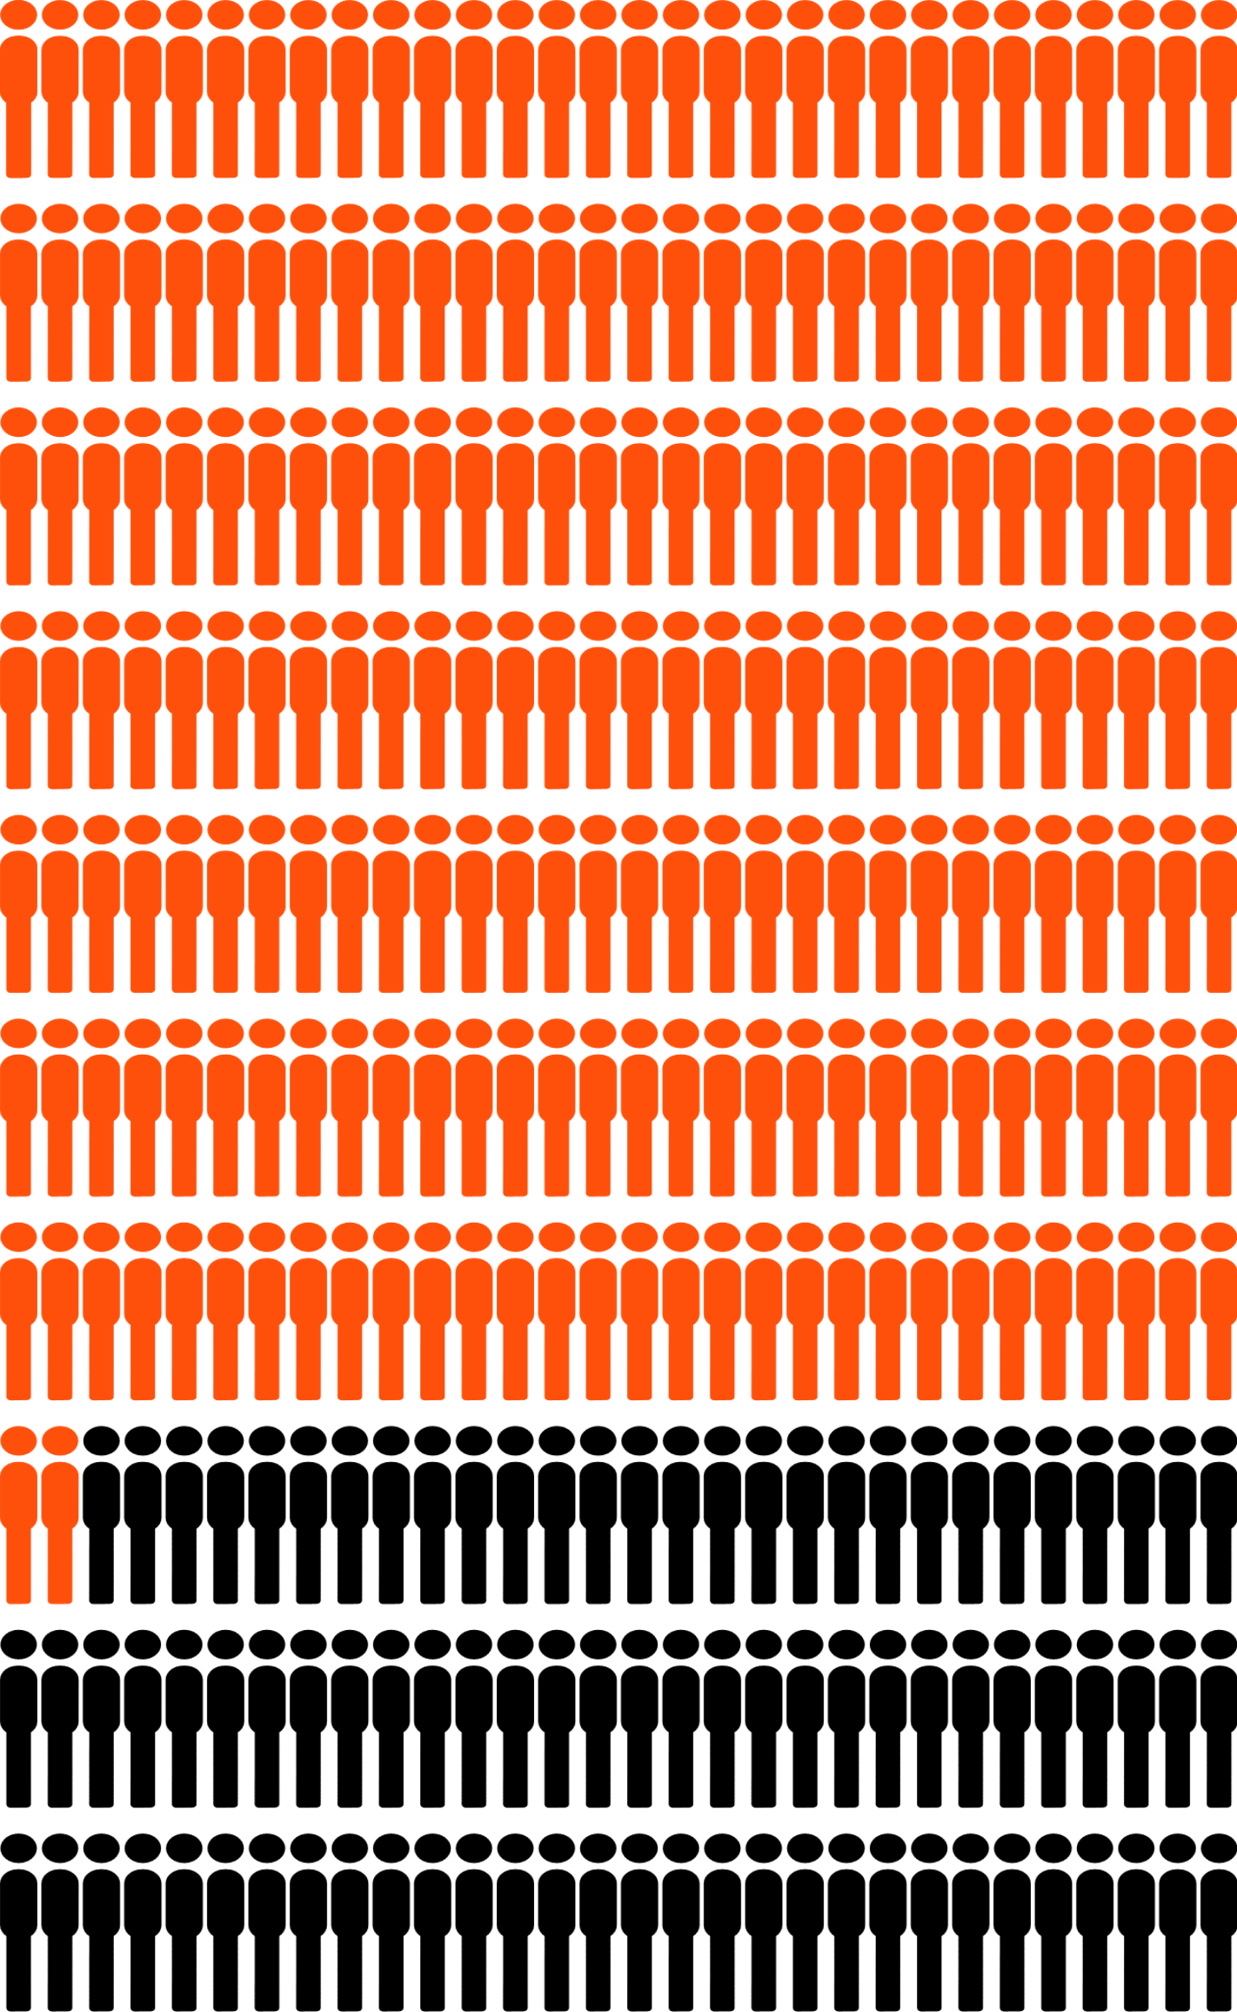






Closing Keynote
Programme Review
212 Contributors
>300 Participants
12
18
24
19
2
46
Notes:
Kamran showed before – 2 keynotes, including the fabulous opening keynote by Alexa McCray (standing on the shoulders of giants)

Slide 5
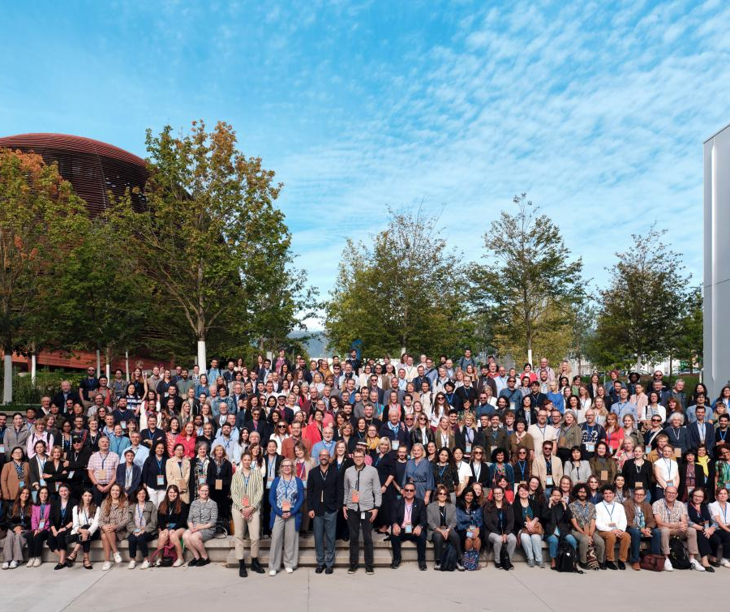
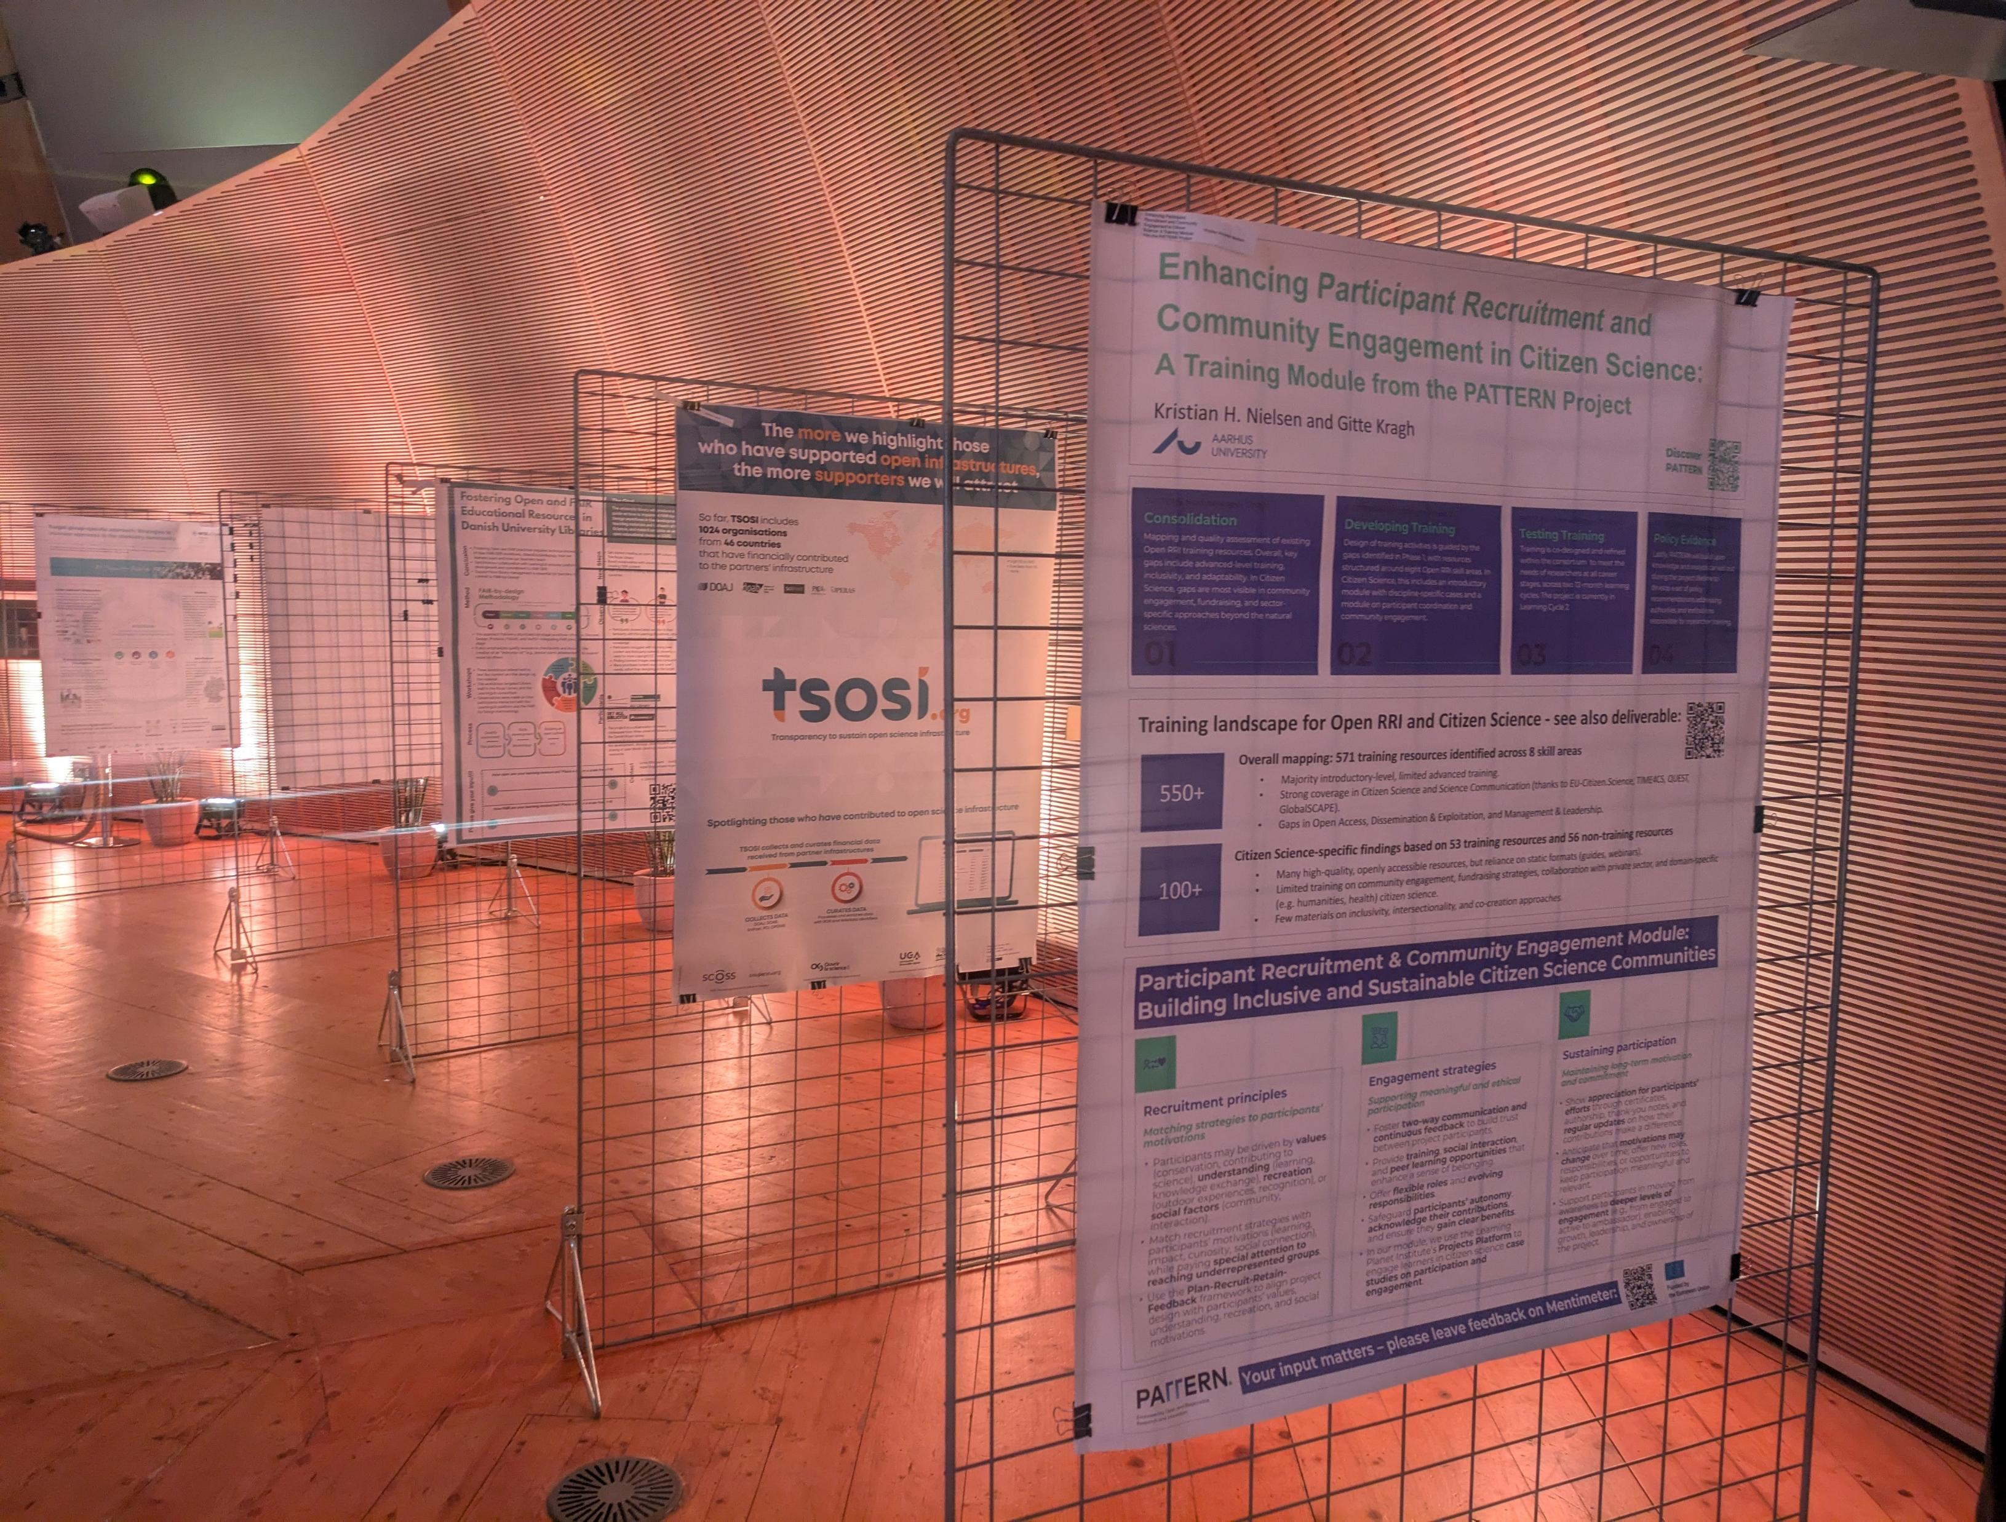
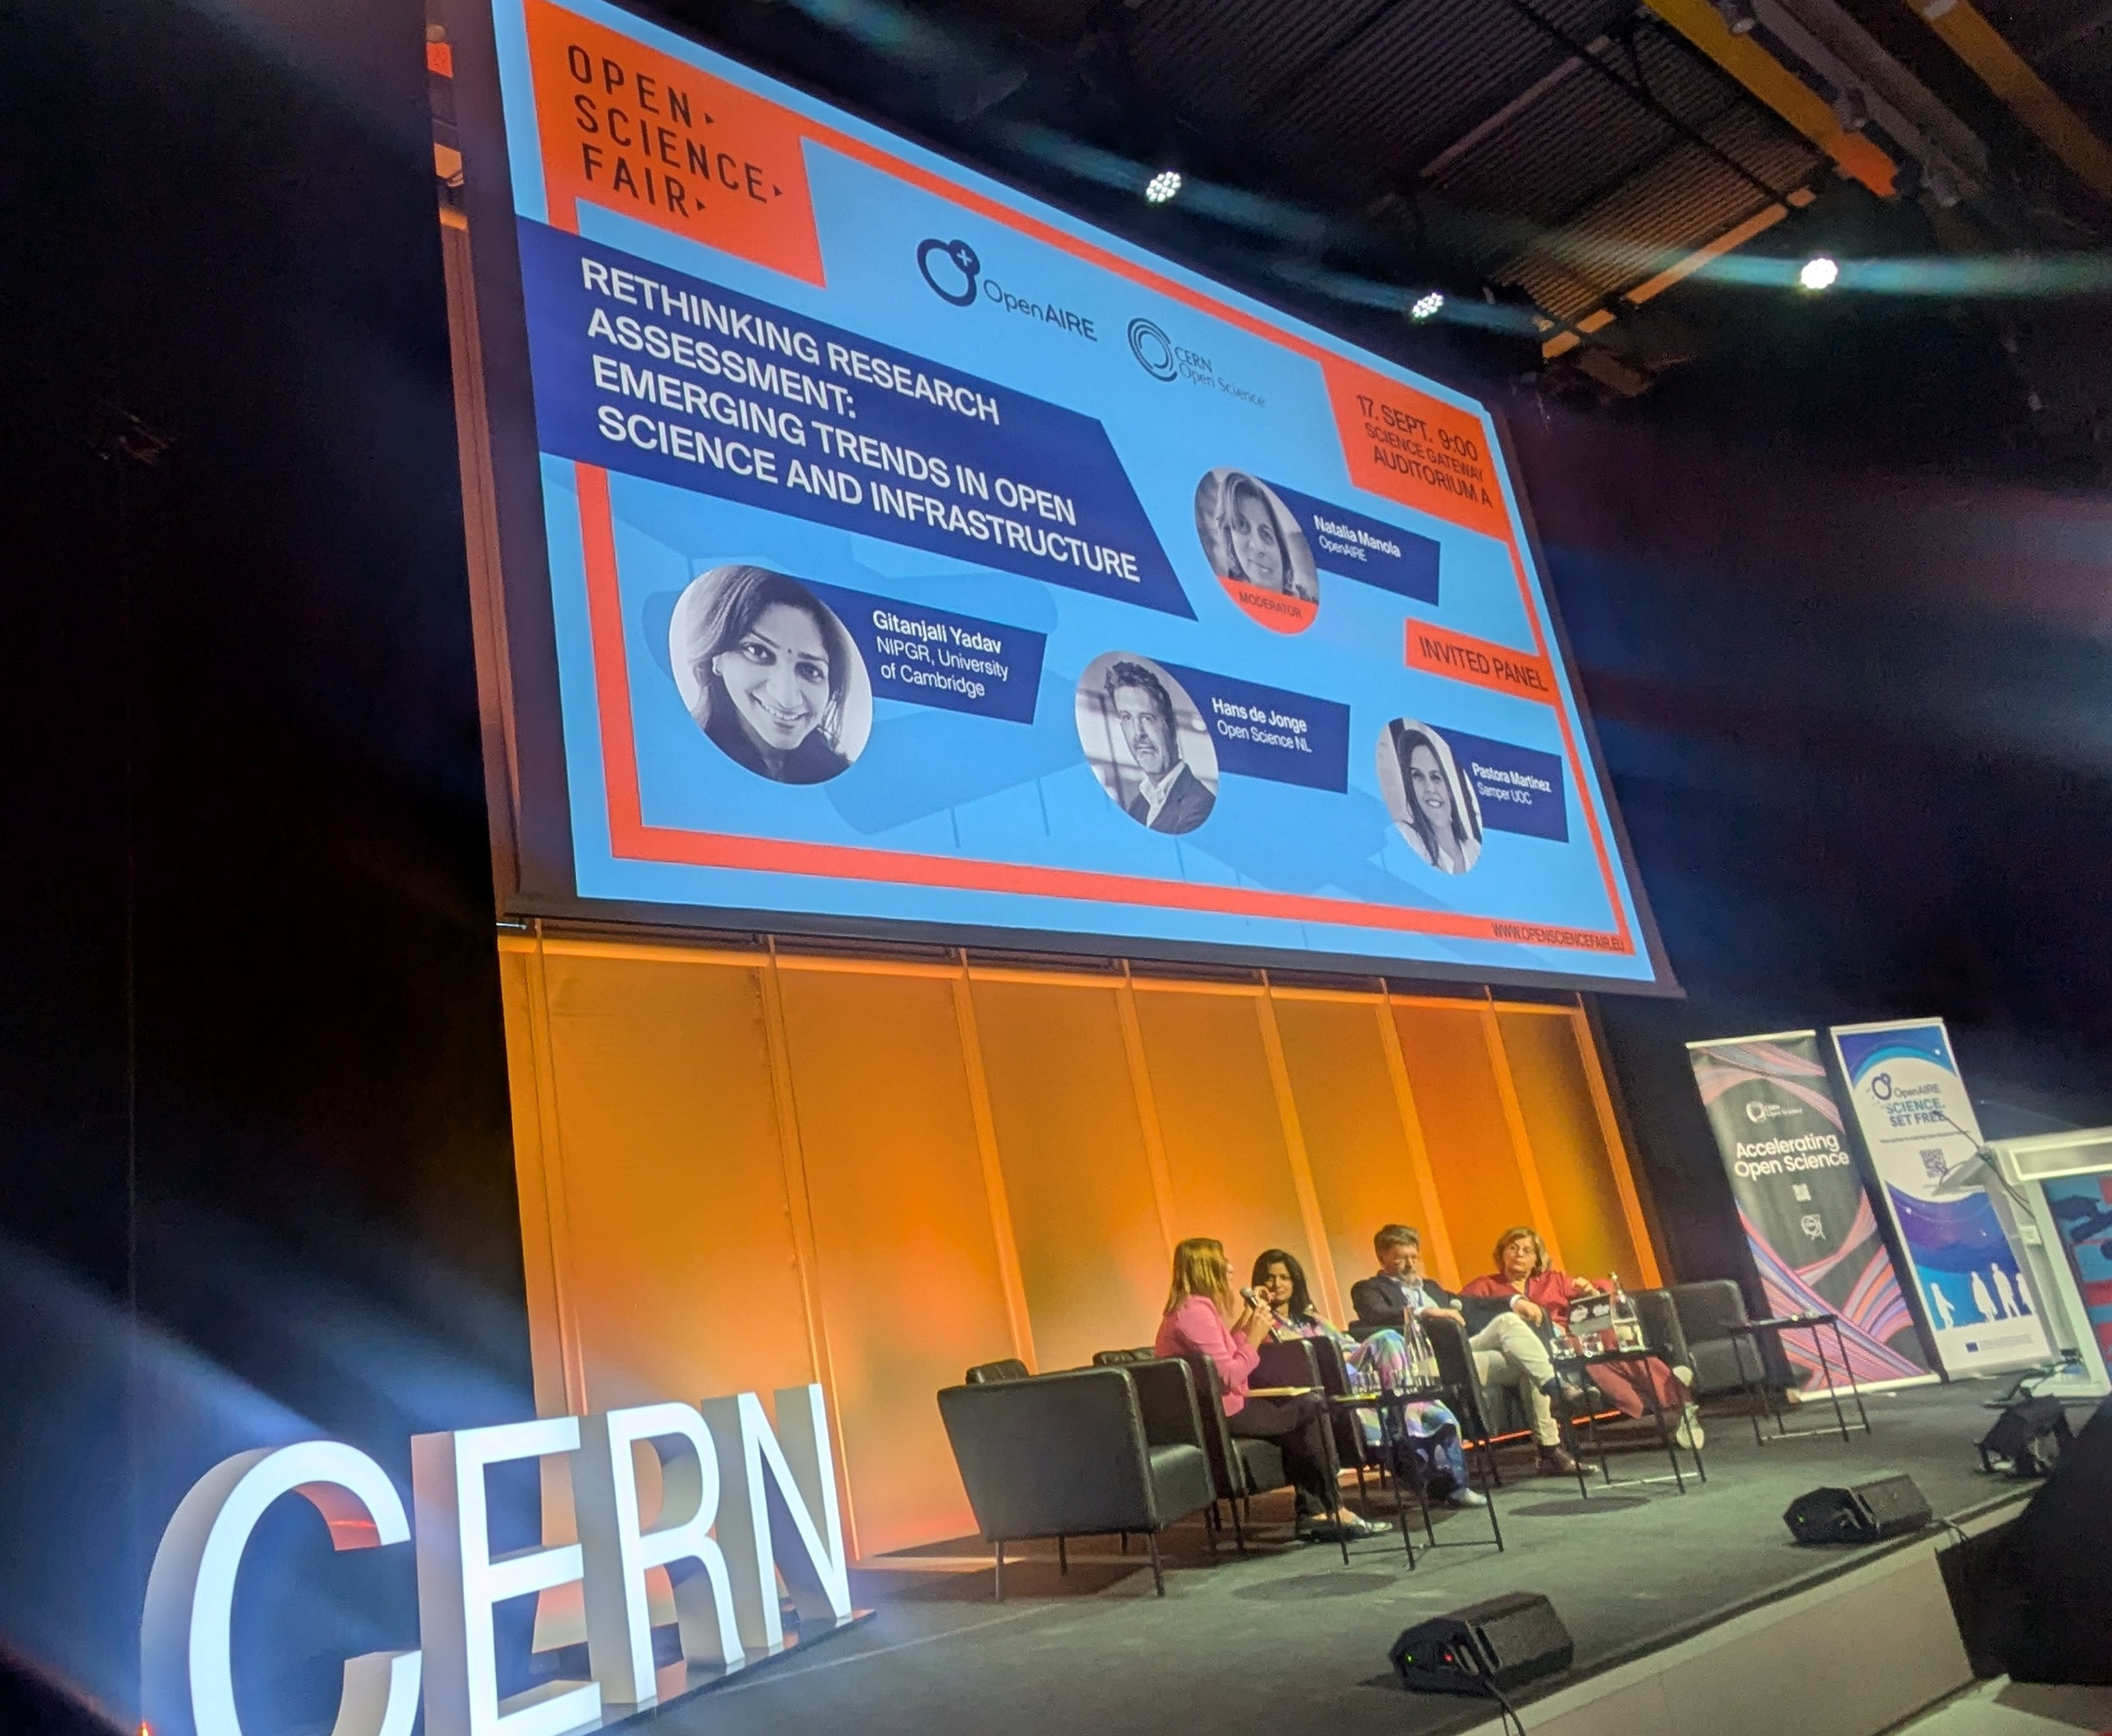
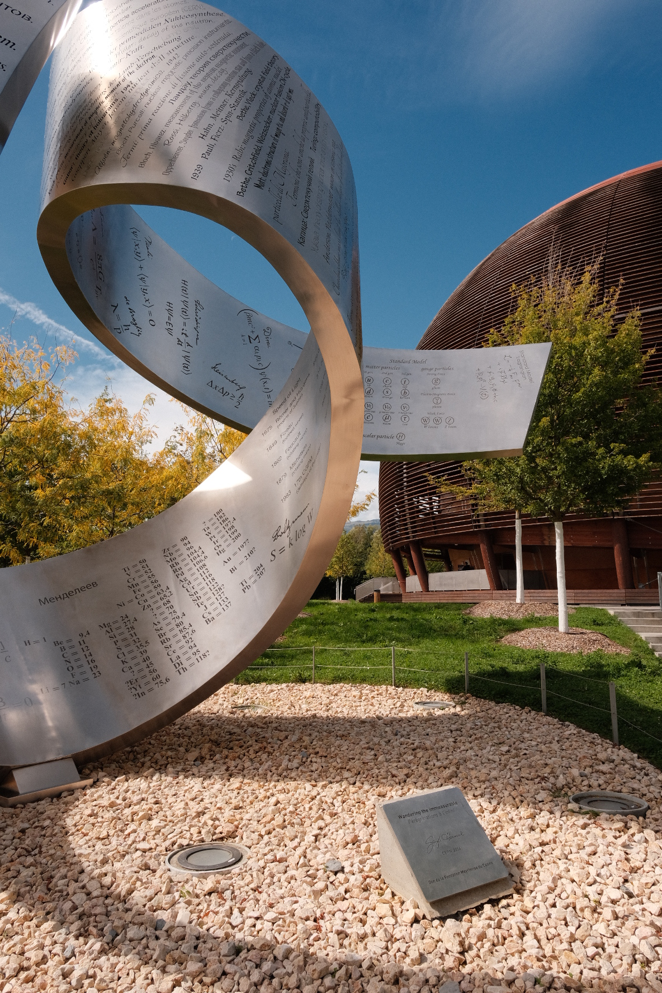
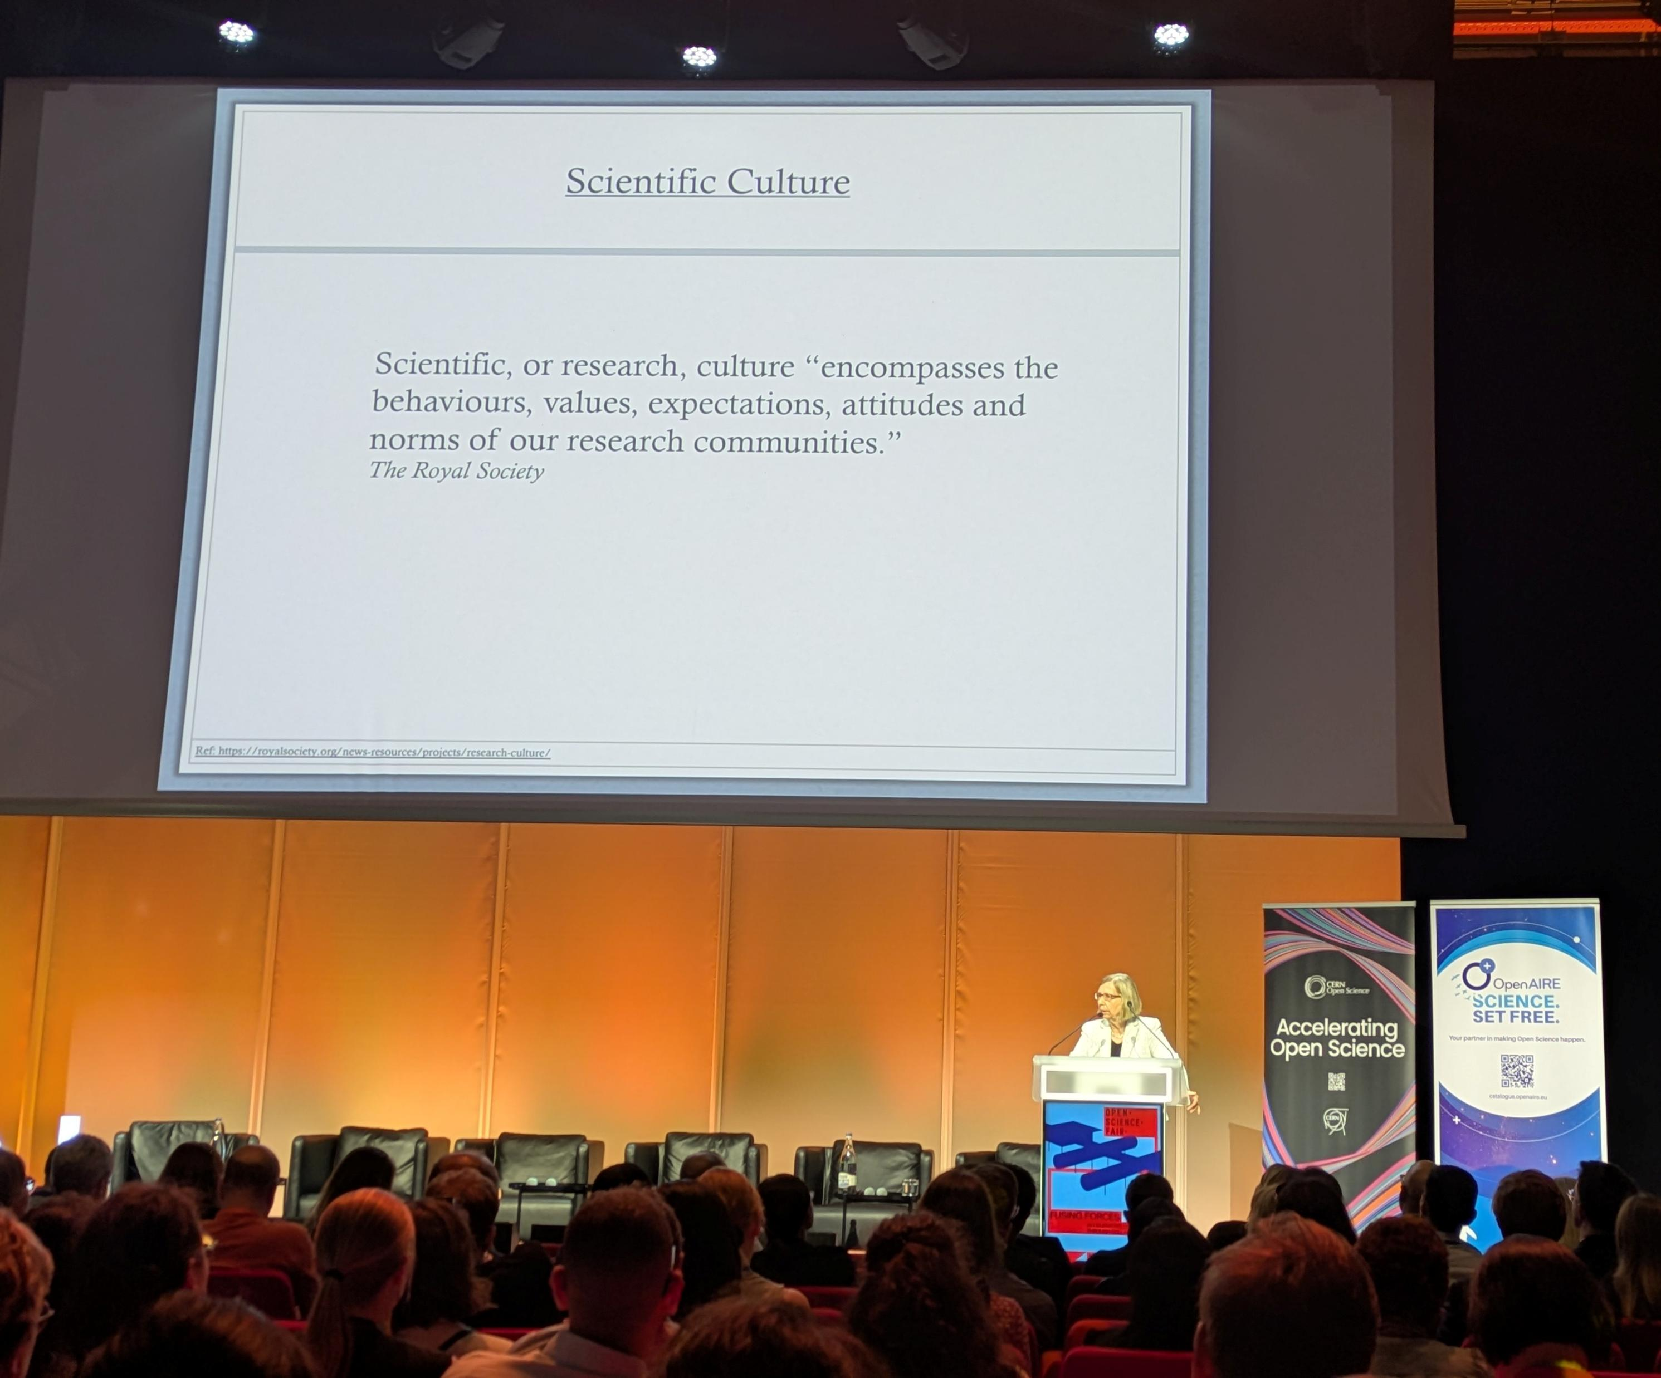
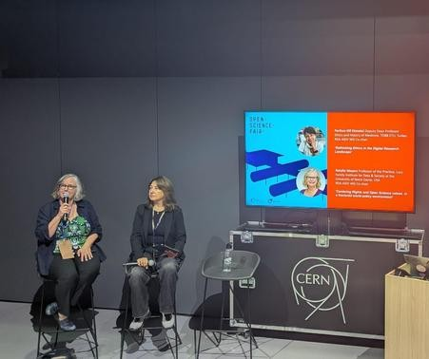
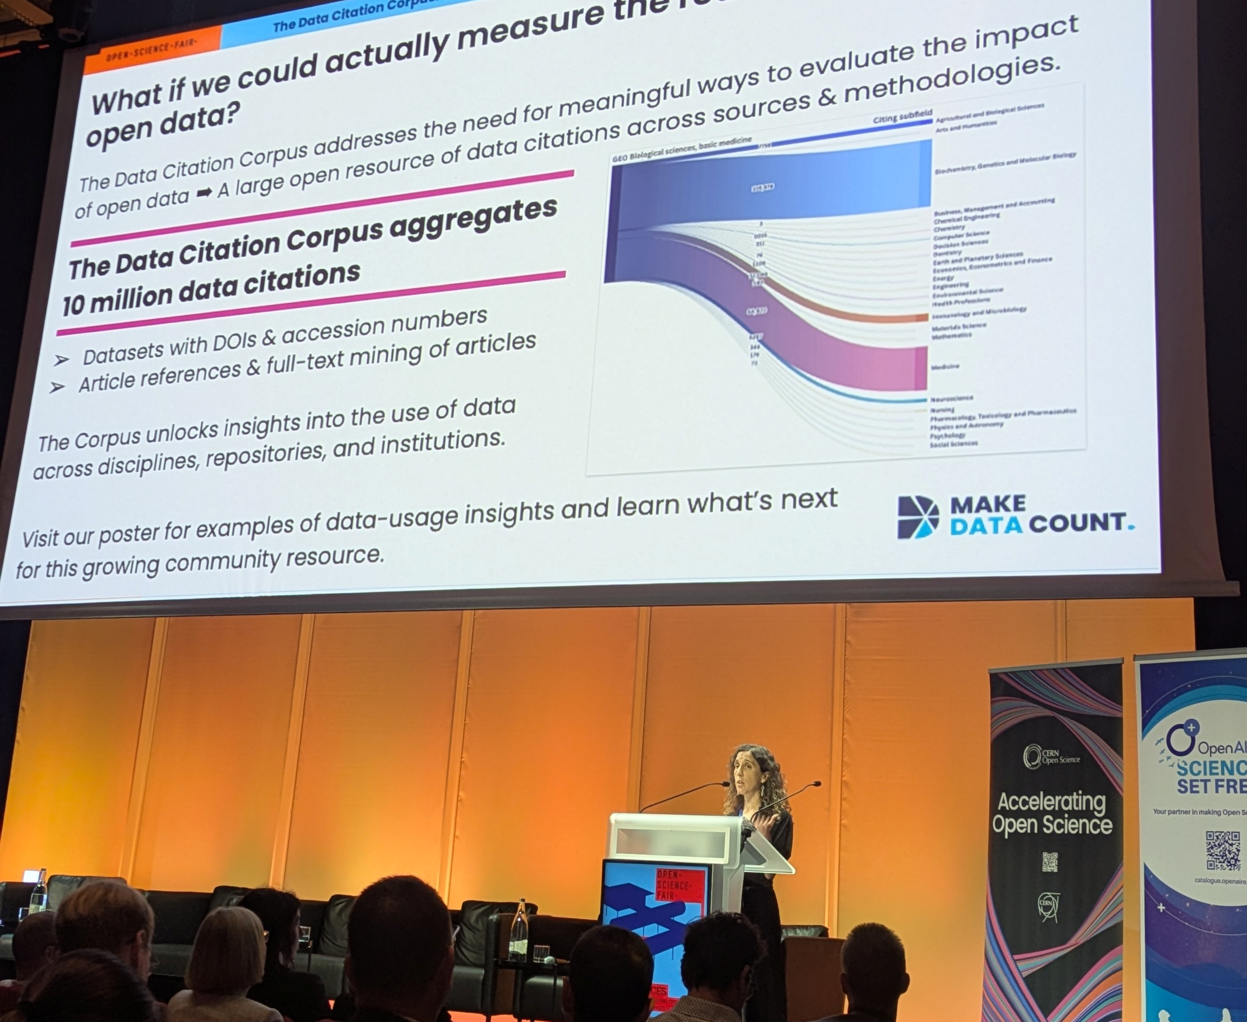

Slide 6
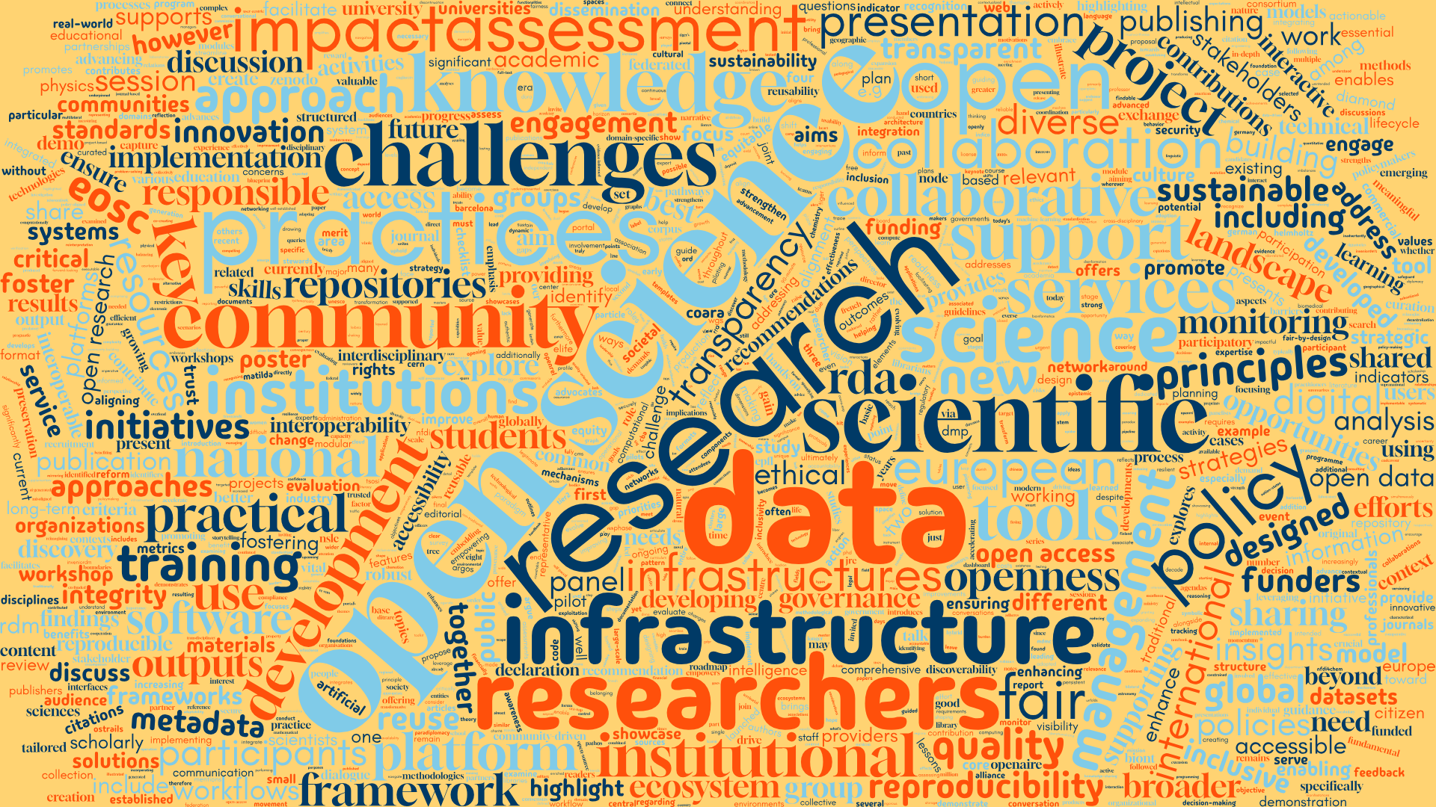
Closing Keynote

Slide 7
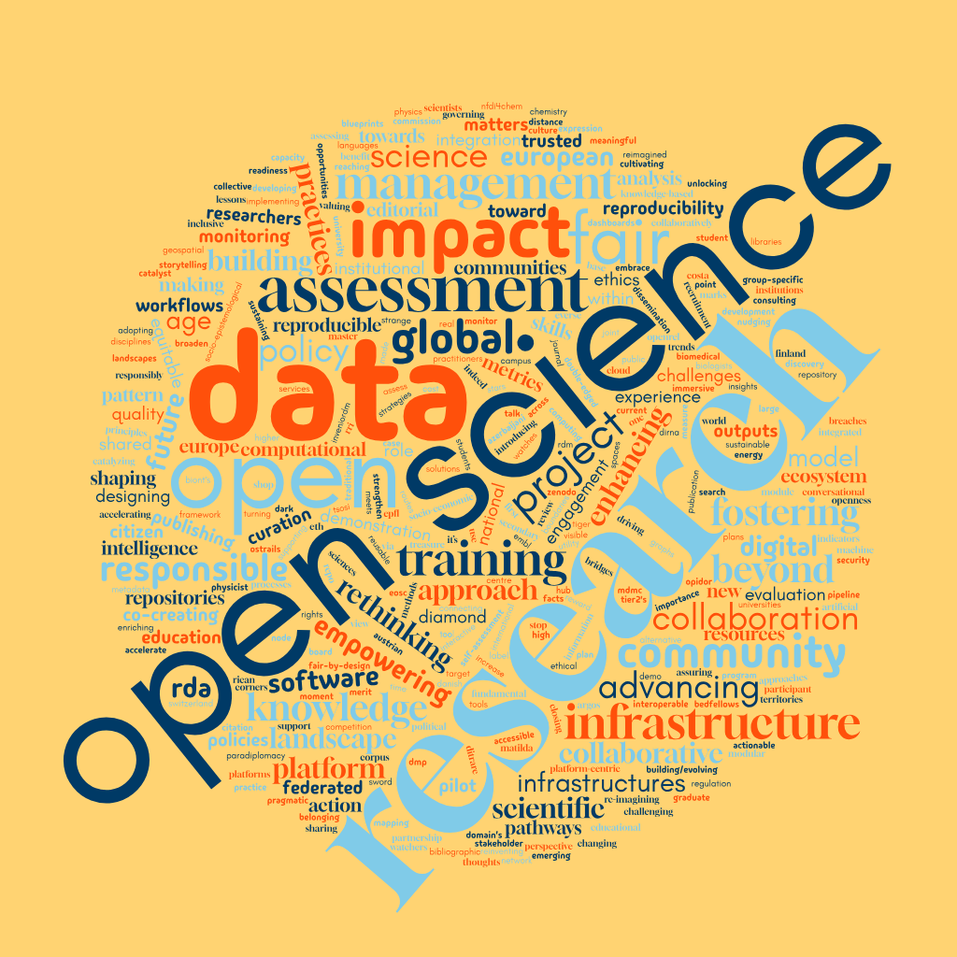
Closing Keynote
Just the titles!

Slide 9


Closing Keynote
Collaborations are our fusing forces
Notes:
Swiftly adopted open science

Slide 10
Closing Keynote
Revealing the hidden collaboration community among Open Science Fair contributors

Slide 11




Closing Keynote
Lookup contributor ORCID ids
Interrogate OpenAlex
Collect OpenAlex Records
Network Analysis
Revealing the hidden collaboration community among Open Science Fair contributors

Slide 12
Closing Keynote
Revealing the hidden collaboration community among Open Science Fair contributors

Slide 13
Closing Keynote
Revealing the hidden collaboration community among Open Science Fair contributors
Contributor A
Contributor B

Slide 14
Closing Keynote
Revealing the hidden collaboration community among Open Science Fair contributors
Contributor A
Contributor B
Collaboration

Slide 15
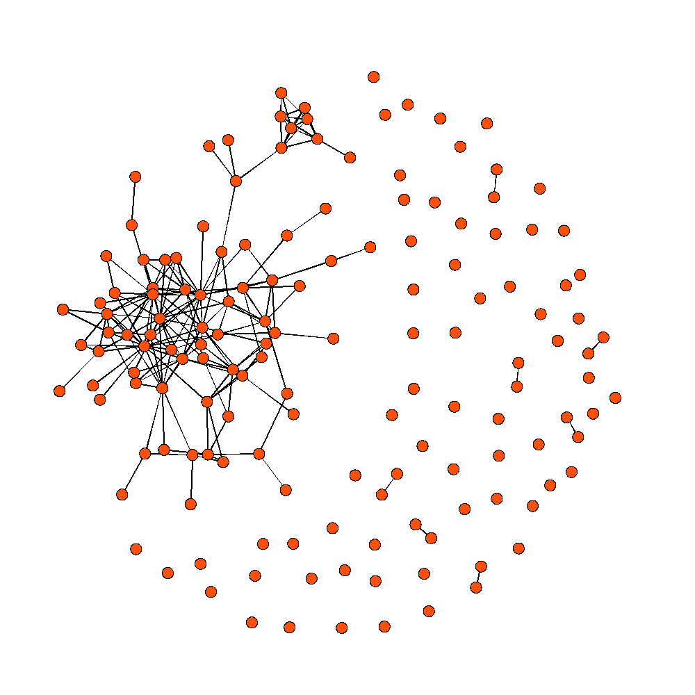
Closing Keynote

Slide 16
Closing Keynote
Subset of contributors with records (n=152)

Slide 17
Closing Keynote
Subset of contributors with records (n=152)
Highly connected main component

Slide 18
Closing Keynote
Subset of contributors with records (n=152)
Highly connected main component
Lots of opportunity for new collaborations

Slide 19
Closing Keynote
Proposal for a new collaboration:

Slide 20
Closing Keynote
Proposal for a new collaboration:
Build the record of versions.

Slide 21
Closing Keynote
What is the record of versions?
Roughly, a system of tracking, linking, and disclosing iterative versions of scholarly output.
Variously articulated by: Herbert Van de Sompel, Bianca Kramer, & Jeroen Bosman Bill Cope & Mary Kalantzis Others

Slide 22






Closing Keynote
What is the record of versions?
Roughly, a system of tracking, linking, and disclosing iterative versions of scholarly output.
Variously articulated by: Herbert Van de Sompel, Bianca Kramer, & Jeroen Bosman Bill Cope & Mary Kalantzis Others

Slide 23
Closing Keynote
What is the record of versions?
Roughly, a system of tracking, linking, and disclosing iterative versions of scholarly output.
Inclusive of any publisher’s Version of Record for manuscripts
NISO RP-8-2008: https://www.niso.org/publications/niso-rp-8-2008-jav

Slide 24
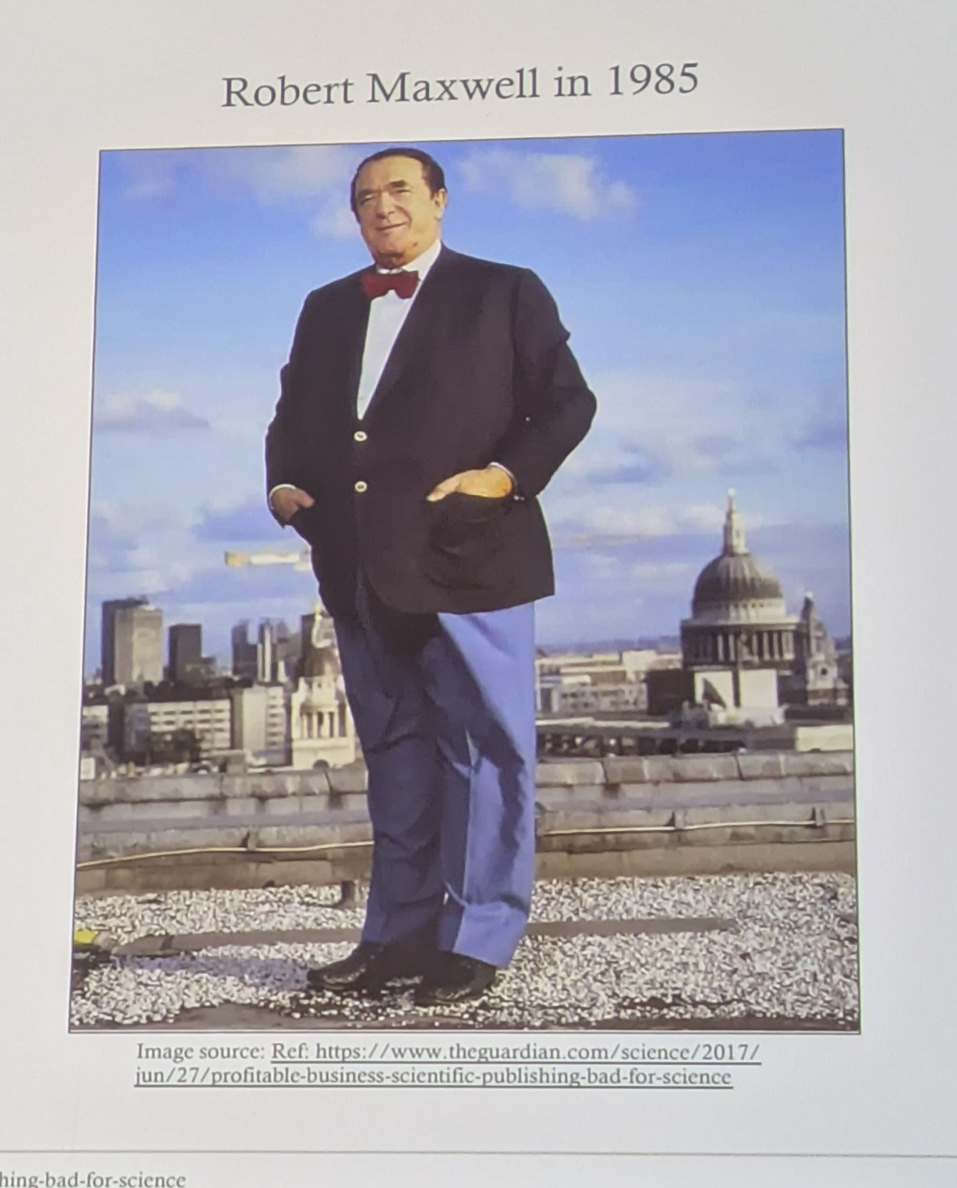
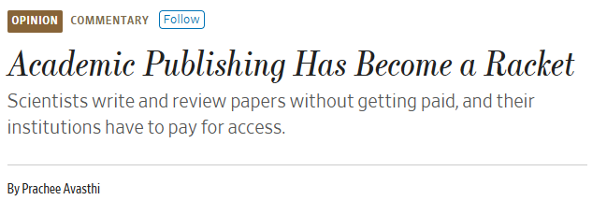
Closing Keynote
What is the record of versions?
Roughly, a system of tracking, linking, and disclosing iterative versions of scholarly output.
Inclusive of any publisher’s Version of Record for manuscripts
“Why have policies that reward the status quo when we have equitable alternatives?”
-Paraphrasing Joeri Both at OSFAIR 2025
NISO RP-8-2008: https://www.niso.org/publications/niso-rp-8-2008-jav
Notes:
Three things happened on Monday that had me reconsider: Alexa McCray’s keynote remarks about Robert Maxwell, Comment from (Joeri Both) on why enabling publishers in response to the ERA panel, and then Prachee Avasthi from Acardia published this editorial in the WSJ

Slide 25
Closing Keynote
What is the record of versions?
Roughly, a system of tracking, linking, and disclosing iterative versions of scholarly output.
Inclusive of any publisher’s Version of Record for manuscripts
NISO RP-8-2008: https://www.niso.org/publications/niso-rp-8-2008-jav
Notes:
Three things happened on Monday that had me reconsider: Alexa McCray’s keynote remarks about Robert Maxwell, Comment from (Joeri Both) on why enabling publishers in response to the ERA panel, and then Prachee Avasthi from Acardia published this editorial in the WSJ

Slide 26
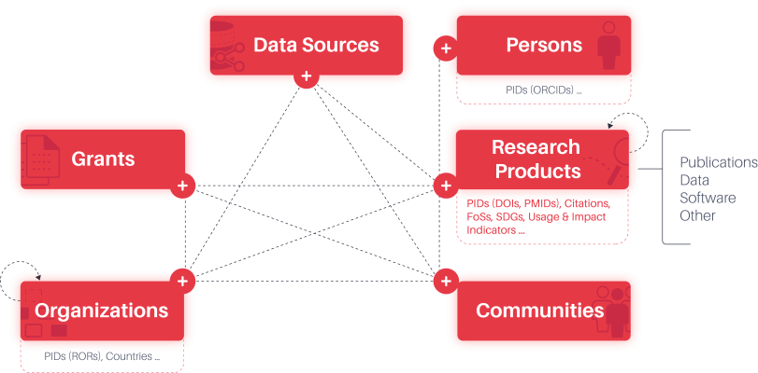
Closing Keynote
What is the record of versions?
OpenAIRE Graph Data Model
Embedded within the larger network of scholarly activity
https://graph.openaire.eu/what-is-the-openaire-graph#Id-Model

Slide 27
Closing Keynote
What is the record of versions?
OpenAIRE Graph Data Model
Embedded within the larger network of scholarly activity
https://graph.openaire.eu/what-is-the-openaire-graph#Id-Model

Slide 28
Closing Keynote
Why the record of versions?

Slide 29
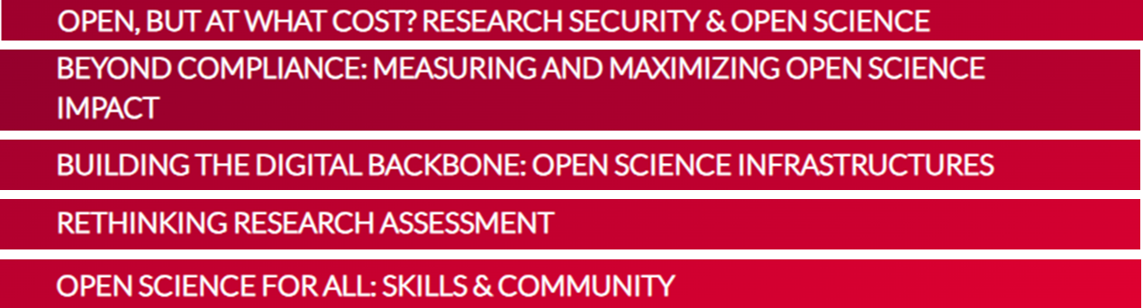
Closing Keynote
Why the record of versions?
Consider the #OSFAIR2025 Tracks
Notes:
Manifest in the collective intelligence of the program: enhances research security and accountability, demonstrates the broader impact of science, founded through critical science infrastructure, provides a wider/more equitable base for research assessment, and replaces an unattainable standard for many with attainable standards for all

Slide 30
Closing Keynote
Why the record of versions?
Consider the #OSFAIR2025 Tracks
Notes:
Convo this morning with Kamran and the plenary panel moderated by Natalia Manola – we need infrastructural support to enable reform of the incentive and reward system as we rethink research assessment

Slide 31
Closing Keynote
Desirable Characteristics for a Record of Versions
Open
Agnostic
Integrative
Collaborative
Sustainable
Let’s refine this
proposal together

Slide 32
Closing Keynote
Desirable Characteristics for a Record of Versions
1. Open

Slide 33





Closing Keynote
Desirable Characteristics for a Record of Versions
1. Open
The entire stack should reflect the values of open science.

Slide 34
Closing Keynote
Desirable Characteristics for a Record of Versions
2. Agnostic

Slide 35
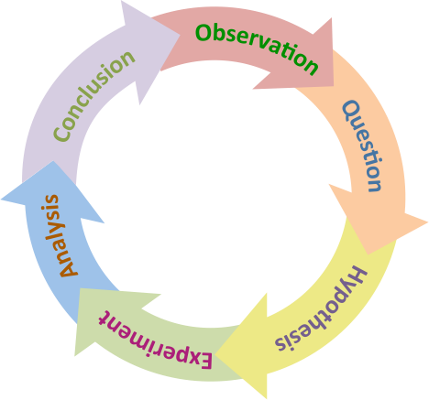
Closing Keynote
Desirable Characteristics for a Record of Versions
2. Agnostic
Records should be accessionable
anywhere in the research lifecycle.
Notes:
Thought a lot about the day one panels on policy and equitable publishing – focus remains on output with some element or pretense of finality –

Slide 36
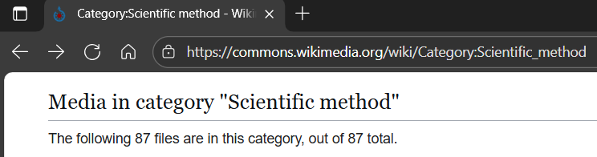
Closing Keynote
Desirable Characteristics for a Record of Versions
2. Agnostic
Records should be accessionable
anywhere in the research lifecycle.

Slide 37
Closing Keynote
Desirable Characteristics for a Record of Versions
3. Integrative

Slide 38
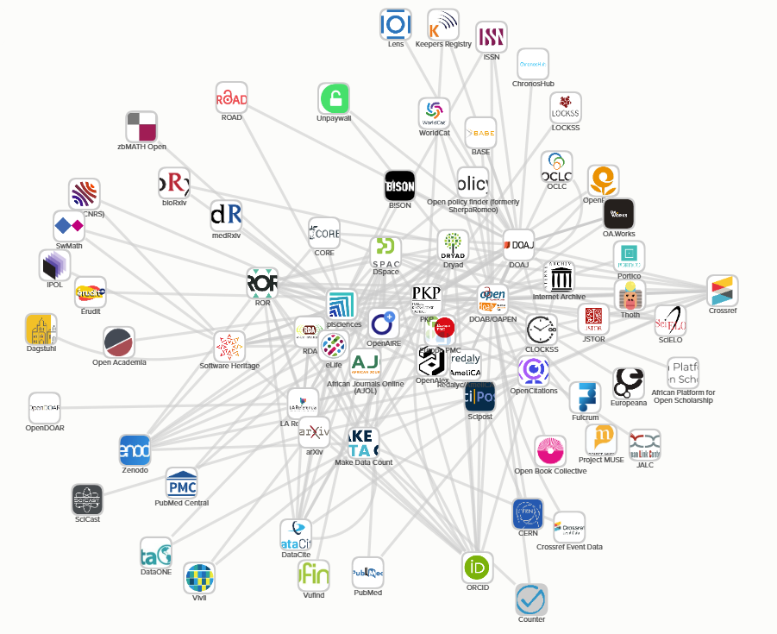
Closing Keynote
Desirable Characteristics for a Record of Versions
3. Integrative
Compatible with existing and emergent systems.
https://scoss.org/smart-investments-shared-impact-strengthening-the-open-infrastructure-ecosystem/
Notes:
Invenio, openAIRE graph, datacite, zenodo, and many others

Slide 39
Closing Keynote
Desirable Characteristics for a Record of Versions
4. Collaborative

Slide 40



Closing Keynote
Desirable Characteristics for a Record of Versions
4. Collaborative
Effort should involve relevant stakeholders and draw from lessons learned.
Notes:
As Felix Reda said during day one panel in the Q&A, collaborations can be planned or informal as we see in the open source community

Slide 41
Closing Keynote
Desirable Characteristics for a Record of Versions
5. Sustainable

Slide 42
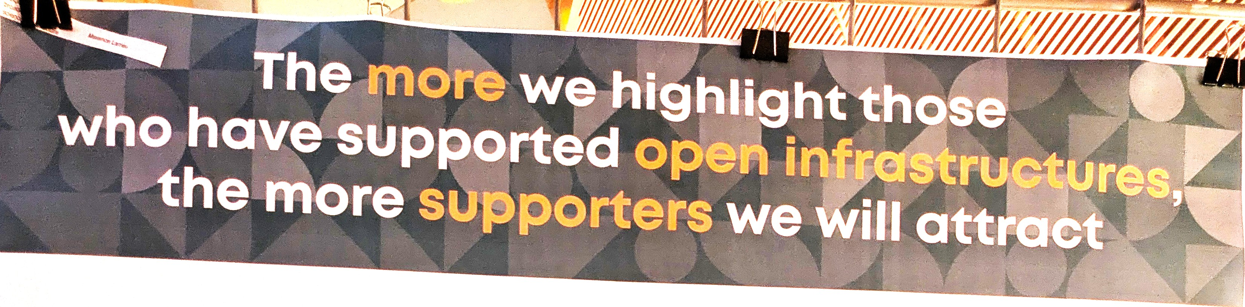
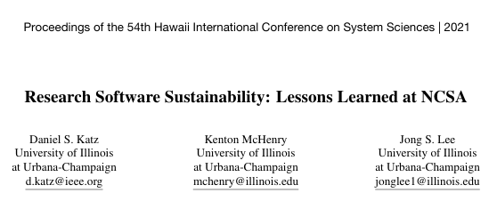

Closing Keynote
Desirable Characteristics for a Record of Versions
5. Sustainable
Support for short- and long-term work should draw from a mixture of resources.
https://indico.cern.ch/event/1484392/contributions/6542364/
https://doi.org/10.24251/HICSS.2021.873
Notes:
Alex Ionnidis from Zenodo talk that open science comes at a cost - lessons learned on funding sustainability – combination of altruism, private funding, public funding – tsosi proposal is that acknowledgment is mutually reinforcing Shared funding models - PREreview

Slide 43
Closing Keynote
Desirable Characteristics for a Record of Versions
Open
Agnostic
Integrative
Collaborative
Sustainable
What is missing/needs revision?
What are the barriers?
Notes:
WIP

Slide 44
Closing Keynote
Desirable Characteristics for a Record of Versions
Open
Agnostic
Integrative
Collaborative
Sustainable
What is missing/needs revision?
What are the barriers?

Slide 45

Closing Keynote
Barriers and Roadblocks for a Record of Versions
Cultural inertia
Financial interests
Competition

Slide 46
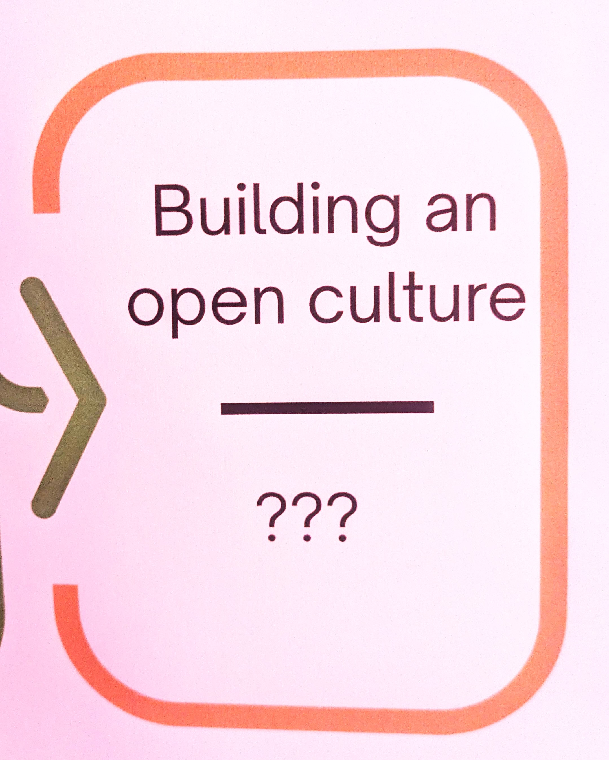
Closing Keynote
Barriers and Roadblocks for a Record of Versions
Cultural inertia
Financial interests
Competition
https://www.opensciencefair.eu/posters/fostering-open-and-fair-educational-resources-in-danish-university-libraries

Slide 47
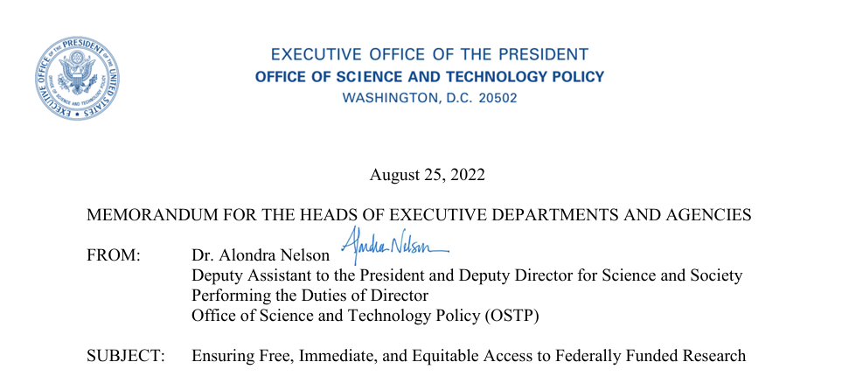
Closing Keynote
Notes:
Short historical detour – so many focus on the removal of the embargo of the doubling-down on data sharing BUT there’s another major component of the requirements of the memo

Slide 48
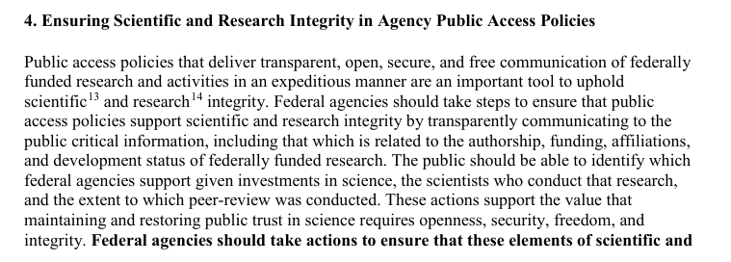
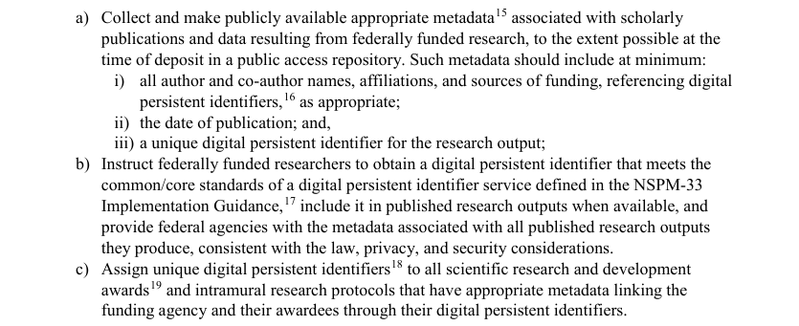
Closing Keynote
Persistent identifiers
Notes:
Defined to be non-proprietary with a metadata schema with certain features

Slide 49

Closing Keynote
ORCIDs
RORs
DOIs
Notes:
Idea was to track research outputs throughout their lifecyle – linking individuals, institutions, grant awards, and outputs had a much longer timeline for adoption not because agencies weren’t technologically ready to do it but because many were not culturally ready – it’s the single aspect of the memo where we found the most resistance – NLM, for instance felt that DOIs were a threat to PMIDs and other agencies felt it was over-reach to require grantees and intramural scientists to get an ORCID. None of the agencies thought they needed a ROR.

Slide 50
Closing Keynote
Barriers and Roadblocks for a Record of Versions
Cultural inertia
Financial interests
Competition
Notes:
Back from that detour - Talked about costs with sustainability; obviously organizations that believe in the supremancy of the VoR want to maintain the status quo; and we as a community have, ironically, invested infrastructure that have often become silos or insulated

Slide 51
Closing Keynote
Coordinate and collaborate to reduce barriers.
Notes:
I certainly do not have the technical insight to tell you how to build the record of versions – here I’ve outlined what the collective intelligence of the community would like to see should we do it – I can tell you, though that I am certain that coordination and collaboration will reduce the barriers to getting it done.

Slide 52
Closing Keynote
Coordinate and collaborate to reduce barriers.
https://scoss.org/smart-investments-shared-impact-strengthening-the-open-infrastructure-ecosystem/

Slide 53
Closing Keynote
Lots of opportunity to fuse forces.

Slide 54
Closing Keynote
Collective intelligence take home from #OSFAIR2025
Institutional need – Research assessment and reform
Technological readiness – Rich infrastructural programs and pilots
Collaborative capacity – Overlapping networks
Notes:
Needed for reform of the reward and incentive structure – all of the projects highlighted at the fair and beyond demonstrate we have the technical capability – and this meeting has shown that we have the collaborative capacity . So, I hope what you’ll take home to your organization and institution, to your projects and teams, is a question: how can what we do link up with what

Slide 55
Closing Keynote
Thank you.
Christopher.Steven.Marcum@gmail.com

Slide 56
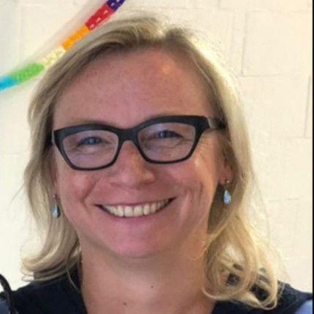
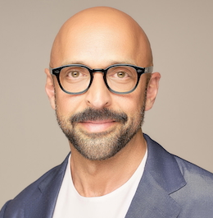
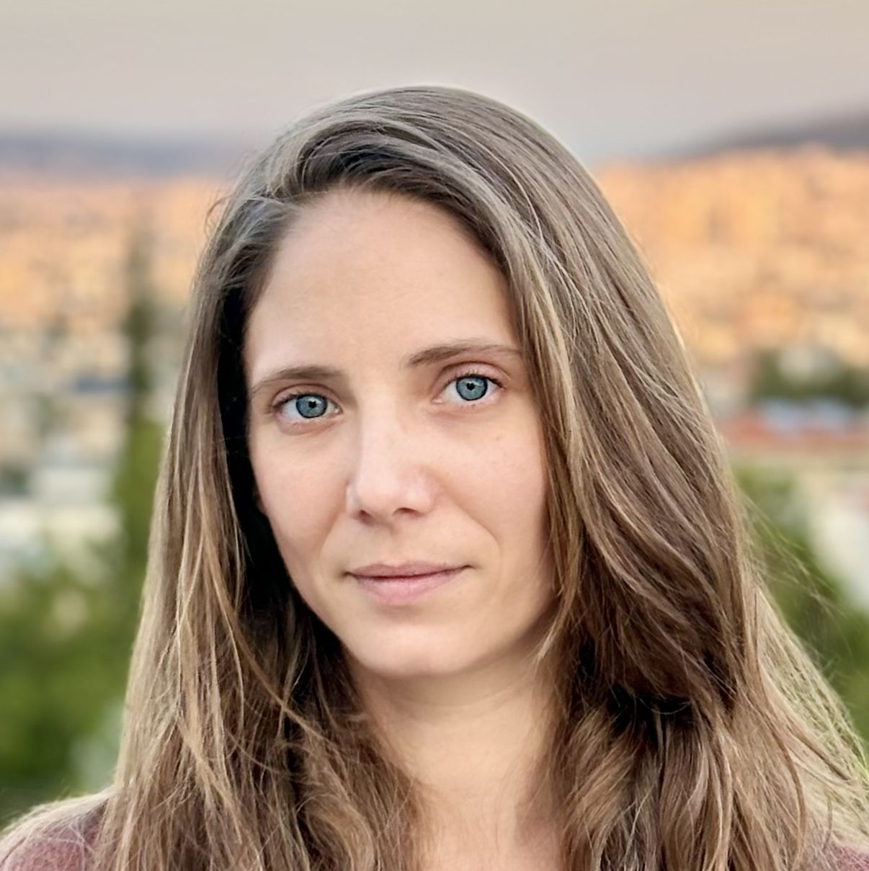
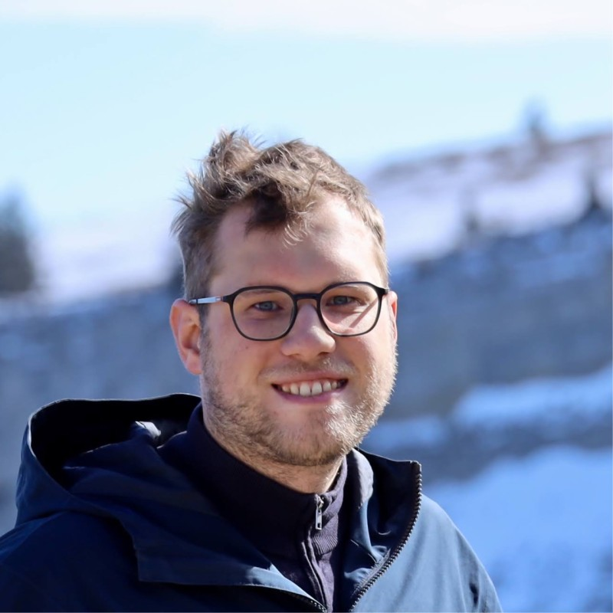
Closing Keynote
Special thanks
Also:
#OSFAIR2025 notetakers for their work
Martin Fenner for reviewing slides

Slide 57
Closing Keynote

