Slide 1
Open Science Fair 2025
Concluding remarks
Programme Committee co-chairs:
Inge Van Nieuwerburgh & Kamran Naim

Slide 2
Poster Competition

Slide 3
Target group-specific approach of NFDI4Chem:
Strategies to increase openness in the chemistry community
Annett Schröter
Friedrich Schiller University Jena

Slide 4
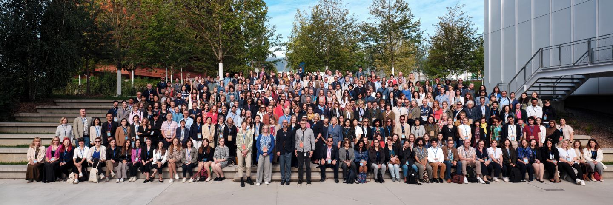
Thank you!

Slide 5
Programme Committee
Inge van Nieuwerburgh (co-chair), Ghent University Library, Belgium, OpenAIRE
Kamran Naim (co-chair), CERN, Switzerland
Ana Persic, UNESCO, France
Angeliki Tzouganatou, OpenAIRE, Greece
Anne Gentil-Beccot, CERN, Switzerland
Bastian Drees, EMBL, Germany
Bregt Saenen, Science Europe, Belgium
Giulia Malaguarnera, OpenAIRE, Italy
Jose Benito Gonzalez Lopez, CERN, Switzerland
Lautaro Matas, La Referencia, Spain
Morane Gruenpeter, Software Heritage, France
Pedro Principe, University of Minho, Portugal
Greg Tananbaum, ORCA, USA
Omo Oaiya, WACREN, Nigeria

Slide 6
Organizing Committee
Marilee Andriopoulou (OpenAIRE)
Elliot Bonfils (CERN)
Iro Bournazou (OpenAIRE)
Alane Brunschweiger (OpenAIRE)
Merten Dahlkemper (CERN)
Sandra Franca Iborra (OpenAIRE)
Anne Gentil-Beccot (CERN)
Konstantinos Kavallaris (OpenAIRE)
Alex Kohls (CERN)
Pia Kretschmar (CERN)
Vasilis Mihalenas (OpenAIRE)
Angeliki Tzouganatou (OpenAIRE)

Slide 7
Volunteers
Adelina Lintuluoto
Antonia Winkler
Cameron Duncan McClymont
Concepcion Perez Carrasco
David Horvat
Enrique Garcia Garcia
Fatimah Zulfiqar
Giacomo Tenaglia
Giovanni Guerrieri
Jakob Miesner
Jens Vigen
Joao Ramiro
Julia Woithe
Kenneth Brian Rioja
Micha Moskovic
Milena Vujanovic
Olivia Mandica-Hart
Pablo Saiz
Pal Kerecsenyi
Panna Liptak
Robin Hofsaess
Saksham Arora
Salome Rohr
Sanje Antona Fenkart
Sara Alaoui Varea
Wesley Middelbos
Yash Lamba
Zacharias Zacharodimos
Zoe Dutoit
Zubeyde Civelek

Slide 8
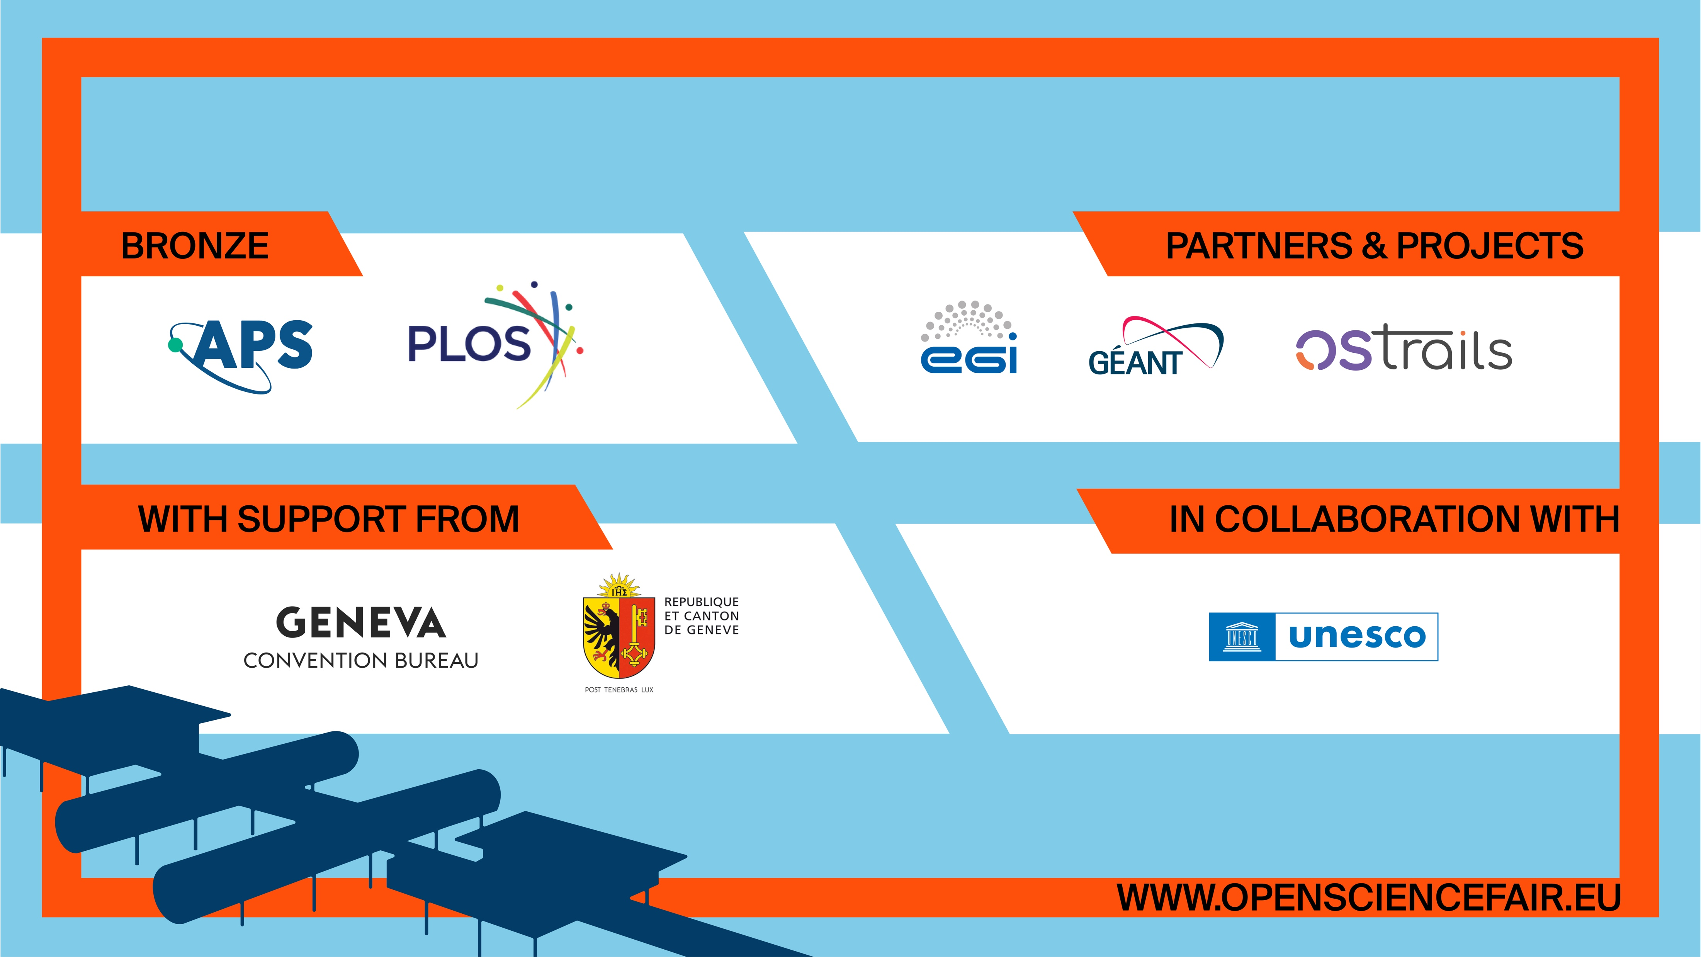
Sponsors & Supporters

Slide 9
Special thanks to our conference organizers!
Marilee Andriopoulou (OpenAIRE)
&
Merten Dahlkemper (CERN)

Slide 10
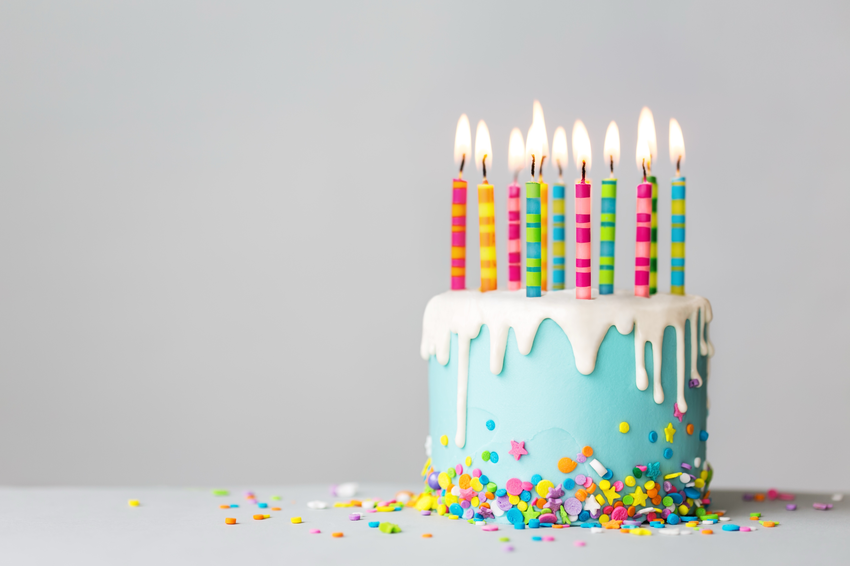
Happy Birthday Merten!

Slide 11
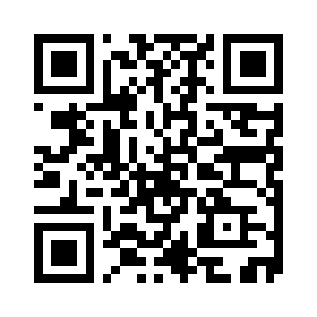
Conference
Outputs
All sessions of the conference have been recorded and will be made available through CERN’s video portal in the coming week
If you haven’t done so, please sign your speaker release form, so we are allowed to publish your recording
Presentations will be made available under CC-BY in the OS FAIR Zenodo community
Please upload your materials to the contribution page on Indico.

