Slide 1
Demo Pitches – Group C
Globe – Ground Floor
Tuesday 10:15 – 11:00
Wednesday 15:30 – 16:15

Slide 2
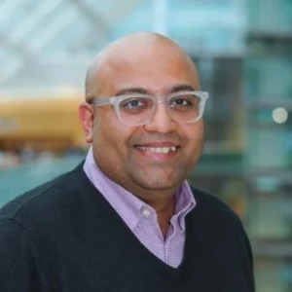
Talk Data to Me:
Conversational AI for FAIR and Accessible Biomedical Data Discovery
Susheel Varma
Sage Bionetworks

Slide 4
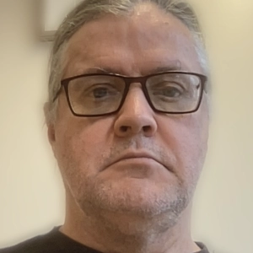
RDA Knowledge Base –
one shop stop for all RDA outputs and resources
Wim Hugo
DANS - KNAW

Slide 6


