Slide 1
Electron cooling in the CERN accelerator complex
D. Gamba
MSC Seminars 07/03/2024 - indico
Acknowledgements: N. Biancacci, A. Borucka, J. Cenede, A. Frassier, G. Khatri, P. Kruyt, A. Latina, A. Rossi, G. Tranquille, and many more colleagues…

Slide 2
Outline
Why cooling?
E-cooling principles
  E-cooler hardware implementation and impact on cooling
E-coolers at CERN
  LEIR
  AD
  ELENA
Disclaimer: discussed here only the e-cooler aspects, not other important effect that affect the circulating beam (e.g. IBS, space charge, impedance …)

Slide 3
Why do we need cooling?
Beam size depends on β (depends on the machine optics) and 𝜖 (property of the beam)
In a collider we want (to keep) small beam size to maximise luminosity:
Normalised emittance is constant with energy
  Good for colliders: the higher the energy the smaller the beam size
  Bad for decelerators: beam size increases, but the vacuum pipe remains the same ➔ losses!
(+ Need for counteract heating effects (e.g. IBS,…))
(+ Allow for multiple injection/stacking)
Example: transverse phase-space
Beam
Acceptance
Notes:
\sqrt{\beta_x\epsilon_x}
\sqrt{\gamma_x\epsilon_x}
\tan{(2\phi)} = \frac{2\alpha_x}{\gamma_x-\beta_x}
\mathrm{Area} = \pi \epsilon_x
\sigma_x = \sqrt{\beta_x\epsilon_x}
\mathcal{L} \propto \frac{N_1 N_2 f N_b}{ 4\pi\sigma_{x} \sigma_y}
\epsilon_{x_N} = \beta_{rel} \gamma_{rel} \epsilon_x = \mathrm{const}

Slide 4
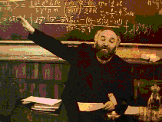
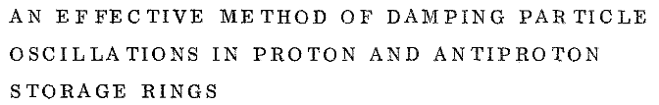
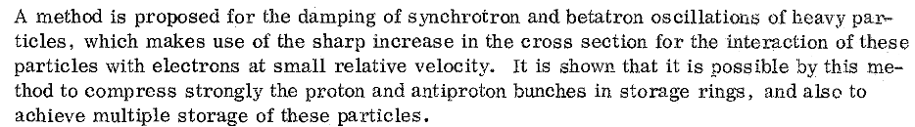
First Idea of Electron Cooling
Electron cooling was proposed by G.I.Budker in 1965 as a method for preparing of the beams for hadron colliders.
The electron beam moving with the same average velocity as proton beam absorbs the kinetic energy of heavy particles (protons or ions).
G.I. Budker is discussing electron cooling
Budker, G. I. (1967), Soviet Atomic Energy 22 (5): 438–440

Slide 5
Electron Cooling Cartoon
Simple analogy (by I. Meshkov): a bullet (“ion”) shot at a heap of sand (“electrons”!) flying with average velocity v₀ :
V_{ion} ⇒ v₀ ≡ ⟨v_{e}⟩
V_{ion} ≠ v₀
ion
e⁻
v₀

Slide 6
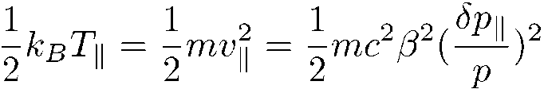
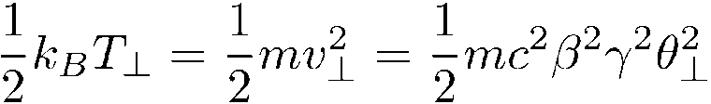
“Cooling”: Talking about Temperatures
Cooling can be represented as a “hot ion gas” cooled by a “cold electron gas”:
The ion beam temperatures are connected to terms like emittance and momentum spread:
while electron beam temperature are primarily given by the e-gun cathode temperature.
Longitudinal
Transverse
Note: “k_{B}” is Boltzmann constant; “v” is meant the r.m.s. 1D velocity spread; 𝜖 is the ion beam emittance and β(s) its Twiss function
Notes:
k_B &= \text{Boltzmann constant} = 8.6173303(50)\times10^{-5} \,[eV \cdot K^{-1}] \
\theta_\perp \approx \sqrt{\frac{\epsilon}{\beta_\perp(s)}}
T_{e,\parallel} < T_{e,\perp}
\frac{1}{2}k_BT_{e} = \frac{1}{2} m_e v_e^2
\frac{1}{2}k_BT_{i} = \frac{1}{2} m_i v_{i}^2
T_i &\rightarrow T_e
v_i \rightarrow v_e \sqrt{\frac{m_e}{m_i}}

Slide 7
More Formal: Modelling of the Cooling Force
Binary collision model
description of the cooling process by successive collisions of two particles and integration over all interactions
Dielectric model
interaction of the ion with a continuous electron plasma
Empiric formula derived from experiments by V. Parkhomchuk:
Electron beam density
“effective e⁻ temperature”
Log of “impact parameters”:
Depends on B field, e- temperatures, …
Typically, ≈ 10

Slide 8
Cooling Time (in lab reference frame)
Carries complexity of defining a model and depends on the regime of the interaction.
Generally, it follows the following proportionality:
Strongly depends on ions temperature: very slow for “hot beams”
Faster for highly charged ions
Quickly increases with beam energy!
Inversely proportional to electron beam current (I_{e})
and cooler/circumference length ratio (η_{C})
Note: independent of ion beam intensity
Notes:
\tau \propto \frac{A}{Z^2} \frac{1}{\eta_c} \frac{1}{I_e} \gamma^5 \beta^4 \Theta_i^3

Slide 9
Electron Cooling Implementation in an Accelerator
Circulating ion beam is (typically) de-bunched (coasting beam) during the cooling process
The circulating ion beam and an intense electron beam share the same orbit on a fraction of a circular accelerator
  The electron beam is guided in/out to/from the ions by a longitudinal magnetic field
  (besides from the electron beam transport, the magnetic field leads to enhanced cooling)
The average velocities of ion and electron beams are set (nearly) equal
Each electron interacts with ions only once (single pass), i.e. ions stored in the ring keep interacting with “fresh” electrons
The process is repeated long enough to reach a “temperature equilibrium”

Slide 10
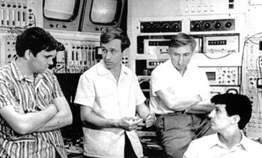
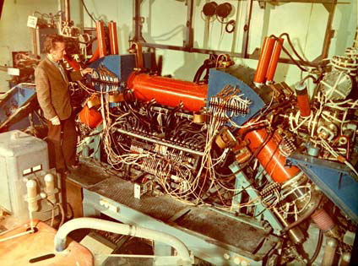
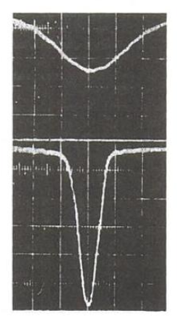
First Experimental Demonstration at NAP-M
The first experiments carried out in Novosibirsk in 1974 demonstrated the high efficiency of this method and triggered the development of heavy particle cooling methods.
The first electron cooler had a cooling length of 1 m.
Electron cooling pioneers in Novosibirsk.
Left to right: V Parkhomchuk, A Skrinsky,
I Meshkov, N Dikansky.
Vertical beam profile at NAP-M without and with electron cooling
First electron cooler in NAP-M ring

Slide 11
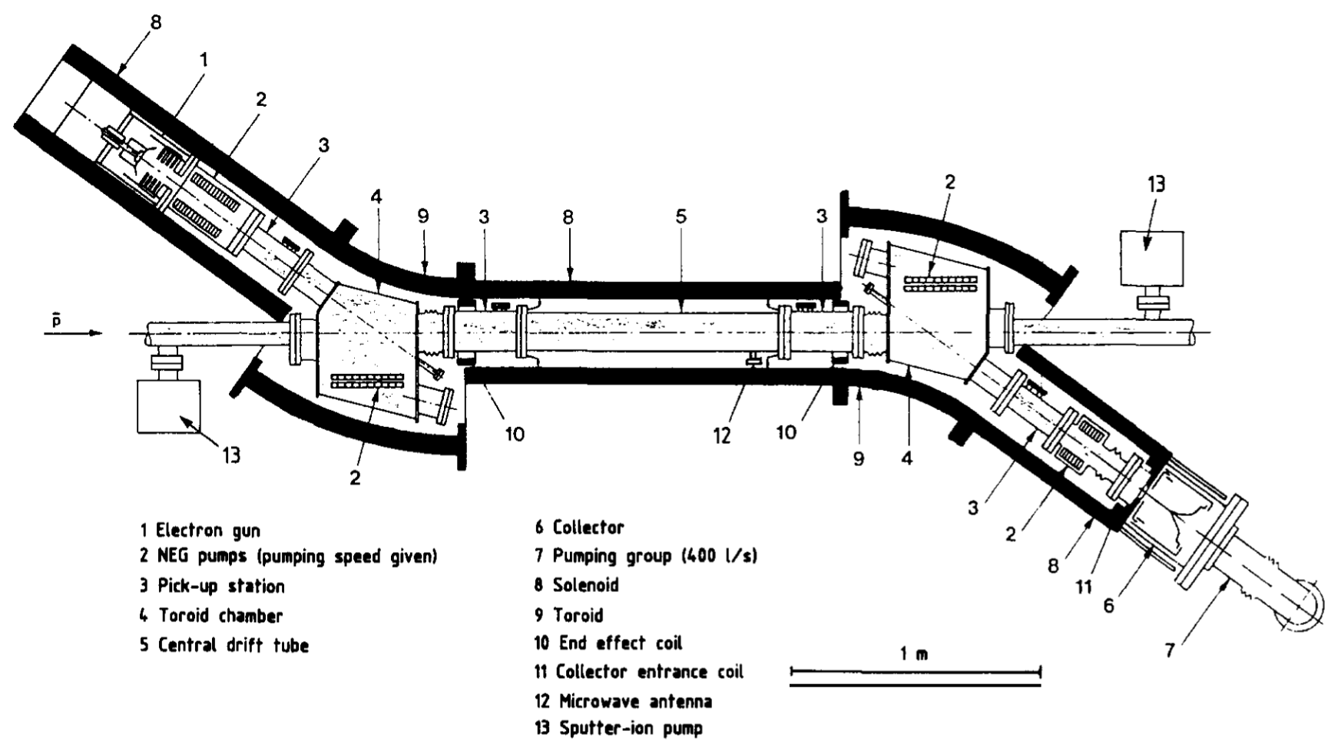
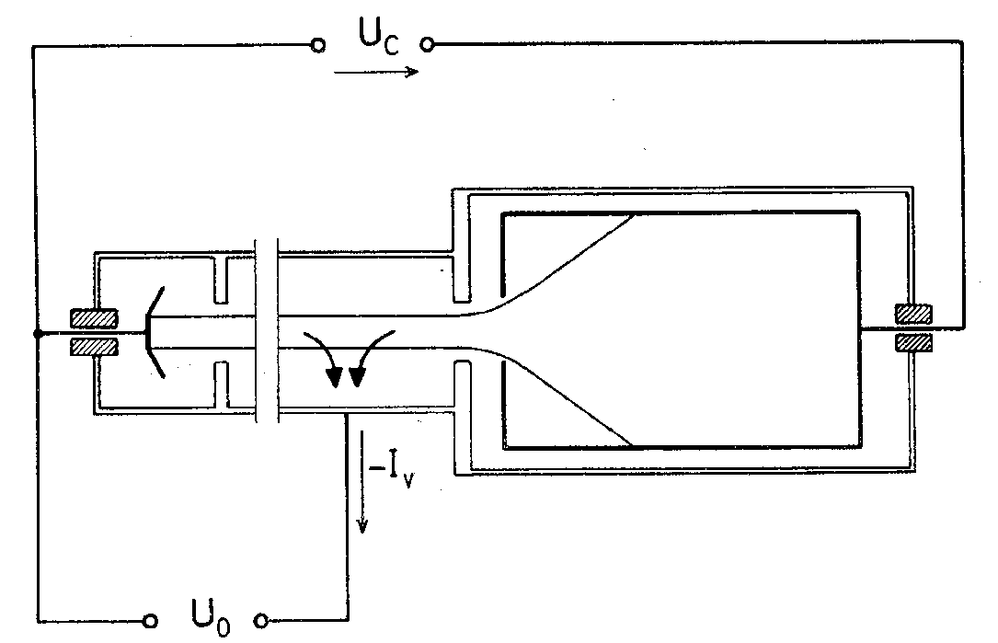
How to Realise Electron Cooling in Practice
A guiding magnetic field carries a DC electron beam from a cathode into the ion beam and then to a collector.
U_{c}
I
Source:
electron gun
E⁻ beam transport: solenoids, toroids, steering magnets
Electron collector
cathode
Drift
e⁻
e⁻
ions
Beam dump:
collector
U₀
ΔI
The LEAR (now ~AD) e-cooler, CERN-EP/90-04

Slide 12
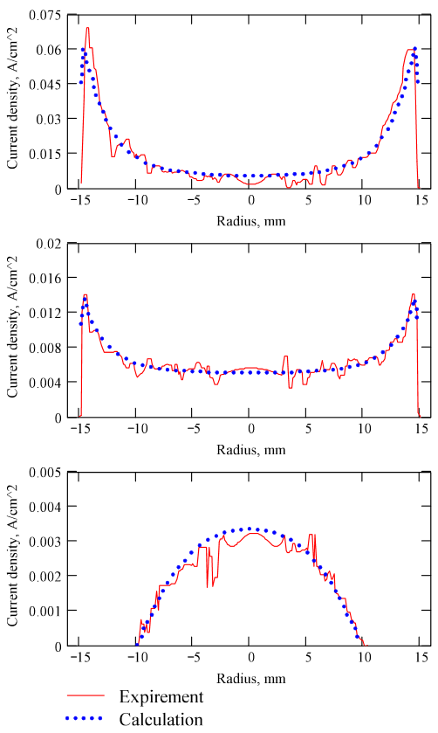
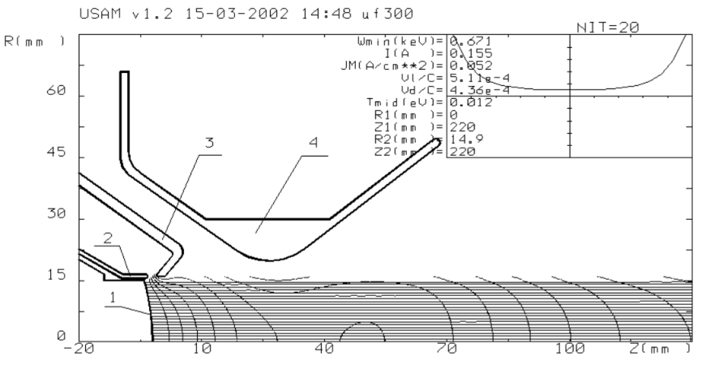
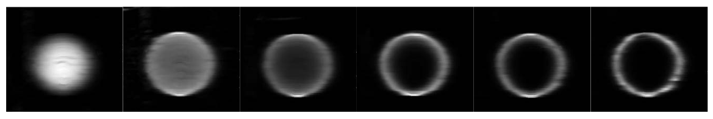
Optimized Electron Gun
Control electrode
Anode/Grid
Cathode
Calculated and measured beam profiles at control electrode potential UC = +300V, -100V and anode potential UA=500V.
Electron beam profiles at control electrode potential Uc = 0V, +100V, +200V, +350V, +400V, +600V and anode potential Ua=500V
LEIR-like electron gun, from A. Bubley et al. Proceedings of EPAC 2002

Slide 13
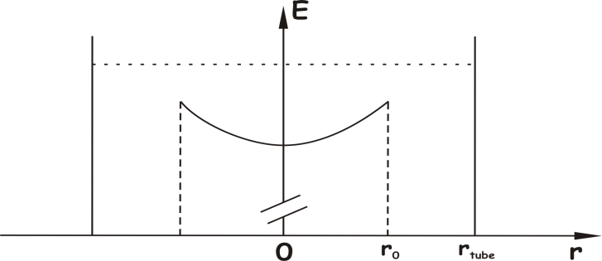
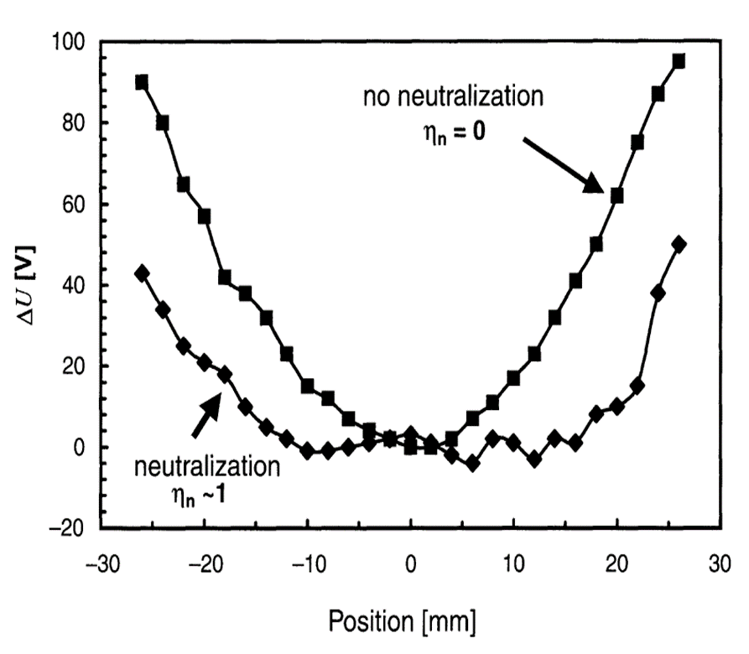
Other Properties of Generated Electron Beam:
Electron velocities
The longitudinal energy a of the electron beam is not constant along its radius (r), but it typically follows the relation:
where E₀ is the energy in the center of the beam and r₀ is the beam radius.
This effect can be partially cured by trapping positive ions in the electron beam along the interaction region!
It can be of a few %!
Details on CERN-EP/90-04
(details not discussed here. See CERN-EP/90-04 )

Slide 14
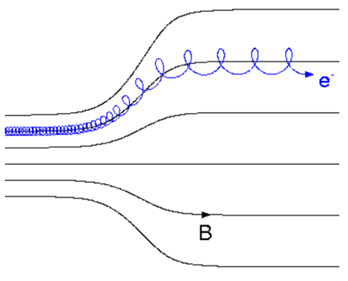
Other Properties of Generated Electron Beam:
Electron transverse temperature
The electron gun and the whole cooler is immersed in a magnetic field to compensate for space charge forces and to guide the beam.
If one sets a stronger magnetic field in the gun than in the e-/ion interaction region, then:
Wider electron beam (but lower e⁻ density)
Proportional reduction of transverse temperature (e.g. up to a factor ~10 in ELENA)
drift
cathode
B adiabatic
expansion
electron-velocity distribution at the cathode and after acceleration in the drift space
Notes:
k_B T_\perp \approx k_B T_{cath} \frac{B_{drift}}{B_{cath}}
B r^2 = const
r_{drift} &\approx r_{cath} \sqrt{ \frac{B_{cath}}{B_{drift}} }

Slide 15
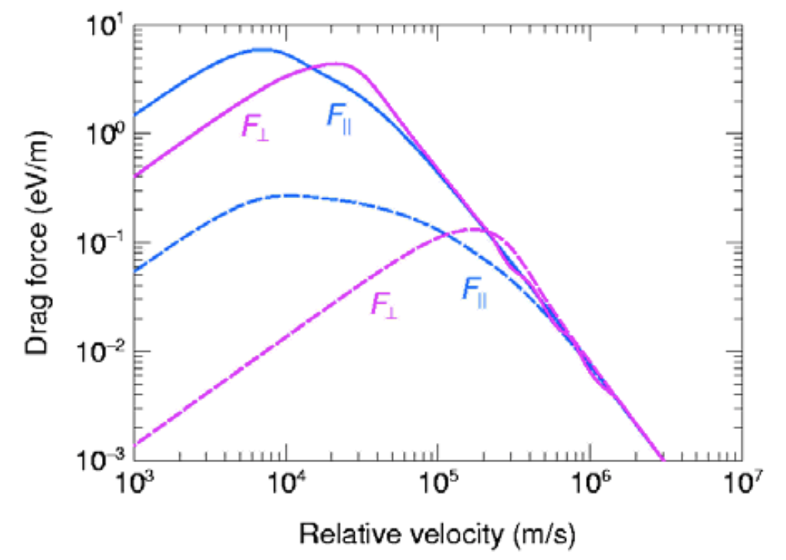
Importance of e⁻ temperatures
Stronger force for “low-relative velocity difference” => obtaining smaller beams, faster
From on CAS2005 proceedings
Notes:
\approx \sqrt{2 T_\parallel/m_e}
\approx \sqrt{2 T_\perp/m_e}
T_\parallel &= 0.1 \mathrm{ [meV]} \\
T_\perp &= 1 \mathrm{ [meV]}

Slide 16
Other Properties of Generated Electron Beam:
Magnetised cooling and field quality
E-cooling is based on Coulomb interaction between ions and e⁻
Greatly enhanced if several interactions along overlapping region: magnetized cooling!
  Magnetized cooling quickly “destroyed” by imperfections!
  General condition on magnetic field quality:
Un-magnetised cooling:
Single interactions per e-
Magnetised cooling:
multiple interactions per e-
e.g.: effect of magnetic field imperfection:
Premature loss of sync. condition…
54 mm ± 8 um rms
e⁻
e⁻
e⁻
24 um rms
p
54*1e-4 mm=5.4 um
p
p
Here simplified cartoons assuming AD e-cooler @300 MeV/c, and
electron-velocity distribution at the cathode and after acceleration in the drift space

Slide 17
Electron Beam Power Recovering: the Collector
U_{cathode}
- +
ΔU_{collector}
|ΔU_{collector}| << |U_{cathode}|
Typical beam power recuperation parameters:
Required high electron collection efficiency to
preserve vacuum and back-scattered electrons
> 3⋅10⁻³ => bad
ΔI/I ∼ 1⋅10⁻⁴ => good
< 1⋅10⁻⁵ => excellent
Collector set to a potential with respect to cathode
to slow down electrons. It also follow Child’s low
I_{max} = P_{collector}×(ΔU_{collector})^{3/2}
Typical value P_{collector} ∼ 15 μA/V^{3/2}, e.g. I = 1 A requires ΔU_{collector} ≥ 1.65 kV.
Warning: reflected electrons can go back to the drift and perturb cooling, i.e. increase T_{elect}
ΔU_{collector}
I
collector
cathode
drift
e⁻
ΔI
electron losses
U_{cathode}

Slide 18
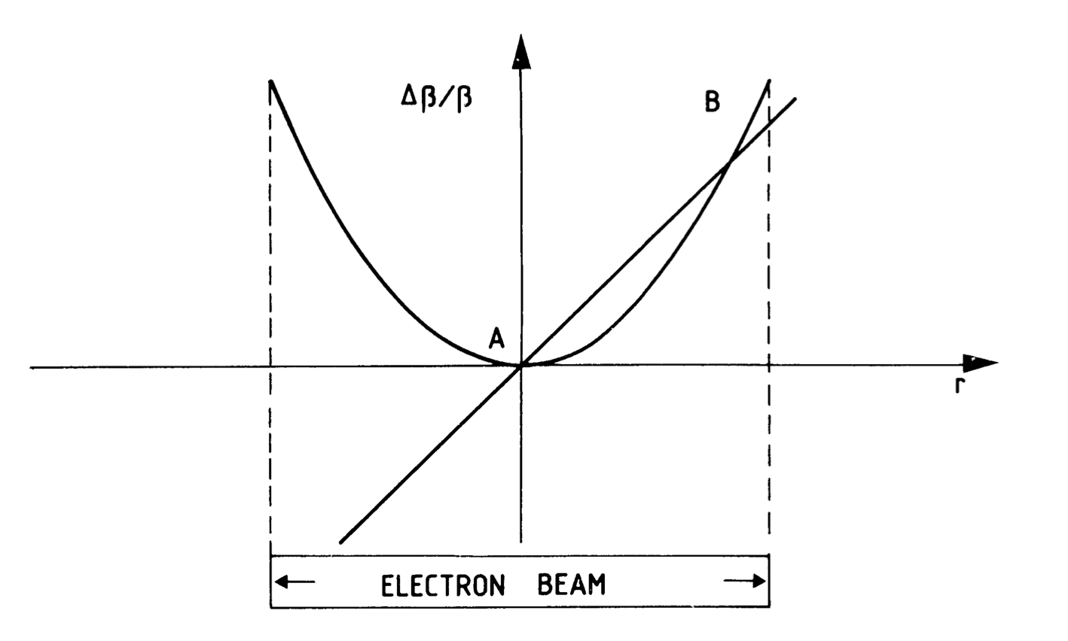
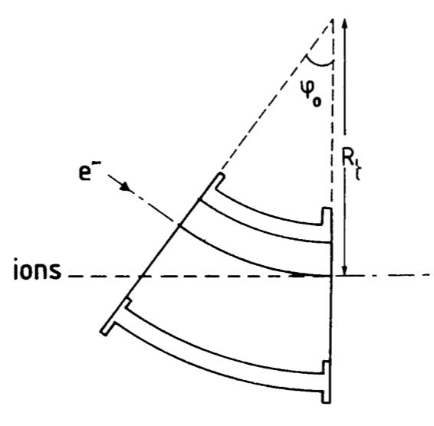
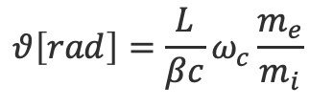

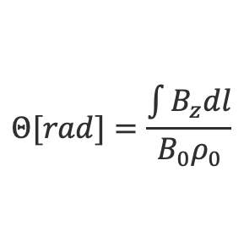
Merging the Electrons with the Ions
Effects on the Circulating Beam
1. Deflection of the circulating beam due to the integrated transverse field in the toroid.
$$Θ[rad]=\frac{\int{B_{z}dl}}{B_{0}ρ_{0}}$$
2. Tune shift due to the focusing effect of the electron beam acting as a lens
$$Δυ=0.5 \left\langle β_{h,v}^{∗}\right\rangle n_{e}r_{p}β^{−2}γ^{−3}L$$
3. The solenoidal field of the cooler twists the ion beam by an angle inducing coupling:
$$θ\left[rad\right]=\frac{L}{βc}ω_{c}\frac{m_{e}}{m_{i}}$$
Effect more important when working close resonances
All those effects are typically compensated also with solenoids and steerers close to the electron cooler.
Details on CERN-EP/90-04

Slide 19
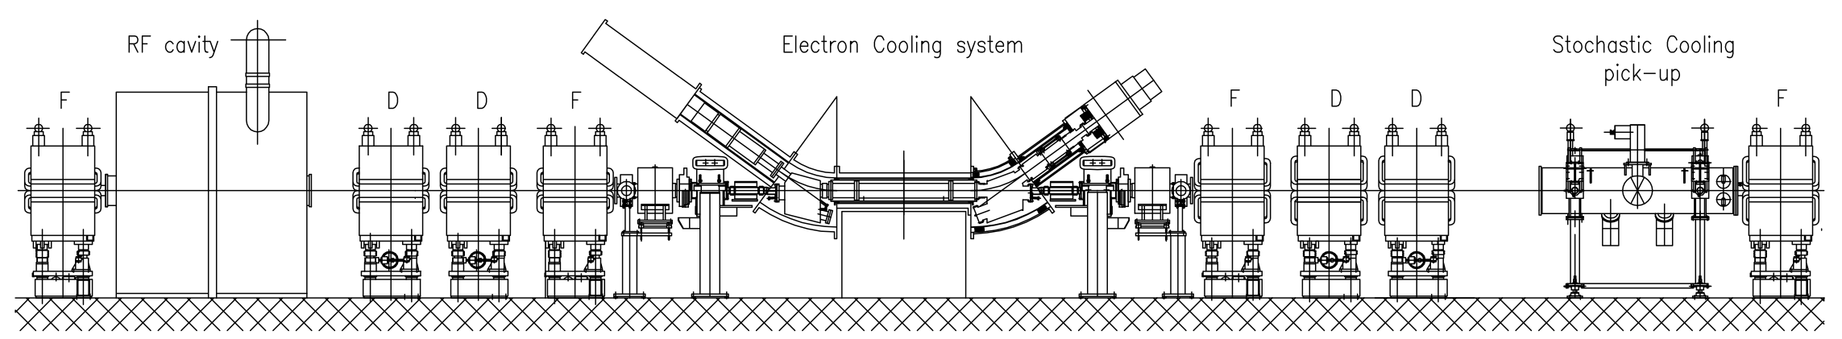
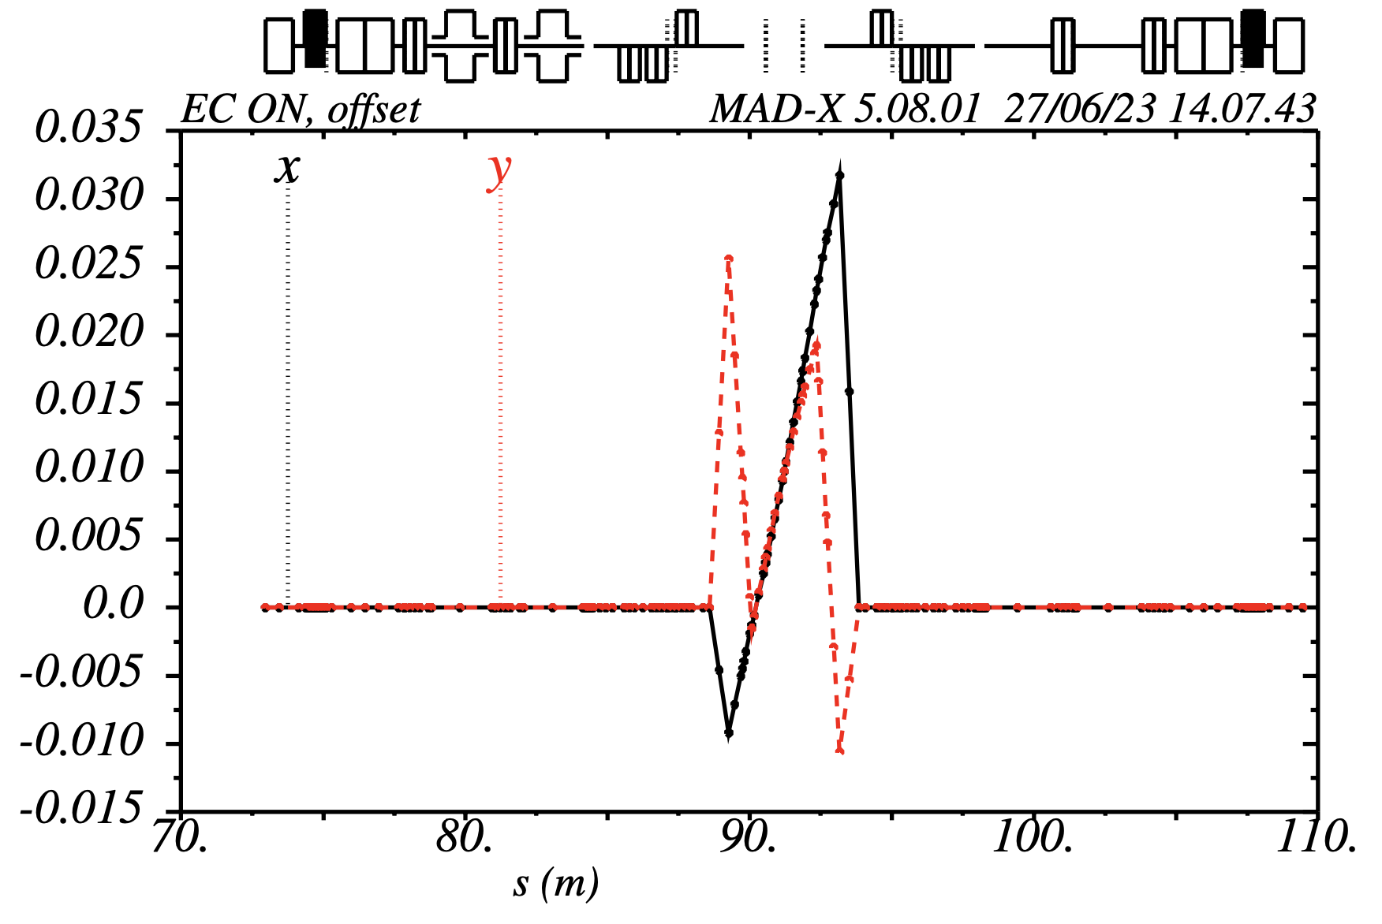
One Integration Example: AD
Compensation Solenoid
HV corrector
(DR.DHV2904)
H corrector
(DR.DHZ2908)
H corrector
(DR.DHZ2913)
HV corrector
(DR.DHV2917)
Compensation Solenoid
H dipole
with trim PC
V corrector
(DR.DVT2608)
V corrector
(DR.DVT3105)
H dipole
with trim PC
Orbit correctors, needed to:
  Compensate kick from toroid
  Tune pbar-e⁻ trajectory alignment in cooling section
Compensation solenoids:
  Correct for coupling induced by cooler solenoid
Note: typically, DC e-cooler magnets
  Varying impact along accelerating cycle
  Complex operation tools and tuning procedures
x, y (m)
Pbar orbit at 100 MeV/c
Aperture limitation
Note: amplitude scales
inversly to momentum!
Kicks fixed by toroids geometry and field
s (m)

Slide 20
Some General Performance Limiting Factors
Magnetic field imperfections (straightness of longitudinal magnetic field in the cooling section, kicks in the transport line, all increasing the “effective” electron temperatures)
Ripple of accelerating voltage also affective effective electron temperatures
Ion recombination and consequent beam losses (but it can be used for beam diagnostics)
Beam control (alignment between two beams requires good diagnostics)
Technical/technological (manufacturing issues incl. tolerances etc., vacuum compatibility)
Reliability issues with increasing complexity

Slide 21
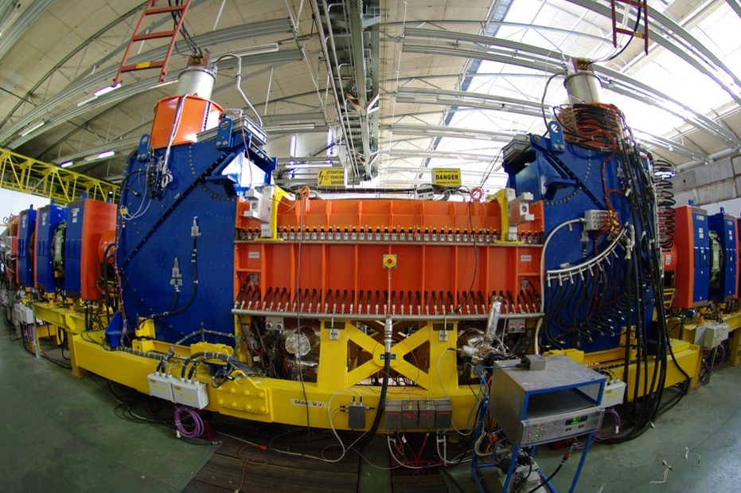
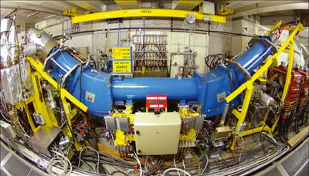
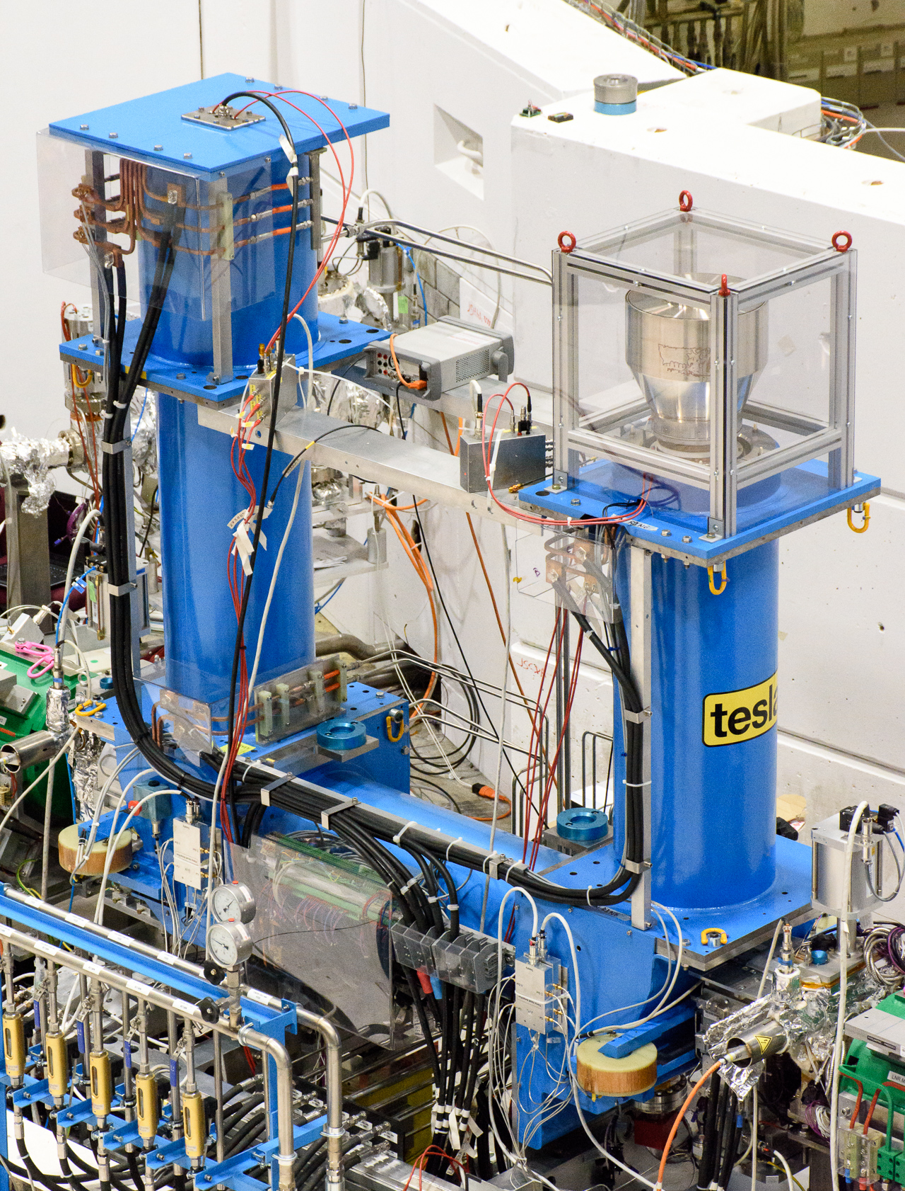
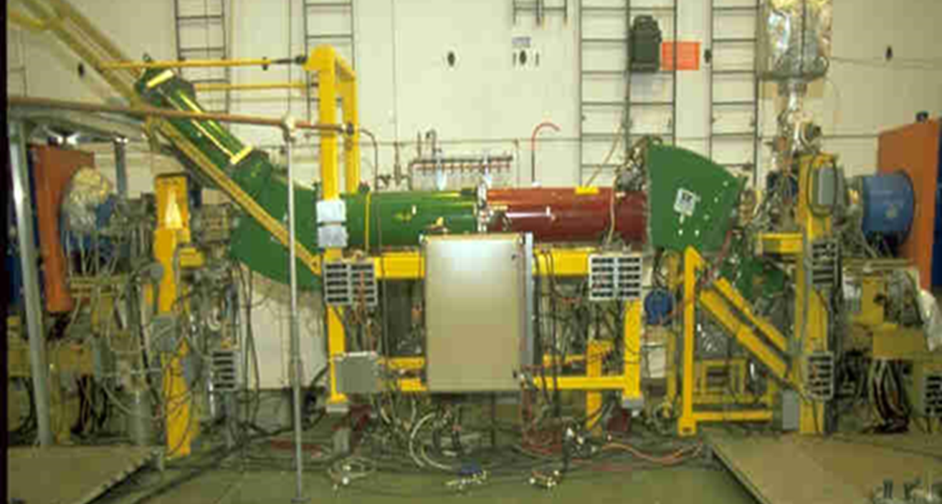
Electron Coolers at CERN
Currently we have three electron coolers in operation at CERN
LEIR
AD
ELENA
LEAR
LEIR e-cooler was designed specifically for the LHC ion chain and uses the most advanced technologies:
Variable density electron gun
Beam expansion
Pancake structure of magnets
Electrostatic bend for improved vacuum
First used in the Initial Cooling Experiment (ICE) in 1977-80, then used in LEAR (1982-97).
Finally moved to the AD (since 1999).
It might “retire” soon with the advent of a new electron cooler specifically designed for AD.
The smallest, start operation in 2018 and required challenging manufacturing/optimization of the very low magnetic field (100 Gauss)

Slide 22
CERN Coolers Main Parameters
Each cooler is designed with specific parameters to match the accelerator needs
 | LEIR | AD |  | ELENA
(Main) Ion particle | ²⁰⁸Pb⁵⁴⁺ | pbar | pbar | pbar | pbar
Ion momentum | ~88 MeV/c/u | 300 MeV/c | 100 MeV/c | 35 MeV/c | 13.7 MeV/c
Electron kinetic energy | 2.3 keV (<6.5 keV) | 25.5 keV (<35 keV) | 2.9 keV | 355 eV | 55 eV
Relativistic beta | 0.094 | 0.305 | 0.106 | 0.037 | 0.015
Electron current | 600 mA | 2.5 A | 100 mA | 5 mA | 1 mA
Cooling length | 2.5 m | 1.5 m |  | 1 m
Ring length | 78.54 m | 182.43 m |  | 30.41 m
Gun magnetic field | Up to 2.3 kG | 590 G |  | Up to 1 kG
Drift magnet field | 750 G | 590 G |  | 100 G
Electron beam radius (drift) | 14 - 25 mm | 25 mm |  | 8 to 25 mm
Notes:
For LEIR we typically speak about 4.2 MeV/u kinetic energy

Slide 23
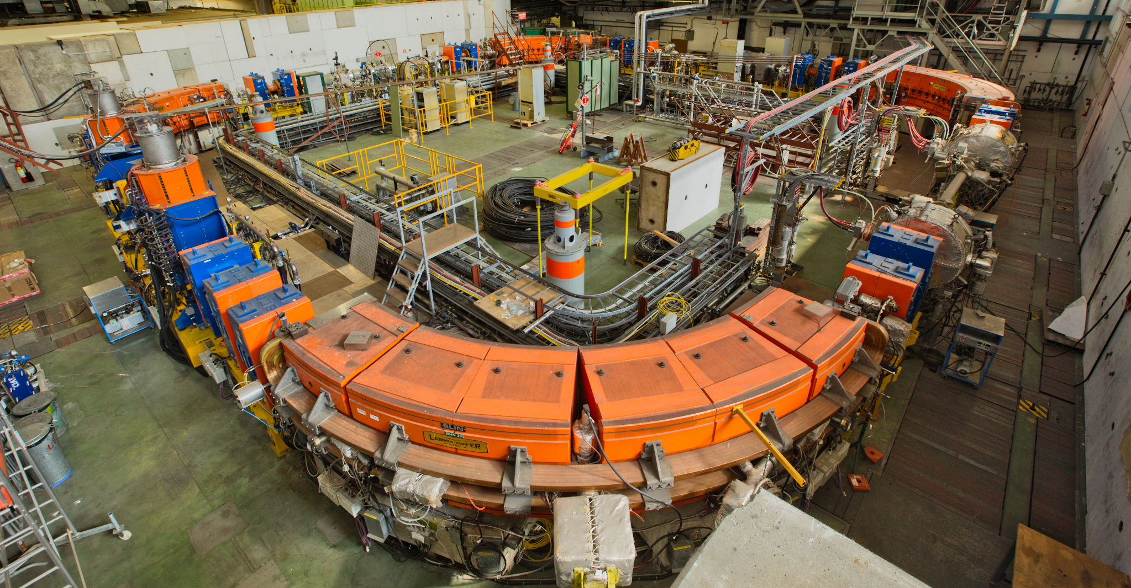
E-Cooling in LEIR

Slide 24
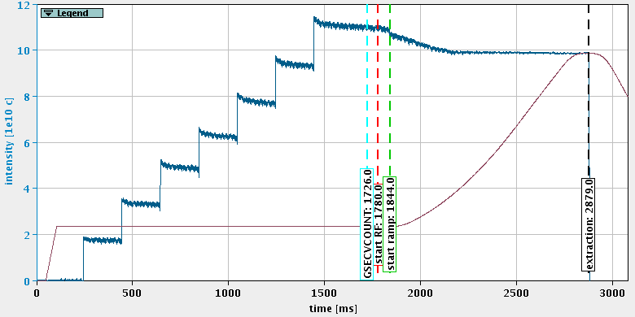
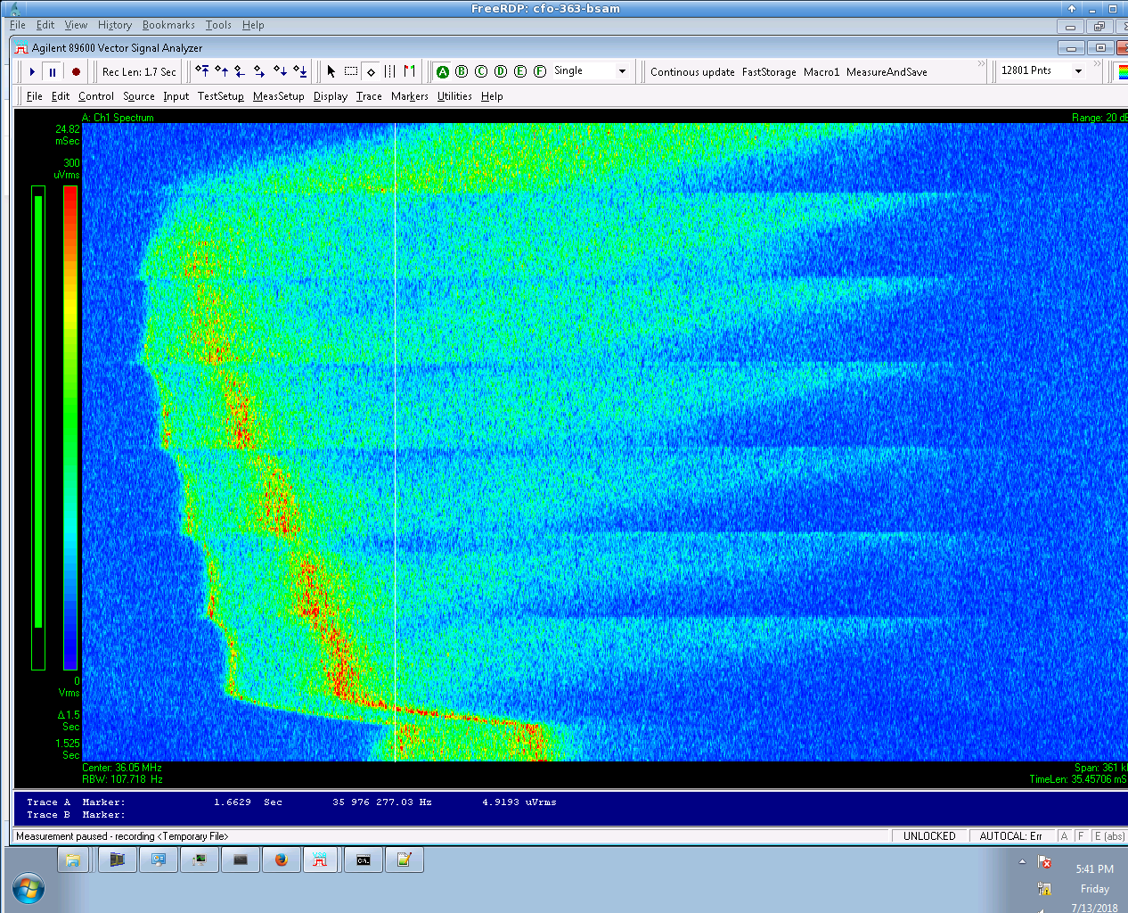



E-cooling in LEIR
LEIR injection process is based on multiple (up to 8) injections of Linac3 pulses: stacking in momentum and transverse phase space.
Cooling essential also for dragging the mean energy!
INJ
S
t
a
c
k
$$−0.1\%$$
$$±0.2\%$$
INJ
S
t
a
c
k
Injected
momentum
$$\sim 1500 ms$$
Reference
momentum
RF
RF

Slide 25
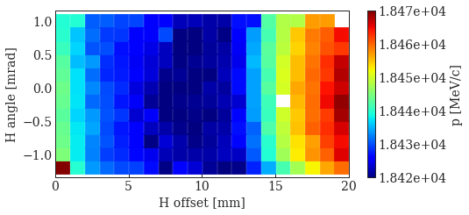
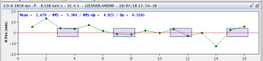
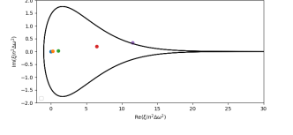


LEIR Ion-Electron Orbit Overlap Adjustment
  Final ion beam profile strongly dependent on ion-electron relative trajectory.
  It can be seen with cooling maps, i.e. scan on the ion orbit
    One can see the electron velocity profile looking at final
    momentum and minimize the final emittance
    Note: best cooling is not necessarily the optimum!
    Impedance-induced instabilities might require some
    “heating” of the circulating ions, e.g. with an angle.
A
H plane
B
$$∝Re\left(Z\right){/σ}_{p}$$
H plane
B
A
A
A: close to boundary
B: more margin!
B
$$∝Im\left(Z\right){/σ}_{p}$$
More Details in CERN-ACC-NOTE-2020-0023 and N. Biancacci ABP-IWG#11

Slide 26
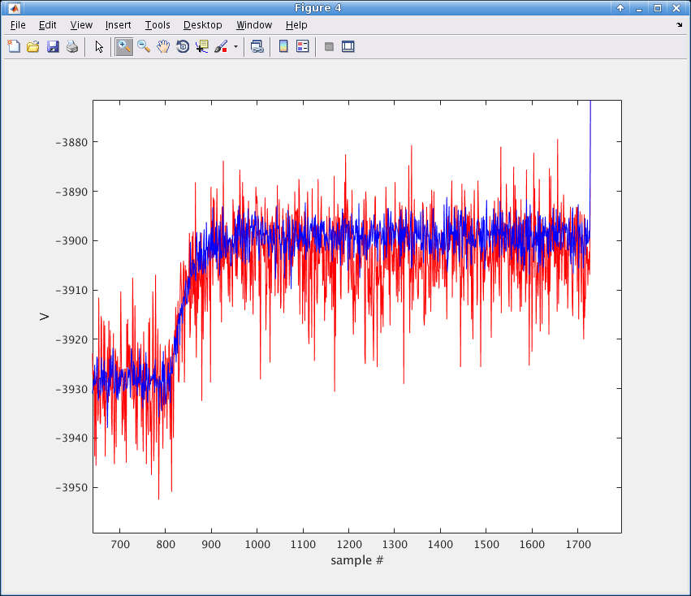
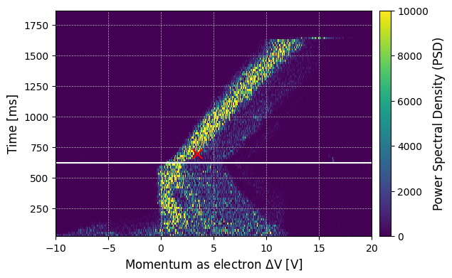
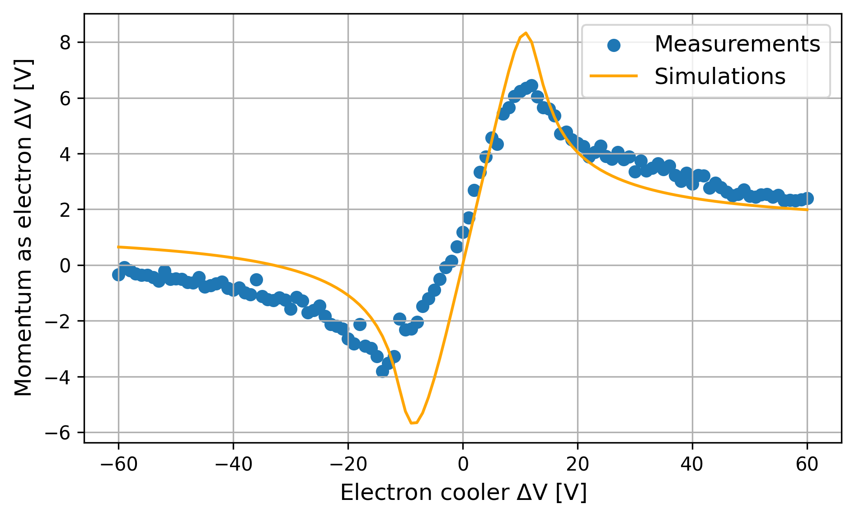
LEIR: Measurement and Simulation of Cooling Force
The longitudinal force can be measured during MDs by applying a voltage step on V_{cathode} and measuring the speed for the ions to follow the change of their mean momentum.
Measurement can be compared with several simulations codes, e.g. RF-Track, Betacool,
JSPEC, PyHEADTAIL, Xsuite…
Gun Voltage
(electron energy)
Time in the cycle
More Details in A. Latina ABP-IWG#11, B. Veglia COOL2019, P. Kruyt Ph.D thesis

Slide 27
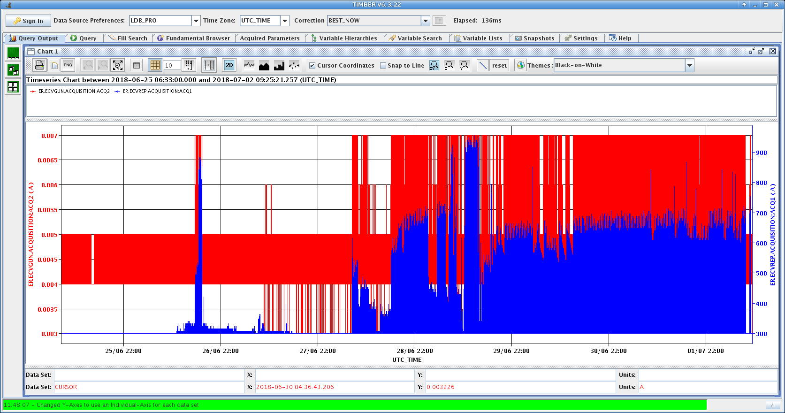
Importance of Magnetic and Electrostatic Settings
Collector and repeller currents (and vacuum) are important diagnostics observables!
They can reveal problems with the electron ”transport” to the collector, and consequent degradation of cooling performance.
From LEIR elogbook 02/07/2018 11:42:
We found losses on the repeller electrode which changes the regulation of Vgun. How these losses occurred we do not know as identical settings on other cycles did not produce the same situation. Are the machine orbit correctors close to the e-cooler affecting the electron beam trajectory? The current in ER.ECNDV9 was changed from 0.5 A to -0.5A and this cured the problem. The new value of ER.ECNDV9 has been copied onto all the cycles.
AF & GT

Slide 28
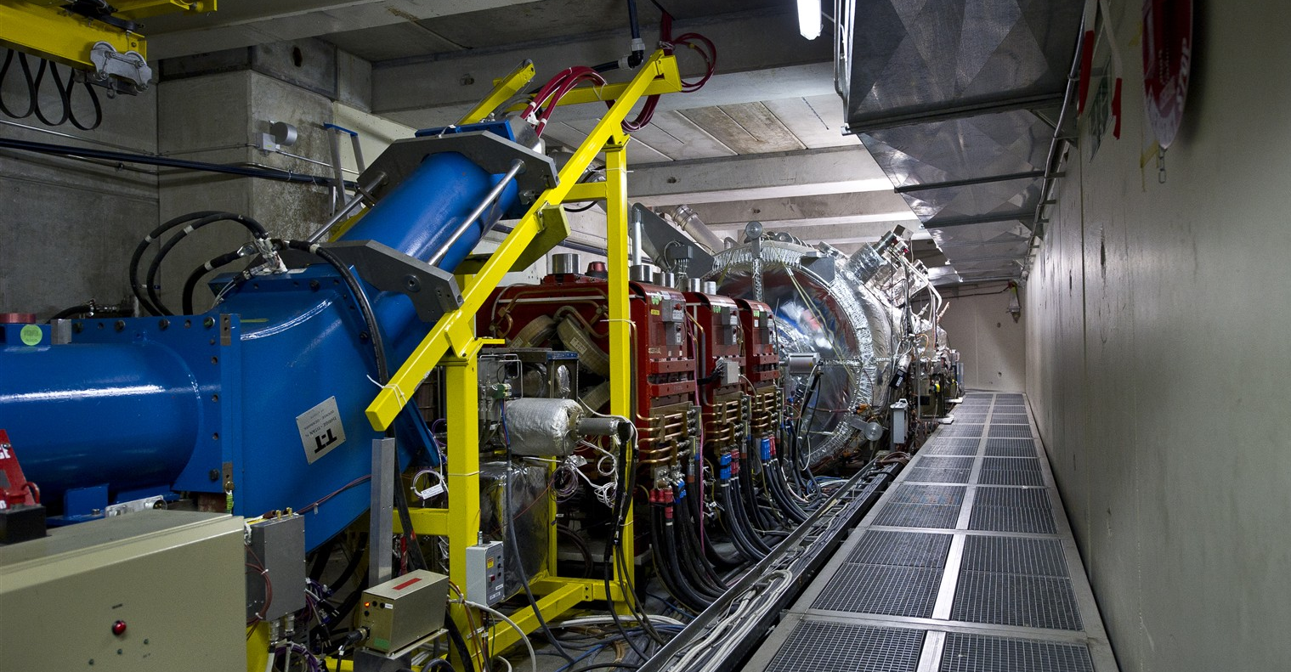
E-Cooling in AD

Slide 29
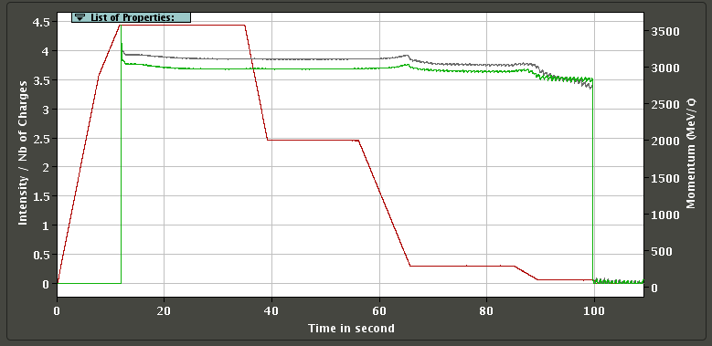
A typical AD cycle nowadays - figure of merits:
  Captured intensity (linked to target + DI + s-cooling performance)
  Tranmission along the cycle (linked to optics control and s-/e-cooling performance)
    Cycle length (mainly driven by s-/e-cooling performance, and tollerated losses…)
  Number of cycles for physics (affected by systems, inc. e-cooling, reliability)
Main losses and/or transmission fluctuations
3.57 GeV/c
ε_{G} x1.8
ε_{G} x6.7
2 GeV/c
~16s e-cooling
s-cooling
ε_{G} x3.0
~9s e-cooling
300 MeV/c
100 MeV/c

Slide 30
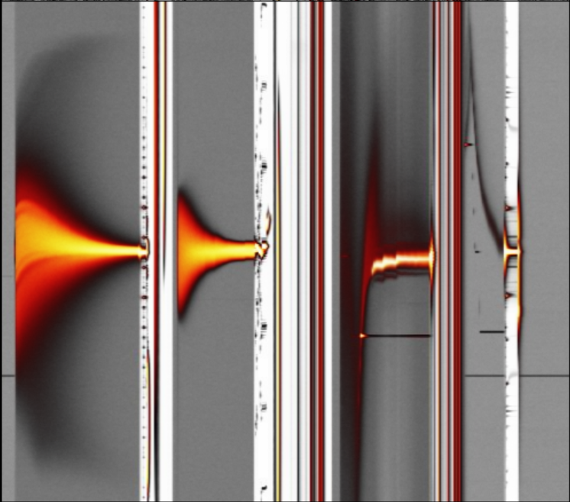
Rough estimate of longitudinal e-cooling performance
Longitudinal cooling relatively fast as seen from Schottky
Energy drift (due to HV power supply and/or e⁻ space charge) clearly observable
Sudden lost of e-cooling performance requiring full retuning observed a few times/year
+7
+36
+19
+11
pbar p=300 MeV/c
pbar p=100 MeV/c
e⁻ ∆E_{K} [eV]
e⁻ ∆E_{K} [eV]
pbar dp/p [10⁻⁴]
pbar dp/p [10⁻⁴]
t ~16s
t ~9s
-19
-7
-36
-11

Slide 31
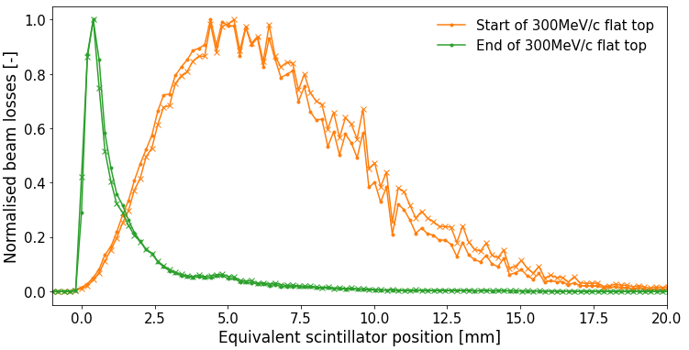
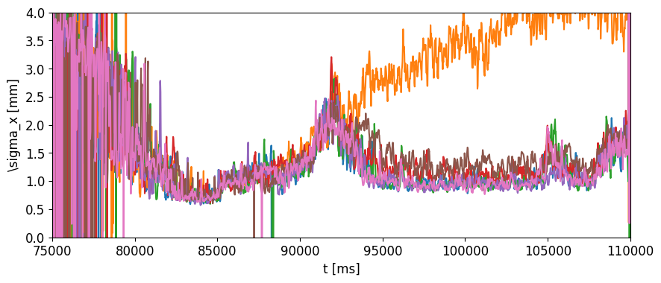
Rough estimate of transverse cooling performance
More difficult to assess!
  Main measurement technique based on punctual (slow!) scraper measurements…
  AD IPM (Ionization Profile Monitor) allows to measure beam size all along the cycle
    Some limitation on its use: no gas injection, affecting trajectory of circulating beam…
    It allowed to reduce 100 MeV/c plateau by a few seconds!
Core about
8 times smaller
after cooling
300 MeV/c
ramp
100 MeV/c
RF ON
Bad settings!
Cooling done?!
And tails?!
???
~half beam size begin 300 MeV/c
Studies by Giulia Russo
~half beam size end 300 MeV/c
Best settings?

Slide 32
New AD e-cooler: an Improvement Opportunity!
First motivation for a new e-cooler is to improve AD reliability
  E.g. issues with e-cooler collector in 2018 caused the loss of about 30% of the beam cycles for physics!
Additionally, one could ultimately aim for:
  20% cycle length reduction to ~90 s (based on AD 1996 design link)
    from ~16 s to ~5 s at 300 MeV/c;
    from ~9 s to ~2 s at 100 MeV/c
  Reduce beam losses
    Today, we lose ~10-20% distributed between 2 GeV/c and 35 MeV/c
  Increasing maximum e-cooler energy to 500 MeV/c could be an asset
    Better equalisation of emittance blow up during deceleration (𝗑4, 𝗑5 instead of 𝗑6.7, 𝗑3)
    Higher chance to cool transverse tails left behind by s-cooling at 2 GeV/c
    But might be limited by other factors (e.g. field strenght/quality?)
Note: part of observed AD performance loss not necessarily linked to the e-cooler itself!
  In parallel, we are investing in our capability of controlling and tuning the whole machine!

Slide 33
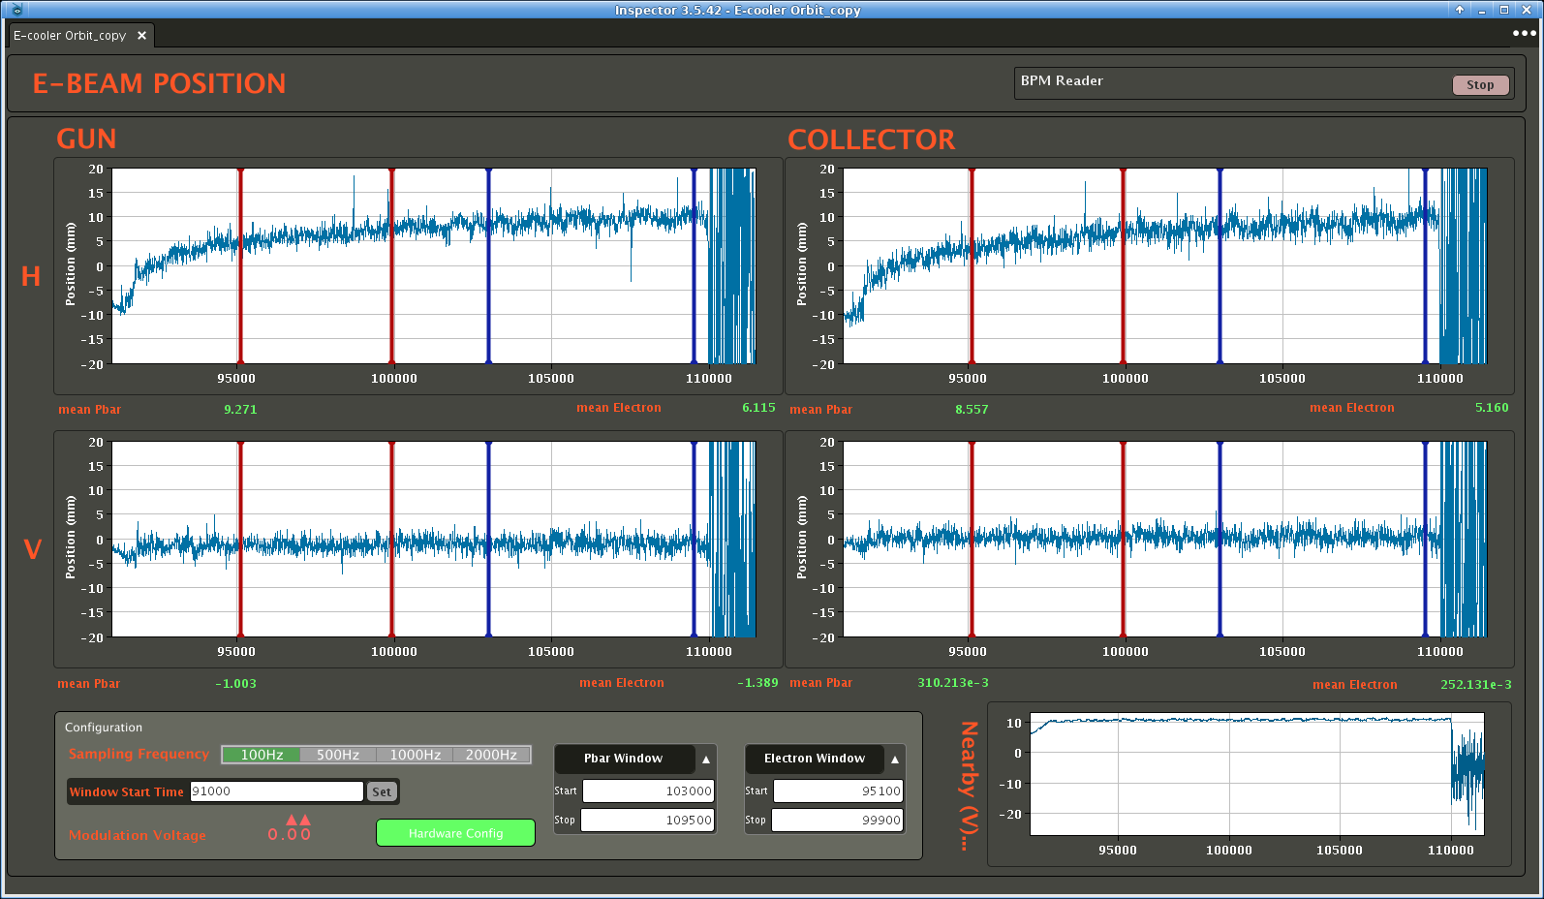
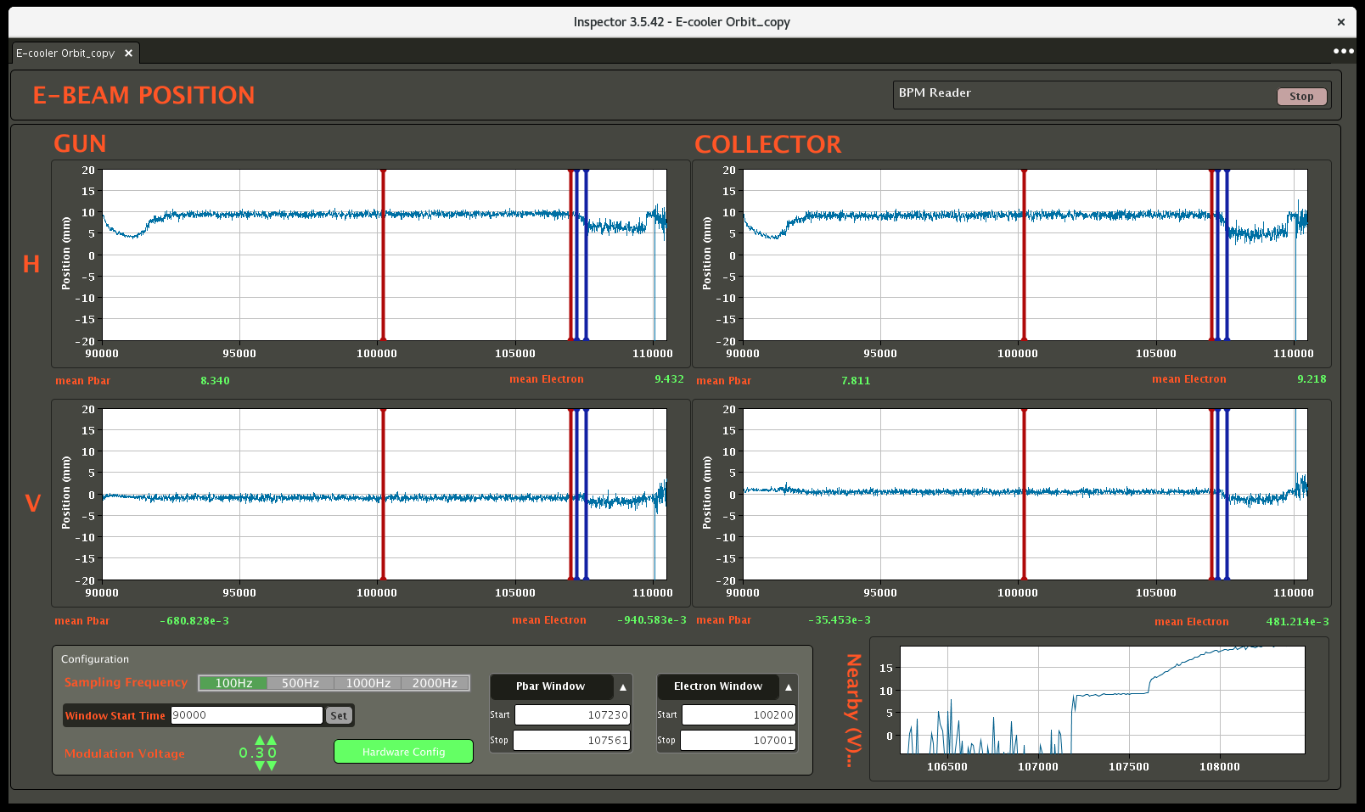
One example: how well do we control pbar/e⁻ orbit overlap?
e⁻ (and pbar) orbit measurement in the e-cooler recently re-established
  It requires to modulate e⁻ beam intensity
  Much faster setup of cooling (at least at first order)!
pbar orbit
e⁻ orbit
>10 mm H-orbit drift!
It reveled that overlap is varying along a plateau (here 100 MeV/c) due to drift of pbar orbit
It could be detrimental for cooling performance, and not linked to e-cooler device itself
Possibly linked to field lag in “wide” bends (normally compensated by BHZ-TRIM PC…)

Slide 34
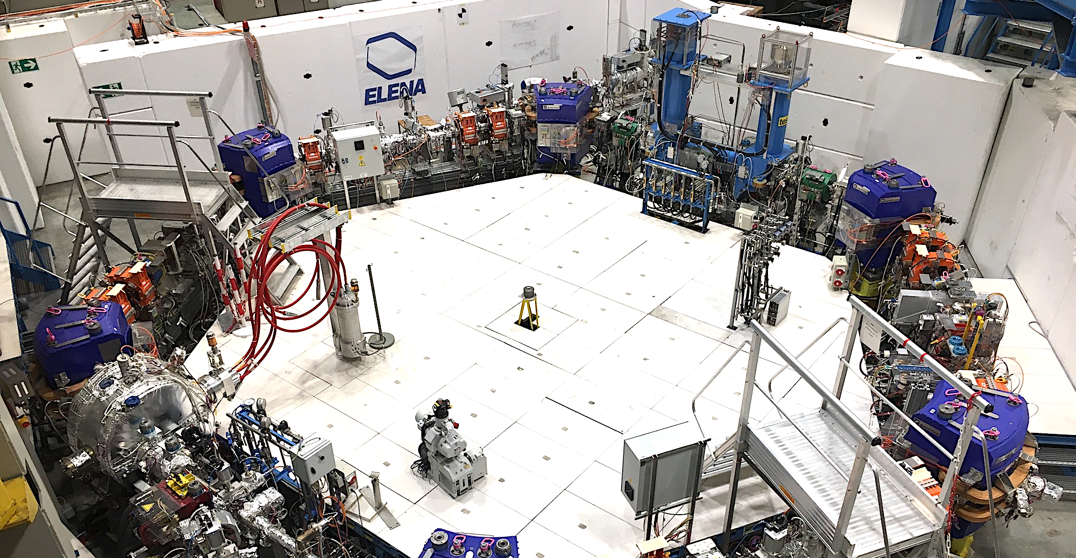
E-Cooling in ELENA

Slide 35
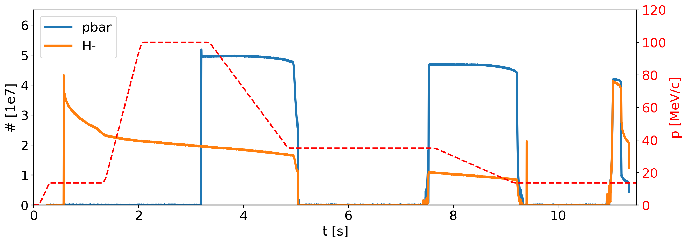
The ELENA cycle
Running with two (magnetically-equal) ~15-second-long pbar or H⁻ cycles
Second H⁻ injection to increase beam intensity @100 keV before extraction
n bunches extracted on demand by users
h=1
h=4
h=4
h=1
E-cooling
E-cooling
E-cooling
Margin of improvement:
    Transmission: today at up to ~10% losses (sometimes further degradation linked to AD e-cooling performance)
    Cycle length: not important if we run in the shadow of AD (baseline), but relevant if we wait for ELENA extraction before restart AD (as today!)
Repetition rate is very slow for any study/setup with pbar
    Good news: No H- lifetime degradation observed with e-cooling! We can use H- for most studies!
    Bad news: H- source reliability questionable, known to be prone to hardware faults…
    Bad news: H- lifetime strongly affected by vacuum levels in the ring (typically 10⁻¹¹ mbar)

Slide 36
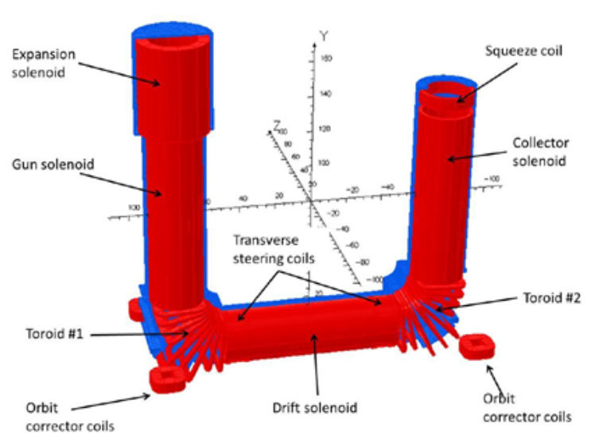
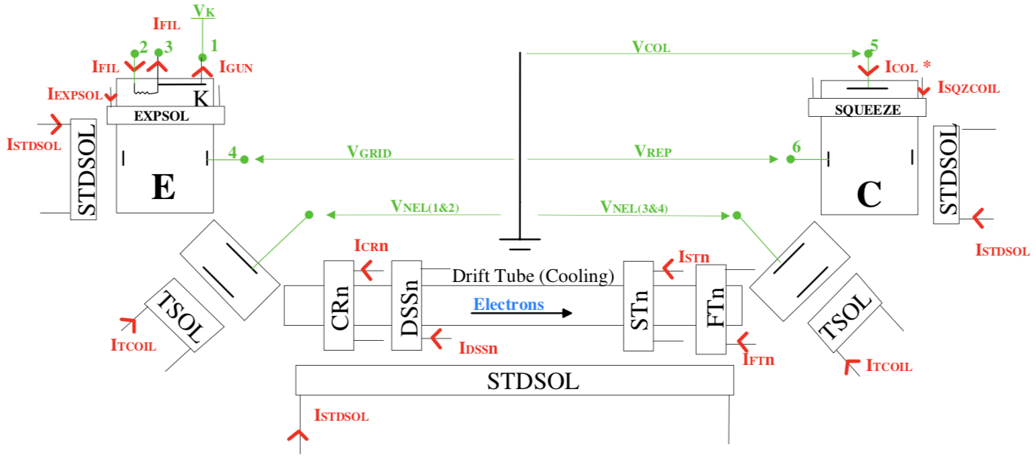
ELENA E-Cooler Hardware
Complex magnetic design by G. Tranquille (see e.g. IPAC2016, IPAC2018)
Very low voltages and e- energy. => All PC referred to ground
  Easier to handle (but also more difficult to spot electron losses: one must rely on power converter accuracies)
In operation since 2018, no major hardware issues observed so far
Main Controls/Observables

Slide 37
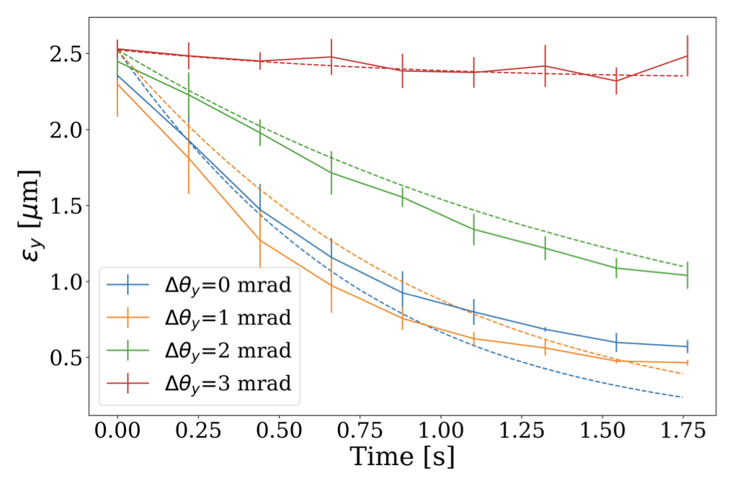
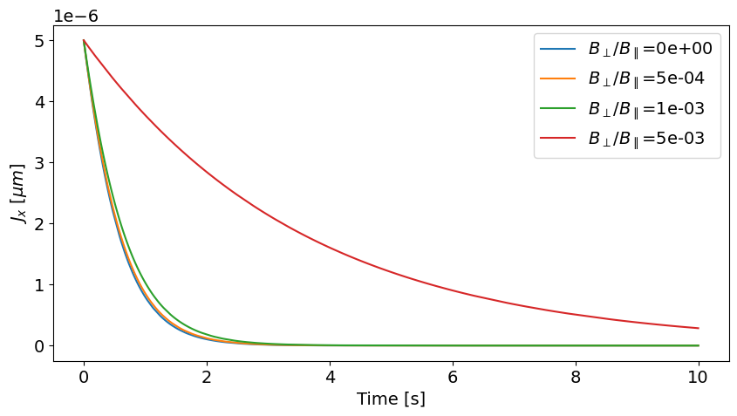
E-cooling studies in ELENA
Test bed for Xsuite e-cooling model benchmark (P. Kruyt (soon to finish his PhD))
  Generally, good agreement between measurements and simulations
  Still to test impact of field quality degradation (introduced with correction coils) on cooling efficiency
Measurements and simulations at 35 MeV/c
Simulations at 35 MeV/c
ELENA magnetic field quality somwhere in this range

Slide 38




MD example: ELENA emittance at ejection
Plots assuming beta_x = 7.7 m and betay = 1.3 m irrespectively from working point => big assumption! Optics is actually diffferent
Present wp assuming:
1e7 pbars
100 keV
65 ns rms
2 um rms
Up to 4th order resonances
A typical challenge in low energy synchrotrons:
Possibly excited resonance limit the possible tunes that one can use in a machine, e.g. ELENA
Space-charge effect induces a tune spread experienced by the beam depending on particle particle density within the beam
  i.e. smaller beam size (or emittance) = higher tune spread
An optimisation example:
Observation: the beam emittance at ELENA extraction was above the design value
We simulated expected tune spread due to space charge, and measured excitation state of resonance by scanning the tune diagram
We identified a more robust working point
Factor 2 emittance reduction obtained in 2023
Used in operation in 2024
Initial working point
Third order
resonance found to be excited
x2 emittance reduction!
ELENA Design

Slide 39
Summary
Electron cooling is an essential instrument for ion and antimatter physics at CERN
  It is based on energy exchange between “hot” ions and “cold” e⁻ which are continuously renewed
  It requires that the mean velocity of e⁻ is matched with the ions velocity
  The alignment between the beams is fundamental, despite sometimes it is useful to introduce some misalignment “not to cool too much”
  Schottky diagnostics is the key to spot any problems and make first order corrections
  The electron transport must be optimized to minimize losses, which are detrimental for cooling efficiency
Three electron coolers are in operation at CERN
  LEIR: probably the most versatile, it has several parameters to adjust the electron beam generation.
  AD: the oldest at CERN, but also the most powerful. Little adjustment possibilities, requiring to watch e⁻ losses.
    Looking forward to restart AD with the new e-cooler after LS3!
  ELENA: the smallest, it needed careful design and optimization of magnetic field (100 Gauss, 10⁻³ straightness!)
Actual cooling performance depends on many parameters and effects also proper of circulating ions
  Not covered here! Space charge, Intra Beam Scattering, Vacuum, Impedance and other instabilities …

Slide 40
Thanks for your attention and questions!
…and some references…
Several references on E-Beam website
Functional Specification for the New AD E-cooler EDMS#2772724
General review of cooling techniques on ICFA Newsletter #65
H. Poth - Electron cooling, theory, experiment, application, CERN-EP/90-04 (doi)
Many slides presented here have been adapted from:
  G. Tranquille – A&T Seminar 2019 - 40 Years of Electron Cooling at CERN – indico
  M. Bai – BND School 2015 – Introduction to electron cooling – indico
  I. Meshkov - ASAO2014 – Beam Cooling Techniques – indico
  H. Danared – CAS2005 – Beam Cooling – presentation – proceedings
  N. Biancacci and A. Saa Hernandez – E-BEAM 2019 – LEIR e-cooler op experience – indico
  … and many others! Thanks to all of you!

Slide 42

Other Properties of Generated Electron Beam:
Electron beam current
Electron current extracted from the “space-charge” cloud in front of the cathode, and it is described by Child’s law:
Note: perveance can be affected by control electrodes, like in the case of LEIR’s cooler from previous slide…
From A. Bubley, The Electron Gun with Variable Beam Profile for Optimization of Electron Cooling, EPAC2002, WEPRI049
electron-velocity distribution at the cathode and after acceleration in the drift space
Notes:
I_{gun} &= P (V_{cathode} - V_{anode})^{3/2} \\
P &= \mathrm{Gun \, perveance} \\
&\approx 7.3 \times 10^{-6} (r_0/d)^2 \mathrm{[A V^{-3/2}]}\\
&\qquad r_0 = \mathrm{cathode\, radius} \\
&\qquad d = \mathrm{cathode-anode \, distance} \\
Formulas from 1990 paper… in reference

Slide 43
Other Properties of Generated Electron Beam:
Electron longitudinal temperature
The electron velocities at the cathode is typically assumed to be Maxwellian:
After acceleration, the longitudinal temperature in the moving frame shrinks:
In practice: longitudinal temperatures of the order of ~10⁻³ eV due to scattering processes
rms kinetic energy
isotropic
flattened
electrostatic
acceleration
(non relativistic case)
Example: k_{B}T_{cath} = 0.1eV (T_{cath}=1100 K)
acceleration voltage U₀ = 2.3 kV, i.e. E₀=2.3 keV
then k_{B}T// = 10⁻⁶ eV
cathode
drift space
electron-velocity distribution at the cathode and after acceleration in the drift space
Notes:
\frac{1}{2} m_e v_{rms}^2 = \frac{3}{2}k_B T
f(\vec{v}) \equiv \frac{1}{(2\pi k_B T/m_e)^{3/2}}e^{-\frac12 m_e\vec{v}^2/k_BT}
k_B T_\perp \approx k_B T_{cath}

Slide 44

LEIR e-cooler main hardware parameters
Voltages referred to cathode (V_{k}), which defines the e⁻ energy:
(not taking into account space charge corrections)
Courtesy of A. Frassier.
Main solenoid and corrector coils currents are typically set during first commissioning and can hardly be adjusted as there are no obvious observables but e⁻ losses/vacuum.
Notes:
\gamma_{rel_{e^-}} = \gamma_{rel_{ions}} = 1 + \frac{e V_{K}}{m_e c^2}

Slide 45


LEIR E-Cooler Gun Settings
Transverse beam distribution can be adjusted (as already seen):
  Electron current depends from both V_{grid} and V_{control} in a
  non trivial way as Perveance (P) is not constant.
Dashed lines generated using “fitted” Perveance
Perveance naïve fit looking at available data:
Notes:
\beta_{rel} &= \frac{\sqrt{\gamma_{rel}^2 - 1}}{\gamma_{rel}} \\
\gamma_{rel} &= 1 + \frac{e V_{gun}}{m_e c^2}
\gamma_{rel_{e^-}} = \gamma_{rel_{ions}} = 1 + \frac{e V_{gun}}{m_e c^2}
-----
E- current, in principle computed as:
I_{gun} &= P (V_{gun} - V_{grid})^{3/2} \\
P &= \mathrm{Gun \, perveance}
In the case of LEIR, as V_grid is referred already to V_gun, then
I_{gun} &= P (V_{grid})^{3/2}
\frac{V_{control}}{V_{grid}}
\begin{cases}
\approx 0.9 => \mathrm{hollow\, distribution} \\
\approx 0.5 => \mathrm{partially\, hollow\, distribution} \\
\approx 0.2 => \mathrm{flat\, distribution} \\
\approx 0 => \mathrm{parabolic\, distribution} \\
\end{cases}
Measured during 2018:
GunVoltageTo_m_s_Factor = (1.53e5)/25 = 6120
Typical voltage is 2 kV

Slide 46
LEIR: Ion Acceleration with the Electron Cooler
The same concept can be used to accelerate the beam! Just keep increasing the Vgun while adjusting magnetic cycle to follow increase of ions momentum
Very slow process! Managed to increase momentum only of about 6% in ~1 second for a low intensity ion beam.
revolution frequency
reduce dp/p with cooling
injection
Longitudinal
Schottky
harmonic 100
h=99
drag ion beam
h=98
h=97
time
h=96
h=95
More Details in CERN-ACC-NOTE-2020-0023 and A. Saa Hernandez E-BEAM#2

Slide 47

AD E-Cooler Power Supplies
Circuitry is very similar to the LEIR e-cooler one, but with some more simplifications and less tuning knobs (e.g. simpler gun, single PC for main solenoids/toroids)
Fast Switch: Ground/V_{K}
Main Controls/Observables
“Effective” perveance might decrease with time due to thermionic cathode aging…
Notes:
E_k &= e V_K \\
I_e &= P V_K^{\frac{3}{2}} \\
P &= 0.58 \times 10^{-6}

Slide 48

AD Tools: E⁻ Beam Current Monitor (similar in LEIR)
Controlling e-cooler interlocks and e- beam current/losses with two independent tools:
LabView: Mixture between BI PLC communication and Power Converters FESA classes
  Estimates e- beam current via I_{collector}; losses via I_{katode}
VirtualScope installed in the HV Cage:
Clearly showing fast switches “stopping” (or not) the beam
Similar view available also for LEIR
Current losses estimates
Poor sampling
With grid fast switch
Example with no grid fast switch

Slide 49



ELENA: Some detailed analysis of Cooling
Schottky signal @h=10
Analysis of Schottky signal
De-bunching
(unclear time)
Re-bunching
Longitudinal cooling time of the order of 1 s
  Momentum spread ~2.5e-4 compatible with expectations
Clear reduction of transverse beam size
Some drift of mean energy
  e- beam energy drift?
Cumulative Distribution Functions from Left/Right scrapings
From J.Hunt PRAB

Slide 50


Beam diagnostics based on recombination
CRYRING COSY
Measured rate coefficient for dielectronic recombination of F6+. The red curve was obtained by fitting a theoretical cross section calculated by Eva Lindroth at Stockholm University to the large peak at 10-2 eV, the shape of which is sensitive to both transverse and longitudinal electron temperatures. This fit gave kTperp = 1.5 meV and kTpar = 0.10 meV. The rate is in arbitrary units and the calibration of the experimental energy scale is only approximate. (CRYRING webpage)
Horizontal and vertical H 0 profiles with a 0.35 mrad horizontally misaligned electron beam. Electron beam current 130 mA.
  M. Bai – BND School 2015 – indico

Slide 51

ELENA Gun and Collector
From- J. Cenede –– BI Day 2016

