Slide 1
Magnet system of the new AD electron cooler
Luke von Freeden
7 March 2025

Slide 2
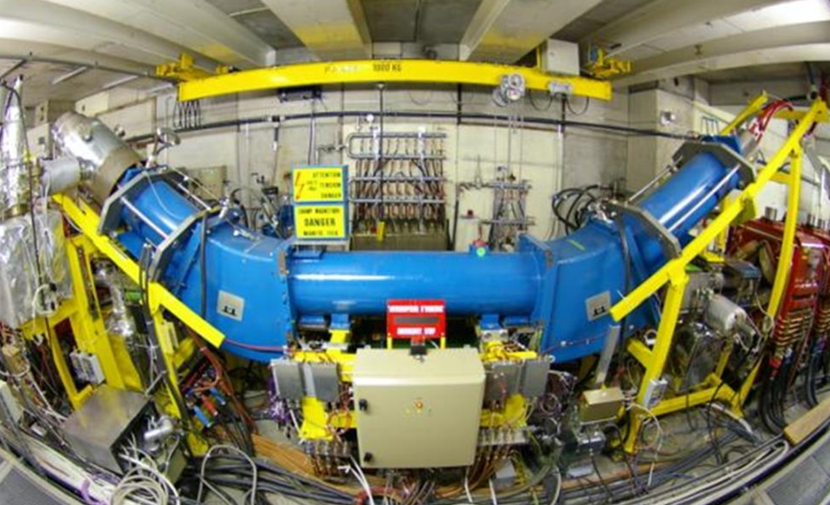
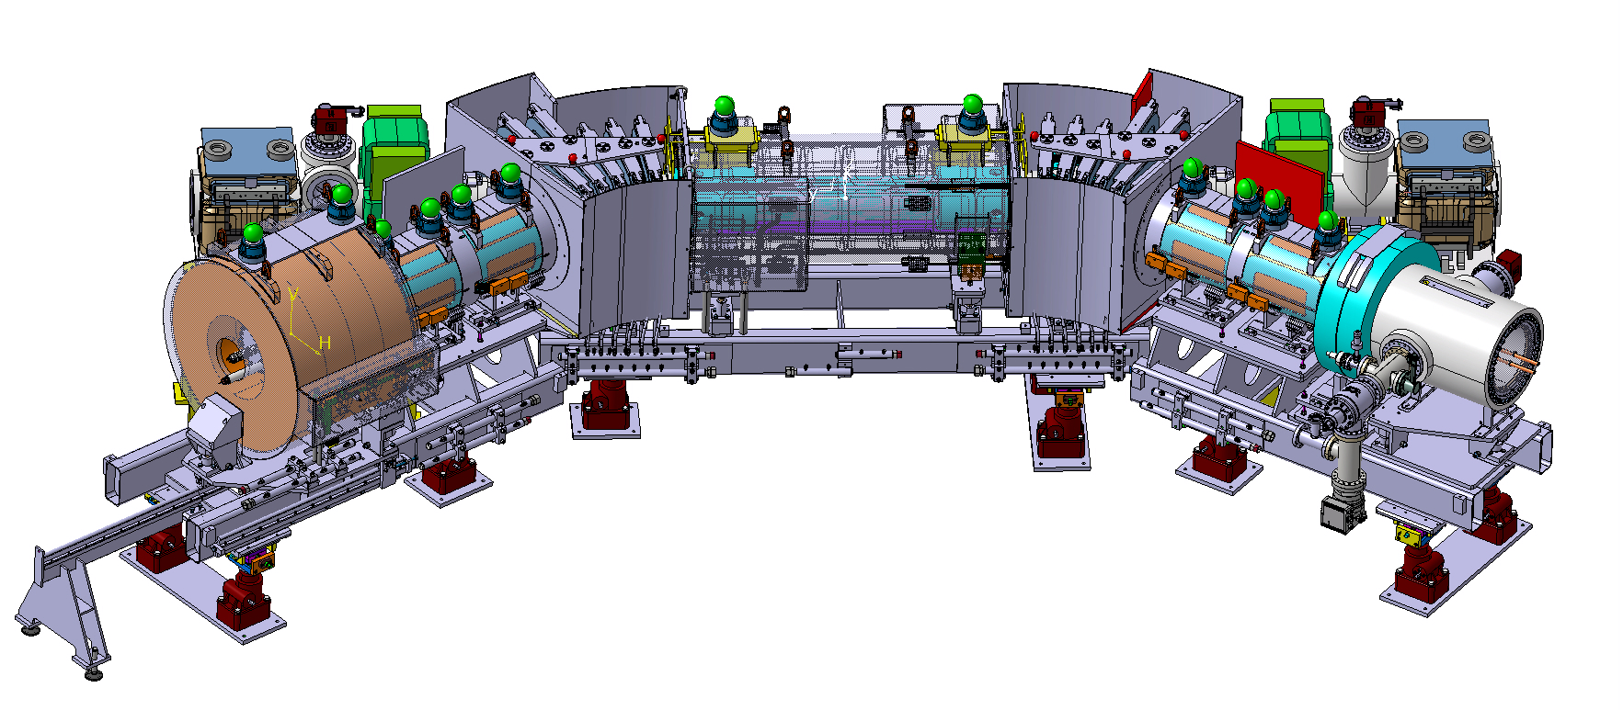
Introduction
Overview of the AD cons project
Magnet system in electron cooling
Functional specification of 2023
Design of this electron cooler
Magnetic measurement
Project roadmap

Slide 3
The AD cooler consolidation project
Present AD electron cooler magnet system built in 1978 used for in 3 experiments: ICE → LEAR → AD
Major breakdowns of collector in 2018 lead to consolidation review in 2019
No spares for a most of the magnets, limited design information, original manufacturer defunct since 2000.
Review identified full-system replacement as best way to minimise down-time. Opportunity to upgrade the system to improve cooling performance.

Slide 4
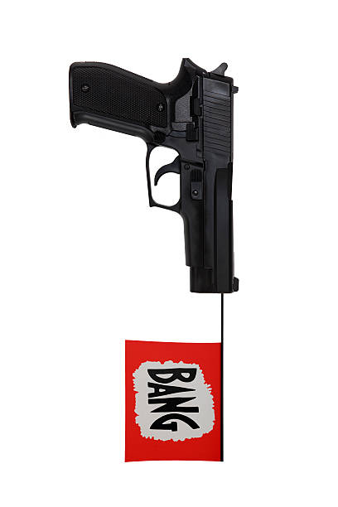



Magnet system of an electron cooler
Electrons produced by gun are trapped onto field lines
Magnetic field guides the electrons from gun to collector
Any transverse momentum from gun → spiraling around field line
B
e⁻

Slide 5
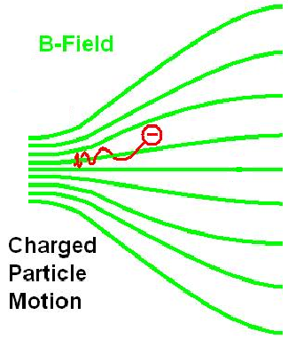

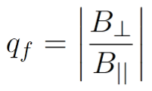
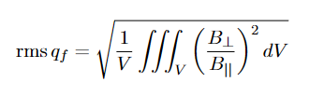
Field quality in the drift
Electrons spiral around flux lines
apparent temperature to antiprotons combination of temp and B
→ B flux lines must be flat in drift.
Field quality in electron cooler
Image remixed from WikiHelper2134 under CC BY-SA 3.0

Slide 6

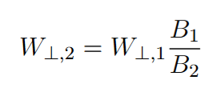
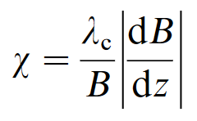
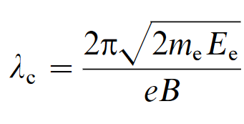
Adiabatic expansion
For a charged particle in a magnetic field, magnetic moment is invariant:
Reducing B → reduction in transverse K.E. (moved to parallel)
Adiabatic condition: the rate of change of B is small relative to the cyclotron wavelength.
Typically, χ < 0.5 is acceptable.
Image remixed from WikiHelper2134 under CC BY-SA 3.0

Slide 7
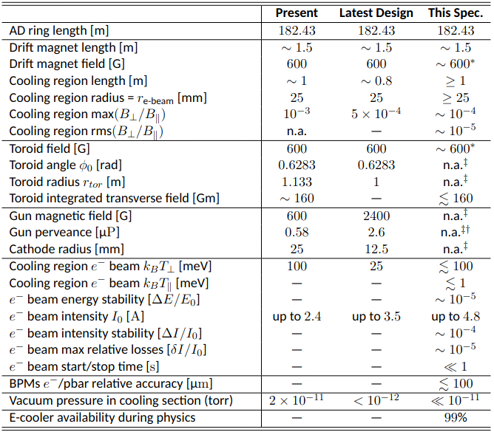
Functional specification
D. Gamba, C. Carli, L. Ponce, A. Rossi, G. Tranquille, L. Varming Joergensen Functional specification of the new electron cooler, Sept. 2022 EDMS 2772724

Slide 8
Overview of the magnet system
Image courtesy of V. Maire and N. Chritin EN-MME

Slide 9
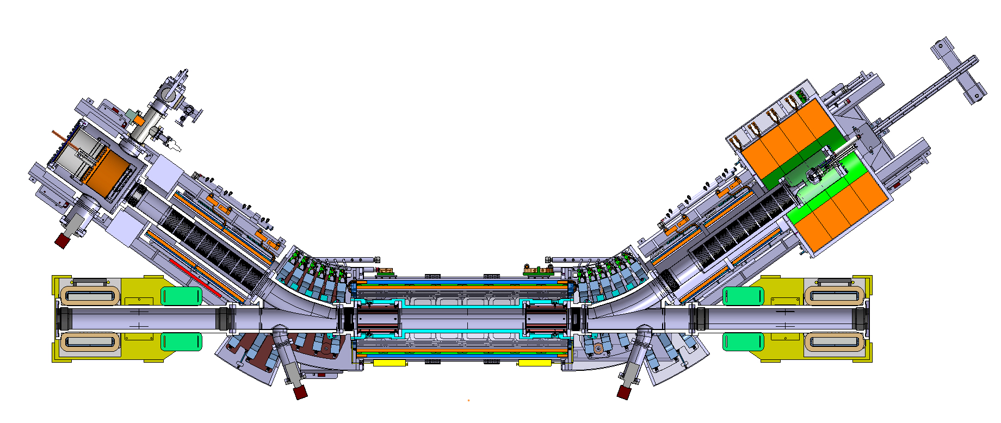
Overview of the magnet system
Drift ID fixed by BPMs
Y-chamber in TF region
Space for gun support (cantilever)
Space for vacuum flange

Slide 10
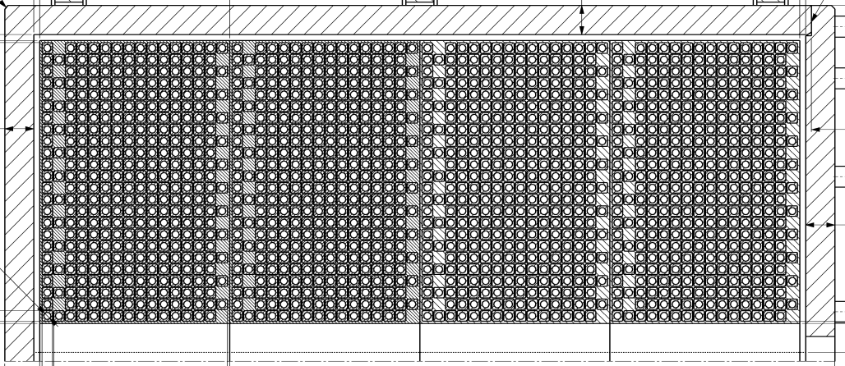
Overview of the magnet system
Expansion solenoid
240 mT
Ø953 × 712 mm³
2600 kg
Image courtesy of V. Maire and N. Chritin EN-MME

Slide 11
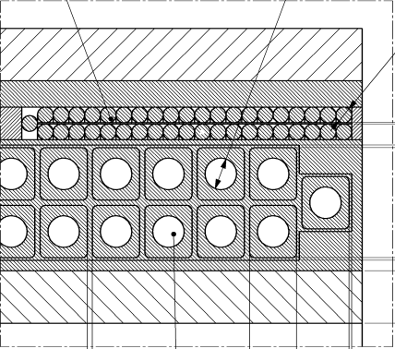
Overview of the magnet system
Arm solenoids
60 mT
2 × 2 coils
Ø395 × 429 mm³
180 kg
Embedded steerer
Image courtesy of V. Maire and N. Chritin EN-MME

Slide 12
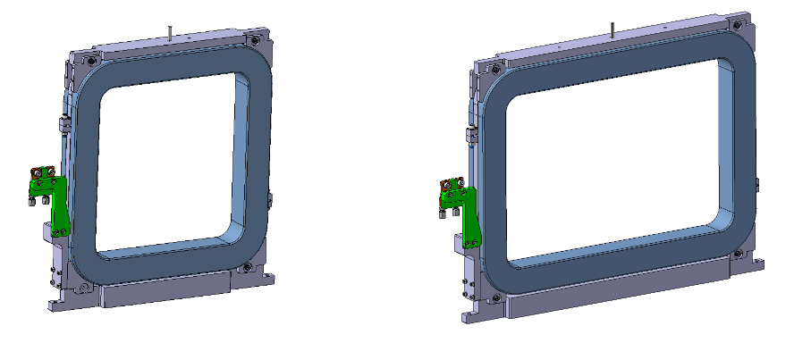
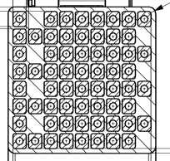
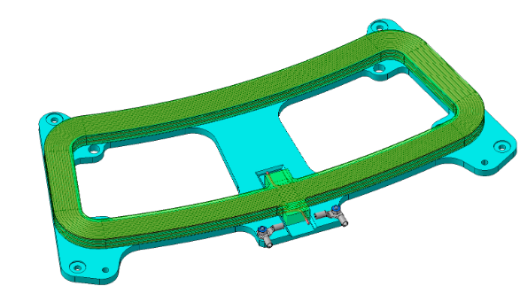
Overview of the magnet system
Toroidal field regions
60 mT
2 × 6 racetrack coils
63 × 525 × (505 & 725) mm³
35 & 42 kg
Steering coil
Image courtesy of V. Maire and N. Chritin EN-MME

Slide 13
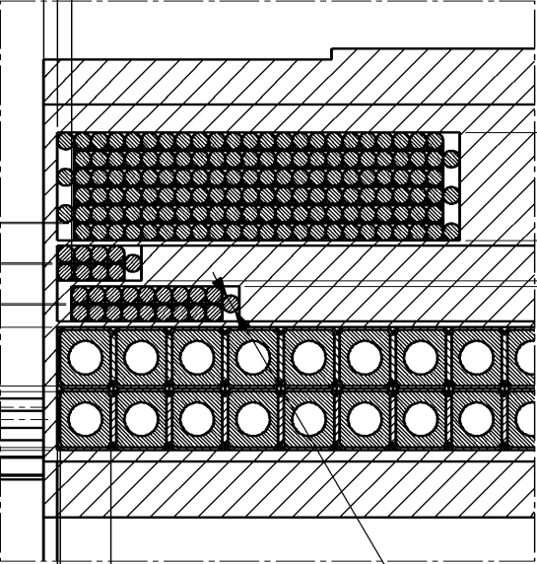
Overview of the magnet system
Drift solenoid
60 mT
Ø570 × 1505 mm³
1200 kg
Steering coils
Correction coils
Image courtesy of V. Maire and N. Chritin EN-MME

Slide 14
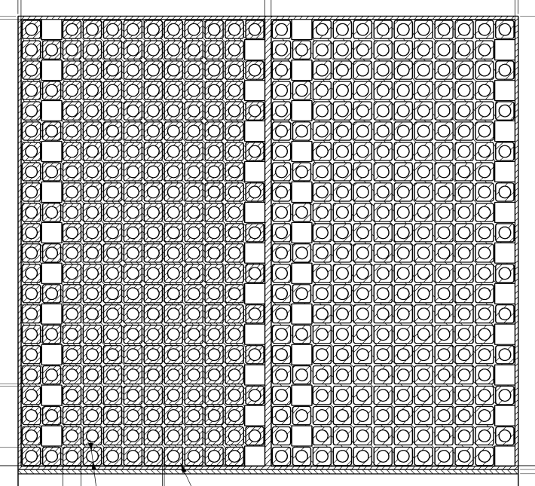
Overview of the magnet system
Squeeze coil
166 mT
Ø680 × 234 mm³
510 kg
Image courtesy of V. Maire and N. Chritin EN-MME

Slide 15
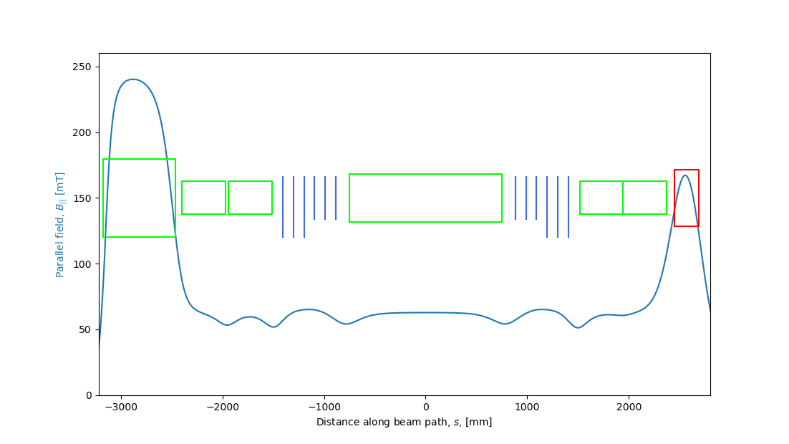
Main field along e⁻ trajectory

Slide 16
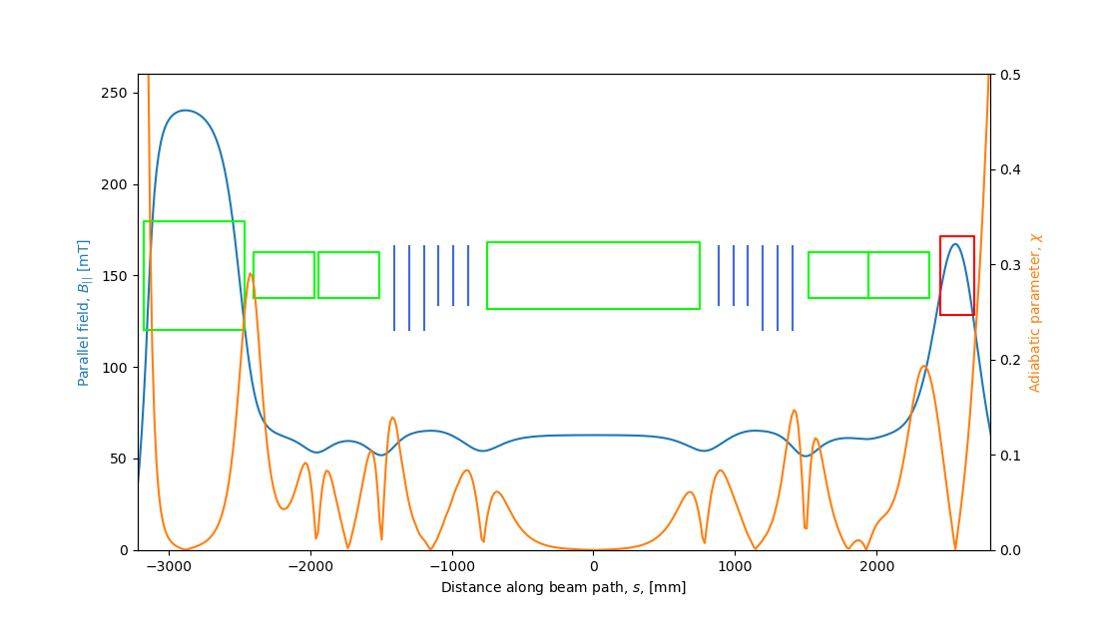
Main field along e⁻ trajectory

Slide 17
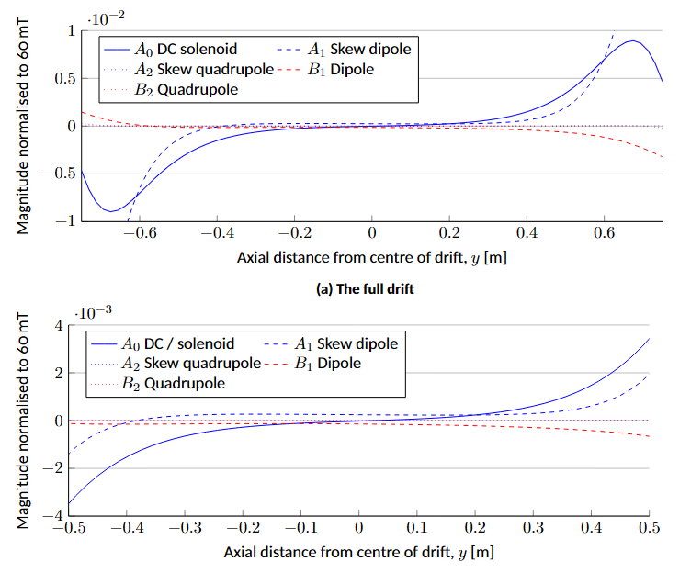
Field errors in the drift
Without correction, relative error > 5 × 10⁻³ in GFR (Ø60 × 1000 mm³)
Strong solenoid component due to drift to TF gap
Skew dipole component due to pollution from TF region
Normal dipole component due to slight up-down asymmetry in shield
Higher orders << 1 × 10⁻⁴

Slide 18
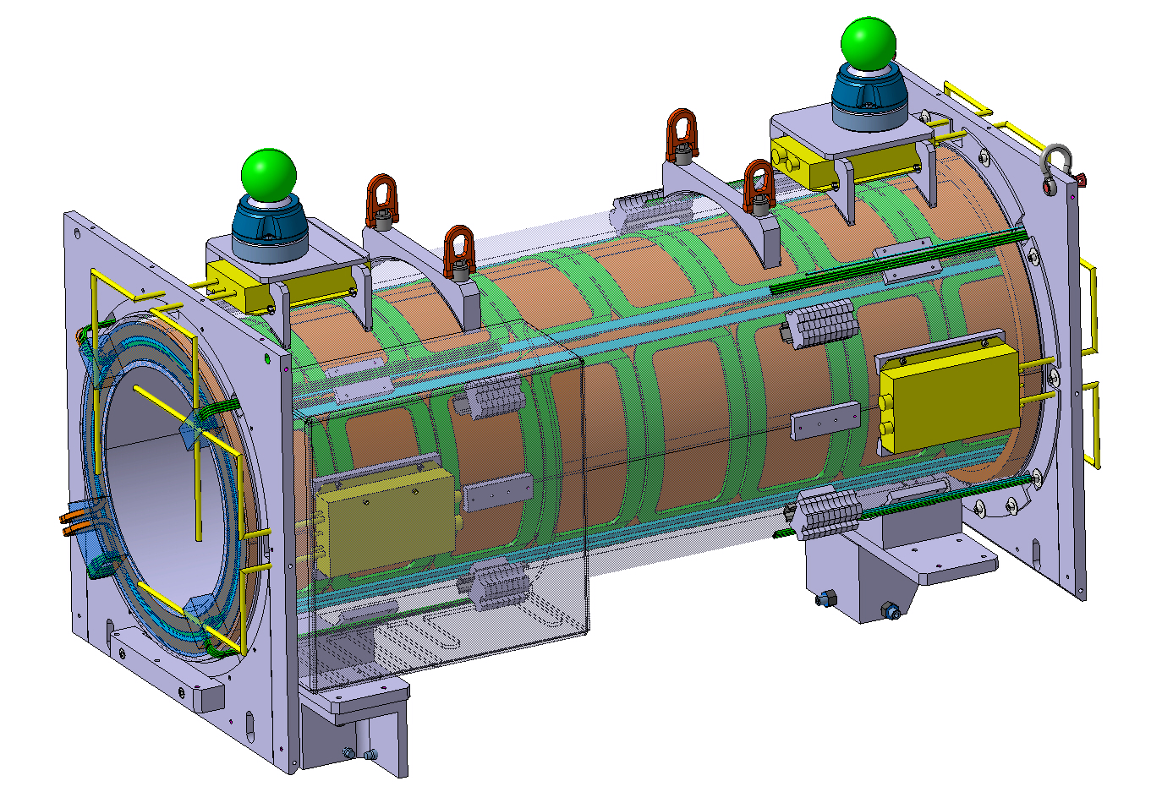
Field correction scheme
8 pairs of vertical dipole correction coils
Solenoid “grading” winding at each end
8 pairs of horizontal dipole correction coils
Image courtesy of V. Maire and N. Chritin EN-MME

Slide 19
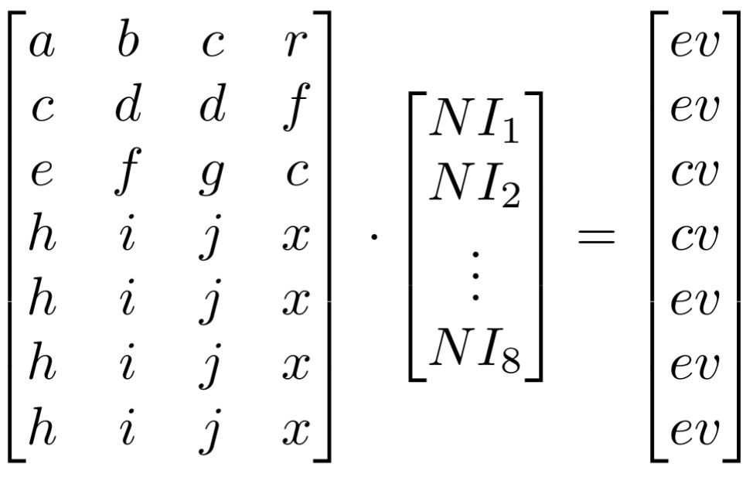
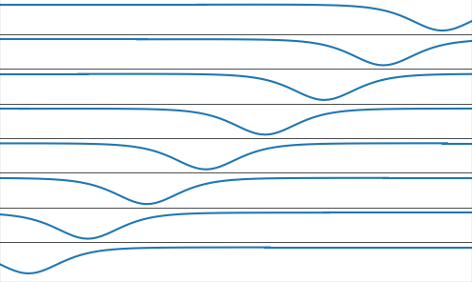
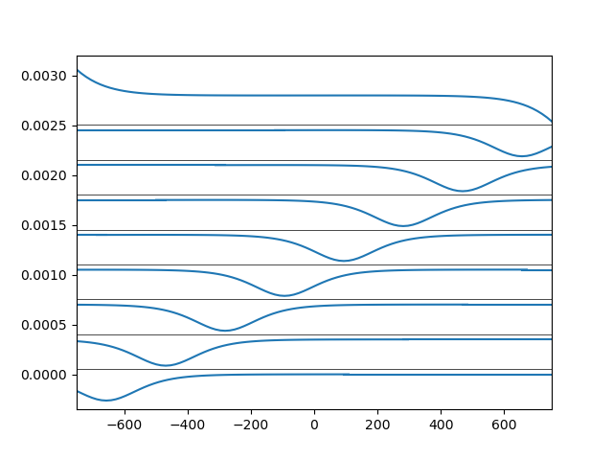
Setting the correction currents via least squares
Matrix of Bx/y(Δs)
for each pair of
saddle coil
Vector of
-1 x error
Vector of
unknown
ampere turns

Slide 20
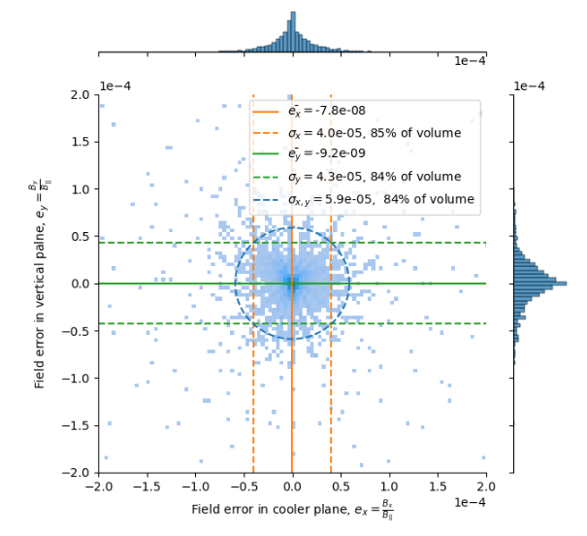
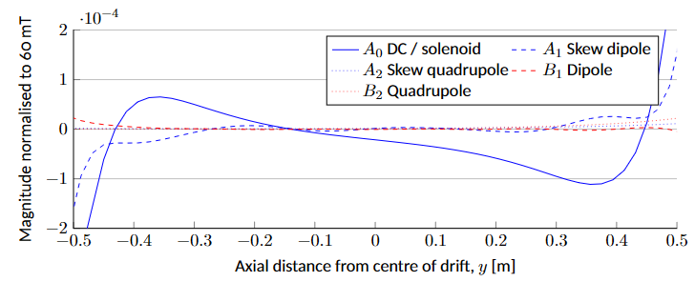
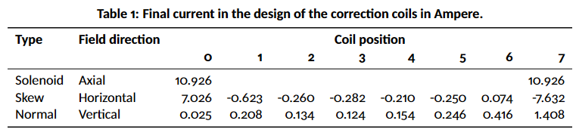
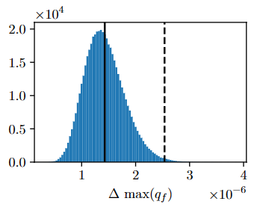
Results of the field correction
< 2.5 × 10⁻⁶ (3σ) from supply precision and ripple
At least 24% (1.5 × 10⁻³) current margin in all coils

Slide 21
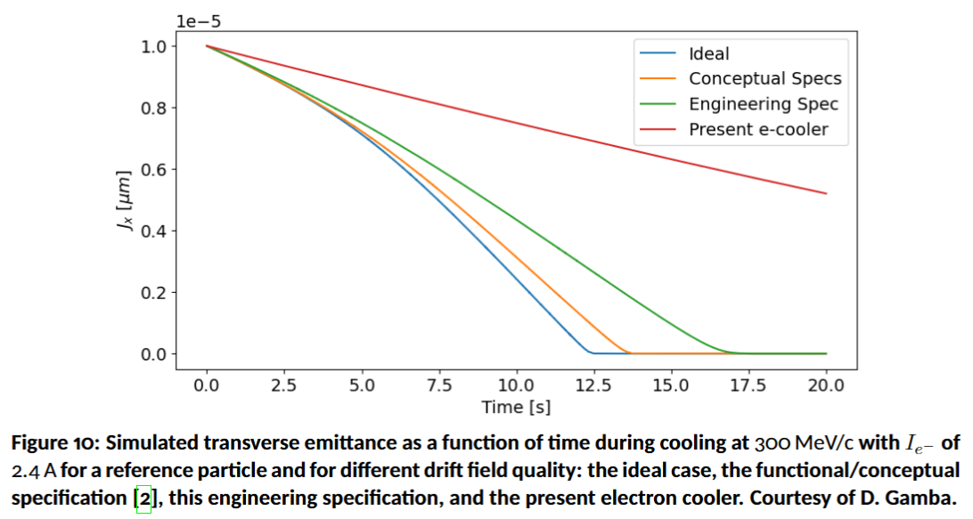
What that means for the AD w/ thanks to D. Gamba

Slide 22
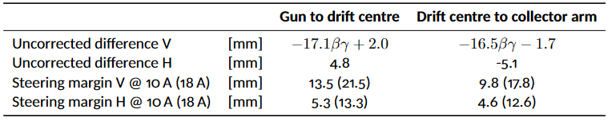
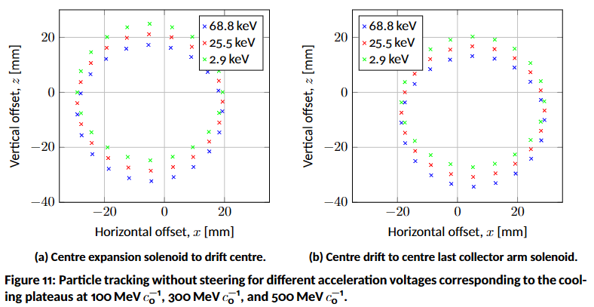
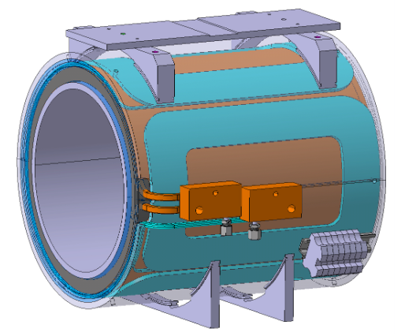
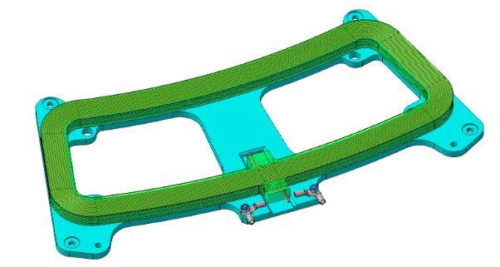
Steering scheme
Constant offset due to central flux line not exactly following the reference trajectory
Offset with accelerating voltage cross drift from centripetal forces acting on the electrons in TF region
Image courtesy of V. Maire and N. Chritin EN-MME

Slide 23
Measurement, alignment and correction
Measurement and correction performed on surface
Tolerance of current and survey → field quality change between correction in B. 311 and installation in tunnel < 3 × 10⁻⁵
Fiducialisation of all magnetic axes allows direct spare substitution

Slide 24
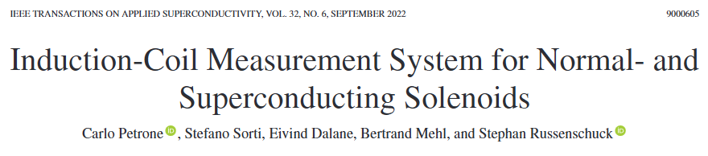
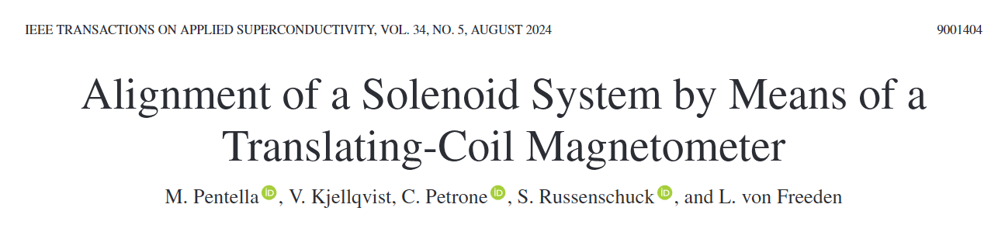
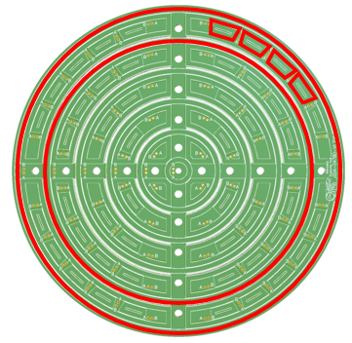
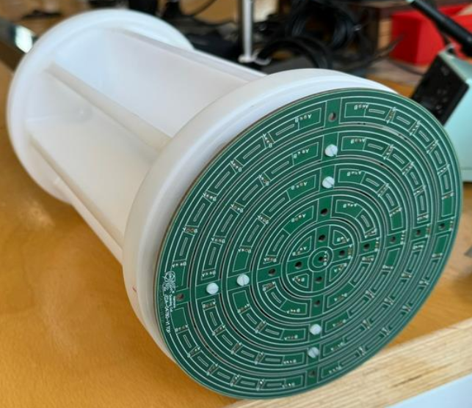
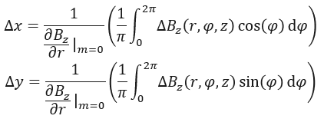
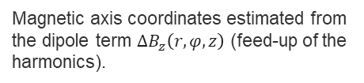
Development of translating flux meter w/ thanks to M. Pentella, C. Petrone, and TE-MSC-MMM
Translating flux meter proof of concept
Novel translating flux meter developed through research in TE-MSC-MMM
Two key outputs yielding very promising results:
  PCB design optimised for field errors in 60 mT
  3D cylindrical harmonic description
Flux meter applied to 60 mT solenoid correction
Magnetic axis coordinates estimated from the dipole term $ΔB_{z}\left(r,φ,z\right)$ (feed-up of the harmonics).

Slide 25
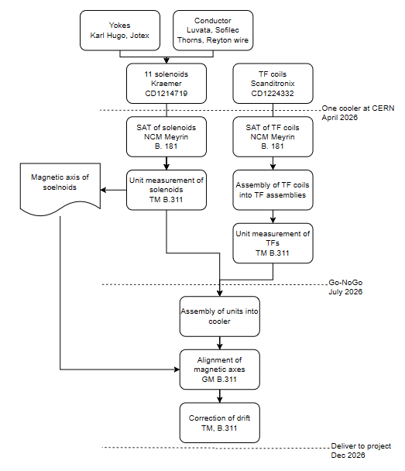
Project roadmap
Contract 1 – 11 solenoids
  1+1 Drift, 4+1 Arm, 1+1 expansion, 1+1 squeeze
  Launched with Krämer Aug 24
  Batches to be delivered Nov 25 to Aug 26
  Free issued shields and conductor reduced total price
Contract 2 – TF region coils
  6+1 small racetracks, 6+1 large racetracks, 4+1 steerers
  Launched with Scanditronix Sept 24
  Manufacturing file accepted
  Batches to be delivered Aug 25 to Dec 25

Slide 26
Conclusion
A new AD electron cooler magnet system has been designed
The new design gives at least a factor 5 improvement in field quality
The procurement is ongoing, first coils mid this year with installation in LS3

Slide 27
Further reading
Functional specification – EDMS 2772724
Engineering specification – EDMS 3014577
Design report and MT29 paper to follow

