Slide 1


FCC-ee positron linac design
Y. Zhao, A. Latina, CERN
FCC-ee WP1 meeting
06 Dec 2024

Slide 2
Positron production
Electrons
  E = 2.86 GeV. σ_{E} / E = 0.5%†. σ_{z} = 1 mm
  σ_{x,y} = 1 mm. ε_{n,x,y} = 4 mm*mrad†. Emittance can be larger or smaller, but the impact on positron yield is negligible
Target
  Conventional scheme (i.e. cylindrical shape, single amorphous tungsten)
  Radius: R = 15 mm. Radius can be reduced to the minimum of 5 mm
  Thickness: W = 15 mm
† Numbers suggested by S. Bettoni from e⁻ linac simulation

Slide 3
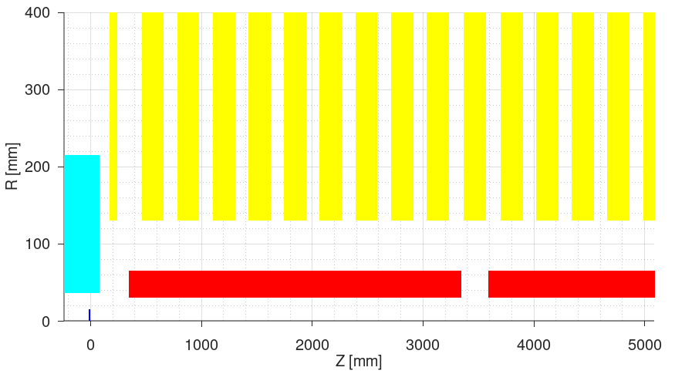
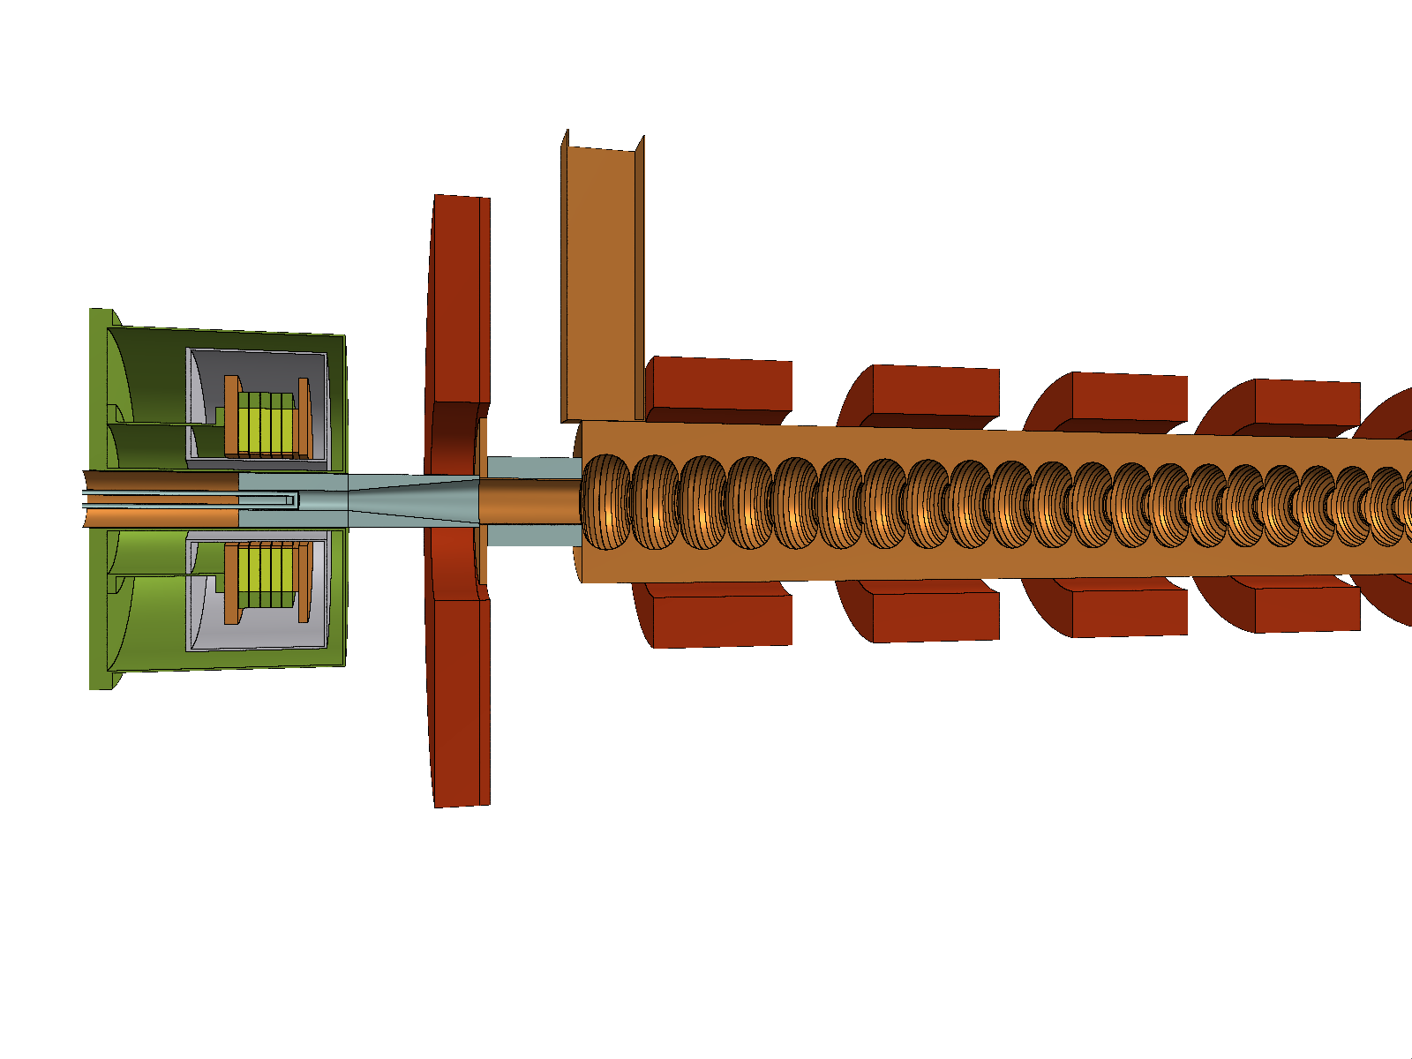
Capture section
AMD
  HTS solenoid. 2D field. B₀ ~ 14.94 T
  Target exit position: 40 mm (w.r.t. HTS B₀)
Matching solenoid
  L = 72 mm. 3D field (Maxwell3D)
  B₀ ~ 0.245 T
  Center position: 244 mm (w.r.t HTS B₀)
Shielding
  Tapered aperture (optimized by WP3). Impact on yield is negligible
Capture Linac (CL)
  RF structure length: 3 m. Iris radius: a₀ = 30 mm (constant)
  N = 6, G = 13.3 MV/m, φ = [235 231 233 251 286 257]° (reoptimized by WP3)
  Regular solenoids: L = 200 mm. 3D field (Maxwell3D). B₀ ~ 0.31 T. N = 9 (per structure)
M. Daugaard

Slide 4
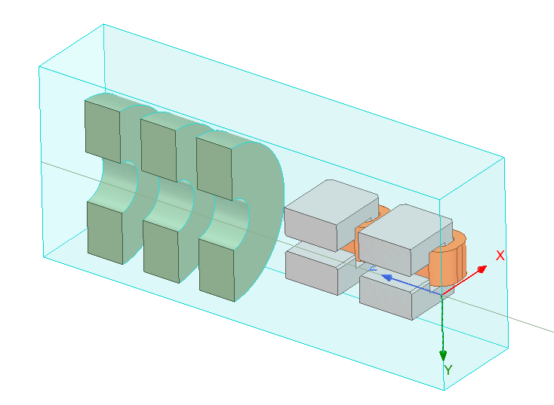
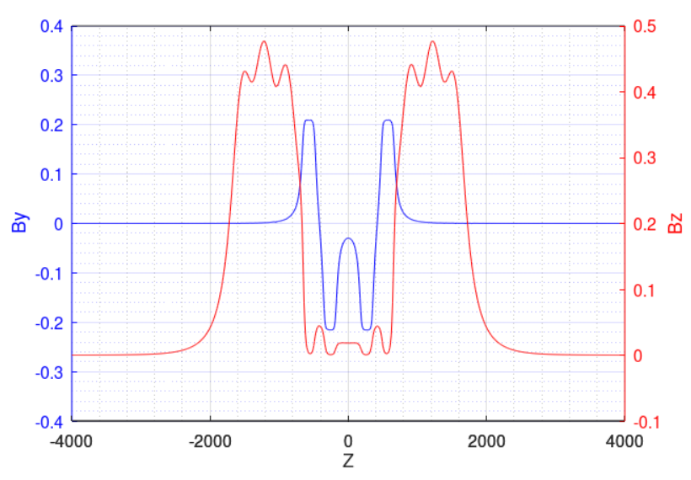
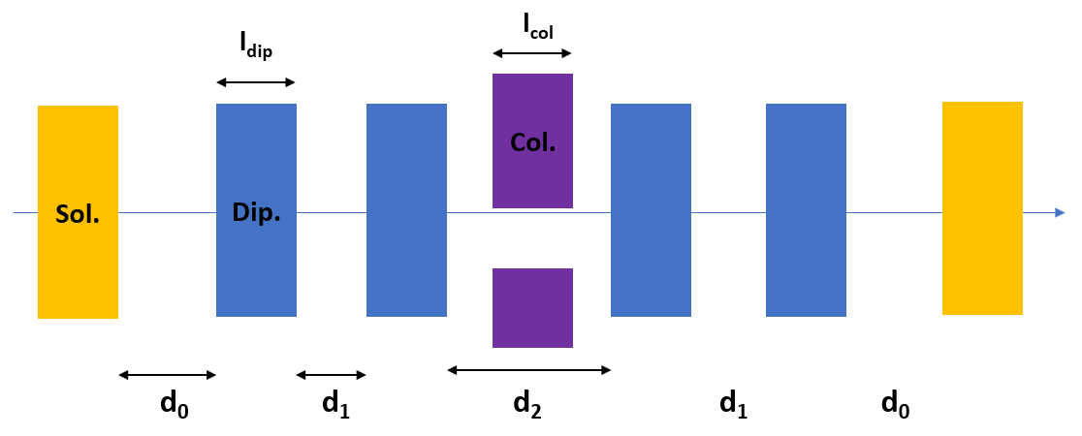
Chicane
Chicane – “V2” (Collaboration with R. Zennaro)
  Combined simulation of chicane (four dipoles) and 6 neighboring solenoids. Therefore, parameters (lengths, apertures, distances) are fixed by design
  Dispersion closed by increasing 2% the current of middle dipoles
  3D field (Maxwell3D)
  Dipole yoke length: l_{dip} = 180 mm
  Apertures of beam pipe: Δx = 150 mm, Δy = 50 mm (yoke aperture is 70 mm)
  Distances between dipole yokes: d1 = 125 mm, d2 = 350 mm
  Distance between solenoid and dipole yoke: d0 = 125 m
¼ view

Slide 5
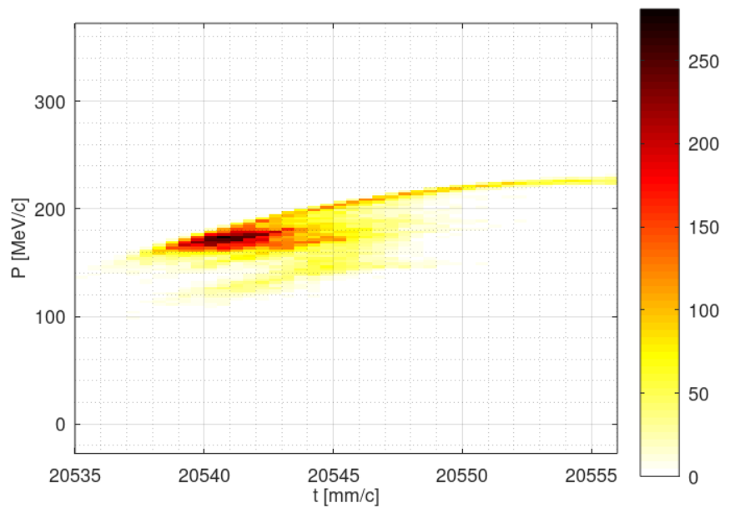
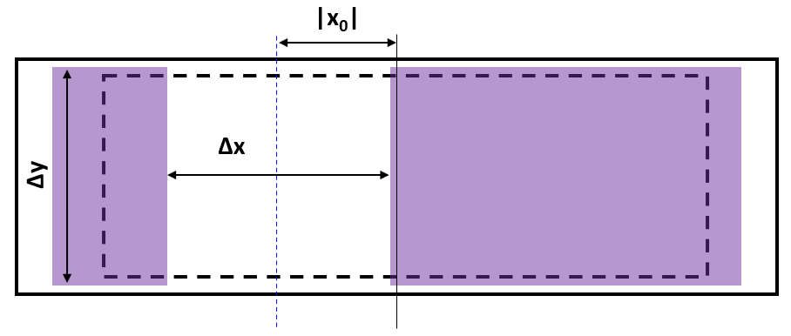
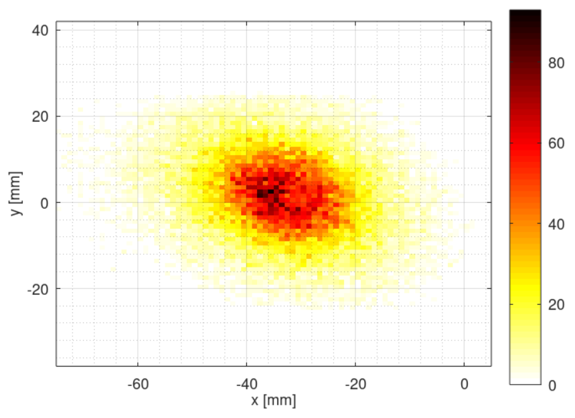
Collimator
Collimator
  Length: l_{col} = 120 mm
  Apertures: Δx = 70 mm, Δy = 50 mm
  X offset: x₀ = -35 mm

Slide 6
Positron linac design
Section 1 (S1)
  Same structure and solenoids as Capture Linac
  N = 20, G = 13.3 MV/m, φ = -10° (optimized for max. yield)
  Average energy (around bunch core) at exit: 931.7 MeV
Section 2 (S2)
  Same structure as Capture Linac
  Periodic FODO cells. 2 structures per FODO cell. FODO phase advance: 76.345° (optimized for min. beta)
  Quadrupole length: 0.4 m. Quadrupole-Structure distance: 0.15 m. Quadrupole spacing: 3.3 m
  N = 52, G = 12.756 MV/m, φ = 5° (optimized for max. yield)
  Average energy (around bunch core) at exit: 2.866 GeV
Parameter | Value
Collective effects considered | Space charge; Short-range wakefield
Primary electron bunch charge assumed for collective effects [nC] | 5.0
Bunch length (around bunch core) at PL exit [mm] | 3.0
Energy spread (around bunch core) at PL exit [%] | 0.95
Total positron yield (all positrons) at PL exit | 3.41
Expected DR accepted yield with ±2% energy acceptance at PL exit | 3.01
Normalized X, Y emittances (accepted positrons) at PL exit [mm*rad] | 13.1, 13.0
Geometric X, Y emittances at (accepted positrons) PL exit [mm*mrad] | 2.34, 2.32

Slide 7
Positron linac power consumption
Power consumption in Positron Linac (based on discussion with J. Raguin)
Parameter | Value
Average gradients in S1, S2 [MV/m] | ~13
Number of structures per RF module | 4
Number of structures in S1, S2 (w/ spare module) | [20, 52+4]
Total number of RF modules (w/ spare module) | 5+13+1 = 19
Total number of solenoids | 20*10 = 200
Total number of quadrupoles | ~52+4 = 56
RF power consumption [MW] | 19*0.19 = 3.61
Solenoid power consumption [MW] | 200*0.016 = 3.20
Quadrupole power consumption [MW] | Neglected
Total power consumption [MW] | 6.81

Slide 8
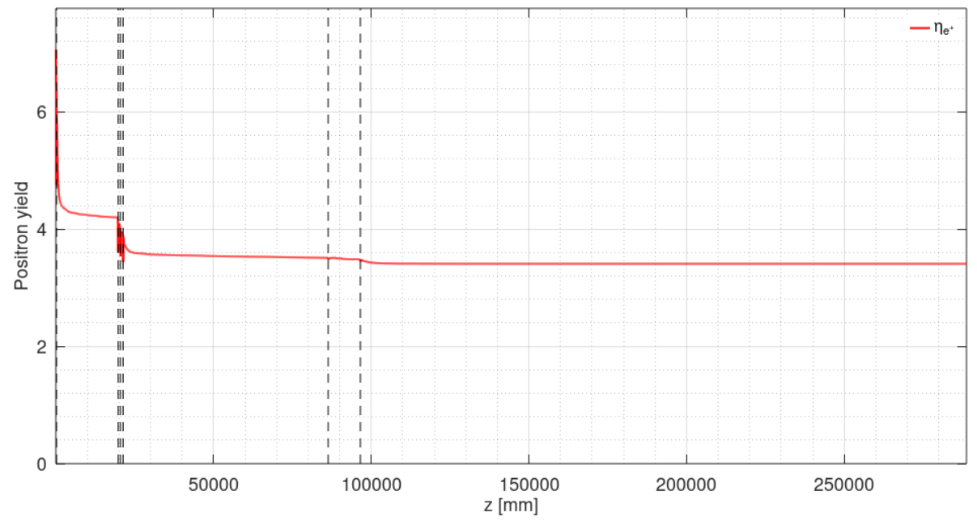
Yield evolution along z
CL S1 S2

Slide 9
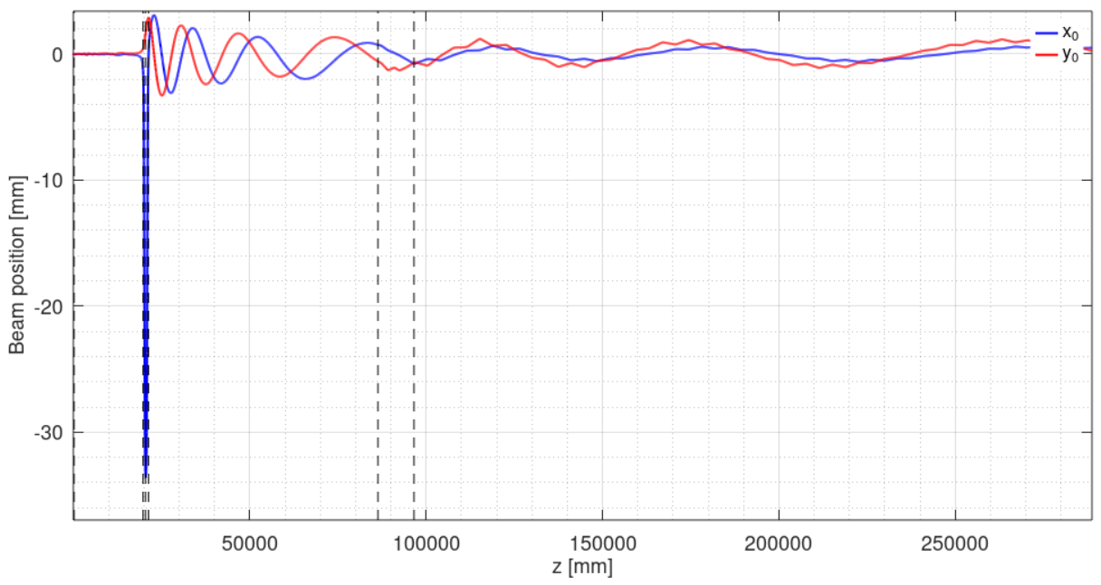
Beam position evolution along z
CL S1 S2

Slide 10
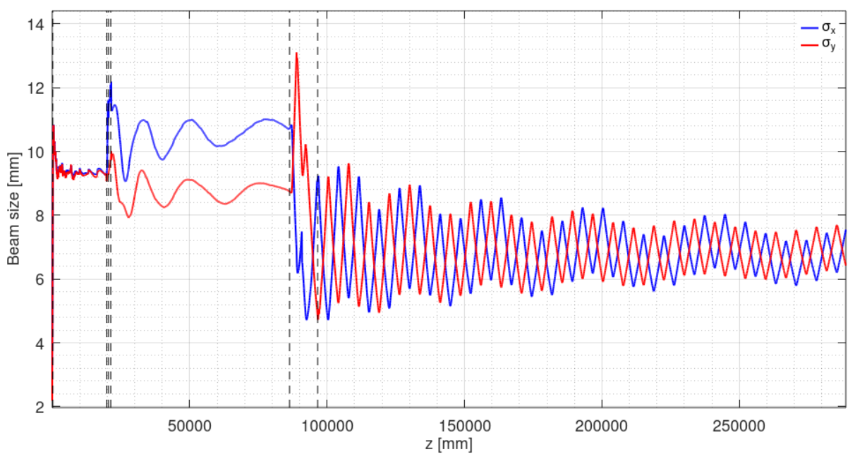
Beam spot size evolution along z
CL S1 S2

Slide 11
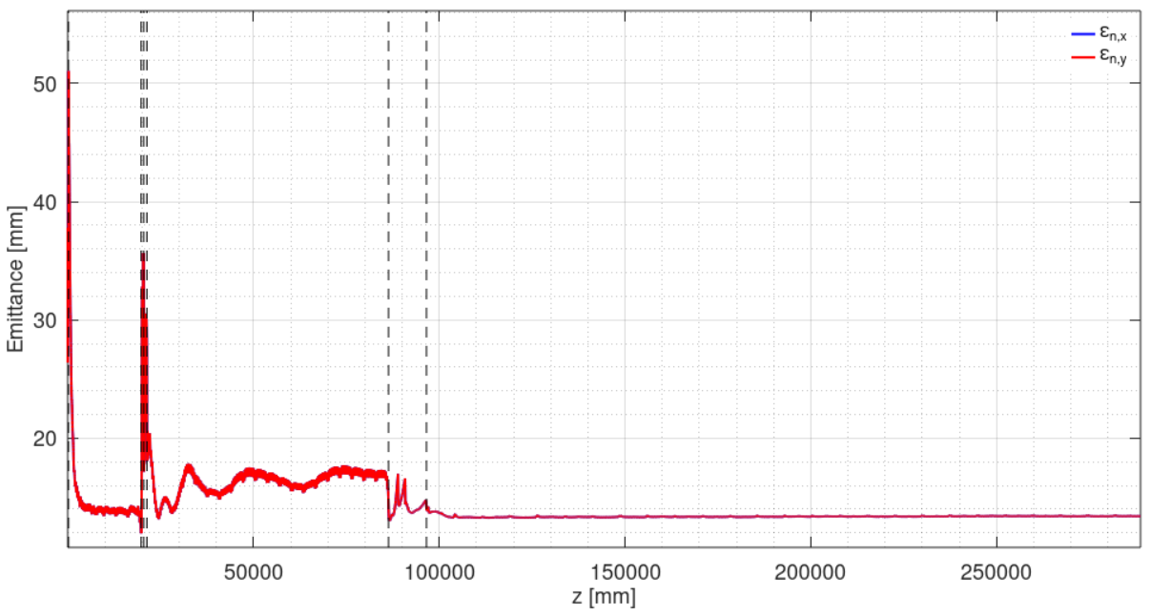
Normalized emittance evolution along z
CL S1 S2

Slide 12
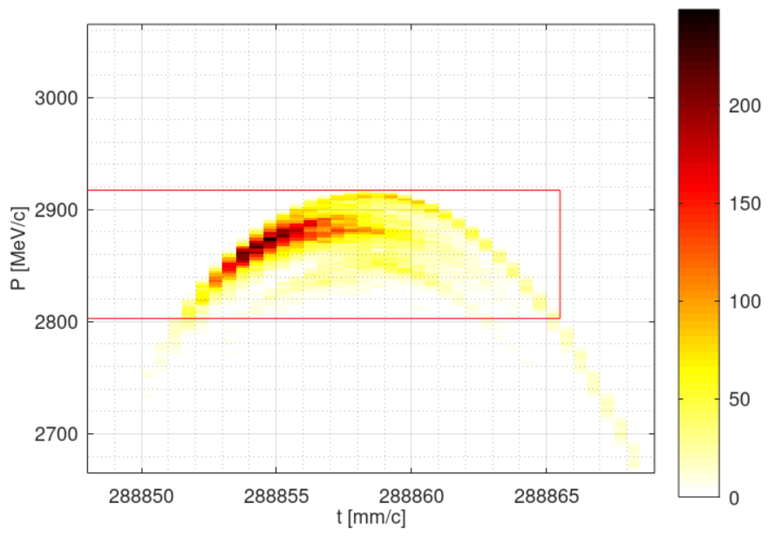
Longitudinal phase space
At PL exit
  Total yield: 3.41
  Yield with cuts (2.86 GeV ± 2% in energy, ±10 mm/c time): 3.01

Slide 13

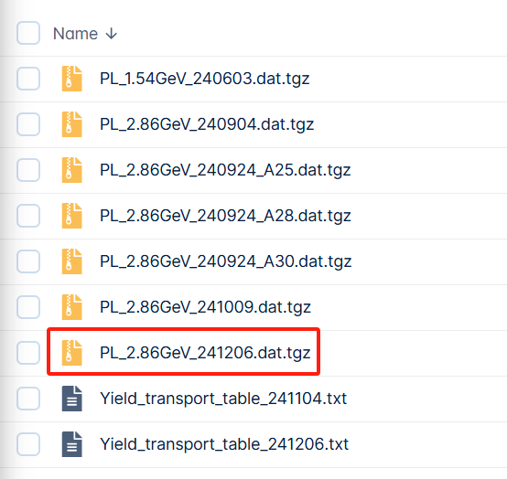
Data sharing
Fieldmaps uploaded to FCC-ee CERNBox / task 3.1
Positron distribution at Positron Linac exit for WP4 uploaded to my personal CERNBox / FCCee / PositronLinacOutput

Slide 14
Imperfections
Imperfections considered
  Position error (x, y): σ = 100 um for all elements
  Angular error (roll, pitch, yaw): σ = 100 urad for all elements, except that σ = 200 urad for all NC solenoids and dipoles
  Magnatic strength error: σ = 0.1% for all magnets
  RF gradient error: σ = 1% for all RF structures
  RF phase error: σ = 0.1° for all RF structures
  Beam position jitter (x, y): σ = 100 um for e⁺ beam from target
  Beam angular jitter (x’, y’): σ = 100 urad for e⁺ beam from target

Slide 15
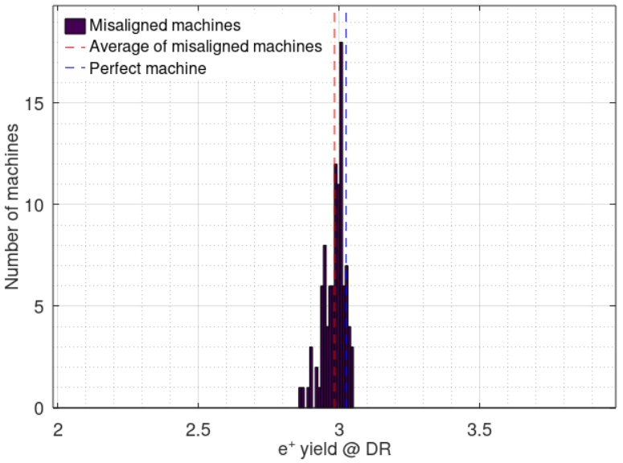
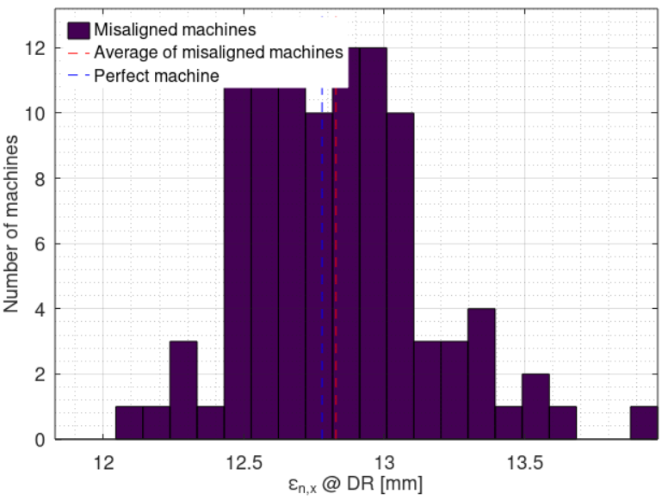
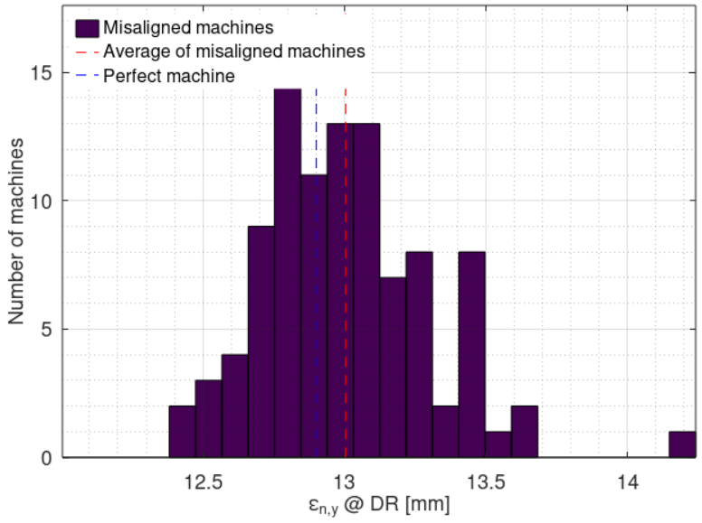
Imperfections
100 random machines with imperfections
Compared with perfect machine:
  Average DR accepted e+ yield reduction: 1.3% (3.01 → 2.97)
  Average normalized X / Y emittance increase: 0.4% / 0.8% (13.1 / 13.0 mm → 13.2 / 13.1 mm)
Impact of considered imperfections is negligible

Slide 16
Backup

