Slide 1


FCC-ee positron linac design
(Revised version)
Y. Zhao, A. Latina, CERN
FCC-ee WP1 meeting
06 Dec 2024

Slide 2
Revision
Compared with my presentation on WP1 meeting on 06/12/2024:
  A bug is fixed in the quadrupole simulation, that the reference energy or strength is not properly set (constant instead of increasing with energy) in S2 section
  Mainly the beam spot size and beta function are affected. The design, yield, emittance, etc. are not affected much

Slide 3
Positron production
Electrons
  E = 2.86 GeV. σ_{E} / E = 0.5%†. σ_{z} = 1 mm
  σ_{x,y} = 1 mm. ε_{n,x,y} = 4 mm*mrad†. Emittance can be larger or smaller, but the impact on positron yield is negligible
Target
  Conventional scheme (i.e. cylindrical shape, single amorphous tungsten)
  Radius: R = 15 mm. Radius can be reduced to the minimum of 5 mm
  Thickness: W = 15 mm
† Numbers suggested by S. Bettoni from e⁻ linac simulation

Slide 4
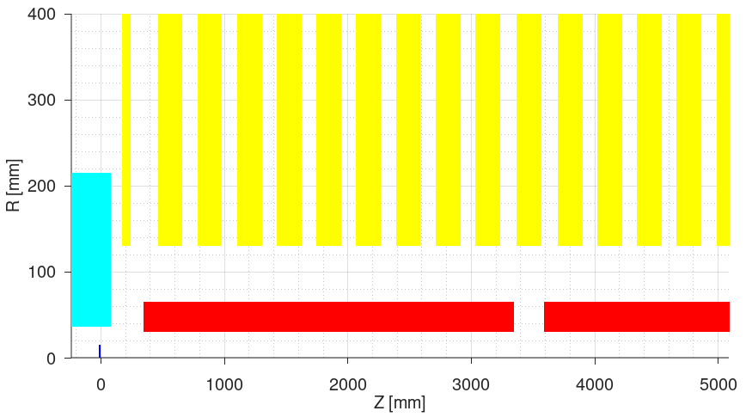
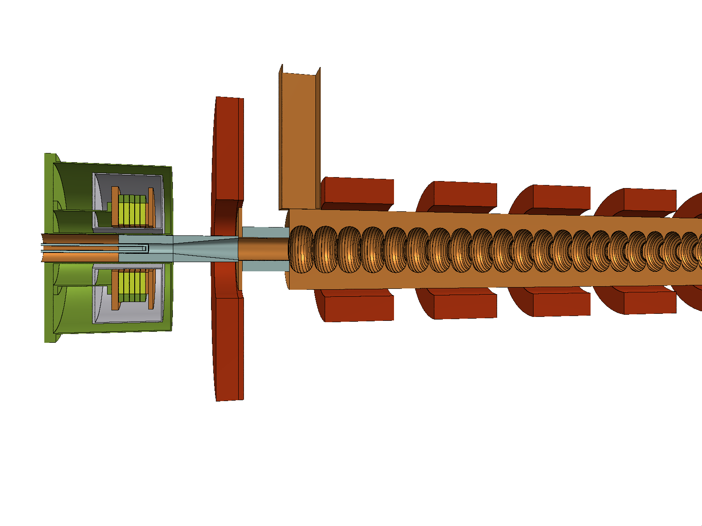
Capture section
AMD
  HTS solenoid. 2D field. B₀ ~ 14.94 T
  Target exit position: 40 mm (w.r.t. HTS B₀)
Matching solenoid
  L = 72 mm. 3D field (Maxwell3D)
  B₀ ~ 0.245 T
  Center position: 244 mm (w.r.t HTS B₀)
Shielding
  Tapered aperture (optimized by WP3). Impact on yield is negligible
Capture Linac (CL)
  RF structure length: 3 m. Iris radius: a₀ = 30 mm (constant)
  N = 6, G = 13.3 MV/m, φ = [235 231 233 251 286 257]° (reoptimized by WP3)
  Regular solenoids: L = 200 mm. 3D field (Maxwell3D). B₀ ~ 0.31 T. N = 9 (per structure)
M. Daugaard

Slide 5
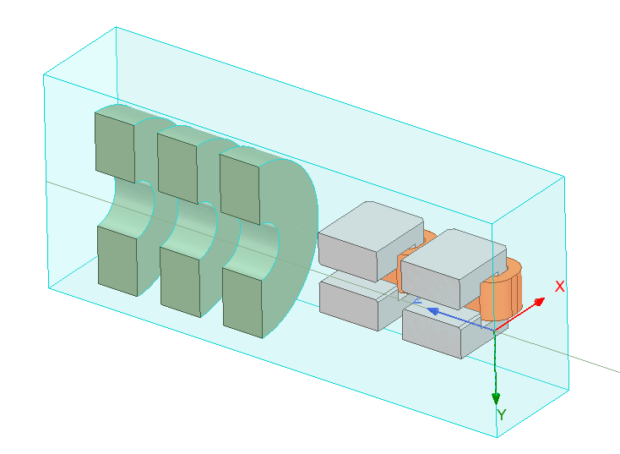
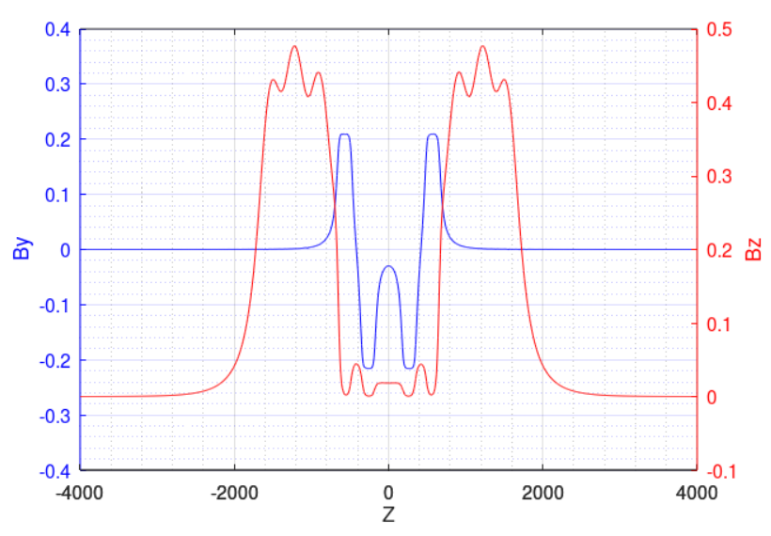
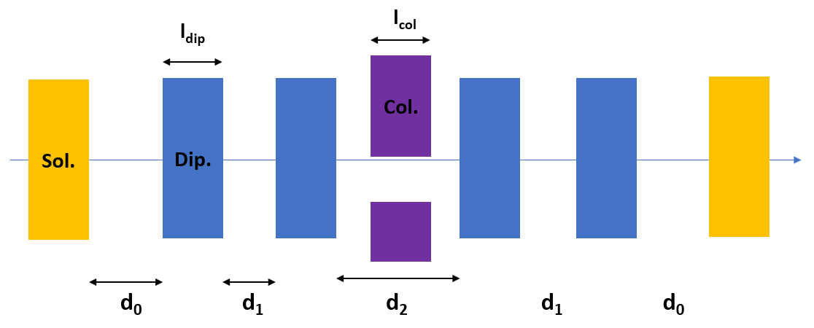
Chicane
Chicane – “V2” (Collaboration with R. Zennaro)
  Combined simulation of chicane (four dipoles) and 6 neighboring solenoids. Therefore, parameters (lengths, apertures, distances) are fixed by design
  Dispersion closed by increasing 2% the current of middle dipoles
  3D field (Maxwell3D)
  Dipole yoke length: l_{dip} = 180 mm
  Apertures of beam pipe: Δx = 150 mm, Δy = 50 mm (yoke aperture is 70 mm)
  Distances between dipole yokes: d1 = 125 mm, d2 = 350 mm
  Distance between solenoid and dipole yoke: d0 = 125 m
¼ view

Slide 6
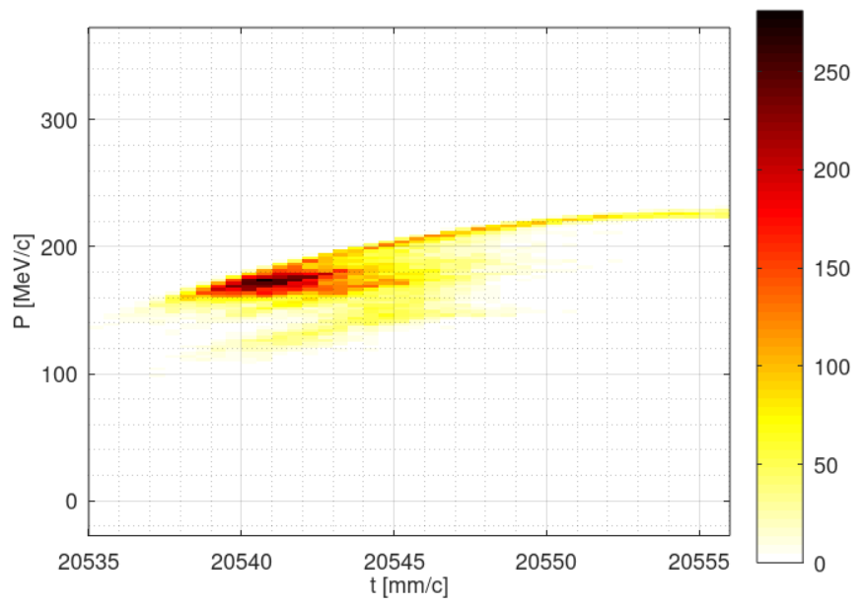
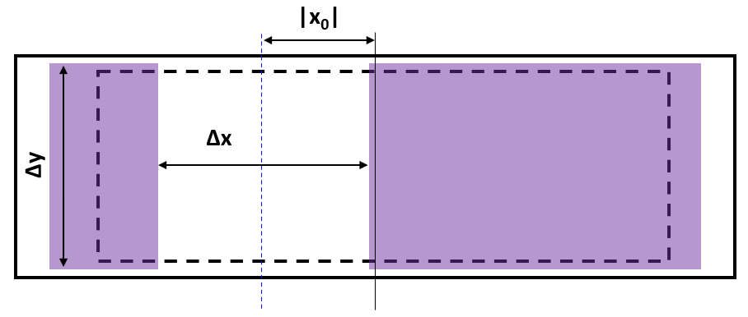
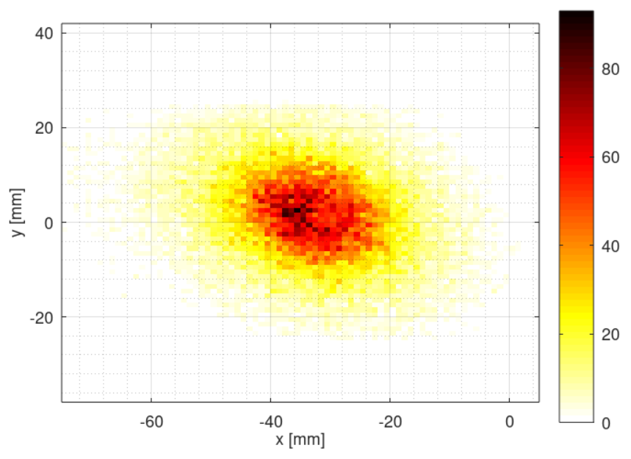
Collimator
Collimator
  Length: l_{col} = 120 mm
  Apertures: Δx = 70 mm, Δy = 50 mm
  X offset: x₀ = -35 mm

Slide 7
Positron linac design
Section 1 (S1)
  Same structure and solenoids as Capture Linac
  N = 20, G = 13.3 MV/m, φ = -10° (optimized for max. yield)
  Average energy (around bunch core) at exit: 931.7 MeV
Section 2 (S2)
  Same structure as Capture Linac
  Periodic FODO cells. 2 structures per FODO cell. FODO phase advance: 76.345° (optimized for min. beta)
  Quadrupole length: 0.4 m. Quadrupole-Structure distance: 0.15 m. Quadrupole spacing: 3.3 m
  N = 52, G = 12.756 MV/m, φ = 5° (optimized for max. yield)
  Average energy (around bunch core) at exit: 2.866 GeV
Parameter | Value
Collective effects considered | Space charge; Short-range wakefield
Primary electron bunch charge assumed for collective effects [nC] | 5.0
Bunch length (around bunch core) at PL exit [mm] | 2.88
Energy spread (around bunch core) at PL exit [%] | 0.97
X, Y spot sizes (around bunch core) at PL exit [mm] | 5.27, 2.78
Total positron yield (all positrons) at PL exit | 3.37
Expected DR accepted yield with ±2% energy acceptance at PL exit | 2.97
Normalized X, Y emittances (accepted positrons) at PL exit [mm*rad] | 13.2, 13.1
Geometric X, Y emittances at (accepted positrons) PL exit [mm*mrad] | 2.36, 2.34

Slide 8
Positron linac power consumption
Power consumption in Positron Linac (based on discussion with J. Raguin)
Parameter | Value
Average gradients in S1, S2 [MV/m] | ~13
Number of structures per RF module | 4
Number of structures in S1, S2 (w/ spare module) | [20, 52+4]
Total number of RF modules (w/ spare module) | 5+13+1 = 19
Total number of solenoids | 20*10 = 200
Total number of quadrupoles | ~52+4 = 56
RF power consumption [MW] | 19*0.19 = 3.61
Solenoid power consumption [MW] | 200*0.016 = 3.20
Quadrupole power consumption [MW] | Neglected
Total power consumption [MW] | 6.81

Slide 9
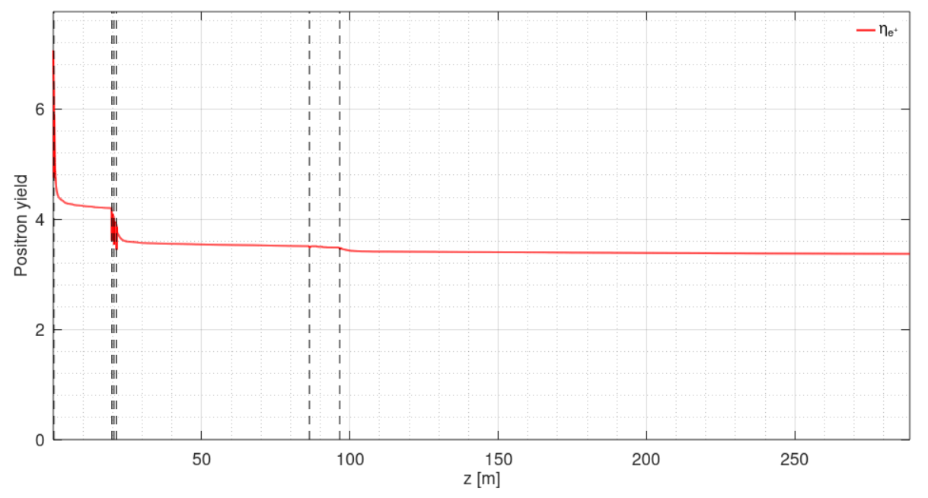
Yield evolution along z
CL S1 S2

Slide 10
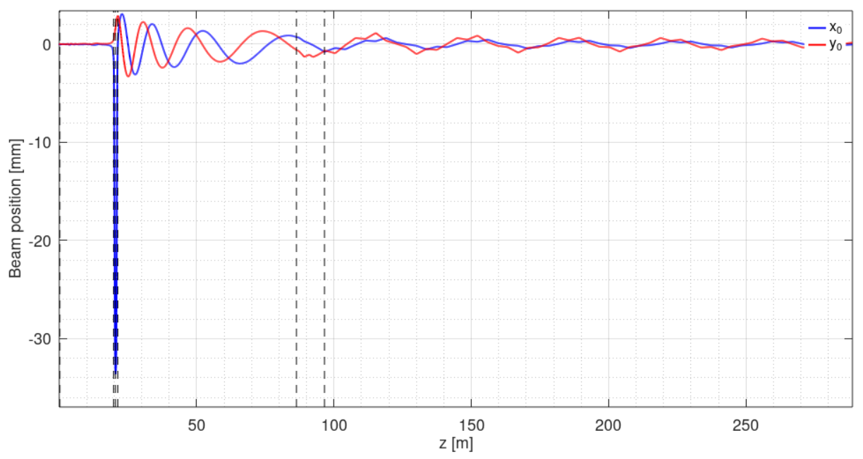
Beam position evolution along z
CL S1 S2

Slide 11
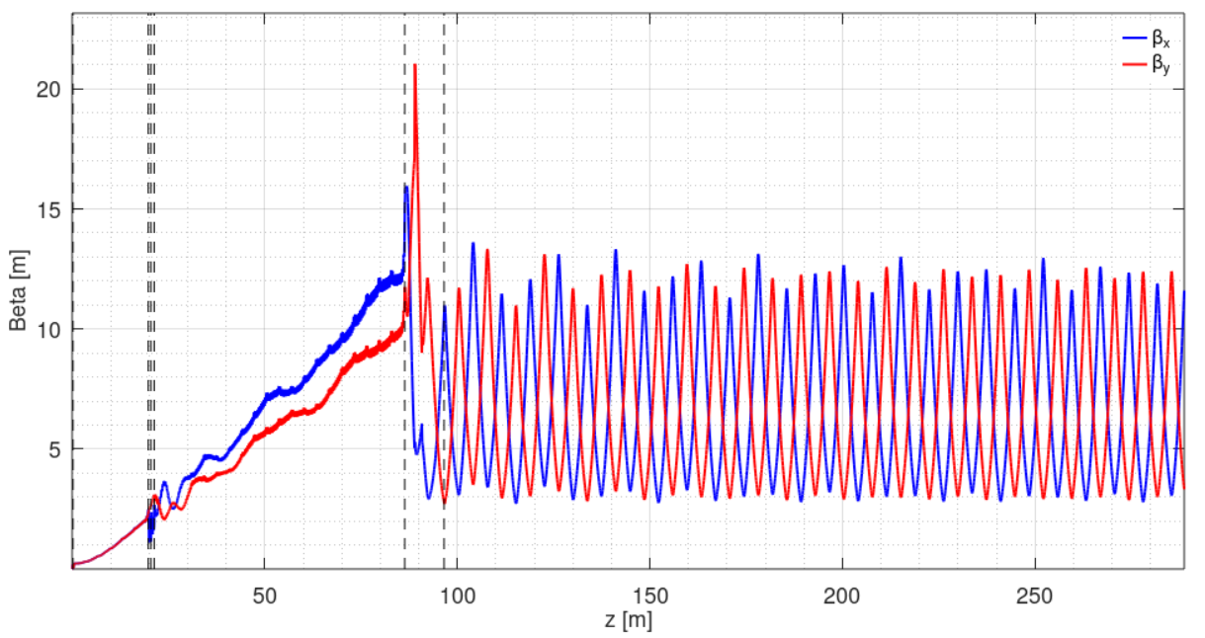
Beam beta function evolution along z
CL S1 S2

Slide 12
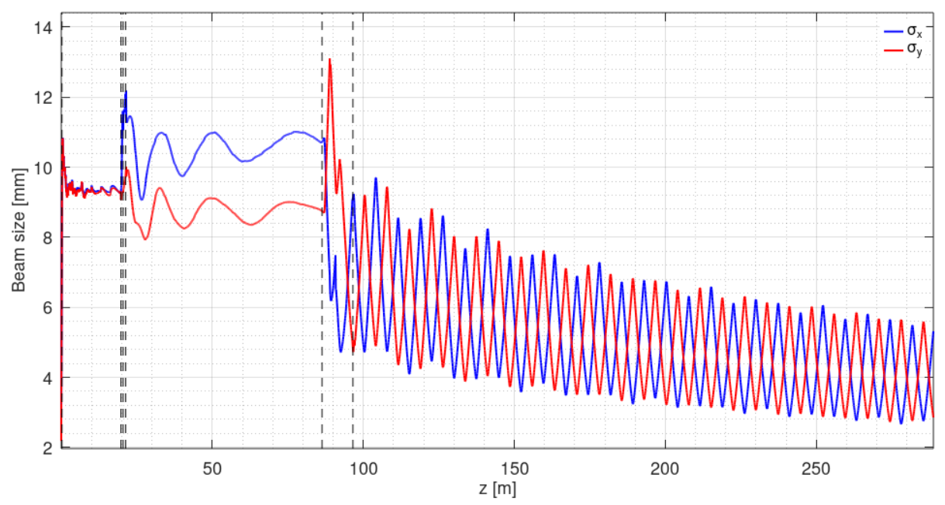
Beam spot size evolution along z
CL S1 S2

Slide 13
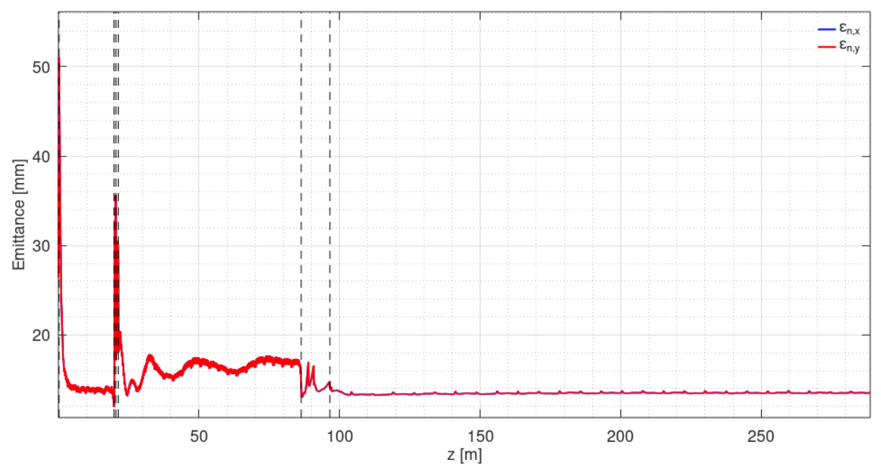
Normalized emittance evolution along z
CL S1 S2

Slide 14
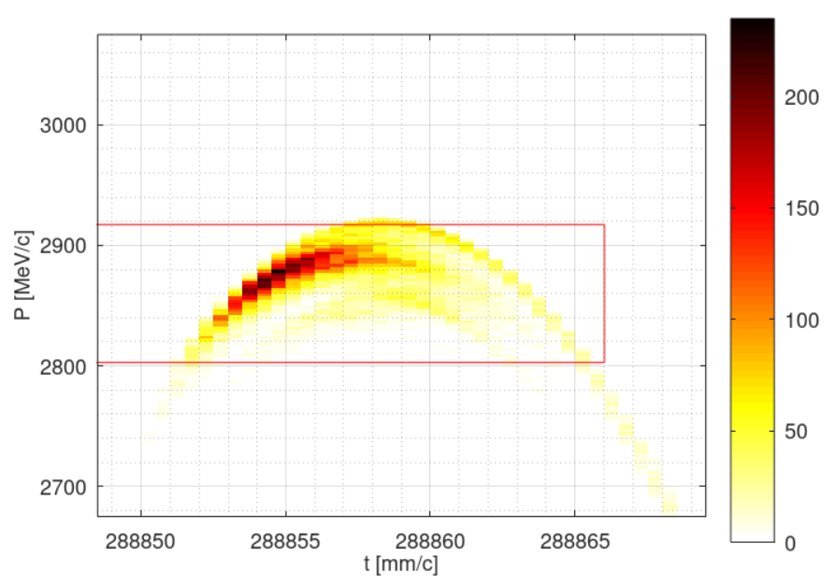
Longitudinal phase space
At PL exit
  Total yield: 3.37
  Yield with cuts (2.86 GeV ± 2% in energy, ±10 mm/c time): 2.97

Slide 15

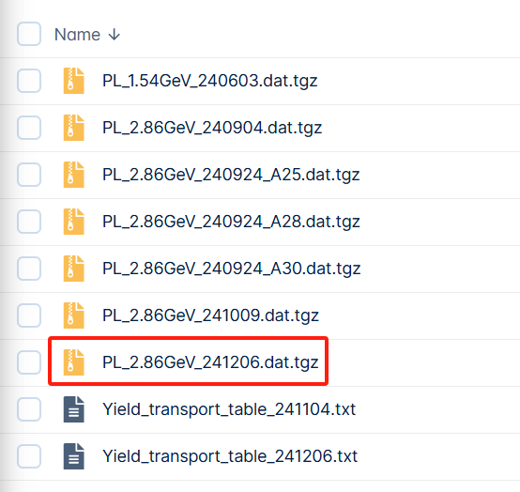
Data sharing
Fieldmaps uploaded to FCC-ee CERNBox / task 3.1
Positron distribution at Positron Linac exit for WP4 uploaded to my personal CERNBox / FCCee / PositronLinacOutput

Slide 16
Imperfections
Imperfections considered
  Position error (x, y): σ = 100 um for all elements
  Angular error (roll, pitch, yaw): σ = 100 urad for all elements, except that σ = 200 urad for all NC solenoids and dipoles
  Magnatic strength error: σ = 0.1% for all magnets
  RF gradient error: σ = 1% for all RF structures
  RF phase error: σ = 0.1° for all RF structures
  Beam position jitter (x, y): σ = 100 um for e⁺ beam from target
  Beam angular jitter (x’, y’): σ = 100 urad for e⁺ beam from target

Slide 17
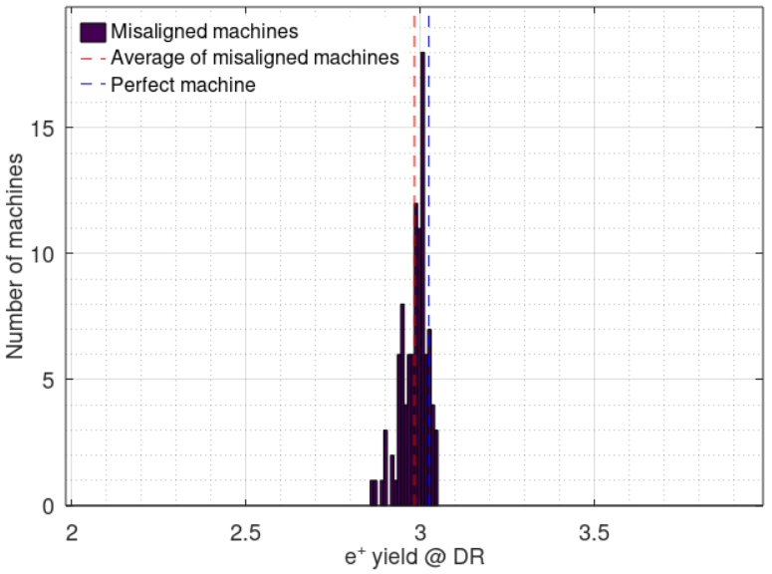
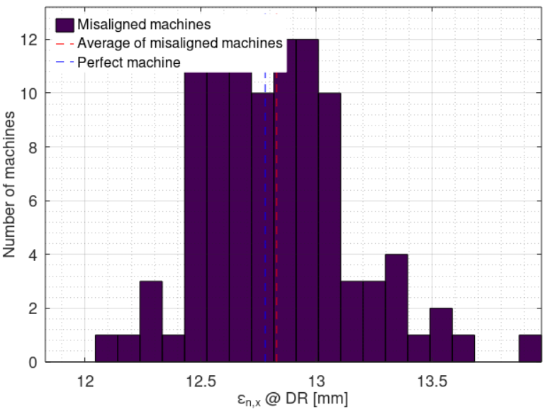
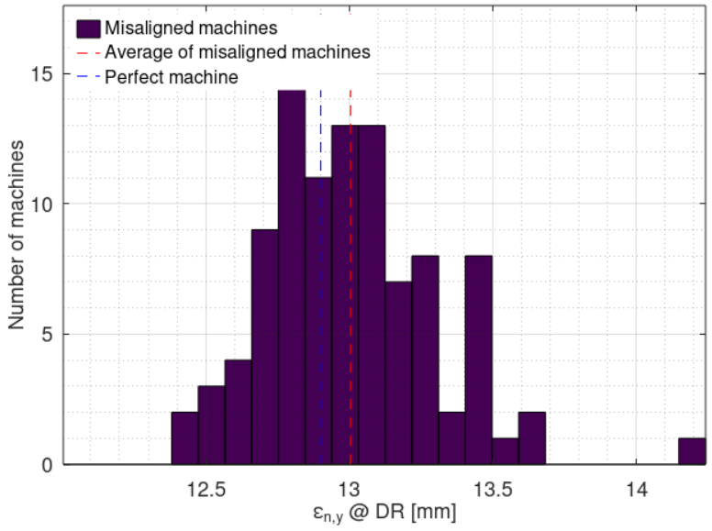
Imperfections
100 random machines with imperfections
Compared with perfect machine:
  Average DR accepted e+ yield reduction: 1.3%† (2.97 → 2.93)
  Average normalized X / Y emittance increase: 0.4% / 0.8%† (13.2 / 13.1 mm → 13.3 / 13.2 mm)
Impact of considered imperfections is negligible
† Assuming the same effects as before. Updates in progress. Conclusions should be the same.

Slide 18
Backup

