Slide 1


QC4HEP Working Group
State of the art: Theory
Stefan Kühn
QC4HEP Working Group Annual Meeting
2025/01/24

Slide 2
What is the conventional approach?
Addressing field theories in the nonperturbative approach
Gauge field theories form the basis of our theoretical understanding of particle pyhsics
They cannot be addressed analytically in many interesting regimes
Conventional Numerical approach
  Discretize the theory on a Euclidean space-time lattice
  Use Markov chain based Monte Carlo (MCMC) methods
Dürr et al., Science 322, 1224 (2008)

Slide 3
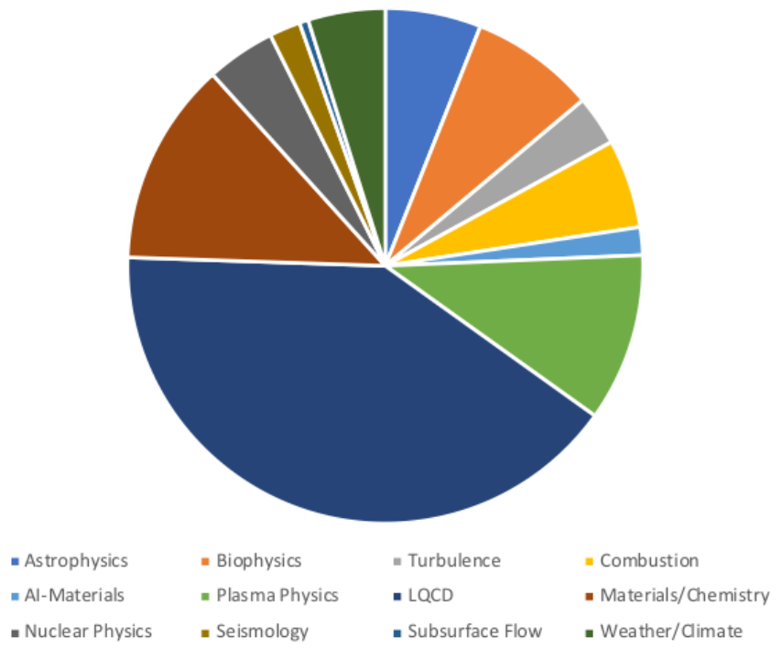
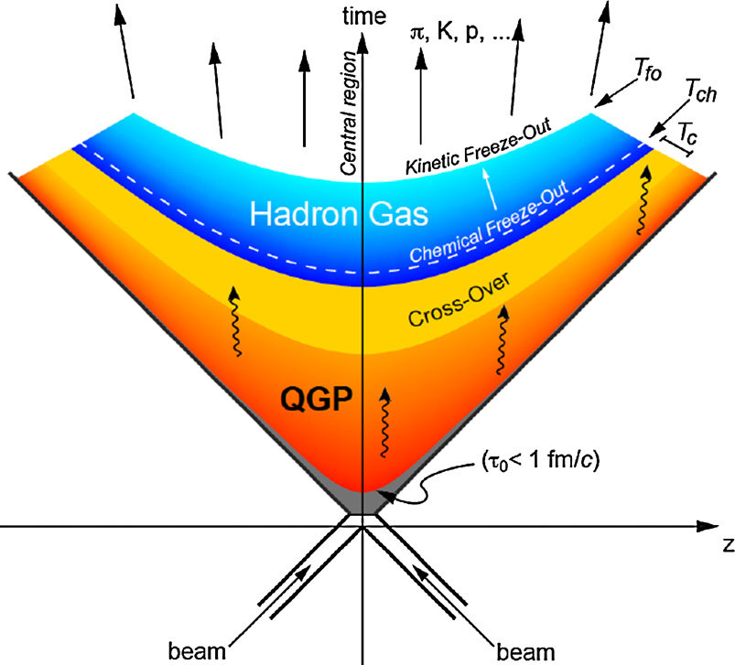
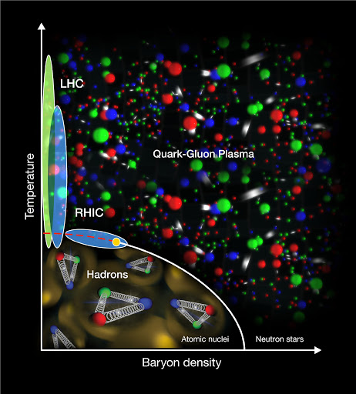
What are the challenges for the conventional approach?
Achievements and limitations of MCMC approaches
State of the art MCMC can do large lattices: 112³ x 224
They require state-of-the-art super computers
MCMC approach ceases to work in certain regimes
  No access to real-time dynamics
  Sign problem in certain parameter regimes
LQCD
~ 40%
C. Alexandrou et al., arXiv:2411.08852
Jack Wells, Kate Clark, https://indico.mitp.uni-mainz.de/event/231/contributions/3417/attachments/2631/2885/MLT-Clark.pdf
P. Braun-Munzinger, B. Dönigus, Nucl. Phys. A 987, 144 (2019)

Slide 4
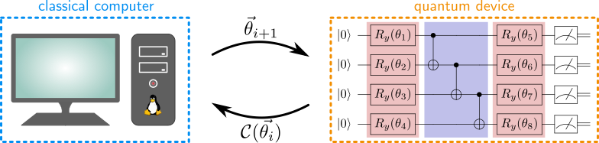
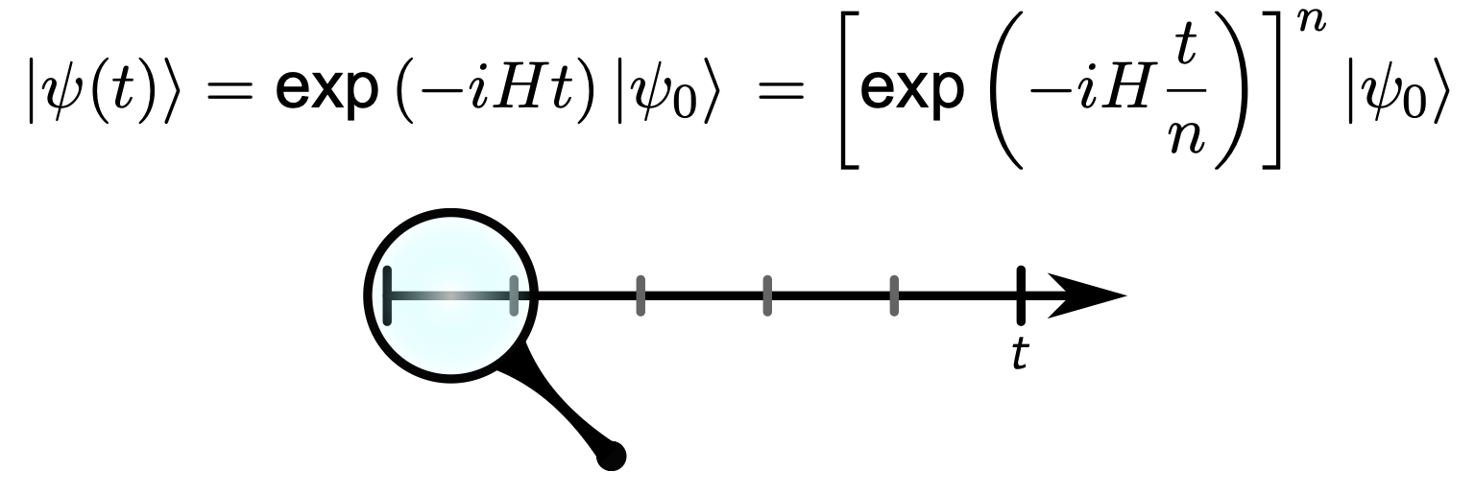
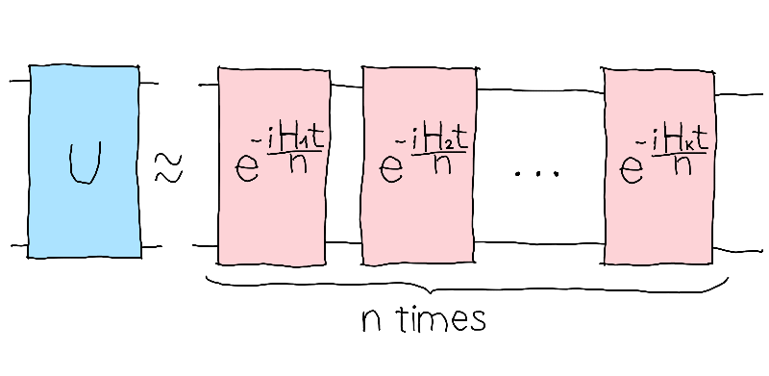
Which approaches have been used for Quantum Computing?
Common algorithms for near-term devices
Variational Quantum algorithms
  Ground states
  Low-lying excitations
  Time evolution
Trotterized time evolution
Picture from https://pennylane.ai/challenges/a_simple_trotterization

Slide 5
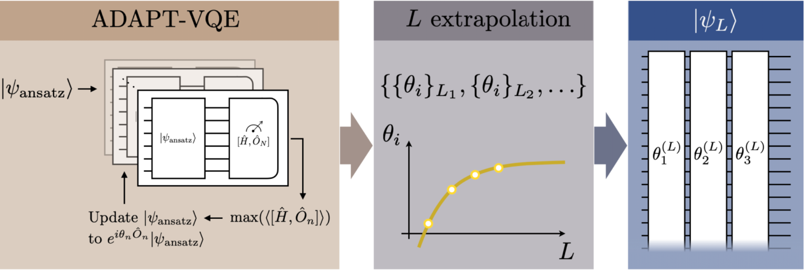
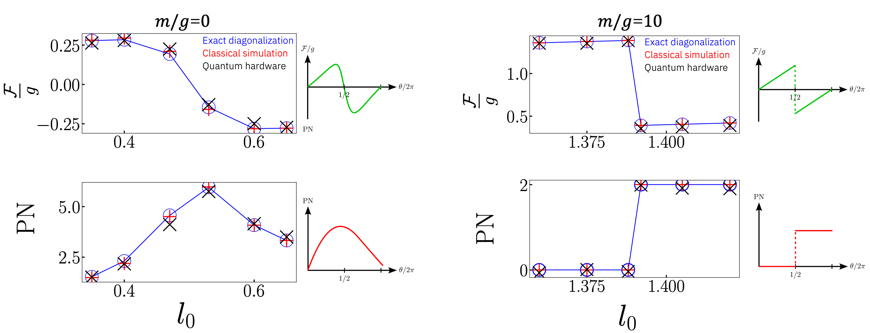
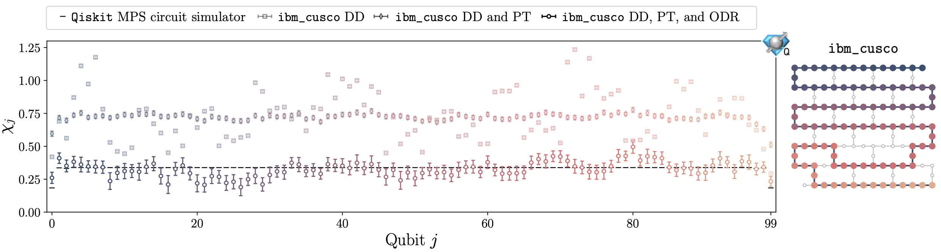
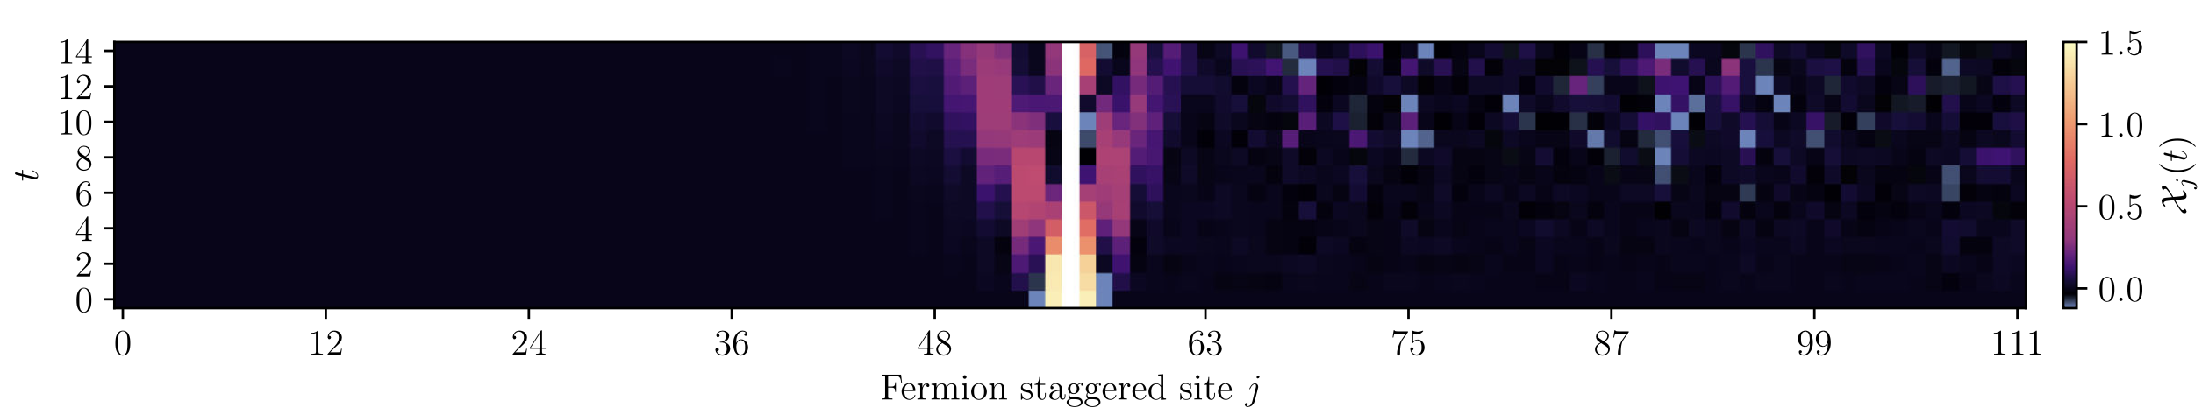
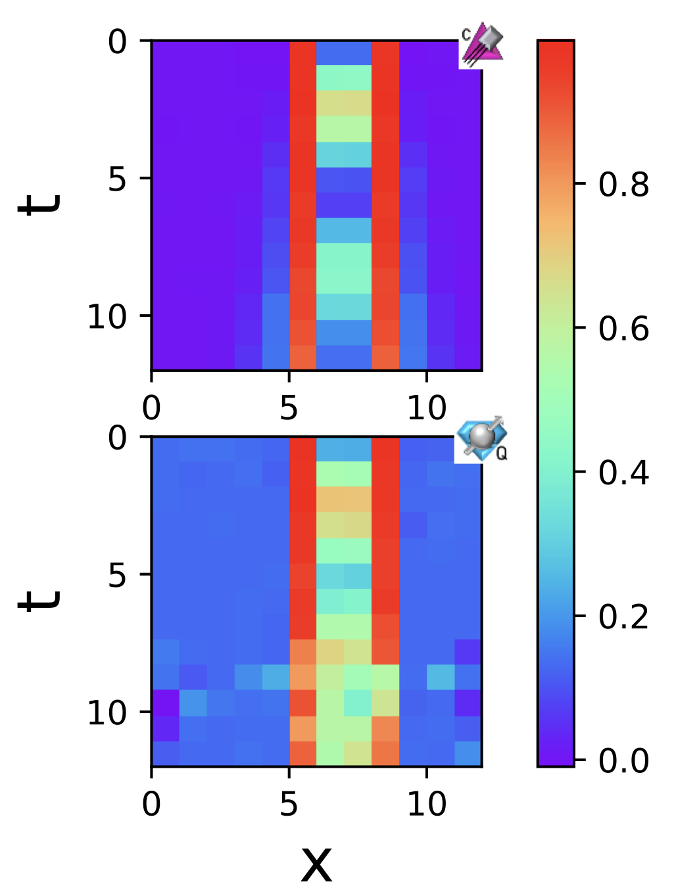
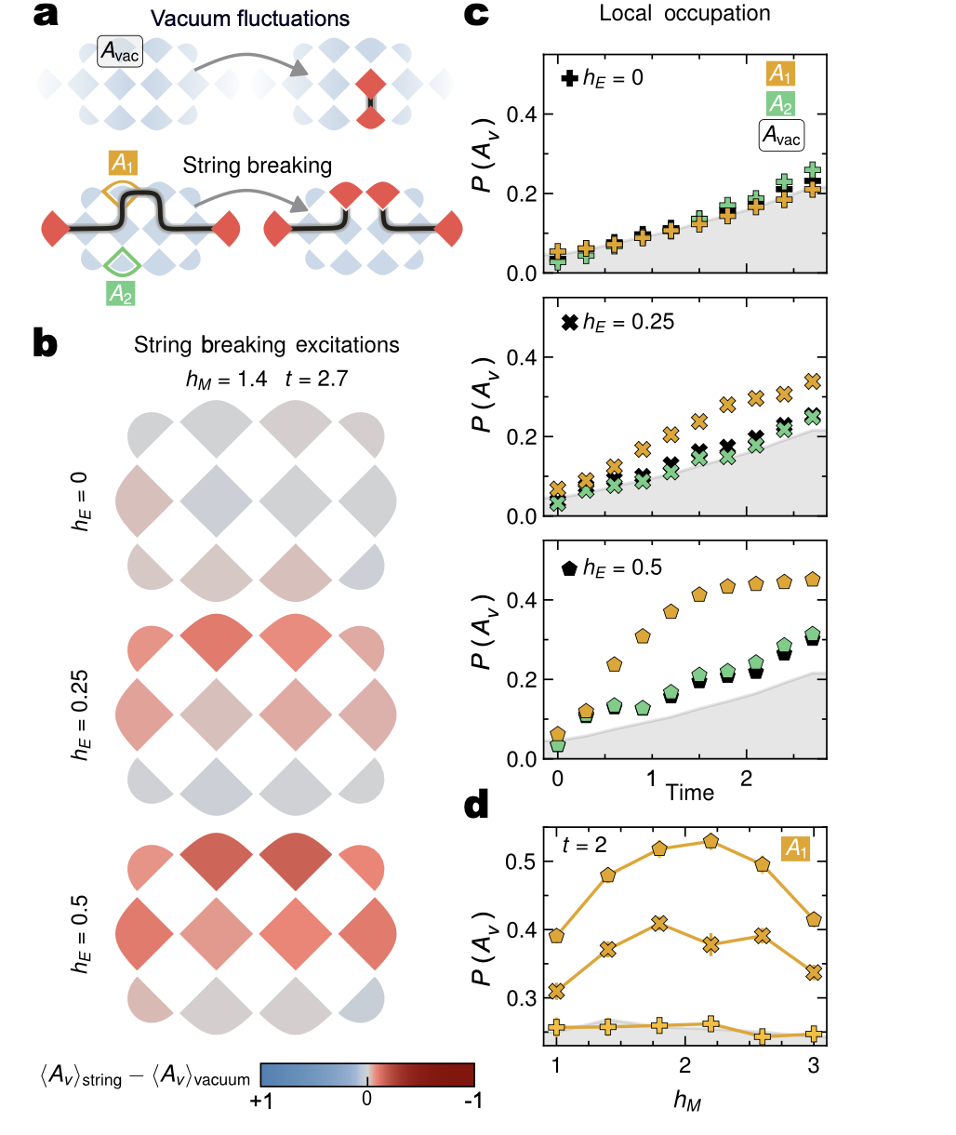
What has been achieved on quantum computers?
Farrell et al., PRD 109, 114510 (2024)
Farrell et al., PRX Quantum 5, 020315 (2024)
Angelides et al., npj Q. Info. 11, 6 (2025)
Chai et al., accepted in Quantum
Mildenberger et al., Nature Physics (2025)
Cochran et al., arXiv:2409.17142
Ciavarella, arXiv:2411.05915

Slide 6
Conclusion
Achievements
Scalable state preparation
Simulating dynamics
Simulating static problems in sign problem afflcited regimes
Challenges
Going to higher dimensions
Error mitigation
Algorithmic improvements

Slide 7
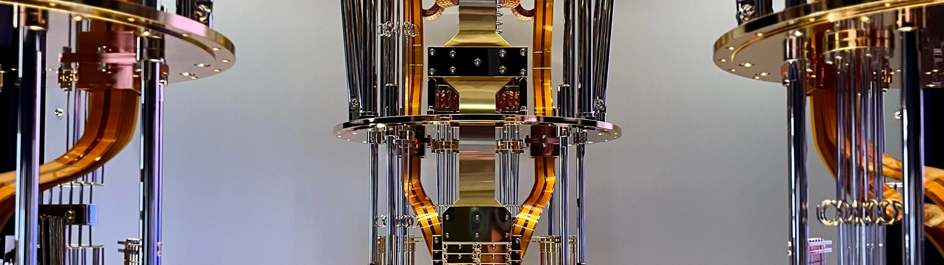

Thank you!
Questions?

