Slide 1


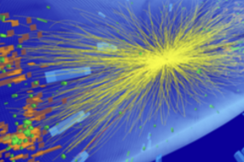
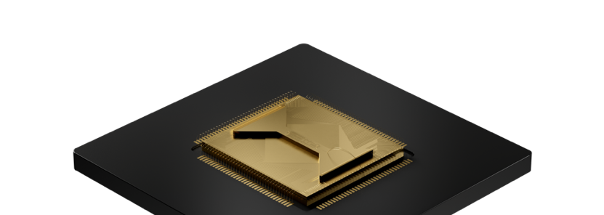
circuit
Quantum Computers for High Energy Physics
Enrico Rinaldi
Lead R&D Scientist
© 2024 Quantinuum. All Rights Reserved.

Slide 2




















at-a-glance
LARGEST
PLAYER
in integrated quantum
hardware and software
H-SERIES
World class QCCD, ion trap hardware with industry-leading fidelity and scalability
>350
Scientists and engineers
(of which > 200 PhDs)
FULL STACK
Origin™ Building a cyber secure future.
InQuanto™ Quantum chemistry TKET™ Open-source Quantum SDK. LAMBEQ™ Open-source QNLP SDK.
>500
Global users of H-Series hardware
>$1.3bn
Invested capital
>100
Publications including 200+ peer-reviewed in leading journals
US Department of Energy Labs
>1.8M
Downloads of TKET
Global presence
(USA, UK, Europe, Japan)
Cloud service partner:
MICROSOFT AZURE QUANTUM

Slide 3
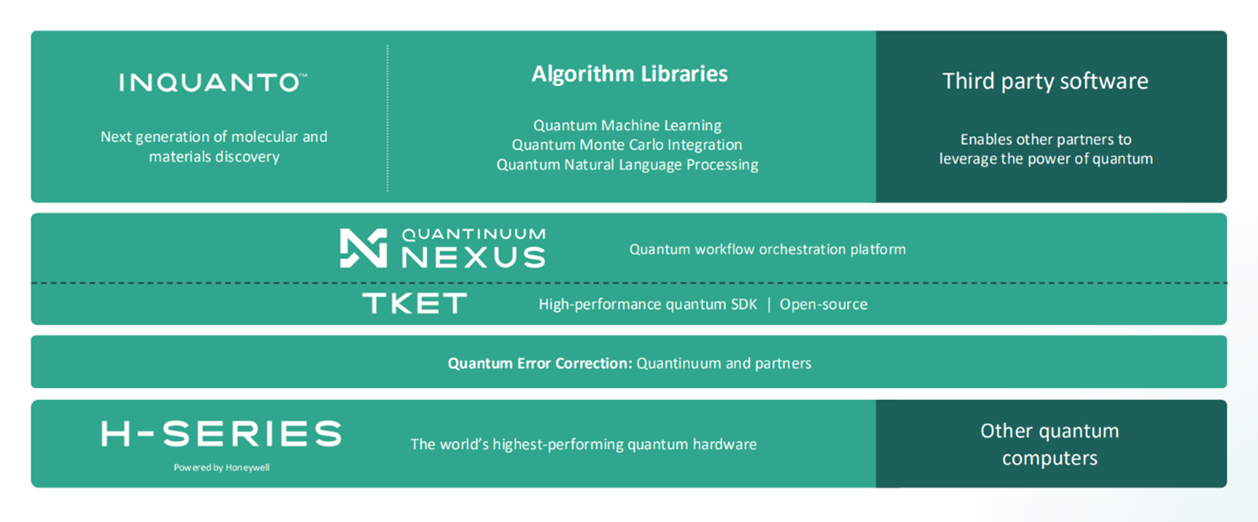
Integrated approach to accelerated quantum computing

Slide 4

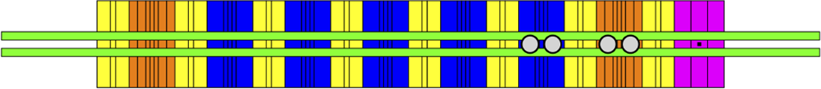



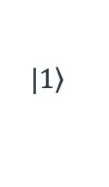
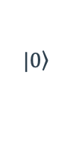
QCCD Trapped-Ion Architecture
Quantum Charge Coupled Device (QCCD) Architecture
Dedicated
storage zone
5 Dedicated
gate zones
Dedicated
storage zone
Ion
loading zone
Gating lasers
H1 Generation Ion Trap Architecture
Quantum bits (qubits) are stored in the electronic states of IDENTICAL Yb⁺ ions
QCCD architecture enables using gate zones
Minimal and frequent calibrations
All-to-all connectivity
High fidelity operations
Cooling ions provide mid-circuit cooling, maintaining circuit fidelity throughout circuit
$$|\left.1\right\rangle$$
Hyperfine qubit
¹³⁸Ba⁺
Cooling ion
¹⁷¹Yb⁺
$$|\left.0\right\rangle$$

Slide 5













Physical Implementation
$$t=0$$
$$t=1$$
1-qubit gate
$t=$ 0 1 2 3 4
Move, Join
$$|0⟩$$
H
$$t=2$$
2-qubit gate
$$|0⟩$$
H
$$|0⟩$$
$$|0⟩$$
Swap, Split
Move, Join
$$c_{1}$$
$$t=3$$
2-qubit gate
$$t=4$$
Measure

Slide 6
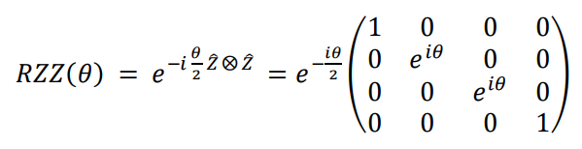
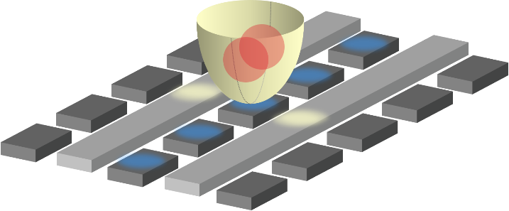
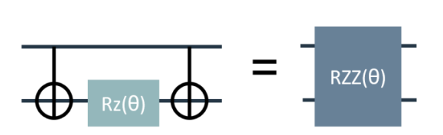
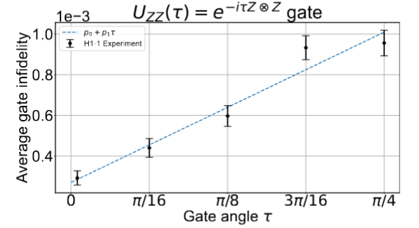
QCCD Architecture Differentiating Features
All-to-All Connectivity
High-Fidelity Gates
Arbitrary Angle two-qubit gate
Nearest Neighbor
All-to-All
Isolated Gates = Scalable Gates
1Q fidelity | > 99.997%
2Q fidelity | > 99.87%
State preparation and measurement | > 99.7%
Measurement cross-talk error | < 0.01%
Memory error per qubit at average depth-1 circuit | < 0.04%
Significantly lower # of gates

Slide 7
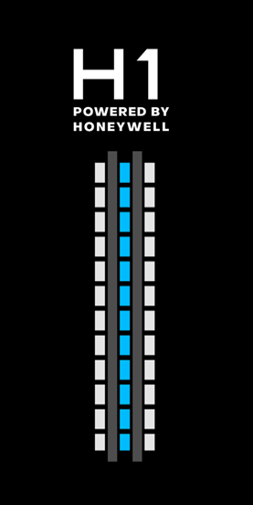
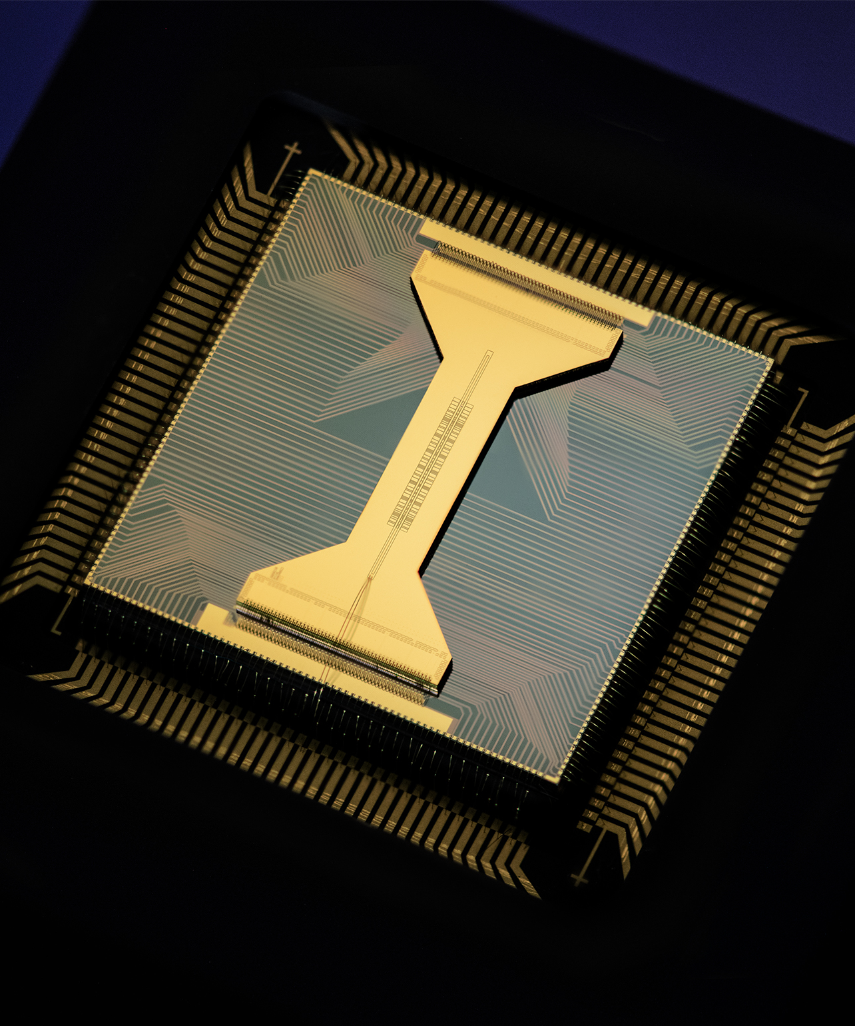
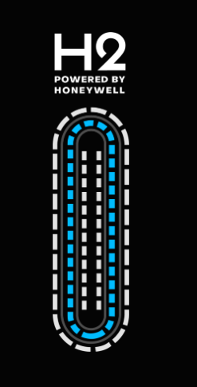
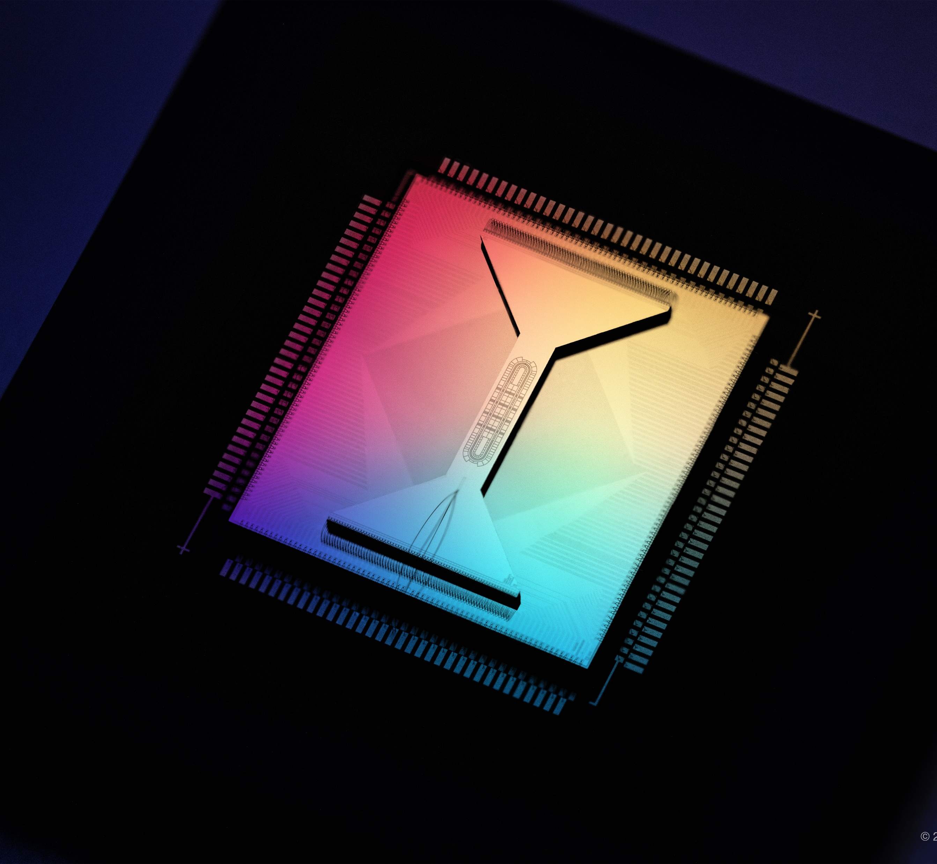
H-Series Commercial Quantum Processing Units
Differentiators
Exceptionally low cross talk enabling robust mid-circuit measurement and qubit re-use
All-to-all connectivity
High gate-fidelities, enabling deep circuits
Universal gate set + unique native arbitrary angle two qubit gate
High fidelity emulator to aid in development and debugging
Tightly coupled classical computing and advanced control features enable real-time, algorithmic decoding
Communication API based on OpenQasm, compatible with QIR, Qiskit, TKET
20 fully-connected qubits
5 parallel gating zones
TQ gate fidelity 99.91%
SQ gate fidelity > 99.998%
SPAM fidelity > 99.7%
Measurement cross talk error < 0.01%
56 fully-connected qubits
4 parallel gating zones
TQ gate fidelity 99.87%
SQ gate fidelity 99.997%
SPAM fidelity > 99.8%
Measurement cross talk error < 0.01%

Slide 8
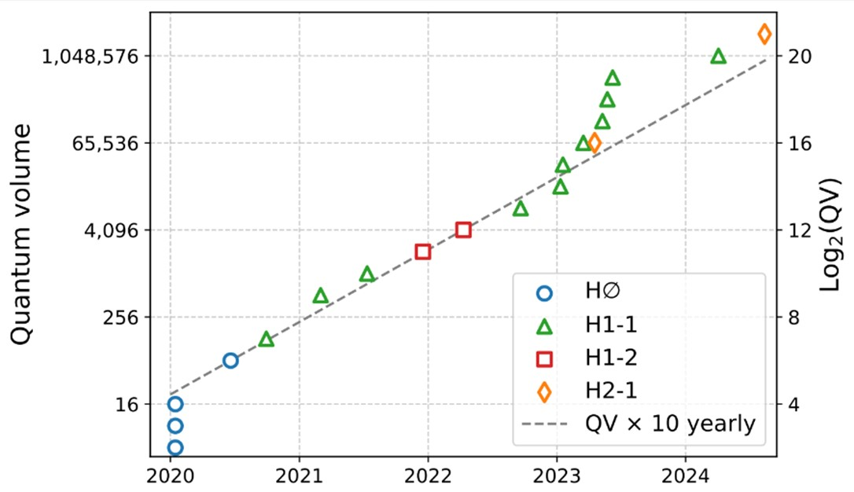
H2: The Most Benchmarked. The Highest Performing.
Component Level
Single-qubit randomized benchmarking
Two-qubit randomized benchmarking
Two-qubit SU(4) randomized benchmarking
Two-qubit parameterized gate randomized benchmarking
Measurement crosstalk bright state depumping
Reset crosstalk bright state depumping
SPAM test
Two-qubit cycle benchmarking
System Level
Mirror benchmarking
Quantum volume
Random circuit sampling
GHZ state fidelity
Algorithmic level
1D transverse field Ising model simulation
QAOA
Repetition code
HoloQUADS
Logical circuits
Algorithmic qubits
https://github.com/CQCL/quantinuum-hardware-specifications
https://github.com/CQCL/quantinuum-hardware-quantum-volume

Slide 9
Some HEP works on H-series
Neutrino oscillations:
  https://arxiv.org/abs/2210.08656
  http://arxiv.org/abs/2407.13914
Nuclear beta decay:
  https://arxiv.org/abs/2209.10781
Quantum gravity in the lab:
  https://arxiv.org/abs/2205.14081
Scattering wave packets of hadrons:
  https://arxiv.org/abs/2402.00840
Shear viscosity of SU(2) LGT:
  https://arxiv.org/abs/2402.04221
(2+1)D QED ground state:
  http://arxiv.org/abs/2411.05628
20 fully-connected qubits
5 parallel gating zones
TQ gate fidelity 99.91%
SQ gate fidelity > 99.998%
SPAM fidelity > 99.7%
Measurement cross talk error < 0.01%

Slide 10

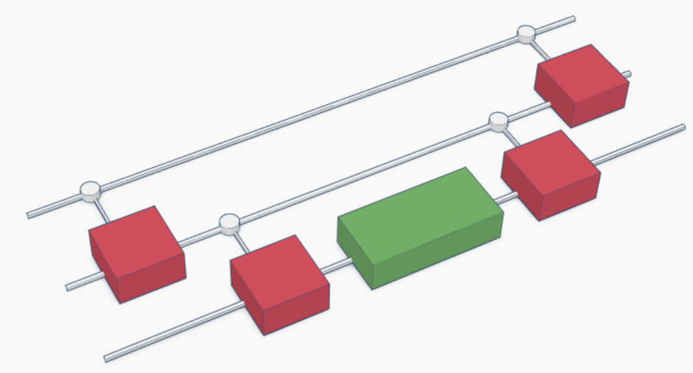

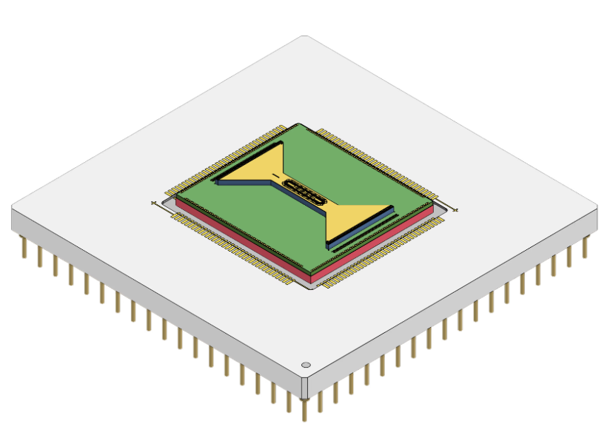
Example of workflow used for (2+1)D QED calculation
  http://arxiv.org/abs/2411.05628
Quantinuum Nexus orchestration platform:
Manage circuits
Submit jobs to multiple backends
Share results within organizations
Quantinuum TKET toolkit:
Design circuits in a compositional way
Optimize and reduce gate count
Compile to any gate set and architecture
Quantinuum H-series:
Emulators with realistic noise models
Support Mid-Circuit-Measurments-and-Reset and qubit reuse
Arbitrary angle ZZ and SU(4) gates
Quantinuum quantum chemistry library:
Define arbitrary Hamiltonians (bosons and fermions)
Define circuit ansatze
Efficient re-usable protocols for quantum observables

Slide 11
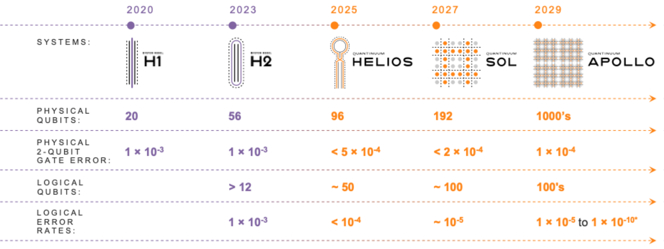
Development roadmap
*analysis based on recent literature in new, novel error correcting codes predict that error could be as low as 1E-10 in Apollo (ref: arXiv:2403.16054, arXiv:2308.07915)

Slide 12
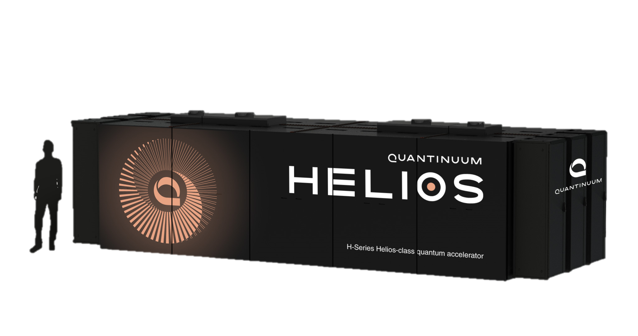
Quantinuum HELIOS: On-premise As a Service

Slide 13
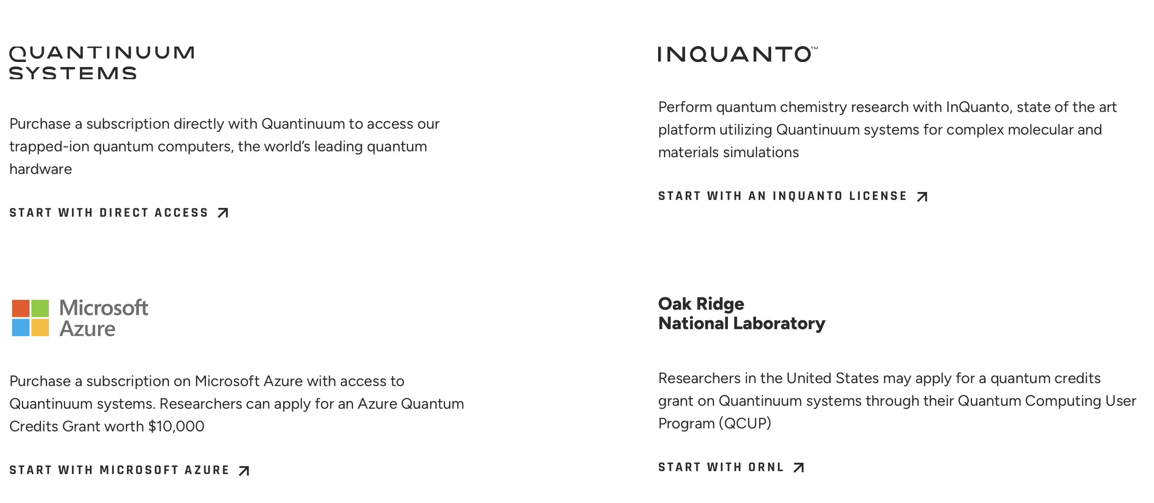
Access to Quantinuum H-series
https://www.quantinuum.com/

Slide 14

docs.quantinuum.com

