Slide 1
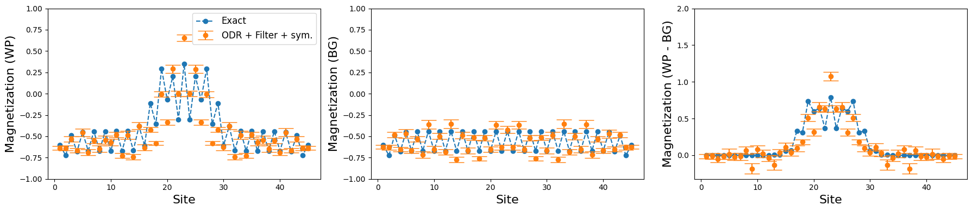
Project update: Simulation of the PXP model
Particle-collider within a quantum computer
Julian Schuhmacher
PhD Student
IBM Quantum
ibm_sherbrooke

Slide 2
Studied model
Propagation
Bloch oscillation
Simulate spin-1/2 QLM
Proposed on cold-atom platform [1]
Our proposal: digital quantum simulation
Hamiltonian of the PXP model:
  First term: constrained three-site interaction
  Second term: chemical potential
  Third term: staggered potential
Effects observed in this model: propagation, bloch oscillation, collision, confinement, …
Collision
Confinement
[1] G. Su, J. Osborne, and J. C. Halimeh. "A Cold-Atom Particle Collider." arXiv:2401.05489 (2024).

Slide 3
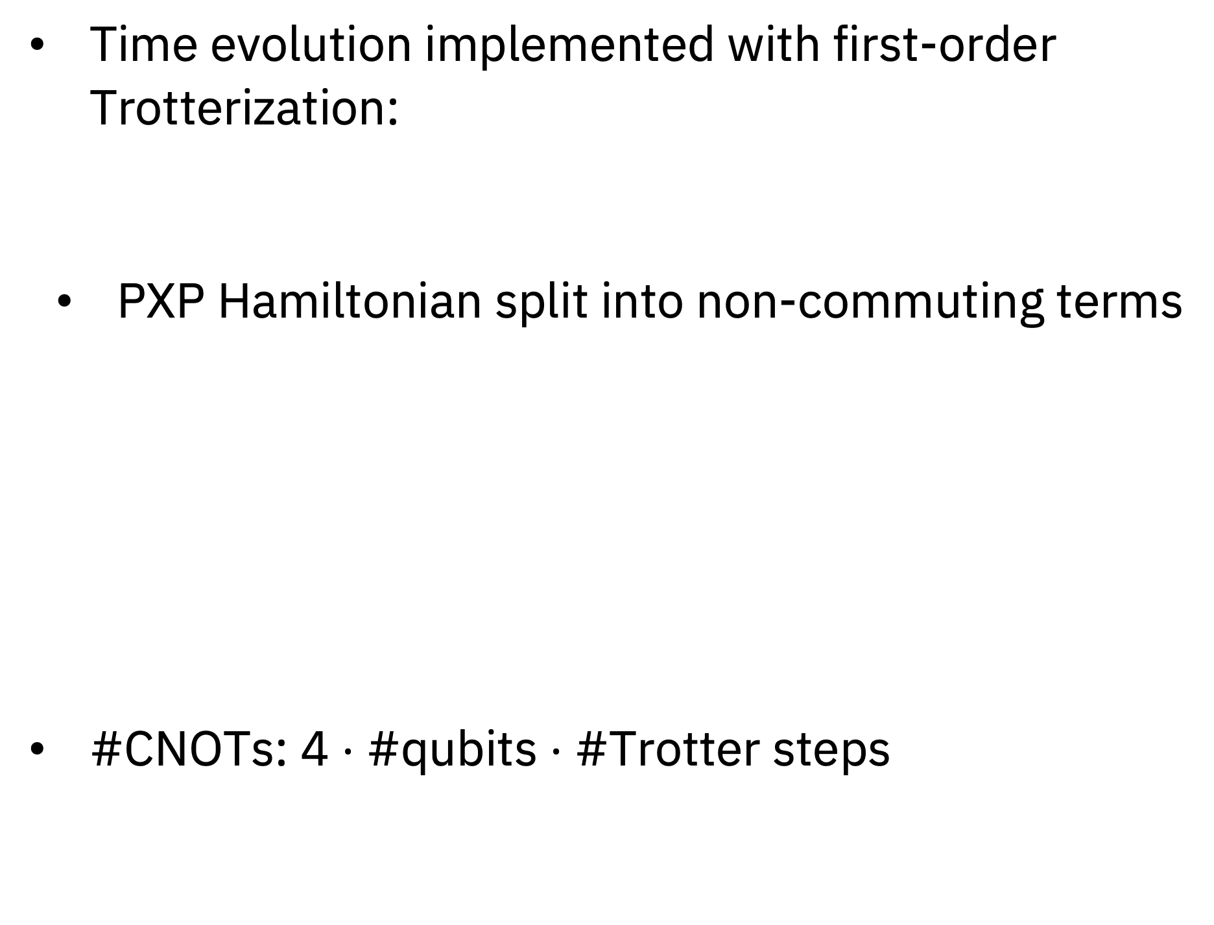
Quantum circuits
Quantum circuit for single interaction term:
Time evolution implemented with first-order Trotterization:
  PXP Hamiltonian split into non-commuting terms
#CNOTs: 4 $⋅$ #qubits $⋅$ #Trotter steps
Quantum circuit for single Trotter step:

Slide 4
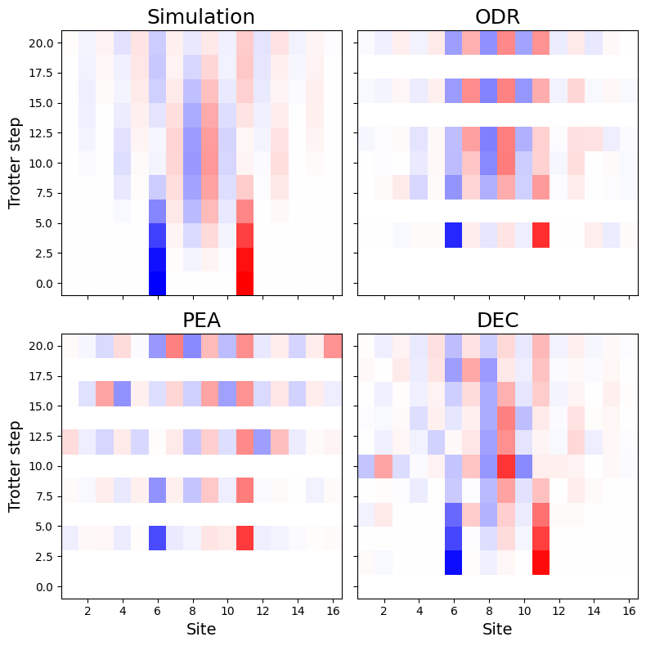
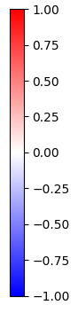
Hardware results
17-qubit Benchmark experiment
Numerical results:
  Noiseless statevector simulations up to 27 qubits
  MPS calculations up to 101 qubits
Quantum hardware calculations:
  Experiments up to 101 qubits
  Applied error mitigation strategies:
    Probabilistic Error Amplification (PEA) [2]
    Operator Decoherence Renormalization (ODR) [3]
    Distribution Error Correction (DEC) [4]
In figures: (Background subtracted) occupation number:
ibm_marrakesh
ibm_brisbane
ibm_marrakesh
[2] Nature 618.7965 (2023): 500-505.
[3] PRX Quantum 5, 020315 (2024)
[4] arXiv:2501.01953v2

Slide 5
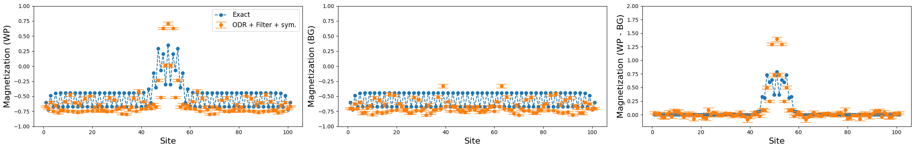
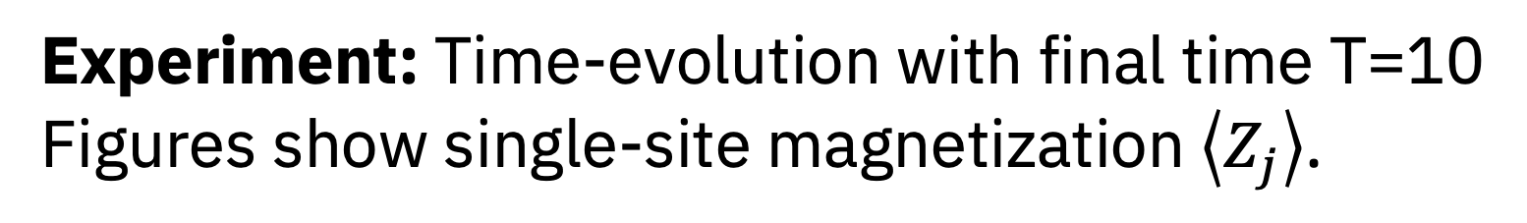
Hardware results
Experiment: Time-evolution with final time T=10
Figures show single-site magnetization $\left\langle Z_{j}\right\rangle$.
Results on largers systems:
  45 qubits, ODR,
  ibm_sherbrooke
  101 qubits, ODR,
  ibm_brisbane

Slide 6
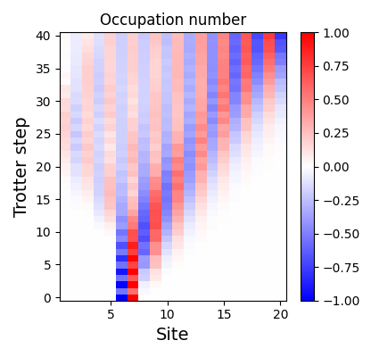
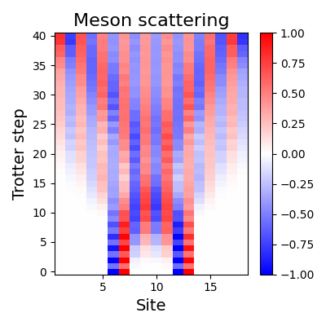
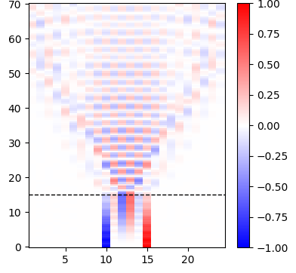
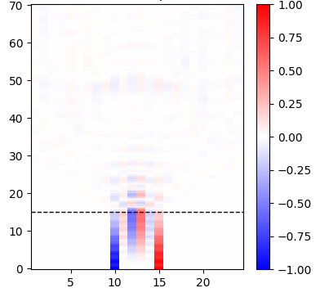
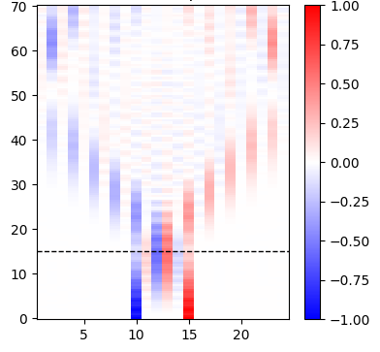
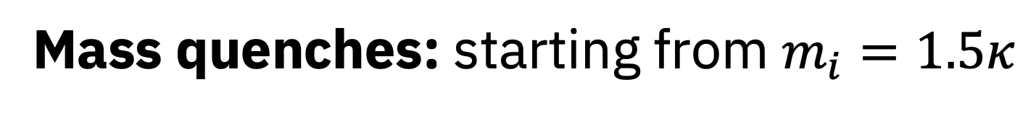
Target applications
Meson evolution:
Single meson
40+ qubit systems
Meson scattering:
  PXP model allows to prepare bound particle states -> mesons
Mass quenches:
  Quench in mass after some time t
  Interesting properties to study: Entropy production, …
Mass quenches: starting from $m_{i}=1.5κ$

