Slide 1
Summary of the neutrino working group
University of Trento – Paris Saclay – University of Washington - IBM

Slide 2
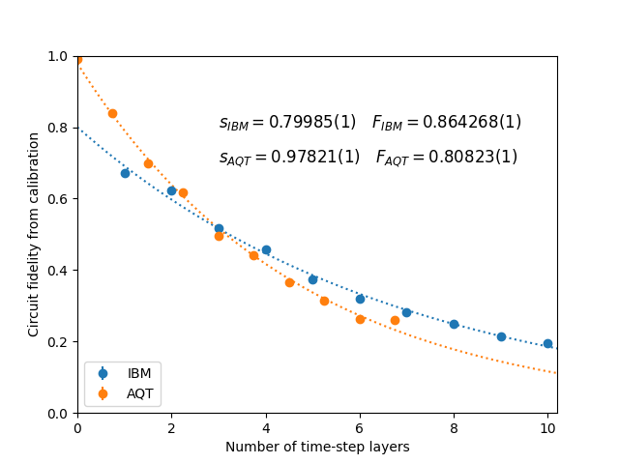
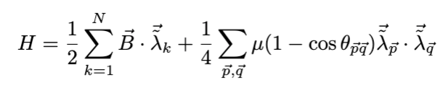
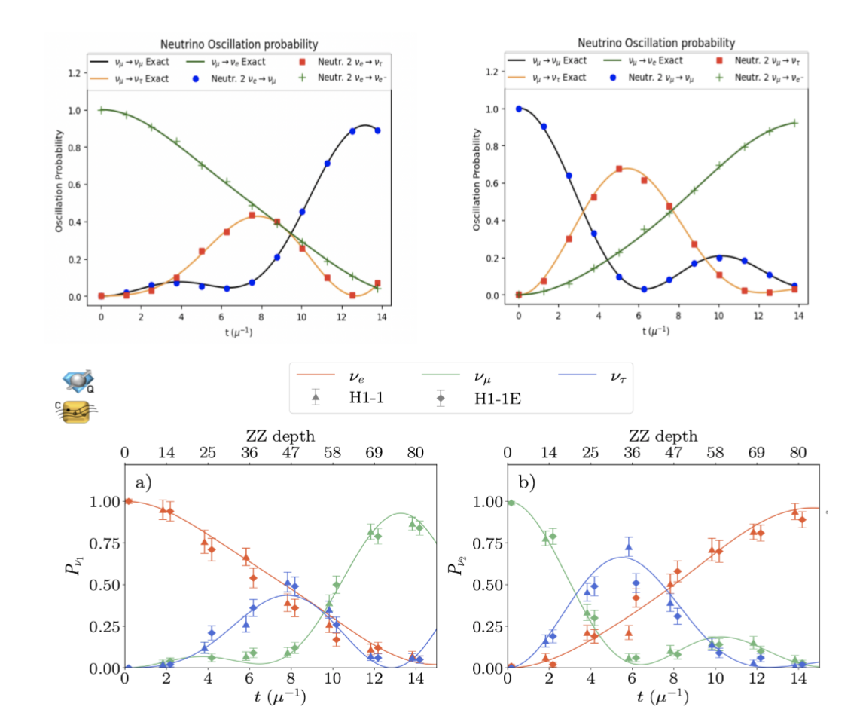
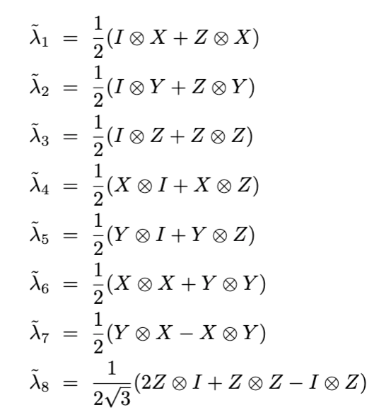
Development of quantum algorithms with 2- or 3-flavors neutrino oscillations
Illustration of the Hamiltonian (3 flavor)
Our calculations:
Spagnoli et al.
with
A code treating interacting neutrinos with three flavors
is validated (with time-dependent coupling and no noise)
M. Mangin-Brinet, D. Lacroix and A. Bauge [Master student]
Turro et al, arxiv:2407.13914

Slide 3
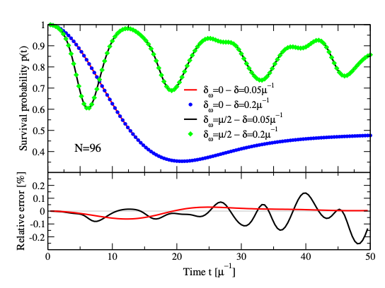
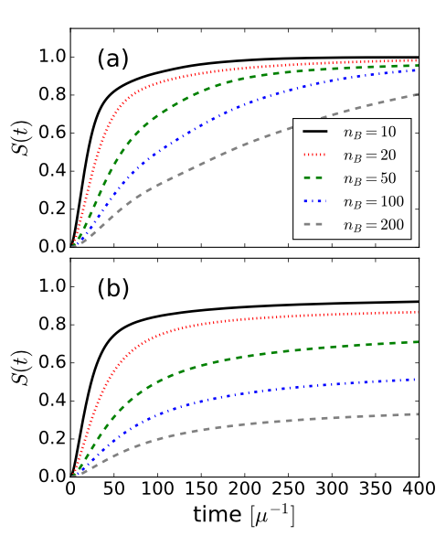
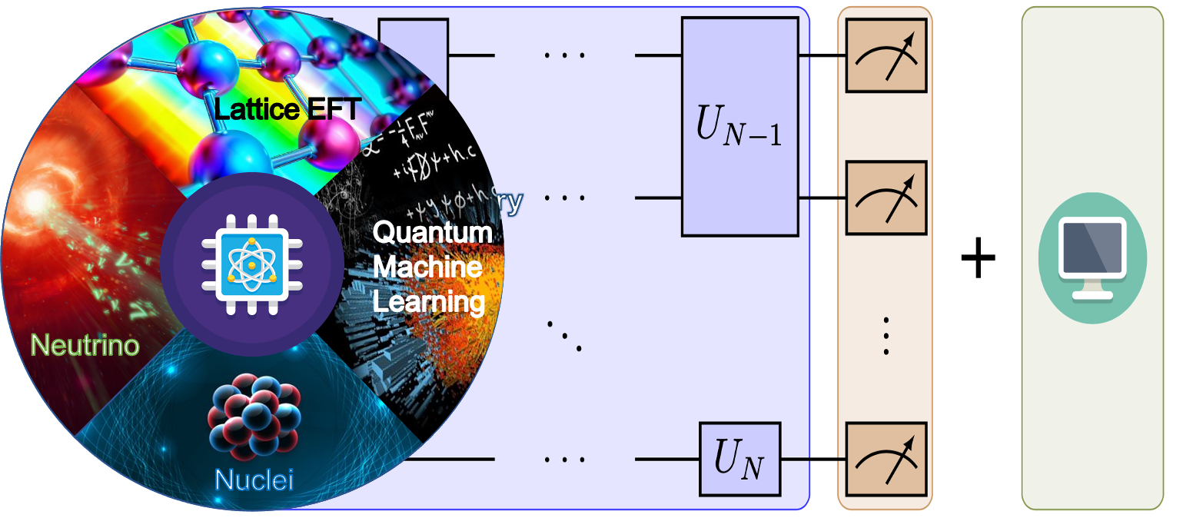
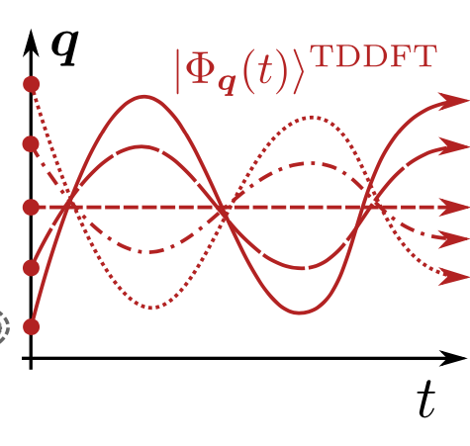
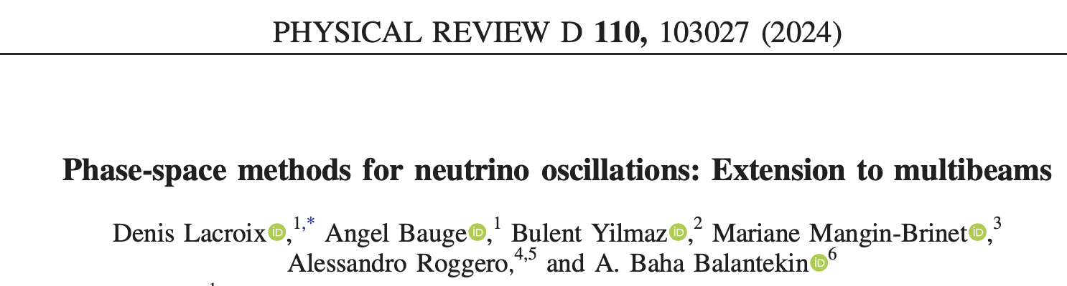
Numerical methods competing with quantum computing
Classical computing techniques:
Tensor network
Up to ~100 neutrinos
Using MPS layers to simulate
neutrino evolution
Phase-space methods
Roggero, Phys. Rev. D 104 (2021)
Cervia et al, Phys. Rev. D 105 (2022)
Several hundreds
of neutrinos
3-flavor code is underway

Slide 4
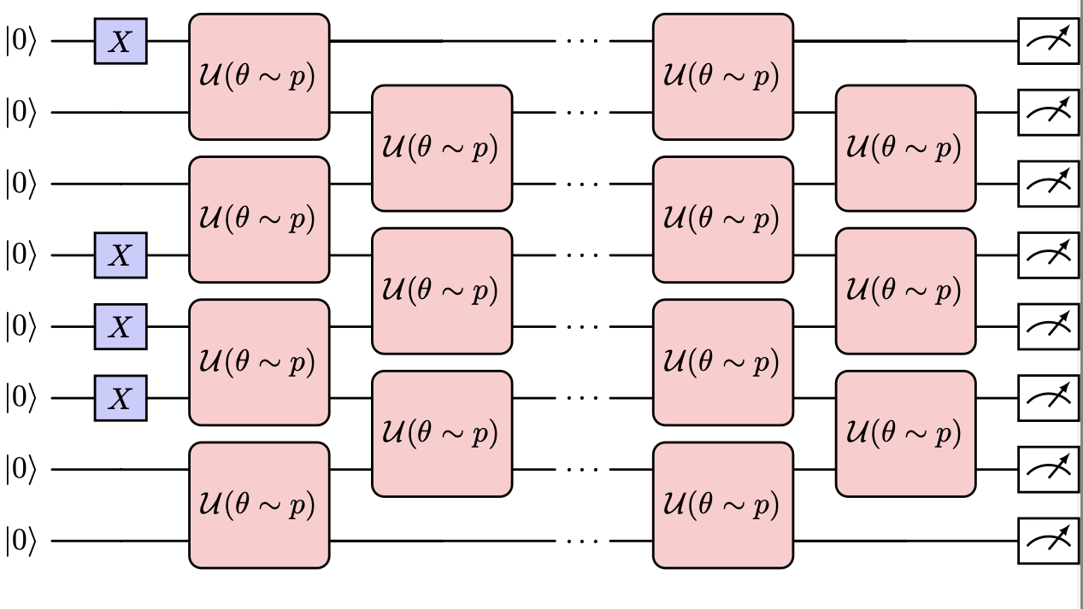
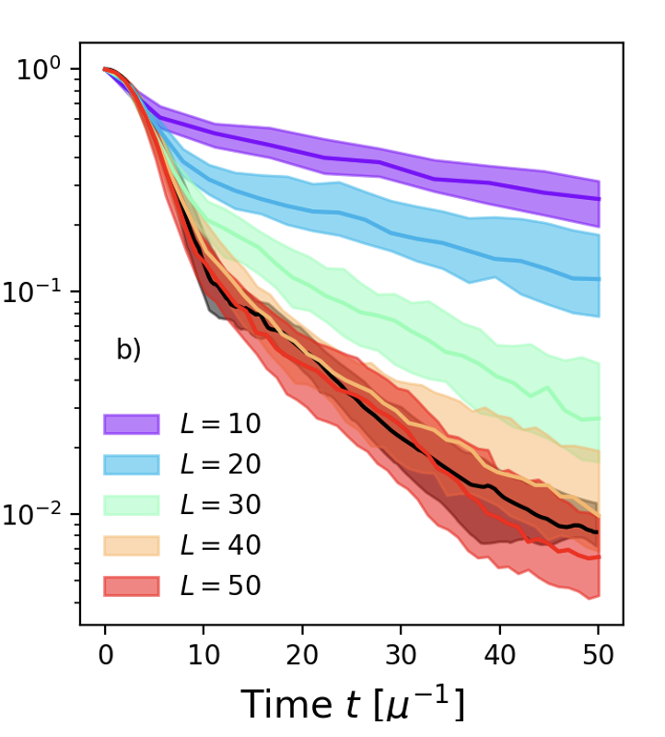

O. Kiss, F. Tacchino, I. Tavernelli & A. Roggero
// Random channel (Qdrift-inspired)
Reproduce as much as possible what we know from the dynamics, average over the rest.
20 neutrinos, 100 random instances.
The number of layers seems to grow as O(t).
Angles are sampled from the Hamiltonian.
Consider a permutation-invariant observable.
Average over permutation of the initial state, since the exact evolution remains invariant.
Fix the time scale by matching the short-time dynamics.

Slide 5
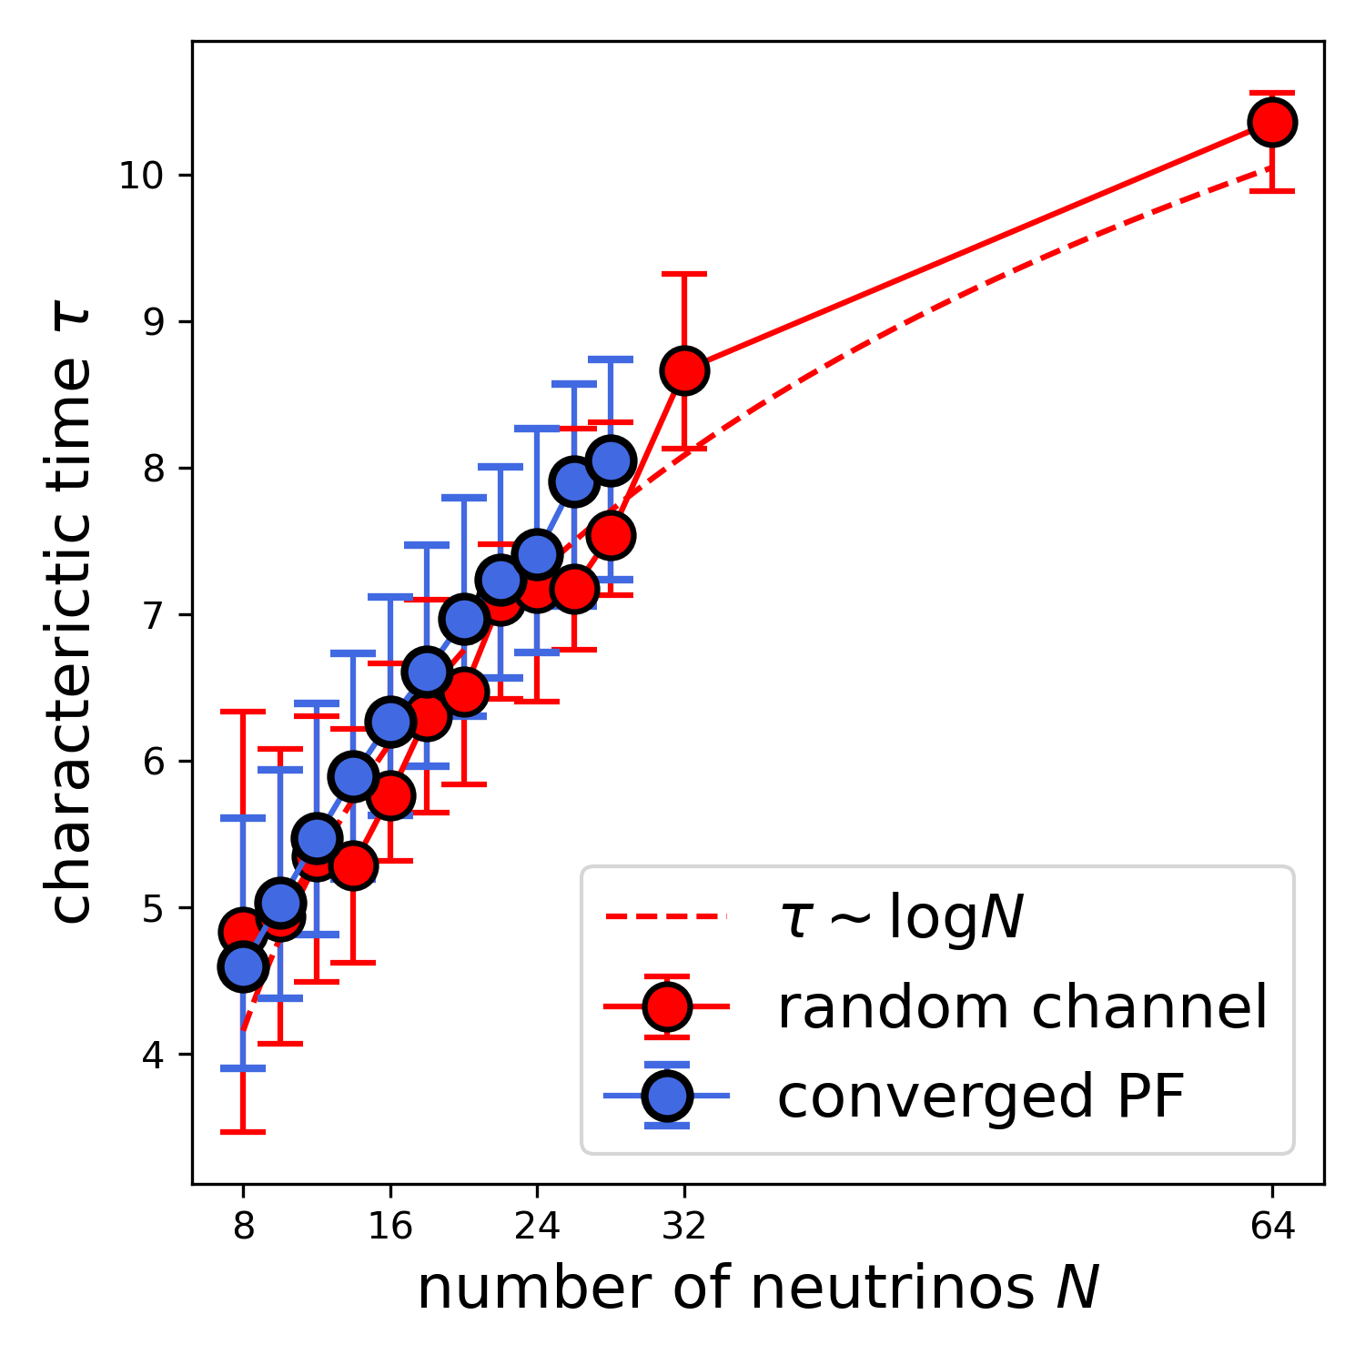
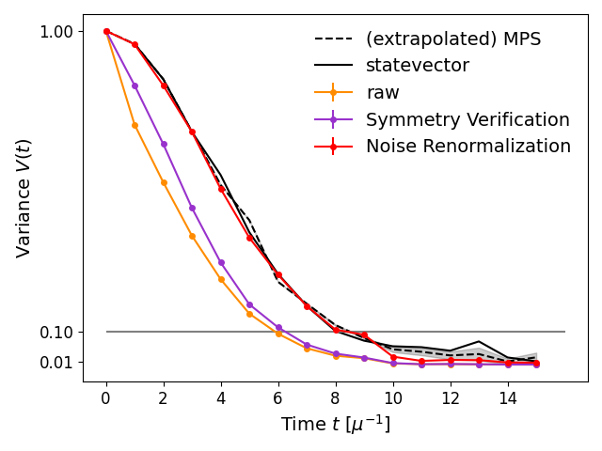
// Let us scale this up!
32 neutrinos, ibm_fez, one realisation
Scaling with the system size (MPS)
We estimate the noise parameters on the (invariant) zero initial state.
Characteristic time
90 CNOTs depth

Slide 6
// Quantum simulation is not a solved problem!
How to choose the best algorithm for a specific system?
Trotter (commutator bound)
Sparsification – composite channels
Qdrift (one norm)
QSP (one norm)
Better LCU
Initial state and observable dependant

Slide 7
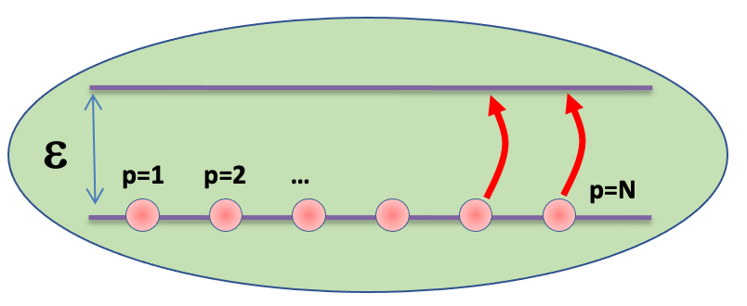
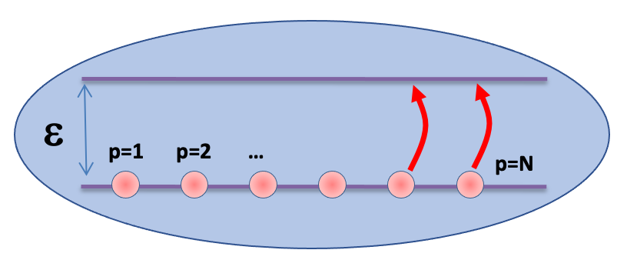
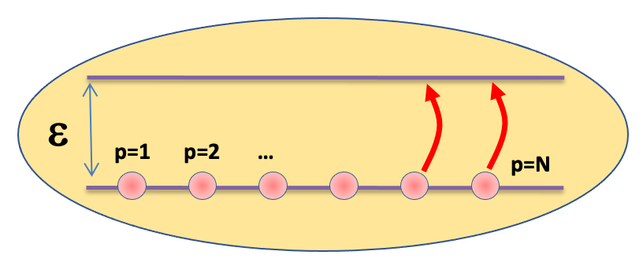
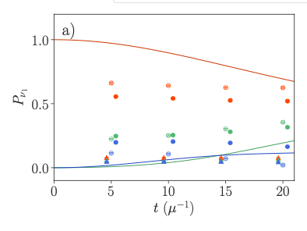
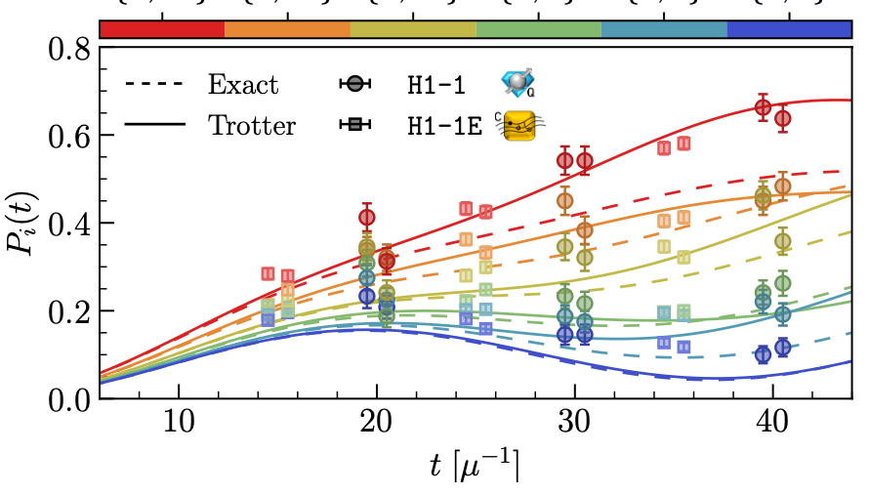
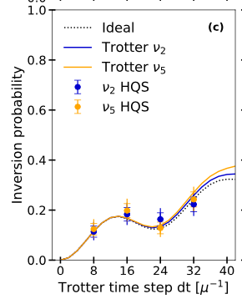
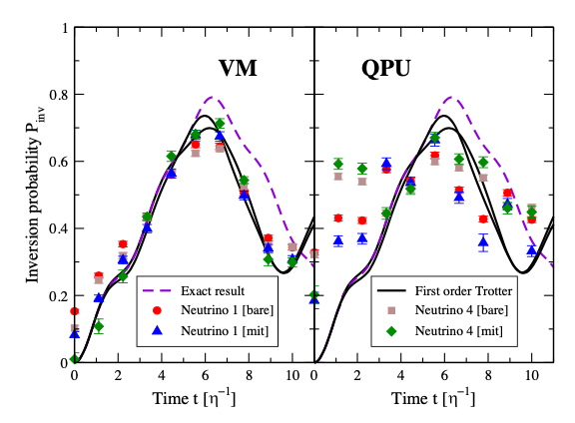
Beam 1
A focus on neutrino oscillation physics simulated
on quantum computers
Illustration of the Hamiltonian (2 flavor approx)
Beam 2
Beam 3
Oscillation
Coupling
12 neutrinos
Quantinuum’s H1-1
20 qubit trapped-ion
12 neutrinos / qutrits
H1-1 & ibm_torino
4 & 8 neutrinos
HQD-H1
Trapped Ion device
4 neutrinos
IBM-Vigo QPU
Illa et al, PRL 130 (2023)
Turro et al,
arxiv:2407.13914
Amitrano,et al, PRD 107, (2023)
Hall et al, PRD 104 (2021)

Slide 8



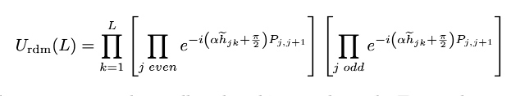
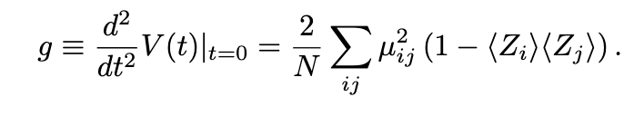

What we do in practice
Sample Hamiltonian
Sample initial states (product states with half zeros)
Sample couplings from the Hamiltonian and let neighboring neutrinos interact.
Fix low-time dynamics
Increase the number of layers L over time (t=L).
Compute the variance of single paulis Z.
Average and take confidence intervals.

