Slide 1



Hi-Lumi Update from TRIUMF
Bob Laxdal
Dec 13, 2024

Slide 2
Funding progress and remaining risks
Due to the nature of the funding agreement ALL funds for the project must be spent and all parts received before April 2025
Over 5M$ has been committed over the last year – TRIUMF has spent or encumbered all funds – a major milestone
Present risks
  Over 50% of funds are encumbered including 22% from CERN that need delivery to TRIUMF before April 2025
2

Slide 3
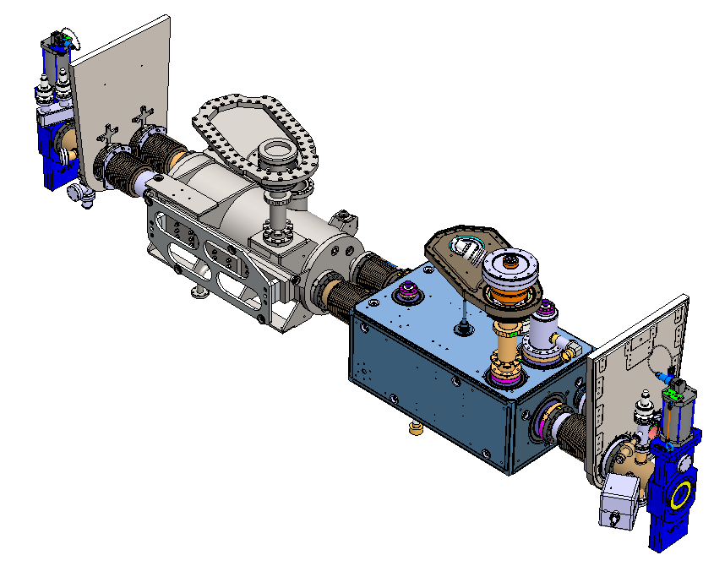
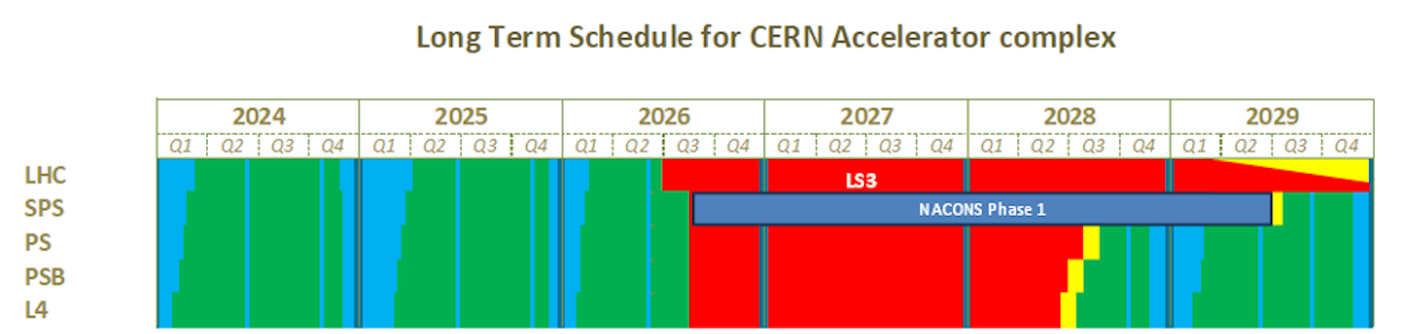
Present schedule including impact of LS26
2025
  Receive and qualify cavity TC0 -> assemble TCM0 string -> requalify TC0
  Receive cavities TC1,2, qualify and assemble TCM1 string
  Receive other cavities and qualify them in sequence
2026
  Priority will be on supporting ARIEL effort
  Qualify any remaining HL cavities as part of our agreement with AUP/CERN
  Opportunistic work on TCM1 to guarantee all parts are in hand
  Project completion expected to be delayed by 6 months

Slide 4
Infrastructure upgrade status
 |  | specified | designed | ordered | received
Clean room upgrade | New clean room |  |  |  | Jan 2025
 | Rinse facility |  |  | Nov 2024 | Jan 2025
 | Pumping/venting
Cavity testing | 4k/2k insert
 | Test diagnostics
 | Clean venting system
 | Qualification (dummy cavity) |  |  |  | Jan 2025
Assembly fixtures | Hermetic string cart
 | Dummy cavity
 | Cavity handling tooling
 | Top down assembly stand
 | Cryomodule trolley

Slide 5
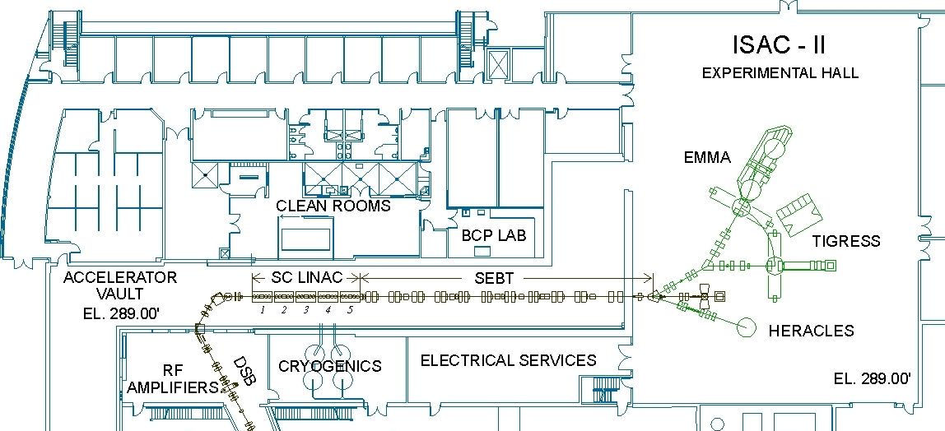
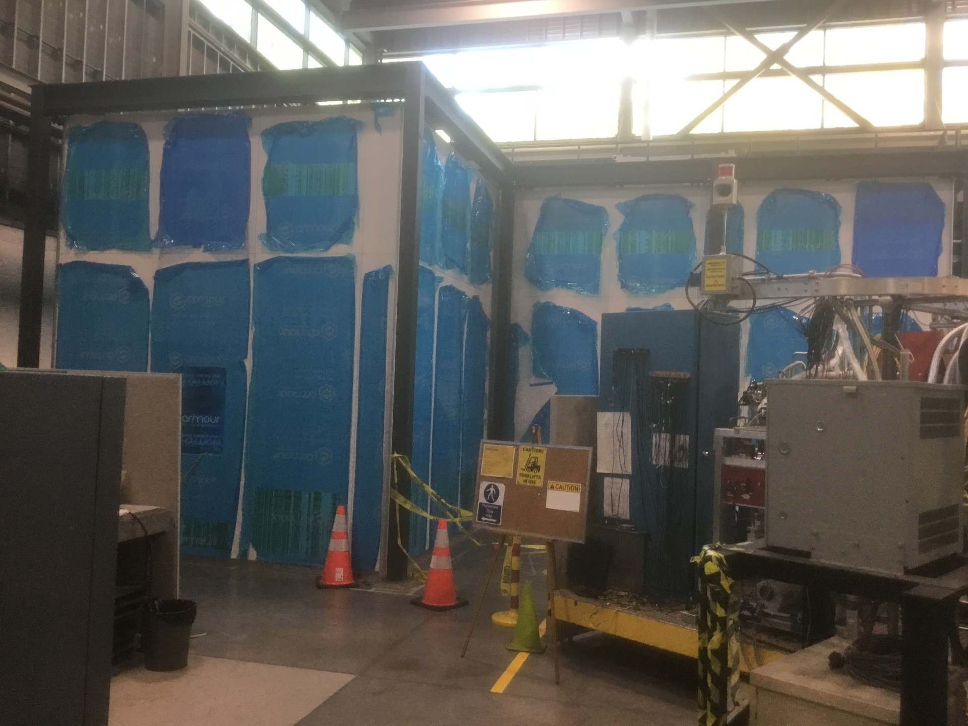
TRIUMF SRF Facilities – Hi-Lumi Upgrade
To improve the throughput of Hi-lumi CMs we are installing a second clean-room in the ISAC-II experimental hall
The clean room will allow dedicated string assembly over the life of the project – being installed and ready Jan 2025
Dirty assembly
Clean assembly
RF
HPWR
Prep room
Cavity/CM testing
Clean assembly
BCP

Slide 6
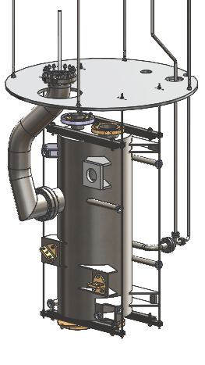
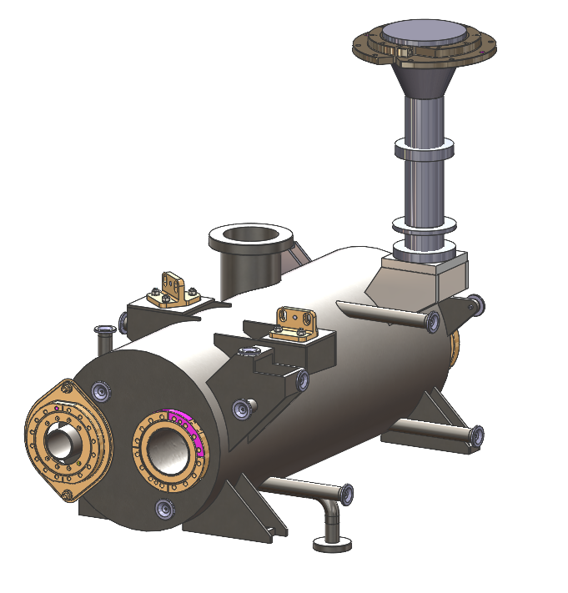
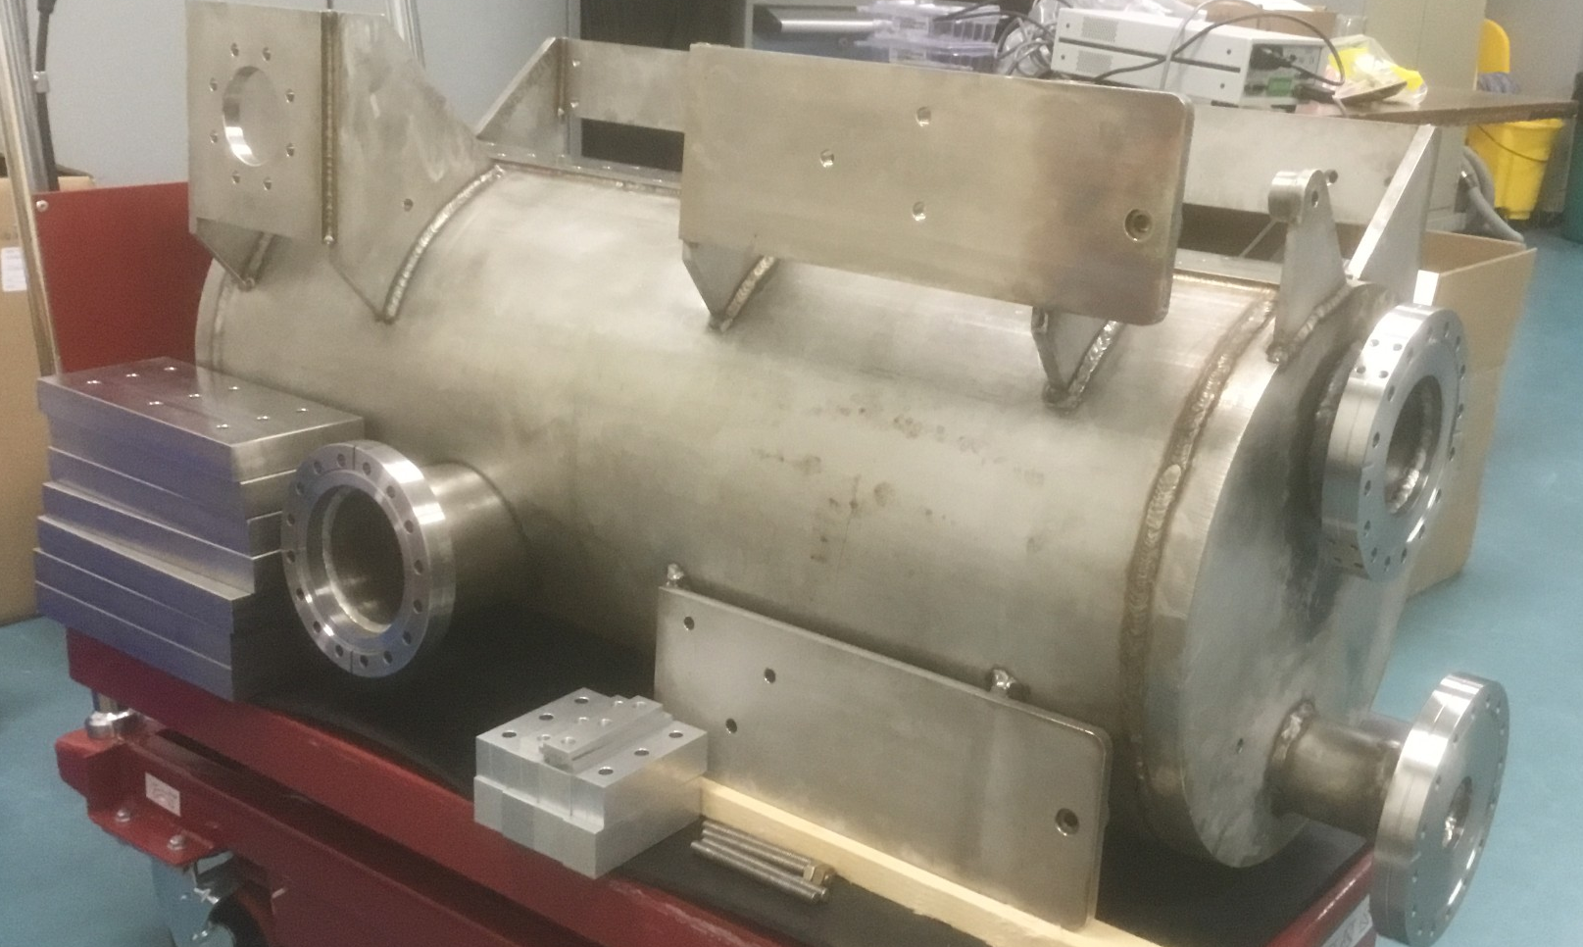
Dummy cavity for TCM0
AUP anticipates delivery of one TCM0 cavity in Feb. 2025
TRIUMF has designed and fabricated a dummy cavity for TCM0 string assembly
  Identical LHe volume and mass as the actual cavity
  Identical beam and helium interfaces as the RFD cavity
  Identical support interfaces
Will be used for testing prior to cavity delivery and during assembly of TCM0 cavity string

Slide 7
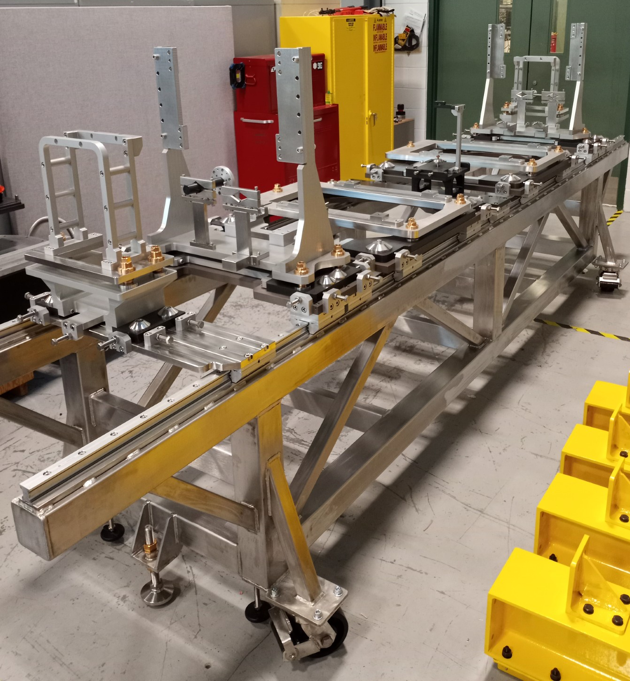
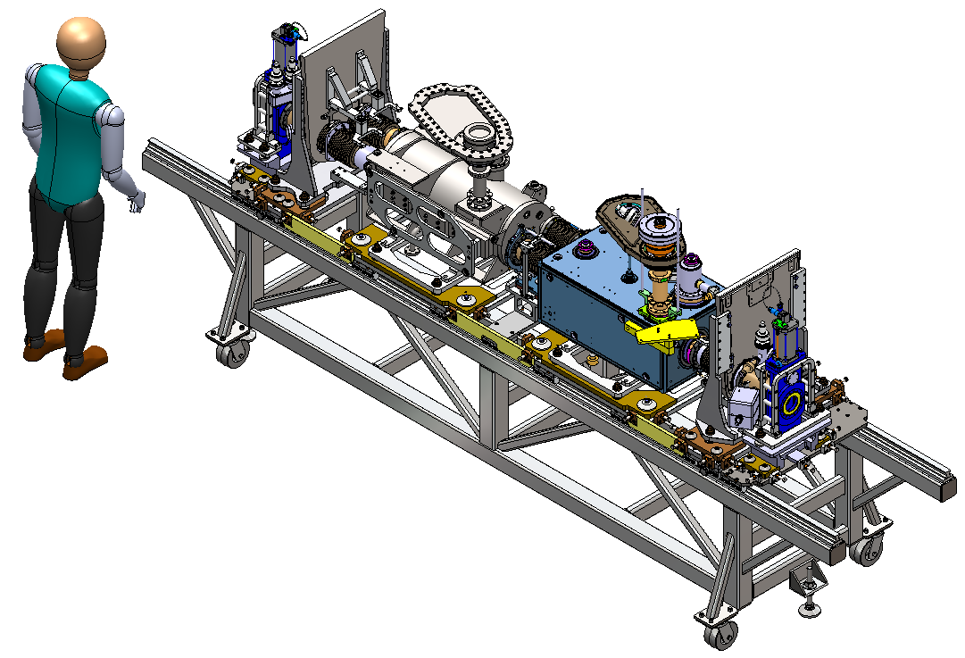
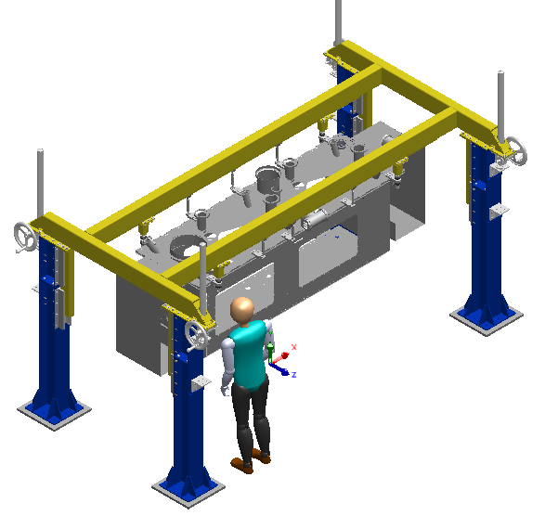
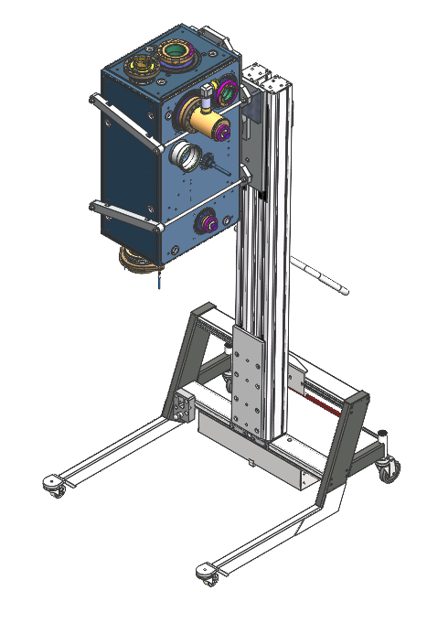
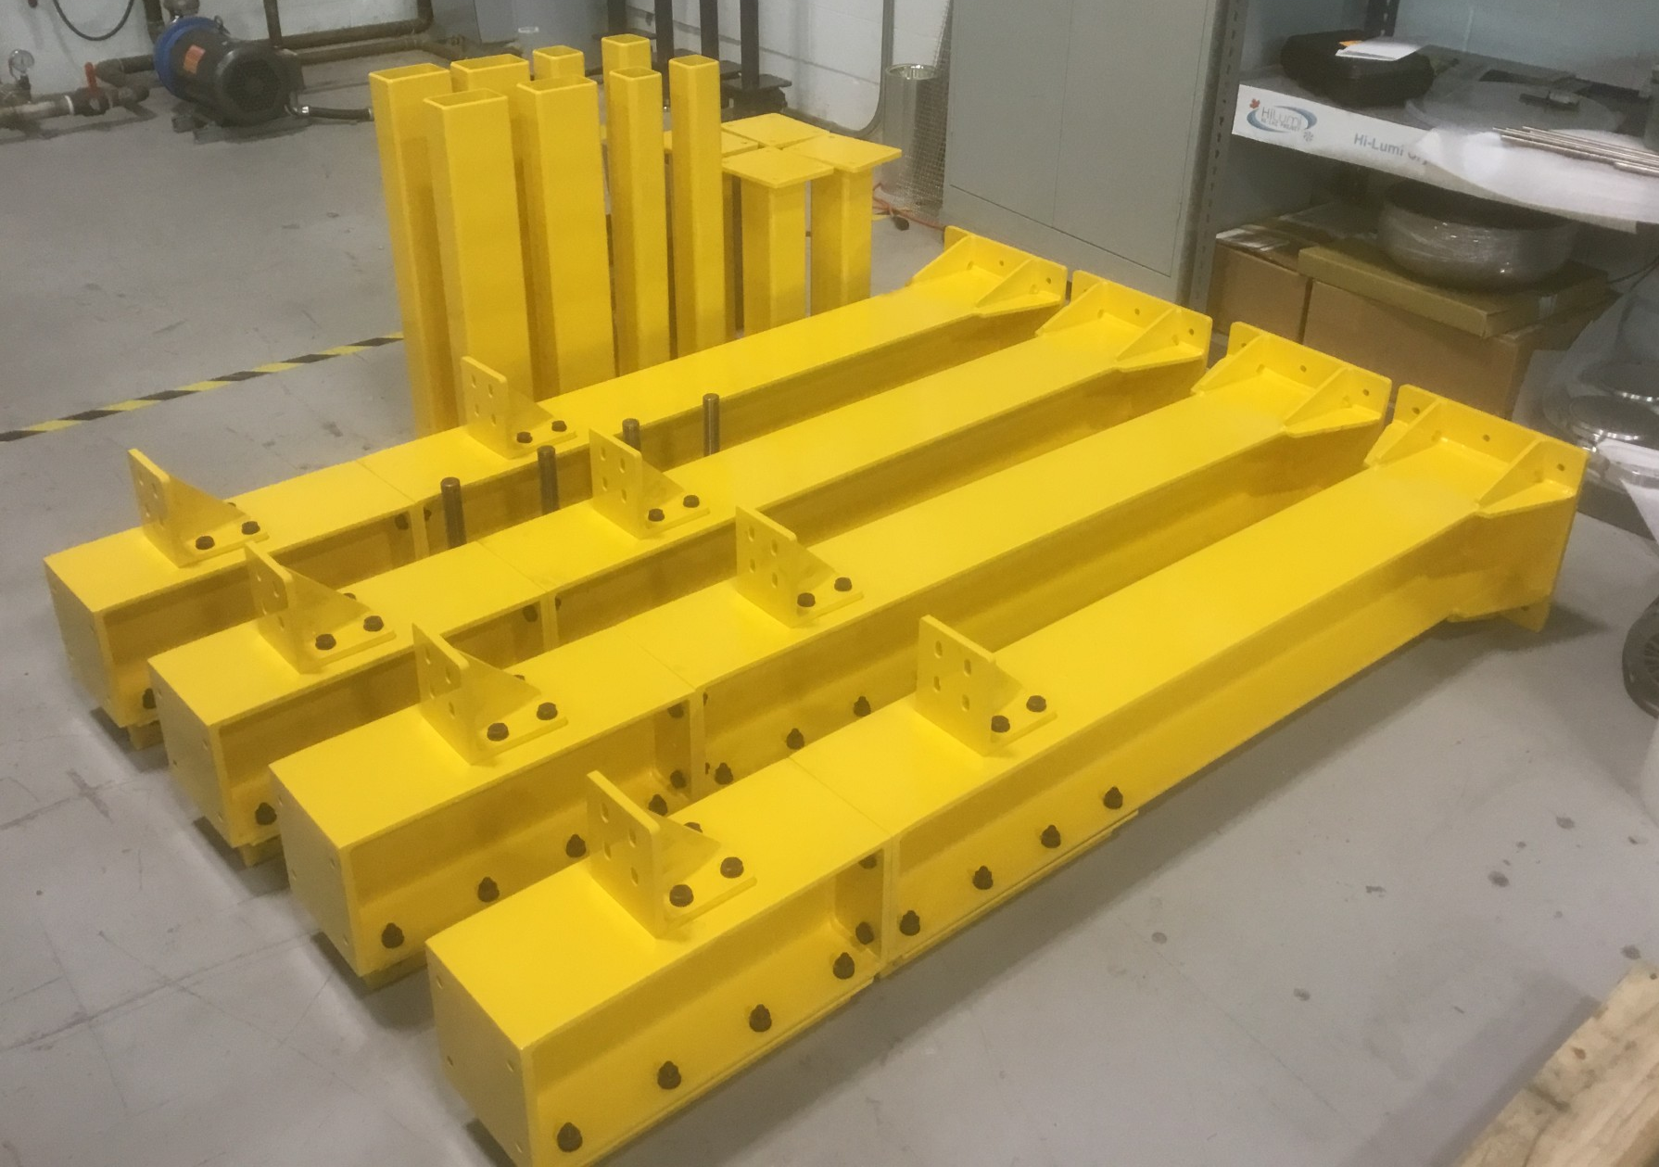
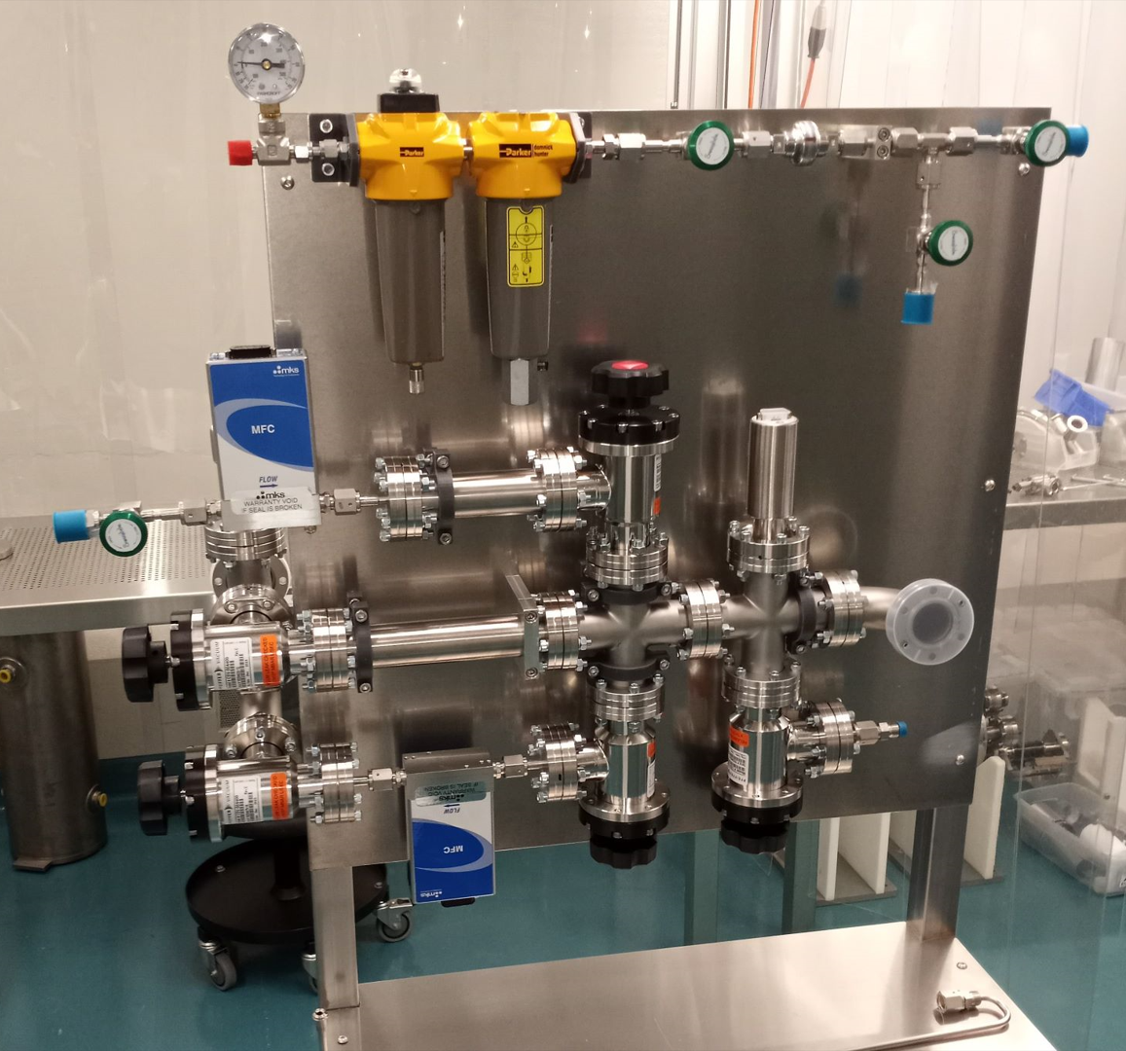
Other Infrastructure
String assembly frame received
  Ready for assembly
Top assembly frame
  Assembled and ready for TCM0
Cavity manipulation/rinsing tooling
  Received
Pumping/Venting stand
  Ready for commissioning

Slide 8
Recent milestones - Cryomodules
Milestone | Application | Achieved
OVC material order received | TCM1-5 | Feb. 2024
OVC fabrication order launched | TCM1-5 | Feb. 2024
MLI contract issued | TCM1-5 | Mar. 2024
Mu-metal received | TCM1-4 | Oct. 2024
Tuner frame/flexures fabrication launched | TCM1-5 | Sept. 2024
Thermal shield fabrication launched | TCM1-5 | Sept. 2024
Cavity support spider fabrication launched | TCM1-5 | Oct. 2024
Bi-phase pipe supports ordered | TCM1-5 | Oct. 2024
OVC lifting blocks ordered | TCM1-5 | Oct. 2024

Slide 9
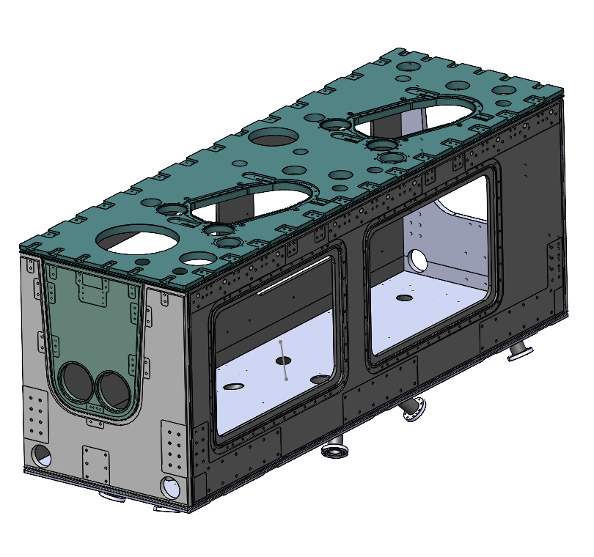
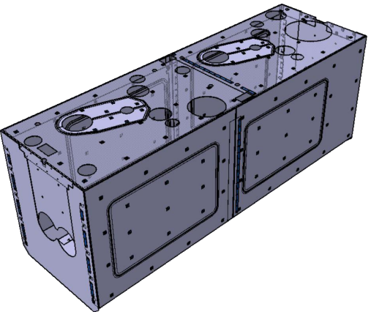
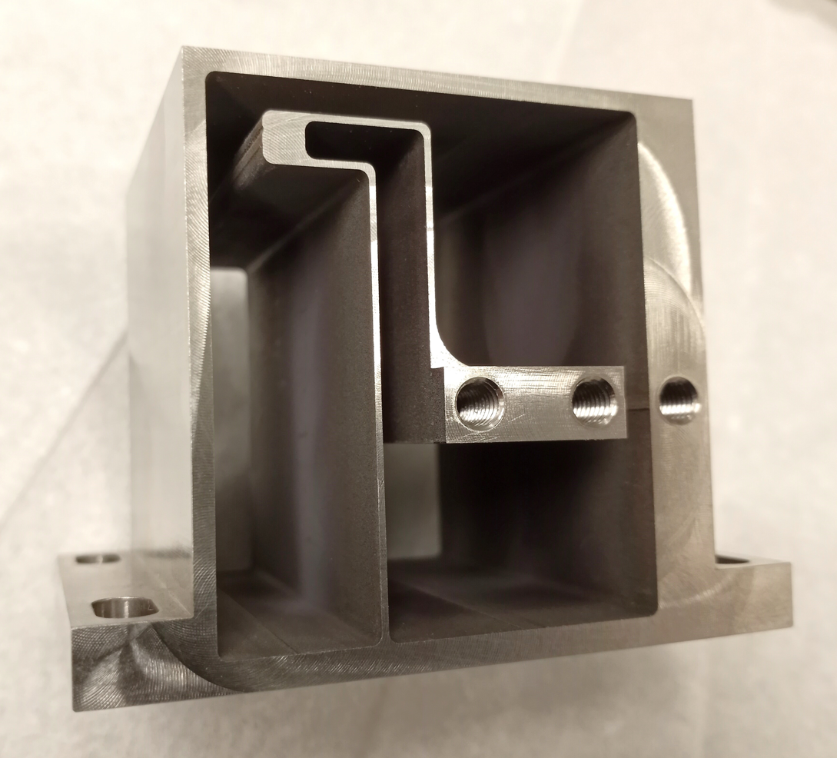
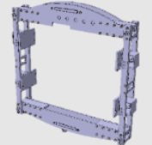
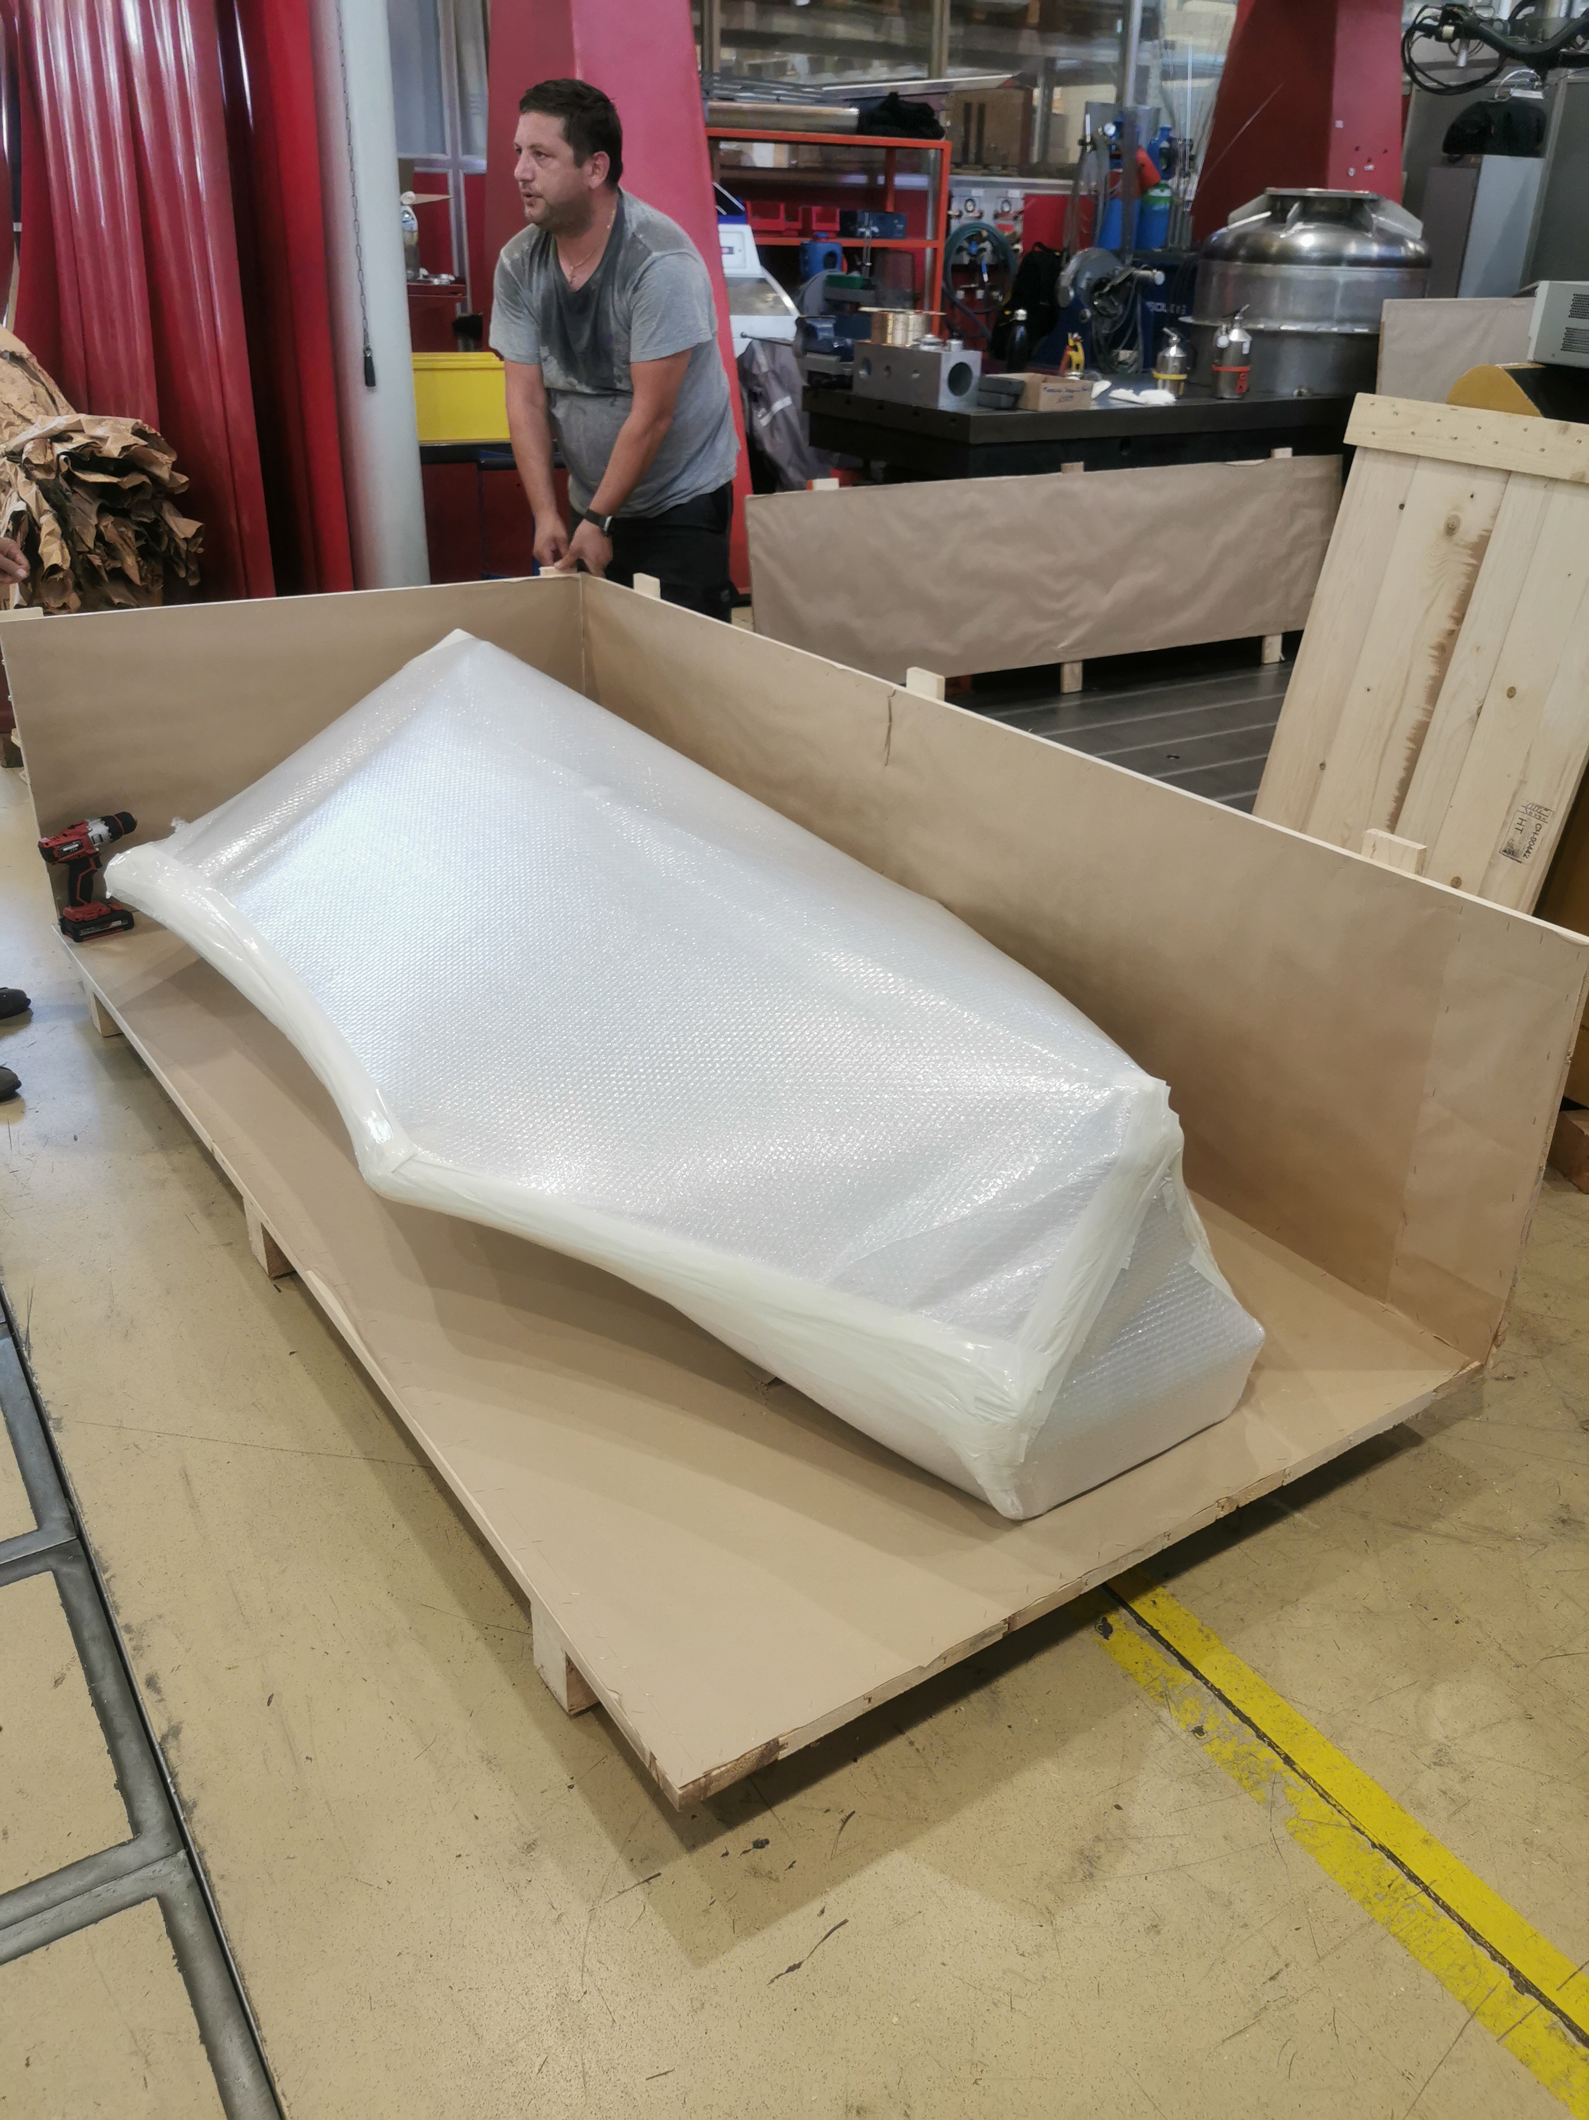
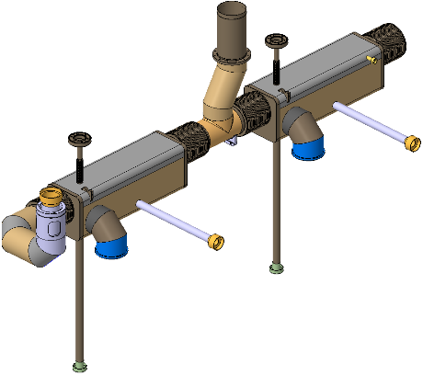
Cryomodule fabrication milestones
Outer vacuum chamber (OVC)
TCM0 and Series contract issued to Axton (Vancouver)
All material in hand
Mu-metal - series
Four articles received with all expected by Dec. 2024
Thermal shield - series
Material in hand and major fabrication contracts launched
Tuner - series
Tuner frame fabrication expected in Jan 2025
Bi-phase lines
Production well advanced at CERN with first article for TCM1 delivered

Slide 10
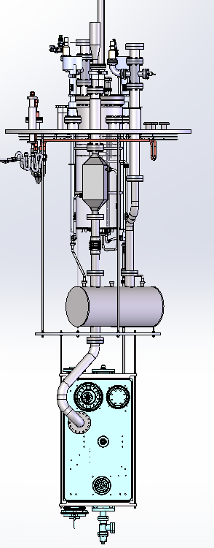
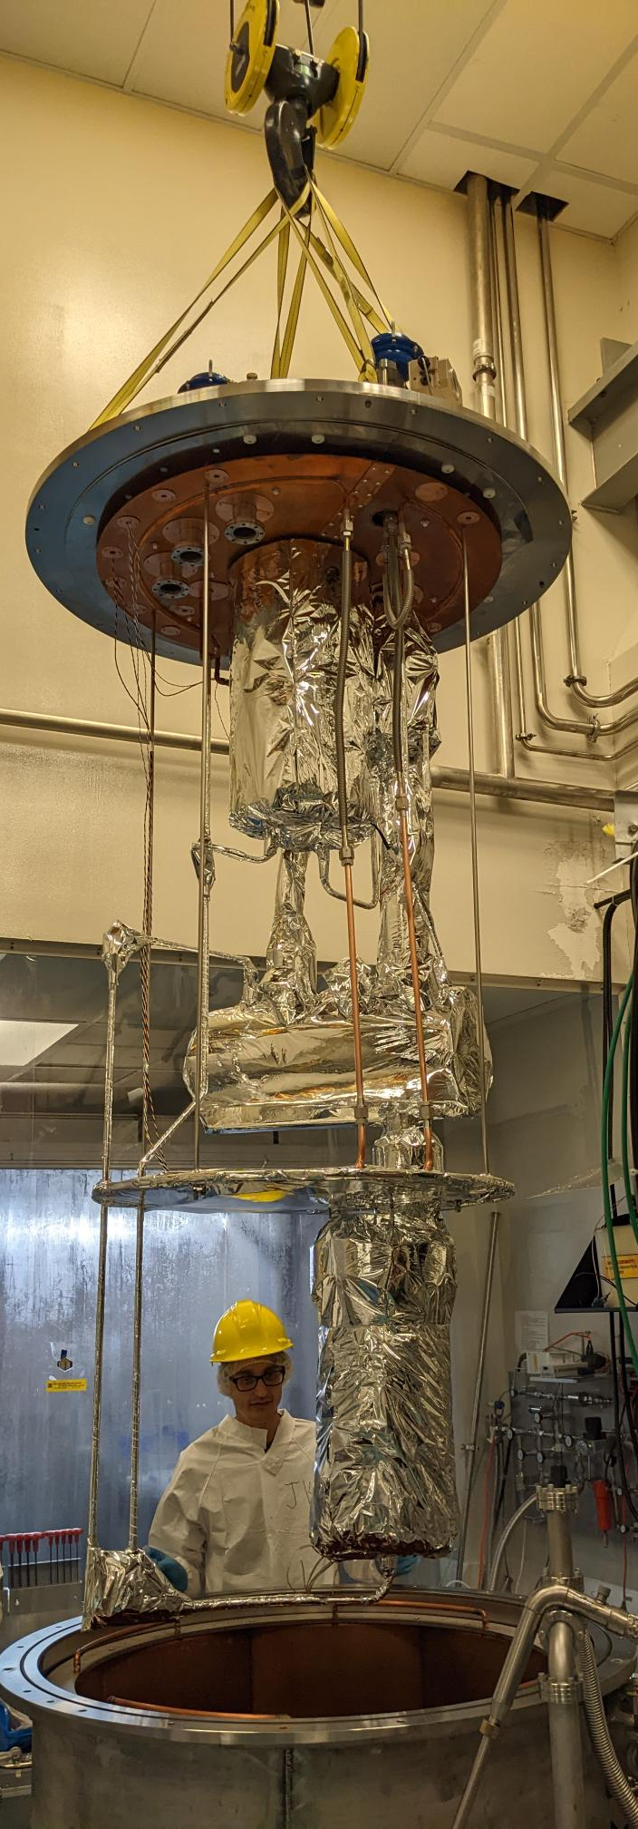
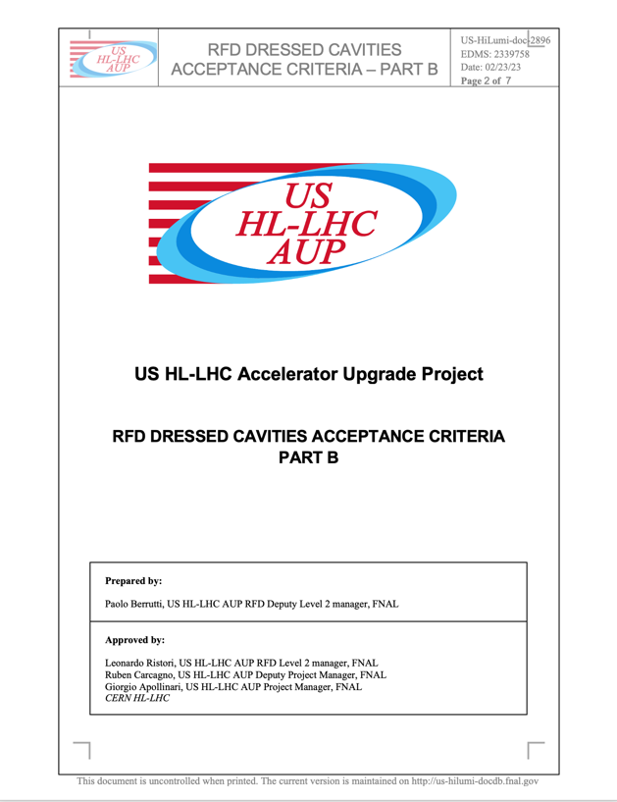
Preparation for cavity testing
TRIUMF will requalify the AUP cavities upon delivery from JLab
TRIUMF has upgraded the cavity test facility
Prepared and qualified cryo-insert for multi-purpose cryostat to test dressed cavities at 2K in jacketed mode
Require signed off requirements document for requalification tests

Slide 11

Cryomodule Assembly Critical Path
Remaining ‘added scope’ from CERN required by April 2025 to satisfy budget condition
CM assembly requires cavities from AUP and CERN parts (FPCs, beamline assemblies, cryo-piping, tuner parts, …)
  Critical path runs through the delivery of first articles for the assembly of TCM0 string and for TCM1
  AUP cavities are expected in Feb 2025 with delivery of series articles highly compressed - expected to be delivered within eight months
  Delivery of CERN articles for TCM0 string and TCM1 full CM required in early 2025
    RF adaptors for cavity testing, 3 FPCs, 1.5 sets of PIMs and other string components, …
AUP, CERN
TRIUMF
AUP Delivery Projection
Cavity Pair | Module | Delivery
Prototype TC0 | TCM0 | Feb 2025
TC1,2 | TCM1 | May 2025
TC3,4 | TCM2 | Jun 2025
TC5,6 | TCM3 | Jul 2025
TC7,8 | TCM4 | Aug 2025
TC9,10 | TCM5 | Sep 2025

Slide 12
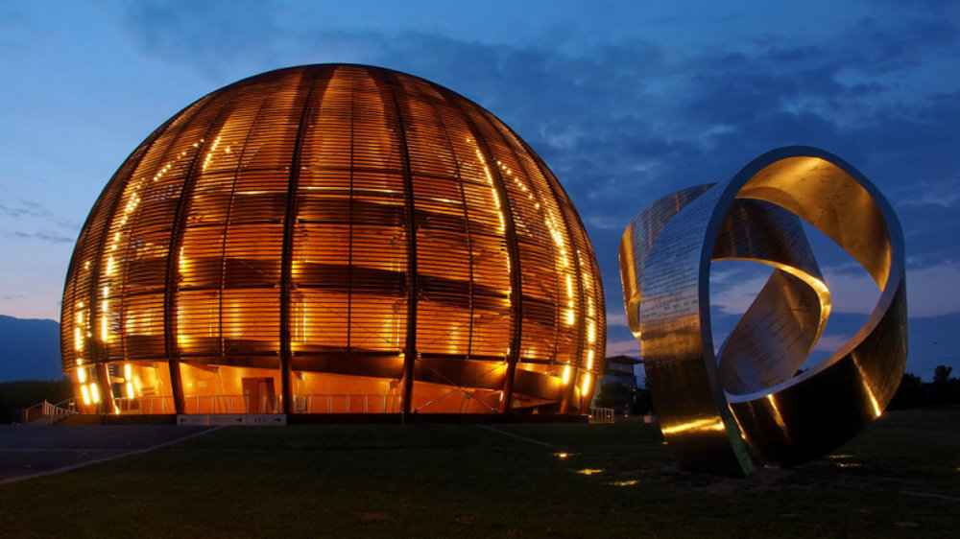
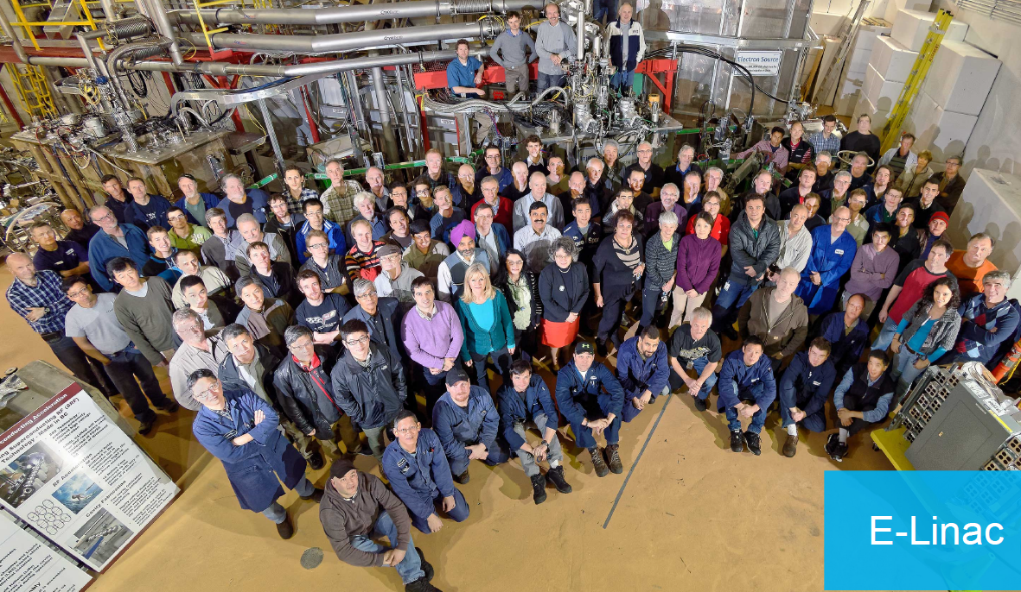

Summary
2024 strategy addresses finite time window for available funds
  All funds now committed
  Requires timely delivery from vendors and CERN of agreed deliverables in order to make payments in time
Preparing for TCM0 string and series production CMs
  Significant progress on fabrication orders
  First out of scope fabricated parts received from CERN
  Require signed off document for cavity requalification requirements
  Major assembly infrastructure in hand
    New clean room being installed for commissioning in Jan 2025
    Cavity testing infrastructure prepared for first cavities from AUP

