Slide 1
UK Updates
Global CCCM
Dec ‘24
Graeme Burt & Niklas Templeton on behalf of UK WP4 team

Slide 2
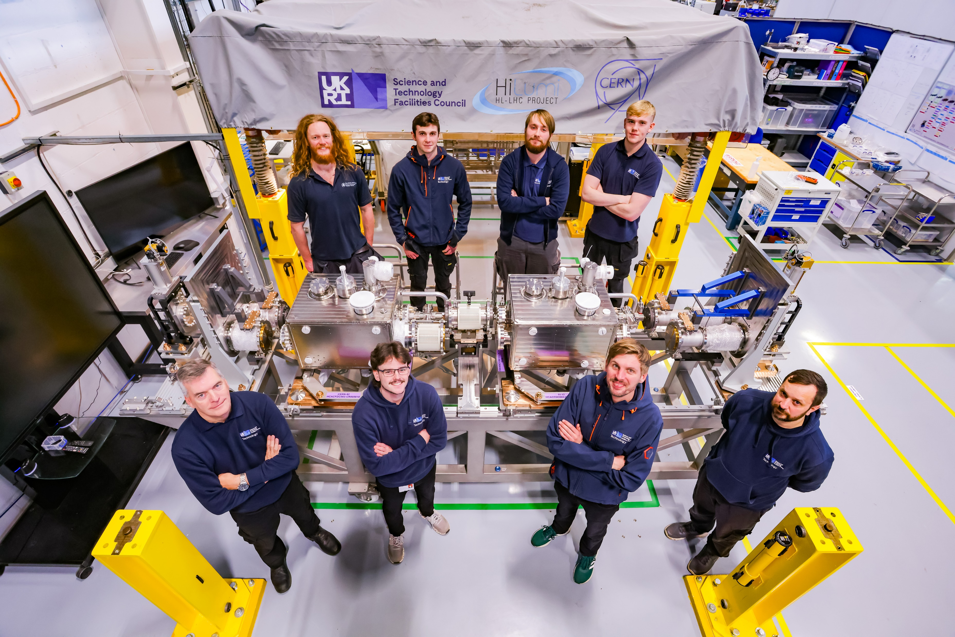
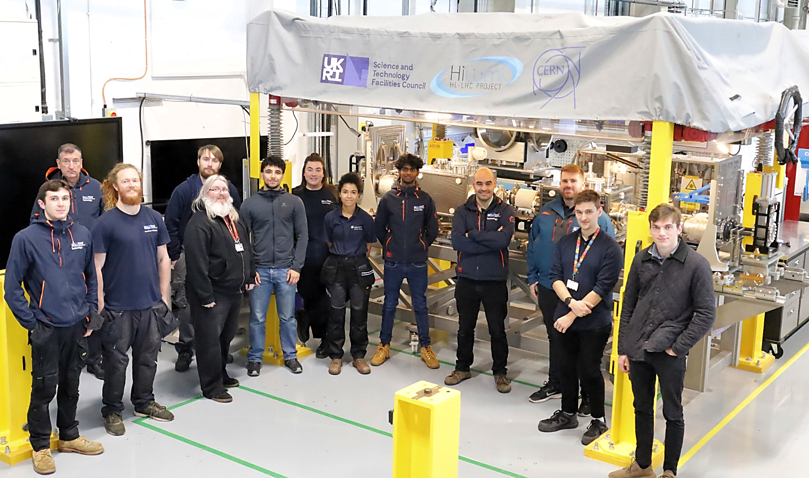
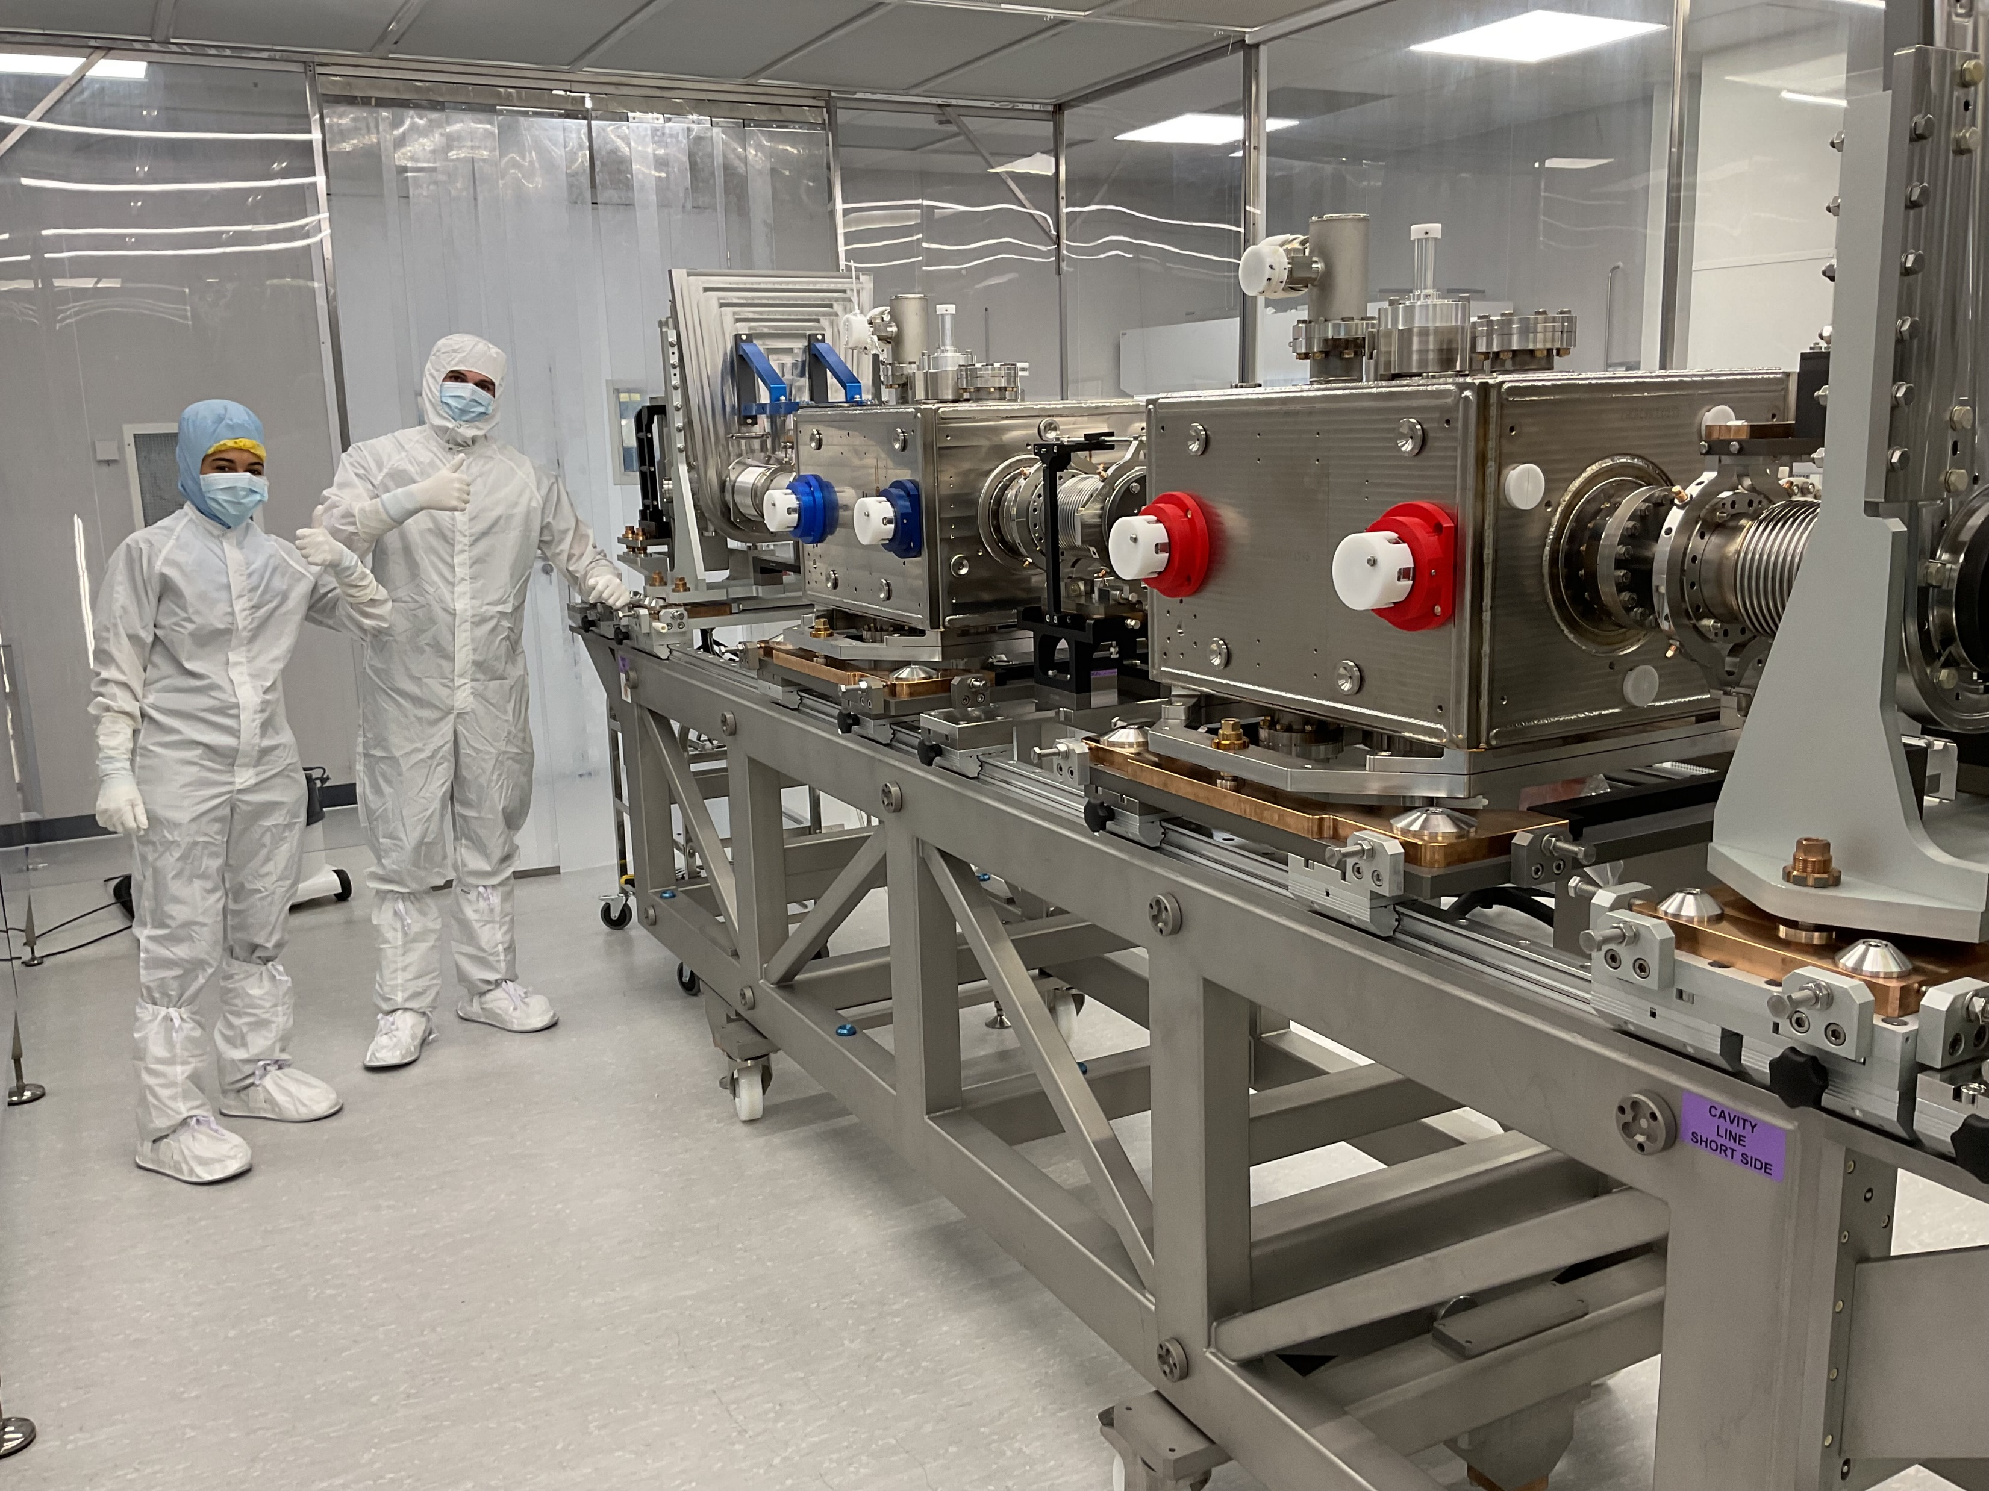
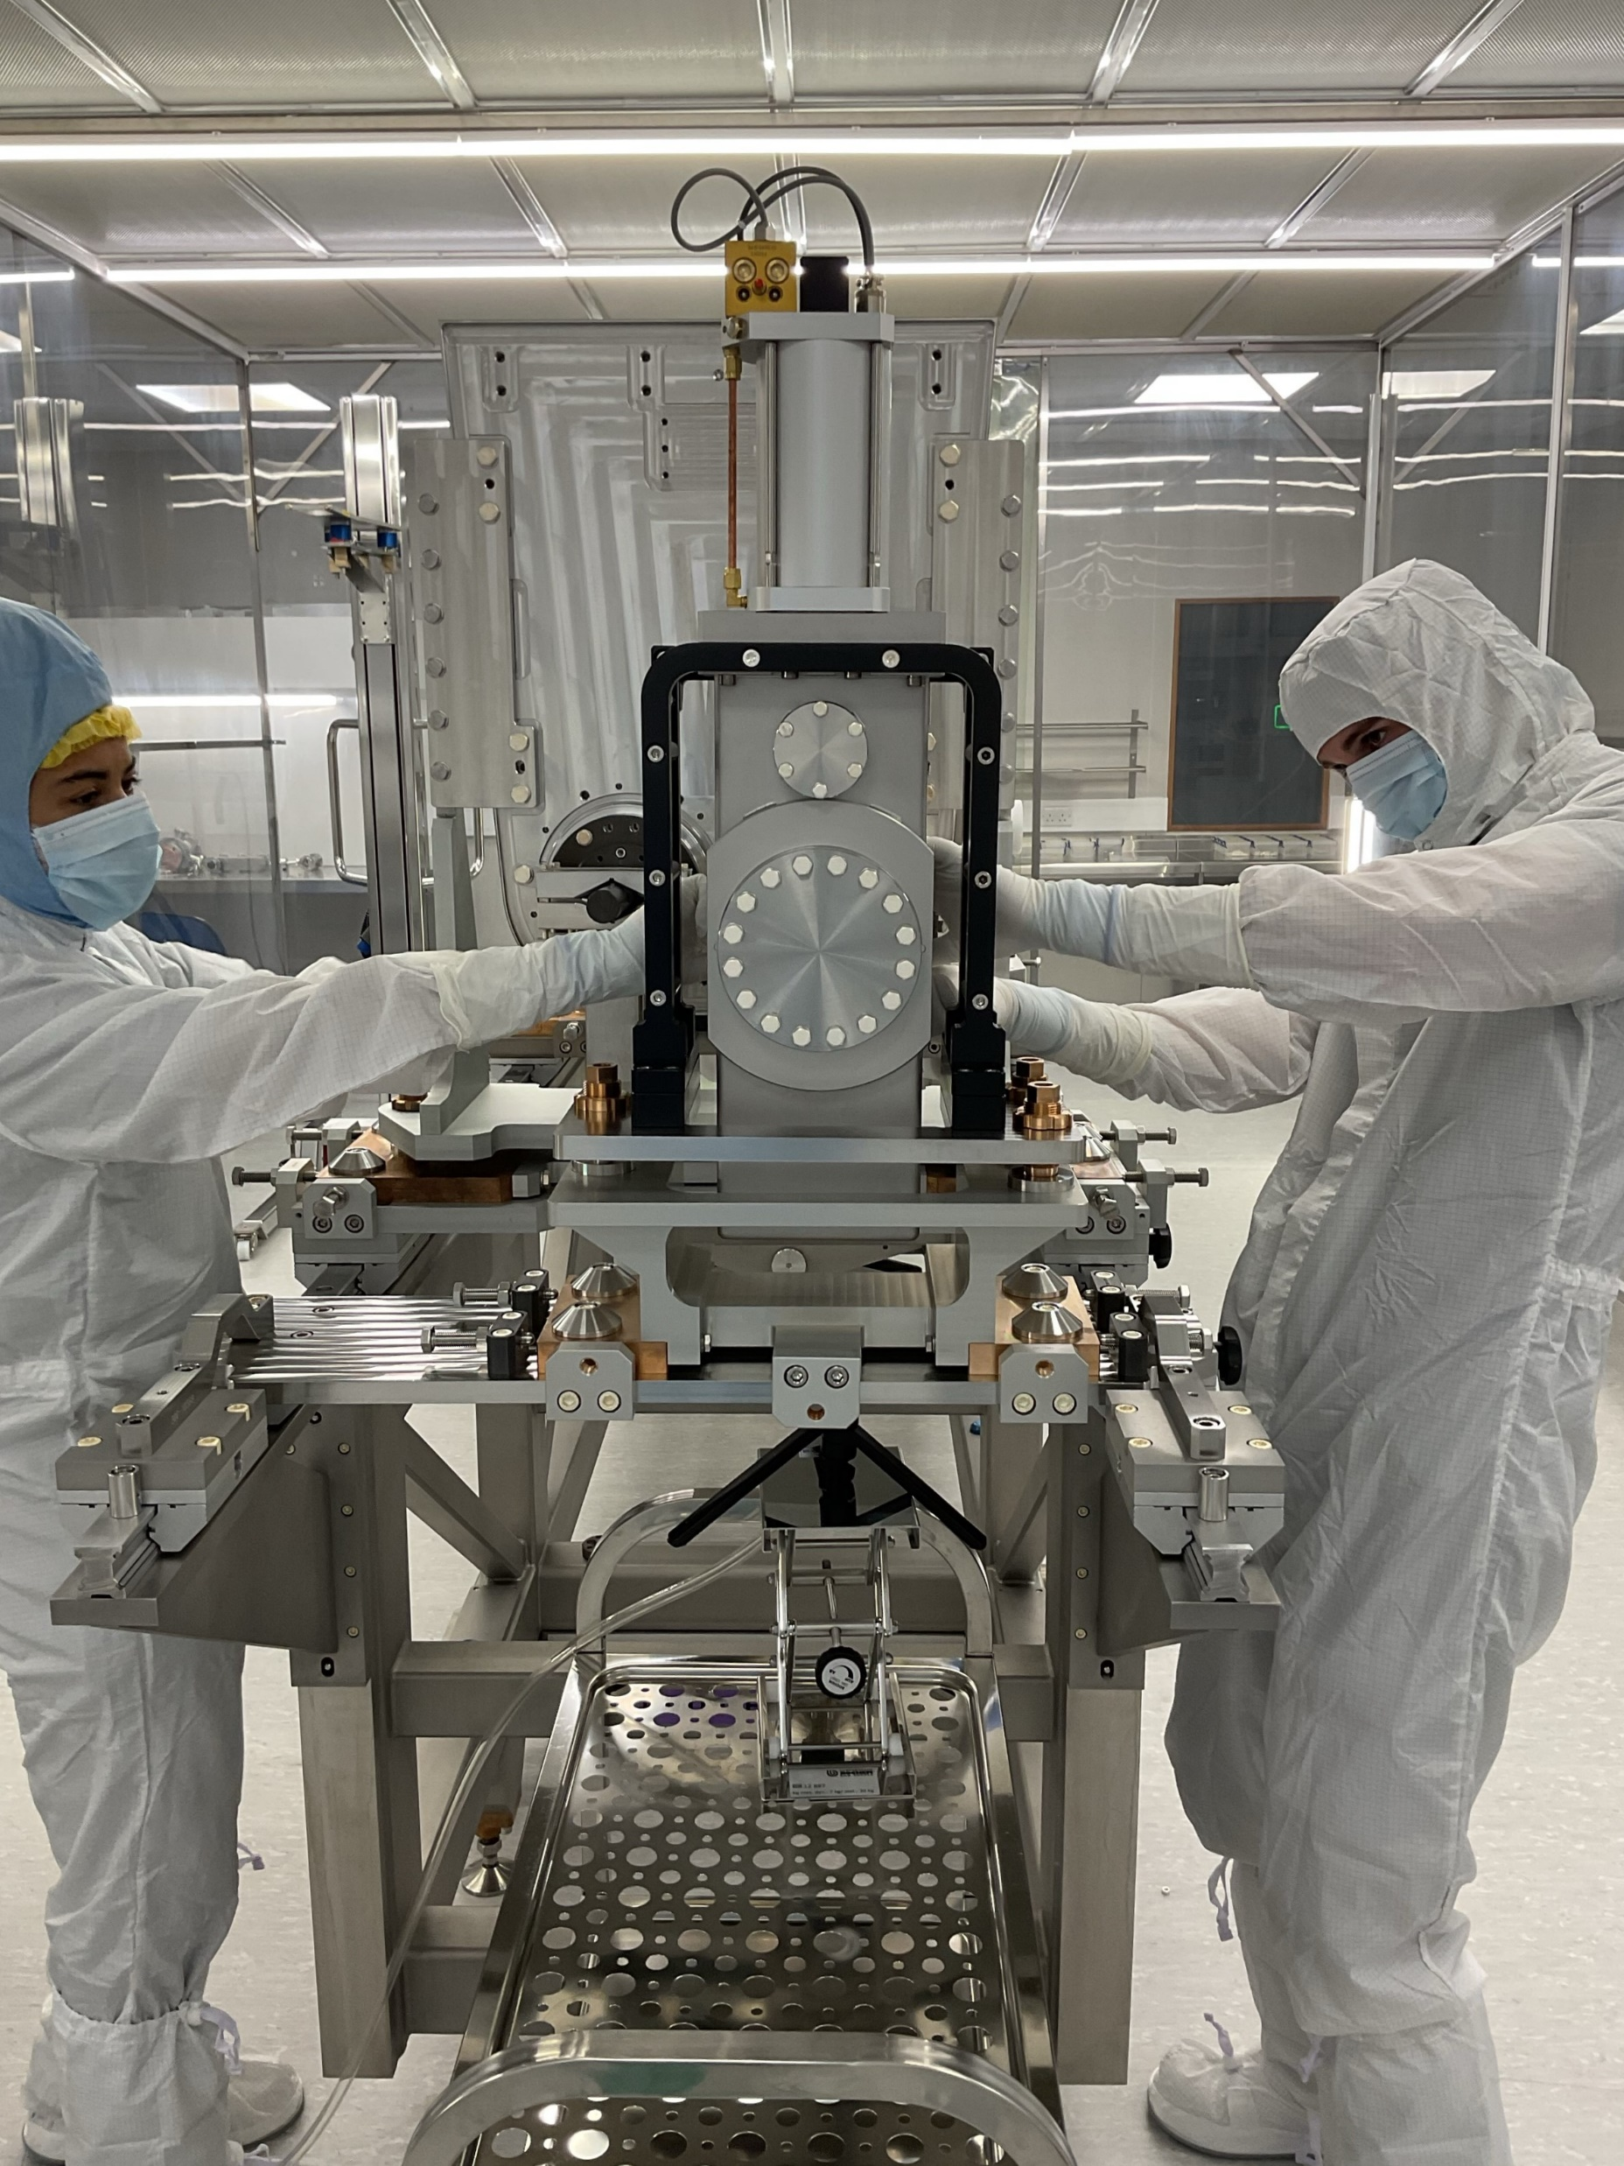
CM2 Build
Pre-cleanroom string assembly complete
+ cleaning & qualification of non-cavity beamline equipment
Step1 underway
Step2 expected mid-Jan’25
Clean-build complete by late-Jan’25
Cold test equipment upgrade & commissioning complete

Slide 3
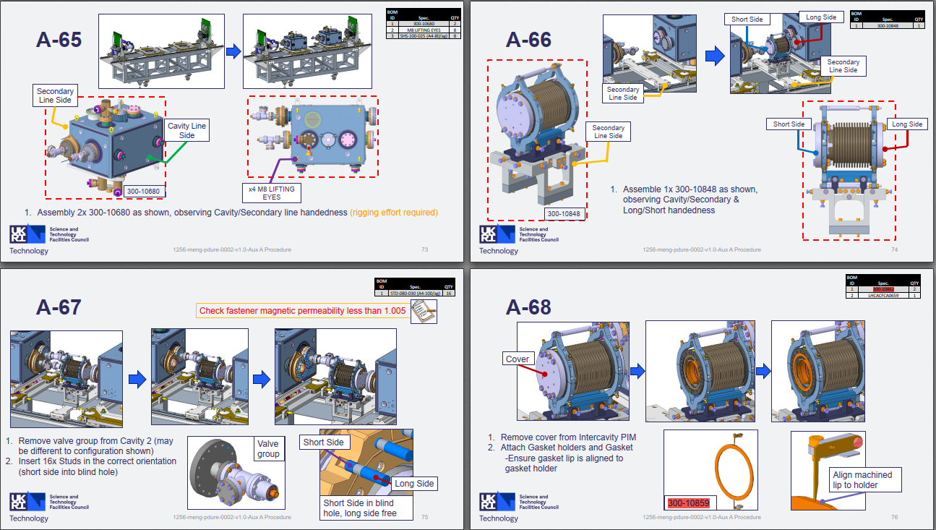
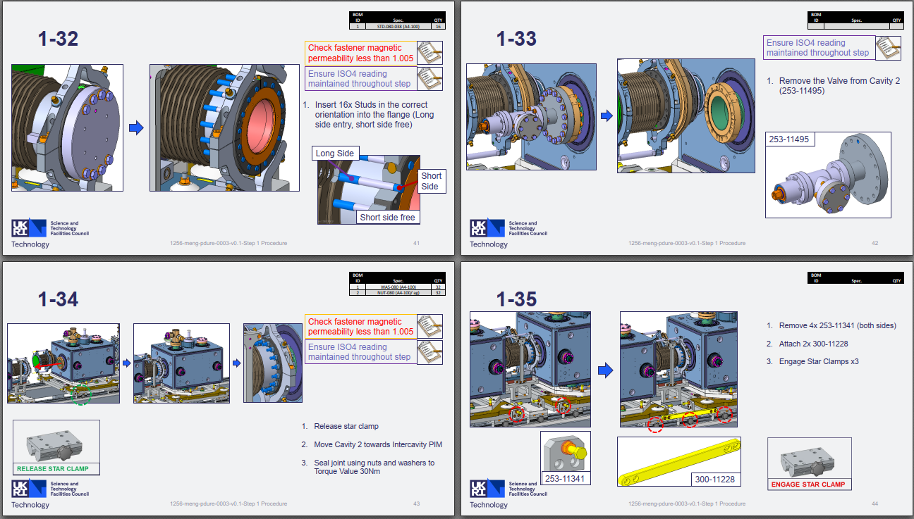
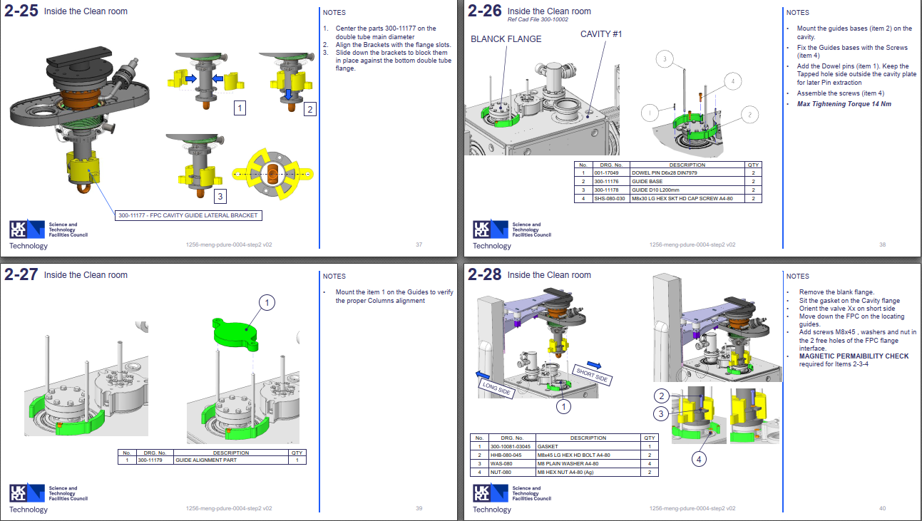
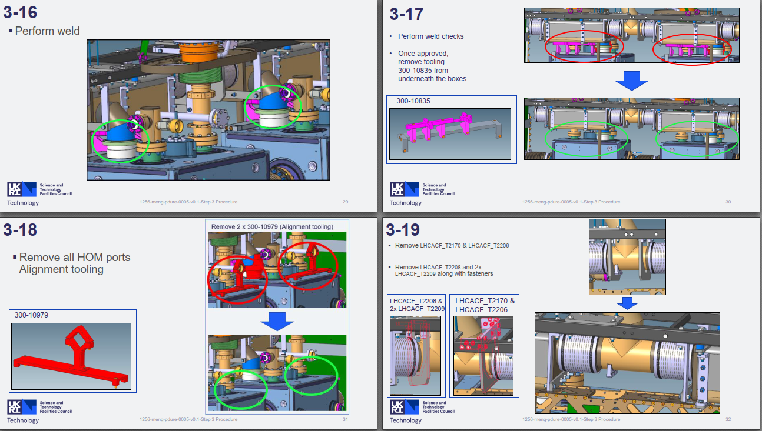
Design, Assembly Procedures & Tooling
Build Procedures
Done: steps 1 & 2
Final edits: steps 3 & 4
1st draft complete: steps 5, 6, 8, 9, 11
To-do: steps 7, 10, 12
Auxiliary Procedures
Done ✓
  pre-cleanroom string assy (step0)
  PIMs processing
  Cav incoming handling & acceptance
  gate valve processing
Final edits: OVC acceptance & handling
1st draft complete:
  CM outgoing tests (step13)
  Thermal screen mock assy
To-do: Transport tooling & frame (step14)
 | Prcdrs | Dwgs
RFD SPS | 892p | 675
DQW LHC | 927p | 280
(so far)

Slide 4
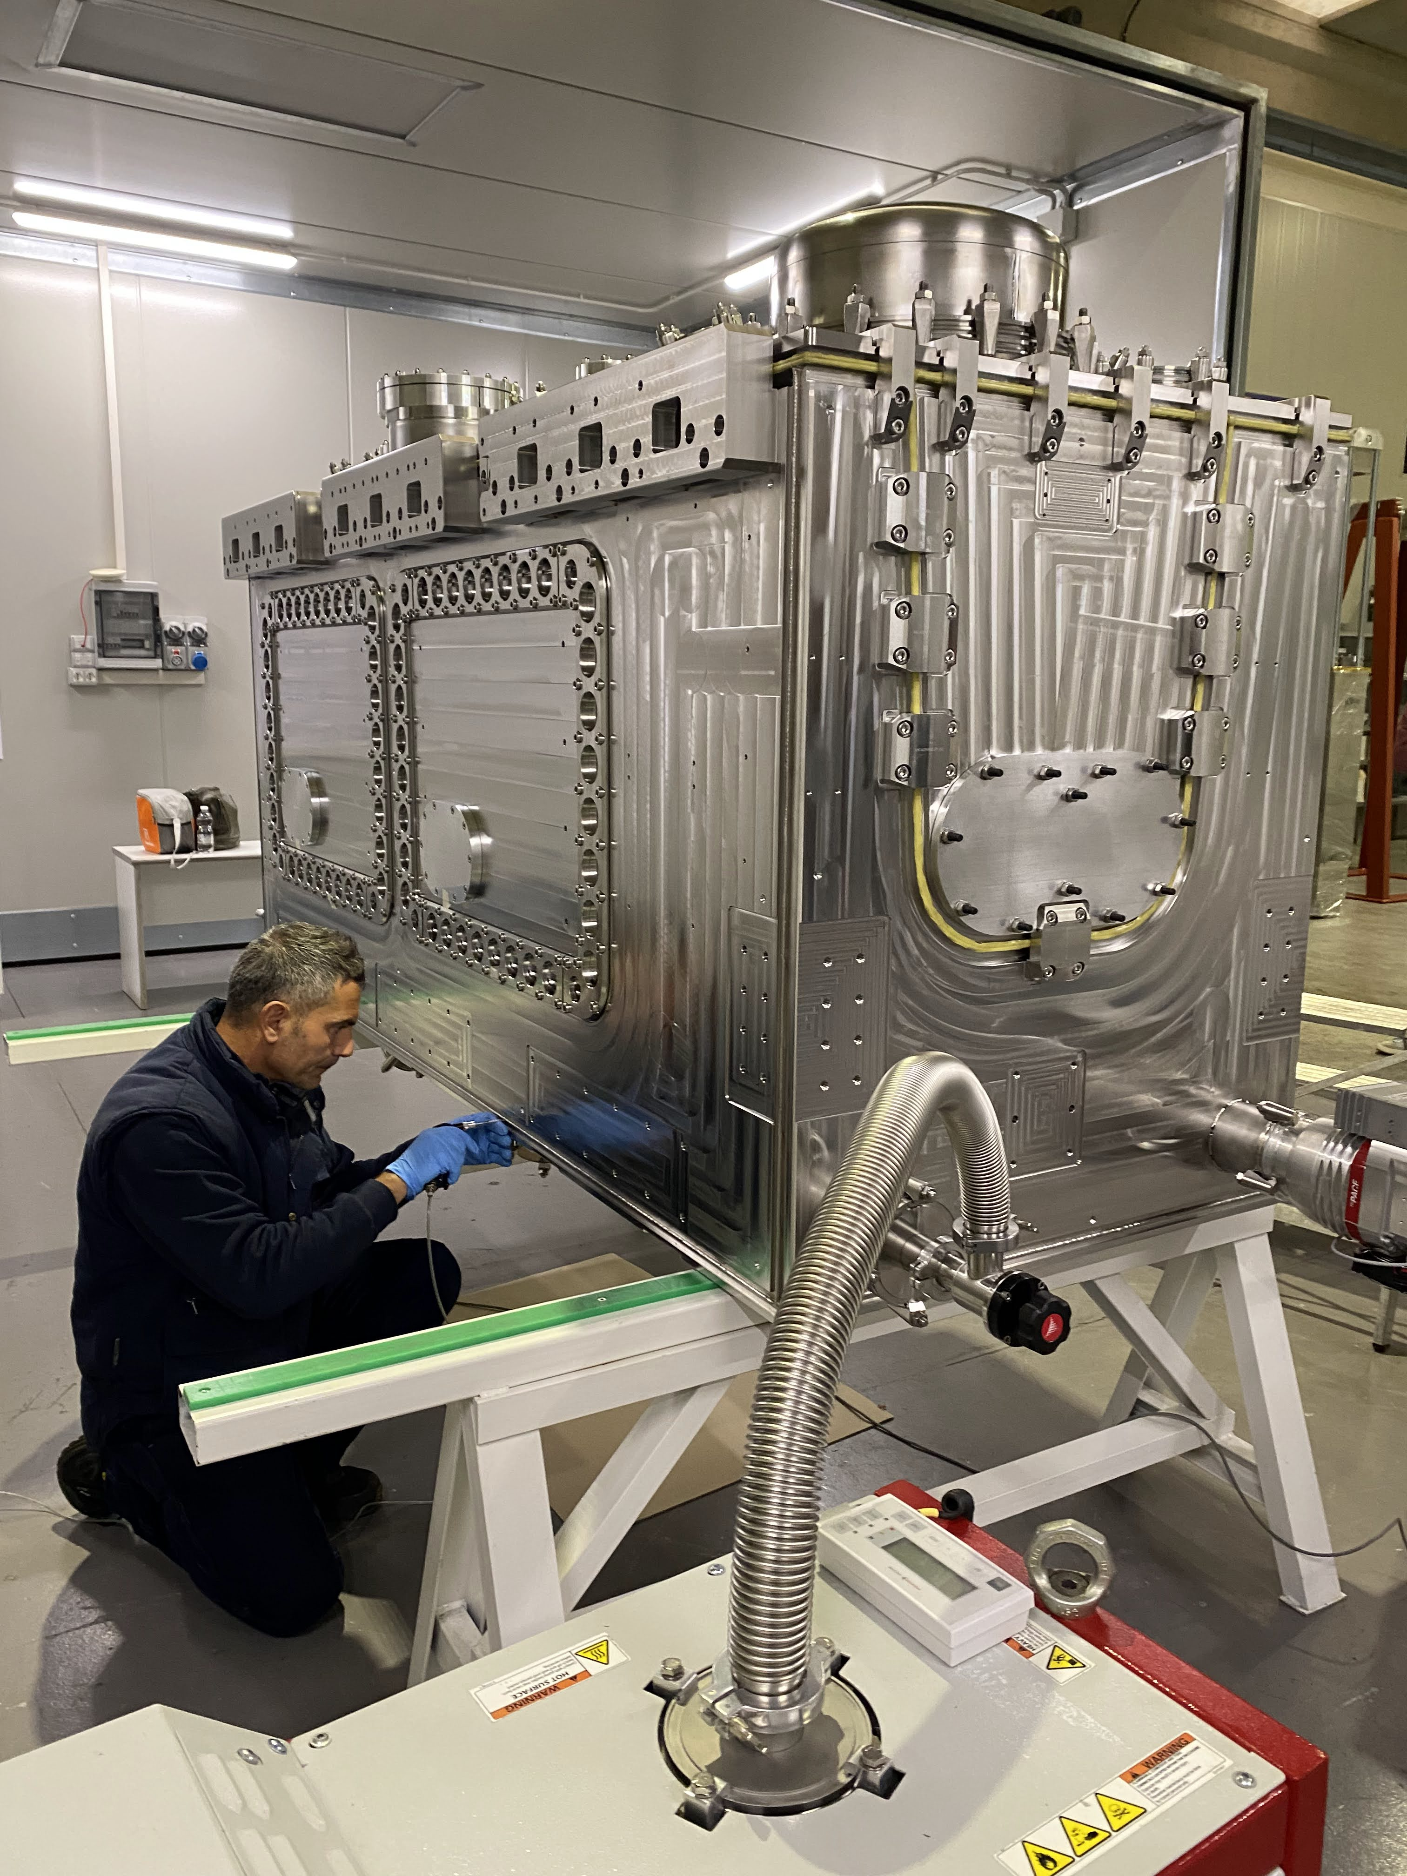
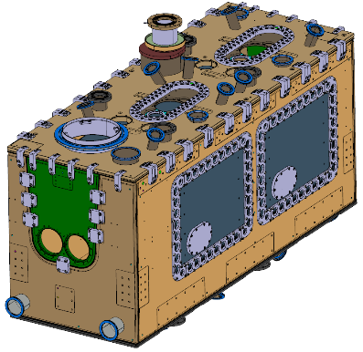
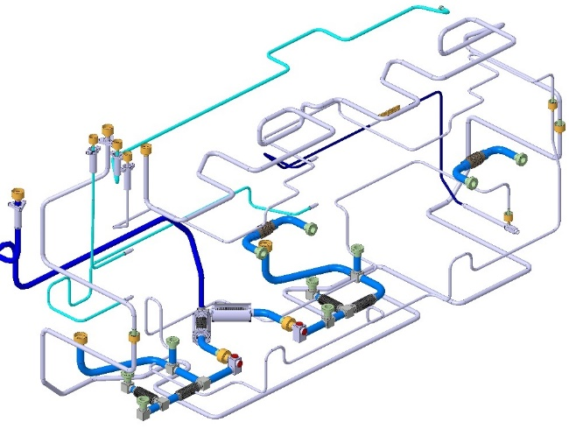
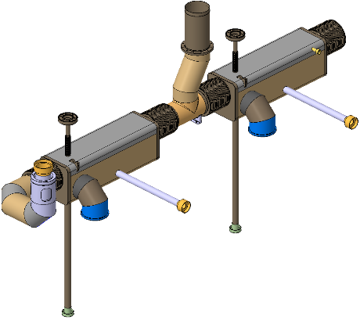
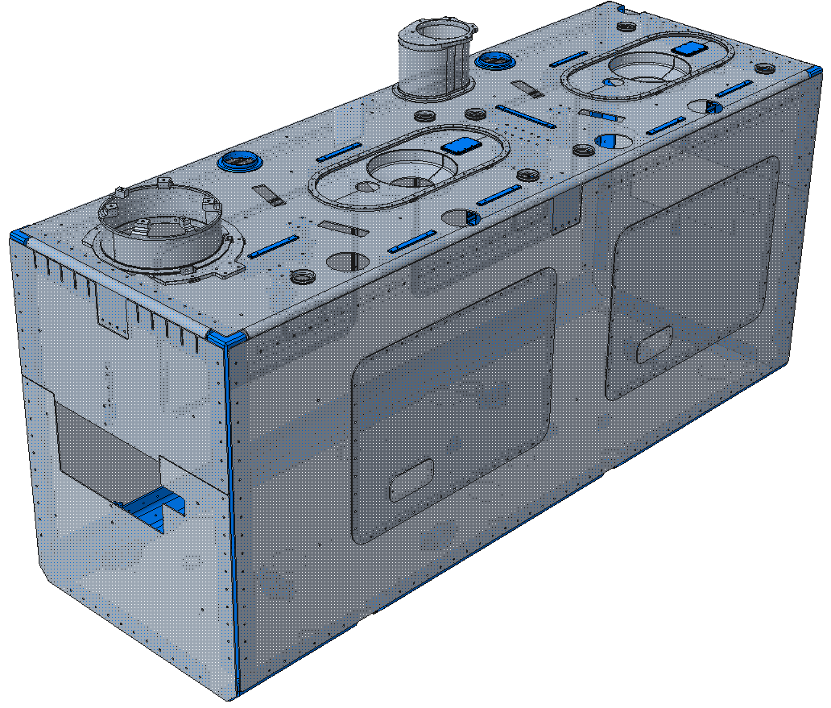
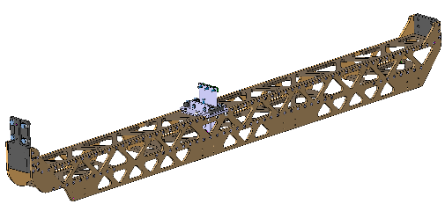
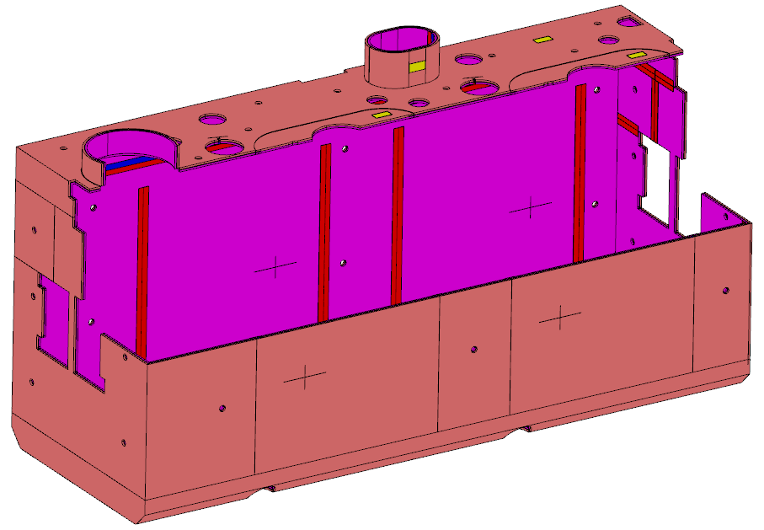
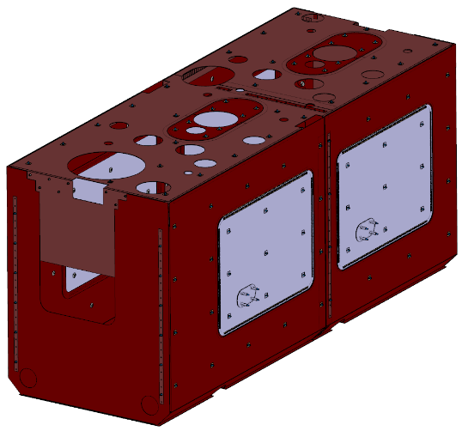
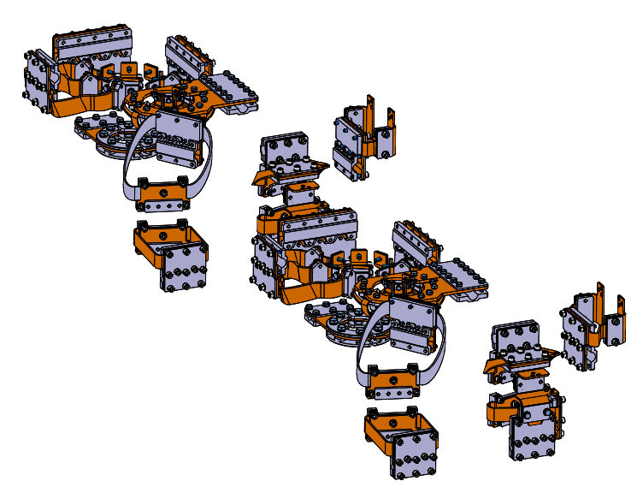
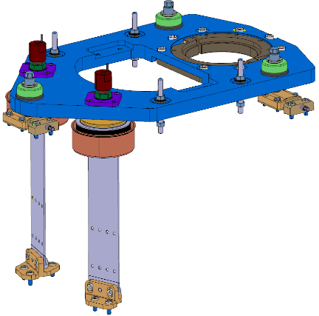
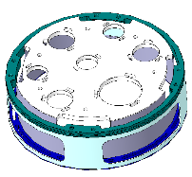
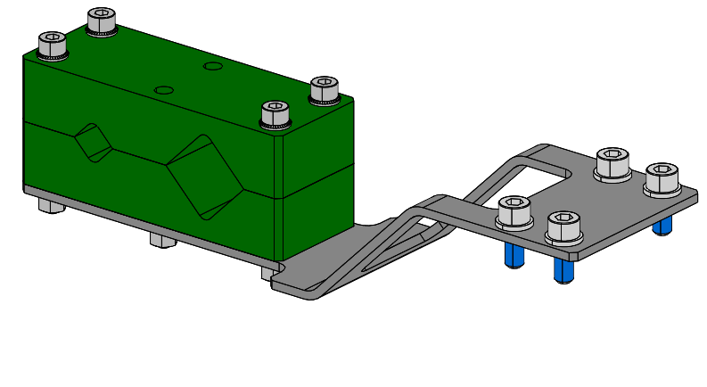
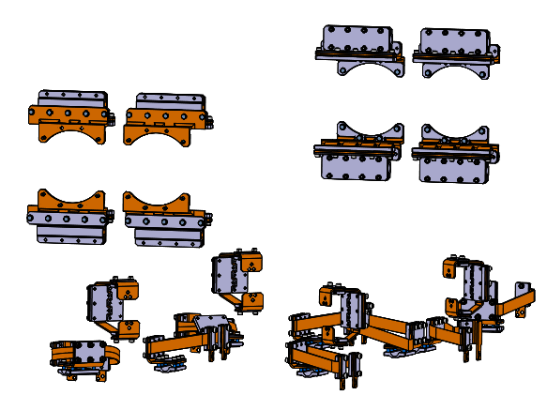
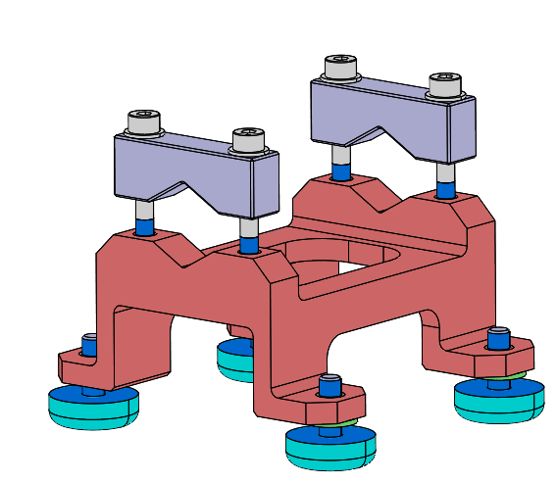
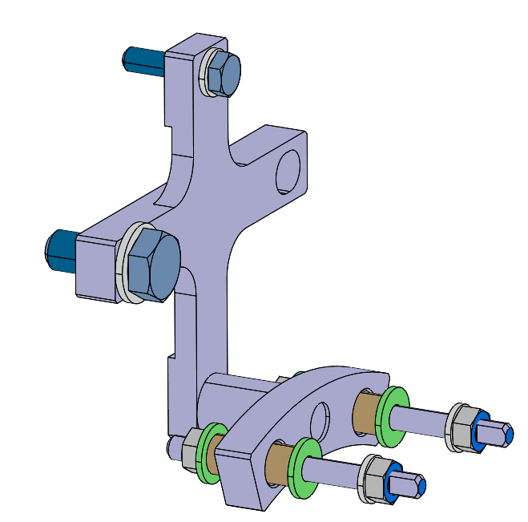
Cryomodule Procurement
Outer Vacuum Chambers: 1st ready to ship
1st Bi Phase line:
  MIP & Weld QA approved
  Fabrication underway
  Awaiting delivery estimate
‘other’ cryolines:
  MIP & Weld QA approved
  Fabrication underway
  CM2 Batch 1 expected late-Jan
Thermal Screens: expected mid-Jan
MLI: 50K delivered – 2K design & drawings approved
Warm Mag Shields: 4 shipped, 5th underway
Cavity Support System & Other Packages:
  All materials delivered & contracts placed
  Some delivered
  TBD – blade welding

Slide 5
CM2 Schedule
OVC Valve Plates Received
CM2 Cavity Set Received
Today
01 Apr'24
May '24
Jul '24
Sep '24
Nov '24
Jan '25
Mar '25
May '25
Jul '25
Infrastructure Upgrade
Finish
01 Aug '25
Procurement Activities
Assembly Tooling & Procedure Development
✔PIMs Processing (CM2)
✔Aux.A Pre-Cleanroom
Step1 String Assembly
Step2 FPC Assembly
Step3 BiPhase & Tuner Frame
Step4 50K Lines & Tuner Mechanism
Aux.C OVC Assembly
Step 5 Top Plate Assy & Interfaces
Step 6 Load Transfer
Step 7 Lower Cryo & Instr. Ports
Step 8 2K MLI & Pick Ups
Step 9 Thermal Screen & 50K MLI
Step 10 Lower OVC Loading
Step 11 Vacuum Equipment
Step 12 OVC Welding & Doors
Outgoing Tests

Slide 6
Management & Oversight
Graeme Burt
HL-LHC-UK PM
Anna Vikhoreva Project Support
Ian Lazarus
STFC Sponsor
Phil Atkinson Technical Oversight
Paul Hindley Technician Manager
Departed
Marco Mangiavini
Contract Engineer Oct’24
Ed Jordan
DAPT Lead
WP Lead
Nik Templeton
Andy Blackett-May
IQT Lead
Luke Bladen
TE Lead
Luke F Lanc. Grad Engineer
Ivan
Cryo Engineer
Ollie
Vac Engineer
John
Welder
Abi
Technician
Matty
Apprentice
Kavi Grad Engineer
David Undergrad Engineer
Carlos Granjeiro
QAWL Lead
Susan Technician
Matty Technician
Stuart
Vac Engineer
Dan Apprentice
Design, Assembly Procedures & Tooling
Quality Assurance, Welding & Logistics
Instrumentation, Qualification & Testing
Technical Engineering
simplified representation – does not reflect STFC pay & management

Slide 7
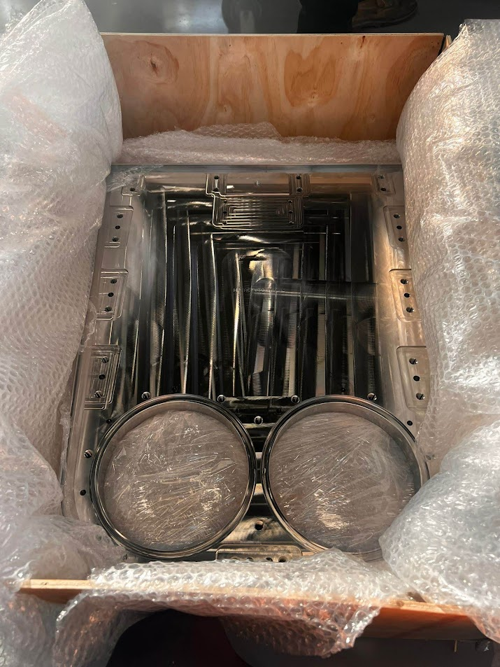
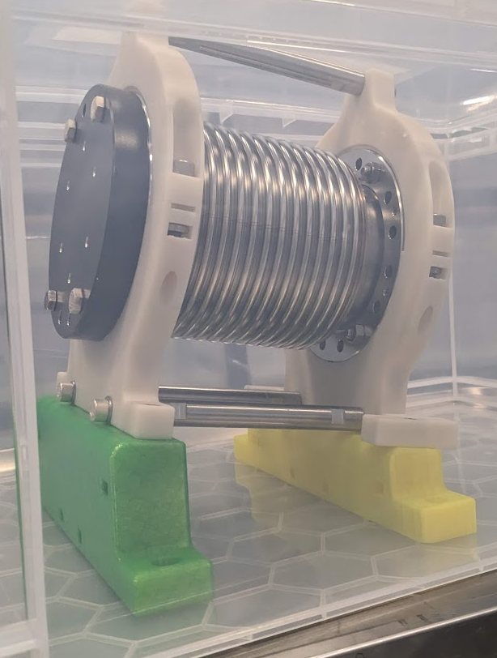
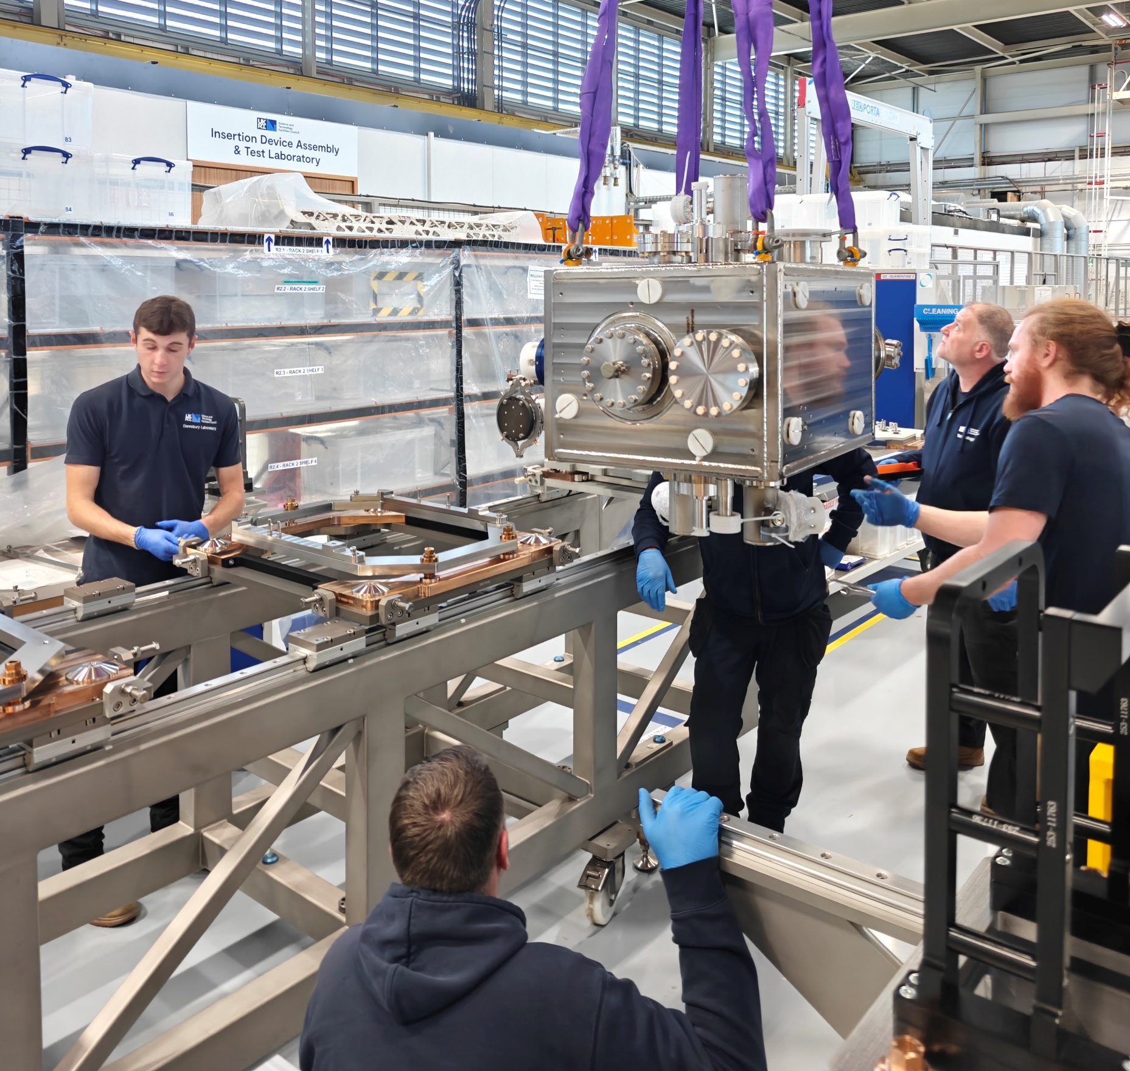

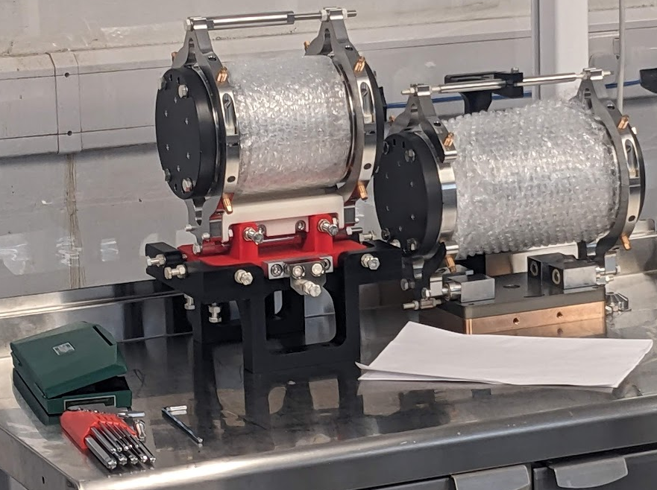
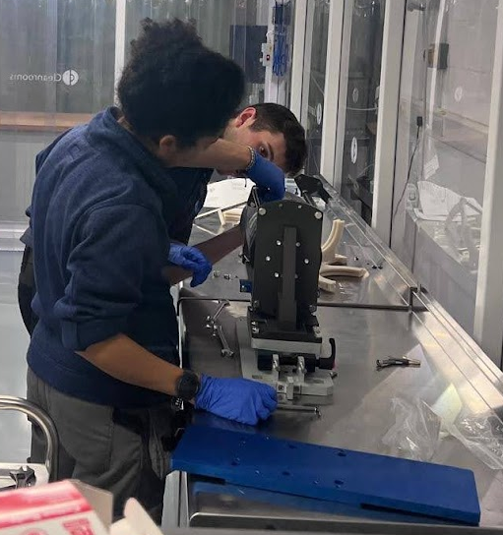
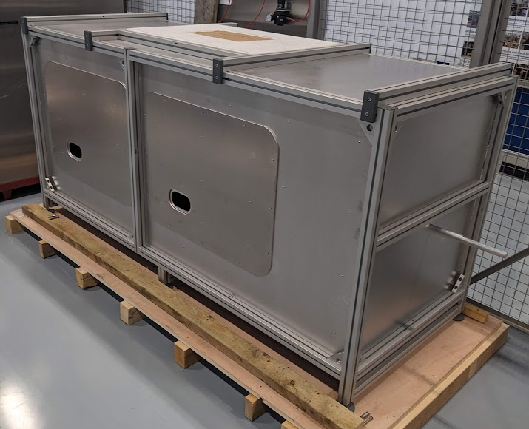
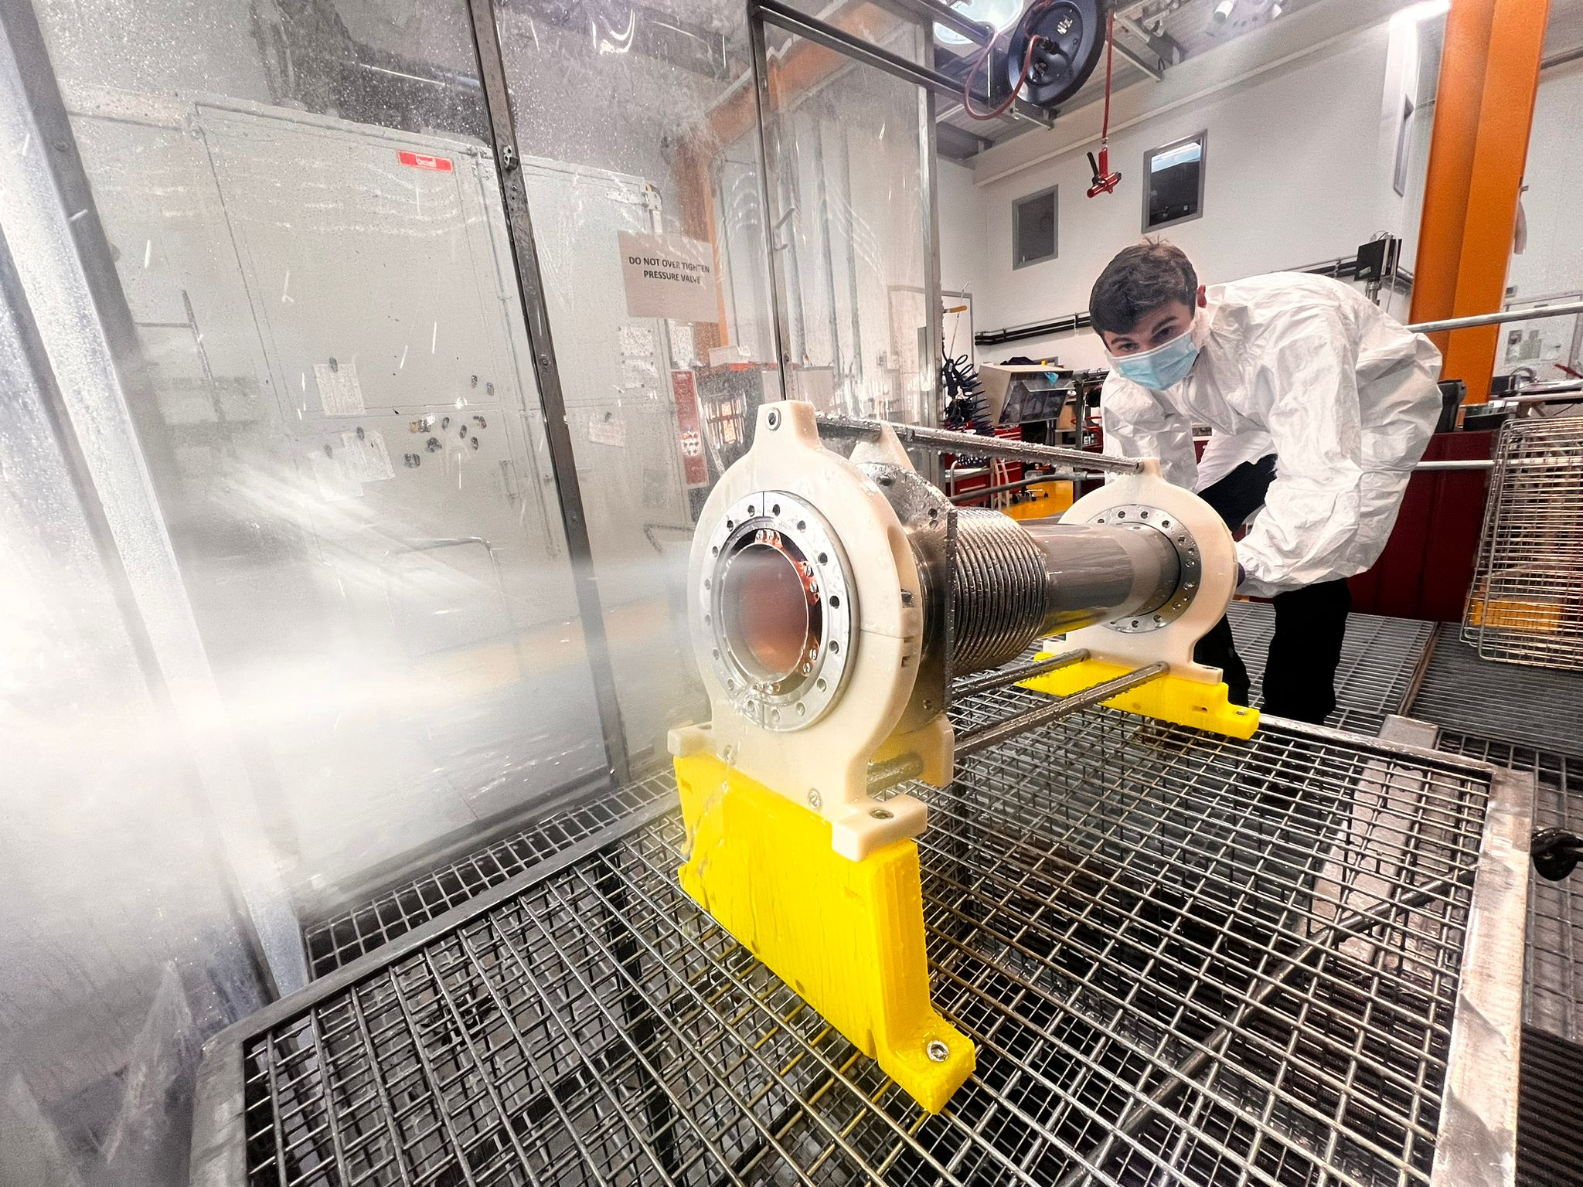
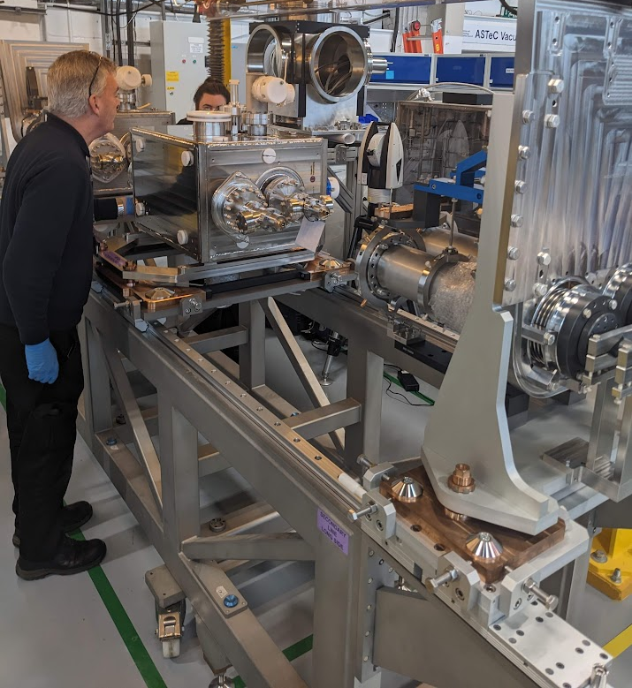
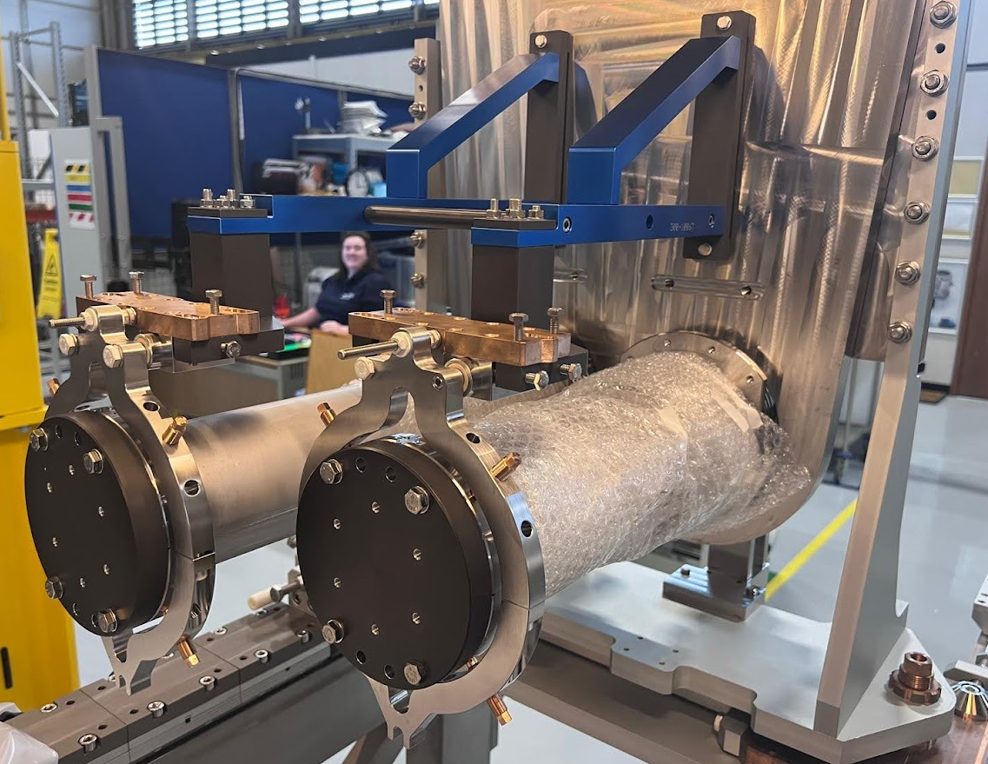




Thanks!
Questions?

