Slide 1


RFD Crab Cavity Contribution from the U.S.
Updates
Leonardo Ristori – Fermilab
WP4 collaboration meeting: AUP-Canada-CERN-UK – 13th December 2024

Slide 2
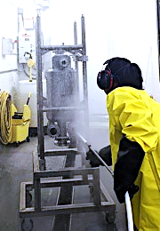
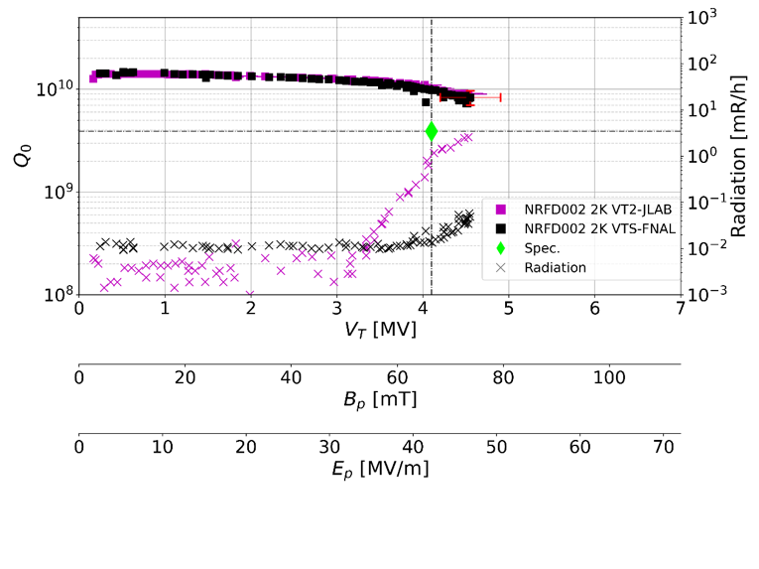
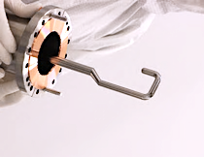
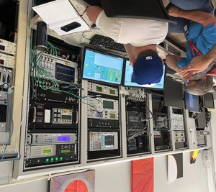
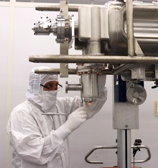

Pre-Series #2 (NRFD02) Test Results
Almost 4 months old, repeating here for our “non regulars”
Manufactured and chemically processed at Zanon. Performed 3 tests in total, always reaching administrative limit, exceeding acceptance requirements, but with radiation onset (indicative of contamination).
Radiation onset continued to improve after successive high-pressure rinses by JLAB.
Moved to FNAL VTS due to JLAB VTA shut-down, final test without radiation up to ~acceptance level.
Low field Q₀ is high: Chemistry by Zanon was successful.
Radiation onset is at high field: HPR and clean assembly by JLAB was successful.
Plot by A. Castilla
Admin. Limit
8/26/24: FNAL VTS Control Room
JLAB Cleanroom
Last 2 tests for Pre-Series Bare Cavity #2

Slide 3
Status Updates
Production at Zanon is paused after the Collaboration Meeting in Genova based on findings from the Steering Committee Meeting regarding deficiencies in QC and documentation.
  Collaborative mindset still exists at Zanon-Simic.
  Need to converge on shortcomings and/or added scope and issue a change order to formalize new documents and plans.
  Joint meetings CERN-Zanon-AUP being organized to facilitate convergence.
  Proposing to hold an in-person Manufacturing Readiness Review at Zanon ~ February 2025.
Working on addressing NCRs for 2 pre-series cavities (still at the bare stage) to allow jacketing, testing and shipment to TRIUMF.
  It appears that we are close to convergence on these.
  Hardware issue: bimetallic transitions for 1 of 2 cavities were sacrificed to unblock the situation and need to be remade.
Imminent cold tests:
  Pre-Series #1 was reprocessed at Zanon (light BCP) and is at FNAL in test-ready conditions since end of October. VTS is just resuming after a ~2mo. shut-down. If successful, will be shipped back to Zanon for jacketing.
  Prototype #2 is at JLAB after jacketing by Zanon. Cold test without HOMs before winter break, and with HOMs after winter break. If all goes well, we could have this cavity ready for shipment to TRIUMF in ~February 2025.
Delivery dates: Unfortunately, it isn’t possible to provide dates currently. Once we have a new plan in place, with approved documents, we will negotiate with Zanon a new delivery schedule.

